Slide 1
Igneous Minerals

Slide 2
Igneous Rock Forming Minerals
Before you can learn to identify igneous rocks, you must first learn to identify the minerals that compose them.

Slide 3
How minerals form
Nearly all minerals crystallize from liquid rock (magma or melt)

Slide 4
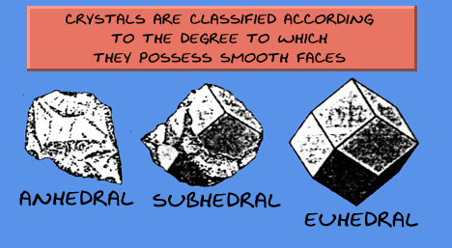
Crystal Shapes
Euhedral - grains completely bounded by crystal faces
Subhedral - grains only partly bounded by crystal faces
Anhedral - grains completely devoid of crystal boundaries
Source: 1, 2

Slide 5
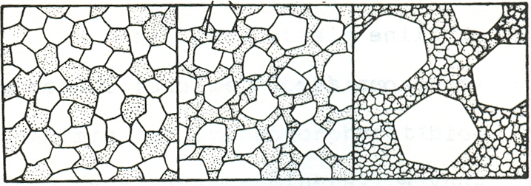
Textures
Arrangement of the grains
Equigranular
Slightly inequigranular
inequigranular

Slide 6
Textures

Slide 7
Bowen's Reaction Series
Bowen proposed (1922) that any one magma can potentially crystallize into rocks of different compositions because of two processes
REACTION - whether early formed minerals (higher in the reaction series) remain with the composition they first crystallized at, or react with the remaining magma and change composition dependent on cooling history. Rapid cooling prevents reaction, slow cooling allows reaction.
Source: 1, 2

Slide 8
Bowen's Reaction Series
Bowen proposed (1922) that any one magma can potentially crystallize into rocks of different compositions because of two processes
FRACTIONATION - whether early formed minerals remain in the magma, or are removed in some way before crystallization is complete.
Source: 1, 2

Slide 9
Bowen's Reaction Series
Temperature
Regimes
Igneous
Rock Types
Olivine
Cooling magma
Ultramafic
High temperature
(first to crystallize)
Plagioclase
Ca rich
Pyroxene
Mafic . (basaltic)
Continuous Series of Crystallization
Amphibole
Biotite
Discontinuous Series of Crystallization
Intermediate (andesitic) .
Na rich
Felsic .
(granitic)
Low temperature
(last to crystallize)
Potassium Feldspar
Muscovite
Quartz

Slide 10
Bowen's Reaction Series
Recall that the minerals at the top of the series . . .
Have the highest melting temperatures
Are dark in color
Are rich in Ca (anorthite) Fe and Mg (e.g. olivine)
And have the highest specific gravity.
Source: 1, 2

Slide 11
Bowen's Reaction Series
Minerals at the bottom of the series. . .
Are light colored.
Are rich in Na (albite), K (orthoclase) and Si (quartz).
And are of low specific gravity.
Source: 1, 2

Slide 12
(From Understanding Earth, 4th Edition)

Slide 13
Olivine Group
Fe Mg silicate
First to form in discontinuous rxn series
Composition ranges from:
Mg₂[SiO₄] (Forsterite)
to Fe₂⁺²[SiO₄] (Fayalite)
Olivine = (Mg,Fe²⁺ )₂[SiO₄]
Source: 1, 2

Slide 14
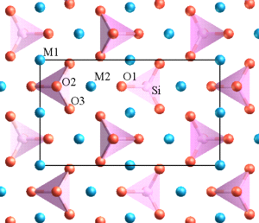
Olivine = (Mg,Fe2+ )2[SiO4]
Crystal Structure
Nesosilicate (single isolated tetrahedra)
Oxygen is shown in red, silicon in pink, and magnesium/iron in blue.
A projection of the unit cell is shown by the black rectangle
Simple structure reflects the fact that this mineral is the first to form in the magma
Source: 1, 2

Slide 15
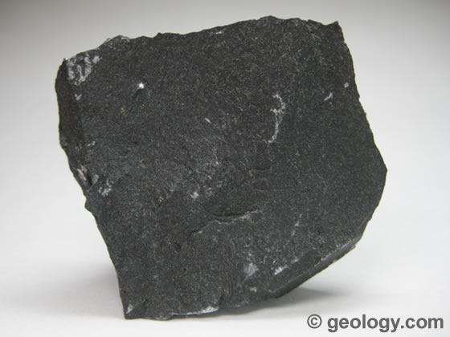
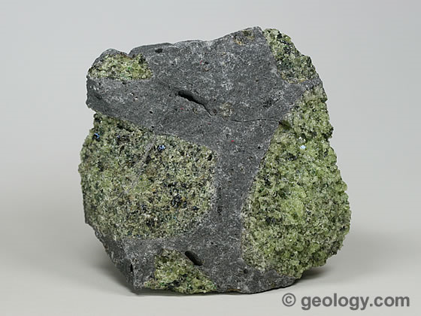
Olivine = (Mg,Fe2+ )2[SiO4]
How olivine gets into basaltic lava flows
Magma erupts to surface
Olivine crystallizes
Settles to the bottom of the chamber
Magma from top of chamber has no olivine crystals, therefore basaltic lava flow has no olivine
Magma from deeper in the chamber has olivine crystals, therefore basaltic lava flow has olivine

Slide 16
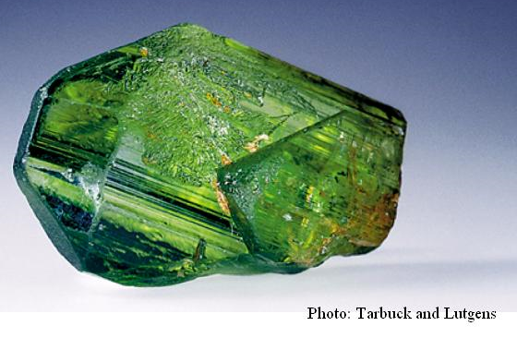
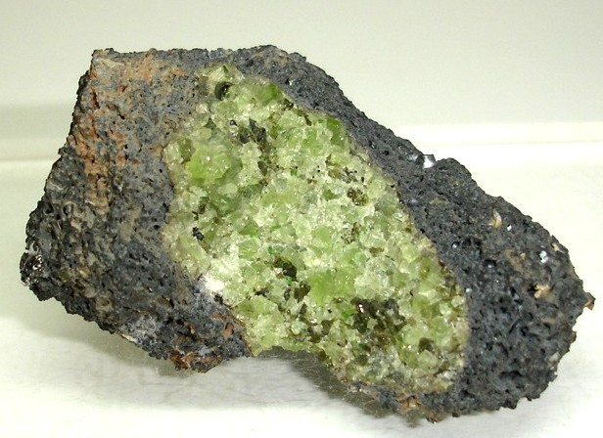
Olivine = (Mg,Fe2+ )2[SiO4]
Physical Properties of Olivine
Luster: Vitreous
Color: Yellowish green, olive green,
Streak: White
Hardness (Mohs): 6½ - 7
Cleavage: none
Source: 1, 2

Slide 17
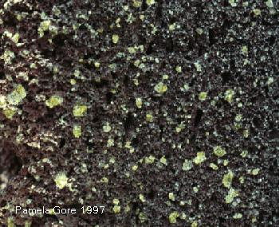
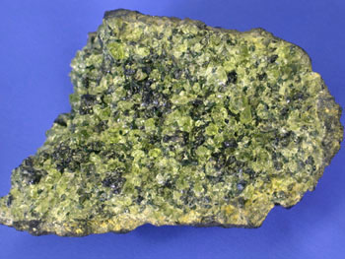
Olivine = (Mg,Fe2+ )2[SiO4]
How to find in an igneous rock:
Roundish glassy crystals
Light to olive green color
Cannot be scratched with a knife
Usually occurs in ultramafic rocks
Source: 1, 2

Slide 18
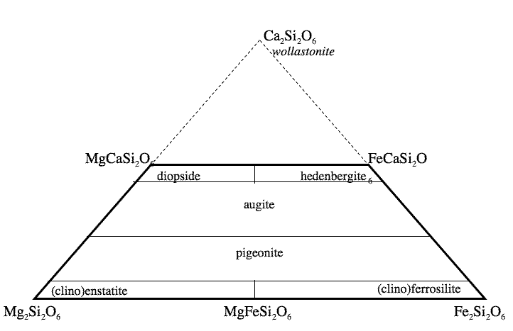
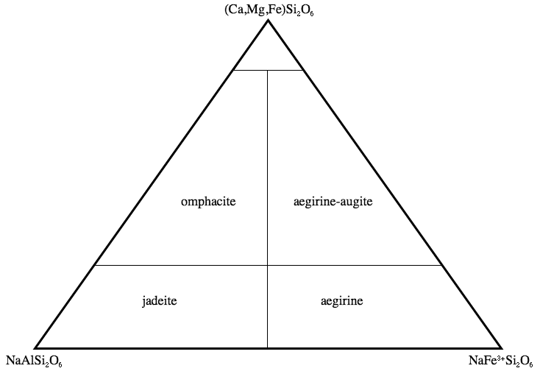
Pyroxene Group
Second to form in the discontinuous rxn series
General formula XY(Si,Al)₂O₆
X = calcium, sodium, iron⁺² and magnesium
Divided into
Clinopyroxene Subgroup Orthopyroxene Subgroup
Augite most common
The nomenclature of the calcium, magnesium, iron pyroxenes.
The nomenclature of the sodium pyroxenes.
Source: 1, 2

Slide 19
Augite: (Ca,Na)(Mg,Fe,Al)(Si,Al)₂O₆
Crystal Structure
Inosilicates (Single Chain Silicates)
Slightly more complicated structure
Source: 1, 2

Slide 20
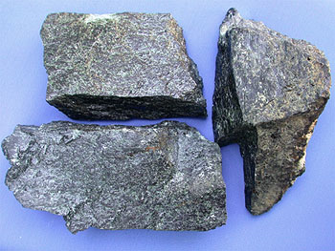
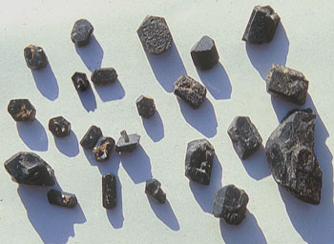
Augite: (Ca,Na)(Mg,Fe,Al)(Si,Al)₂O₆
Physical Properties
Luster: Vitreous, Resinous, Dull
Color: black, green-black
Streak: Greenish grey
Hardness (Mohs): 5½ - 6
Cleavage: Two distinctive cleavages at nearly 90°
Cleavage not great
Surfaces not shiny
Source: 1, 2, 3

Slide 21
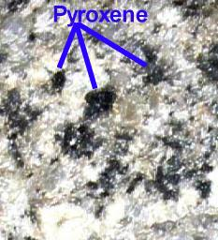
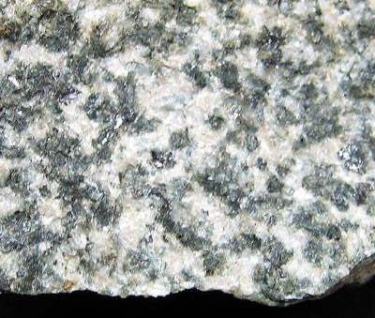
Augite: (Ca,Na)(Mg,Fe,Al)(Si,Al)₂O₆
How to find in an igneous rock:
Short, stubby crystals
Dark green
Cleavage
Cannot be scratched with a knife
Usually occurs in dark-colored rocks
Source: 1, 2

Slide 22
Amphibole Group
Next to form in the discontinuous rxn series
A complex group of minerals divided into several subgroups
Hornblende Ca₂(Mg,Fe,Al)₅(Al,Si)₈O₂₂(OH)₂ most common
Source: 1, 2, 3

Slide 23
Hornblende Ca₂(Mg,Fe,Al)₅(Al,Si)₈O₂₂(OH)₂
Crystal Structure
Inosilicates (Double Chain Silicates)
Considerably more complicated structure
Source: 1, 2, 3

Slide 24
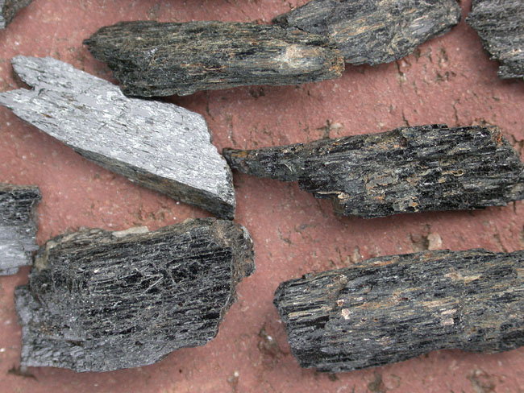
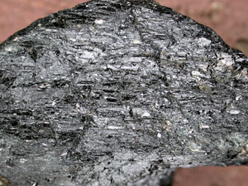
Hornblende Ca₂(Mg,Fe,Al)₅(Al,Si)₈O₂₂(OH)₂
Physical Properties
Luster: Vitreous, Dull
Color: black, green-black
Streak: colorless to brown-grey
Hardness (Mohs): 5 - 6
Cleavage: Two distinctive cleavages at 60° and 120°
Cleavage not great
Surfaces shiny
“Stepped” or “splintery” appearance
Source: 1, 2, 3

Slide 25
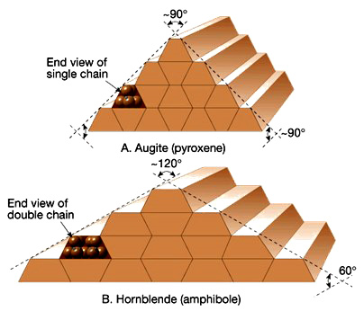
Augite vs. Hornblende
Source: 1, 2, 3

Slide 26
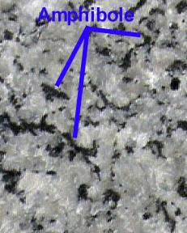
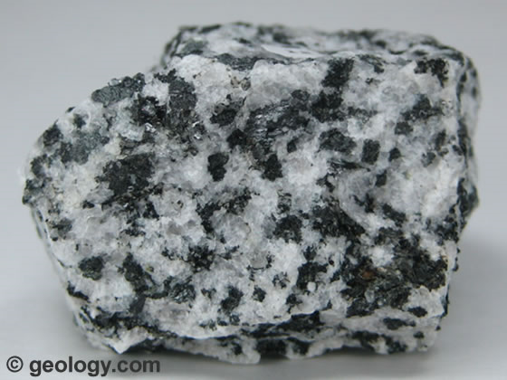
Hornblende Ca₂(Mg,Fe,Al)₅(Al,Si)₈O₂₂(OH)₂
How to find in an igneous rock:
Slender, needle-like crystals
black
Cleavage (stair-step appearance)
Cannot be scratched with a knife
Common igneous mineral
Source: 1, 2

Slide 27
Mica Group, Biotite
Last to form in the discontinuous rxn series
Part of a dark mica series
iron-end member annite,
magnesium-end member phlogopite
Biotite: K(Mg,Fe)₃AlSi₃O₁₀(F,OH)₂
Source: 1, 2

Slide 28
Biotite: K(Mg,Fe)₃AlSi₃O₁₀(F,OH)₂
Crystal Structure
Phyllosilicates (Sheet Silicates)
Considerably more complicated structure
Source: 1, 2

Slide 29
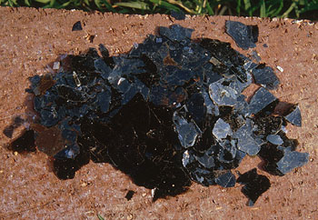
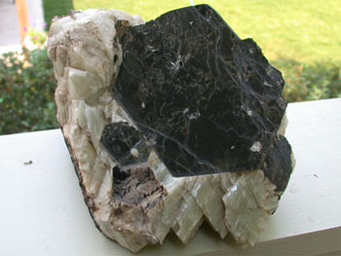
Biotite: K(Mg,Fe)₃AlSi₃O₁₀(F,OH)₂
Physical Properties
Luster: Vitreous, pearly
Color: blackish brown
Streak: White
Hardness (Mohs): 2 ½ - 3
Cleavage: 1 perfect cleavage
Flexible, elastic “sheets”
Mirror-like surface
Source: 1, 2, 3

Slide 30
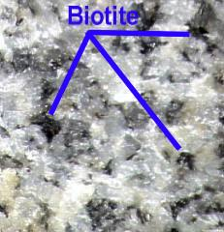
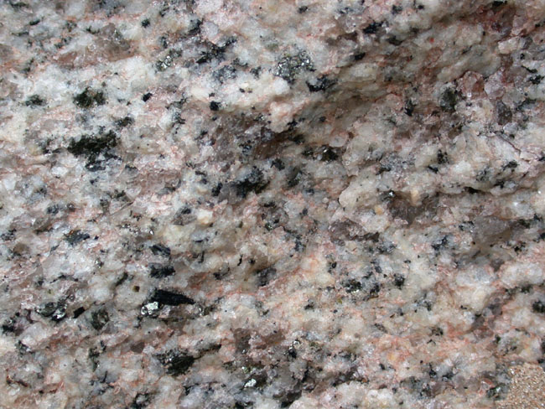
Biotite: K(Mg,Fe)₃AlSi₃O₁₀(F,OH)₂
How to find in an igneous rock:
Shiny, “stop signs”, “books”
Black
Can be scratched with a knife
Occurs in small quantities
Source: 1, 2

Slide 31
Plagioclase Feldspar Series
First to form in the continuous rxn series
Part of a solid solution series
Albite: NaAlSi₃O₈
Anorthite: CaAl₂Si₂O₈
Typically need a microscope to distinguish
“Plagioclase” is the common name for all minerals in this series
Source: 1, 2

Slide 32
Plagioclase Feldspar Series
Crystal Structure
Tectosilicates (Framework Silicates)
Al⁺³ replaces some of the SiO_{2,} creates a charge imbalance forms
allows other ions to be incorporated
Source: 1, 2

Slide 33
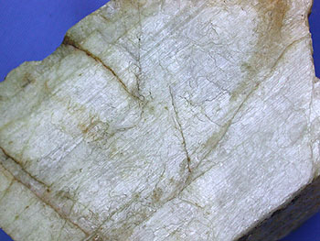
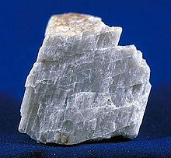
Plagioclase Feldspar Series
Physical Properties
Luster: Vitreous
Color: white, but varies with species
Streak: White
Hardness (Mohs): 6 – 6 ½
Cleavage: two cleavages meet at nearly 90°
“striations”, which show up in reflected light.
Source: 1, 2

Slide 34
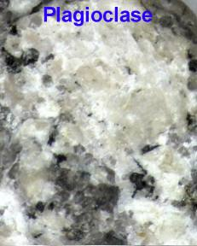
Plagioclase Feldspar Series
How to find in an igneous rock:
Chalky white
Striations
Cleavage
Cannot be scratched with a knife
Most common igneous mineral
Source: 1, 2

Slide 35
Alkali Felspar
Forms after the discontinuous and continuous reaction series minerals have formed
Rich in K and Na
Includes:
Albite: NaAlSi₃O₈
Anorthoclase: (Na,K)AlSi₃O₈
Microcline: KAlSi₃O₈
Orthoclase: KAlSi₃O₈
Sanidine: KAlSi₃O₈
Source: 1, 2

Slide 36
Orthoclase: KAlSi₃O₈
Crystal Structure
Tectosilicates (Framework Silicates)
Al⁺³ replaces some of the SiO_{2,} creates a charge imbalance forms
allows other ions to be incorporated
Source: 1, 2

Slide 37
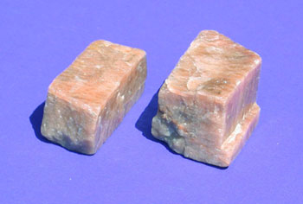
Orthoclase: KAlSi₃O₈
Physical Properties
Luster: Vitreous
Color: salmon/pink, but varies with species
Streak: Colorless to White
Hardness (Mohs): 6 – 6 ½
Cleavage: two cleavages meet at nearly 90°
Source: 1, 2, 3, 4

Slide 38
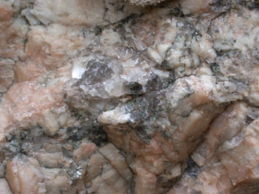
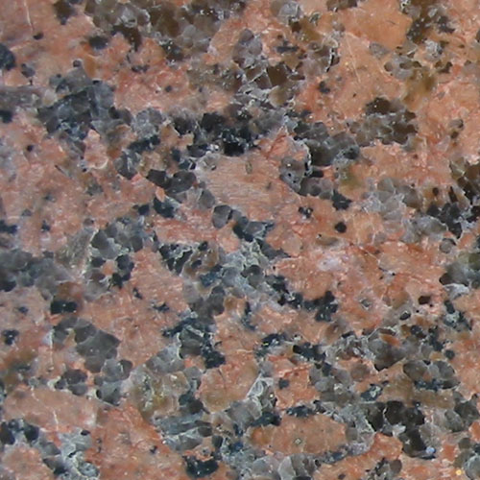
Orthoclase: KAlSi₃O₈
How to find in an igneous rock:
Think PINK!
No striations
Cleavage
Cannot be scratched with a knife
Source: 1, 2

Slide 39
Mica Group (light)
Forms after the discontinuous and continuous reaction series minerals have formed
Rich in K (all other elements have been “used up”)
Muscovite: KAl 2AlSi 3O 10(OH) 2

Slide 40
Muscovite: KAl₂AlSi₃O₁₀(OH)₂
Crystal Structure
Phyllosilicates (Sheet Silicates)
Considerably more complicated structure
Source: 1, 2

Slide 41
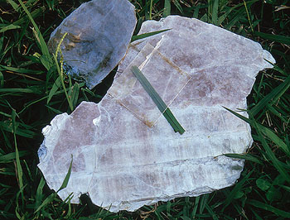
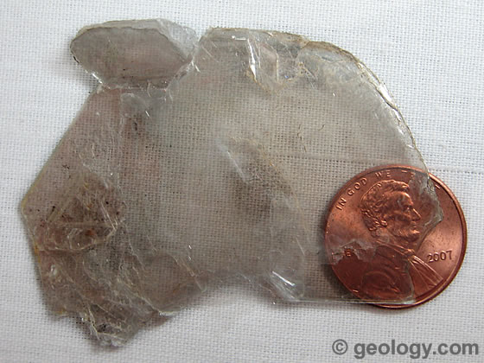
Muscovite: KAl₂AlSi₃O₁₀(OH)₂
Physical Properties
Luster: Vitreous
Color: White, grey, silvery
Streak: White
Hardness (Mohs): 2 - 2 ½
Cleavage: 1 perfect cleavage
Flexible, elastic “sheets”
Mirror-like surface
Source: 1, 2, 3, 4

Slide 42
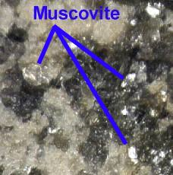
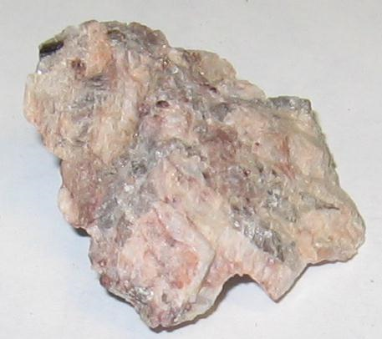
Muscovite: KAl₂AlSi₃O₁₀(OH)₂
How to find in an igneous rock:
“books”
shiny
Silvery or golden (when oxidized)
Scratches easily
Not common
Source: 1, 2

Slide 43
Quartz
Last mineral to form in the rxn series
All other elements used up, only Si and O are left
SiO₂

Slide 44
Quartz: SiO₂
Crystal Structure
Tectosilicates (Framework Silicates)
The basic structural group then becomes SiO₂
Source: 1, 2, 3

Slide 45
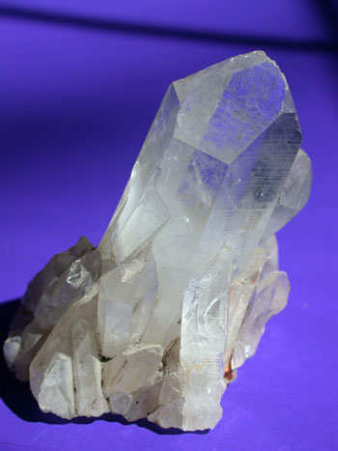
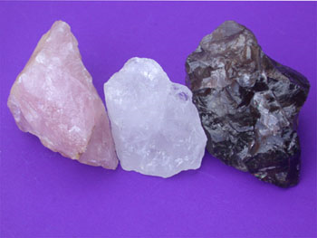
Quartz: SiO₂
Physical Properties
Luster: Vitreous
Color: clear, white, pink, purple, smoke, brown, yellow
Streak: White
Hardness (Mohs): 7
Cleavage: NONE!
The ideal crystal shape is a six-sided prism terminating with six-sided pyramids at each end.
Concoidal Fracture
Source: 1, 2, 3

Slide 46
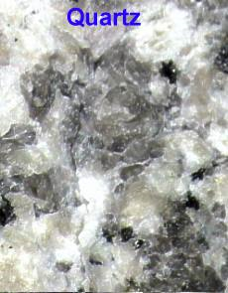
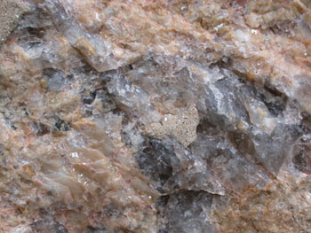
Quartz: SiO₂
How to find in an igneous rock:
Glassy appearance
Clear to dark grey
Cannot be scratched with a knife
Source: 1, 2

Slide 47
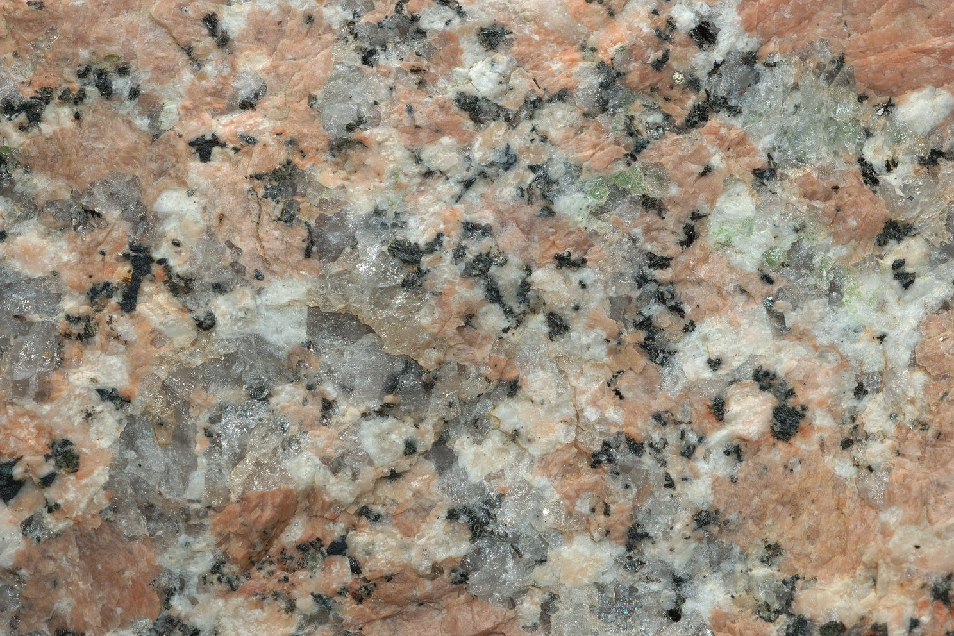
Biotite
Plagioclase
K Feldspar
Quartz
Source: 1

Slide 48
Tourmaline
Common in granites and granite pegmatites
Classified as a semi-precious gemstone
Varieties:
Schorl (NaFe²⁺₃Al₆Si₆O₁₈(BO₃)₃(OH)₄)
Dravite (NaMg₃Al₆Si₆O₁₈(BO₃)₃(OH)₄)
Elbaite (Na(Li_{1.5},Al_{1.5})Al₆Si₆O₁₈(BO₃)₃(OH)₄)

Slide 49
Tourmaline var Schorl
Crystal Structure
Cyclosilicates (Ring Silicates)
Six-Membered Rings with borate groups
Source: 1, 2, 3

Slide 50
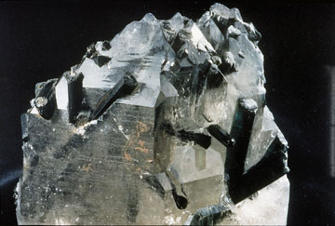
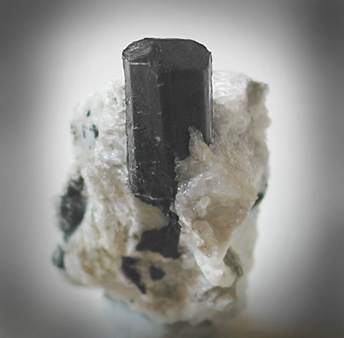
Tourmaline var Schorl
Physical Properties
Luster: Vitreous, Resinous
Color: Bluish-black to black
Streak: White
Hardness (Mohs): 7–7 ½
Cleavage: two but poor/indistinct
Crystal habit: Parallel and elongated. Acicular prisms, sometimes radiating. Sometimes massive as scattered grains (in granite).
Source: 1, 2

Slide 51
Magnetite
Iron oxide mineral, member of the spinel group
Fe₃O₄
Most magnetic of all the minerals
Named for locality of Magnesia, Greece (site for lodestone).
Source: 1, 2

Slide 52
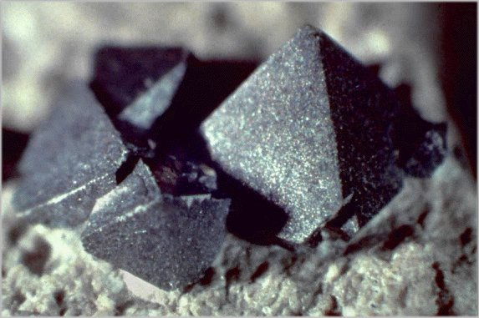
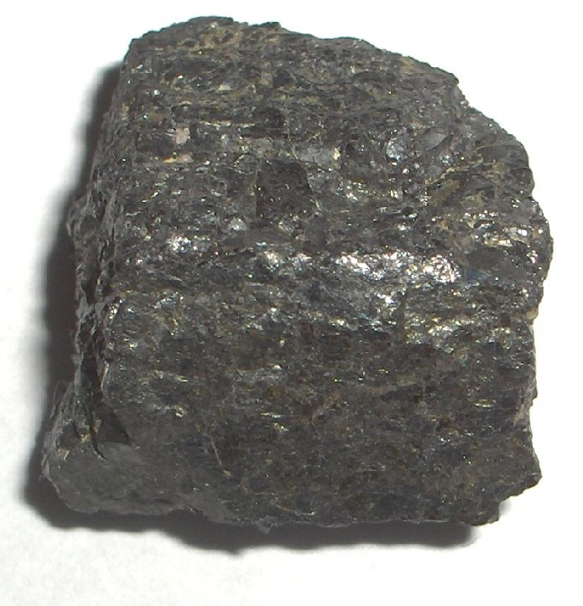
Magnetite Fe²⁺ Fe³⁺₂O₄
Physical Properties
Luster: Metallic
Color: Greyish black or iron black
Streak: Black
Hardness (Mohs): 5½ - 6½
Cleavage: none visible
Crystal habit:
Crystalline : Fine - Occurs as well-formed fine sized crystals.
Massive: Uniformly indistinguishable crystals forming large masses
Source: 1, 2, 3

Slide 53
Igneous Minerals
Olivine
Pyroxene (Augite)
Amphibole (Hornblende)
Biotite
Plagioclase
K Feldspar
Muscovite
Quartz
Tourmaline
Magnetite
Olive or light green
Dark green
Black
Black
White
Pink
Silvery or golden
Translucent grey
Black
Black

Slide 54
~ end ~

