Slide 1
Coastal Erosion

Slide 2
Assessing the risk
How common is this disaster and where does this disaster normally occur?

Slide 3
Assessing the risk
The Coast is a Dynamic Environment
Subject to Many Processes
Waves, tides, and currents
Storms, wind, etc
Subsidence
Rise of sea level due to global climate change

Slide 4
Assessing the risk
Natural Disasters May be Especially Severe
Hurricanes – killed 13,000 in the US since 1900
Tsunami
Earthquakes

Slide 5
Assessing the Risk
A Huge Population Lives in Coastal Areas
In 2010, 123.3 million people, or 39 percent of the nation’s population lived in counties directly on the shoreline.
Source: http://oceanservice.noaa.gov/facts/population.html

Slide 6
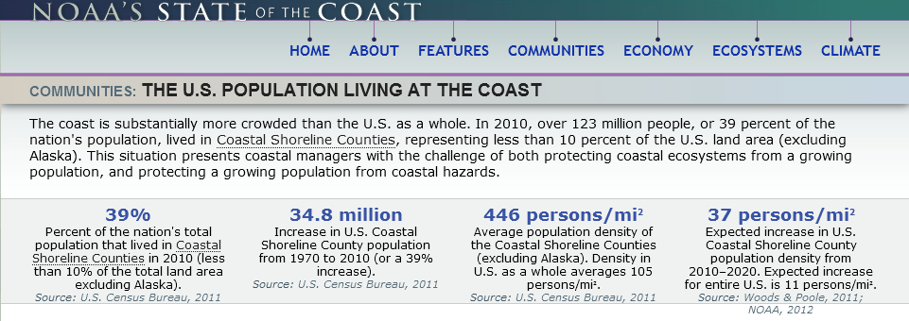
Assessing the risk
Source: http://stateofthecoast.noaa.gov/population/welcome.html

Slide 7
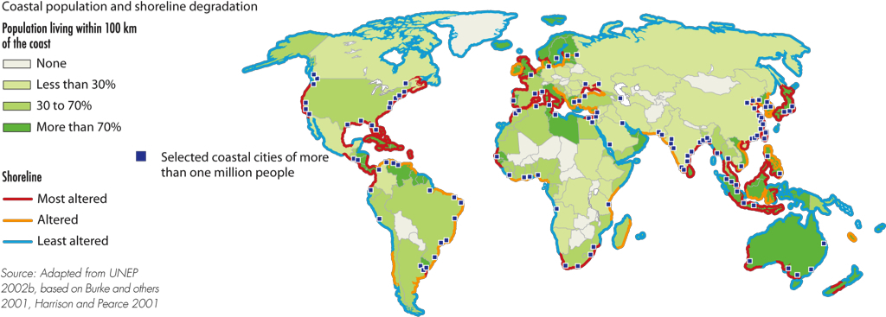
Assessing the risk
Source: http://www.grida.no/graphicslib/detail/coastal-population-and-shoreline-degradation_16b9
Notes:
http://www.grida.no/graphicslib/detail/coastal-population-and-shoreline-degradation_16b9

Slide 8
The Bottom Line
POPULATION DENSITY IS GROWING AT THE COAST
Regardless of how the coast is defined, it is substantially more crowded than the U.S. as a whole, and population density in coastal areas will continue to increase in the future.
In 2010: Out of the 3 million mi² of land in the US
<10% <20%
Within the limited space of the nation’s coast, population density far exceeds the nation as a whole, and this trend
will continue into the future. This situation presents coastal managers with the challenge of protecting both coastal ecosystems from a growing population and protecting a growing population from coastal hazards.
or 275,351 mi² comprise
Coastal Shoreline Counties
or 511,971 mi² comprise
Coastal Watershed Counties
In Just 40 Years: 1970-2010
In 2010: Out of the 313 million people living in the US
Coastal Shoreline Counties added 125 persons/mi
2
Coastal Watershed Counties added 99 persons/mi
2
39% 52%
United States as a whole added 36 persons/mi
2
500
or 123.3 million people lived in
Coastal Shoreline Counties
or 163.8 million people lived in
Coastal Watershed Counties
400
Persons Per Square Mile
300
In 2010:
A small amount of land and a large number of people means high density
446 persons/mi² 319 persons/mi²
105 persons/mi²
200
Each box represents 1 square mile.
100
All United States Counties
= 10 persons
0
1970
1980
1990
2000
2010
2020
Coastal
Shoreline Counties
Coastal
Watershed Counties
United States
Note: Land area and density values exclude Alaska. Population values include Alaska and US Territories.
Source: U.S. Census Bureau, 2011b; NOAA, 2012; Crowell et al., 2010
Source: stateofthecoast.noaa.gov/features/coastal-population-report.pdf
NOAA’s National Coastal Population Report

Slide 9
Assessing the risk
What are the major causes of damage, destruction, death associated with this disaster?

Slide 10
Assessing the risk:
What is “Coastal Erosion”?
Coastal erosion is the removal of land or sediments along a coastal area by wave action, tidal currents, wave currents, drainage or high winds

Slide 11
Assessing the risk:
Hydraulic Action | Abrasion | Attrition | Corrosion
When a wave impacts a cliff face, air is forced into cracks under high pressure, widening them. Over long periods of time, the growing cracks destabilize the cliff and fragments of rock break off of it. | The repeated action of waves breaking on a cliff is enough to remove material from it over time. If sand & shingle are present in the water, it will act like sandpaper and erosion will take place faster. | Beach material is knocked together in water reducing their size and increasing their roundness & smoothness. | Carbon dioxide in the atmosphere is dissolved into water turning it into a weak carbonic acid. Several rocks (e.g., Limestone) are vulnerable to this acidic water and will dissolve into it.
Source: https://geographyas.info/coasts/coastal-erosion/

Slide 12
Assessing the risk:
Natural Factors Affecting the Rate of Erosion
Width of the beach
Amount of wave energy
Nature of the rock present

Slide 13
The beach is a buffer zone protecting the onshore area. It is typically wide in the summer and narrow in the winter

Slide 14
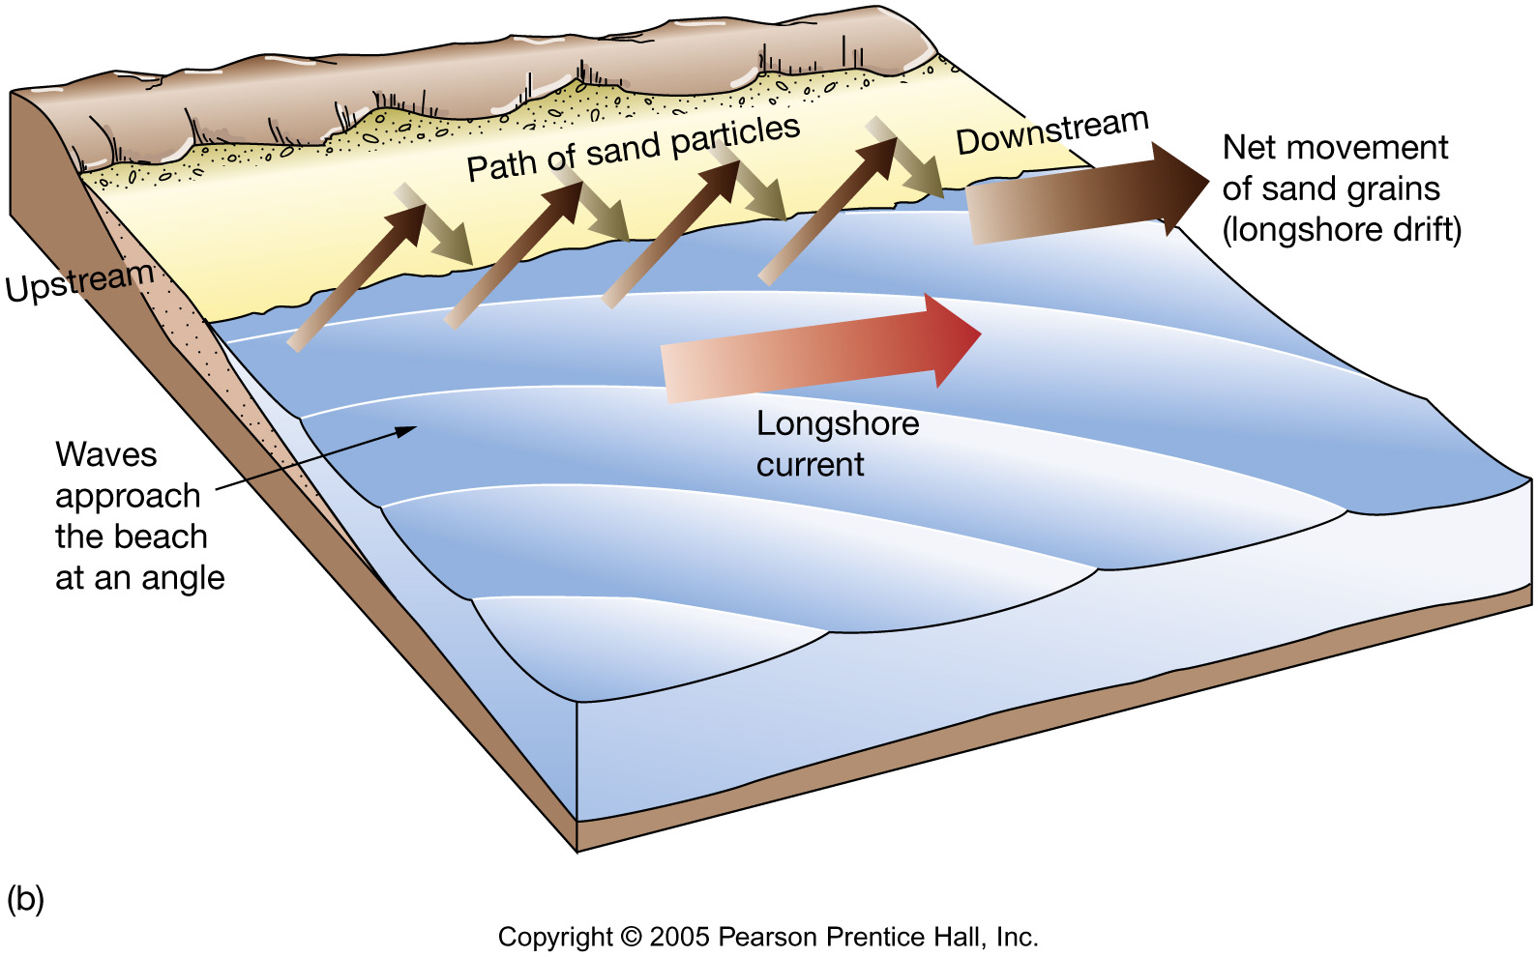
Sand movement along beach
Swash and backwash
Perpendicular to shoreline (toward and away)
Longshore current
Parallel to shoreline (up-coast or down-coast)

Slide 15
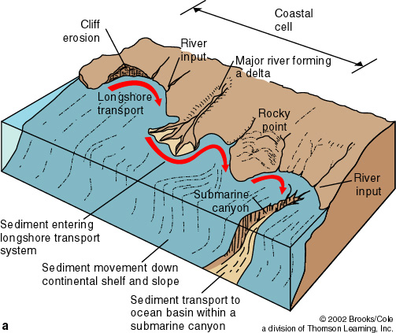
Littoral Cells
Cycle of sediment transport along shore
© 2002 Brooks/Cole, a division of Thomson Learning, Inc.

Slide 16
Assessing the risk:
Natural Factors: Width of the beach
Light wave activity & fair weather
Swash dominates
Sediment moved toward shore
Wider beach
“Summertime” beach

Slide 17
Assessing the risk:
Natural Factors: Width of the beach
Heavy wave activity & stormy weather
Backwash dominates
Sediment moved away from shore
Narrower beach
Sand forms offshore sand bars
“Wintertime” beach

Slide 18
Source: http://coastalchange.ucsd.edu/st3_basics/beaches.html

Slide 19
Source: http://coastalchange.ucsd.edu/st3_basics/beaches.html

Slide 20
Source: http://coastalchange.ucsd.edu/st3_basics/beaches.html

Slide 21
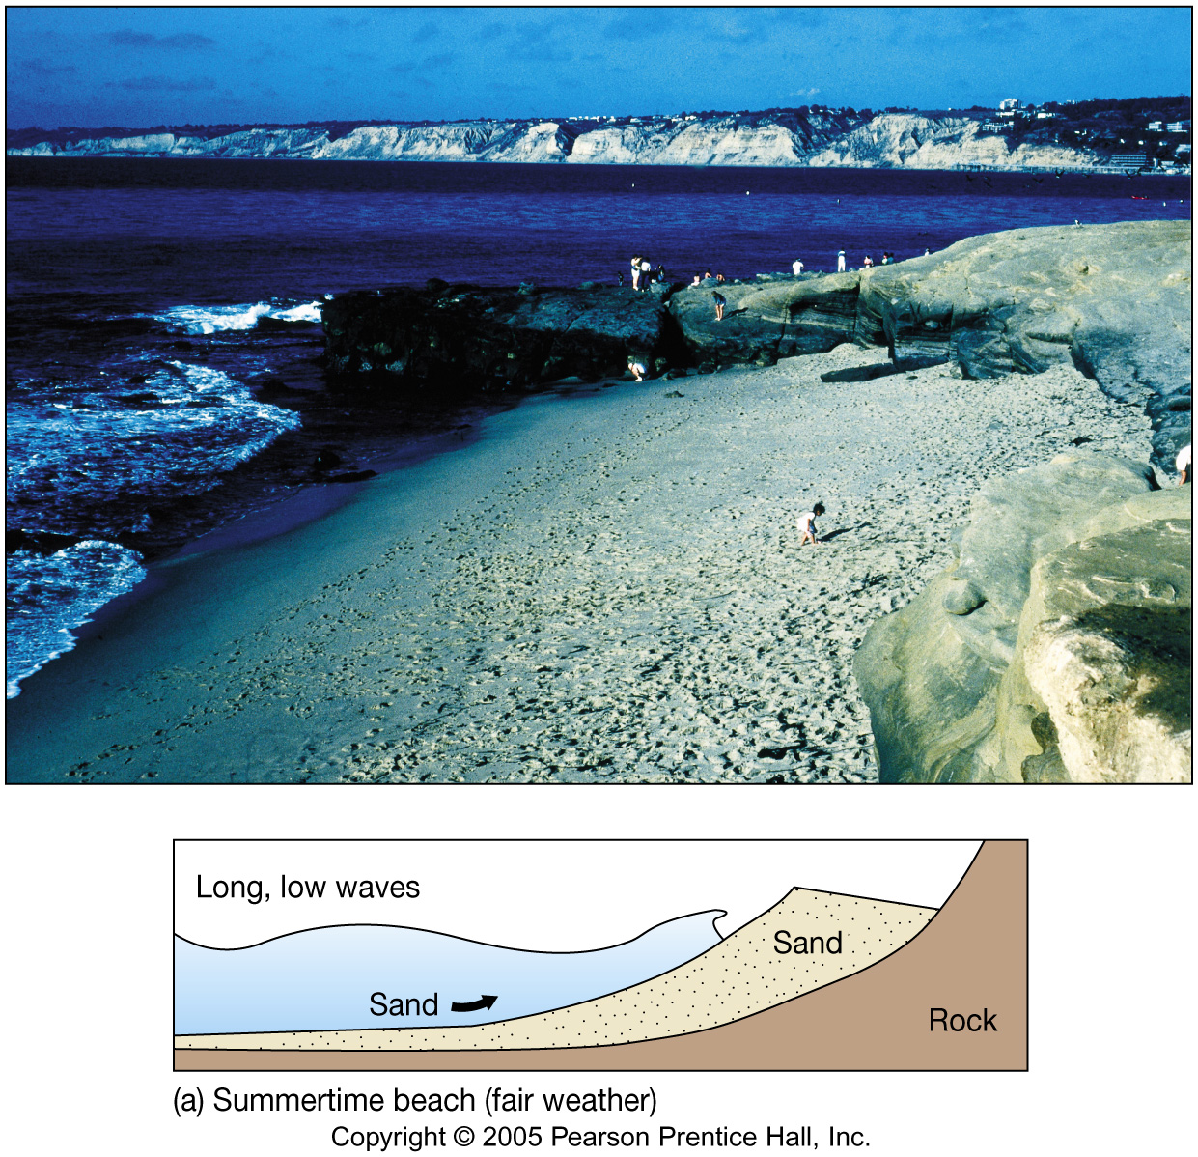

Slide 22
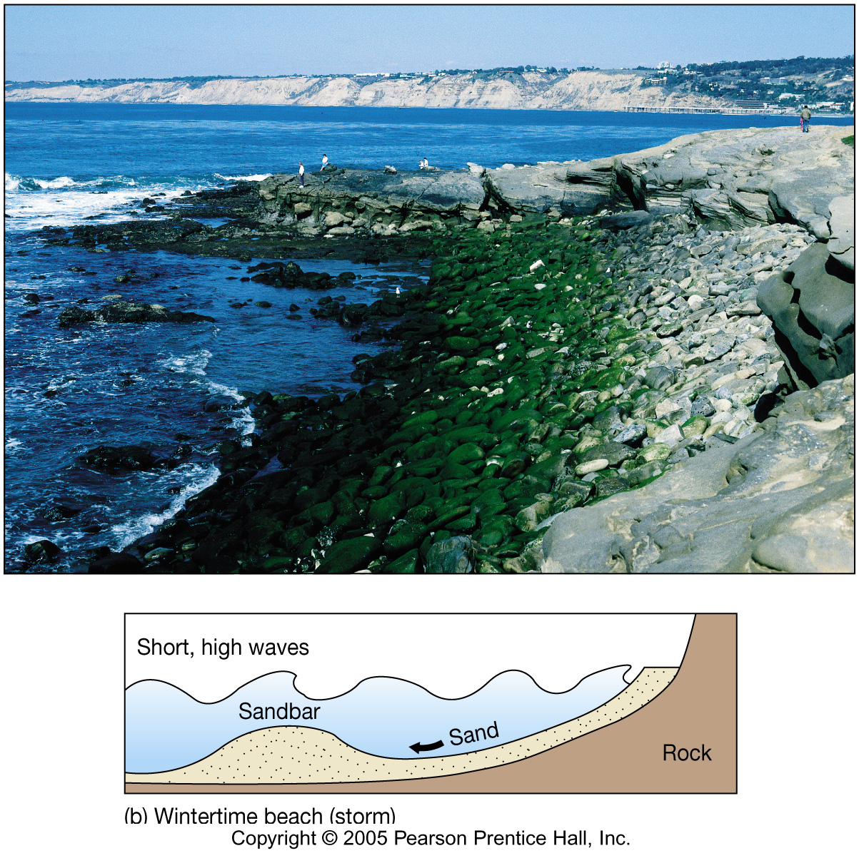

Slide 23
Assessing the risk:
Natural Factors: Amount of wave energy
Most ocean waves wind-generated
Wind Strength – wind speed
Wind Duration – how long the wind blows
Fetch – distance wind is blowing without a change in direction

Slide 24
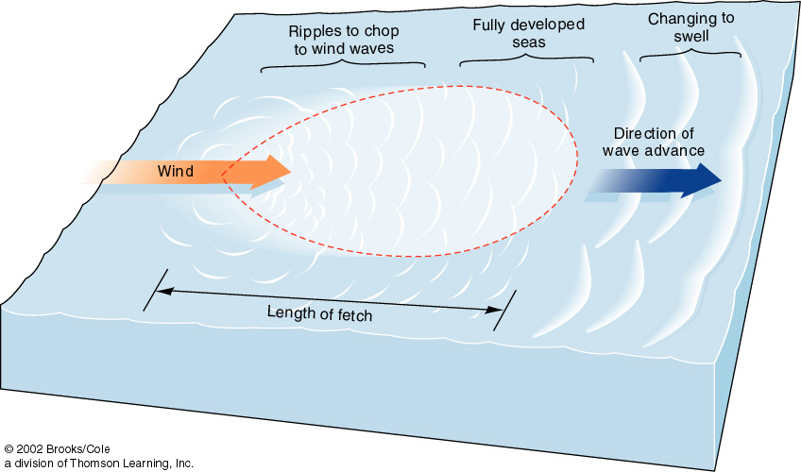

Slide 25
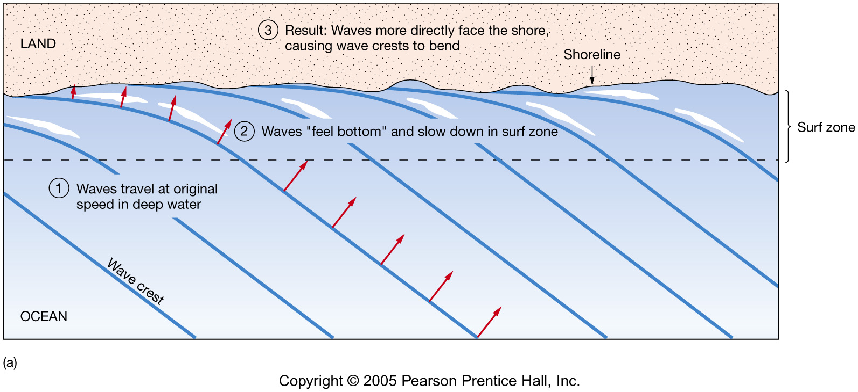
Assessing the risk:
Natural Factors: Amount of wave energy
Refraction = bending of waves
Responsible for the swash/backwash & longshore current

Slide 26
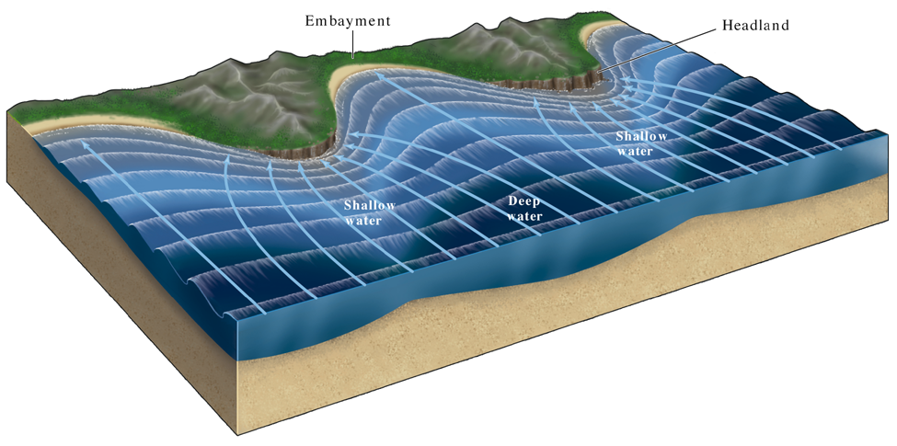
Assessing the risk:
Natural Factors: Amount of wave energy
Refraction = bending of waves
Erodes headlands, sediment is deposited in bays

Slide 27
Assessing the risk:
Natural Factors: Nature of the rock present
Hard vs soft rocks
Dip of bedding

Slide 28
A concordant coastline. The hard rock shields the soft rock from erosion.
Source: https://geographyas.info/coasts/coastal-erosion/

Slide 29
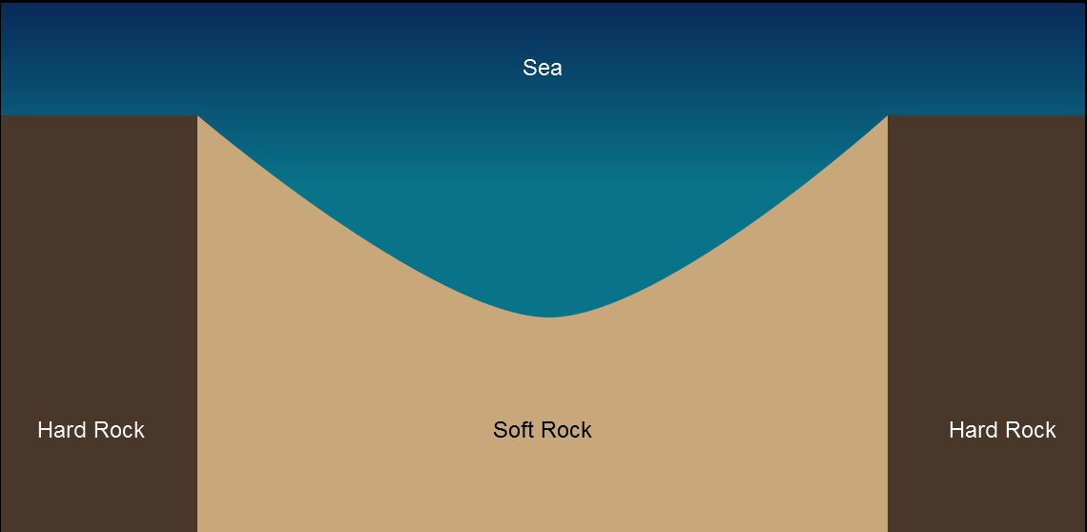
A discordant coastline. The soft rock is less resistant, so it erodes faster.
Source: https://geographyas.info/coasts/coastal-erosion/

Slide 30
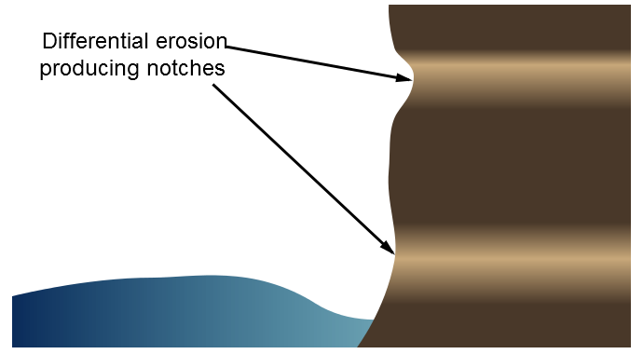
An idealized horizontally bedded cliff. Its profile is steep but the softer (lighter in color) rock has undergone differential erosion producing several notches.
Source: https://geographyas.info/coasts/coastal-erosion/

Slide 31
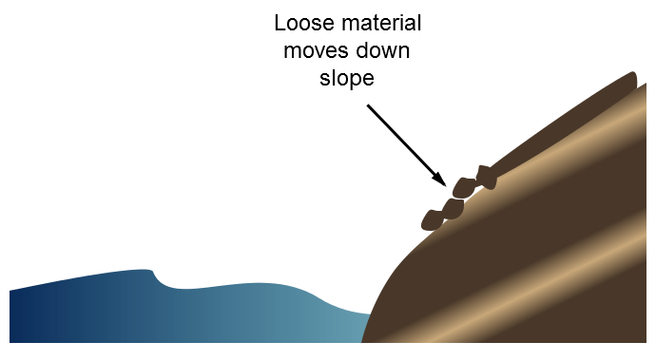
A cliff with seaward dipping bedding planes. Loose material can slide down the bedding planes making the cliff unstable & dangerous.
Source: https://geographyas.info/coasts/coastal-erosion/

Slide 32
A cliff with landward dipping bedding planes. Compared to cliffs with seaward dipping bedding planes, it is relatively steep and stable.
Source: https://geographyas.info/coasts/coastal-erosion/

Slide 33
Natural Factors
Winds
Rain
Climate Change
Storm Surges
Waves
Saturation
Erosion
Sea Level Rise
Sediment Transport

Slide 34
Assessing the risk:
Human Factors Affecting the Rate of Erosion
Cliff tops are loaded with buildings
Surface drainage is altered
Roads, seawalls, etc. are constructed
Most factors do more harm than good

Slide 35
Assessing the risk:
Human Factors Affecting the Rate of Erosion: Dams

Slide 36
Assessing the risk:
Human Factors Affecting the Rate of Erosion: Sea Walls

Slide 37
Assessing the risk:
Human Factors Affecting the Rate of Erosion: Groins

Slide 38
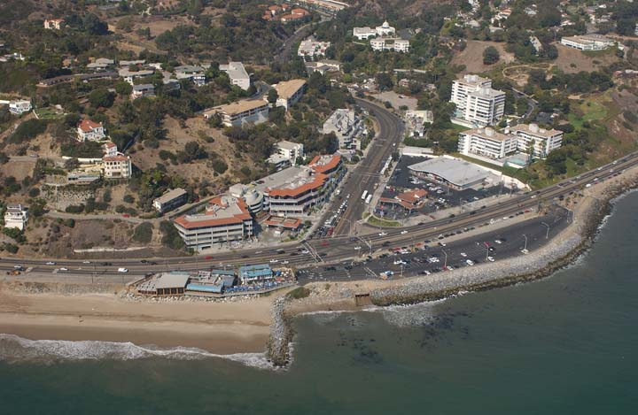
Longshore drift and groin erosion, Sunset Boulevard at PCH 9/23/2002
Source: http://www.californiacoastline.org/
Notes:
http://www.californiacoastline.org/
N34 02.10 W118 33.50 Image 4066 Mon Sep 23 14:08:20 2002 Sunset Blvd.

Slide 39
Groins at Cape May, New Jersey

Slide 40
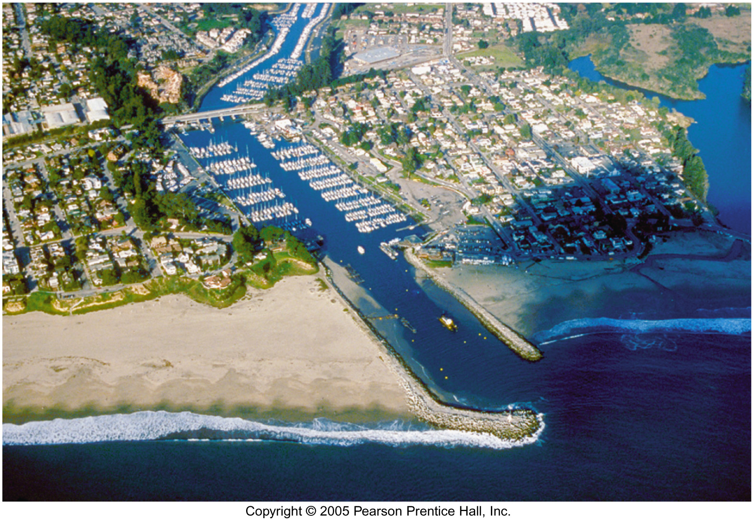
Marina Del Rey Harbor Entrance
Notes:
N33 57.68 W118 27.69 Image 8284 Wed Oct 30 11:34:03 2002 Left - Marina Del Rey Harbor Entrance, Middle - Ballona Creek, Right - Toes Beach

Slide 41
Assessing the risk:
Human Factors Affecting the Rate of Erosion: Breakwaters

Slide 42
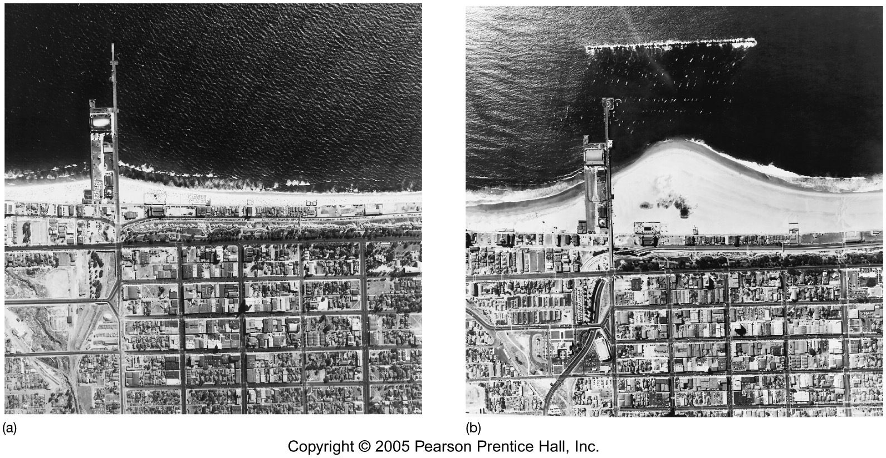
Santa Monica Breakwater

Slide 43
Breakwater along the Mediterranean coast of Israel

Slide 44
Assessing the risk:
Human Factors Affecting the Rate of Erosion: Riprap
Source: https://en.wikipedia.org/wiki/Revetment#/media/File:MumbaiCaltroplikeSeashoreDefence.JPG
Notes:
"MumbaiCaltroplikeSeashoreDefence" by Kelisi - Own work. Licensed under CC BY-SA 3.0 via Commons - https://commons.wikimedia.org/wiki/File:MumbaiCaltroplikeSeashoreDefence.JPG#/media/File:MumbaiCaltroplikeSeashoreDefence.JPG

Slide 45
Assessing the risk:

Slide 46
Prepare, Respond, & Recover

Slide 47
PREPARE: Floods
Know your flood risk & familiarize yourself with local emergency plans.
Make a flood emergency plan, & an emergency kit and family communications plan.
Consider buying flood insurance.
Stay tuned to your phone alerts, TV, or radio for weather updates, emergency instructions, or evacuation orders.
Bring in outdoor furniture and move important indoor items to the highest possible floor.
Minimize travel. If travel is necessary, keep a disaster supplies kit in your vehicle.
Bring pets/companion animals inside
Source: http://www.ready.gov/floods

Slide 48
Reducing the risk
What, if anything, can be done to prevent this disaster from occurring?

Slide 49
Reducing the risk
What, if anything, can be done to prevent this disaster from occurring?
Don’t build in flood plains, or on alluvial fans, or on barrier islands, or along the coast.
Not really an option . . .

Slide 50
Reducing the risk
What can be done to reduce the damages caused by this disaster?

Slide 51
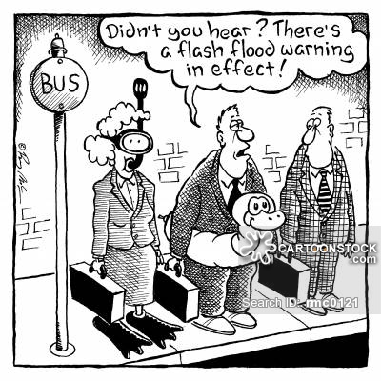
~ end ~
Notes:
https://www.cartoonstock.com/directory/f/flash_floods.asp

