Slide 1
Floods

Slide 2
Assessing the risk
How common is this disaster and where does this disaster normally occur?

Slide 3
Assessing the risk
Floods - The Worst Geological Hazard
They are the most costly in terms of life, property, and land
They can occur almost anywhere

Slide 4
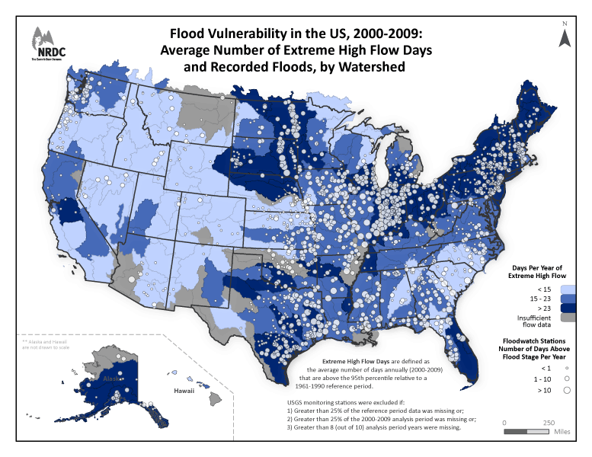
Source: http://www.nrdc.org/health/climate/floods.asp

Slide 5
Observed changes in sea level relative to land elevation in the United States between 1958 and 2008.
Source: http://www.epa.gov/climatechange/impacts-adaptation/coasts.html

Slide 6
Assessing the risk
Causes of floods
Episodic Coastal Flooding
Too much rain / general flooding
Snow melt
Storm surges
Tsunami
Longer-Term Coastal Flooding
Global (or eustatic) sea level rise
Relative sea level rise

Slide 7
Assessing the risk
The Three Fates of Precipitation
Infiltration
Runoff
Evapotranspiration
Notes:
Image Source: Essentials of Geology by Stephen Marshak

Slide 8
Assessing the risk
Infiltration capacity of the soil is controlled by:
Intensity and duration of rainfall
Soil saturation
Soil texture
Slope of the land
Nature of the vegetative cover

Slide 9
Assessing the risk
The Function of Rivers
Move runoff away from land and out to the sea (or lake)
Transport sediments (erosion)

Slide 10
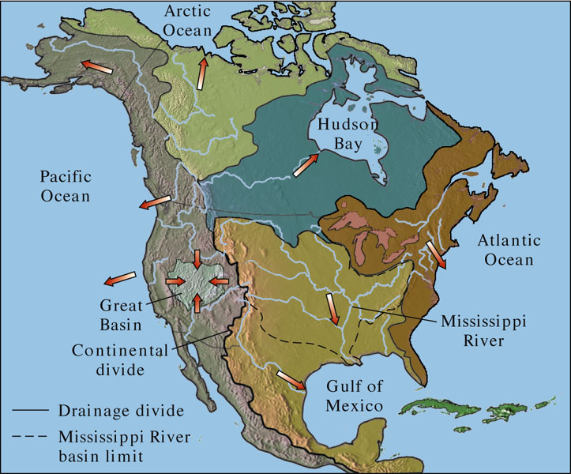
North American Drainage Basins
Drainage basins are separated by divides (mountains) and are comprised of several watersheds
Notes:
Image Source: Essentials of Geology by Stephen Marshak

Slide 11
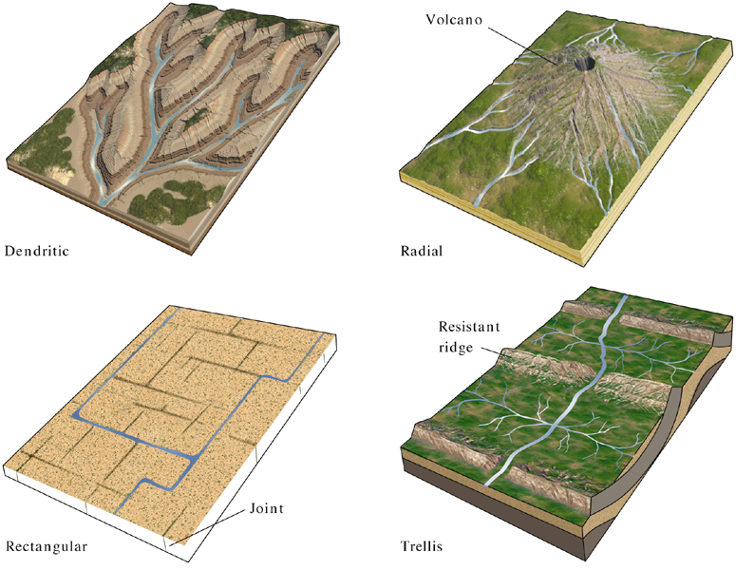
Types of Drainage Patterns

Slide 12
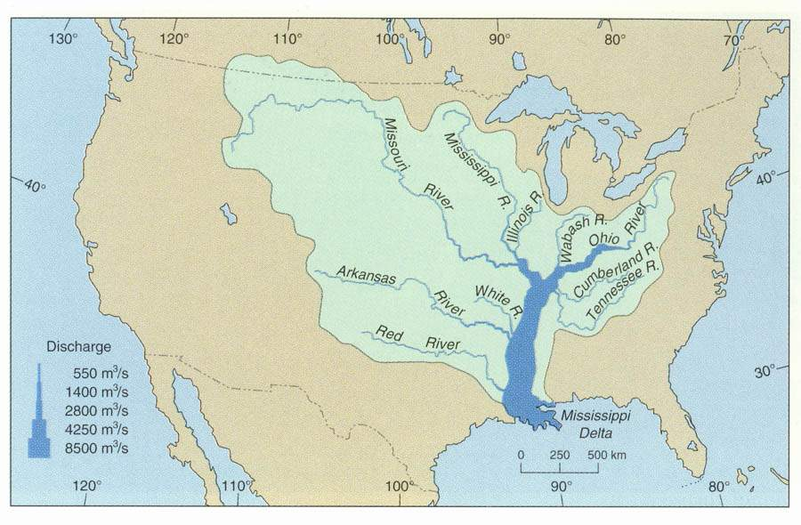
The drainage basin of the Mississippi River
Notes:
http://www.wiley.com/college/geocases/cases/case2/images/tour_2/2_1.html

Slide 13
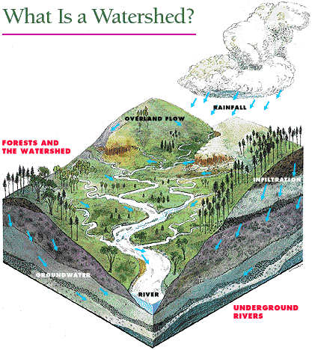
Assessing the risk
How water moves through a watershed
Watershed Problems
Too much rain/snow melt
Erosion
Urbanization
Source: http://www.co.rockingham.nc.us/pView.aspx?id=15003&catid=407

Slide 14
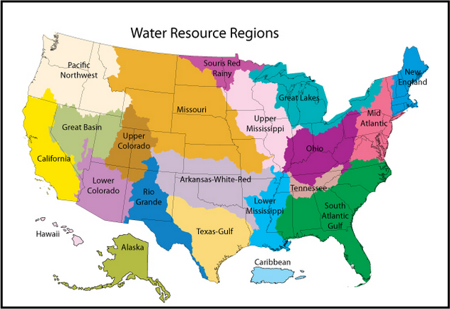
U.S. Watersheds
Source: http://water.usgs.gov/wsc/watershed_finder.html

Slide 15
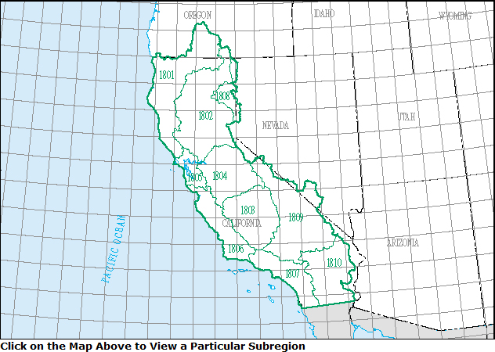
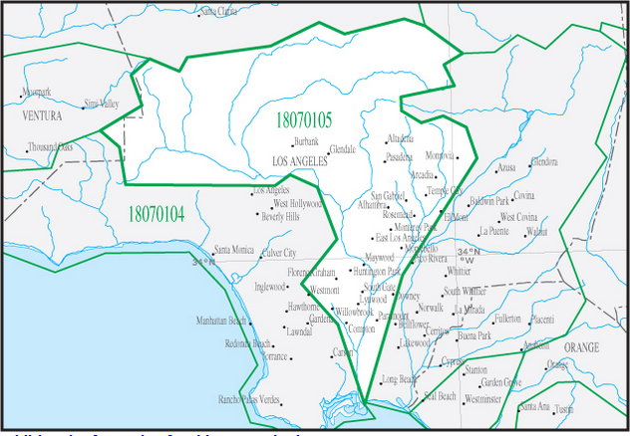
California Watersheds
Source: http://water.usgs.gov/wsc/watershed_finder.html

Slide 16
Assessing the risk
The Hydrograph
Used to discover discharge patterns for a given drainage basin
Analysis can help predict future floods

Slide 17
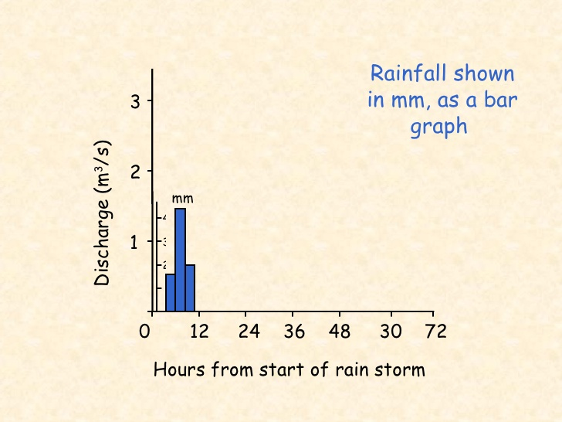
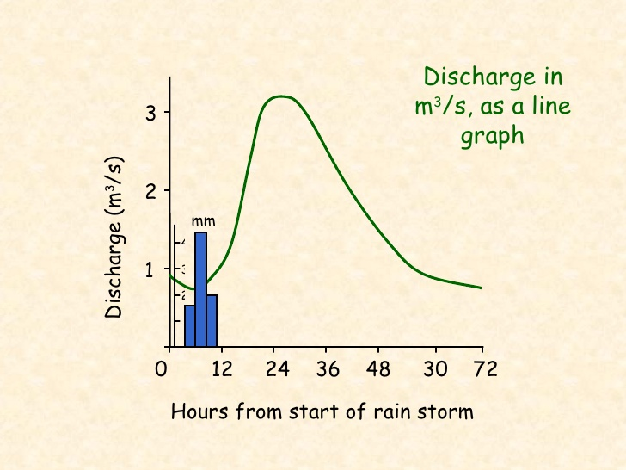
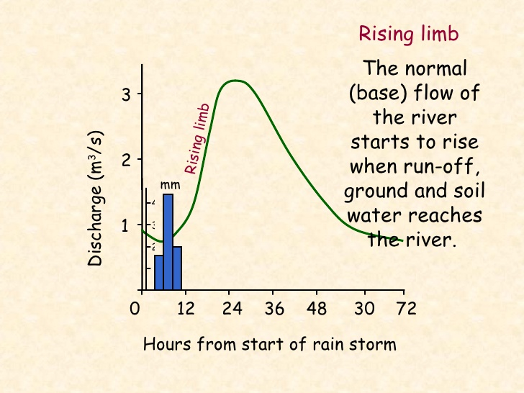
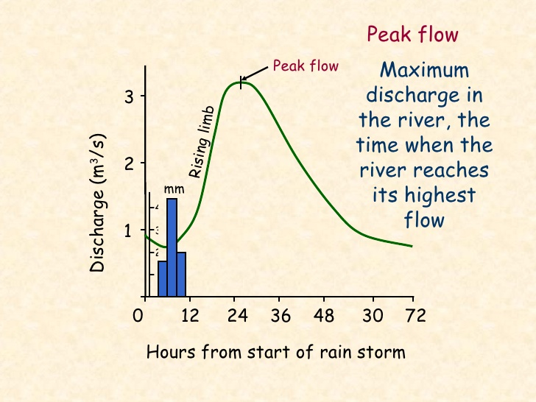
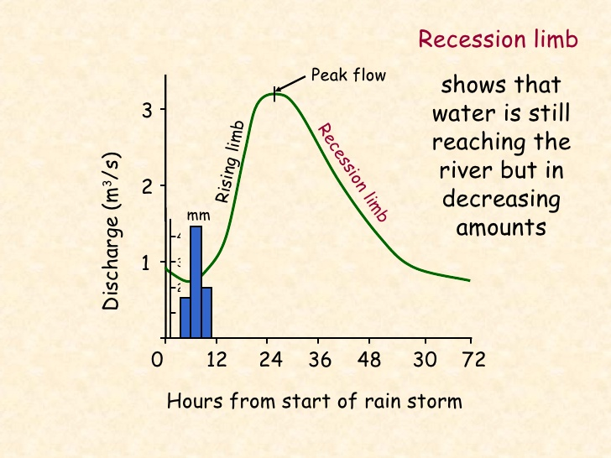
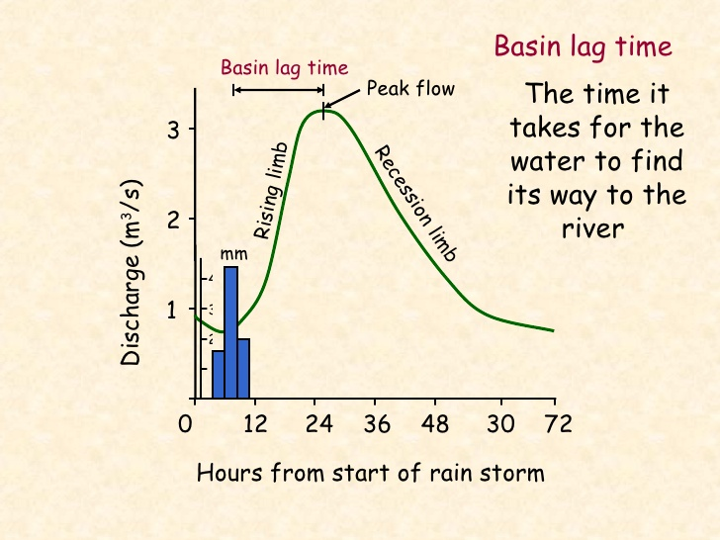
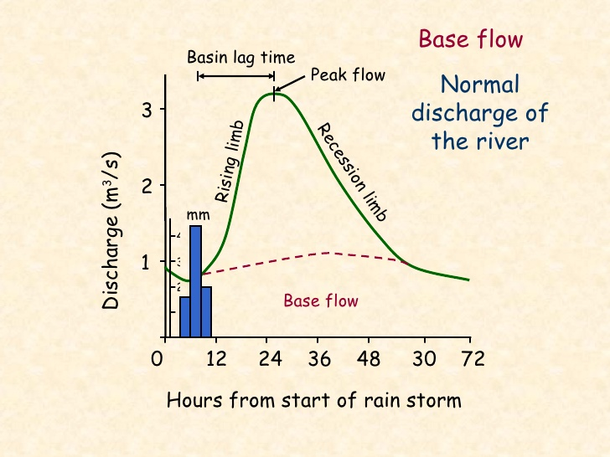
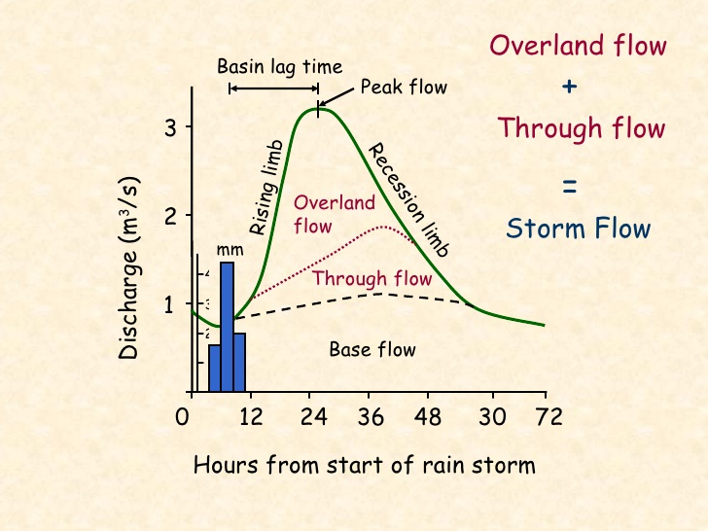
Assessing the risk: Hydrograph Analysis
Factors
Area
Slope
Rock type
Land use
Soil
Temperature
Precipitation
Overland flow
Volume of water reaching the river from surface run off
Through flow
Volume of water reaching the river through the soil and underlying rock layers
Source: http://www.slideshare.net/DuncanAshton/hydrograph-explanation-and-animation

Slide 18
Assessing the risk
Recurrence Interval
The statistical average number of years between flows of a certain discharge
Example: there is 1 in 100 chance that a peak flow of a certain amount (say, 30,000 cf/s) can occur on a river. Thus, that river is said to have a 100-year interval

Slide 21
Example of a National Flood Insurance flood hazard map for part of East Lansing, Michigan

Slide 22
Assessing the risk
Urbanization and Erosion
Both natural and urban landscapes have low erosion rates
Construction as natural lands are urbanized causes high erosion rates

Slide 23
Assessing the risk
Factors which Have Increased Erosion
Deforestation – results in increased erosion
Overgrazing – also increased erosion
Urbanization – More rapid discharge to streams
More frequent floods, Higher flood peaks
Urban runoff is highly toxic

Slide 25
Assessing the risk
Recurrence Interval
Engineers design for particular recurrence intervals
Streets 2-5 years
Debris dams 5 – 25 years
Upper valley dams 100 years
Levees 100 yrs
Large dams 1000+ years

Slide 26
Assessing the risk
Problems with Recurrence Intervals
Data must cover a long enough time frame
Use of paleoflood data
Conditions affecting stream flow upstream must be similar throughout time*
*rare!

Slide 27
Determination of Past Events

Slide 28
Assessing the risk
What are the major causes of damage, destruction, death associated with this disaster?

Slide 29
Types of floods
Flash Flooding In Arroyos/washes
River (Regional) Flood
Urban Flood
Ice Jam
Dam Failure
Coastal Flood

Slide 30
Flood damage is caused by:
Erosion by flood waters
Impact of water on structures
Sediment deposition
Contamination of surface waters

Slide 31
Flood Styles: Flash Floods
Typically caused by:
Intense rainfall
Short period of time
Topography, soil conditions, and ground cover also important

Slide 32
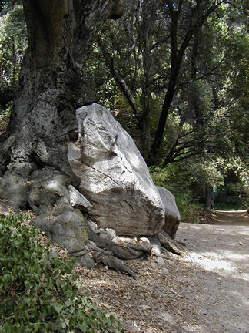
Flood Styles: Flash Floods
Damages:
Roll boulders
Tear out trees
Destroy buildings and bridges
Scour out new channels
Landslides
Sturtevant Falls Trail, San Gabriel Mountains
Photo by S. Leyva © 2001

Slide 34
Flood Styles: Regional Floods
Some floods occur seasonally when winter or spring rains, coupled with melting snows, fill river basins with too much water, too quickly.
Torrential rains from decaying hurricanes or tropical systems can also produce river flooding.

Slide 35
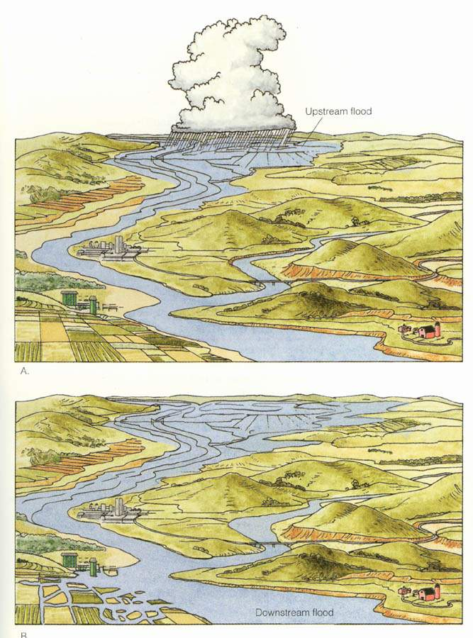
Flood Styles: Regional Floods
Upstream floods
Generally local in extent & short lag times.
Result from intense storms of short duration.
Notes:
http://www.wiley.com/college/geocases/cases/case2/images/tour_2/2_6.html

Slide 36
Flood Styles: Regional Floods
Downstream floods
Result from regional storms of long duration or extended periods of above-normal precipitation.
Longer lag times & higher peak discharges.
Notes:
http://www.wiley.com/college/geocases/cases/case2/images/tour_2/2_6.html

Slide 37
Flood Styles: Regional Floods
The Great Midwestern Flood of 1993
Flooding began in the upper Mississippi River Valley
Record flood stage levels recorded
Covered nine states and 400,000 square miles.
Notes:
http://www.nwrfc.noaa.gov/floods/papers/oh_2/great.htm

Slide 38
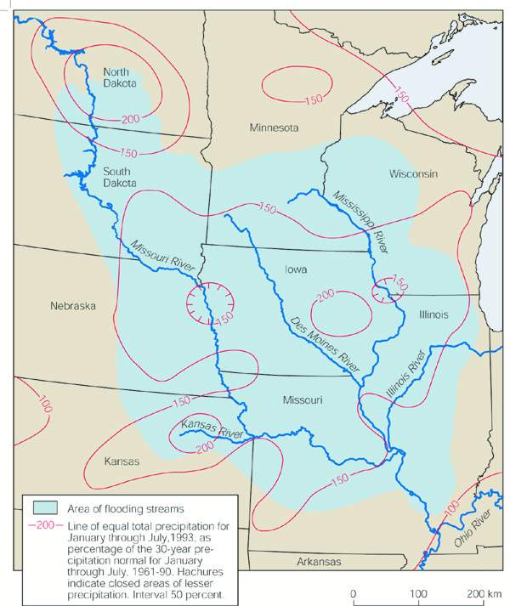
Flood Styles: Regional Floods
The Great Midwestern Flood of 1993
Abnormally high rainfall in many Midwest states
Ground became over saturated
Streams filled to capacity
Notes:
http://www.nwrfc.noaa.gov/floods/papers/oh_2/great.htm

Slide 40
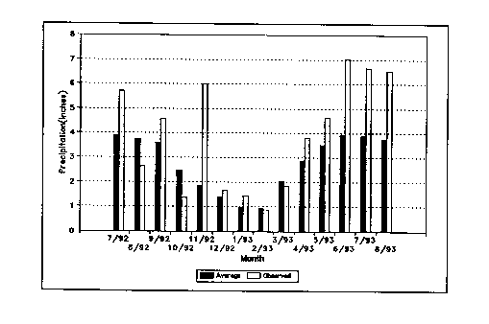
Comparison of Average and Observed Monthly Precipitation Totals for the Upper Mississippi River Basin
Notes:
http://www.nwrfc.noaa.gov/floods/papers/oh_2/great.htm

Slide 41
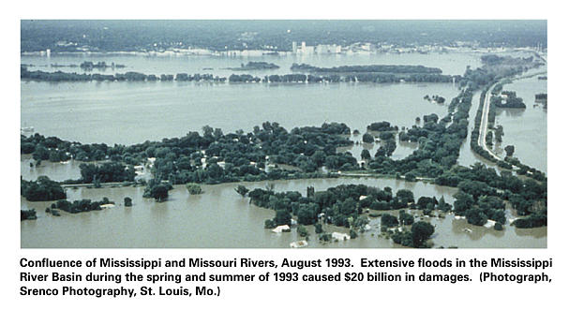
Flood Styles: Regional Floods

Slide 42
Flood Styles: Regional Floods
Missouri and Mississippi rivers near St. Louis before (1988) and after peak flood conditions
Notes:
http://www.wiley.com/college/geocases/cases/case2/images/tour_2/2_10.html

Slide 45
Levee Breech

Slide 46
Flood Styles: Urban Flood
Roads and parking lots prevent infiltration of water
Urbanization increases runoff 2 to 6 times over what would occur on natural terrain.
Streets can become swift moving rivers, can flood homes and businesses

Slide 47
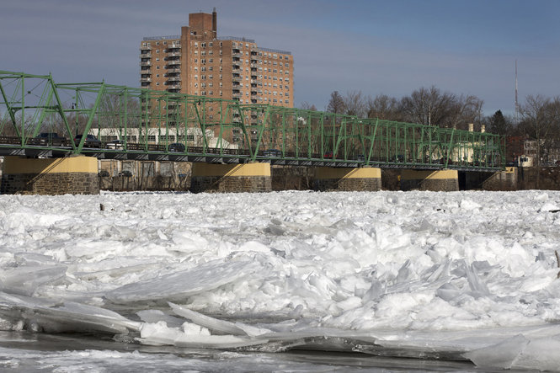
Flood Styles: Ice Jams
Floating ice can accumulate at a natural or man-made obstruction and stop the flow of water.
Ice jams in Delaware River cause minor flooding in Trenton, NJ
Notes:
http://media.nj.com/the-times/photo/2014/01/14055687-standard.jpg

Slide 48
Flood Styles: Dam Failure
St. Francis Dam 3/12/28
Dream of William Mulholland
200 ft high curved concrete gravity dam
Failed catastrophically at midnight upon first filling

Slide 49
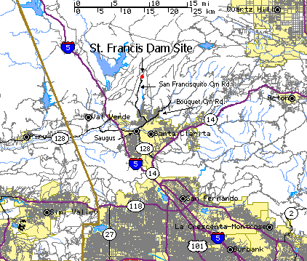
Notes:
http://seis.natsci.csulb.edu/VIRTUAL_FIELD/Francesquito_Dam/franmayn.htm

Slide 50
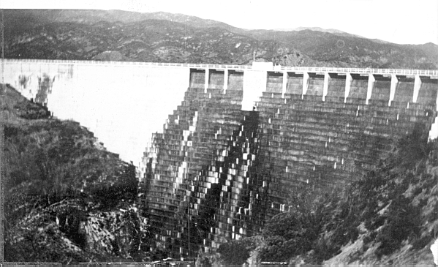
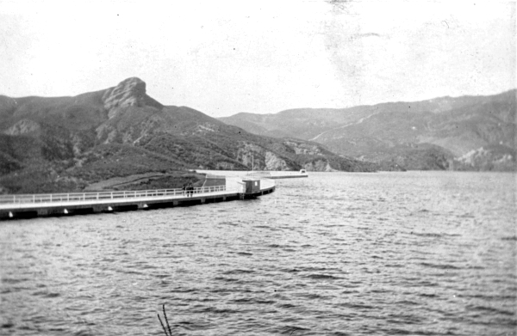
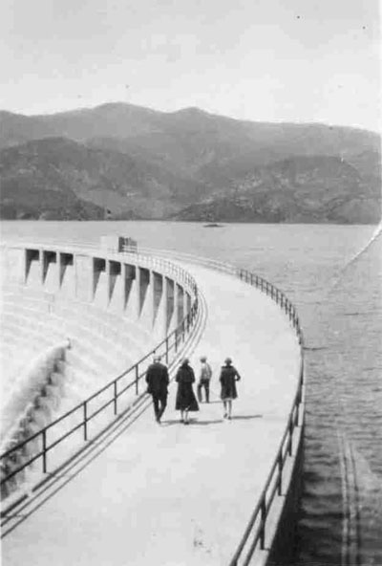
St. Francis Dam shortly before its March 12, 1928, collapse.
It is said that this photograph was taken at noon on March 12, 1928. However, the caption on the back of the original photo reads: "Taken March 9, 1928, by E.B. (Al) Louden." In any case it is believed to be the last photograph of the St. Francis Dam before it broke at 3 1/2 minutes before midnight on March 12.
Walking across the top of the St. Francis Dam, looking west, sometime between 1926 and 1928.
Notes:
http://www.scvhistory.com/scvhistory/stfrancis.htm

Slide 51
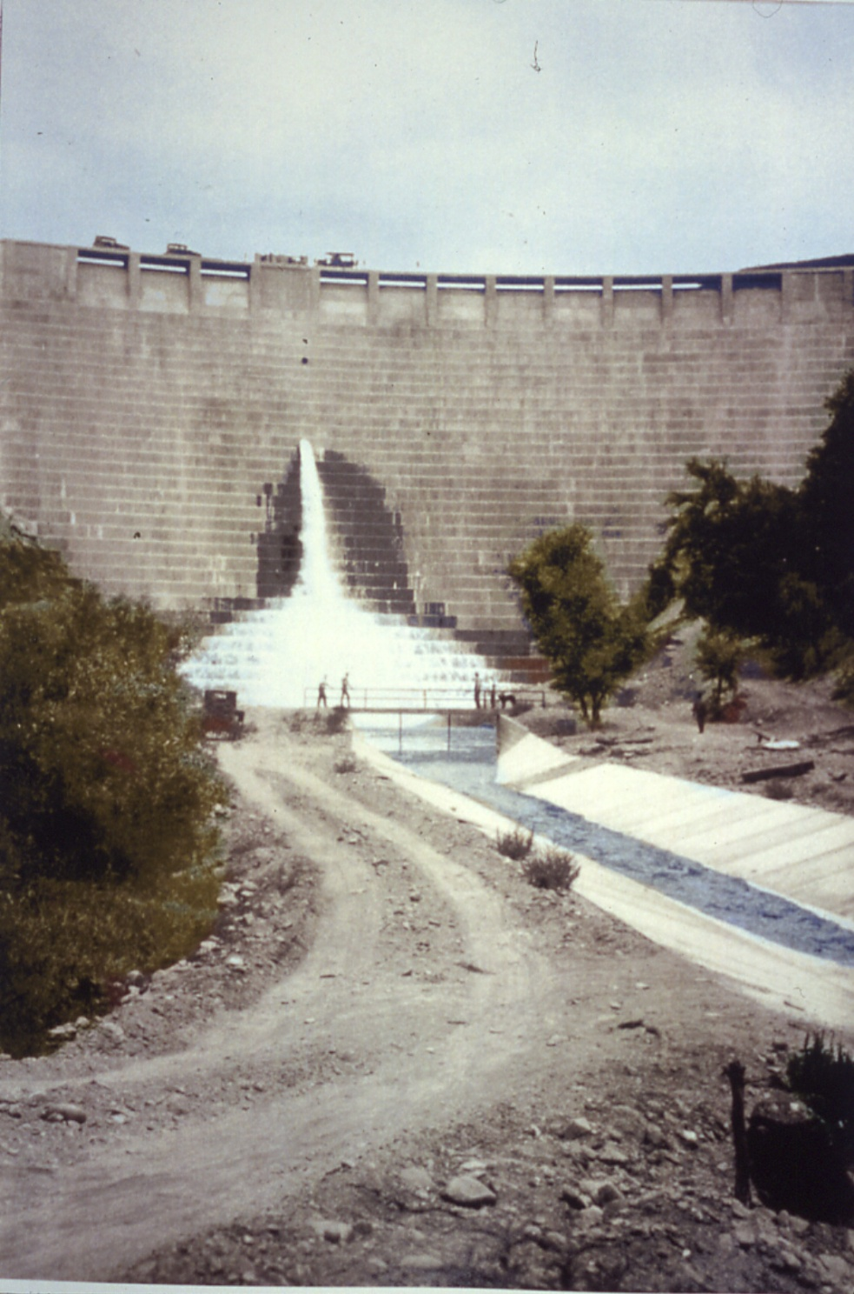
This colorized photo shows the St. Francis Dam on its day of formal dedication in May of 1926, almost two years before the failure.
http://web.umr.edu/~rogersda/st_francis_dam/

Slide 52
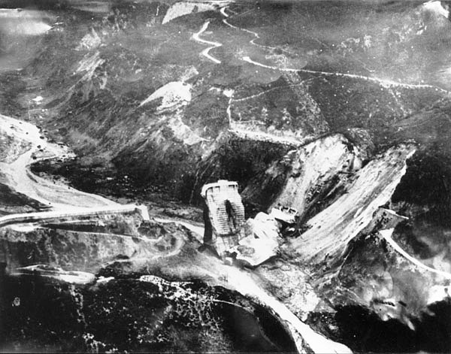
Photo, looking north, shows what was left of the St. Francis Dam shortly after it failed on March 12, 1928.
Notes:
http://www.scvhistory.com/scvhistory/ap2333a.htm

Slide 53
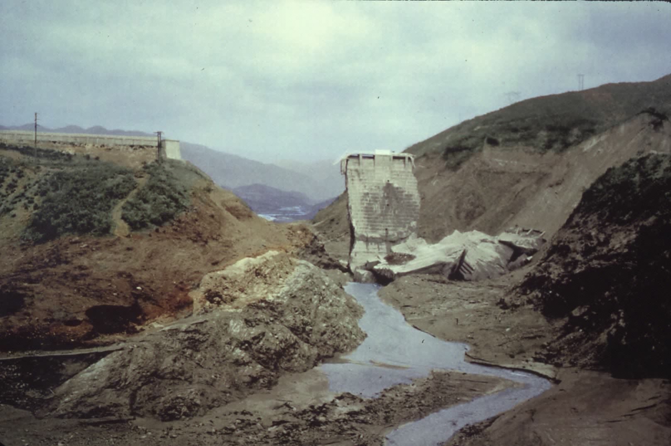
This colorized photo was taken the day after St. Francis Dam failed.
Notes:
http://web.umr.edu/~rogersda/st_francis_dam/

Slide 54
This picture, taken just after the 1928 disaster,looks towards the southwest. The San Francisquito Fault dips to the northwest.
Notes:
http://seis.natsci.csulb.edu/VIRTUAL_FIELD/Francesquito_Dam/franmayn.htm

Slide 55
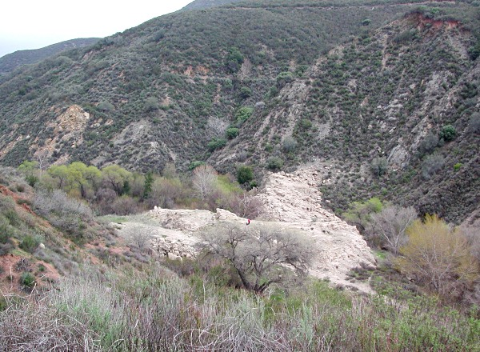
March 11, 2001: Ruins at the base of the former St. Francis Dam in San Francisquito Canyon. The red speck in the center is a person.
Notes:
http://www.scvhistory.com/scvhistory/lw2100c.htm

Slide 57
Flood Styles: Dam Failure
St. Francis Dam 3/12/28
Cause of failure complex
Sespe formation prone to “slaking”
excessive titling when fully loaded
an absence of seepage relief in the dam's sloping abutments
and the partial reactivating of underlying paleo mega-slides within the Pelona Schist.

Slide 58
Flood Styles: Dam Failure
St. Francis Dam 3/12/28
Some of the most important consequences included
the formulation of the world's first dam safety agency
normalization of uniform engineering criteria for testing of compacted earthen materials
A reassessment of all LADWP dams and reservoirs
the formulation of a state-mandated process for arbitration of wrongful death suits
Notes:
http://dibblee.geol.ucsb.edu/news/st_francis_book.html

Slide 59
Flood Styles: Coastal Flood
Caused by:
Storm Surges
Tsunami
Sea Level Rise

Slide 60
Flood Styles: Coastal Flood
Storm Surge
Tropical Storms
Hurricanes
NOAA’s Storm Surge Animation (http://www.nhc.noaa.gov/surge/animations/hurricane_stormsurge.swf)
Source: http://www.nhc.noaa.gov/surge/

Slide 61
Flood Styles: Coastal Flood
Storm Surge
Made worse by high tides
Storm Surge vs. Storm Tide
NOAA’s Surge animation with shallow continental shelf (http://www.nhc.noaa.gov/surge/animations/surgea.swf)
NOAA’s Surge animation with steep continental shelf (http://www.nhc.noaa.gov/surge/animations/surgeb.swf)

Slide 62
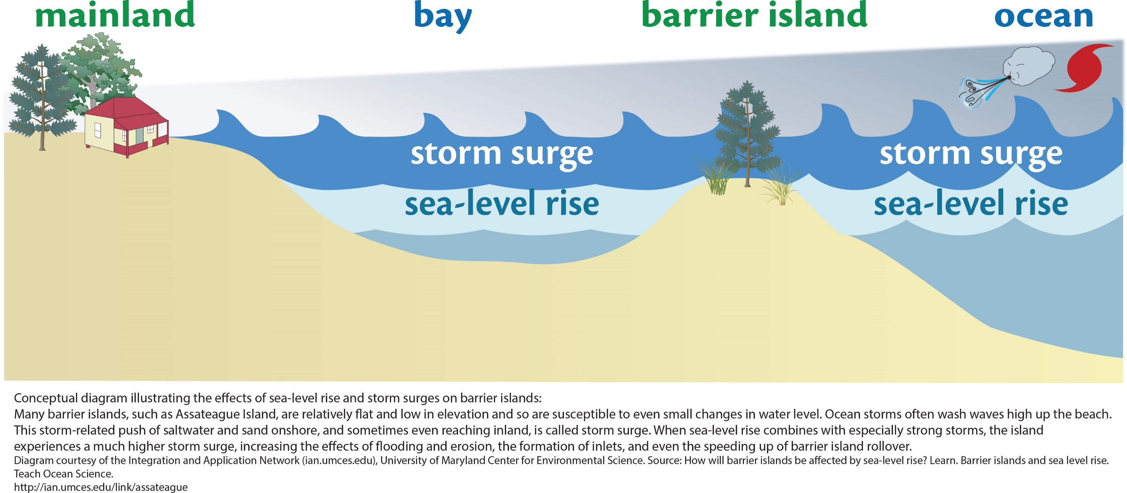
Source: http://ian.umces.edu/imagelibrary/displayimage-83-7792.html

Slide 63
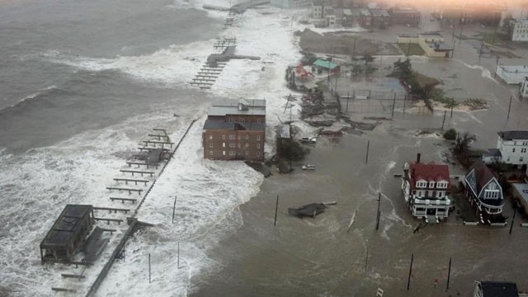
Hurricane Sandy storm surge makes its way through Atlantic City, N.J. (c) 6abc Action News
Source: http://www.zmescience.com/research/studies/hurricane-surges-worsen-future-climate-change-042342/

Slide 64
Flood Styles: Coastal Flood
Storm Surge
Made worse by coastal erosion
Wetlands
Barrier islands
Beaches
Source: http://pubs.usgs.gov/pp/2007/1751/professional-paper/tile7-8/hurricanes.html

Slide 65
Flood Styles: Coastal Flood
Tsunami
Large waves inundate coastal areas
Low-lying areas = greater run up
Source: http://oregonstate.edu/instruct/oer/earthquake/11%20chapter%209_color.html

Slide 66
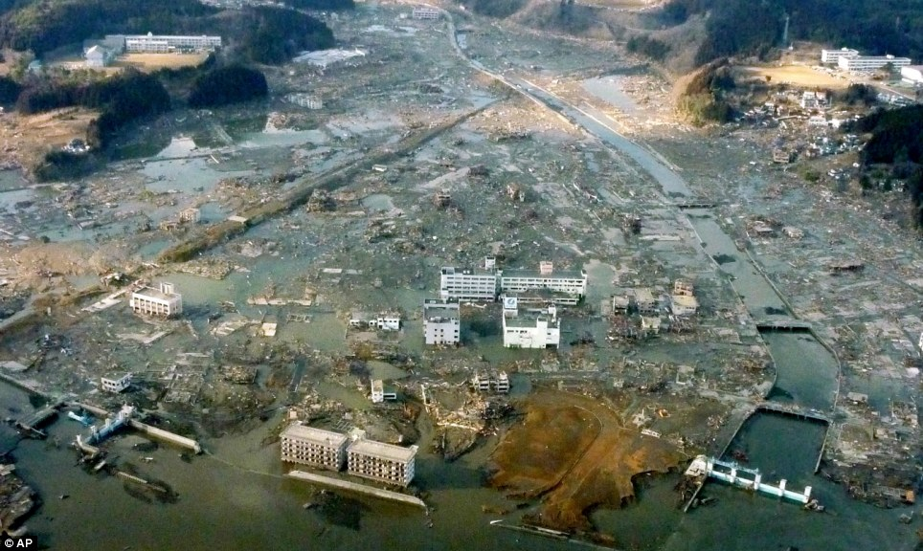
2011 tsunami damage in the port city of Minamisanriku, Japan
Notes:
http://www.dailymail.co.uk/news/article-1365546/Japan-earthquake-pictures-Devastation-rescue-workers-fight-fires-search-survivors.html

Slide 67
Flood Styles: Coastal Flood
Relative sea level rise
Land goes up or down due to
Tectonic activity
Subsidence
Source: http://pubs.usgs.gov/of/2008/1206/html/figs/fig3_8.html

Slide 68
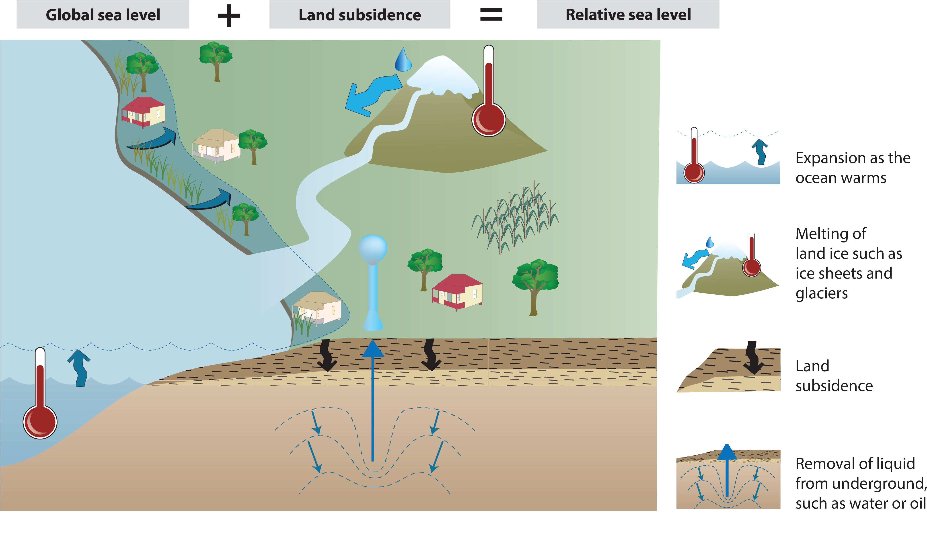
Source: http://ian.umces.edu/imagelibrary/displayimage-7784.html

Slide 69
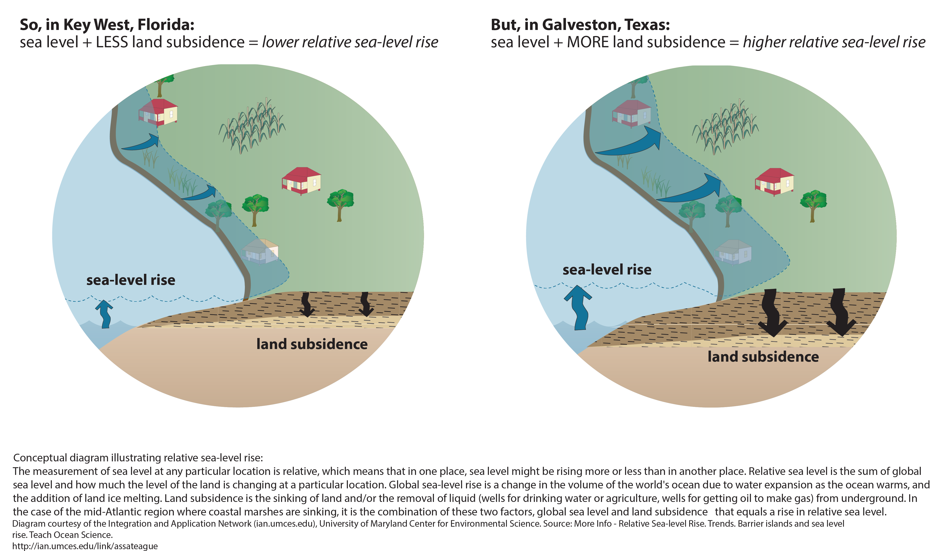

Slide 70
Weight of sediments + erosion + urbanization ______________ Subsidence of the Mississippi River Delta
Image by Zina Derestsky, National Science Foundation.
Source: http://www.geosociety.org/news/pr/06-26.htm

Slide 71
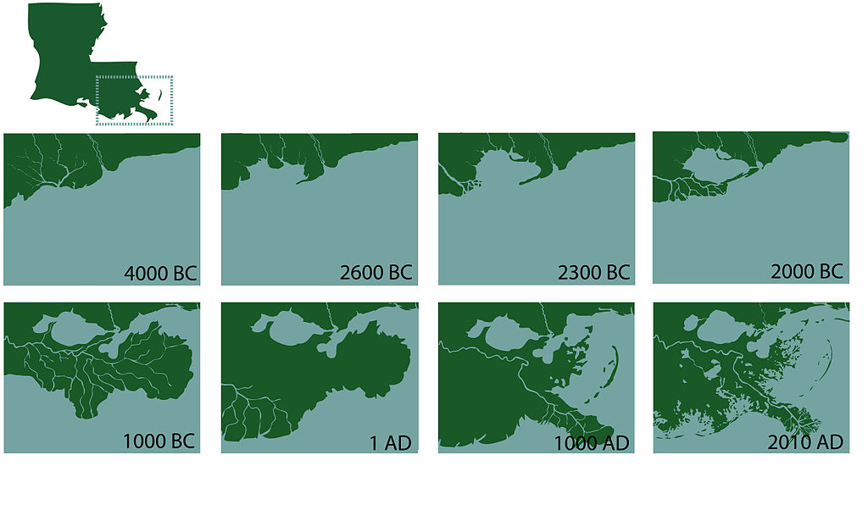
Coastal Change in South Eastern Louisiana
Source: https://en.wikipedia.org/wiki/Mississippi_River_Delta
Notes:
"Coastal changediagram5" by Dboutte - Dboutte. Licensed under CC BY 3.0 us via Commons - https://commons.wikimedia.org/wiki/File:Coastal_changediagram5.jpg#/media/File:Coastal_changediagram5.jpg

Slide 72
Flood Styles: Coastal Flood
Global (eustatic) sea level rise
Global warming = ice melts, causes sea level to rise
Global cooling = ice forms, causes sea level to lower
Climate Time Machine (http://climate.nasa.gov/interactives/climate-time-machine)
Source: http://pubs.usgs.gov/of/2008/1206/html/figs/fig3_8.html

Slide 73
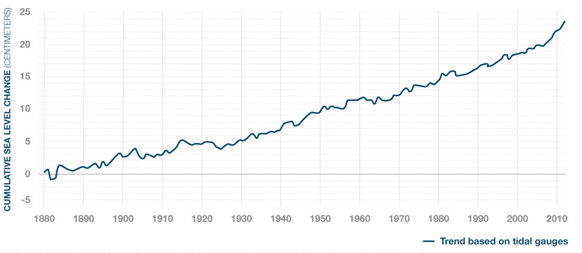
Flood Styles: Coastal Flood
Global (eustatic) sea level rise
Source: http://www.cnn.com/2015/06/10/opinions/sutter-climate-sea-level-facts/

Slide 74
Flood Styles: Coastal Flood
Global (eustatic) sea level rise
Surging Seas: sea level rise analysis by Climate Central http://ss2.climatecentral.org/
Source: http://ss2.climatecentral.org/

Slide 75
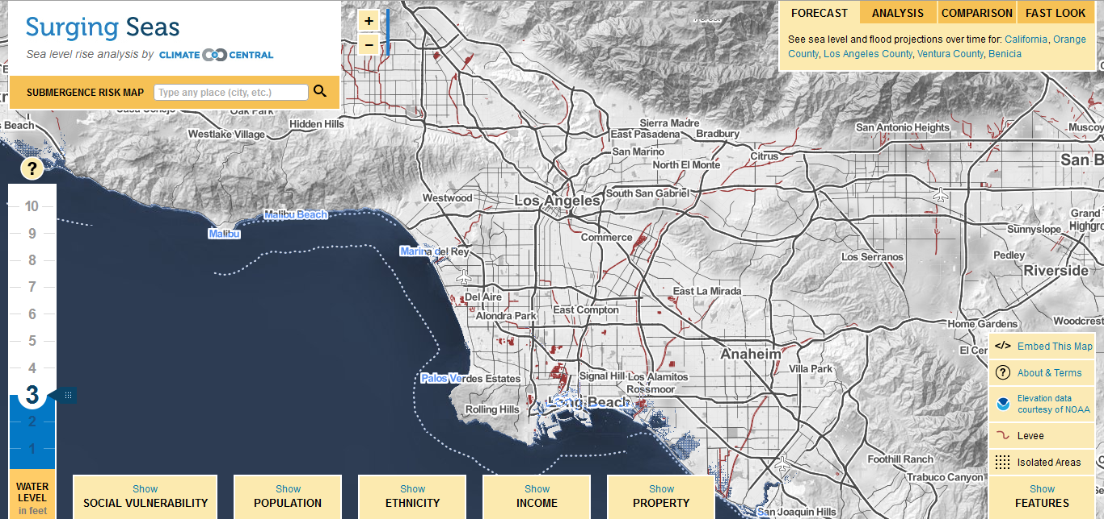
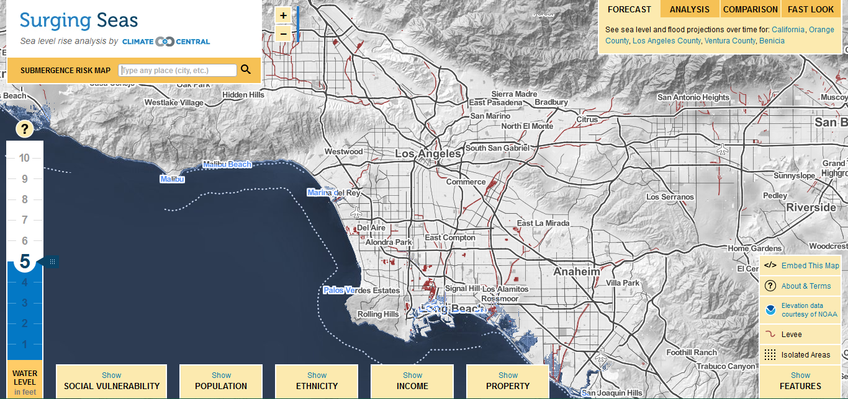
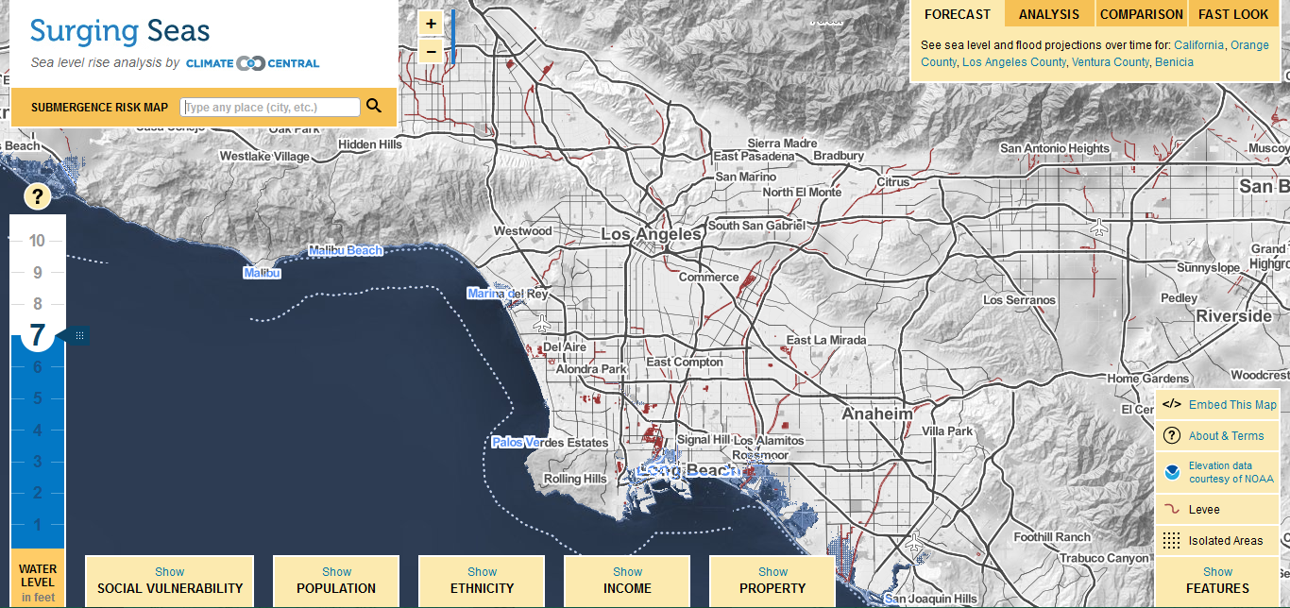
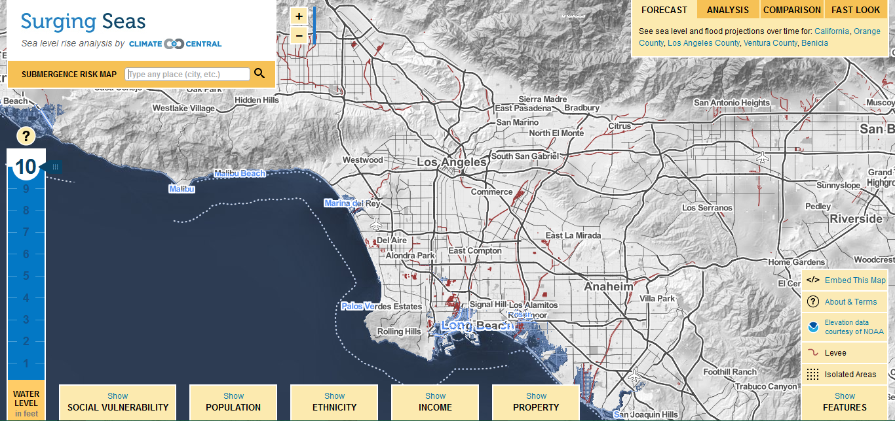
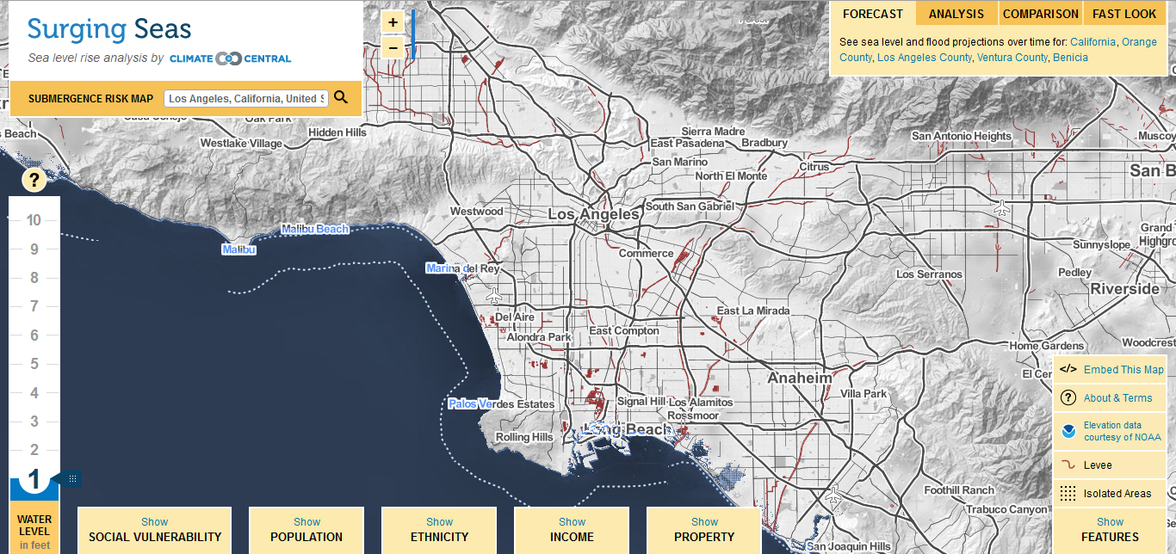
Source: http://ss2.climatecentral.org/

Slide 76
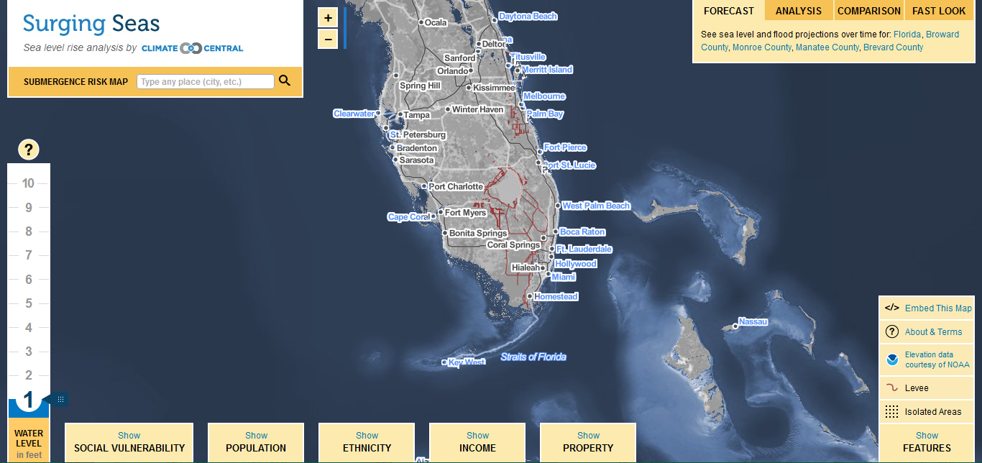
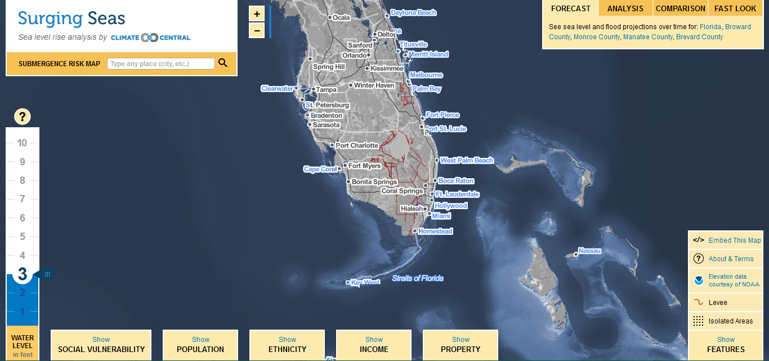
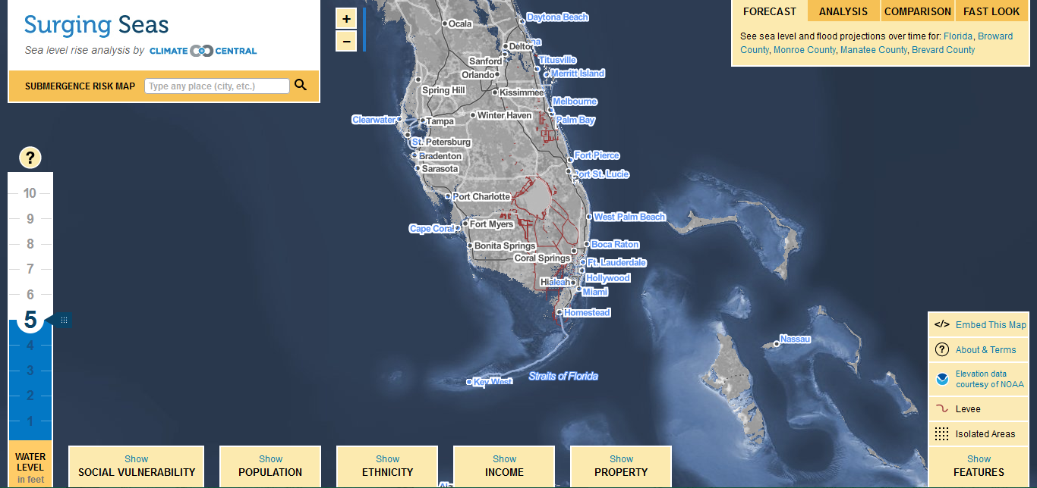
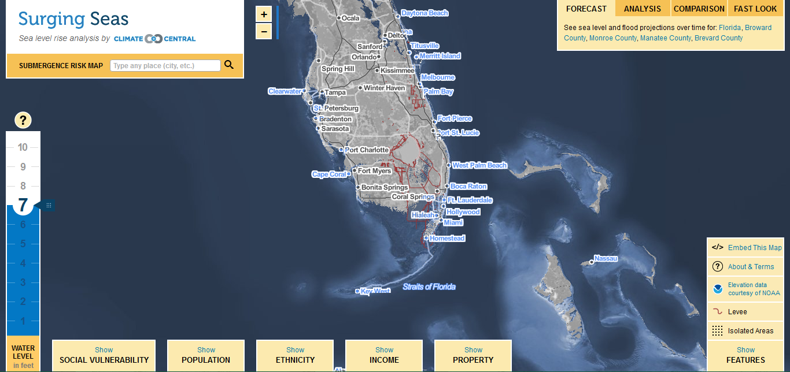
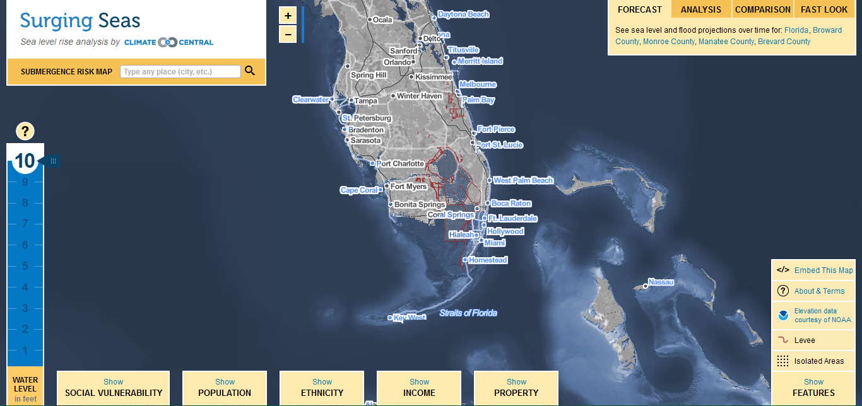
Source: http://ss2.climatecentral.org/

Slide 77
Prepare, Respond, & Recover

Slide 78
PREPARE: Floods
Know your flood risk & familiarize yourself with local emergency plans.
Make a flood emergency plan, & an emergency kit and family communications plan.
Consider buying flood insurance.
Stay tuned to your phone alerts, TV, or radio for weather updates, emergency instructions, or evacuation orders.
Bring in outdoor furniture and move important indoor items to the highest possible floor.
Minimize travel. If travel is necessary, keep a disaster supplies kit in your vehicle.
Bring pets/companion animals inside
Source: http://www.ready.gov/floods

Slide 79
PREPARE: Floods
Expect to be without power
Pack your freezer with bags of water. That will keep your food colder, longer.
Disconnect electrical appliances; if instructed, turn off your gas and electricity at the main switch or valve.
Make sure you have flashlights and plenty of batteries.
Stock up on plenty of water and non-perishable food items.
Charge your cellphones.
Fuel up your car.
Visit an ATM in case they close down in a power outage.
Notes:
http://usatoday30.usatoday.com/weather/resources/safety/wtstorm.htm

Slide 80
PREPARE: Floods
Flood watch = “Be Aware.” Conditions are right for flooding to occur in your area.
Steps to Take
Turn on your TV/radio. You will receive the latest weather updates and emergency instructions.
Know where to go. You may need to reach higher ground quickly and on foot.
Build or restock your emergency preparedness kit. Include a flashlight, batteries, cash, and first aid supplies.
Source: http://www.ready.gov/floods

Slide 81
PREPARE: Floods
Flood Warning = "Take Action!" Flooding is either happening or will happen shortly.
Steps to Take
Move immediately to higher ground or stay on high ground.
Evacuate if directed.
Avoid walking or driving through flood waters. Turn Around, Don’t Drown! Just 6 inches of moving water can knock you down and 2 feet of water can sweep your vehicle away.
Source: http://www.ready.gov/floods

Slide 82
PREPARE: Tsunami
Be aware of the signs of a tsunami:
A strong earthquake lasting 20 seconds or more near the coast.
A noticeable rapid rise or fall in coastal waters.
Source: http://www.ready.gov/floods

Slide 83
RESPOND: Floods
Stay informed
Plan to evacuate in a moment’s notice
When a flood or flash flood warning is issued for your area, head for higher ground and stay there.
Heed evacuation orders
Avoid flood waters
Source: http://www.ready.gov/floods & http://www.floodsafety.noaa.gov/during.shtml

Slide 84
RESPOND: Tsunami
If you are in a coastal area and feel an earthquake that lasts 20 seconds or longer:
Drop, cover and hold on. You should first protect yourself from the earthquake.
When the shaking stops, gather members of your household and move quickly to higher ground away from the coast. A tsunami may be coming within minutes.
Avoid downed power lines and stay away from buildings and bridges from which heavy objects might fall during an aftershock.
Source: http://www.ready.gov/tsunamis & http://www.floodsafety.noaa.gov/during.shtml

Slide 85
RESPOND: Tsunami
What to Do During a Tsunami Watch
Turn on your TV/radio. You will receive the latest weather updates and emergency instructions.
Locate household members and review evacuation plans. Be ready to move quickly if a tsunami warning is issued.
Source: http://www.redcross.org/prepare/disaster/tsunami

Slide 86
RESPOND: Tsunami
What to Do During a Tsunami Warning
If you hear an official tsunami warning or detect signs of a tsunami, evacuate at once.
Take your emergency preparedness kit. Having supplies will make you more comfortable during the evacuation.
Take your pets with you. If it is not safe for you, it’s not safe for them.
Get to higher ground as far inland as possible. Watching a tsunami could put you in grave danger. If you can see the wave, you are too close to escape it.
Source: http://www.redcross.org/prepare/disaster/tsunami

Slide 87
RECOVER: Floods & Tsunami
STAY SAFE!
Go to a designated public shelter if you have been told to evacuate or you feel it is unsafe to remain in your home. Text SHELTER + your ZIP code to 43362 (4FEMA)
Register on the American Red Cross Safe and Well web site to let your family and friends know you are safe. (https://safeandwell.communityos.org/cms/index.php)

Slide 88
RECOVER: Floods & Tsunami
Stay informed
Avoid flood waters & disaster areas
Heed road closed signs
Wait for the “all clear” before returning home
Source: http://www.ready.gov/floods & http://www.floodsafety.noaa.gov/during.shtml

Slide 89
Reducing the risk
What, if anything, can be done to prevent this disaster from occurring?

Slide 90
Reducing the risk
What, if anything, can be done to prevent this disaster from occurring?
Don’t build in flood plains, or on alluvial fans, or on barrier islands, or along the coast.
Not really an option . . .

Slide 91
Reducing the risk
What can be done to reduce the damages caused by this disaster?

Slide 92
Reducing the risk: Societal Responses
Hard Responses
Dams
Levees
Channelization
Soft Responses
Watershed Management
Zoning and Land Use
Insurance
Erosion Control
Forecasting

Slide 93
Dams
Prevents downstream flooding
Prevents scour
Prevents sediments from reaching the ocean
Prevents groundwater recharge
Created by S. Leyva © 2006

Slide 95
Levees

Slide 98
Reducing the risk: Societal Responses
United States
Netherlands
Disaster relief instead of disaster avoidance
Insufficient planning
Riskier design
Safety compromised by bureaucracy
Poor maintenance
Insufficient funds
Disaster avoidance first priority
Thinking long term (10,000 year design)
Less reliance on solid barriers (marsh plains and specially constructed rivers)
Tough, synthetic textiles to better anchor earthen levees
Better monitoring systems
Source: http://science.howstuffworks.com/engineering/structural/levee.htm

Slide 99
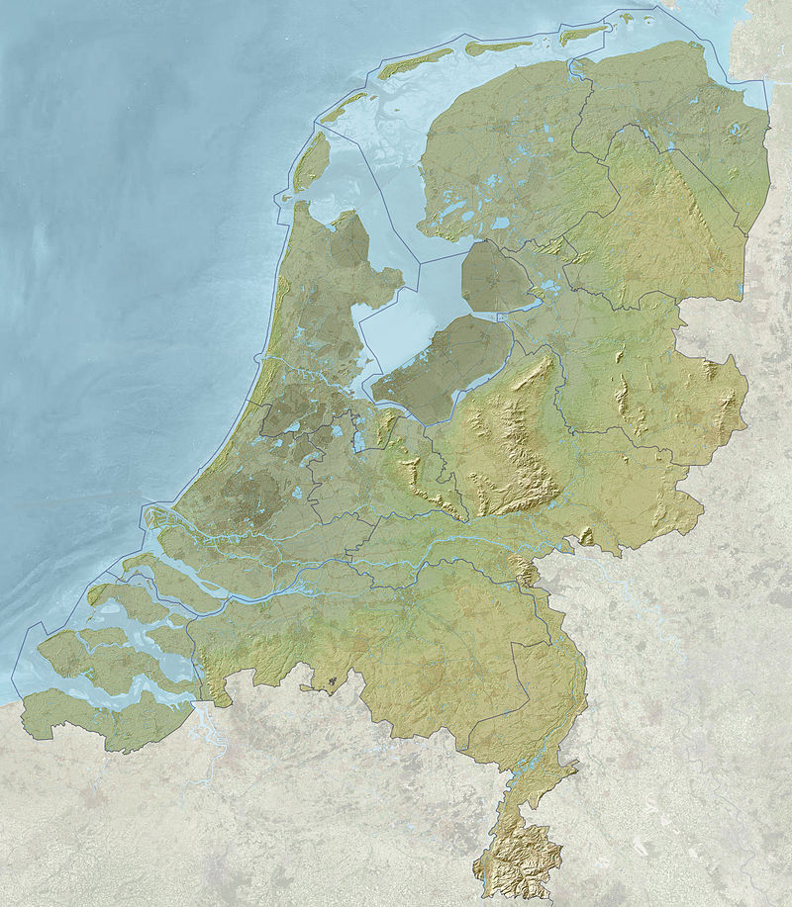
Map of the Netherlands with relief and depth, including provincial borders. Cities and motorways are faintly visible through the relief image for orientation purposes. The terrain height varies from approximately −7 meter (−23 ft; below sea level, dark green) to approximately 322.7 meter (1,059 ft; above sea level, light green).
Source: http://tinyurl.com/oqoqfbj
Notes:
https://commons.wikimedia.org/wiki/Category:Topographic_maps_of_the_Netherlands#/media/File:2012-NL-prov-relief-3000.jpg
"2012-NL-prov-relief-3000" by Janwillemvanaalst - Own work. Licensed under CC BY-SA 3.0 via Wikimedia Commons - https://commons.wikimedia.org/wiki/File:2012-NL-prov-relief-3000.jpg#/media/File:2012-NL-prov-relief-3000.jpg

Slide 100
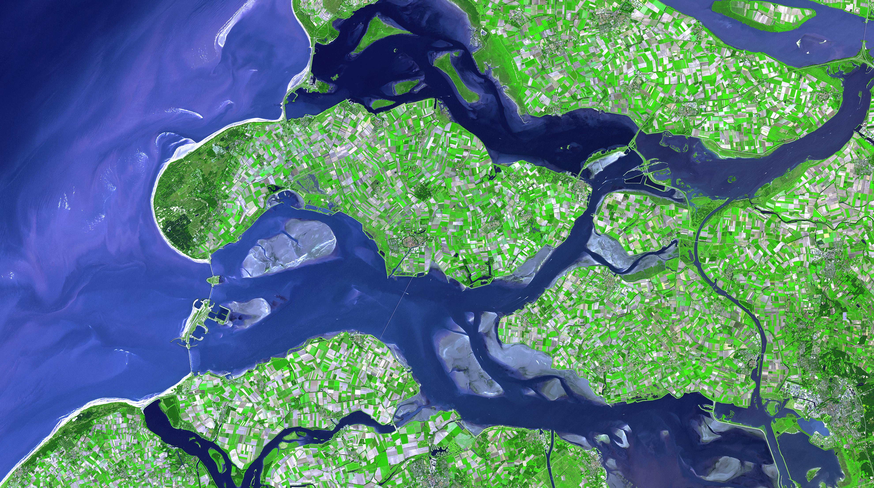
Aerial view of the dike system in the Netherlands
Source: http://asterweb.jpl.nasa.gov/gallery-detail.asp?name=netherlands

Slide 101
How to Climate-Proof a Country
Raise the Lake
Extend the Coast
Dam the Waters
Source: http://archive.wired.com/science/planetearth/magazine/17-01/ff_dutch_delta

Slide 102
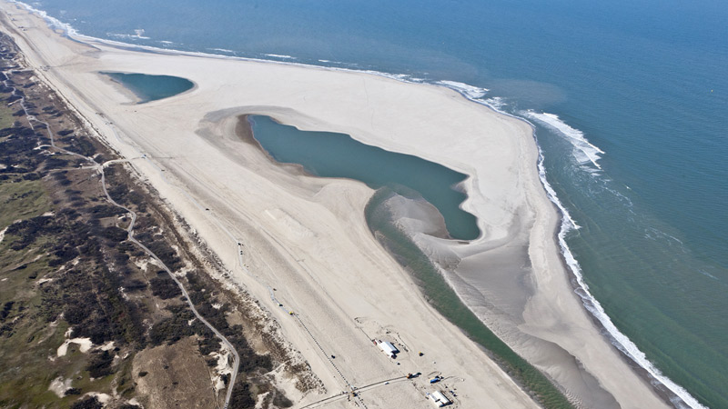
The Sand Engine, 2012
Source: http://e360.yale.edu/slideshow/to_control_floods_the_dutch_turn_to_nature_for_inspiration/172/2/

Slide 103
The Maeslant barrier
Source: http://www.deltawerken.com/The-functioning/463.html/

Slide 104
Reducing the risk: Flood Control Channels
The Los Angeles River
fully lined reinforced concrete
Controls high velocity flow
Prevents scour
Also prevents sediments from reaching the coast

Slide 105
Los Angeles River, highlighted in red on the left.
The San Gabriel River is highlighted in red on the right
Source: http://en.wikipedia.org/wiki/Los_Angeles_River

Slide 106
Los Angeles River Revitalization Master Plan
Source: http://www.lariver.org/index.htm

Slide 107
LA River near Marsh Park

Slide 108
LA River near Marsh Park

Slide 109
Reducing the risk: Watershed Management
Flood Plain Zoning
Flood inundation maps are easy to prepare for zoning purposes
Zoning is hard to do because of extensive flood plain development
Urban development is the worst use of flood plains
Farming, recreation, and natural areas are best

Slide 110
Reducing the risk: Watershed Management
Federal Flood Disaster Protection Act of 1973
Provides flood insurance at affordable rates
But it also requires:
Stringent control on new construction in flood plains
Comprehensive flood management plans

Slide 111
Reducing the risk: Watershed Management
FEMA Flood Insurance Rate Maps (FIRMS)
Cartographers map Special Flood Hazard Areas (SFHAs) on maps
SFHAs are areas that are subject to inundation by a 100-year flood
The Santa Clarita Valley is the only area in L.A. County to be affected by FIRMS.

Slide 112
Reducing the risk: Watershed Management
FEMA Flood Insurance Rate Maps (FIRMS)
Source: http://buildipedia.com/at-home/design-remodeling/how-to-read-flood-zone-maps

Slide 113
FEMA Coastal Zones and Limit of Moderate Wave Action (LiMWA)
Notes:
https://www.fema.gov/media-library/assets/videos/82399

Slide 114
~ end ~
Notes:
https://www.cartoonstock.com/directory/f/flash_floods.asp

