Slide 1

National Coastal Population Report
Population Trends from 1970 to 2020
N O A A ’s S TATE OF THE C O AST

Slide 2


Dear Reader,
This National Coastal Population Report continues the commitment by NOAA’s National Ocean Service to describe the nation’s coastal population, as a complement to the decadal Census conducted by the U.S. Census Bureau. One of our nation’s ongoing challenges
is to manage ecologically sensitive coastal areas such that future generations of Americans will continue to reap the immeasurable economic, cultural, recreational, and aesthetic benefits provided by our coastal resources. At the core of this management challenge are both the large numbers and high densities of residents and visitors at the coast.
This concentration of people impacts the integrity of coastal ecosystems, and at the same time, the lives and livelihoods of some of these residents and visitors can be at risk from natural processes at the coast – such as hurricanes, erosion, and sea level rise. This report explores this dynamic relationship by presenting both the population in Coastal Watershed Counties and in Coastal Shoreline Counties. Joined by our federal and state coastal management partners, we hope this reporting framework will both increase awareness and enhance policy discussions, by promoting a deeper understanding of our nation’s coastal population.
Holly Bamford
Assistant Administrator for Ocean Services and Coastal Management National Ocean Service
NOAA

Slide 3



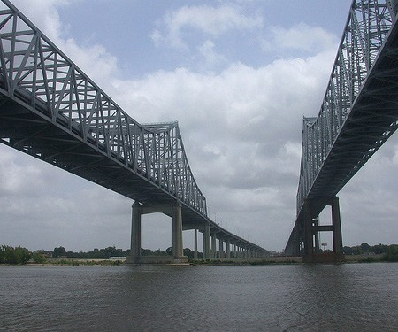
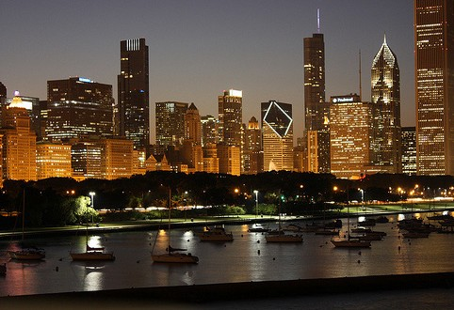
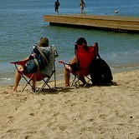

Table of Contents
Our Nation’s Coastal Population
How to Use this Document
The Bottom Line
Coastal Shoreline Counties
Population Population Density Age
Race
Hispanic Origin Education Attainment Household Income Seasonal Housing Building Permits
Coastal States Summary
Coastal Watershed Counties
Population Population Density Age
Race
Hispanic Origin Education Attainment Household Income Seasonal Housing Building Permits
Coastal States Summary
Appendix A Appendix B Appendix C
2
National Coastal Population Report
Population Trends from 1970 to 2020
3
4
March 2013
10
This document is a product of the NOAA State of the Coast Report Series, a publication of the National Oceanic and Atmospheric Administration, Department of Commerce, developed in partnership with the U.S. Census Bureau. Visit: http://stateofthecoast.noaa.gov.
17
18
19

Slide 4

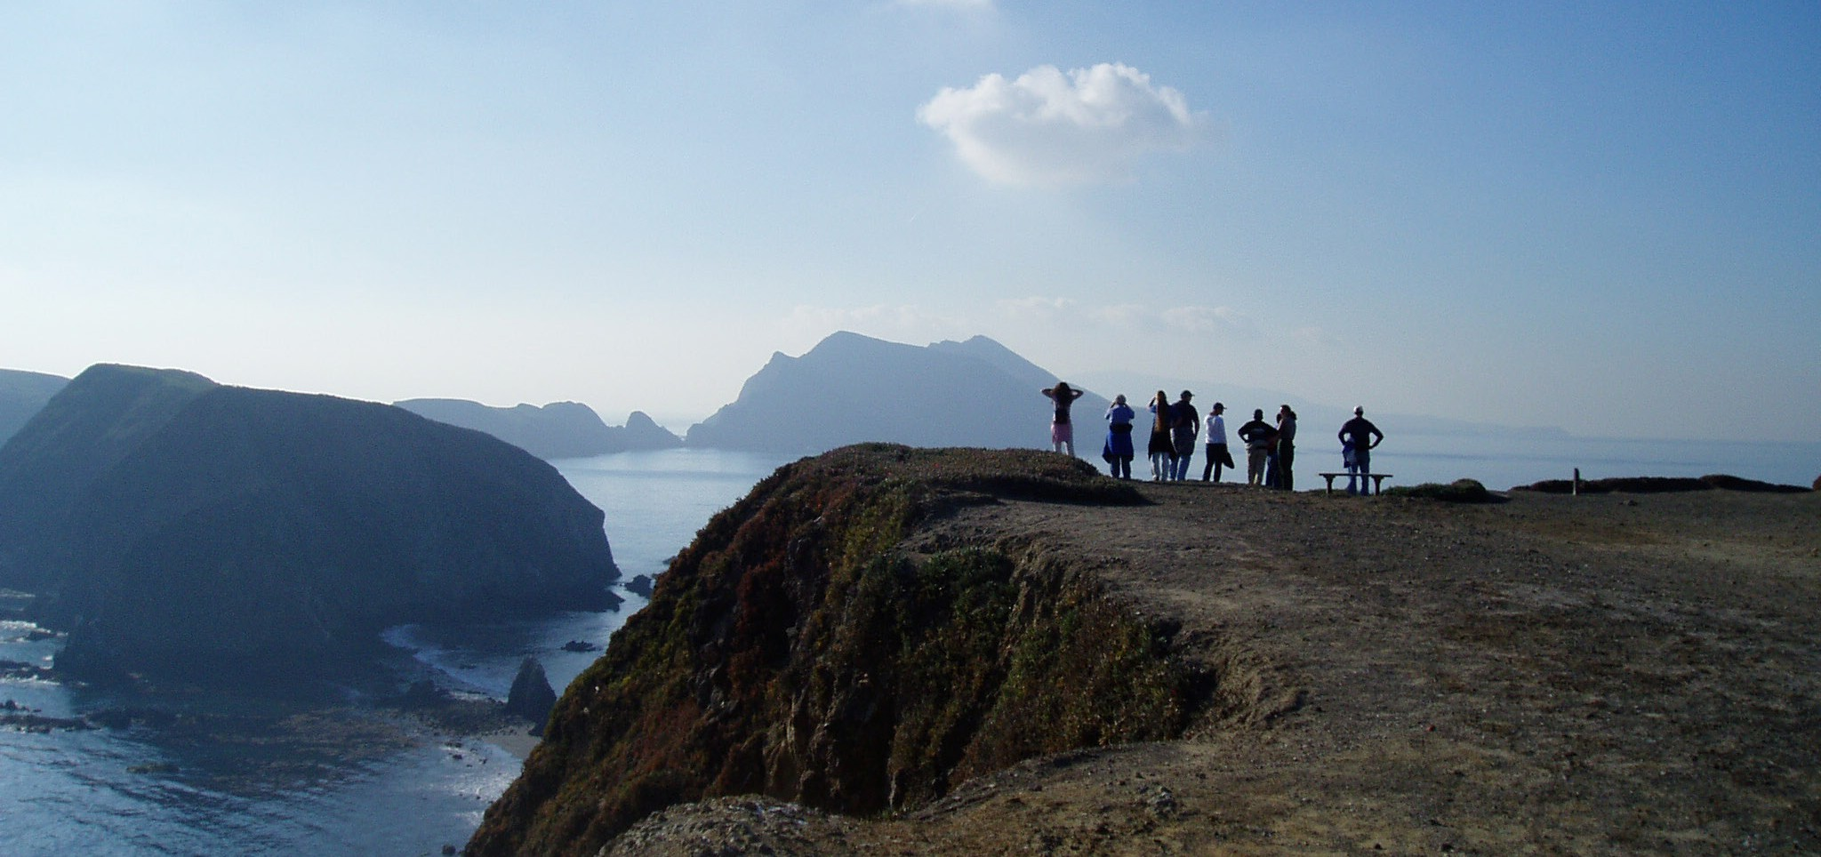

Our Nation’s Coastal Population
Our nation’s bountiful coastal resources have influenced American history
and culture, and have drawn a substantial portion of our country’s population to the coast. The concentration of people and economic activity at the coast places pressures on ecologically sensitive coastal ecosystems and also leaves residents and visitors vulnerable to coastal hazards, such as hurricanes, erosion, and sea level rise. One focus of this management challenge is to understand who lives at the coast and how this population is changing.
However, this is not a simple matter as federal agencies, researchers, and non- governmental organizations define “the coast” in various ways.
How to Use this Document
This report offers two independent sections that present basic demographic status and trends information for Coastal Shoreline Counties and for Coastal Watershed Counties, allowing the coastal management community the opportunity to choose the appropriate statistics for their needs.
Appendices A and B provide maps of Coastal Shoreline Counties and Coastal Watershed Counties, respectively. The Coastal Shoreline Counties are a subset of Coastal Watershed Counties, and Appendix C provides a simple comparison between these two groups of counties.
To increase consistency in how we describe our nation’s coastal population, this report presents the nation’s coastal population in two different lights. One is the population that lives in Coastal Watershed Counties, or those counties where a substantial portion of their land area intersect coastal watersheds, and consequently represent where land use changes and water quality impacts most directly impact coastal ecosystems. NOAA
has historically reported population for Coastal Watershed Counties, and continues this framework in this report. For the first time, NOAA also presents the population that lives in a subset of Coastal Watershed Counties, the Coastal Shoreline Counties, or those counties directly adjacent to the open ocean, major estuaries, and the Great Lakes. The Coastal Shoreline Counties, due to their proximity to these waters, bear the most direct effects of coastal hazards and host the majority of economic production associated with coastal and ocean resources.
Section 1: People who live in Coastal Shoreline Counties This section describes basic demographic status and trends of the U.S. population that resides in 452 Coastal Shoreline Counties (see map in
Appendix A). These counties are directly adjacent to the open ocean, major estuaries, and the Great Lakes, and due to their proximity to these waters, bear the most direct effects of coastal hazards and host the majority of economic production associated with coastal and ocean resources. This group
of coastal residents could generally be considered “the U.S. population most directly affected by the coast.”
When are these statistics most applicable?
Providing context for coastal community resilience, coastal hazards, and other ocean resource-dependent issues.
Section 2: People who live in Coastal Watershed Counties This section describes basic demographic status and trends of the U.S. population that resides in 769 Coastal Watershed Counties. A substantial
portion of the land area of these counties intersect coastal watersheds, and consequently represent where land use changes and water quality impacts can most directly impact coastal ecosystems. This group of coastal residents could generally be considered “the U.S. population that most directly affects the coast.”
When are these statistics most applicable?
Providing context for land use changes in coastal watersheds and local watershed impacts of human activities to coastal and estuarine water quality.
Channel Islands National Marine Sanctuary and the Channel Islands National Park, CA. Credit: Claire Johnson
2

Slide 5





The Bottom Line
POPULATION DENSITY IS GROWING AT THE COAST
Regardless of how the coast is defined, it is substantially more crowded than the U.S. as a whole, and population density in coastal areas will continue to increase in the future.
In 2010: Out of the 3 million mi² of land in the US
<10% <20%
Within the limited space of the nation’s coast, population density far exceeds the nation as a whole, and this trend
will continue into the future. This situation presents coastal managers with the challenge of protecting both coastal ecosystems from a growing population and protecting a growing population from coastal hazards.
or 275,351 mi² comprise
Coastal Shoreline Counties
or 511,971 mi² comprise
Coastal Watershed Counties
In Just 40 Years: 1970-2010
In 2010: Out of the 313 million people living in the US
Coastal Shoreline Counties added 125 persons/mi
2
Coastal Watershed Counties added 99 persons/mi
2
39% 52%
United States as a whole added 36 persons/mi
2
500
or 123.3 million people lived in
Coastal Shoreline Counties
or 163.8 million people lived in
Coastal Watershed Counties
400
Persons Per Square Mile
300
In 2010:
A small amount of land and a large number of people means high density
446 persons/mi² 319 persons/mi²
105 persons/mi²
200
Each box represents 1 square mile.
100
All United States Counties
= 10 persons
0
1970
1980
1990
2000
2010
2020
Coastal
Shoreline Counties
Coastal
Watershed Counties
United States
Note: Land area and density values exclude Alaska. Population values include Alaska and US Territories.
Source: U.S. Census Bureau, 2011b; NOAA, 2012; Crowell et al., 2010
NOAA’s National Coastal Population Report
3

Slide 6
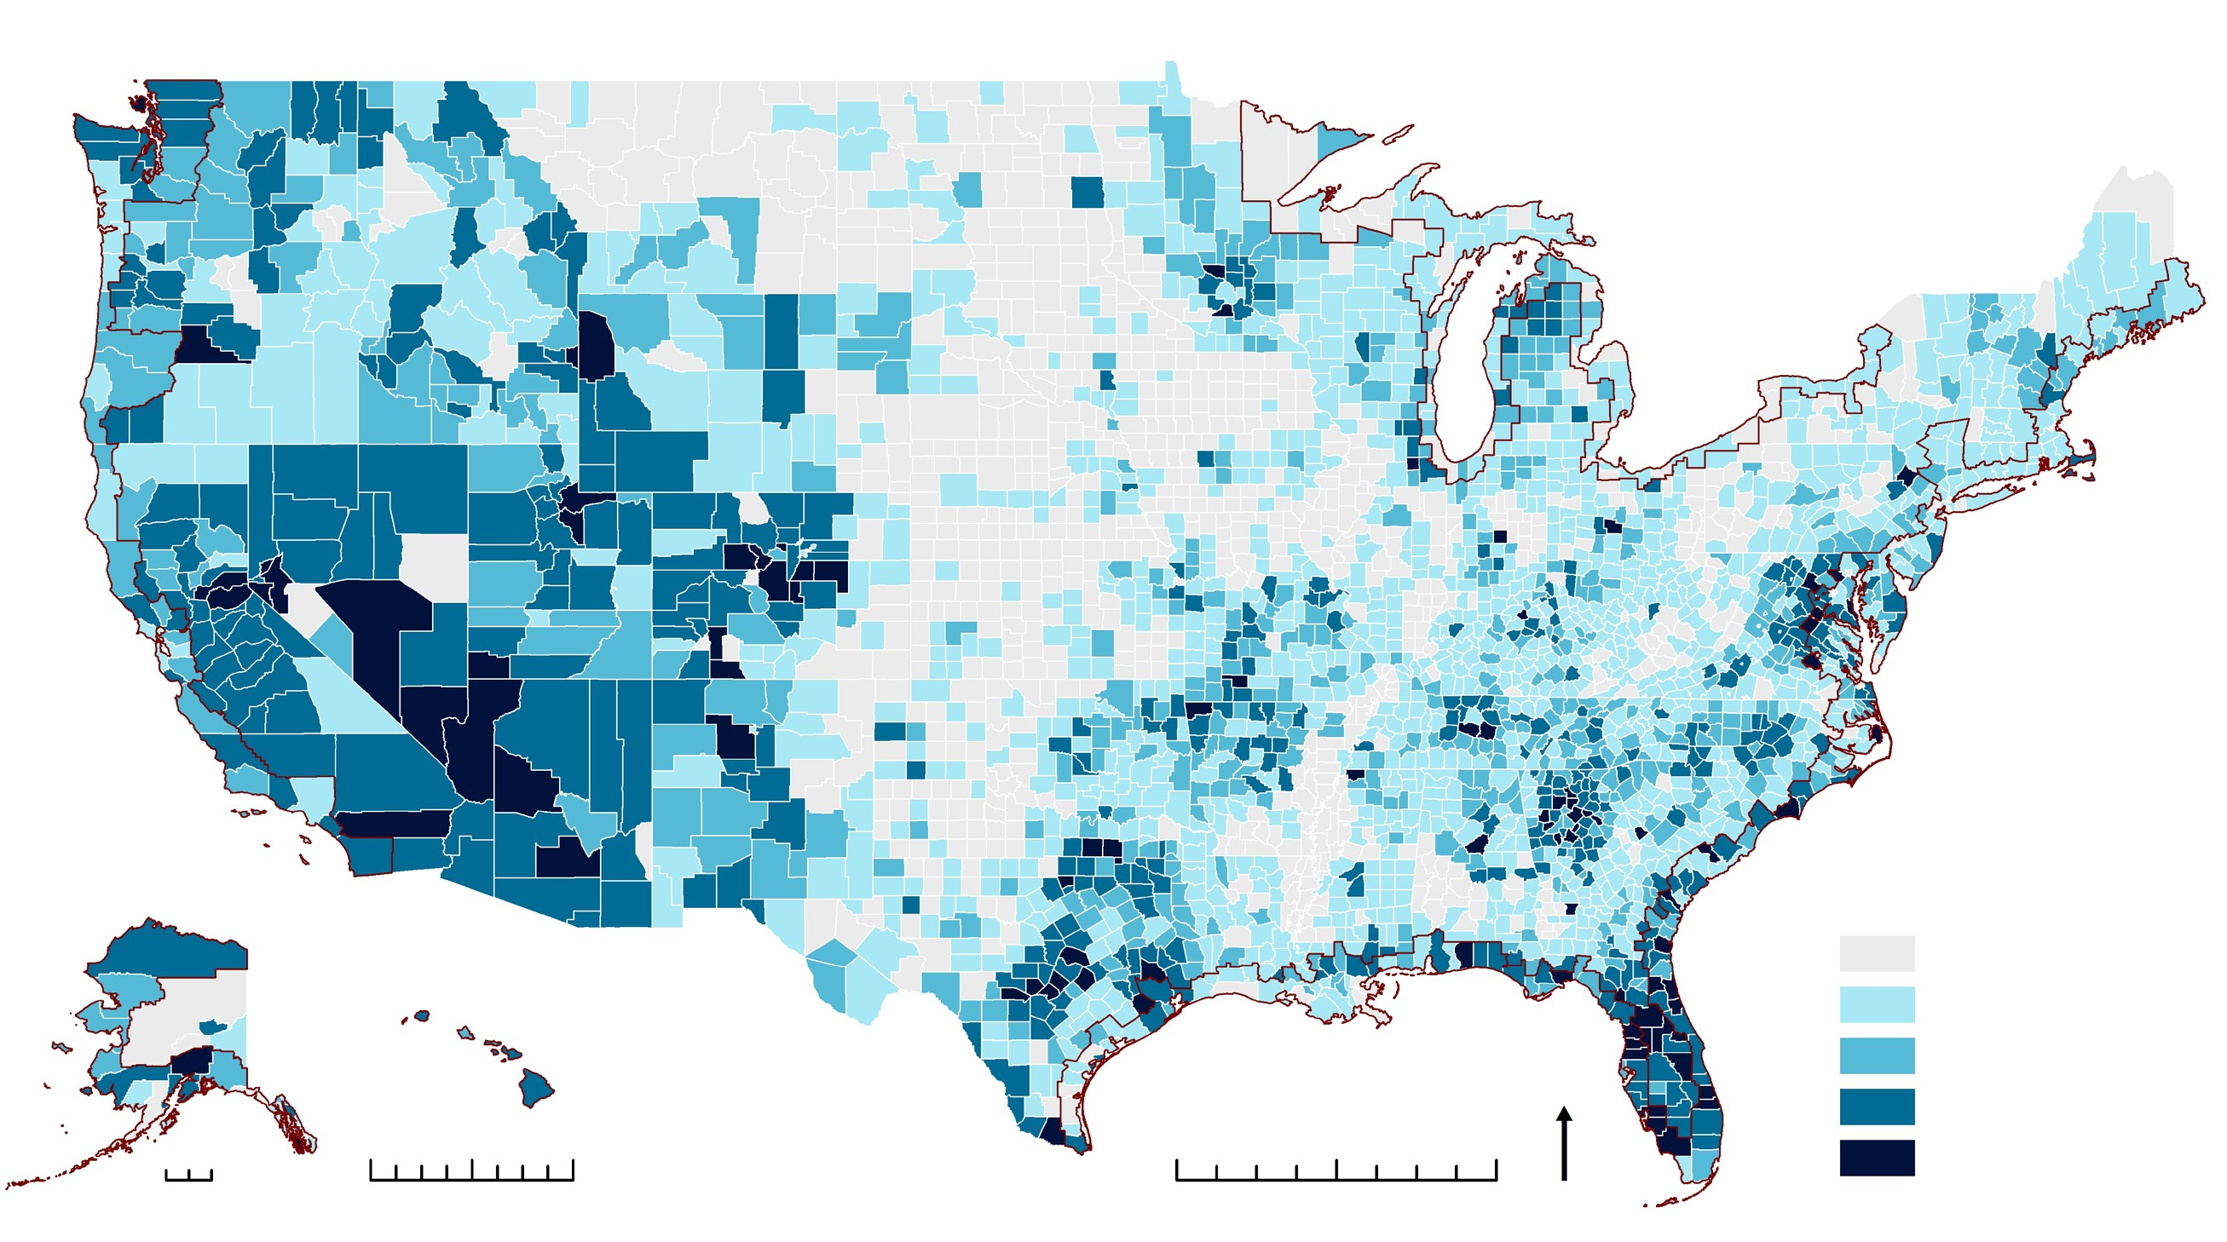
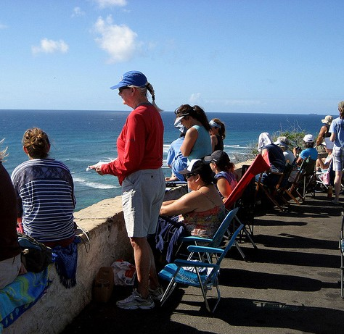
CCooaassttaall SShhoorreelliinnee CCoouunnttiieess
123.3 million
Coastal Shoreline County population in 2010.
Population
The Bottom Line
Figure 3
Population Change in Coastal Shoreline Counties: 1970-2010
In 2010, 123.3 million people, or 39 percent of the nation’s population lived in Coastal Shoreline Counties. Population growth in these counties occurred at a lower rate than the nation as a whole from 1970 to 2010. The population in Coastal Shoreline Counties increased by 34.8 million people, a 39 percent increase, while the nation’s entire population increased by 52 percent over the same time period.
200
100%
80%
Percent U.S. Population
39%
Million People
160
Percent of the U.S. population that resides in Coastal Shoreline Counties in 2010.
120
80
40
60%
40%
43% |  | 42% |  | 42% |  | 41% |  | 39% |  | 39%
1970 |  | 1980 |  | 1990 |  | 2000 |  | 2010 |  | 2020
20%
0%
34.8 million
Coastal Shoreline County population change from 1970 to 2010, a 39% increase.
(U.S. average 52%)
0
Figure 4
Percent Population Change in U.S. Counties, Highlighting Coastal Shoreline Counties: 1970-2010
10 million
Projected population change in Coastal Shoreline Counties from 2010 to 2020, an 8% increase.
(U.S. average 10%)
Coastal Shoreline County Area
Percent
-45 - 0
1 - 49
50 - 99
100 - 299
Alaska
Hawaii
U.S. Territories American Samoa Guam
N
Humpback Whale National Marine Sanctuary. Credit: Fiona Langenberger
0 500
0
250
500
CNMI
Puerto Rico
U.S. Virgin Islands
0
250
500
300+
Note: Includes U.S. Territories.
Source: U.S. Census Bureau, 2011b; NOAA, 2012; Crowell et al., 2010
4

Slide 7
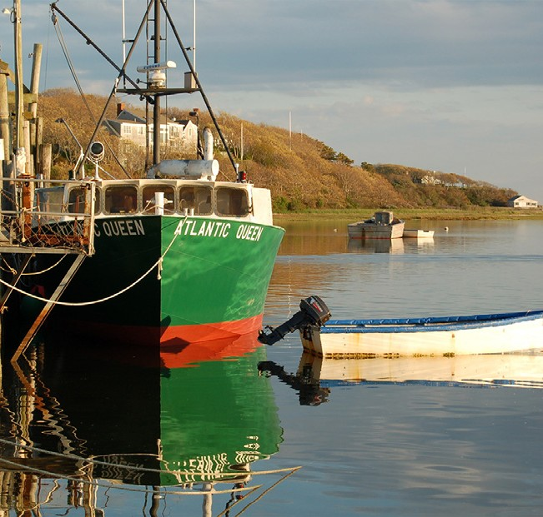
Coastal Shoreline Counties
446 pers/mi²
Population density of Coastal Shoreline Counties in 2010 (excluding Alaska).
(U.S. average 105 pers/mi² excluding Alaska )
Population Density
Figure 5
Population Density Change in Coastal Shoreline Counties and Inland Counties from 1970 to 2020
500
450
400
350
300
250
200
150
100
50
0
Coastal Shoreline Counties Inland Counties
The Bottom Line
In 2010, 39 percent of the U.S. population lived in Coastal Shoreline Counties (less than 10 percent of the total land area excluding Alaska). The population density of Coastal Shoreline Counties is over
six times greater than the corresponding inland counties.
37 pers/mi²
Persons Per Square Mile
Projected population density increase in Coastal Shoreline Counties from 2010 to 2020 (excluding Alaska).
89%
Percent increase in the 65 and older population from 1970
to 2010 in Coastal Shoreline Counties. (U.S. average 100%)
-4%
Percent change in persons younger than 18 from 1970 to 2010 in Coastal Shoreline Counties. (U.S. average 6%)
1970
1980
1990
Year
2000
2010
2020
Note: Density values include U.S. Territories and exclude Alaska. Source: U.S. Census Bureau, 2011b; NOAA, 2012; Crowell et al., 2010
Age
Figure 6
Percent Population Change of Coastal Shoreline Counties and Inland Coun- ties by Age from 1970 to 2010
The Bottom Line
120%
Coastal Shoreline Counties Inland Counties
In 2010, age distribution within Coastal Shoreline Counties and inland counties differed only slightly and the share of the
U.S. population living in Coastal Shoreline Counties by age category was consistent with the share of total population. However, from 1970 to 2010, the growth rate among the age categories differed substantially, demonstrating an aging population in both Coastal Shoreline Counties and inland counties, with inland counties growing faster within each age category.
100%
Percent Population Change
80%
60%
40%
20%
0%
-20%
5 and Under 6 to 17 18 to 24 25 to 34
35 to 44 45 to 54 55 to 64 65 and Older
Chatham, MA. Credit: Louis Cafiero
Age Category
Note: U.S. Territories not inlcuded.
Source: U.S. Census Bureau, 2011b; NOAA, 2012; Crowell et al., 2010
NOAA’s National Coastal Population Report
5

Slide 8
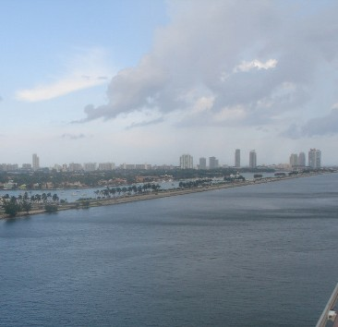
CCooaassttaall SShhoorreelliinnee CCoouunnttiieess
Race
64%
Share of the U.S. Asian Alone population living in Coastal Shoreline Counties.
(Share of total U.S. Population 39%)
Figure 7
80%
Percent Population of Coastal Shoreline Counties and Inland Counties by Race in 2010
Table 1
Share of the U.S. Population by Race in Coastal Shoreline Counties in 2010
Coastal Shoreline Counties Inland Counties
Race Category | Percent U.S. Population
Total Population | 39%
White Alone | 35%
Black or African American Alone | 47%
American Indian and Alaska Native Alone | 27%
Asian Alone | 64%
Native Hawaiian and Pacific Islander Alone | 60%
Some Other Race Alone | 49%
Two or More Races | 47%
60%
47%
Percent Population
Share of the U.S. Black or African American Alone population living in Coastal Shoreline Counties.
(Share of total U.S. Population 39%)
40%
20%
0
White Alone
Black or African American Alone
American Indian and Alaska Native
Asian Native Hawaiian Some Other Alone and Pacific Race Alone
Islander Alone
Two or More Races
211%
Alone
Race Category
Percent increase in Hispanic or Latino population from 1980 to 2010 in Coastal Shoreline Counties.
(U.S. average 220%)
Note: The U.S. Census Bureau uses the word “Alone” following certain race categories to distiquish those populations that chose a single race to characterize themselves.
U.S. Territories not included.
Source: U.S. Census Bureau, 2011b; NOAA, 2012; Crowell et al., 2010
The Bottom Line
In 2010, minority population groups residing in Coastal Shoreline Counties represented a combined 35 percent of the Coastal Shoreline County population. This is higher than the combined share of the total U.S. population at 28 percent.
Hispanic Origin
Figure 8
Percent Population of Coastal Shoreline Counties and Inland Counties by Hispanic or Latino Origin in 2010
Table 2
Share of the U.S. Population by Hispanic or Latino Origin in Coastal Shoreline Counties in 2010
Hispanic or Latino
Non Hispanic or Latino
Ethnicity Category | Percent U.S. Population
Total Population | 39%
Hispanic or Latino | 49%
Non Hispanic or Latino | 37%
Percent of Population in Coastal Shoreline Counties
Percent of Population in Inland Counties
0
20%
40% 60%
Percent Population
80%
100%
Miami, FL. Credit: B. O’Grady
Note: U.S. Territories not included. Source: U.S. Census Bureau, 2011b; NOAA, 2012; Crowell et al., 2010
6

Slide 9
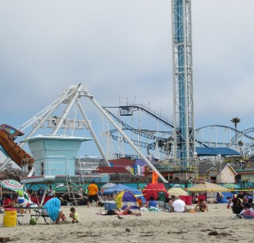
Coastal Shoreline Counties
Education Attainment
38%
Percent of the population in Coastal Shoreline Counties that hold a higher education degree in 2010 (for those 25 years and over).
(U.S. average 35%)
Figure 9
Percent Population of Coastal Shoreline Counties and Inland Counties by Education Attainment for Those 25 Years and Over in 2010
Table 3
Share of the U.S. Population by Education Attainment for Those 25 Years and Over in Coastal Shoreline Counties in 2010
35%
Education Attainment Category | Percent U.S. Population
Total Population | 39%
No School Completed | 48%
Some or All Elementary | 43%
Some High School | 39%
High School Graduate | 37%
Some College | 38%
Associate’s Degree | 40%
Bachelor’s Degree | 44%
Master’s Degree | 46%
Professional School Degree | 49%
Doctorate Degree | 46%
30%
Coastal Shoreline Counties Inland Counties
Percent Population
25%
13%
20%
Percent of the population in Coastal Shoreline Counties living below the poverty line in 2010.
(U.S. average 13%)
15%
10%
5%
0
All
e
No School
Some High
High School
Some
Associate’s
Bachelor’s
Master’s
Professional
Doctorat
Some or
School
College
Degree
Degree
Degree
Degree
Degree
47%
Completed
Elementary
Graduate
Share of the U.S. households making over $100,000 that are in Coastal Shoreline Counties. (Share of total U.S. Households 39%)
Education Attainment Category
Note: Puerto Rico included. Remaining U.S. Territories excluded. Source: U.S. Census Bureau, 2012a; NOAA, 2012; Crowell et al., 2010
Household Income
Figure 10
Percent Households of Coastal Shoreline Counties and Inland Counties by Income in 2010
Table 4
Share of the U.S. Households by Household Income in Coastal Shoreline Counties in 2010
30%
Coastal Shoreline Counties Inland Counties
25%
20%
15%
10%
5%
Income Category | Percent U.S. Households
Total Households | 39%
Less than $10,000 | 37%
$10,000 to $24,999 | 35%
$25,000 to $49,999 | 36%
$50,000 to $74,999 | 38%
$75,000 to $99,999 | 40%
$100,000 to $124,999 | 43%
$125,000 to $149,999 | 46%
$150,000 + | 52%
Source: U.S. Census Bureau, 2011b; NOAA, | 2012; Crowell et al., 2010
Percent Households
0
Less than $10,000- $25,000-
$10,000 $24,999 $49,999
$50,000- $75,000-
$74,999 $99,999
Income Category
$100,000-
$125,000- $150,000 +
Santa Cruz, CA. Credit: K. Crossett
$124,999
$149,999
Note: U.S. Territories not included.
NOAA’s National Coastal Population Report
7

Slide 10
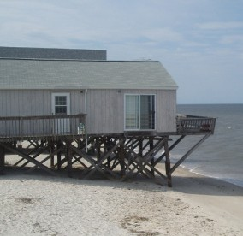
Coastal Shoreline Counties
49.4 million
Seasonal Housing
Number of housing units in Coastal Shoreline Counties in 2010, 39% of the U.S. total.
Figure 11
Leading States in Number of Seasonal Housing Units in Coastal Shoreline Counties in 2010
Figure 12
Leading States in Percent of Housing Units that are Seasonal in Coastal Shoreline Counties in 2010
18%
Percent increase in seasonal housing units in Coastal Shoreline Counties from 2000 to 2010. Total housing units
in Coastal Shoreline Counties increased 8%.
Florida Michigan New York New Jersey California
Massachusetts South Carolina
Maine New Hampshire Washington
Maine North Carolina South Carolina Minnesota
Florida Delaware
Alaska Oregon Michigan Alabama
42%
Share of all U.S. seasonal homes located in Coastal Shoreline Counties in 2010.
0 100 200 300 400 500 600 700 800
Number of Seasonal Homes (Thousand)
0
5%
10%
Percent
15%
20%
Note: U.S. Territories not included.
Source: U.S. Census Bureau, 2011a; NOAA, 2012; Crowell et al., 2010
1355
Number of building permits issued per day in Coastal Shoreline Counties from 2000 to 2010.
Building Permits
Figure 13
Building Permits Issued for Single-Family Units in Coastal Shoreline Counties from 2000 to 2010
Figure 14
Building Permits Issued for Multi-Unit Buildings in Coastal Shoreline Counties from 2000 to 2010
1,250
350
Building Permits Issued (Thousand)
300
1,000
250
Building Permits Issued (Thousand)
750
200
500
150
100
Coastal Shoreline Counties Inland Counties
250
Coastal Shoreline Counties Inland Counties
2002 2004 2006
Year
50
0
0
Broadkill Beach, DE. Credit: K. Crossett
2000
2008
2010
2000
2002 2004 2006 2008 2010
Year
Source: U.S. Census Bureau, 2011c; NOAA, 2012; Crowell et al., 2010
Note: U.S. Territories not included.
8

Slide 11
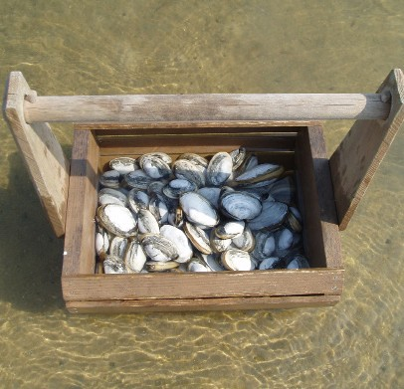
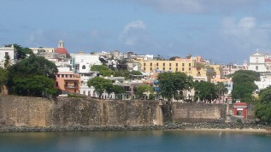
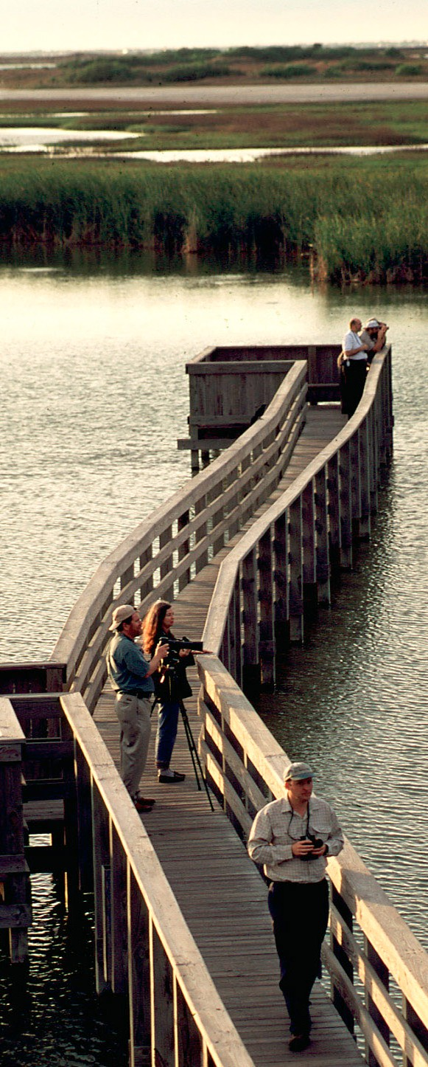
Coastal Shoreline Counties
Coastal States Summary
Table 5
Demographic Summary of Aggregated Coastal Shoreline Counties by State
U.S. State or | 2010 |  | 2010 Population Density |  | 1970-2010 Percent Historic Population | 2010-2020 Percent Projected Population | 1970-2010 Percent Increase in 65 and Older | 2010 Percent Population
Territory | Population | Rank | (pers/mi²) | Rank | Change | Change | Population | Living in Poverty
Alabama | 595,257 | 27 | 211 | 20 | 58 | 11 | 702 | 17
Alaska | 598,207 | 26 | 2 | 31 | 147 | 13 | 168 | 10
California | 25,520,252 | 1 | 716 | 10 | 62 | 8 | 111 | 12
Connecticut | 2,219,037 | 15 | 980 | 8 | 18 | 5 | 72 | 9
Delaware | 897,934 | 21 | 461 | 14 | 64 | 10 | 196 | 11
District of Columbia | 601,723 | 25 | 9,864 | 1 | -20 | 1 | -3 | 18
Florida | 14,468,197 | 3 | 454 | 15 | 165 | 16 | 208 | 13
Georgia | 563,967 | 28 | 121 | 26 | 82 | 19 | 175 | 15
Hawaii | 1,360,301 | 17 | 212 | 19 | 77 | 16 | 340 | 9
Illinois | 5,898,137 | 6 | 4,246 | 2 | 0 | 2 | 28 | 14
Indiana | 771,815 | 23 | 509 | 13 | 4 | 4 | 94 | 14
Louisiana | 2,247,053 | 14 | 165 | 24 | 23 | 10 | 89 | 16
Maine | 836,502 | 22 | 97 | 28 | 49 | -5 | 43 | 11
Maryland | 4,148,642 | 11 | 631 | 11 | 37 | 10 | 117 | 9
Massachusetts | 4,924,916 | 7 | 1,400 | 4 | 16 | 5 | 97 | 9
Michigan | 4,680,503 | 9 | 154 | 25 | -4 | 0 | 53 | 16
Minnesota | 216,268 | 31 | 22 | 30 | -9 | 4 | 27 | 14
Mississippi | 370,702 | 30 | 209 | 21 | 54 | 5 | 202 | 15
New Hampshire | 418,366 | 29 | 393 | 17 | 100 | 13 | 264 | 7
New Jersey | 7,045,573 | 4 | 1,360 | 5 | 21 | 4 | 178 | 9
New York | 15,691,096 | 2 | 1,280 | 6 | 6 | 5 | 69 | 14
North Carolina | 999,064 | 20 | 102 | 27 | 92 | 10 | 30 | 15
Ohio | 2,534,282 | 12 | 809 | 9 | -14 | -1 | 39 | 15
Oregon | 653,112 | 24 | 42 | 29 | 53 | 9 | 181 | 16
Pennsylvania | 2,365,551 | 13 | 2,118 | 3 | -16 | 0 | -2 | 20
Rhode Island | 1,052,567 | 19 | 1,018 | 7 | 11 | 5 | 46 | 12
South Carolina | 1,241,048 | 18 | 168 | 23 | 127 | 23 | 443 | 15
Texas | 6,121,490 | 5 | 410 | 16 | 107 | 16 | 198 | 18
Virginia | 4,730,951 | 8 | 544 | 12 | 94 | 18 | 248 | 8
Washington | 4,615,192 | 10 | 245 | 18 | 99 | 15 | 164 | 10
Wisconsin | 2,049,934 | 16 | 195 | 22 | 7 | 3 | 31 | 14
American Samoa | 55,502 |  | 445 |  | 104 | 8
Guam | 159,358 |  | 752 |  | 86 | 11
CNMI | 53,883 |  | 305 |  | 449 | 9
Puerto Rico | 2,525,305 |  | 1,281 |  | 27 | 0
U.S. Virgin Islands | 106,405 |  | 580 |  | 68 | 1
Source: U.S. Census Bureau, 2011b; NOAA, 2012; Crowell et al., 2010
9

Slide 12
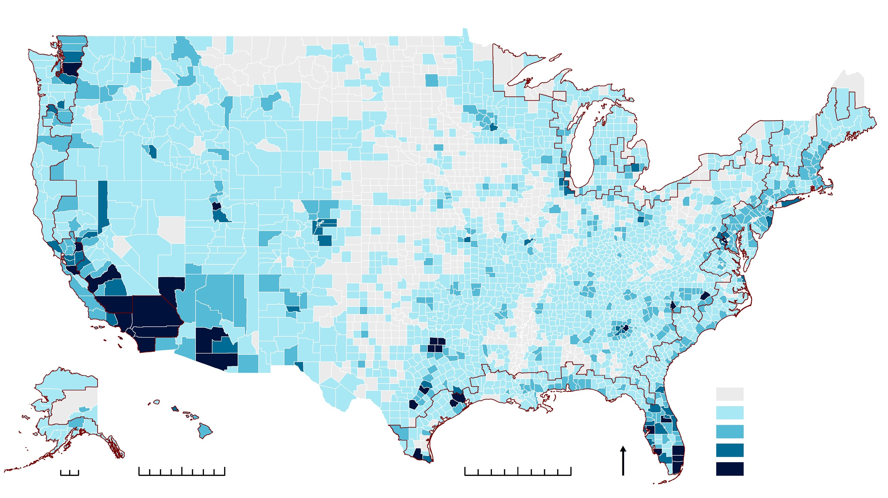

Coastal Watershed Counties
163.8 million
Population Change
2010
Figure 15
The Bottom Line
Coastal Watershed County population in 2010.
Population Change in Coastal Watershed Counties: 1970-2010
In 2010, 163.8 million people, or 52 percent of the nation’s population lived in Coastal
Watershed Counties. Population growth in these counties occurred at a lower rate than the nation as a whole from
1970 to 2010. The population in Coastal Watershed Counties increased by 50.9 million people, a 45 percent increase, while the nation’s entire population increased by 52 percent over the same time period.
200
160
100%
52%
80%
Percent U.S. Population
Million People
60%
40%
Percent of the U.S. population that resides in the Coastal Watershed Counties in 2010.
120
55%
80
54%
54%
53%
52%
52%
40
0
20%
0%
50.9 million
1970
1980
1990
Year
2000
2010
2020
Population change in Coastal Watershed Counties from 1970 to 2010, a 45% increase.
(U.S. average 52%)
Figure 16
Numeric Population Change in U.S. Counties, Highlighting Coastal Watershed Counties: 1970-
15 million
Projected population change in Coastal Watershed Counties from 2010 to 2020, a 9% increase.
(U.S. average 10%)
Alaska
Coastal Watershed County Area
Persons
-846,000 - 0
Hawaii
U.S. Territories American Samoa Guam
1 - 49,999
N
50,000 - 249,999
250,000 - 499,999
Los Angeles County, CA, had the largest single county population growth from 1970 to 2010, increasing by over 2.7 million people.
Credit: Bruce Perry, CSULB
0 500
0
250
500
CNMI
Puerto Rico
U.S. Virgin Islands
0
250
500
500,000 - 2,850,000
Note: Includes U.S. Territories.
Source: U.S. Census Bureau, 2011; NOAA, 2012
10

Slide 13
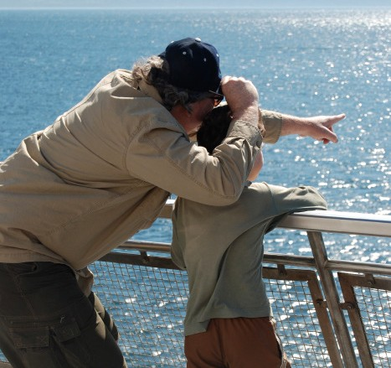
Coastal Watershed Counties
319 pers/mi²
Population Density
Population density of Coastal Watershed Counties in 2010 (excluding Alaska).
(U.S. average 105 pers/mi² excluding Alaska)
Figure 17
Population Density Change in Coastal Watershed Counties and Inland Counties from 1970 to 2020
The Bottom Line
400
Coastal Watershed Counties Inland Counties
In 2010, 52 percent of the U.S. population lived in Coastal Watershed Counties (less than 20 percent of the total land area
excluding Alaska). The population density of Coastal Watershed Counties is over five times greater than the corresponding inland counties, a trend that has been consistent since 1970.
350
24 pers/mi²
Persons Per Square Mile
300
Projected population density increase in Coastal Watershed Counties from 2010 to 2020 (excluding Alaska).
250
200
150
97%
100
Percent increase in the 65 and older population from 1970
to 2010 in Coastal Watershed Counties. (U.S. average 100%)
0%
50
Note: Density values include U.S. Territories and exclude Alaska. Source: U.S. Census Bureau, 2011; NOAA, 2012
0
1970
1980
1990
Year
2000
2010
2020
Age
Percent change in persons younger than 18 from 1970 to 2010 in Coastal Watershed Counties. (U.S. average 6%)
Figure 18
Percent Population Change of Coastal Watershed Counties and Inland Counties by Age from 1970 to 2010
Older
120%
The Bottom Line
Coastal Watershed Counties Inland Counties
In 2010, age distribution within Coastal Watershed Counties and inland counties differed only slightly and the share of the
U.S. population living in Coastal Watershed Counties by age category was consistent with the share of total population. However, from 1970 to 2010, the growth rate among the age categories differed substantially, demonstrating an aging population in both Coastal Watershed Counties and inland counties, with inland counties growing faster within each age category.
100%
Percent Population Change
80%
60%
40%
20%
0%
-20%
5 and Under 6 to 17 18 to 24 25 to 34
35 to 44 45 to 54 55 to 64 65 and
Port Townsend, WA Credit: D. Nieters
Age Category
Note: U.S. Territories not inlcuded.
Source: U.S. Census Bureau, 2011b; NOAA, 2012
NOAA’s National Coastal Population Report
11

Slide 14
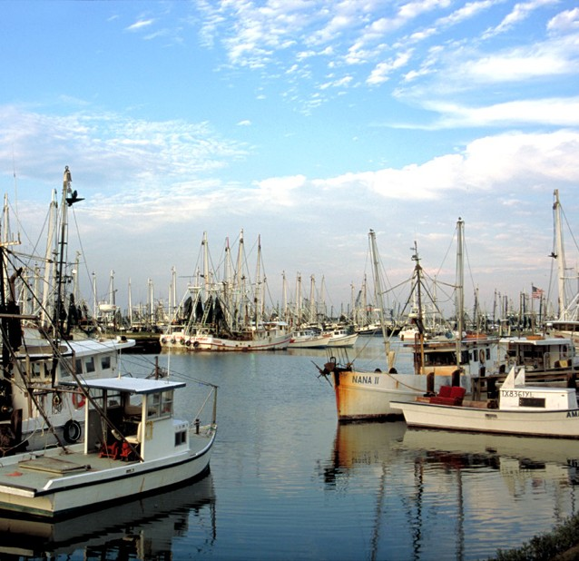
Coastal Watershed Counties
Race
75%
Share of the U.S. Asian Alone population living in Coastal Watershed Counties.
(Share of total U.S. Population 52%)
Figure 19
Percent Population of Coastal Watershed Counties and Inland Counties by Race in 2010
Table 6
Share of the U.S. Population by Race
in Coastal Watershed Counties in 2010
80%
Race Category | Percent U.S. Population
Total Population | 52%
White Alone | 48%
Black or African American Alone | 59%
American Indian and Alaska Native Alone | 35%
Asian Alone | 75%
Native Hawaiian and Pacific Islander Alone | 70%
Some Other Race Alone | 61%
Two or More Races | 59%
Coastal Watershed Counties Inland Counties
Percent Population
60%
59%
Share of the U.S. Black or African American Alone population living in Coastal Watershed Counties.
(Share of total U.S. Population 52%)
40%
20%
0
White Alone
Black or African American Alone
American Indian and Alaska Native
Asian Native Hawaiian Some Other Alone and Pacific Race Alone
Islander Alone
Two or More Races
239%
Percent increase in the Hispanic or Latino population from 1980 to 2010 in Coastal Watershed Counties.
(U.S. average 220%)
Alone
Race Category
The Bottom Line
Note: The U.S. Census Bureau uses the word “Alone” following certain race categories to distiquish those populations that chose a single race to characterize themselves.
U.S. Territories not included.
Source: U.S. Census Bureau, 2011b; NOAA, 2012
In 2010, minority population groups residing in Coastal Watershed Counties represented a combined 33 percent of the Coastal Watershed County population. This is higher than the combined share of the total U.S. population at 28 percent.
Hispanic Origin
Figure 20
Percent Population of Coastal Watershed Counties and Inland Counties by Hispanic or Latino Origin in 2010
Table 7
Share of the U.S. Population by Hispanic or Latino Origin in Coastal Watershed Counties in 2010
Hispanic or Latino
Non Hispanic or Latino
Ethnicity Category | Percent U.S. Population
Total Population | 52%
Hispanic or Latino | 62%
Non Hispanic or Latino | 50%
Percent of Population in Coastal Watershed Counties
Percent of Population in Inland Counties
Shrimp boats in the Gulf of Mexico.
Credit: Texas Parks and Wildlife Department
0
20%
40%
60% 80%
100%
Percent Population
Note: U.S. Territories not included. Source: U.S. Census Bureau, 2011b; NOAA, 2012
12

Slide 15
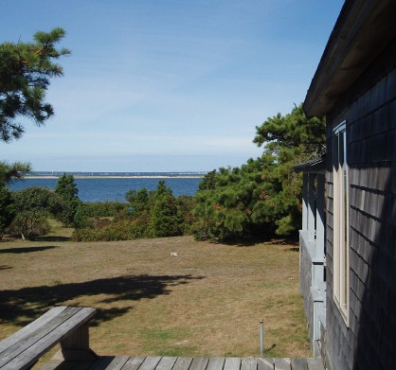
Coastal Watershed Counties
37%
Percent of the population in Coastal Watershed Counties that hold a higher education degree in 2010 (for those 25 years and over).
(U.S. average 35%)
13%
Percent of the population in Coastal Watershed Counties living below the poverty line in 2010. (U.S. average 13%)
60%
Share of the U.S. households making over $100,000 that are in Coastal Watershed Counties. (Share of total U.S. Households 52%)
Education Attainment
Figure 21
Percent Population of Coastal Watershed Counties and Inland Counties by Education Attainment for Those 25 Years and Over in 2010
Table 8
Share of the U.S. Population by Education Attainment for Those 25 Years and Over in Coastal Watershed Counties in 2010
35%
30%
Education Attainment Category | Percent U.S. Population
Total Population | 52%
No School Completed | 61%
Some or All Elementary | 56%
Some High School | 52%
High School Graduate | 50%
Some College | 51%
Associate’s Degree | 53%
Bachelor’s Degree | 56%
Master’s Degree | 59%
Professional School Degree | 61%
Doctorate Degree | 59%
Coastal Watershed Counties Inland Counties
Percent Population
25%
20%
15%
10%
5%
0
No School
Some or All
Some High
High School
Some
Associate’s
Bachelor’s
Master’s
Professional
Doctorate
Completed
Elementary
School
Graduate
College
Degree
Degree
Degree
Degree
Degree
Education Attainment Category
Note: Puerto Rico included. Source: U.S. Census Bureau, 2012a; NOAA, 2012 Remaining U.S. Territories
excluded.
Household Income
Figure 22
Percent Households of Coastal Watershed Counties and Inland Counties by Income in 2010
Table 9
Share of the U.S. Households by Household Income in Coastal Watershed Counties in 2010
30%
Coastal Watershed Counties Inland Counties
25%
Income Category | Percent U.S. Households
Total Households | 52%
Less than $10,000 | 48%
$10,000 to $24,999 | 47%
$25,000 to $49,999 | 48%
$50,000 to $74,999 | 50%
$75,000 to $99,999 | 53%
$100,000 to $124,999 | 56%
$125,000 to $149,999 | 59%
$150,000 + | 64%
ries not included. Source: U.S. Census Bur | eau, 2011b; NOAA, 2012
Percent Households
20%
15%
10%
5%
0
Less than $10,000- $25,000-
$10,000 $24,999 $49,999
$50,000- $75,000- $100,000- $125,000- $150,000 +
$74,999 $99,999 $124,999 $149,999
Income Category
Martha’s Vineyard, MA. Credit: K. Crossett
Note: U.S. Territo
NOAA’s National Coastal Population Report
13

Slide 16
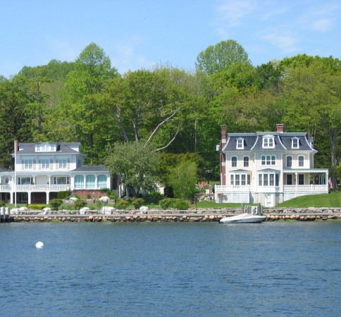
Coastal Watershed Counties
65.2 million
Seasonal Housing
Number of housing units in Coastal Watershed Counties in 2010, 51% of the U.S. total.
Figure 23
Leading States in Number of Seasonal Housing Units in Coastal Watershed Counties in 2010
Figure 24
Leading States in Percent of Housing Units that are Seasonal in Coastal Watershed Counties in 2010
Florida Michigan California New York New Jersey
Massachusetts
Maine North Carolina South Carolina
Texas
Maine Minnesota South Carolina
Delaware Florida
New Hampshire North Carolina
Alaska Michigan Hawaii
16%
Percent increase in seasonal housing units in Coastal Watershed Counties from 2000 to 2010. Total housing units in Coastal Watershed Counties increased 9%.
55%
Share of all U.S. seasonal homes located in Coastal Watershed Counties in 2010.
0 100 200 300 400 500 600 700 800
Number of Seasonal Homes (Thousand)
0
5%
10%
Percent
15%
20%
Note: U.S. Territories not included.
Source: U.S. Census Bureau, 2011a; NOAA, 2012
1876
Building Permits
Number of building permits issued per day in Coastal Watershed Counties from 2000 through 2010.
Building Permits Issued for Single-Family Units in Coastal Watershed Counties from 2000 to 2010
Building Permits Issued for Multi-Unit Buildings in Coastal Watershed Counties from 2000 to 2010
Figure 25
Figure 26
1,250
350
Building Permits Issued (Thousand)
300
1,000
250
Building Permits Issued (Thousand)
750
200
500
150
Coastal Watershed Counties Inland Counties
100
250
Coastal Watershed Counties Inland Counties
50
0
2000
2002
2004
2006
2008
2010
0
2000 2002
2004 2006 2008 2010
Year
Source: U.S. Census Bureau, 2011c; NOAA, 2012
Mystic Seaport, CT. Credit: J. O’Grady
Year
Note: U.S. Territories not included.
14

Slide 17
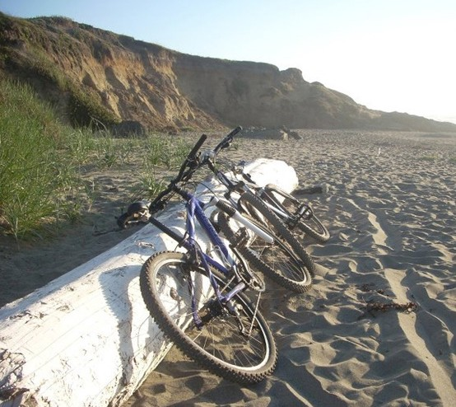
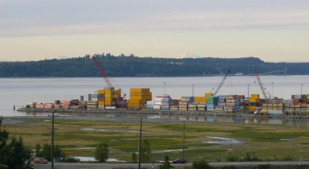

Coastal Watershed Counties
Coastal States Summary
Table 10
Demographic Summary of Aggregated Coastal Watershed Counties by State
U.S. State or | 2010 |  | 2010 Population Density |  | 1970-2010 Percent Historic Population | 2010-2020 Percent Projected Population | 1970-2010 Percent Increase in 65 and Older | 2010 Percent Population
Territory | Population | Rank | (pers/mi²) | Rank | Change | Change | Population | Living in Poverty
Alabama | 764,613 | 27 | 88 | 27 | 44 | 9 | 131 | 18
Alaska | 598,207 | 30 | 2 | 31 | 147 | 13 | 702 | 10
California | 32,258,738 | 1 | 415 | 11 | 79 | 11 | 127 | 13
Connecticut | 3,574,097 | 14 | 738 | 7 | 18 | 6 | 75 | 9
Delaware | 897,934 | 26 | 461 | 10 | 64 | 10 | 196 | 11
District of Columbia | 601,723 | 29 | 9,864 | 1 | -20 | 1 | -3 | 18
Florida | 18,427,589 | 2 | 362 | 14 | 178 | 17 | 228 | 13
Georgia | 1,043,009 | 25 | 77 | 28 | 72 | 9 | 138 | 18
Hawaii | 1,360,301 | 21 | 212 | 18 | 77 | 16 | 340 | 9
Illinois | 5,898,137 | 9 | 4,246 | 2 | 0 | 2 | 28 | 14
Indiana | 1,432,512 | 20 | 352 | 15 | 16 | 6 | 87 | 14
Louisiana | 3,573,854 | 15 | 137 | 22 | 27 | 8 | 95 | 17
Maine | 1,238,956 | 22 | 61 | 29 | 40 | 8 | 85 | 12
Maryland | 5,287,553 | 11 | 703 | 8 | 46 | 11 | 138 | 8
Massachusetts | 6,318,177 | 8 | 961 | 5 | 15 | 5 | 41 | 10
Michigan | 8,797,000 | 4 | 173 | 20 | 12 | 3 | 78 | 14
Minnesota | 251,654 | 31 | 24 | 30 | -5 | 4 | 33 | 14
Mississippi | 628,502 | 28 | 93 | 26 | 59 | 8 | 154 | 17
New Hampshire | 1,073,438 | 23 | 255 | 16 | 90 | 10 | 138 | 7
New Jersey | 8,683,202 | 5 | 1,241 | 3 | 22 | 4 | 70 | 9
New York | 17,586,787 | 3 | 604 | 9 | 6 | 4 | 31 | 14
North Carolina | 2,254,172 | 17 | 114 | 24 | 59 | 8 | 198 | 18
Ohio | 4,326,145 | 13 | 411 | 12 | -4 | 1 | 55 | 14
Oregon | 1,982,081 | 18 | 94 | 25 | 56 | 8 | 101 | 14
Pennsylvania | 6,388,180 | 7 | 834 | 6 | 14 | 4 | 54 | 12
Rhode Island | 1,052,567 | 24 | 1,018 | 4 | 11 | 5 | 46 | 12
South Carolina | 1,932,243 | 19 | 127 | 23 | 83 | 17 | 290 | 17
Texas | 8,287,623 | 6 | 207 | 19 | 130 | 19 | 202 | 19
Virginia | 5,425,647 | 10 | 392 | 13 | 83 | 18 | 198 | 8
Washington | 5,229,486 | 12 | 212 | 17 | 103 | 17 | 170 | 10
Wisconsin | 2,569,028 | 16 | 167 | 21 | 14 | 5 | 42 | 12
American Samoa | 55,519 |  | 445 |  | 103 | 8
Guam | 159,358 |  | 752 |  | 86 | 11
CNMI | 53,883 |  | 305 |  | 449 | 9
Puerto Rico | 3,725,789 |  | 1,088 |  | 37 | 2
U.S. Virgin Islands | 106,405 |  | 580 |  | 68 | 1
Source: U.S. Census Bureau, 2011a; NOAA, 2012
15

Slide 18
Acknowledgements
References
This document was compiled by the following individuals of the National Oceanic and Atmospheric Administration:
Ache, B., K. Crossett, P. Pacheco, J. Adkins, P. Wiley. 2012. “The Coast” is Complicated: A Model to Consistently Describe the Nation’s Coastal Population. Estuaries and Coasts. In Press.
Kristen Crossett Brent Ache Percy Pacheco Kate Haber
Crowell, M., Coulton, K., Johnson, C., Westcott, J., Bellomo, D., Edelman, S., and Hirsch, E., 2010. An Estimate of the U.S. Population Living in 100-year Coastal Flood Hazard Areas. Journal of Coastal Research, Vo. 26, No. 2, pp. 201-211.
The authors would like to thank the following individuals for their contributions to the National Coastal Population Report:
National Ocean Service, NOAA. 2012. Spatial Trends in Coastal Socioeconomics. Demographic Trends Database 1970-2010; Woods and Poole Economics, Inc. Projections Database 1970-2040. Available from: http:// coastalsocioeconomics.noaa.gov (accessed June 8, 2012).
National Oceanic and Atmospheric Administration Jeff Adkins
Chris Clement Theresa Goedeke Alison Hammer John Hayes
Susan Holmes Linwood Pendleton Peter Wiley
U.S. Census Bureau. 2011a. American Community Survey 5-Year Estimates, 2006-2010. Available from: http://factfinder.census.gov/home/saff/main. html?_lang=en
U.S. Census Bureau. 2011b. Census 2010. Available from: http://factfinder2. census.gov/faces/nav/jsf/pages/index.xhtml
. 2011c. Residential Construction Files 1998-2010.
U.S. Census Bureau Thomas Fischetti Marc Perry
Steven Wilson
Federal Emergency Management Agency Mark Crowell
Photo Credits
Cover:
Ocean City, MD. Credit: Christopher Parypa (Shutterstock)
Inside Cover:
San Francisco, CA. Credit: D. Nieters
Title Page:
Lower Mississippi River. Credit: NOAA’s National Ocean Service Chicago coastal skyline. Credit: NOAA’s National Ocean Service Kayaks in Santa Cruz, CA. Credit: K. Crossett
Puerto Rico. Credit: Cary Friday
Page 2:
Channel Islands National Park, CA. Credit: Claire Johnson Cambria, CA. Credit: J. O’Grady
San Diego, CA. Credit: J. O’Grady
Nubble Light House, Cape Neddick, CA. Credit: J. O’Grady Rockport, TX. Credit: Texas Parks and Wildlife Department
Page 9:
Martha’s Vineyard, MA. Credit: K. Crossett San Juan, PR. Credit: B. O’Grady
Port Aransas, TX. Credit: Texas Parks and Wildlife Department
Page 15:
San Simeon, CA. Credit: J. O’Grady Anchorage, AK. Credit: D. Nieters San Francisco, CA. Credit: D. Nieters
16

Slide 19
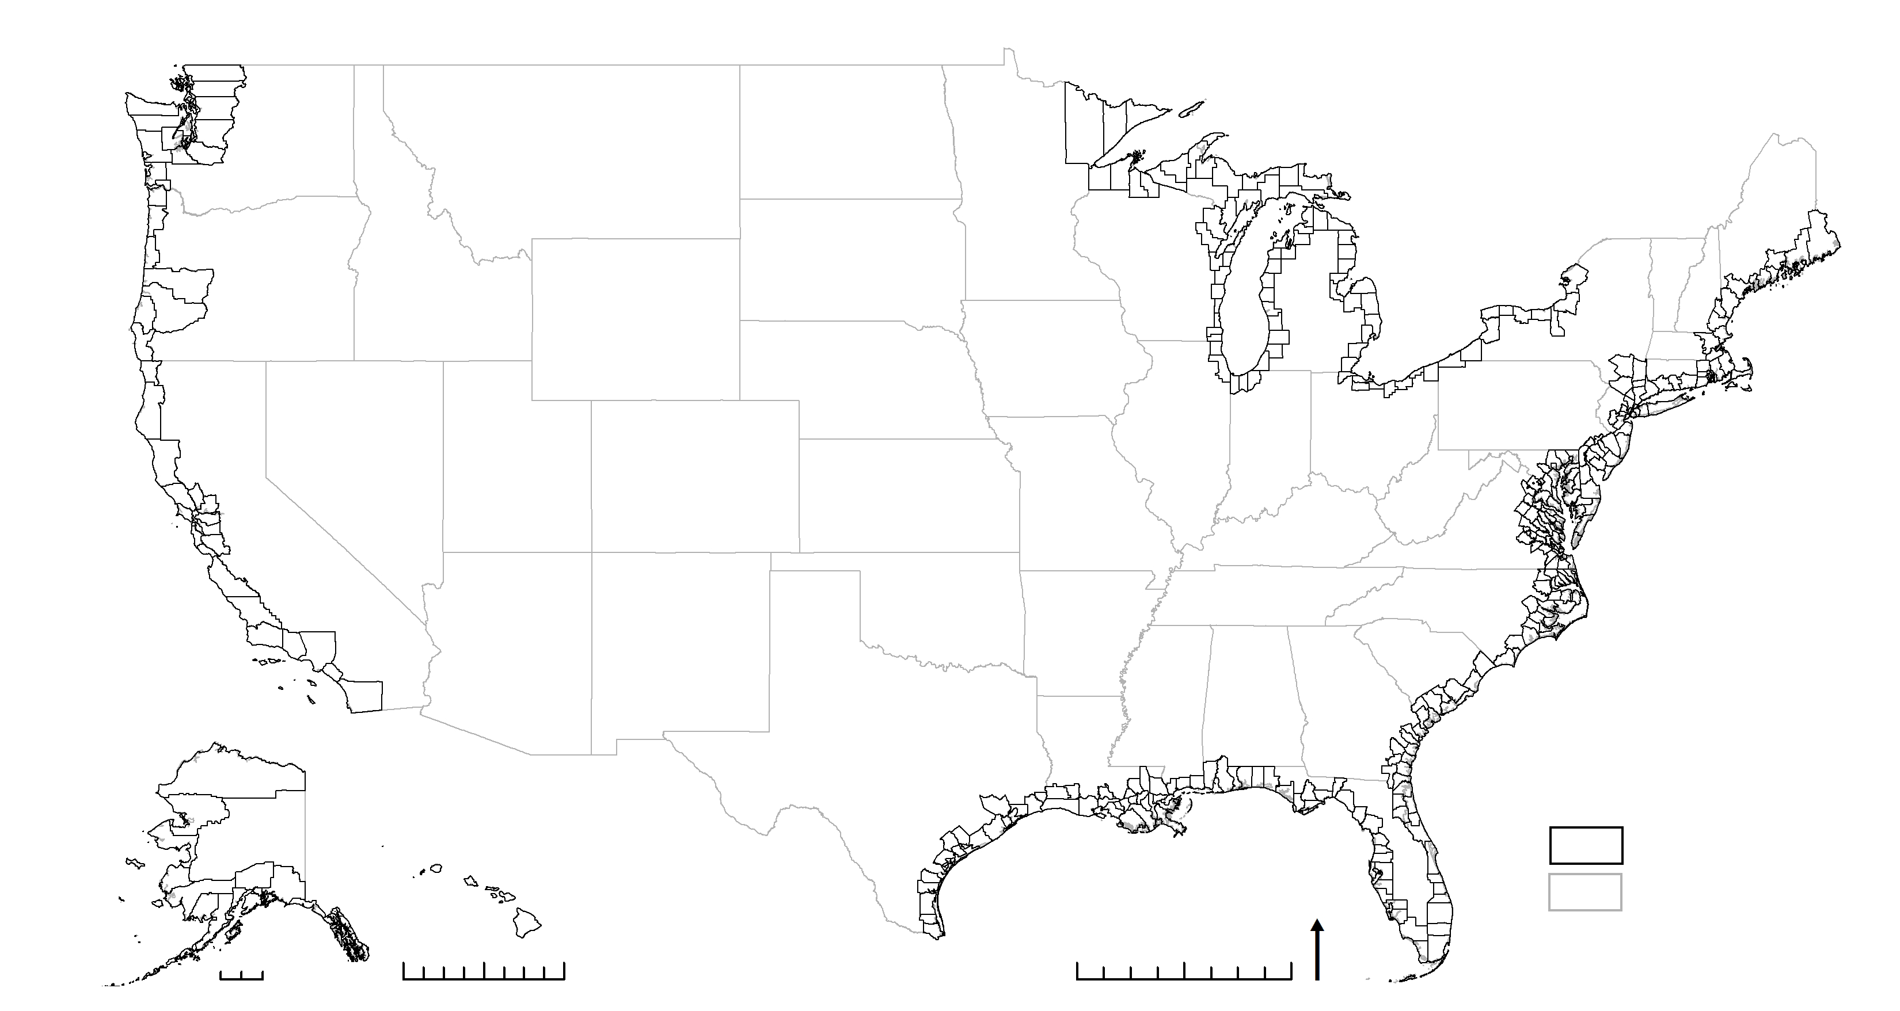
Appendix A: Coastal Shoreline Counties
The Federal Emergency Management Agency (FEMA) has derived 452 Coastal Shoreline Counties. FEMA’s 100-year flood plain, or Special Flood Hazard
Area (SFHA), delineates where the National Flood Insurance Program’s floodplain management regulations must be enforced and the area where the mandatory purchase of flood insurance applies. The Coastal Shoreline Counties are counties that have a coastline bordering the open ocean, or contain
FEMA identified coastal high hazard areas in the SFHA (Crowell et al., 2010).
American Samoa, Guam, the Commonwealth of the Northern Mariana Islands, the U.S. Virgin Islands, and Puerto Rico are included in this suite (Ache et al., 2012).
For more detailed information about Coastal Shoreline Counties visit: http:// coastalsocioeconomics.noaa.gov/coast_defined.html.
Alaska
Coastal Shoreline County
Hawaii
N
U.S. States
0 500
0
250
500
0
250
500
Note: Coastal Shoreline Counties in the
U.S. Territories are not shown.
NOAA’s National Coastal Population Report
17

Slide 20
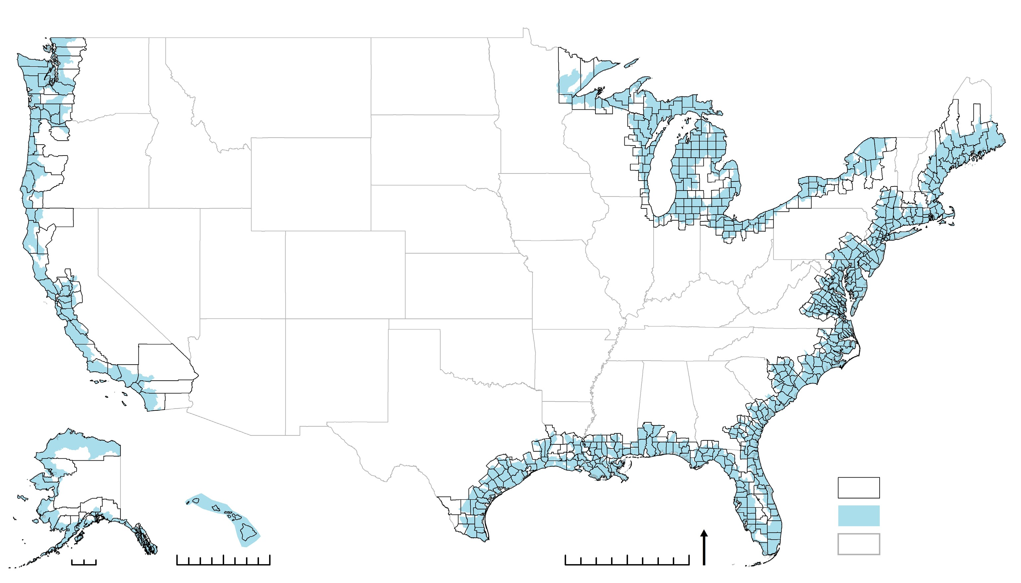
Appendix B: Coastal Watershed Counties
NOAA has derived 769 Coastal Watershed Counties. A county is considered a Coastal Watershed County if one of the following criteria is met: (1) at a
minimum, 15 percent of the county’s total land area is located within a coastal watershed; or (2) a portion of a county, or an entire county, accounts for at least 15 percent of a coastal USGS 8-digit cataloging unit. This “15-percent rule” intends to identify counties that have a substantial watershed-based
impact on coastal and ocean resources. In addition, the five U.S. Territories – American Samoa, Guam, the Commonwealth of the Northern Mariana Islands, the U.S. Virgin Islands, and Puerto Rico, are included in their entirety (Ache et al., 2012).
For more detailed information about the Coastal Watershed Counties visit: http://coastalsocioeconomics.noaa.gov/coast_defined.html.
Alaska
Coastal Watershed County
Estuarine and Coastal Drainage Areas
U.S. States
Hawaii
N
0 500
0
250
500
0
250
500
Note: Coastal Watershed Counties in the U.S. Territories are not shown.
18

Slide 21
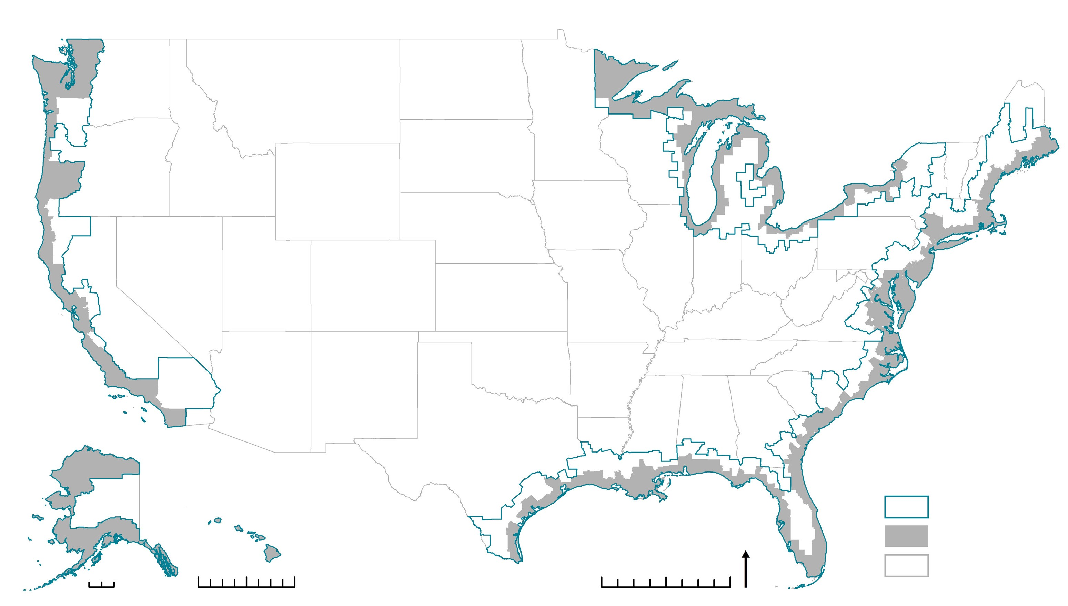
Appendix C: Comparing Coastal Shoreline and Coastal Watershed Counties
Coastal Shoreline Counties are contained entirely within the inland extent of Coastal Watershed Counties, making up 53 percent of the total land area of Coastal Watershed Counties. However, Coastal Shoreline Counties exhibit a much higher population density than Coastal Watershed Counties, as they contain 75 percent of the total population in this area.
Land Area Population
Average Density
ti
n
e
u
s
ti
o
P
n
e
u
s
L
C
o
o
a
p
C
n
d
u
d
d
e
l
e
A
h
a
Coastal Watershed Counties
319 pers/mi²
Coastal Shoreline Counties
446 pers/mi²
Note: Land area and density numbers exclude Alaska. Population values include Alaska.
h
r
s
ti
s
e
r
o
r
e
n
e
a
t
t
-
a
-
a
5
W
1
W
1
l
6
l
2
a
3
a
,
t
.
t
0
s
8
s
0
a
a
0
o
m
o
m
C
i
C
Coastal Shoreline Counties contain
i
Coastal Shoreline Counties contain
l
2
of the Coastal Watershed County land area
of the Coastal Watershed County population
Alaska
Extent of Coastal Watershed Counties
Extent of Coastal Shoreline Counties
U.S. States
Hawaii
N
0 500
0
250
500
0
250
500
NOAA’s National Coastal Population Report 19

Slide 22

stateofthecoast.noaa.gov

