Slide 1
Geologic Time

Slide 2
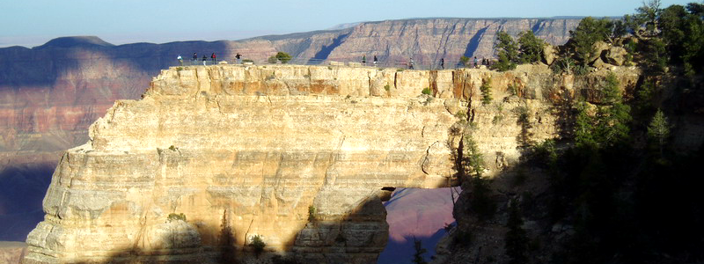
Geologic Time
Discovering the magnitude of the Earth’s past was a momentous discovery in the history of humanity.
This discovery forever altered our perception of ourselves within nature and the Universe.

Slide 3
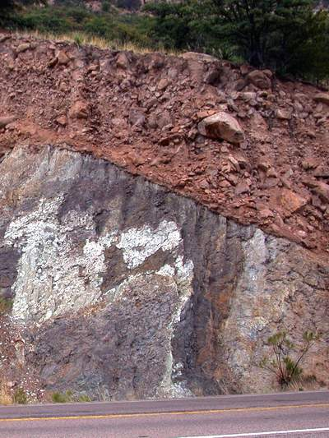
Geologic Time
Understanding time permits assigning an age to…
Rocks.
Fossils.
Geologic structures.
Landscapes.
Tectonic events.

Slide 4
Geologic Time
Deep time – The immense span of geologic time.
It is so vast that it is difficult for people to grasp.
We think of time in terms of our lives…
Human history is tiny compared to geologic time.

Slide 5
Geologic Time
Prior to the late 17th century, geologic time was thought to be the same as historical time.
Archbishop James Ussher of Armagh, Ireland, 1654.
He added up generations from the Old Testament.
He determined that Earth formed on October 23, 4004 BCE.
Image source

Slide 6
Geologic Time
Scientists began to find clues to an ancient Earth.
Nicolaus Steno (1638–1686) – Danish physician.
Observed marine fossils high in the Apennines.
Deduced that these were ancient animals in loose sediment.
Lithification and uplift suggested long periods of time.
Illustration from Steno's 1667 paper comparing the teeth of a shark head with a fossil tooth.
Image source

Slide 8
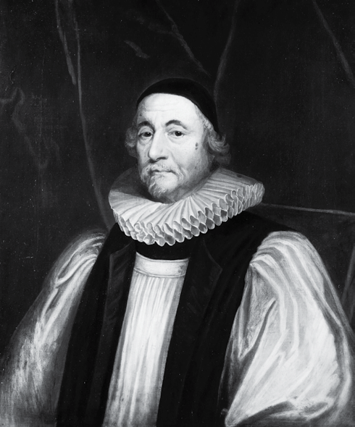
Geologic Time
Early estimates of Earth’s age were based on religious dogma.
In the mid 1600s, Archbishop James Ussher determined the exact date of the creation of the Earth . . . “nightfall preceding 23 October 4004 BC”

Slide 9
Geologic Time
James Hutton (1726-1797) – Scottish physician.
Called “the Father of Modern Geology.”
First to articulate the “Principle of Uniformitarianism.”
Of the abyss of time, Hutton wrote: “we find no vestige of a beginning; no prospect of an end.”
Image source

Slide 10
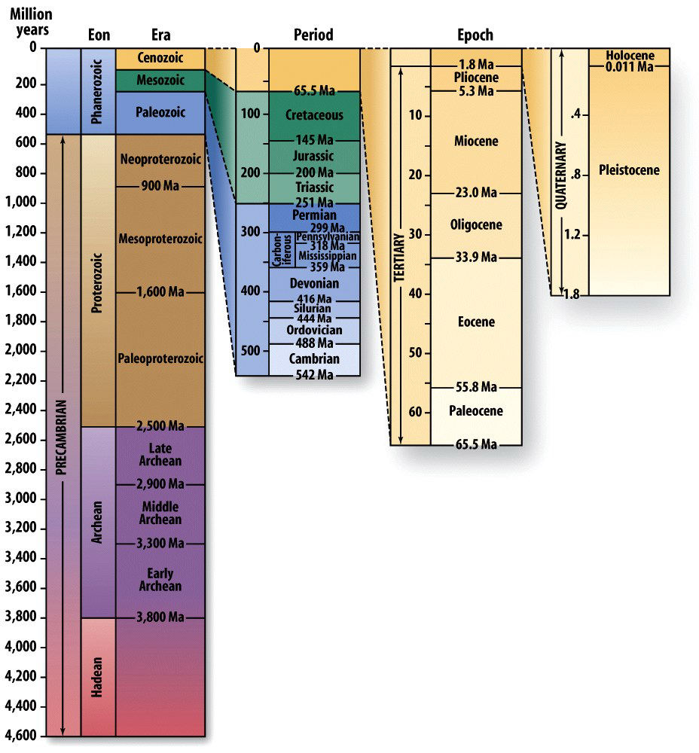
The Geologic Time Scale

Slide 11
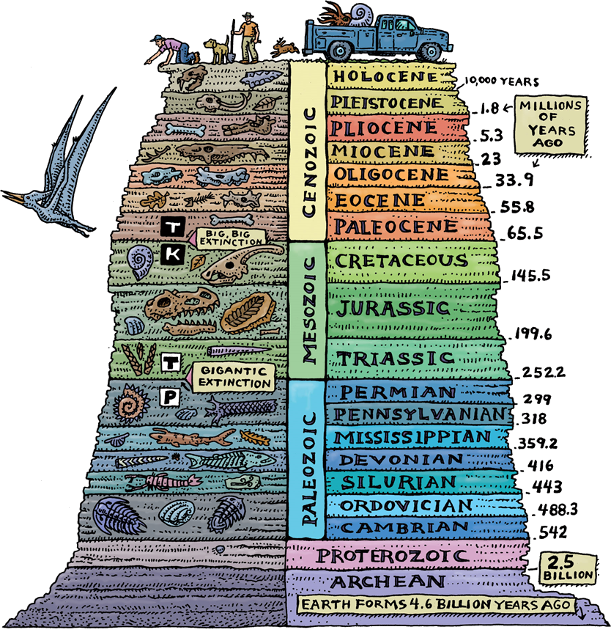
Eons
Hadean
“Hell” (4.6 to 3.8 Ga).
Internal differentiation.
Formation of the oceans and secondary atmosphere
Archean
“Ancient” (3.8 to 2.5 Ga).
Birth of continents.
Appearance of the earliest life forms.

Slide 12
Eons
Proterozoic
“Before life” (2.5 to 0.542 Ga).
Development of tectonic plates like those of today.
Buildup of atm O²; multicellular life appears.

Slide 13
Eons
Phanerozoic
Paleozoic, Mesozoic & Cenozoic Eras
“Visible life” (542 Ma to the present).
Marks the 1st appearance of hard shells.
Life diversified rapidly afterward.

Slide 14
Eras
Cenozoic – “Recent life.”
65.5 Ma to present.
The “Age of Mammals.”
Mesozoic – “Middle life.”
251 to 65.5 Ma.
The “Age of Dinosaurs.”
Paleozoic – “Ancient life.”
542 to 251 Ma.
Life diversified rapidly.

Slide 15
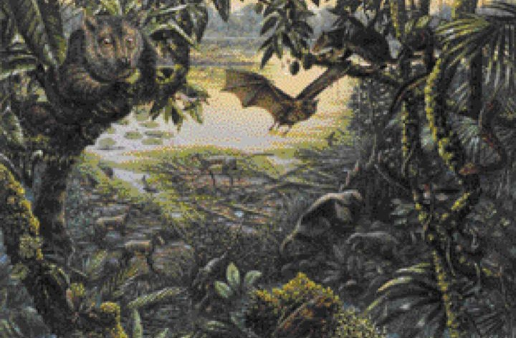
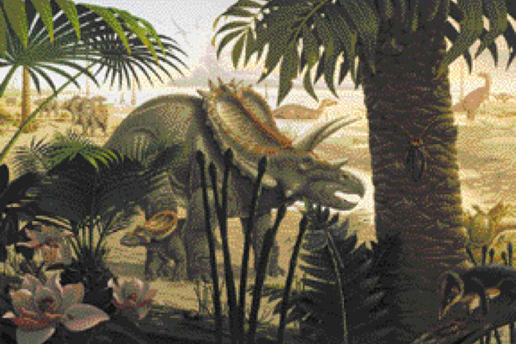
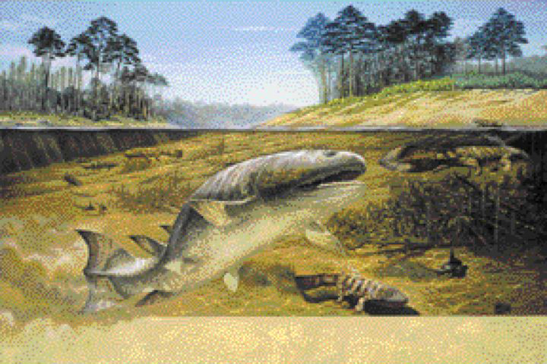
Eras are divided into shorter units called periods.
Cambrian explosion
Periods are divided into epochs
© 2008, John Wiley and Sons, Inc.

Slide 16
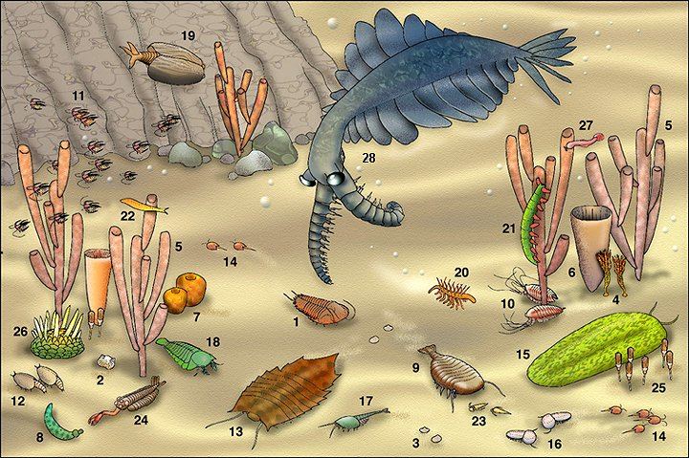
The Cambrian Explosion
Image source

Slide 17
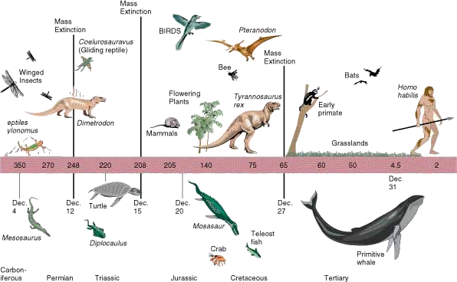
So, Where Are We?
Eon = Phanerozoic
Era = Cenozoic
Period = Quaternary
Epoch = Holocene

Slide 18
The Geologic Time Scale
Difficulties in dating the time scale
Not all rocks are datable (sedimentary ages are rarely reliable)
Materials are often used to bracket events and arrive at ages

Slide 19
Dating the Earth
Relative dating
Placing rocks and events in sequence
Radiometric dating
Uses the half-lives of radioactive elements to yield numerical dates

Slide 20
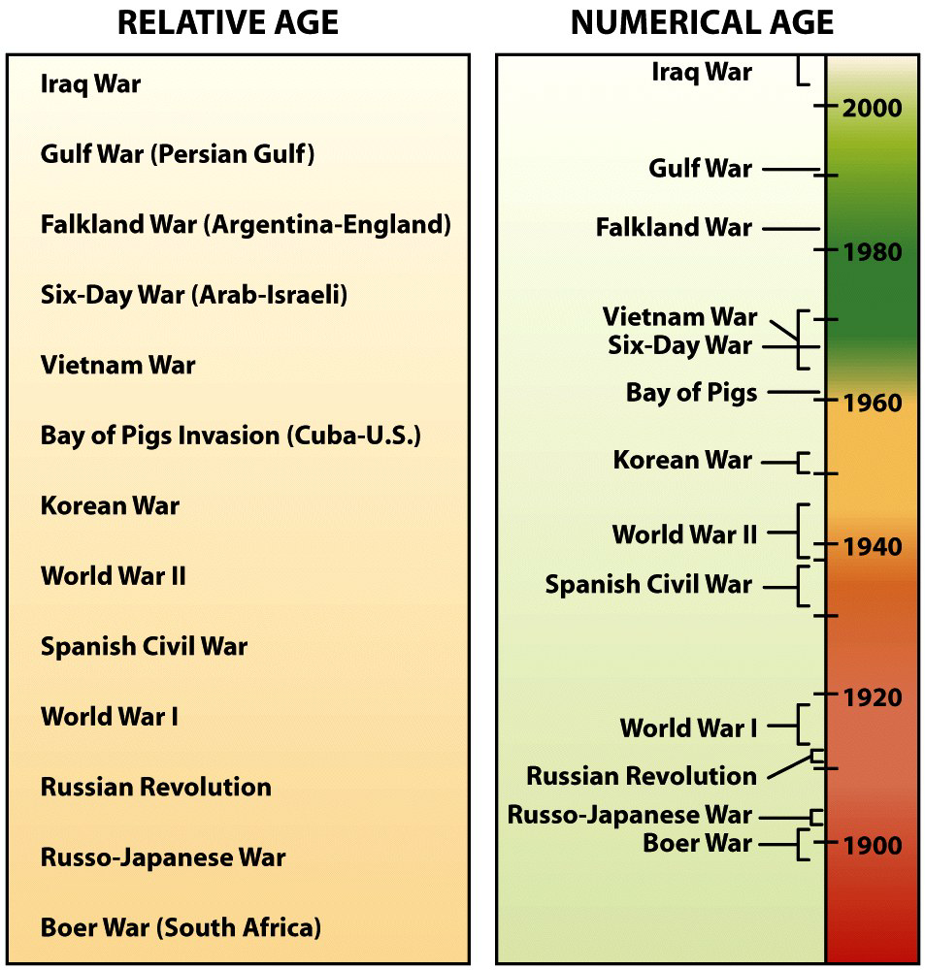
Relative vs. Absolute
Relative ages assign order to events.
Numerical ages assign exact dates to events.

Slide 21
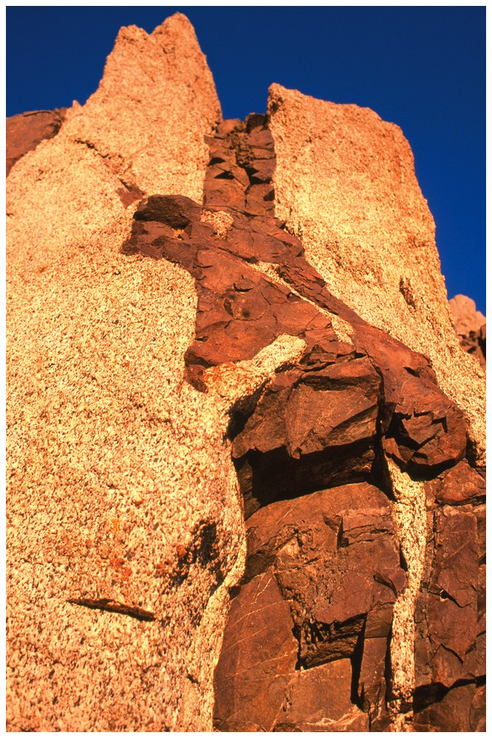
Five Fundamental Geologic Events are "ordered" by Relative Dating.
Intrusion
Erosion
Deposition
Faulting
Rock Deformation

Slide 22
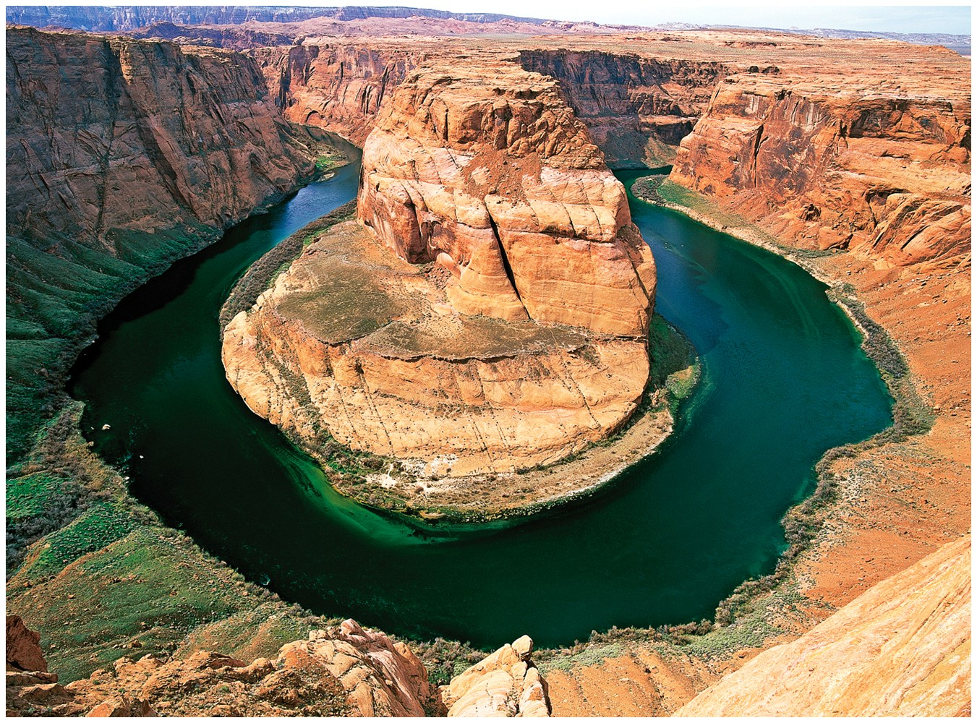
Five Fundamental Geologic Events are "ordered" by Relative Dating.
Intrusion
Erosion
Deposition
Faulting
Rock Deformation

Slide 23
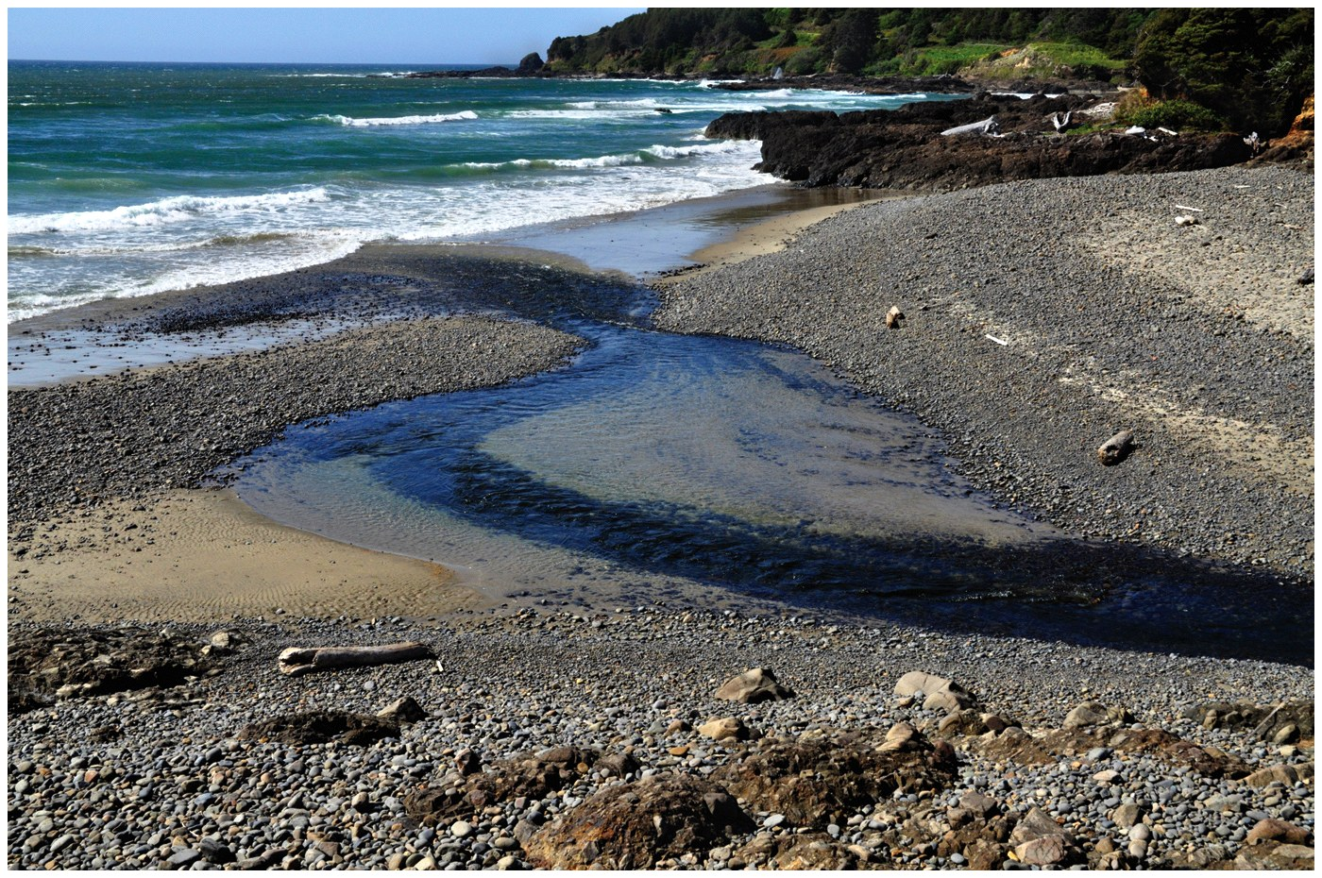
Five Fundamental Geologic Events are "ordered" by Relative Dating.
Intrusion
Erosion
Deposition
Faulting
Rock Deformation

Slide 24
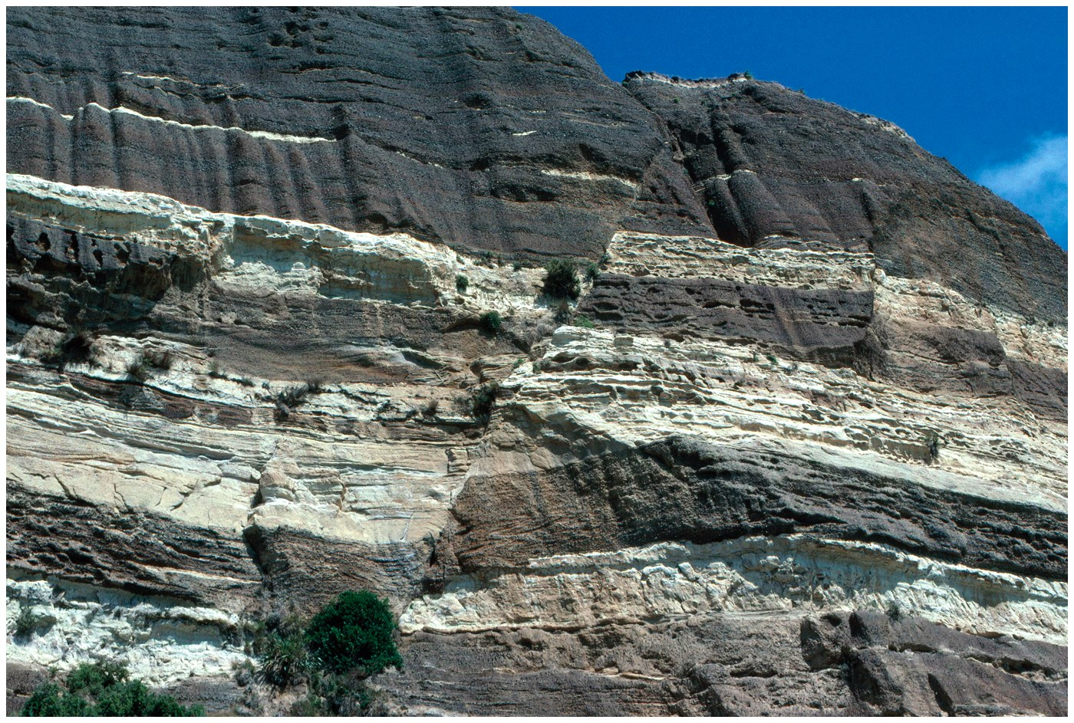
Five Fundamental Geologic Events are "ordered" by Relative Dating.
Intrusion
Erosion
Deposition
Faulting
Rock Deformation

Slide 25
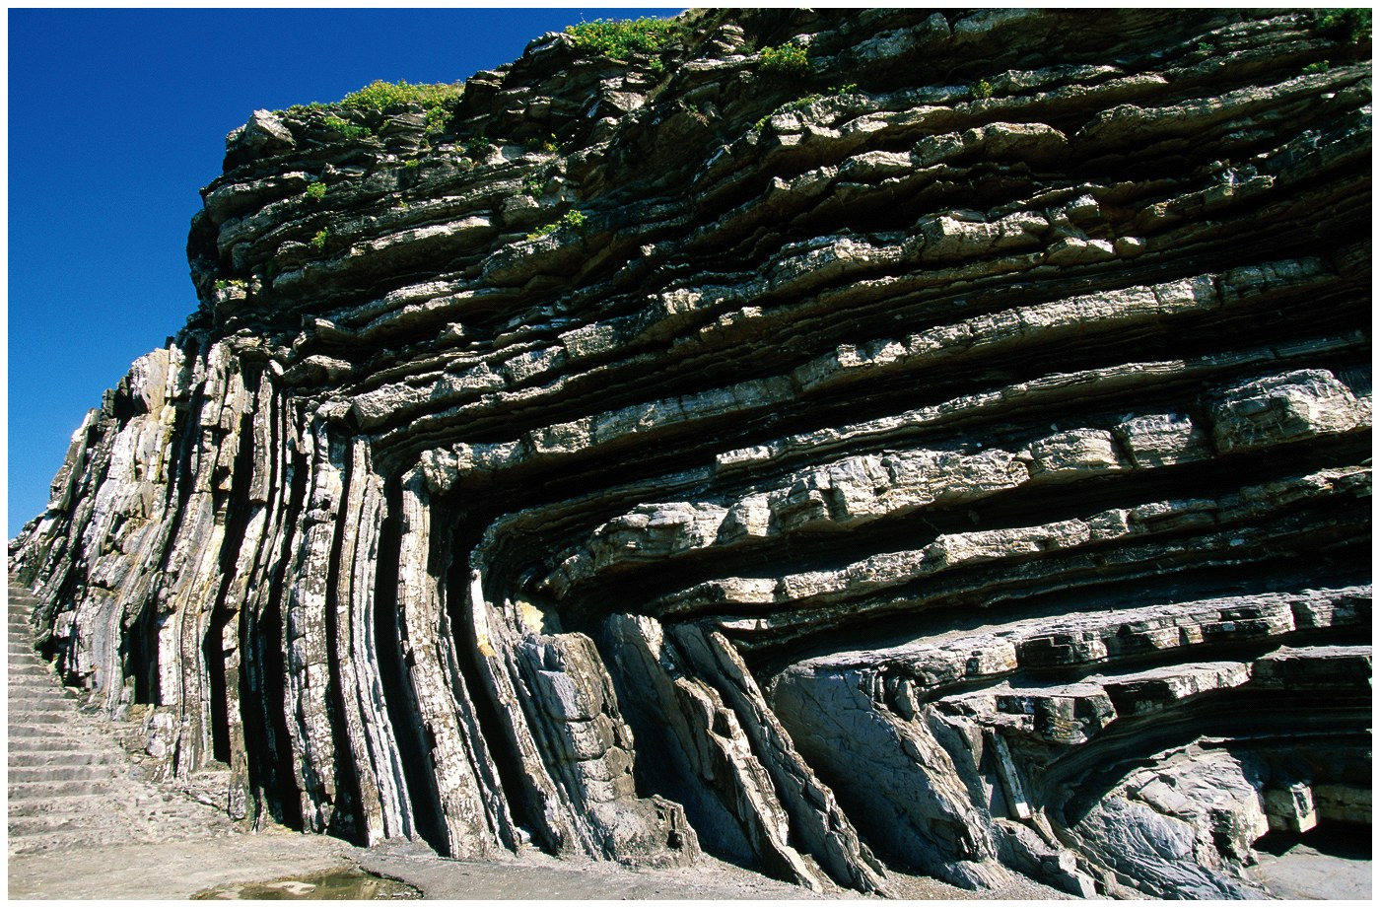
Five Fundamental Geologic Events are "ordered" by Relative Dating.
Intrusion
Erosion
Deposition
Faulting
Rock Deformation

Slide 26
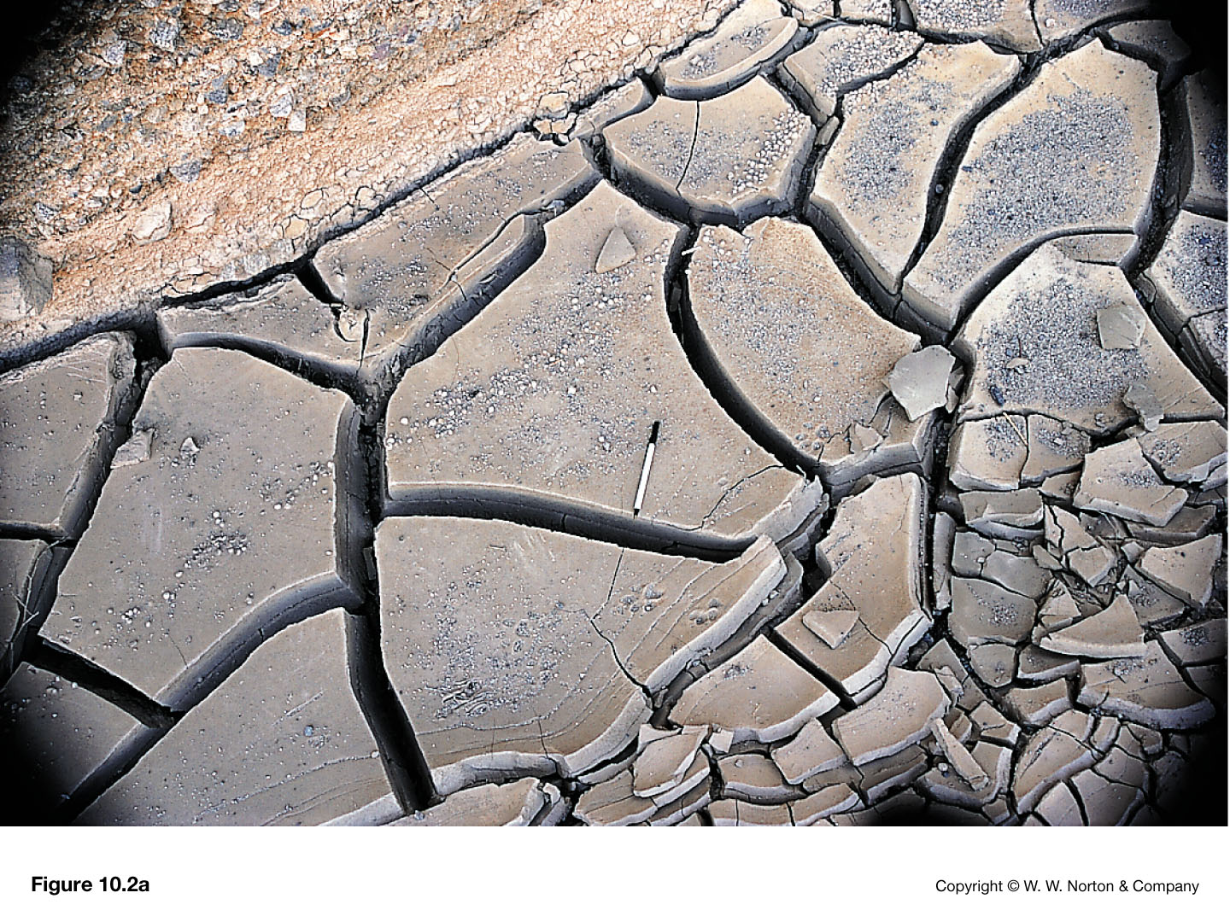
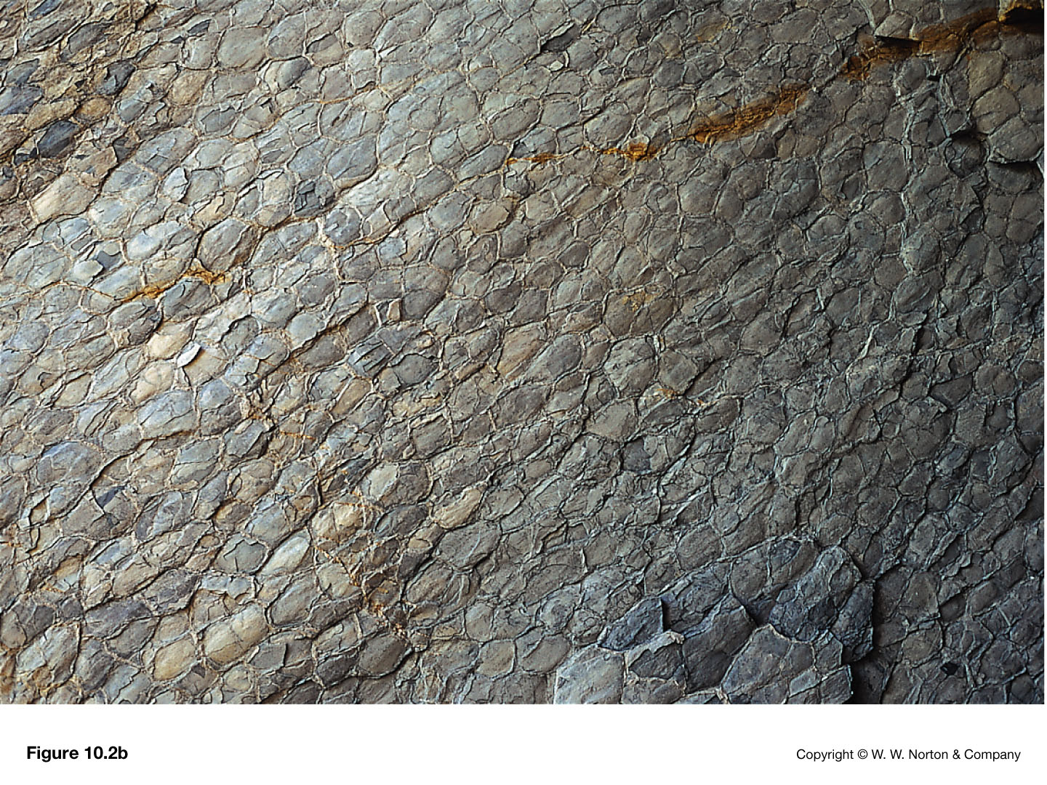
Relative dating
Principle of uniformitarianism – “The present is the key to the past”

Slide 27
Stratigraphic Principles Used in Relative Dating.
Principle of Superposition
Principle of
Original Horizontality
Notes:
Suggested tips to give students: What's "on top" is usually the youngest and was originally deposited horizontal to Earth's surface.

Slide 28
Relative dating
Principle of
Original Lateral Continuity
Principle of
Cross-Cutting Relationships
Notes:
Suggested tips to give students: Rock layers can be "correlated" from one area to another and can only be "cross-cut" if they already exist.

Slide 29
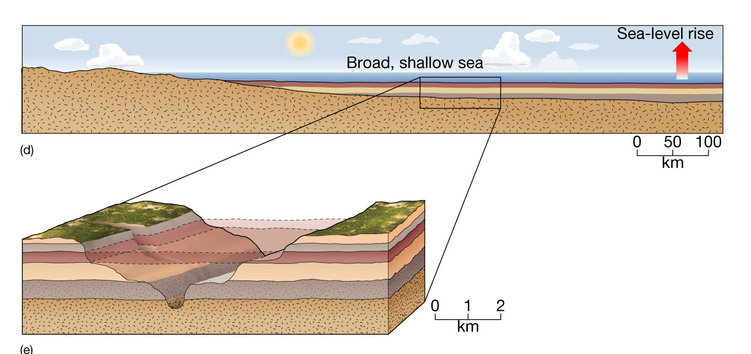
Original Horizontality & Continuity

Slide 30
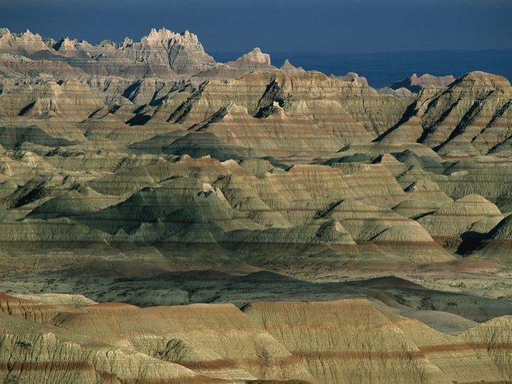
Badlands State Park, South Dakota

Slide 31
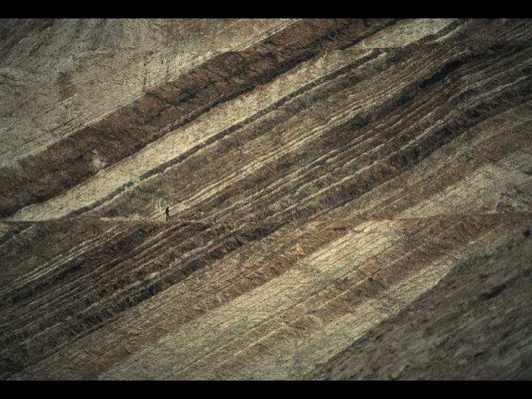
Telfer Gold Mine, Great Sandy Desert, Western Australia

Slide 32
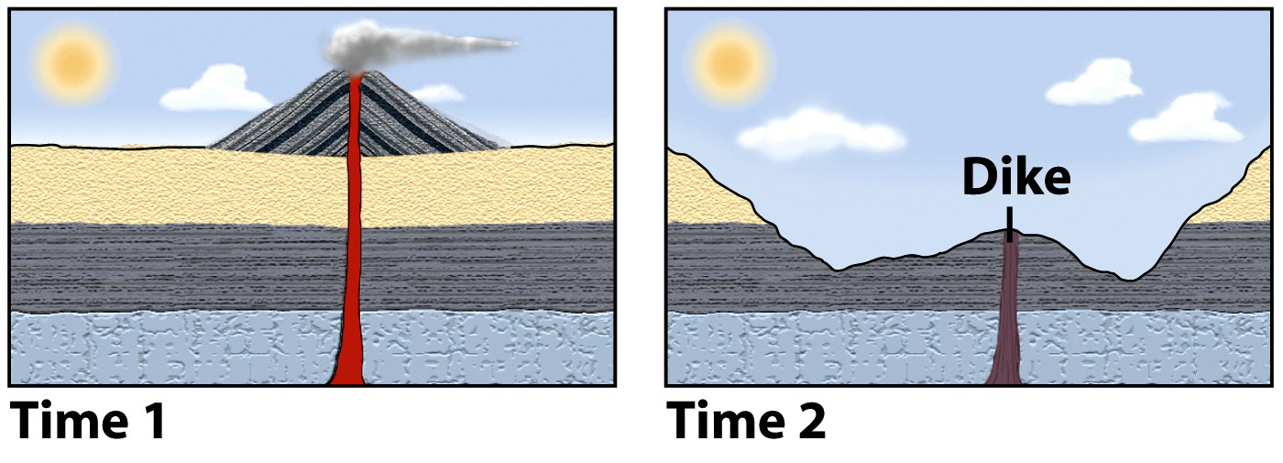
Relative dating
Principle of cross-cutting relationships
Younger feature cuts through an older feature
Faults, dikes, erosion, etc., must be younger than the material that is faulted, intruded, or eroded.
A volcano cannot intrude rocks that aren’t there yet.

Slide 33
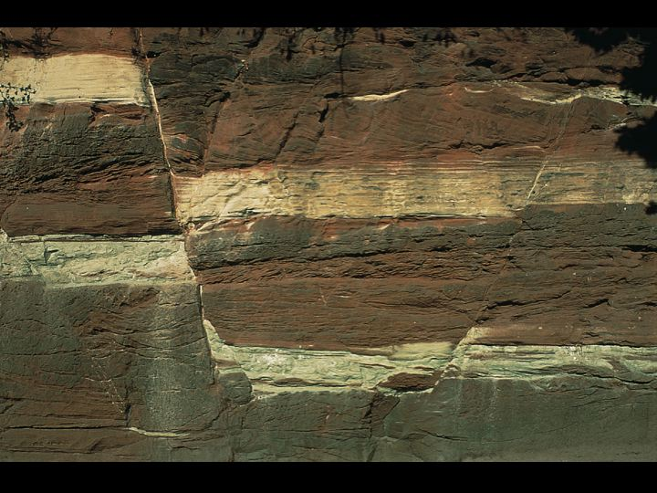
Fractures in sandstone, Merseyside, United Kingdom

Slide 34
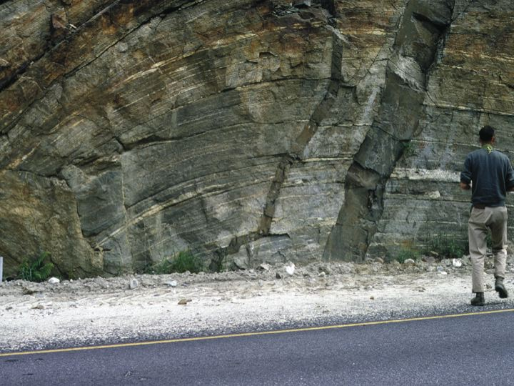
Dikes in metamorphic rocks, Three Valley Gap, Alberta, Canada

Slide 35
Relative dating
Principle of Inclusions
Principle of Unconformities
Notes:
Suggested tips to give students: In order to be "included", the rocks have toalready be there. James Hutton's recognition of the amount of time required for rock layers to be deposited, folded, eroded, and subsequently covered with new deposition (Principle of Unconformities) is what led him to believe in "Deep Time".

Slide 36
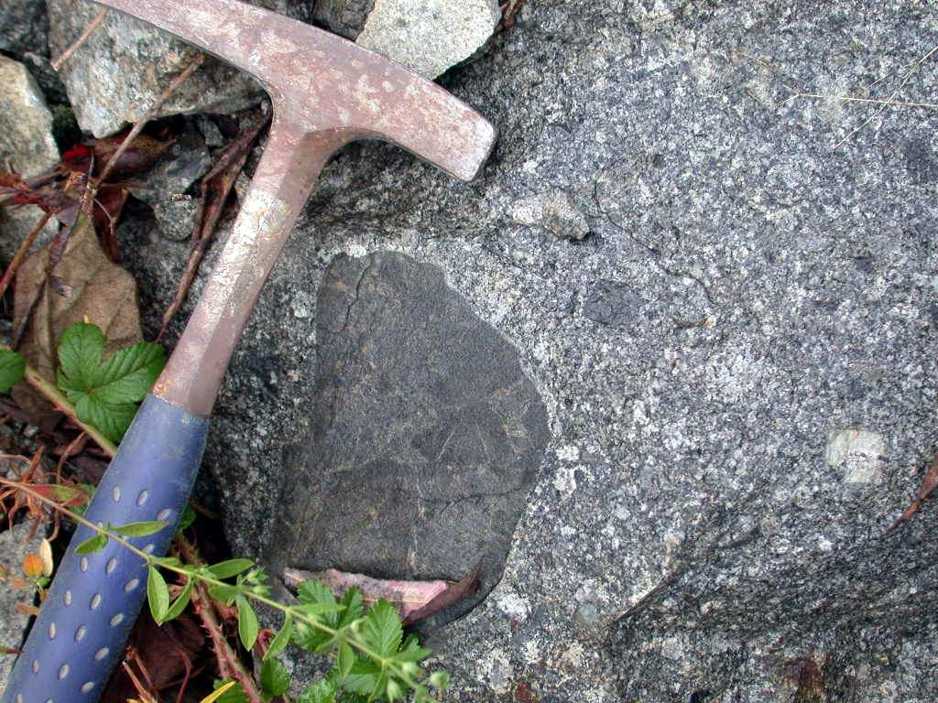
Relative dating
Principle of inclusions
A rock fragment within another.
Igneous xenoliths – Country rock that fell into magma.
Weathering rubble – Debris from pre-existing rocks.
The inclusion is older than the material enclosing it.
xenolith

Slide 37
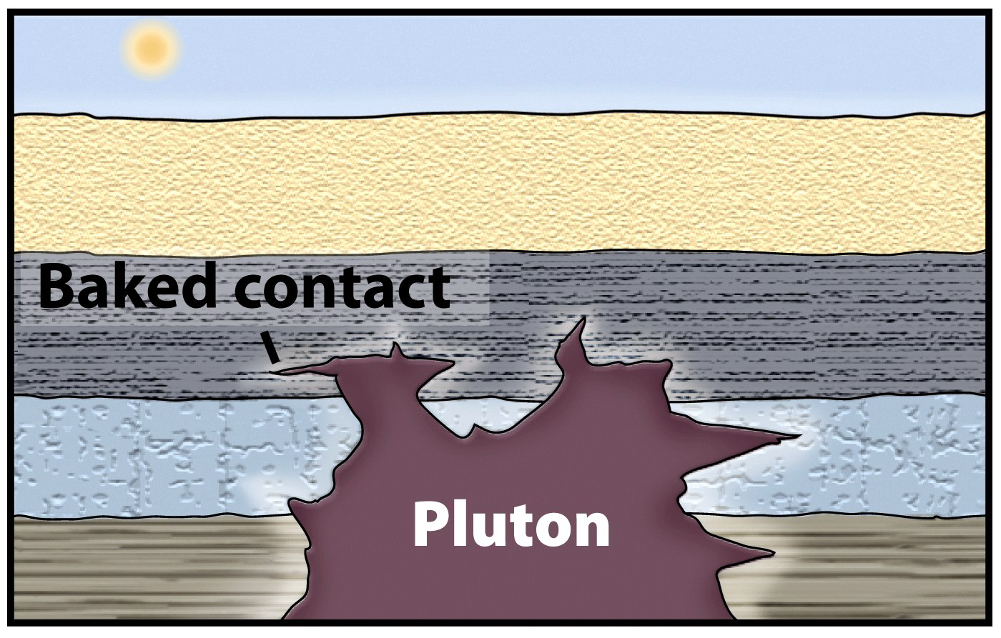
Relative dating
Principle of “baked” contacts
Thermal metamorphism occurs when country rock is invaded by a plutonic igneous intrusion.
The baked rock must have been there first (it is older).

Slide 38
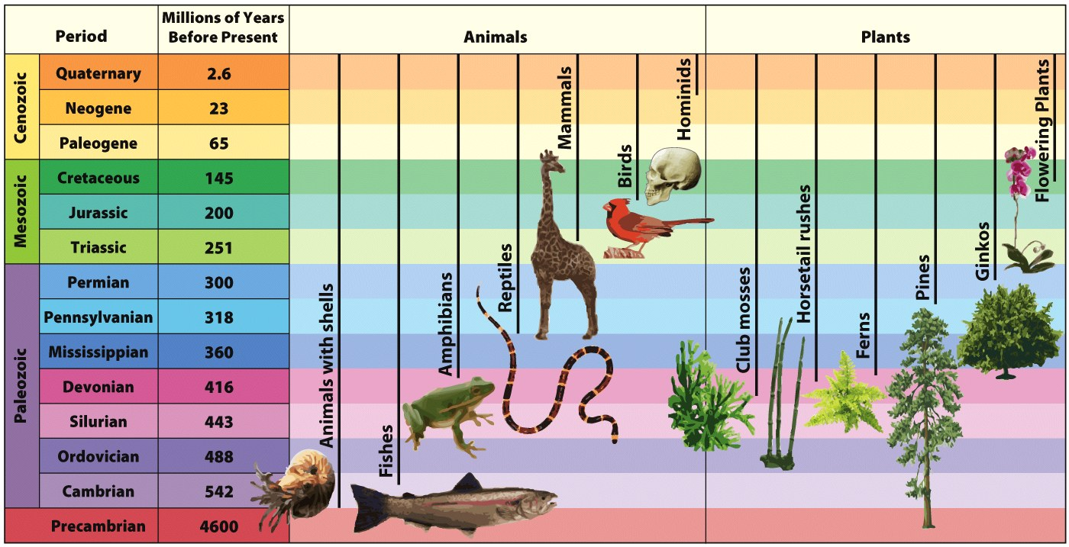
The Principle of Faunal Succession
(Evolution)
Notes:
Suggested tips to give students: More discussion about evolution in Chapter 14.

Slide 39
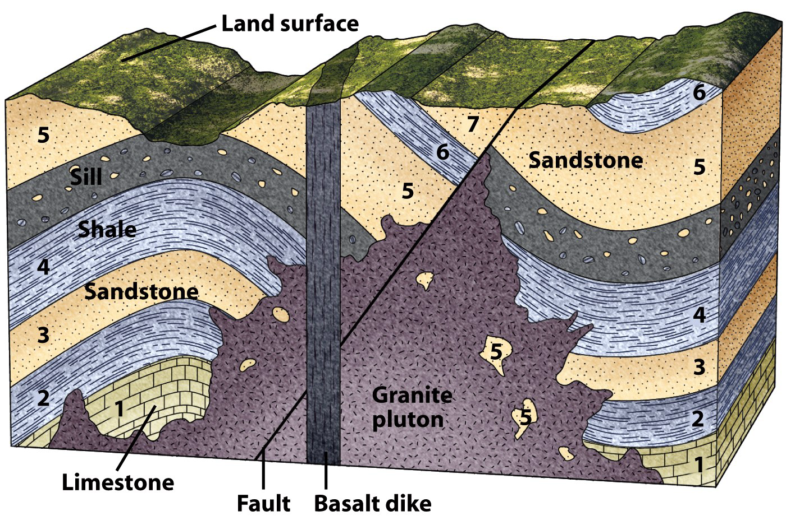
Determining relative ages empowers geologists to easily unravel complicated geologic histories.

Slide 40
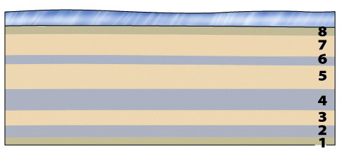
Geologic History
Deposition of horizontal strata below sea level in order 1, 2, 3, 4, 5, 6, 7, and 8 (oldest to youngest).

Slide 41
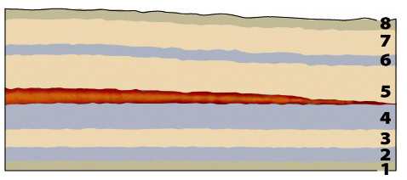
Geologic History
Igneous intrusion of a sill.

Slide 42
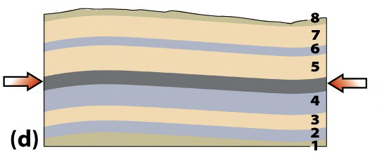
Geologic History
Tectonic compression and folding.
(Beds had to be present to be folded.)
Uplift above sea level and erosion.

Slide 43
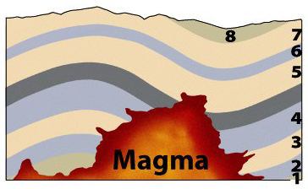
Geologic History
Intrusion of a granitic igneous pluton.

Slide 44
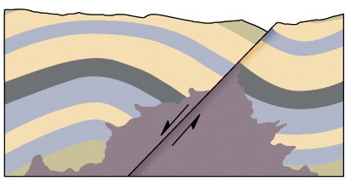
Geologic History
Extensional normal faulting.
Faulting cross-cuts the older granitic pluton.

Slide 45
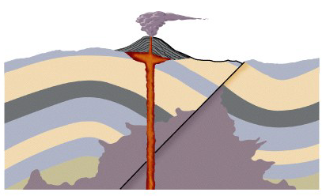
Geologic History
Intrusion of a dike.
Dike cross-cuts the normal fault.

Slide 46
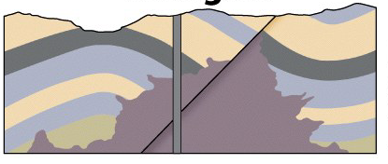
Geologic History
Erosion to present landscape configuration.
Erosion removed the volcano and cross-cuts the dike.

Slide 47
Relative ages help to unravel a complicated history.
Simple rules permit one to decipher this diagram.

Slide 48
Relative dating
Unconformities - A break in the rock record
Types of unconformities
Angular unconformity
Disconformity
Nonconformity

Slide 49
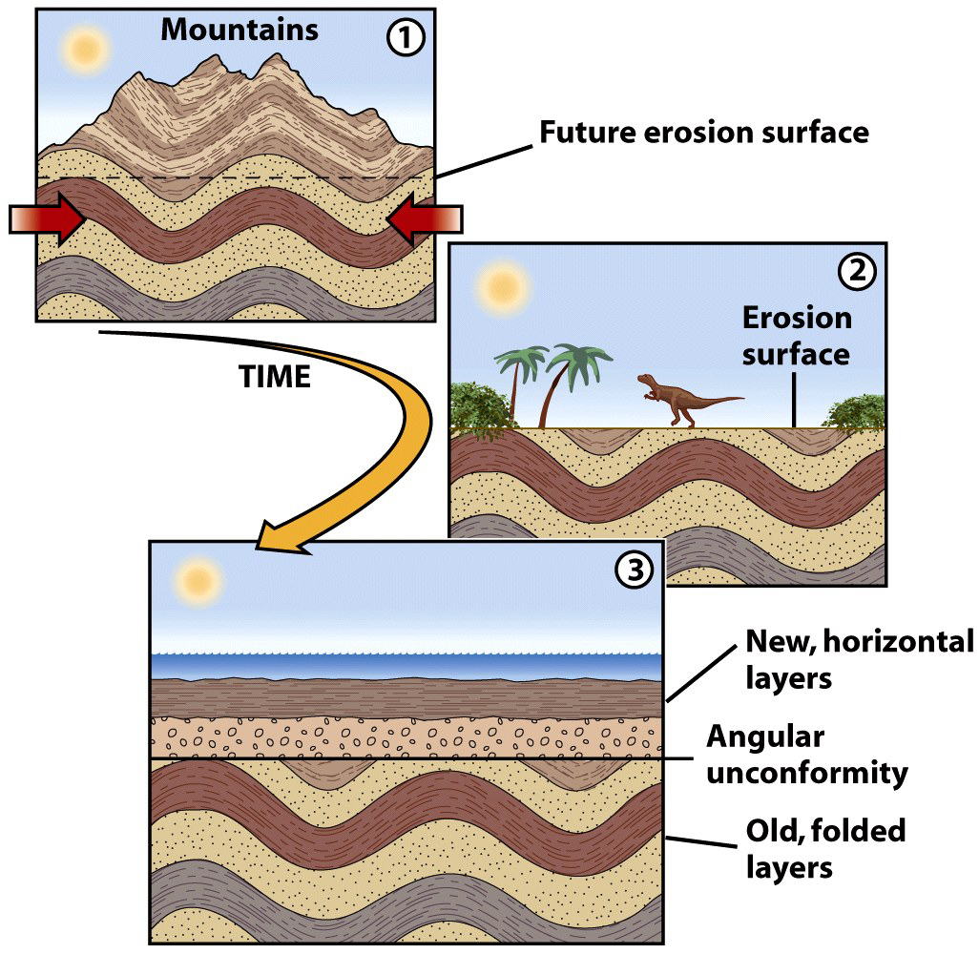
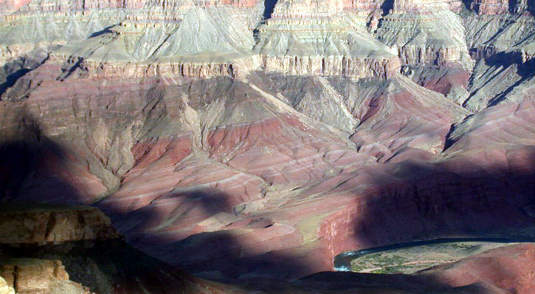
Relative dating
Angular Unconformity
Mountains created.
Mountains completely erased.
New sediment deposition.
Incomprehensible time.

Slide 50
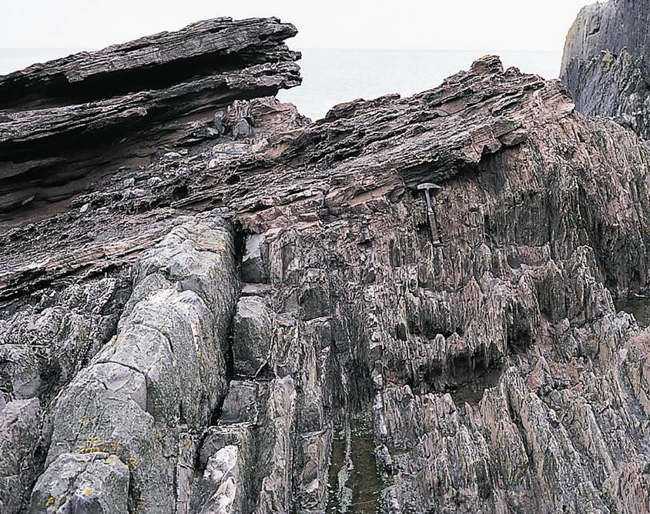
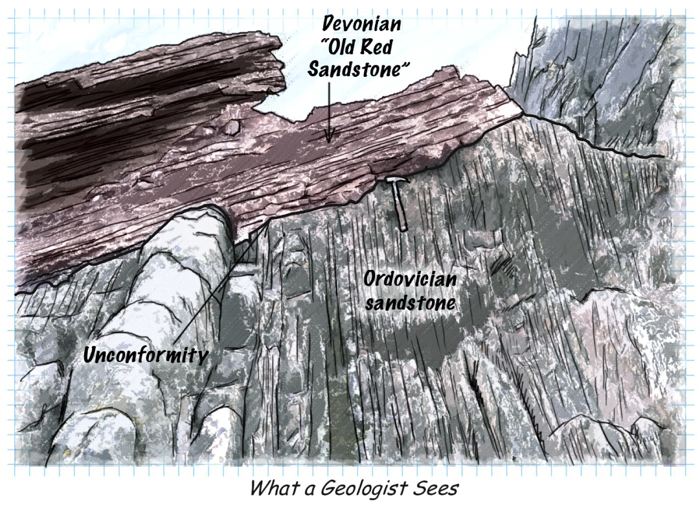
Relative dating
“Hutton’s Unconformity” on Siccar Point, Scotland, is a common destination for geologists.

Slide 51
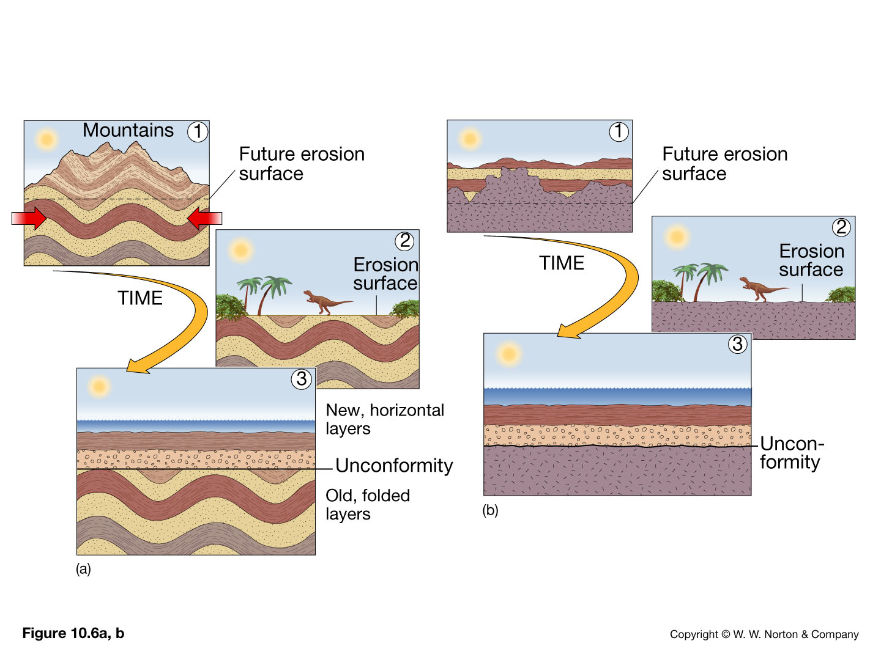
Formation of an angular unconformity

Slide 52
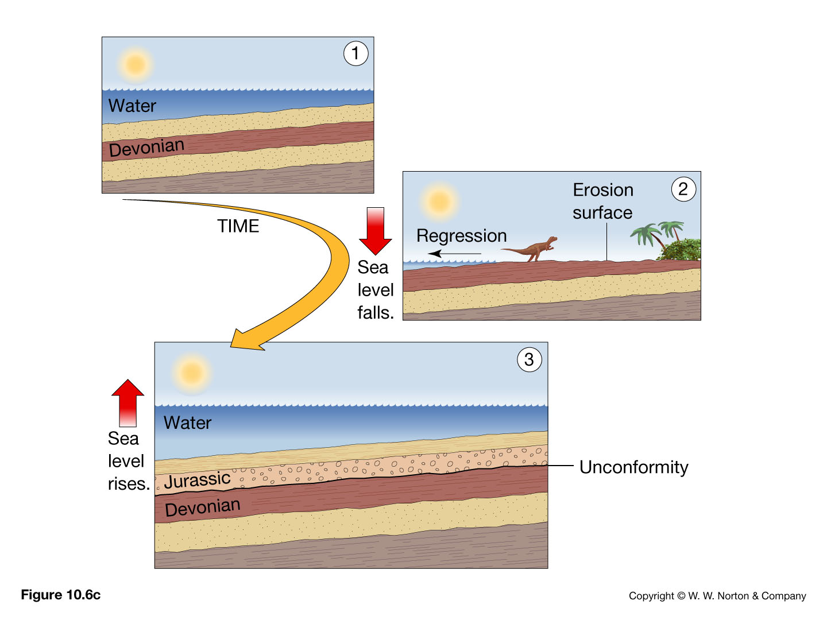
Relative dating
Disconformity – erosion of strata leaves a “gap” in geologic time. Strata on either side are parallel

Slide 53
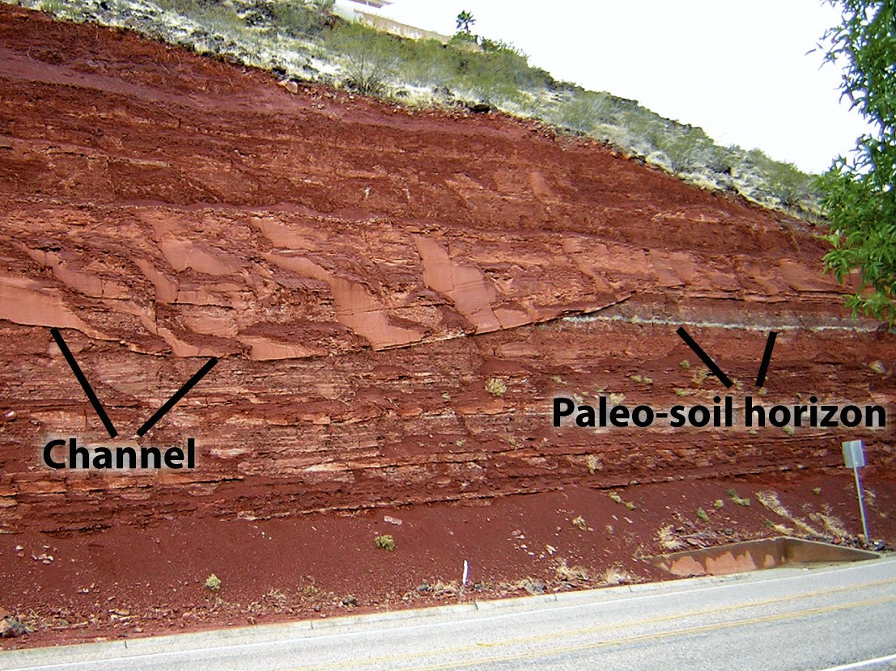
Disconformities

Slide 54
Relative dating
Nonconformity
Metamorphic or igneous rocks overlain by sedimentary strata.
Crystalline igneous and/or metamorphic rocks were exposed by erosion.
Sediment was deposited on this eroded surface.

Slide 55
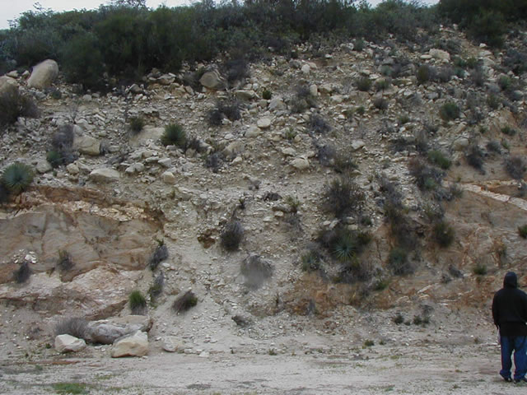
Nonconformity, San Gabriel Mountains

Slide 56
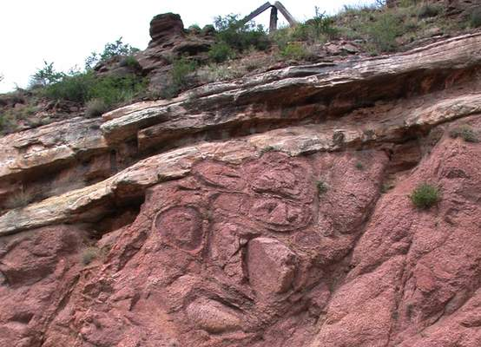
Nonconformity

Slide 57
Several unconformities are present in the Grand Canyon

Slide 58
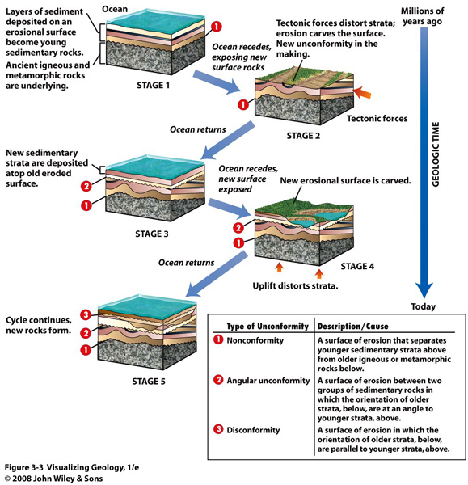

Slide 59
Fossils: evidence of past life
Types of fossils
Petrified – cavities and pores are filled with precipitated mineral matter

Slide 60
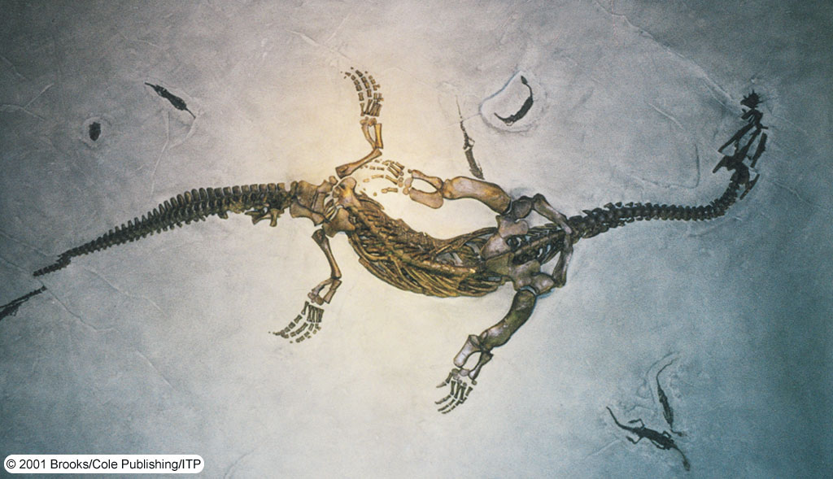
Fossils: evidence of past life
Types of fossils
Formed by replacement – cell material is removed and replaced with mineral matter

Slide 61
Fossils: evidence of past life
Types of fossils
Mold – shell or other structure is buried and then dissolved by underground water
Cast – hollow space of a mold is filled with mineral matter

Slide 62
Natural casts of shelled invertebrates

Slide 63
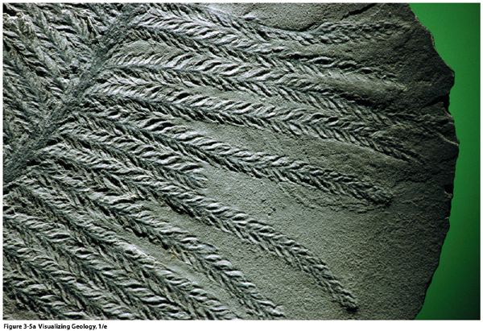
Fossils: evidence of past life
Types of fossils
Carbonization – organic matter becomes a thin residue of carbon
Impression – replica of the fossil's surface preserved in fine-grained sediment
Impression of a Lebachia branches and leaves

Slide 64
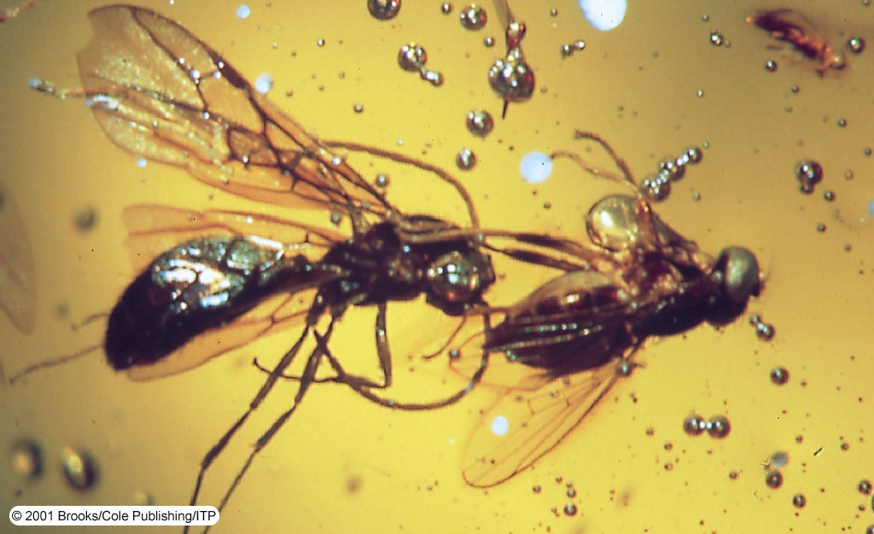
Fossils: evidence of past life
Types of fossils
Preservation in amber – hardened resin of ancient trees surrounds an organism

Slide 65
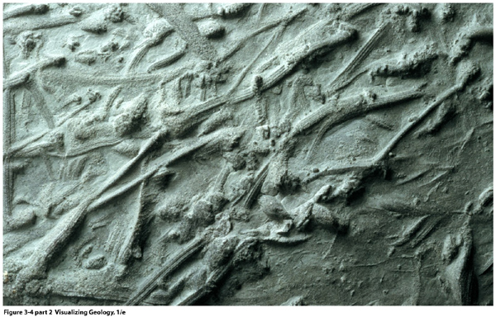
Fossils: evidence of past life
Types of fossils
Indirect evidence:
Tracks
Burrows
Coprolites
Gastroliths
530 million year old tracks and burrows of unknown marine organisms in what is now Sweden.

Slide 66
A dinosaur footprint

Slide 67
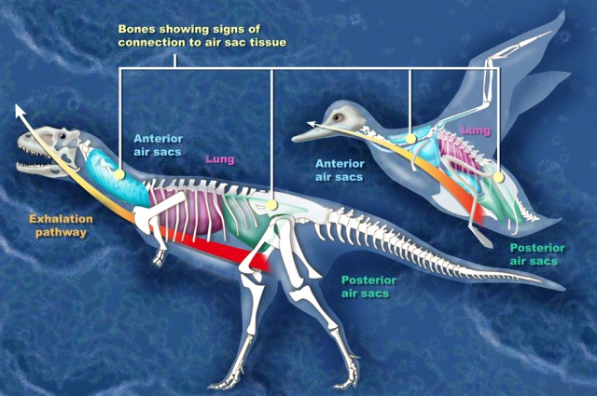
source

Slide 68
Fossils: evidence of past life
Conditions favoring preservation
Rapid burial
Possession of hard parts

Slide 69
Fossil Succession
Fossil remnants, or traces of once living organisms, are often preserved in sedimentary rocks.
Fossil are useful for relative age determination.
Several types of fossils will occur as an assemblage.
Fossils are time markers.

Slide 70
Fossil Succession
Species evolve, exist for a time, and then go extinct.
First appearance, range, and extinction dates rocks.
Fossils succeed one another in a known order.
A time period is recognized by its fossil content.

Slide 71
Fossil Succession
Fossil range – First and last appearance.
Each fossil has a unique range.
Overlapping ranges provide
distinctive time markers.
Permit correlation of strata.
Locally.
Regionally.
Globally.

Slide 72
Fossil Succession
Index fossils
Widespread geographically
Existed for a short range of geologic time

Slide 73
Fossil Correlation

Slide 74
Stratigraphic Correlation
Stratigraphic columns depict strata in a region.
Drawn to scale to accurately portray relative thicknesses.
Rock types are depicted by graphical fill patterns.
Divided into formations.
Mapable rock units.
Formations are
separated by contacts.

Slide 75
Stratigraphic Correlation
In 1793, William “Strata” Smith was the first to note that strata could be matched across distances.
Similar rock types in a similar order.
Rock layers contained the same distinctive fossils.
After years of work, he made the 1st geologic map.

Slide 76
Stratigraphic Correlation
Lithologic correlation is based on rock type.
Sequence – The relative order in which the rocks occur.
Limited to correlation between nearby regions.
Fossil correlation – Based on fossils within rocks.
Applicable to much broader areas.

Slide 77
Stratigraphic Correlation
National parks of Arizona and Utah.
Formations can be traced long distances.
Overlap is seen in the sequences of rock types.
Overlapping rock columns are used to build a composite.

Slide 78
Correlation among rock strata in 3 national parks.

Slide 79
The Geologic Column
A composite stratigraphic column exists.
Constructed from incomplete sections across the globe.
It brackets almost the entirety of Earth history.

Slide 80
Radioactivity and radiometric dating
The relative age of geologic events is established.
Based on radioactive decay of atoms in minerals.
Radioactive decay proceeds at a known, fixed rate.
Radioactive elements act as internal clocks.
Numerical dating is also called geochronology.

Slide 81
Radioactivity and radiometric dating
Atomic structure reviewed
Nucleus
Protons – positively charged
Neutrons
Neutral charge
Protons and electrons combined
Orbiting the nucleus are electrons – negative electrical charges

Slide 82
Radioactivity and radiometric dating
Atomic structure reviewed
Atomic number
An element's identifying number
Number of protons in the atom's nucleus
Mass number
Number of protons plus (added to) the number of neutrons in an atom's nucleus
Isotope
Variant of the same parent atom
Different number of neutrons and mass number
Stable – Isotopes that never change (i.e., 13C).
Radioactive – Isotopes that spontaneously decay.

Slide 83
Radioactivity and radiometric dating
Radioactivity
Spontaneous breaking apart (decay) of atomic nuclei
Radioactive decay
Parent – an unstable isotope
Daughter products – isotopes formed from the decay of a parent

Slide 84
Radiometric Dating Uses Radioactive Decay to Estimate the Age of Geologic Samples.

Slide 85
Radiometric Dating
The age of a mineral can be determined by…
Measuring the ratio of parent to daughter isotopes.
Calculating the amount of time by using the known t½.
Must pick the right mineral and the right isotope.
Geochronology requires analytical precision.

Slide 86
Radioactive Decay
Half-life (t½) – Time for ½ unstable nuclei to decay.
t½ is a characteristic of each isotope.
After one t½ half of the original parent remains.
After three t½ an eighth of the original parent remains.

Slide 88
Radon is the second leading cause of lung cancer

Slide 89
What Is a Radiometric Date?
Radiometric dates give the time a mineral began to preserve all atoms of parent and daughter isotopes.
Requires cooling below a “blocking temperature.”
If rock is reheated, the radiometric clock can be reset.
Igneous / Metamorphic rocks are best for geochronologic work.
Sedimentary rocks cannot be directly dated.

Slide 90
Dating sedimentary strata using radiometric dating

Slide 91
Radioactivity and radiometric dating
Carbon-14 dating
Half-life of only 5730 years
Used to date very recent events
Carbon-14 produced in upper atmosphere
Useful tool

Slide 92
Other Numerical Ages
Numerical ages are possible without isotopes.
Growth rings – Annual layers from trees or shells.
Rhythmic layering – Annual layers in sediments or ice.

Slide 93
Magnetic Polarity Dating
Paleomagnetism
The study of rock magnetism to determine the intensity and direction of Earth’s magnetic field in the geologic past
Magnetic reversal
A period of time in which Earth’s magnetic polarity reverses itself
aka “Magnetostratigraphy”

Slide 94
Fission-track analysis
Measures decay paths.
Radioactive decay particles scar crystals.
The number of scars is proportional to age.

Slide 95
Dating the Geologic Column
Geochronology less useful for sediment deposits.
It can, however, constrain these deposits.
Sediments can be bracketed by absolute dates.
Yields age ranges that improve as data accumulates.
Defines major boundaries in the geologic column.

Slide 97
The Age of the Earth
Before radioactivity-based dating methods…
20 Ma – From Earth cooling.
90 Ma –Ocean salinization.
Assumed oceans were initially freshwater.
Measured the mass of dissolved material in rivers.
Uniformitarianism and evolution indicated an Earth older than ~100 Ma.

Slide 98
Oldest mineral– ~4.4 bya

Slide 99
Oldest known rocks on Earth formed ~4.28 bya

Slide 100
Most meteorites formed
~4.4 - ~4.7 bya.

Slide 101
Moon rocks formed
~4.3 - ~4.6 bya.

Slide 102
Geologic Time
The immensity of time is beyond comprehension.
Metaphors illustrate the scale of time.
The age of Earth (4.6 Ga) can be compared to pennies.
Lined up, 4.6 billion pennies would be 87,400 km long.
More than twice around Earth.

Slide 104
~ End ~

