Slide 1
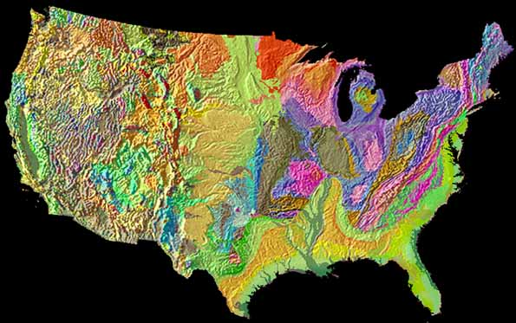
The Geology Of The United States
Notes:
All if these images were taken from the text unless otherwise credited.Suggested tips to give students: All of these images were taken from the text unless otherwise credited. Look them up and read the captions … interesting and useful information that helps you relate to the subject matter.
The United States Geological Survey maintains an extensive website concerning the geology of the United States.

Slide 2
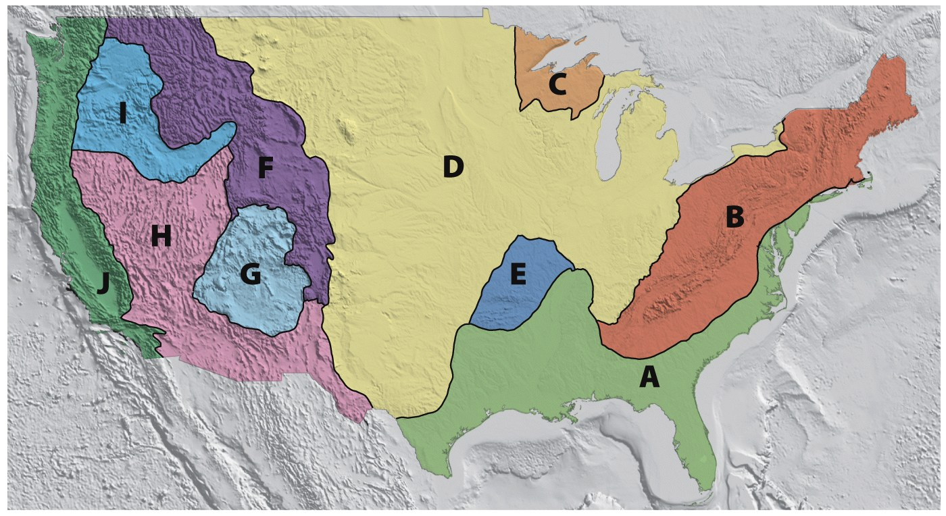
The United States Is Organized into 10 Geologic Provinces plus Hawaii and Alaska.
Columbia
Plateau
Rocky Mountain
System
Laurentian Upland
Interior Plains
Pacific
Mountain
System
Interior Highlands
Colorado
Plateau
Appalachian Highlands
Basin and
Range
Coastal Plain
Notes:
Suggested tips to give students:
A. Coastal Plain, B. Appalachian Highlands, C. Laurentian Upland, D. Interior Plains, E. Interior Highlands, F. Rocky Mountain System, G. Colorado Plateau, H. Basin and Range, I. Columbia Plateau, and J. Pacific Mountain System.

Slide 3
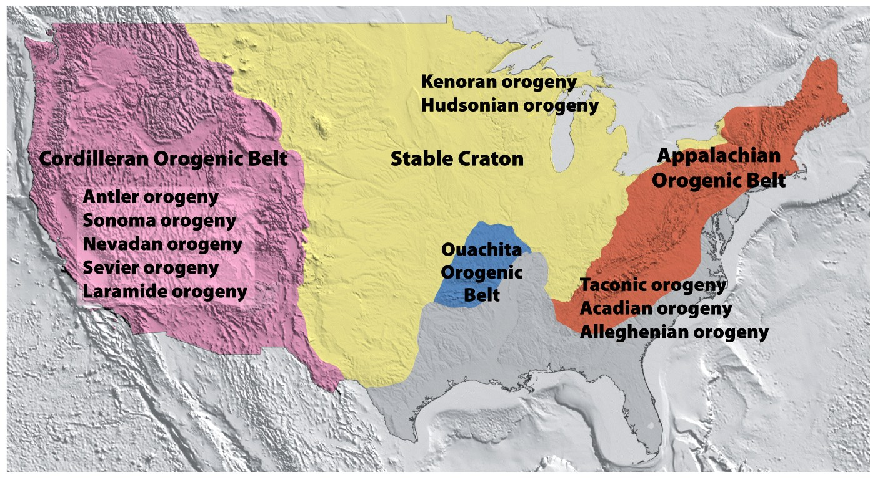
Orogeny added added new land to the Precambrian craton through Continental Accretion.

Slide 4
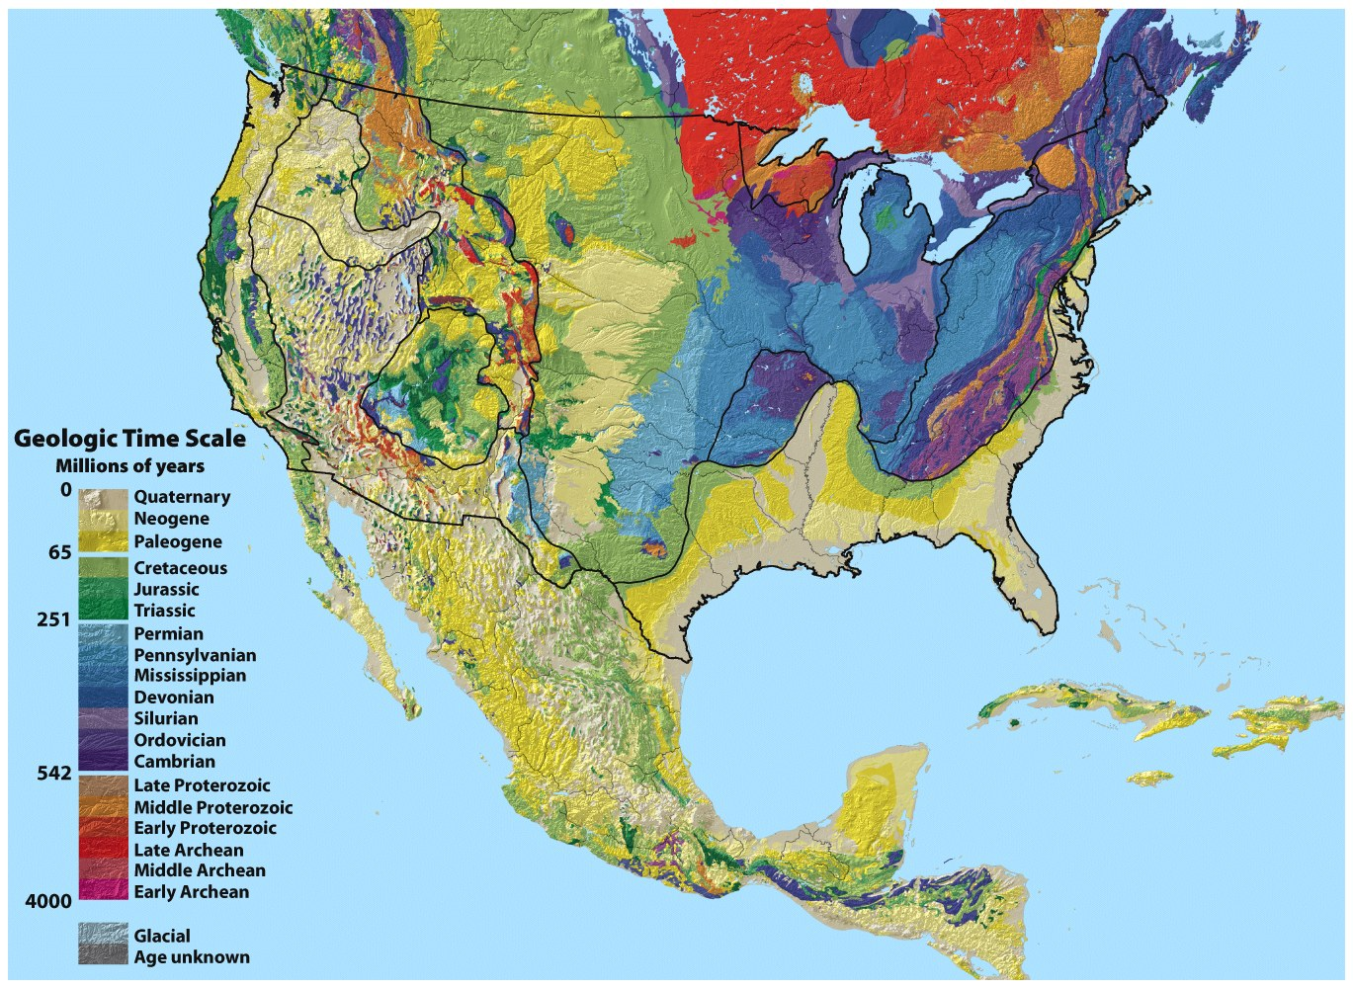
On Geologic Maps, colors are used
to depict the location and age of rocks that form the uppermost crust. Symbols are used to depict the lithology.
The Geologic Map of the United States
compiled by P.B. King and H.M. Beikman
Notes:
Suggested tips to give students: P.B. King was a legendary Field Geologist for the United States Geological Survey.

Slide 5
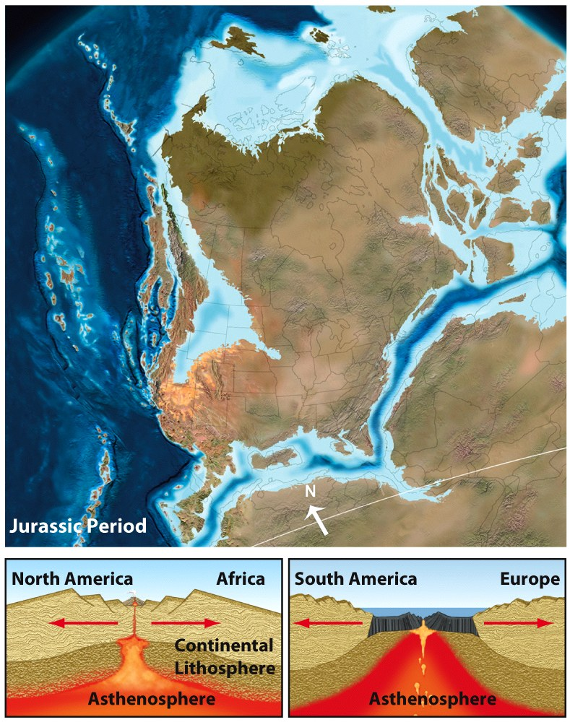
The Coastal Plain Province Is Composed of Young, Thick Sedimentary Rocks

Slide 6
Coastal Plain
Originated with the breakup of Pangaea.
Passive margin of the North American Plate.
Sediments up to 15 km in thickness.
Eroded Appalachian Highland
Sediments were deposited in
deltas,
estuaries,
barrier islands,
and other coastal and marine environments.

Slide 7
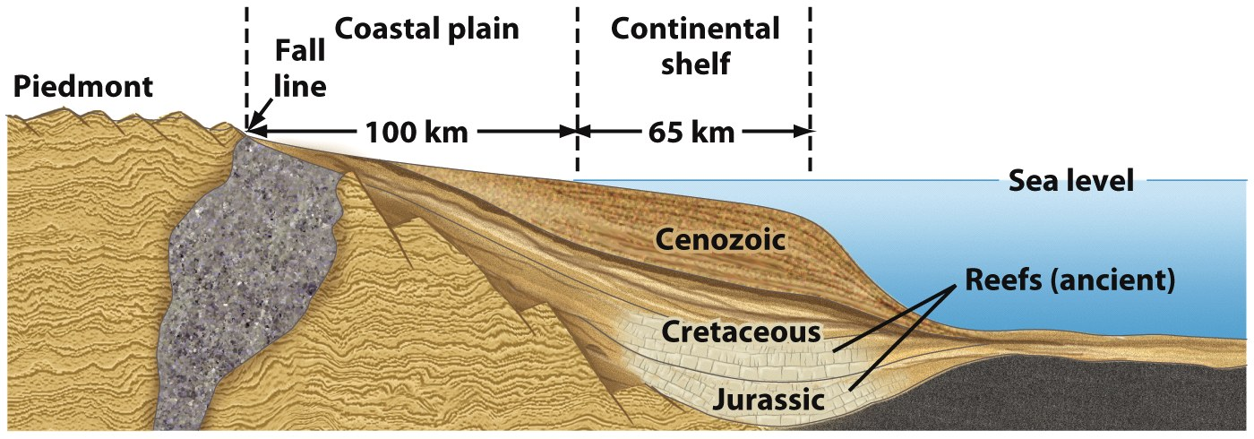
Coastal Plain

Slide 8
Florida Peninsula
Originated with the breakup of Pangaea
Florida Platform developed - a carbonate platform on a block of crystalline crustal rock.
Siliciclastic Appalachian sediments eventually filled in a deep trough between the platform and the mainland of the United States.

Slide 9
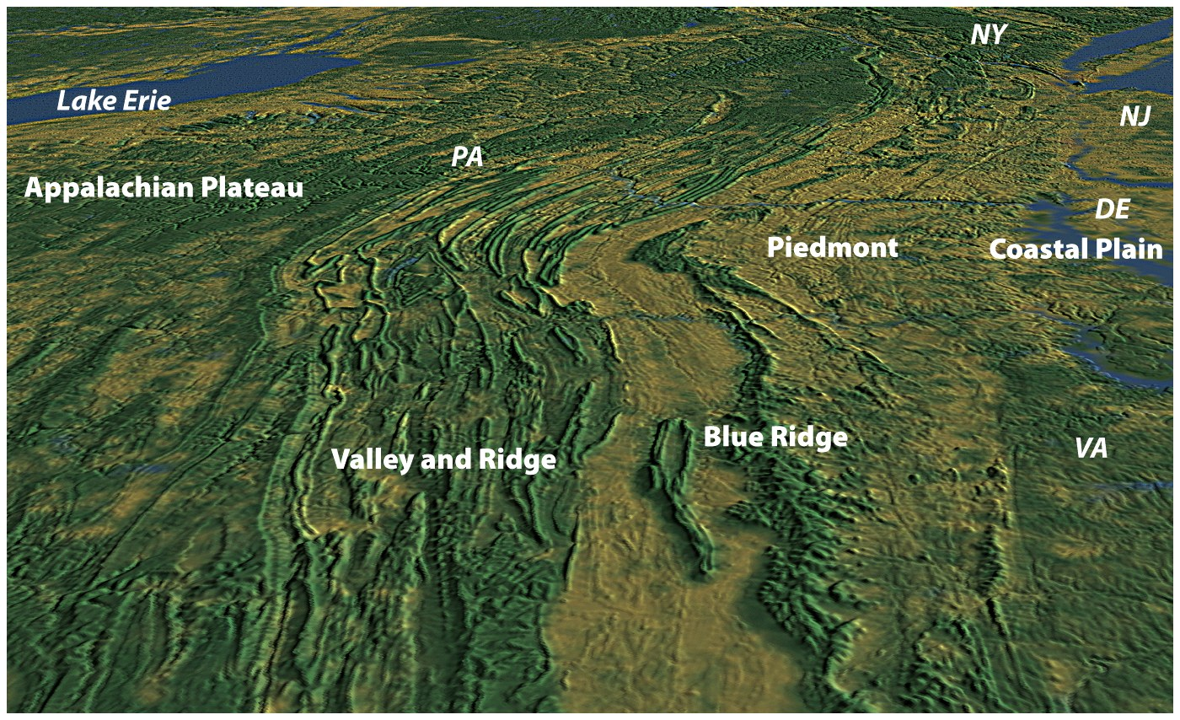
The Appalachian Highland Province Has Been Evolving since the Precambrian Eon.

Slide 10
Appalachian Highlands
Originated during the Paleozoic:
Taconic Orogeny
Acadian Orogeny
Alleghenian Orogeny
Mountain system consisting of numerous ranges.

Slide 11
Appalachian Highlands
Subdivided into four distinct regions:
Piedmont
Blue Ridge
Valley and Ridge
Appalachian Plateau
Isostatic rebound during the Cenozoic.

Slide 12
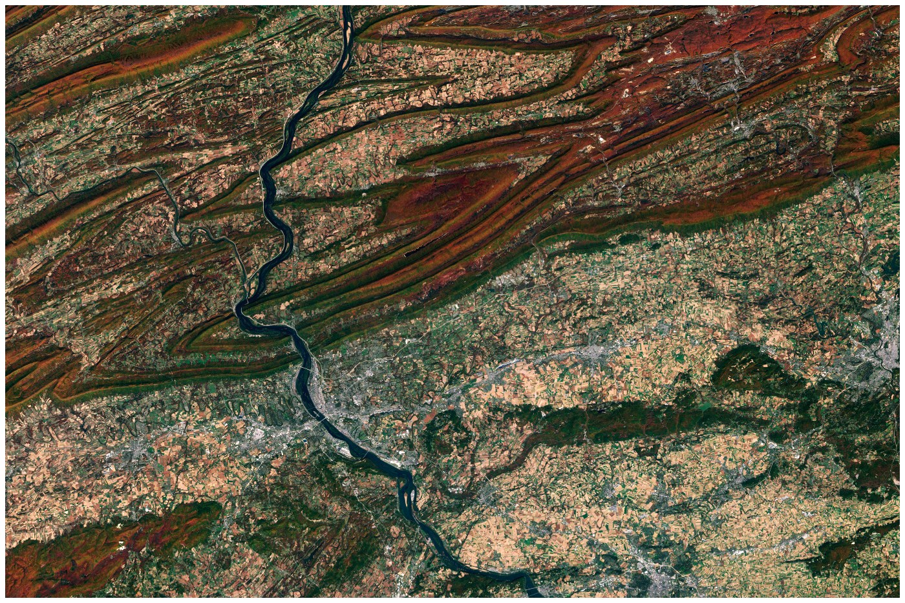
Contorted ridges in the Valley and Ridge region.

Slide 13
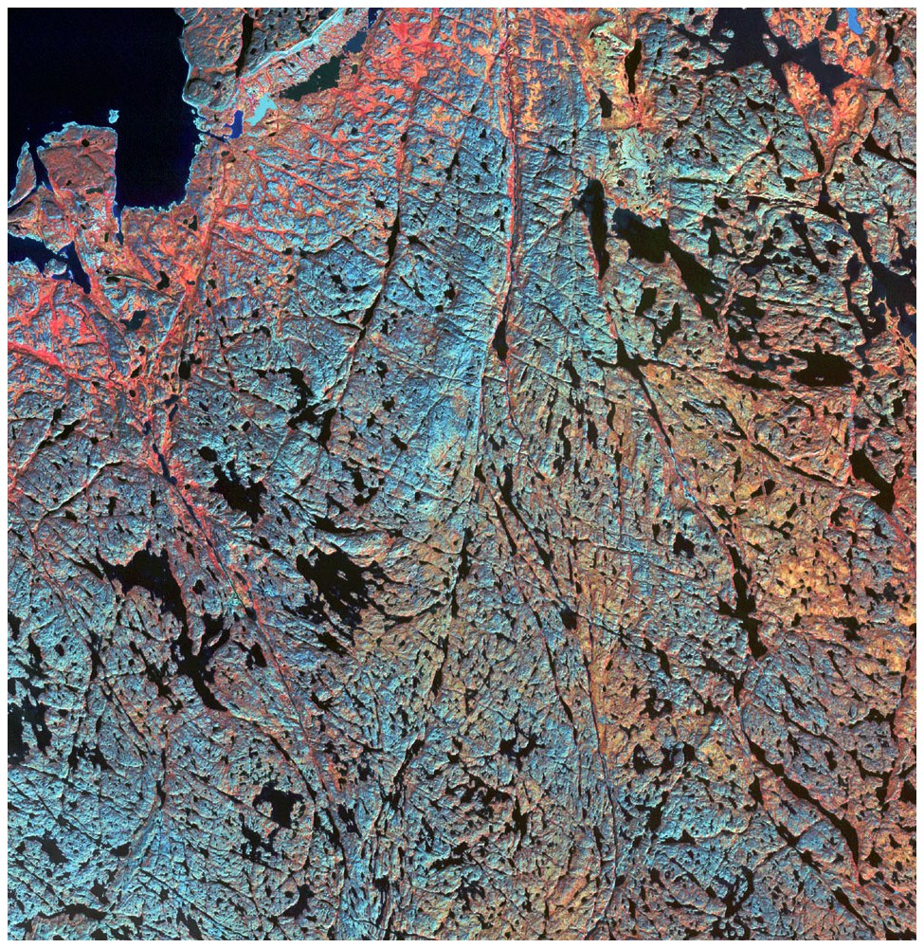
The
Laurentian Upland Province
Contains the Oldest
Rocks in the Nation

Slide 14
Laurentian Upland
Part of the Canadian Shield.
Belts of volcanic and sedimentary rocks metamorphosed to greenschist, separated by belts of granitic rock.
Seafloor rifting ~2.7 bya caused metamorphism.
Glaciated during the Quaternary by the Laurentide Ice Sheet.

Slide 15
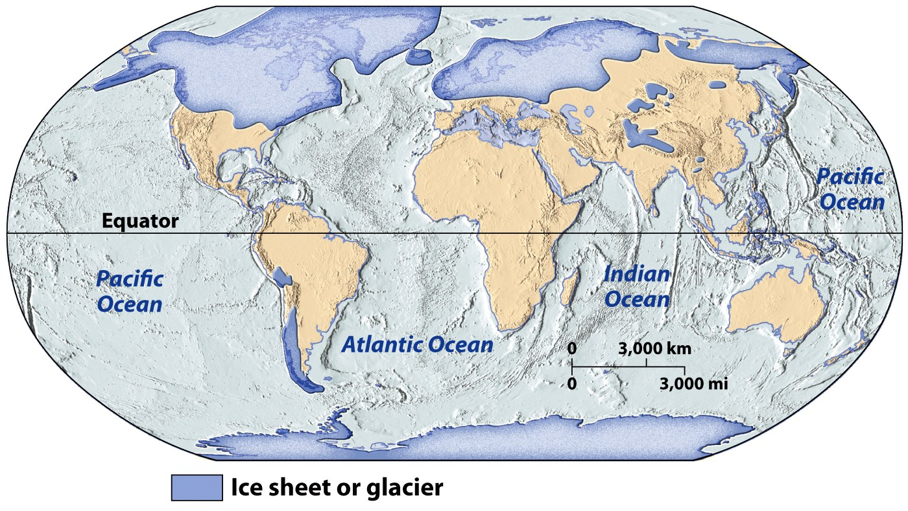
The Last ice Age – 20,000 to 25,000 years ago

Slide 16
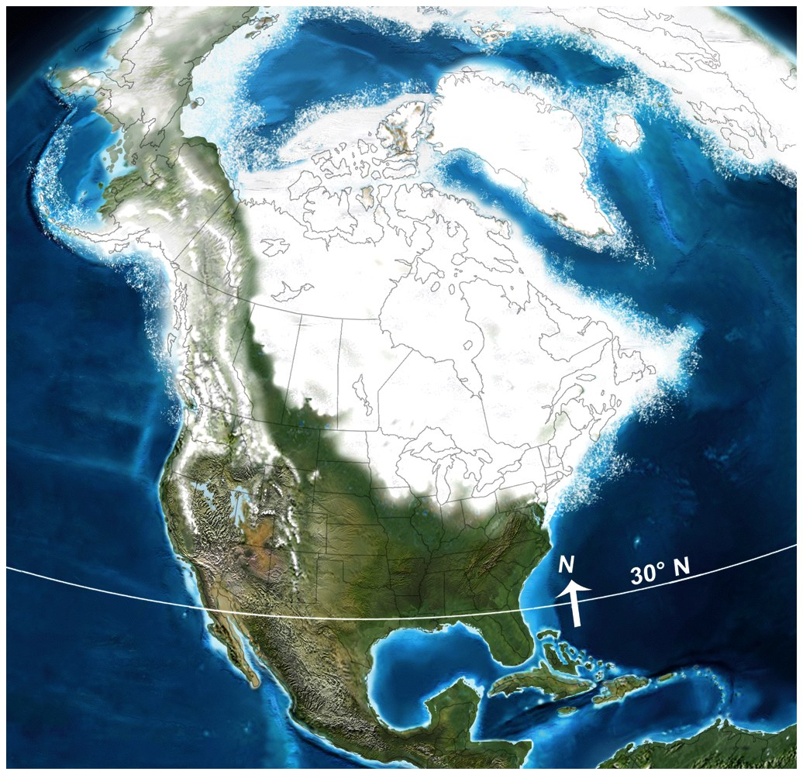
Laurentide Ice Sheet

Slide 17
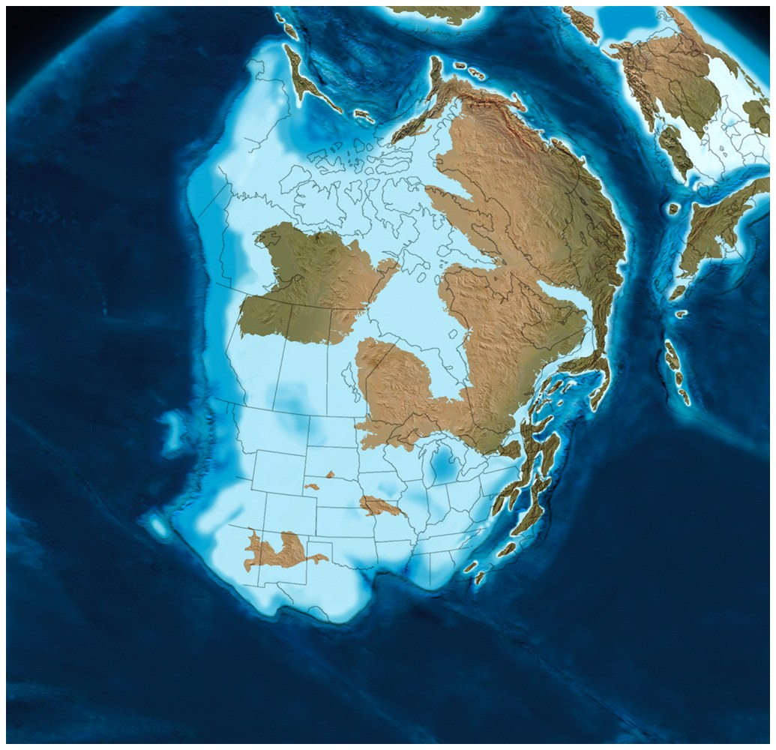
The Interior Plains and Interior Highlands Consist of
Exposed Paleozoic and Mesozoic Rocks
Ordovician Period

Slide 18
Interior Plains
Broad, generally flat area of the central United States between the Rocky Mountains and the Appalachians.
Mostly composed of flat-lying or gently dipping sedimentary strata:
Paleozoic sediments deposited in the east.
Mesozoic sediments deposited in the west.
Accumulated sediments buried the interior stable platform of the craton.

Slide 19
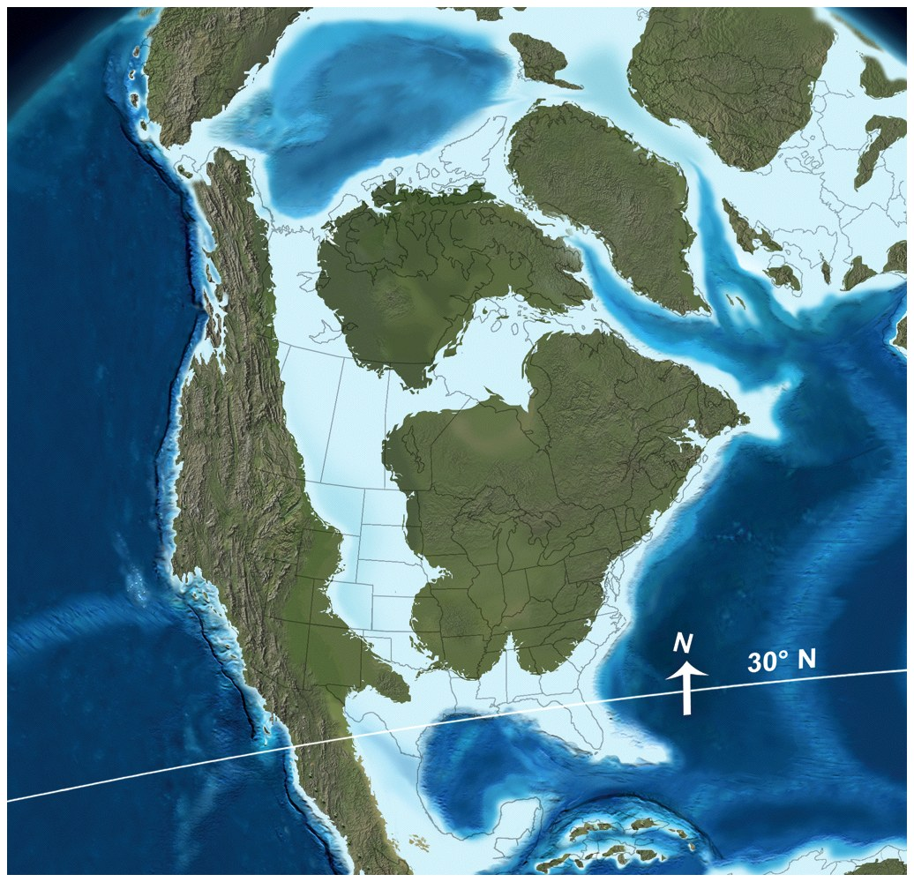
Western Interior Seaway, Cretaceous Period

Slide 20
Interior Highlands
Parts of Texas, Oklahoma, Arkansas, and Missouri.
Composed of sequences of folded Paleozoic sedimentary rocks.
Originated in the formation of Pangaea.
High levels of deformation in the Ouachita Orogenic Belt.
Distinctive from adjacent provinces for high relief and topographic elevation.

Slide 21
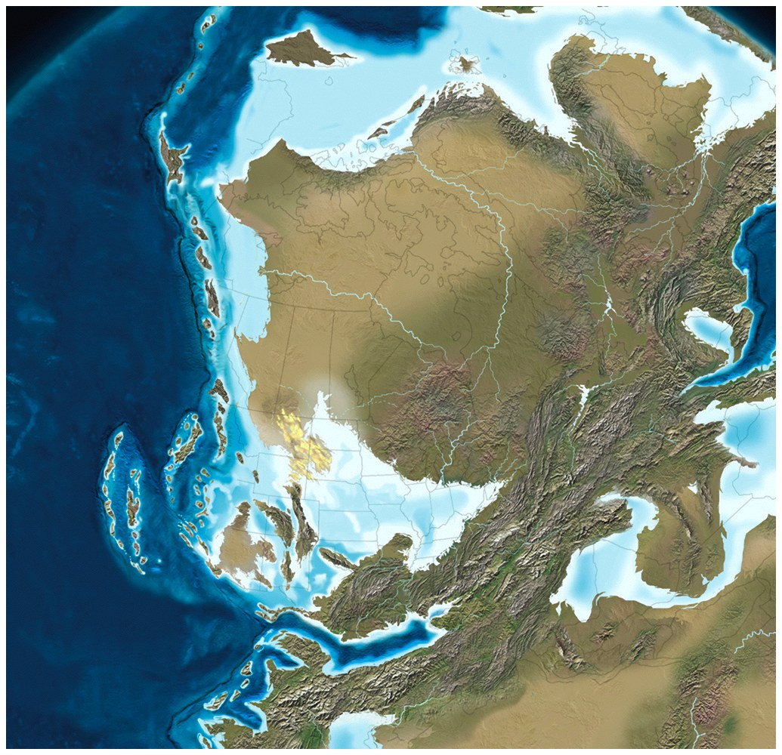
Ouachita and Appalachian Orogenic Belts

Slide 22
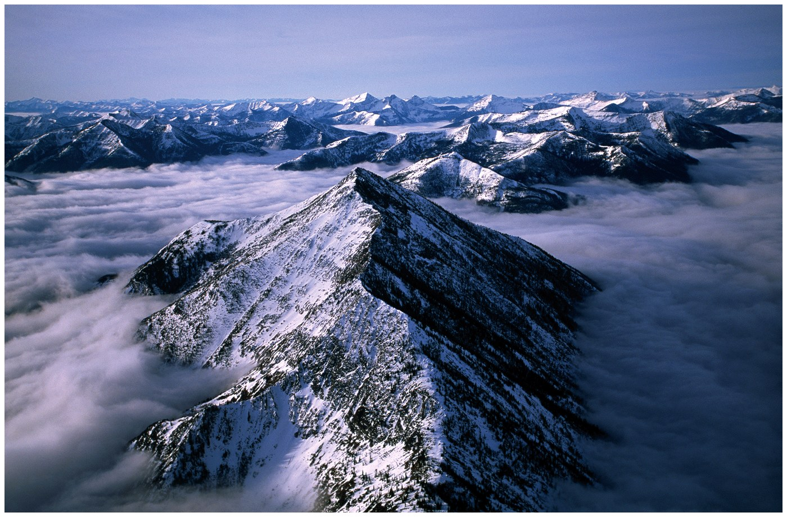
Crust in the Rocky Mountain System Dates from the Proterozoic to the Late Phanerozoic Eons.
Notes:
Suggested tips to give students: The Fountain Formation consists of reddish sands and gravels that were eroded from the Ancestral Rockies.

Slide 23
Rocky Mountain System
Midcontinent portion of North American Cordillera.
Covered by shallow seas during the early Paleozoic.
Ancestral Rocky Mountains created during convergence of Gondwanaland and North America.
Uncompahgre Uplift
Amarillo-Wichita-Arbuckle Uplift
Front Range–Pedernal Uplift
Modern Rocky Mountains created by the Laramide Orogeny.
Current topography result of erosion after Neogene uplift and "sculpting" during Quaternary glaciation.

Slide 24
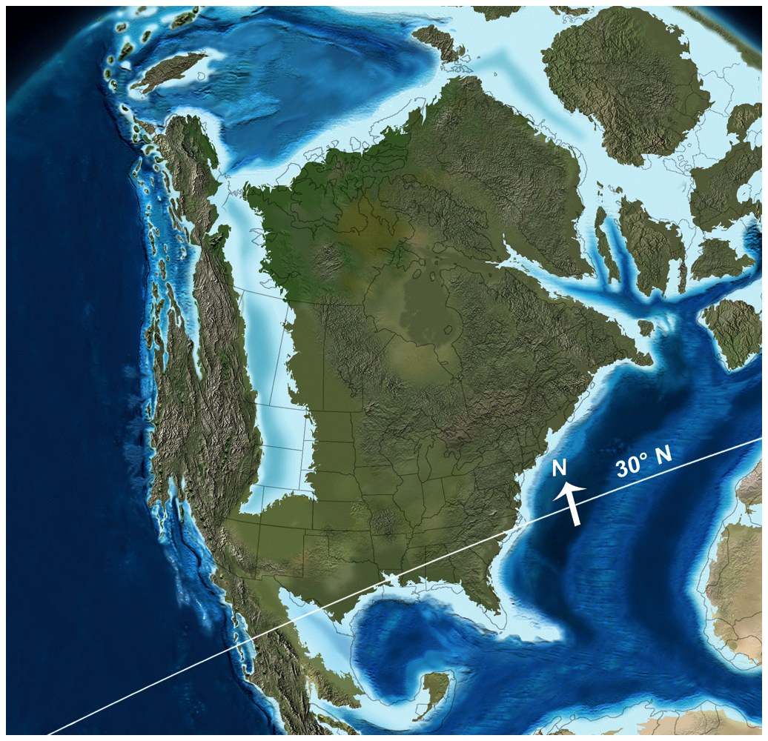
North American Plate (Mesozoic – early Cenozoic)
crustal "shortening" in the west, extension in the east

Slide 25
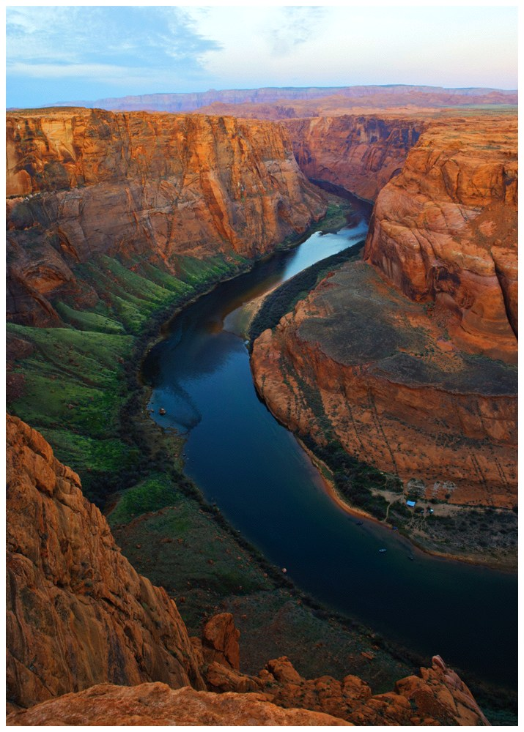
The Colorado Plateau Is Composed of
Uplifted
Phanerozoic Strata.

Slide 26
Colorado Plateau
Originated with the formation of Rodinia.
Eroded to a flat, nearly featureless surface by ~600 mya.
Sediments from western highlands deposited in the region during the Jurassic and Cretaceous.
Widespread volcanism during the Mesozoic.
Last marine deposits are Cretaceous.
Uplifted by subduction of Farallon Plate in the Neogene.
Modern stream drainage established in Neogene.

Slide 27
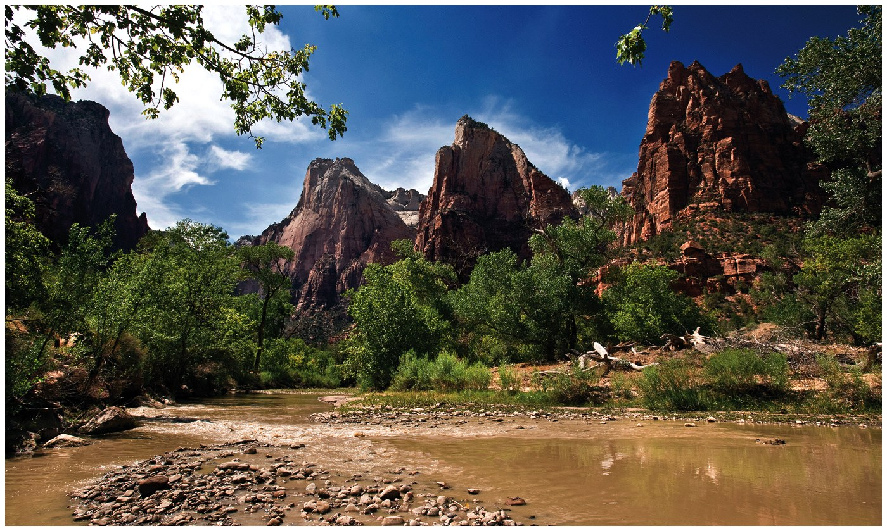
The Dakota Sandstone

Slide 28
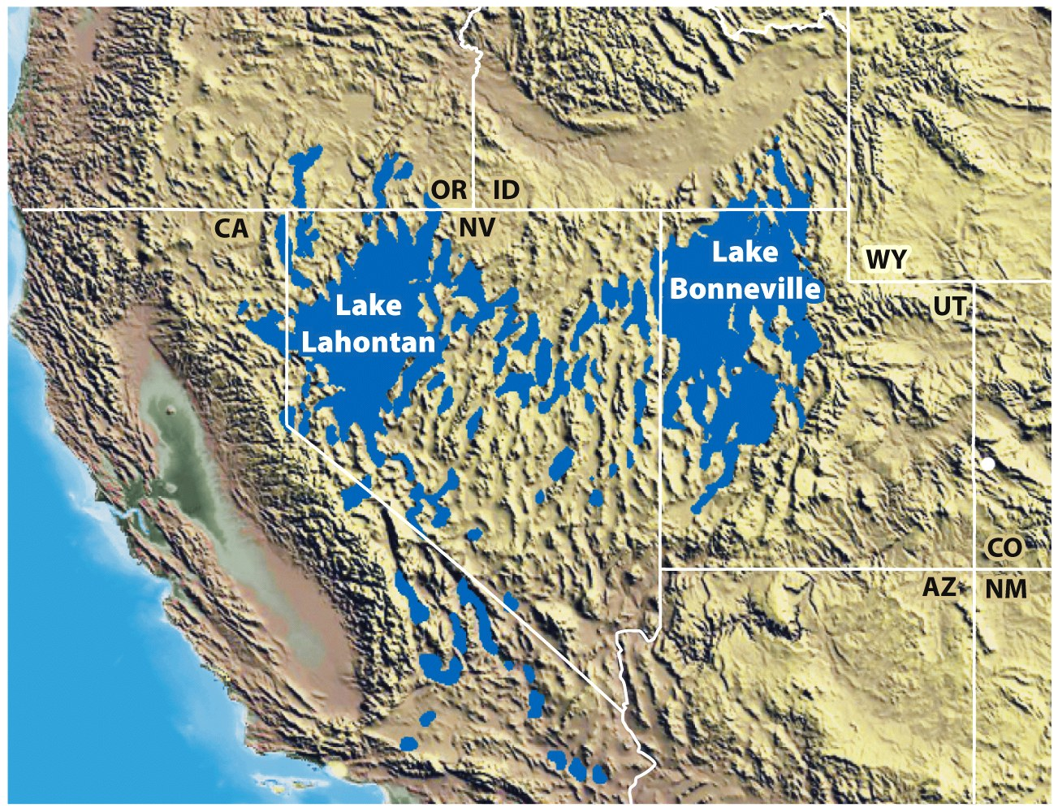
The Basin and Range and Columbia Plateau Provinces Were Formed during the Cenozoic Era

Slide 29
Basin and Range Province
Unique topography produced by normal faulting.
Basins are down-faulted blocks of crust (grabens)
Ranges are up-thrusted slabs (horsts).
Deformed Precambrian and Paleozoic crust uplifted and broken into huge fault blocks by extensional stresses.
Stresses still active as remnants of the Farallon Plate continue subduction beneath the North American Plate.

Slide 30
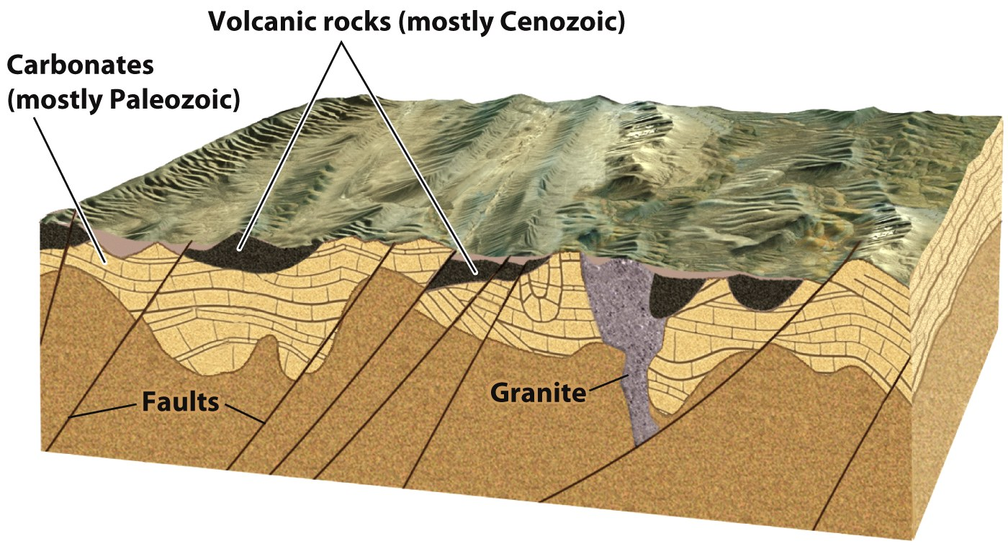
Basin and Range crustal extension

Slide 31
Columbia Plateau Province
Northwestern corner of the United States.
Created by westward movement of North American Plate.
World’s youngest large igneous province (LIP).
Inundated by the largest documented flood in geologic history, creating the channeled scablands

Slide 32
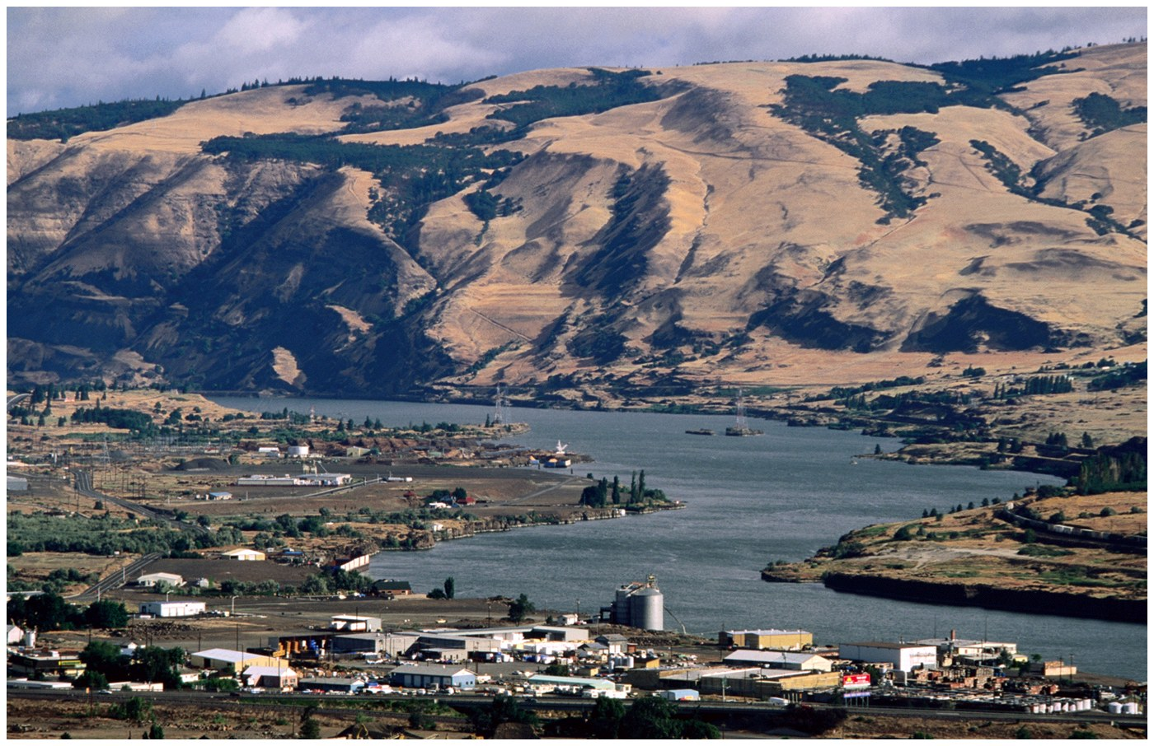
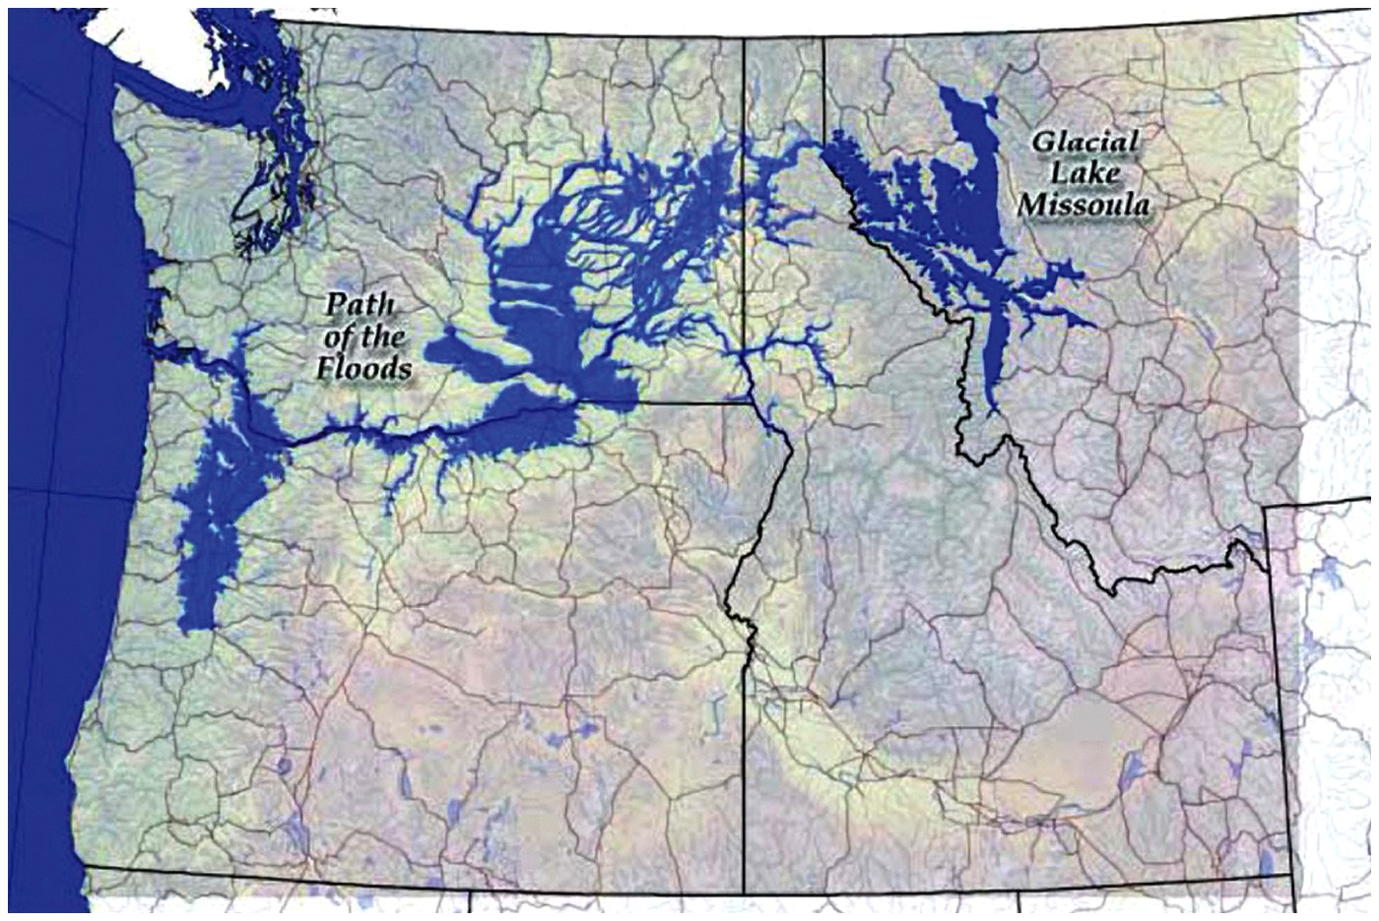
Columbia Plateau basalts
glacial Lake Missoula

Slide 33
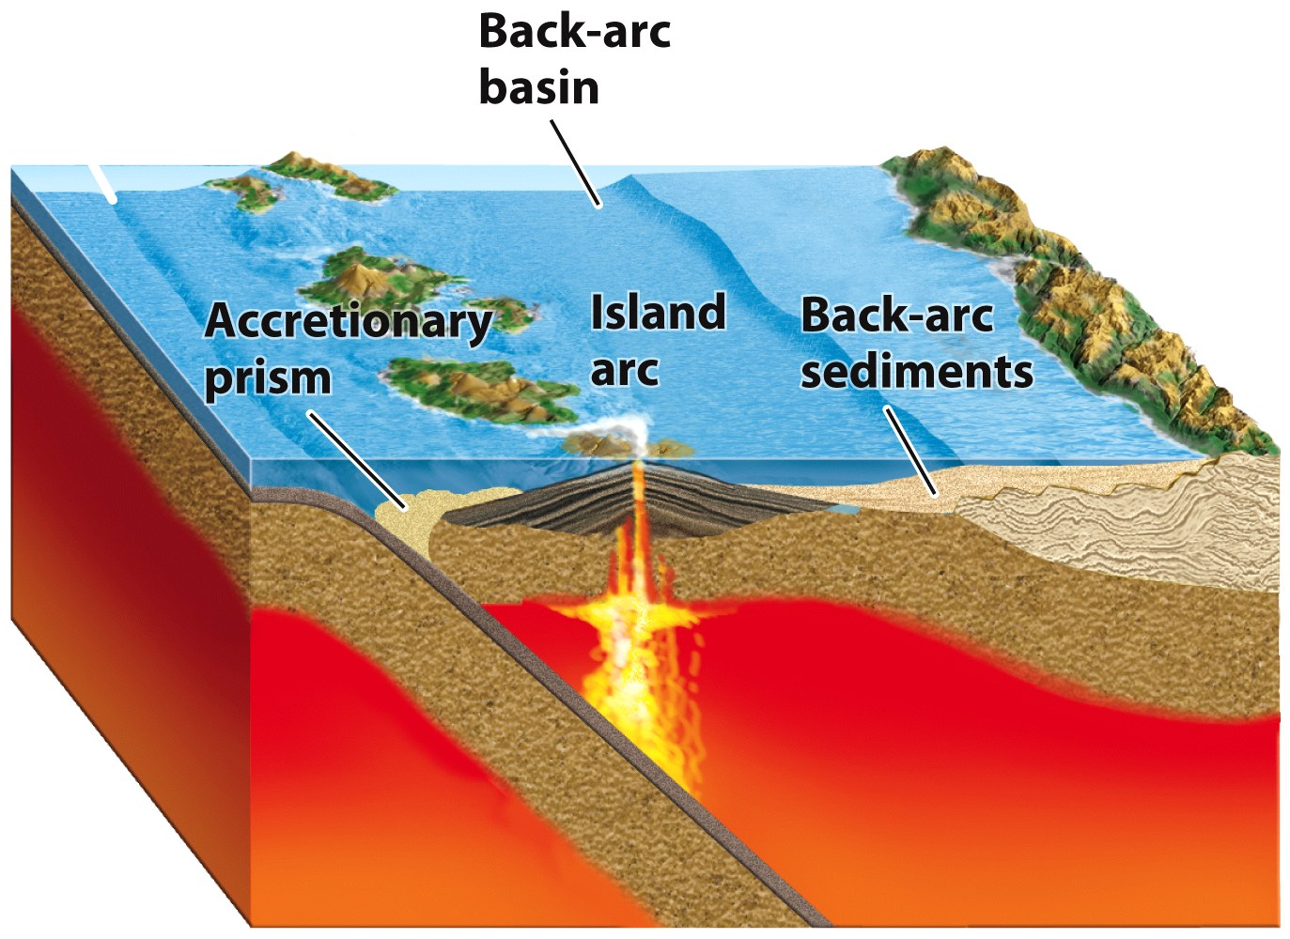
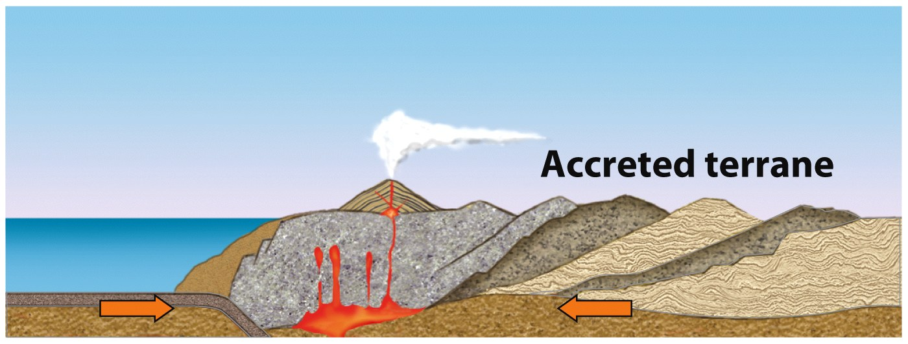
The Pacific Mountain System Marks the Western Shore
of the Continental
United States

Slide 34
Pacific Mountain System
Young, tectonically active highlands.
volcanic Cascade Range
Sierra Nevada Range
Coast Range
Active margin of the North American Plate.
Juan de Fuca, Gorda and Farallon Plates – subduction
Pacific Plate - transform boundary
Eastward movement of island arcs on subducting plates resulted in Cordilleran Orogenic Belt.
Current volcanism began in the Neogene with eruption of the Columbia River basalts and the formation of the Cascades.

Slide 35
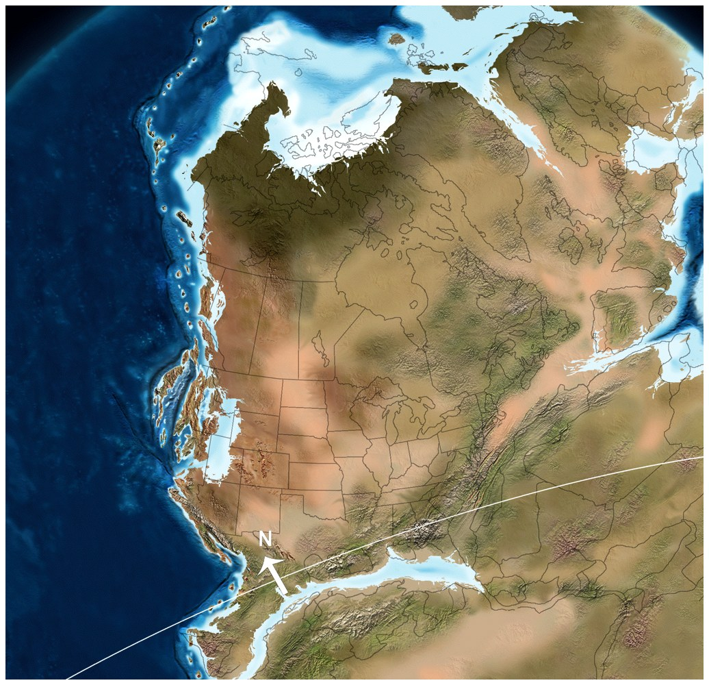
Early Triassic Paleogeography

Slide 36
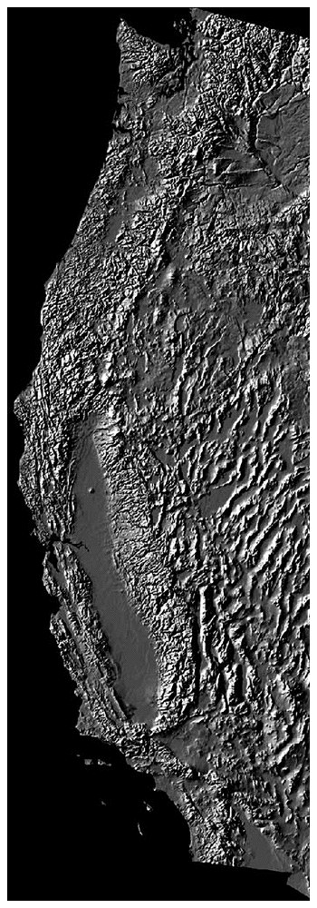
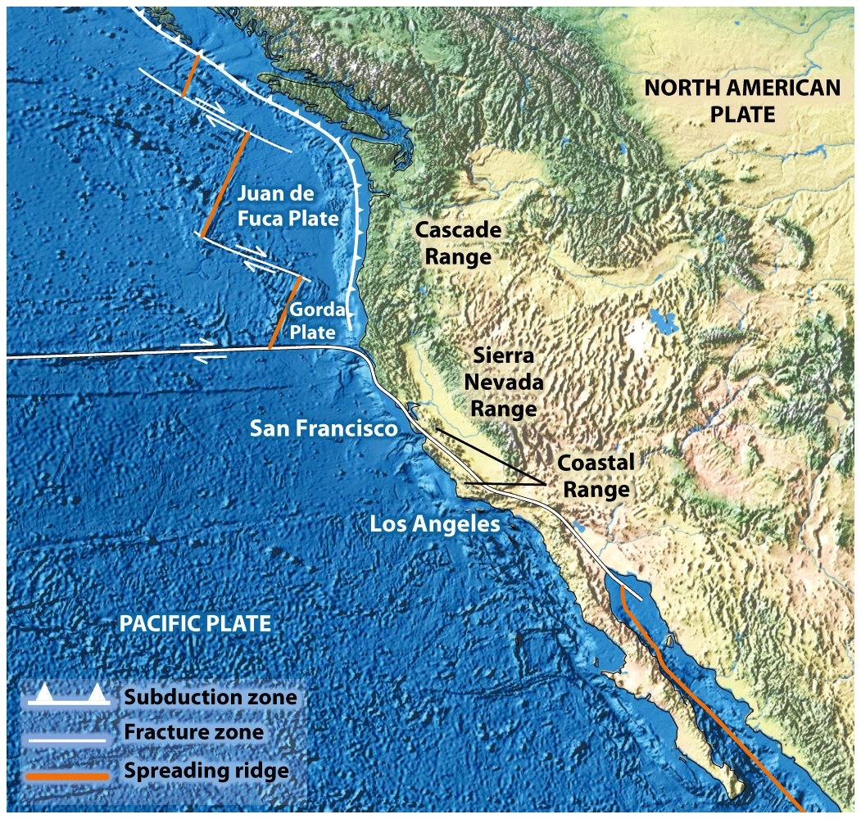
Pacific Mountain System tectonics

Slide 37
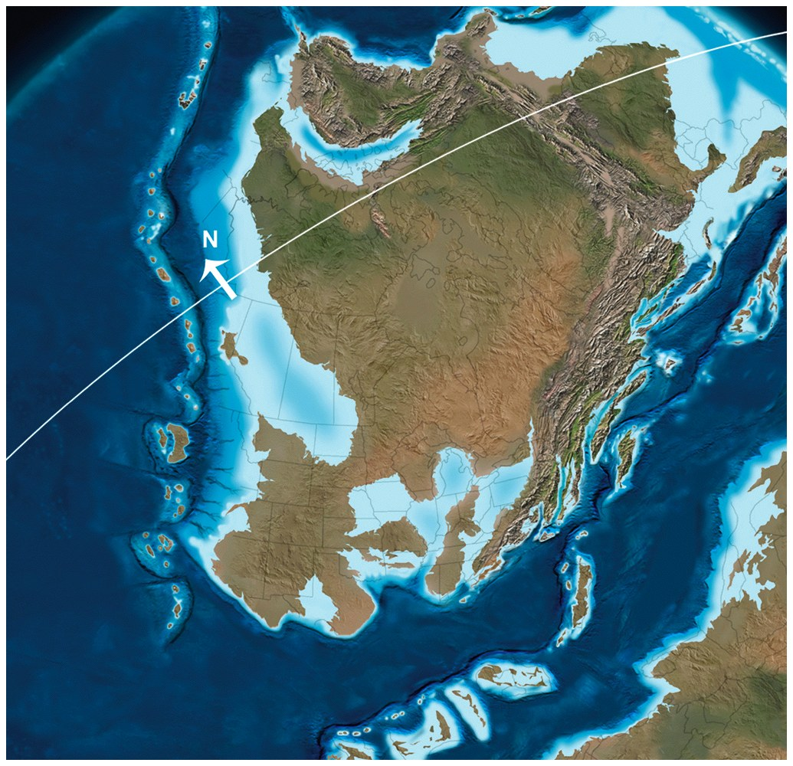
Alaska Is the Northern Extension of the Cordilleran Orogenic Belt.
Late Devonian

Slide 38
Alaska
Three broad types of physiographic forms.
Lowlands
low mountains, plateaus, and highlands
high rugged mountains
The Coastal Range and Alaska Range are part of the Pacific Mountain System.
The Brooks Range is an extension of the Rocky Mountain System.
Alaska consists of accreted terranes of continental crust, island arcs, and crushed oceanic crust and sediments.

Slide 39
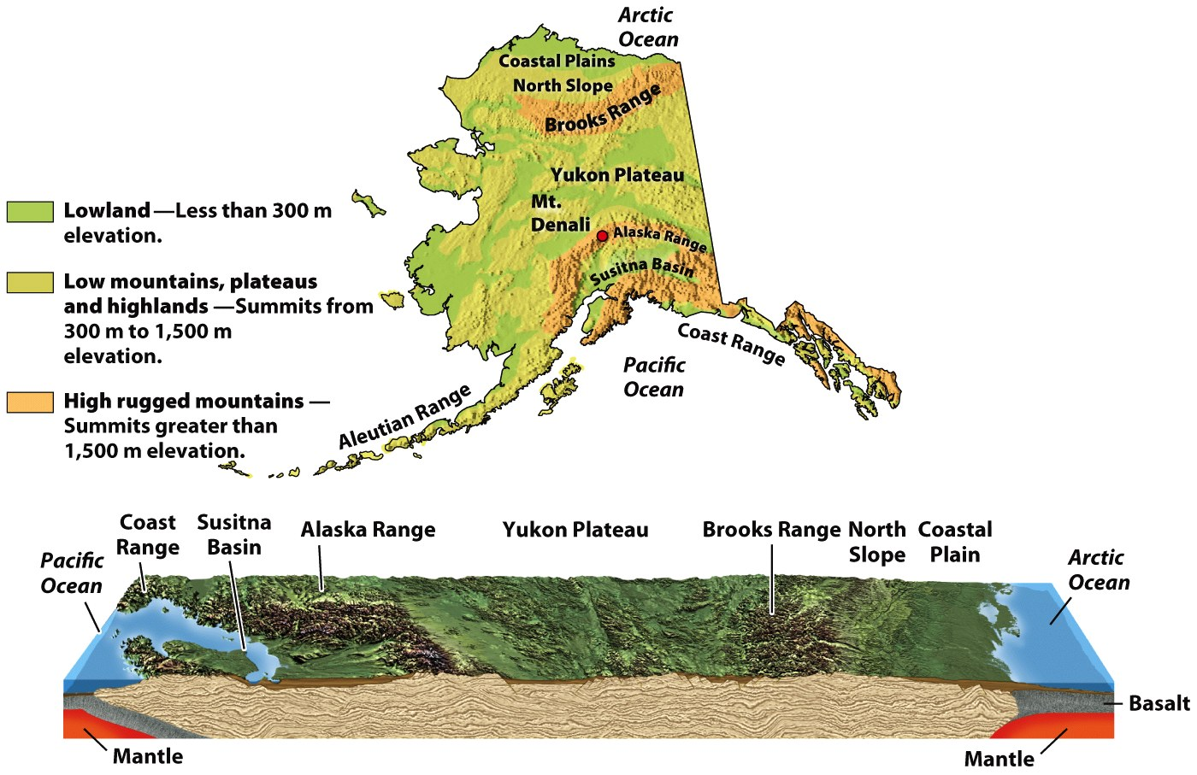

Slide 40
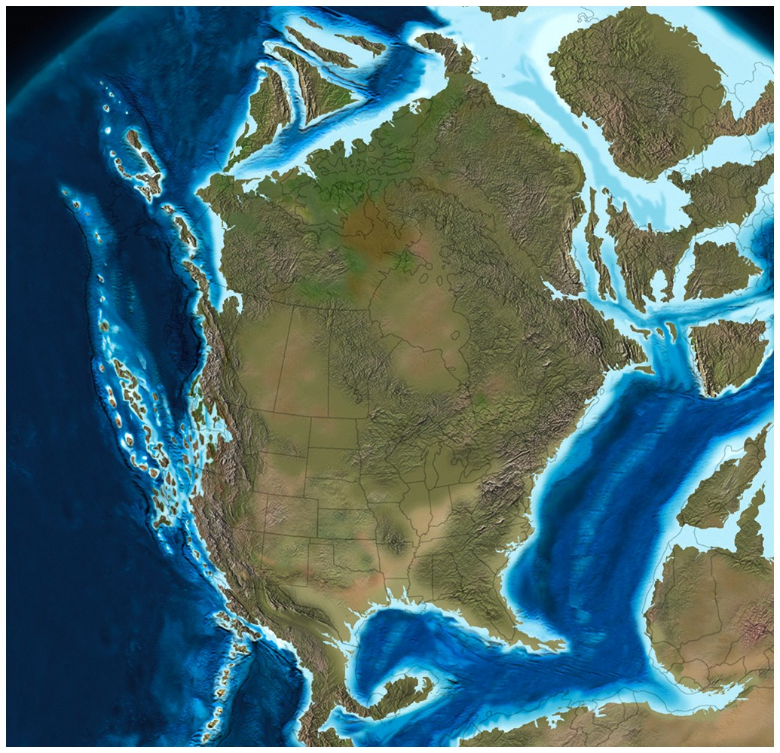
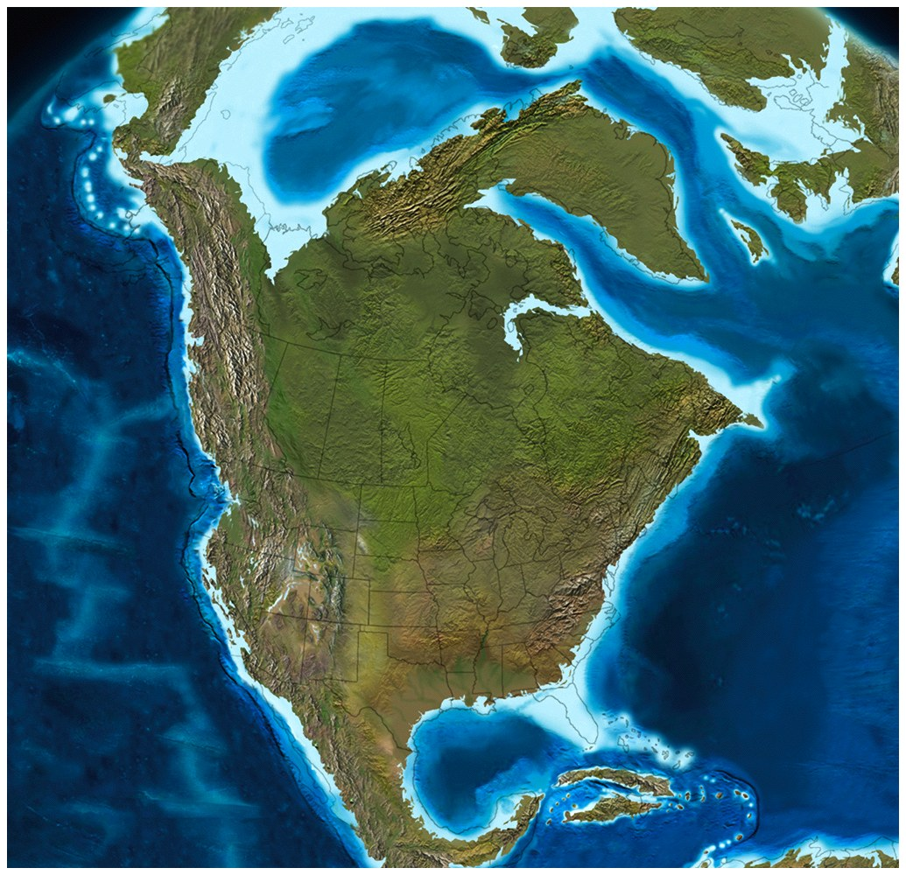
Early Cretaceous
Paleogene

Slide 41
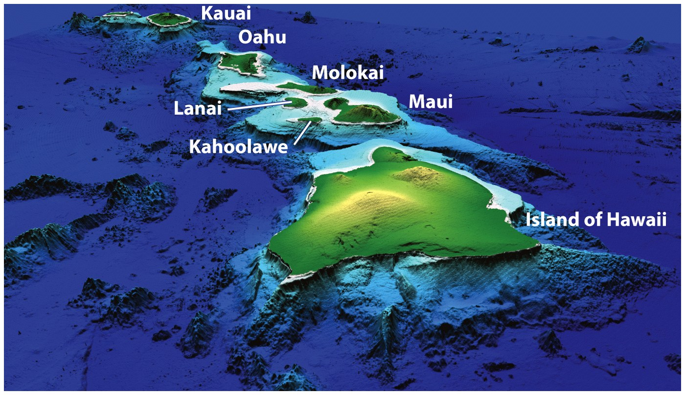
Hawaii Is a Chain of Volcanic Islands Formed
by a Hot Spot

Slide 42
Hawaii
Eight main islands are exposed tips of the Hawaiian Ridge.
Age range is modern to ~ 5 million years old.
Volcanoes develop on the Pacific Plate as it moves across the Hawaiian Hot Spot.
Hawaiian volcanoes progress through pre-shield, shield, post-shield, and rejuvenated stages.
During their younger phases, most Hawaiian volcanoes rise above sea level, forming islands.
As the islands age, they erode and subside, becoming atolls and seamounts.

Slide 43
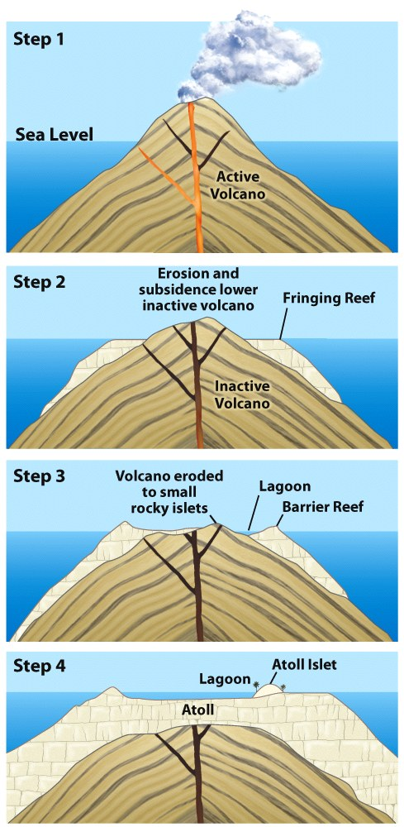
Pacific Atoll formation

Slide 44
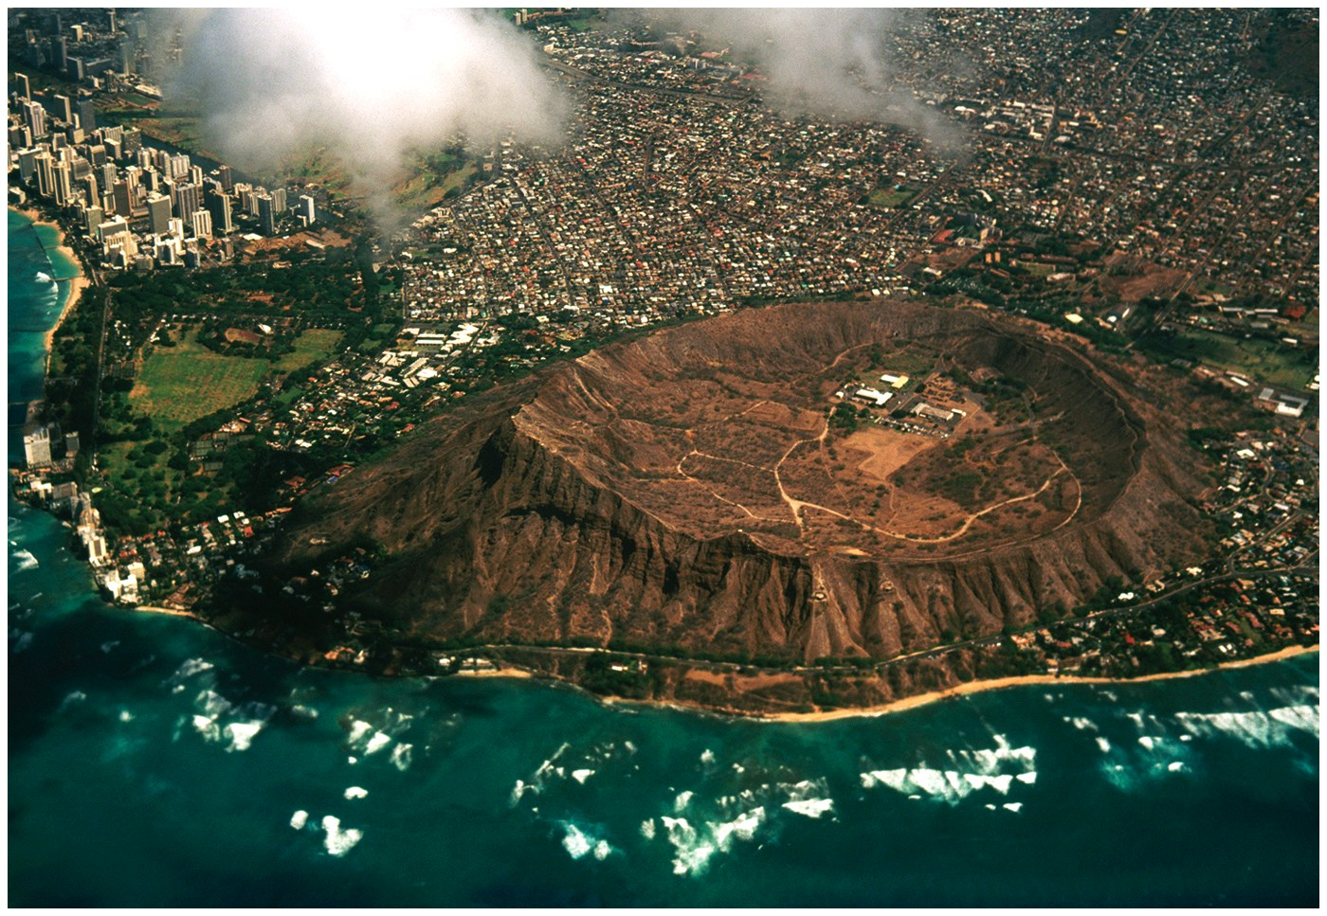
Diamond Head

Slide 45
~ End ~

