Slide 1
Plate Tectonics

Slide 2
Plate Tectonics:
Content Standards Addressed
6th | 1 | Plate tectonics accounts for important features of Earth's surface and major geologic events. As a basis for understanding this concept:
 | 1a | Students know evidence of plate tectonics is derived from the fit of the continents; the location of earthquakes, volcanoes, and mid-ocean ridges; and the distribution of fossils, rock types, and ancient climatic zones
 | 1b | Students know Earth is composed of several layers: a cold, brittle lithosphere; a hot, convecting mantle; and a dense, metallic core.
 | 1c | Students know lithospheric plates the size of continents and oceans move at rates of centimeters per year in response to movements in the mantle.
 | 1d | Students know that earthquakes are sudden motions along breaks in the crust called faults and that volcanoes and fissures are locations where magma reaches the surface.
 | 1e | Students know major geologic events, such as earthquakes, volcanic eruptions, and mountain building, result from plate motions
 | 1f | Students know how to explain major features of California geology (including mountains, faults, volcanoes) in terms of plate tectonics.
2 / 85

Slide 3
Plate Tectonics
Earth’s lithosphere is broken up into plates
Hot, weak asthenosphere allows for plates to move
Plates are in motion and continually changing in shape and size
  Move very slowly – 5 cm/yr
  Movement is NOT constant – more of stop and go (earthquakes!)

Slide 4
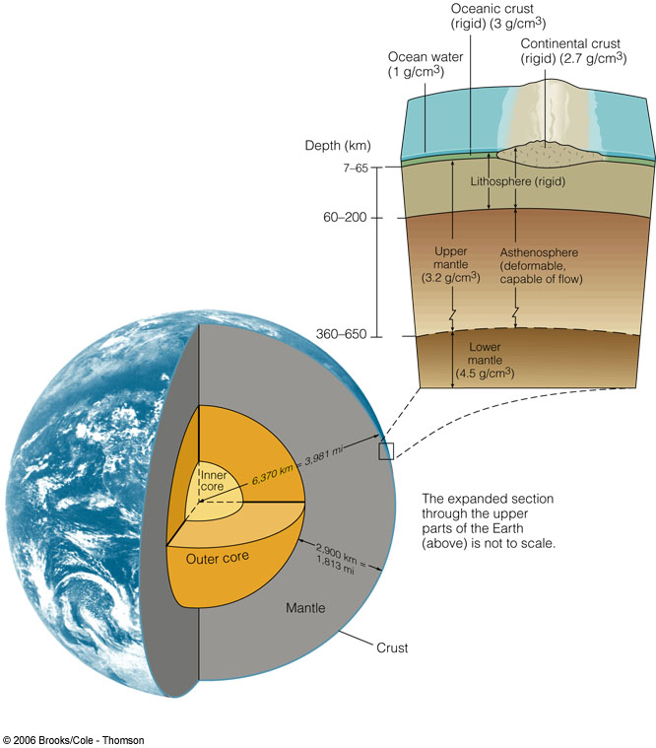
Structure of the Earth
Layers – by composition
  Crust
  Mantle
  Core

Slide 5
Structure of the Earth
Layers – by physical properties
  Lithosphere
  Asthenosphere
  Mesosphere
  Outer Core
  Inner Core

Slide 6
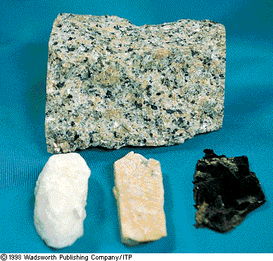
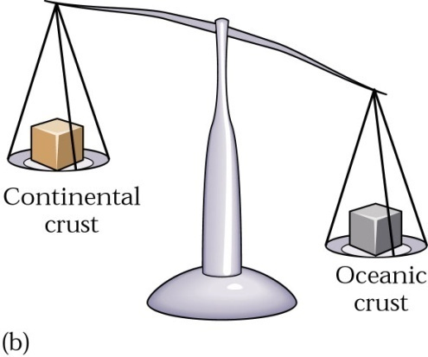
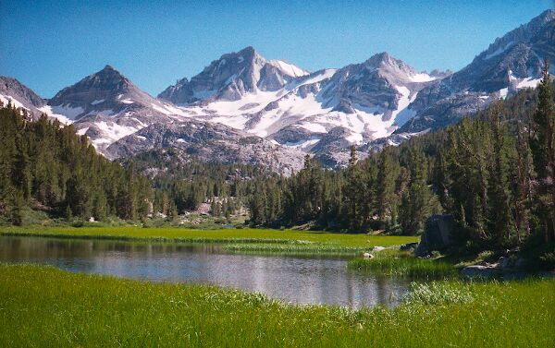
Structure of the Earth
Crust
  Continental crust
    Average rock density about 2.7 g/cm3
    Composition = the felsic igneous rock granodiorite

Slide 7
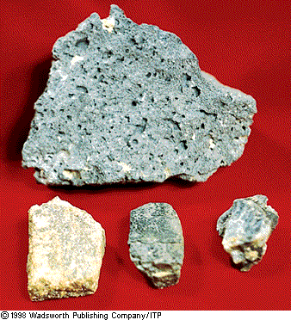
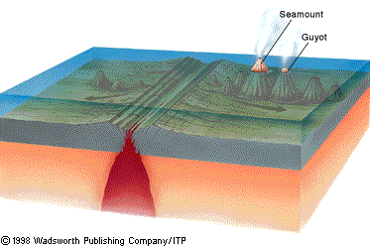
Structure of the Earth
Crust
  Oceanic crust
    Density about 3.0 g/cm3
    Composed mainly of the igneous rock basalt

Slide 8
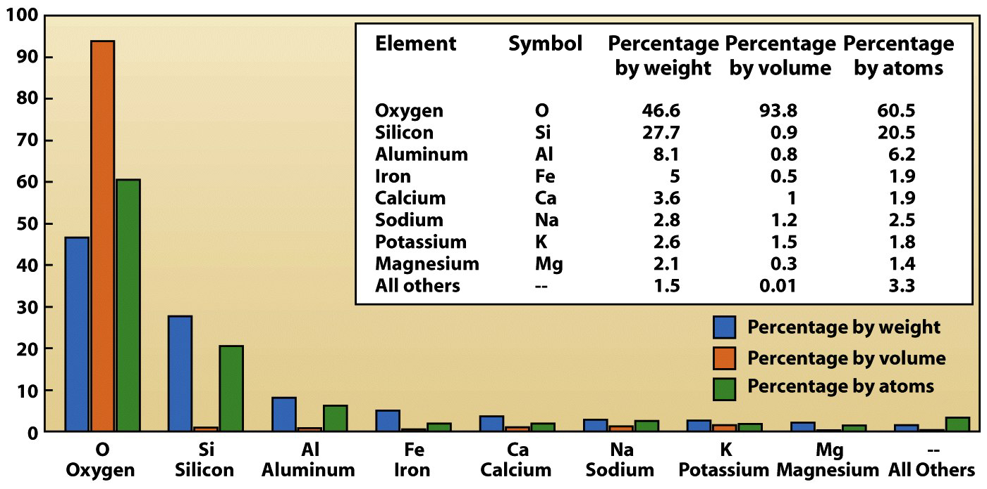
The Crust
98.5% of the crust is comprised of just 8 elements.

Slide 9
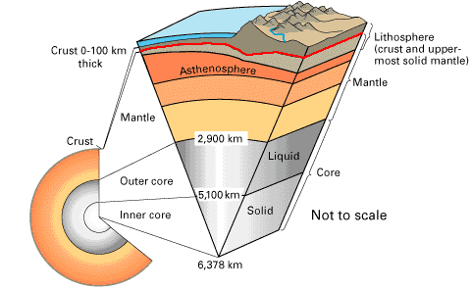
The Crust
The Mohorovicic discontinuity
  Separates the crust from the upper mantle.
  Discovered in 1909 by
  Andrija Mohorovicic.
  Marked by a change
  in the velocity of
  P waves.
source

Slide 10
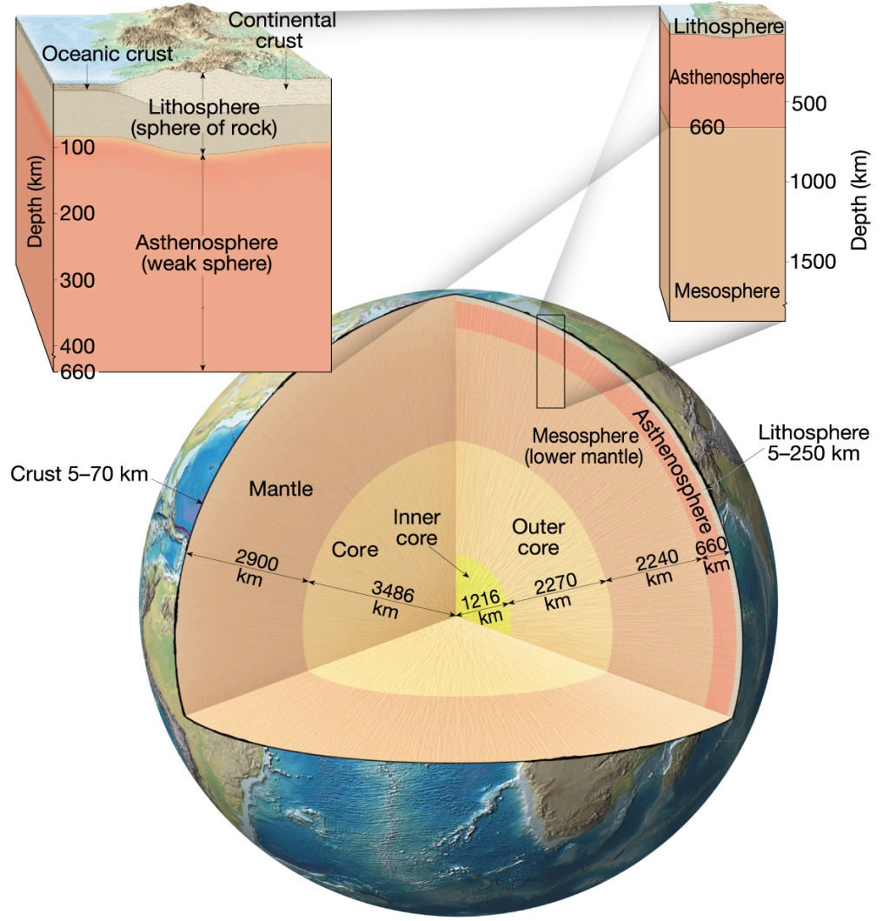
The Mantle
Contains 82% of Earth’s
volume
2,925 km thick.
Composition is the
ultramafic rock peridotite.
Solid, rocky layer, below
~24 -150 km, the rock is hot
enough to flow.
It convects: hot mantle rises, cold mantle sinks.

Slide 11
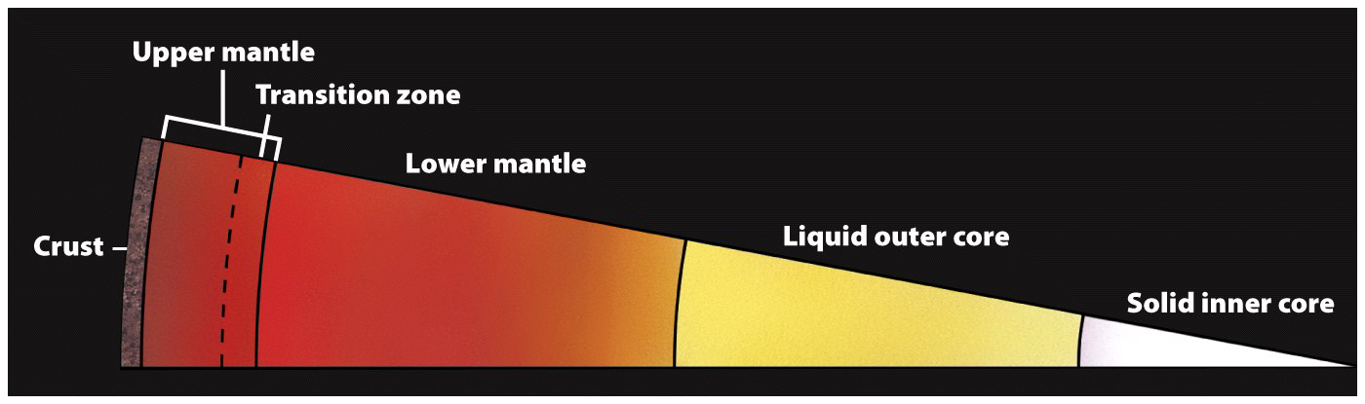
The Mantle
Three subdivisions:
  Upper = Asthenosphere
  Transitional
  and lower = Mesosphere.

Slide 12
Structure of the Earth
Core
  Larger than the planet Mars
  Mostly iron with some nickel
    Average density is nearly 11 g/cm3
  Two parts
    Outer core - liquid
    Inner core - solid

Slide 13
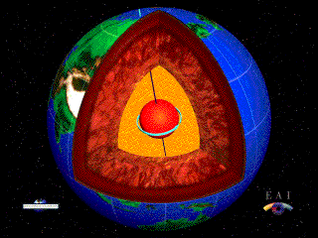
Structure of the Earth
Core
  Responsible for Earth’s magnetic field
    Made of material that conducts electricity
    Core is mobile
  Very hot
    3,950 Kelvin
    6,650º F / 3,677º C
Source

Slide 14
Magnetic Reversals
Reversal rate varies wildly
  Last 10 – 20 million years = average rate of
  5 times/million years
  Cretaceous Normal Synchron (84 – 125 million years ago) = only flipped once or twice
Flips take thousands of years to complete
Last flip? 780,000 years ago
source

Slide 15
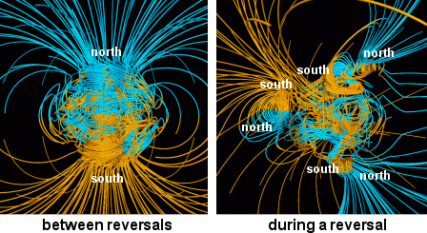
The Earth’s Magnetic Field
Credit & Copyright: Gary A. Glatzmaier (UCSC)
Notes:
Explanation: Why does the Earth have a magnetic field? The electrical conductivity of the molten plasma of the Earth's core should be able to damp the current magnetic field in only thousands of years. Yet our five billion year old Earth clearly causes magnets to point to (defined) north. The mystery is still being studied but recently thought related to motions in the Earth's liquid outer core. Specifically, as portions of the outer core cool and fall inward, oceans of the liquid iron-rich magma rise outward, forced into a helical motion by the spin of the Earth. This motion, many geologists now believe, regenerates Earth's magnetism. Pictured above, a computer simulation shows the resulting magnetic field lines out to two Earth radii, with blue lines directed inward and yellow lines directed outward.

Slide 16
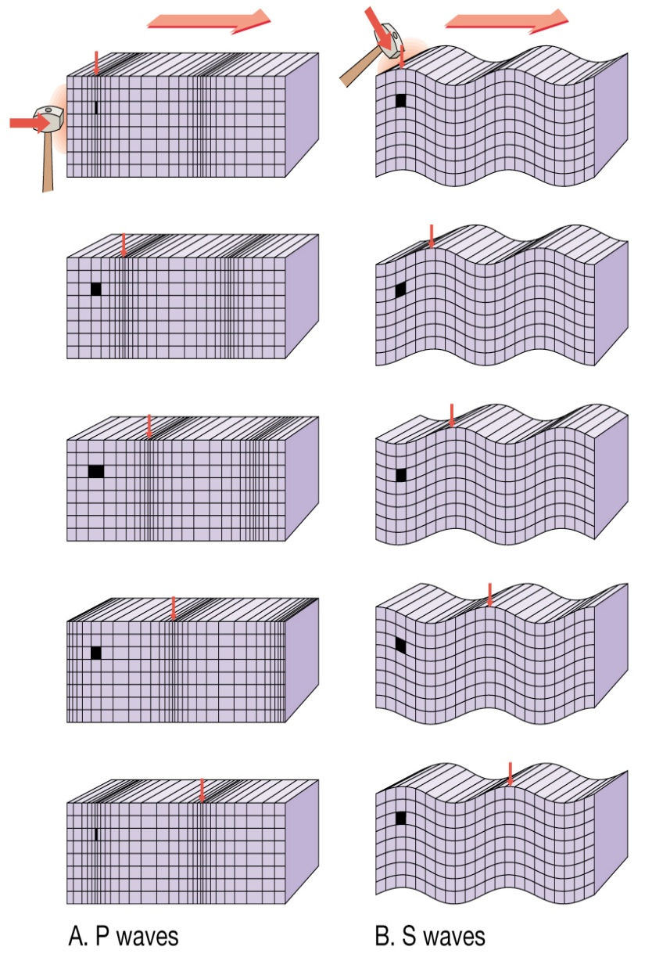
Structure of the Earth
Seismic waves
  P waves
    Travels through liquids as well as solids
    In all materials, P waves travel faster than do S waves
  S waves
    Cannot travel through liquids

Slide 17
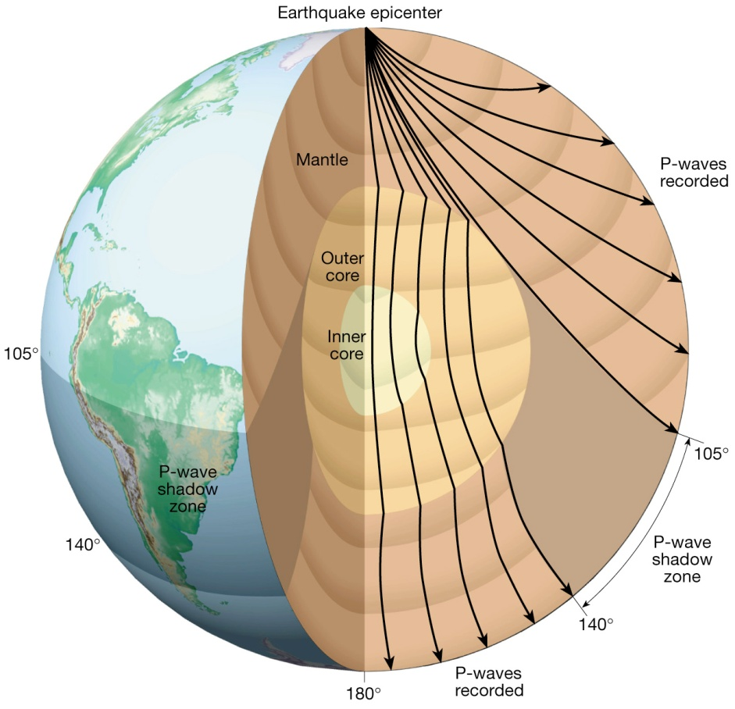
Structure of the Earth
Seismic waves
  Seismic waves refract as they pass from one material to another
  P & S wave shadow zones
P-Wave Shadow Zone

Slide 18
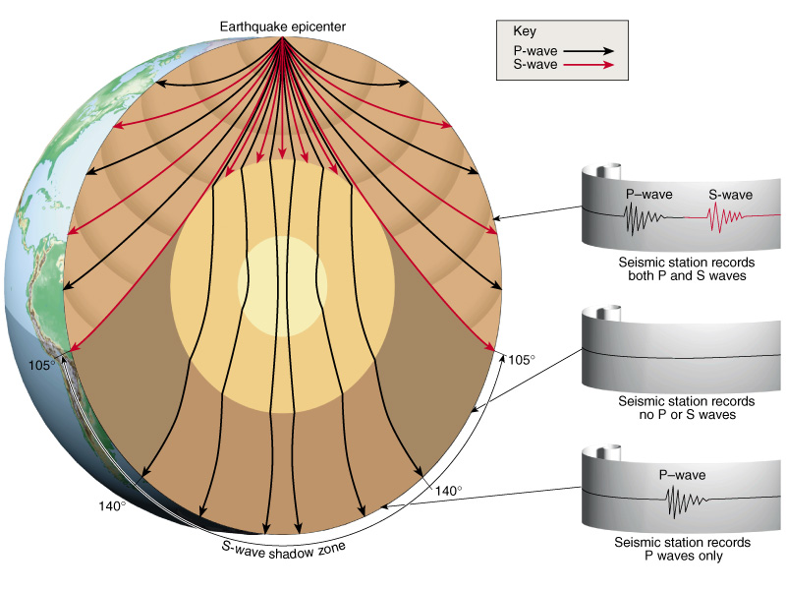
Structure of the Earth
Seismic waves
  Seismic waves refract as they pass from one material to another
  P & S wave shadow zones
S-Wave Shadow Zone

Slide 19
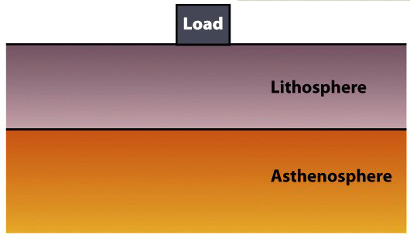
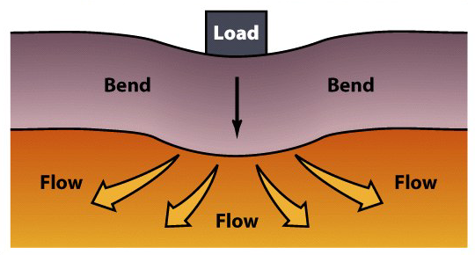
Lithosphere
Tectonic plates are fragments of lithosphere.
  Lithosphere is made of both crust and the upper mantle.
  The lithosphere is in motion over the asthenosphere.
  Lithosphere bends elastically when loaded.
  Asthenosphere flows plastically when loaded.

Slide 20
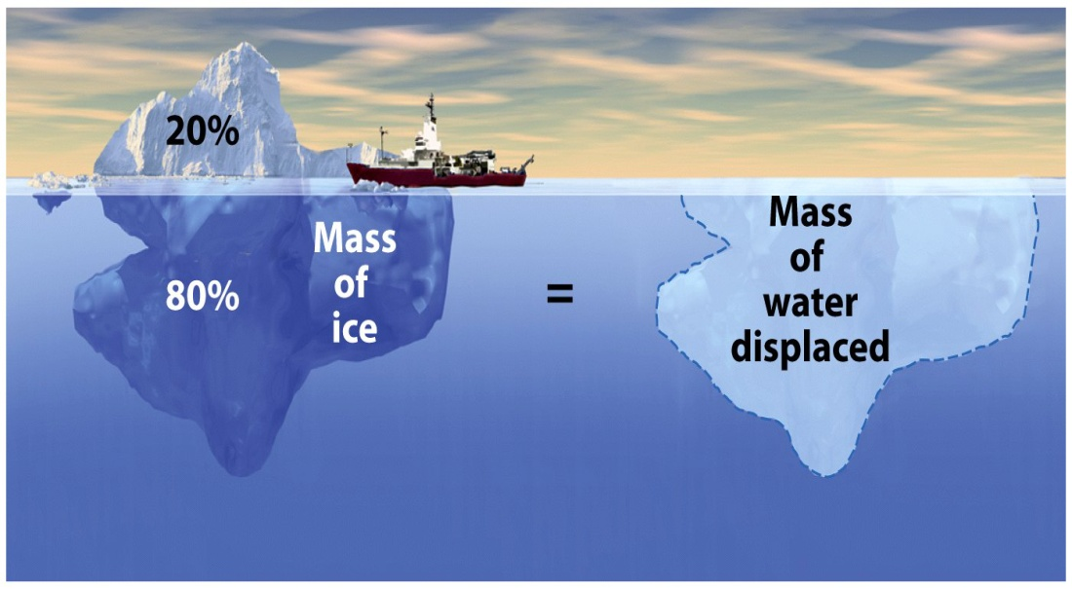
Buoyancy
Floating solids displace water equal to their mass.
This concept applies to lithospheric plates.
  Continental – Floats higher.
  Oceanic – Sinks lower.

Slide 21
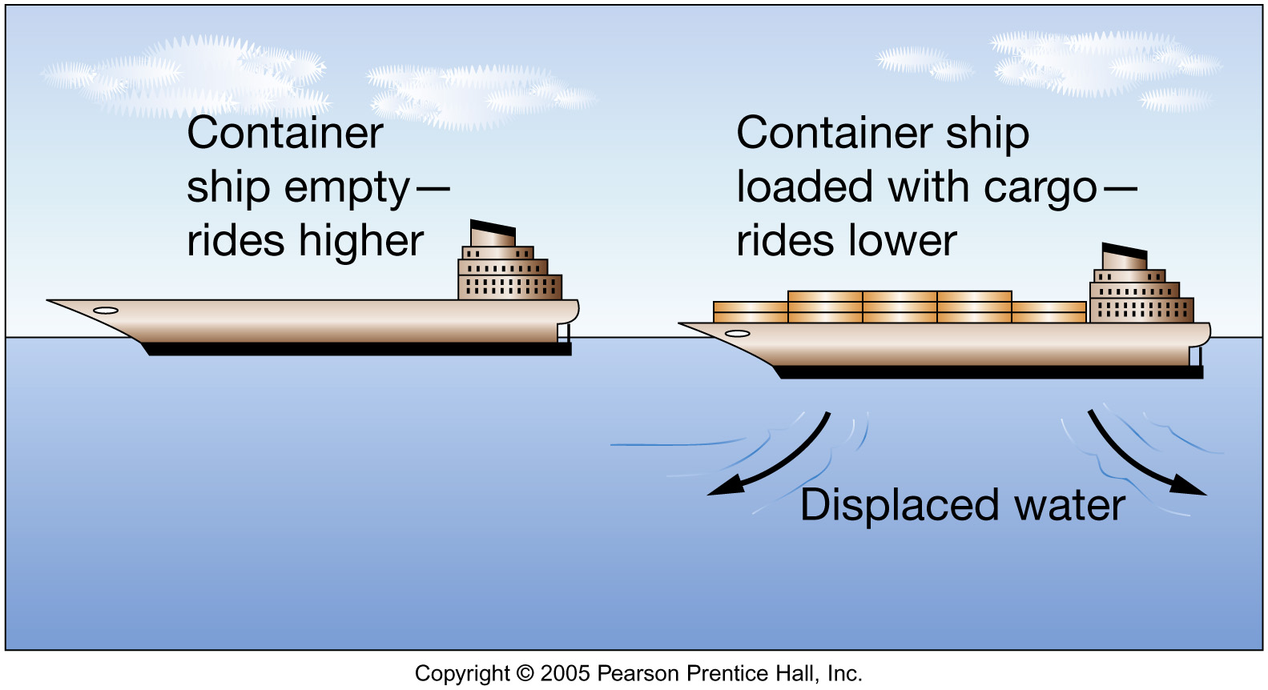
Fig. 1.14

Slide 22
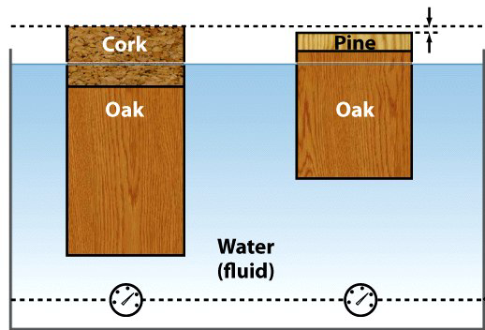
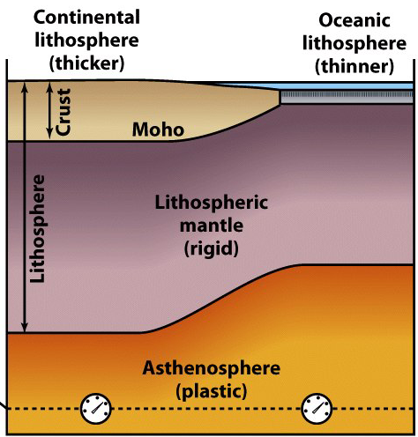
2 Types of Lithosphere
Continental ~ 150 km thick.
  Granitic crust.
    35-40 km thick.
    Lighter (less dense) .
    More buoyant – Floats higher.

Slide 23
2 Types of Lithosphere
Oceanic ~ 7 to 92 km thick.
  Basaltic crust.
    7-10 km thick.
    Heavier (more dense).
    Less buoyant – Sinks lower.

Slide 24
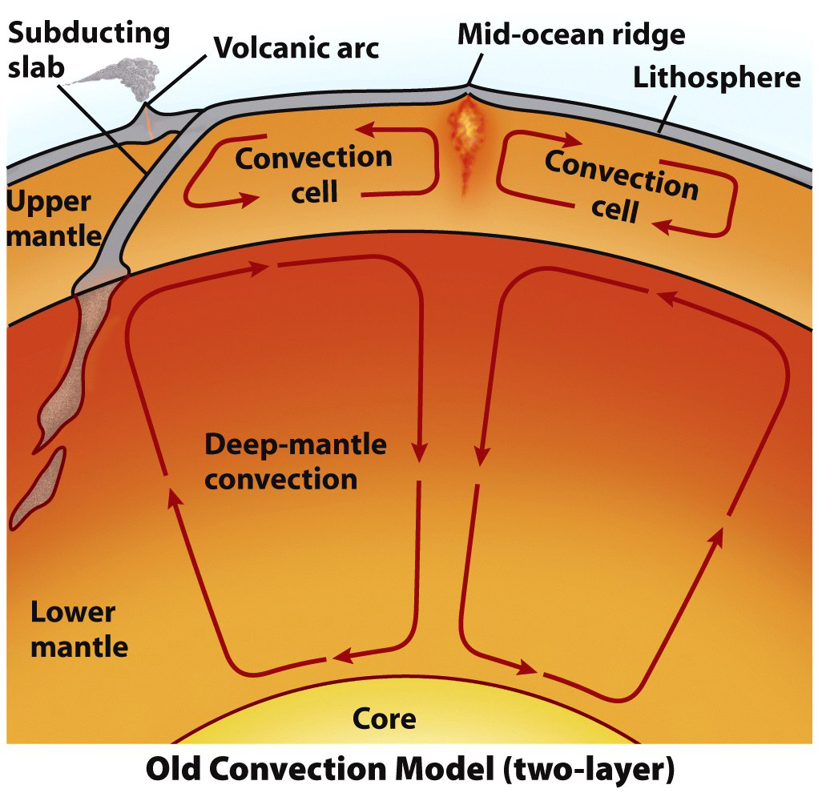
Driving Mechanisms
Old: Plates are dragged atop a convecting mantle.
  Plate motions are much
  too complex.
  Convection does occur.
    It is not the prime
    driving mechanism.

Slide 25
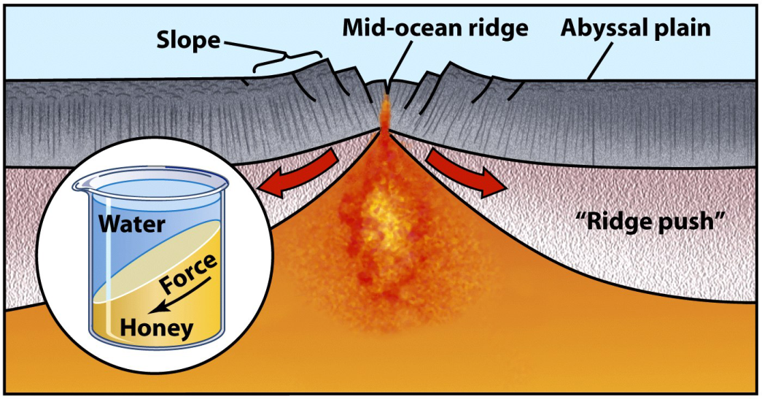
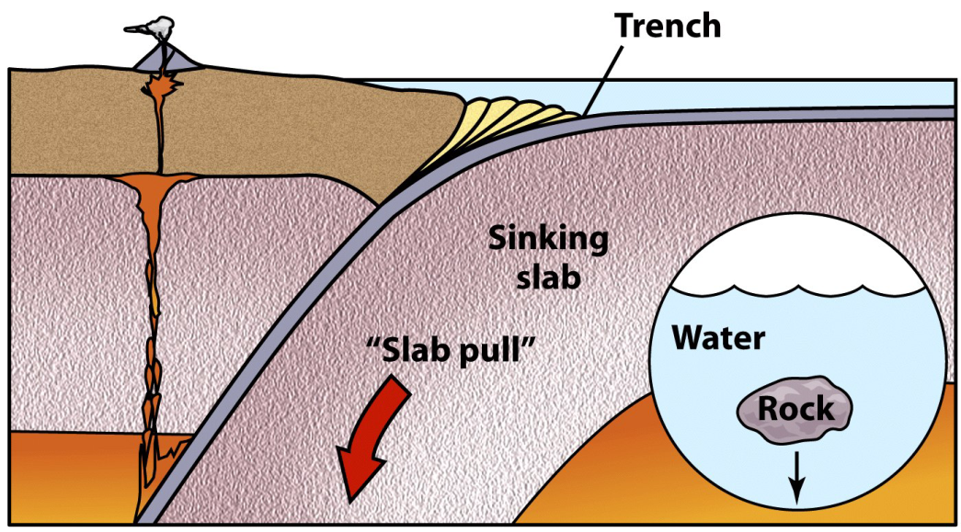
Driving Mechanisms
Modern: 2 other forces drive plate motions.
  Ridge-push – Elevated MOR pushes adjacent lithosphere.
  Slab-pull – Gravity pulls a subducting plate downward.
  Convection in the asthenosphere adds or subtracts.

Slide 26
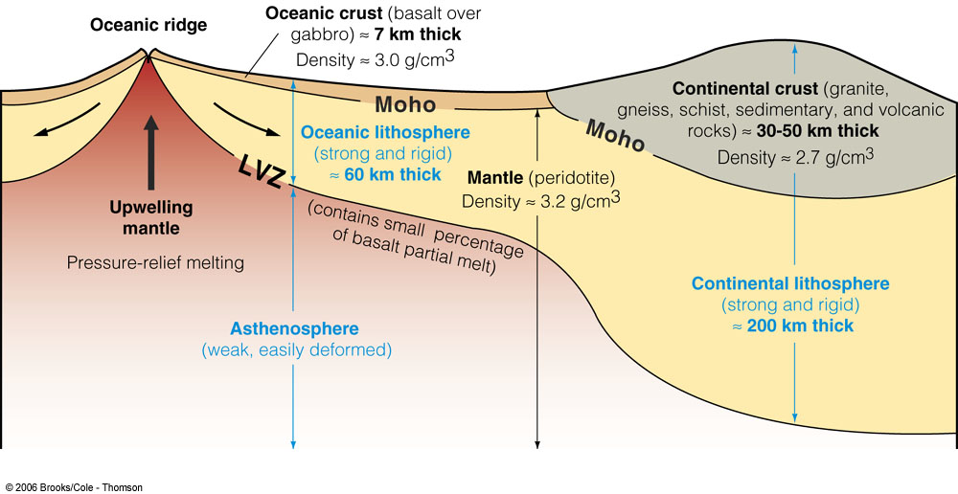
Asthenosphere & mantel rises up at weak spots
Heavy areas push down on asthenosphere & mantel

Slide 27
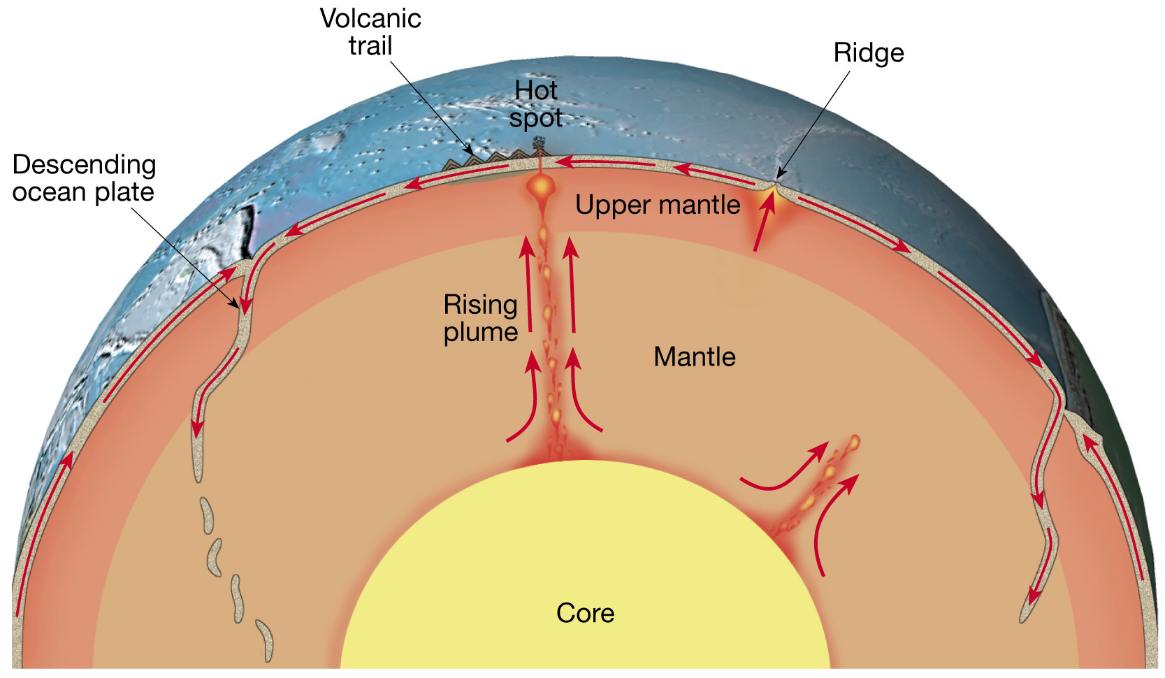
Asthenosphere & mantel rises up at weak spots
push
Descending plate pushes down into asthenosphere & mantel
pull

Slide 28
Push – Pull Theory
push
pull

Slide 29
Plate Tectonics
Plate boundaries
  All major interactions among individual plates occur along their boundaries

Slide 30
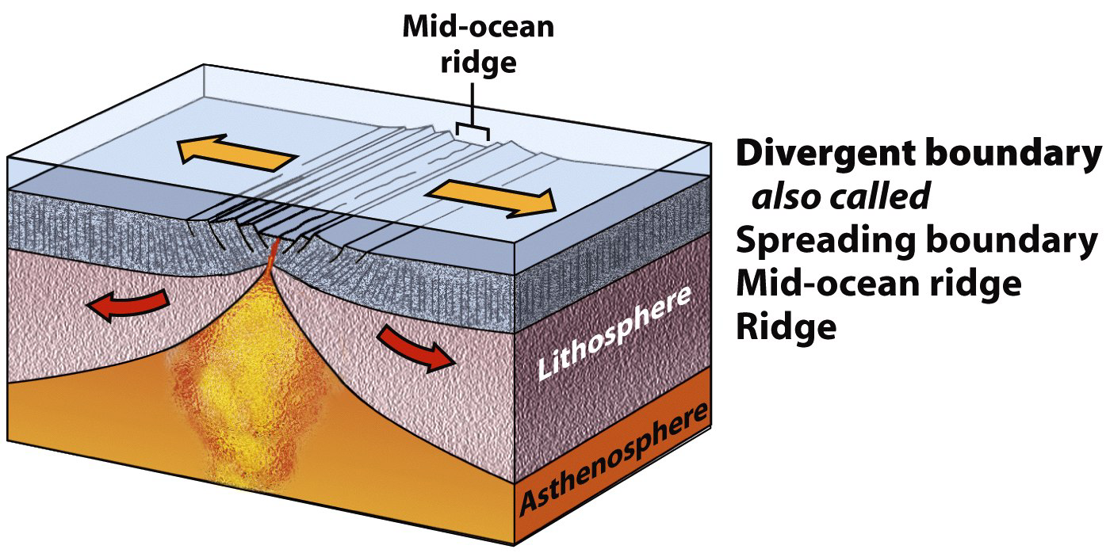
Plate Boundaries: 3 Types
Divergent – Tectonic plates move apart.

Slide 31
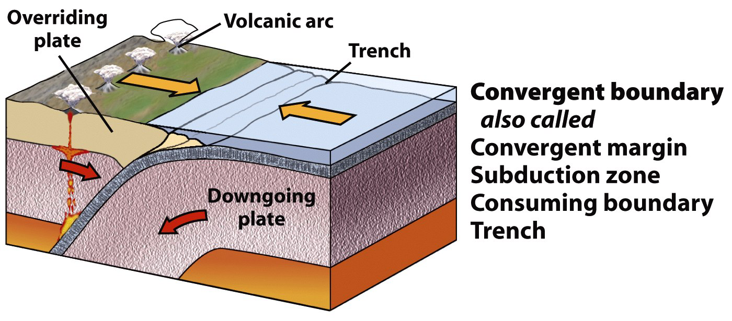
Plate Boundaries: 3 Types
Convergent – Tectonic plates move together.

Slide 32
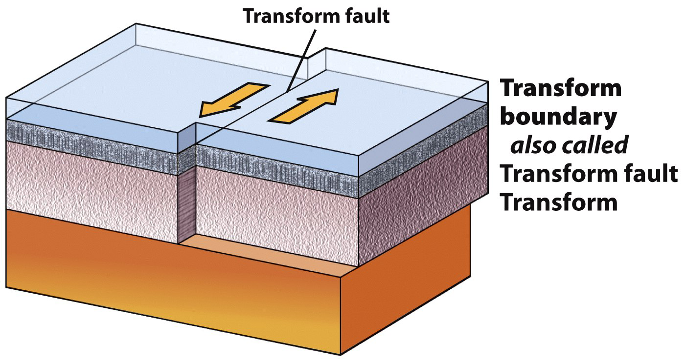
Plate Boundaries: 3 Types
Transform – Tectonic plates slide sideways.

Slide 33
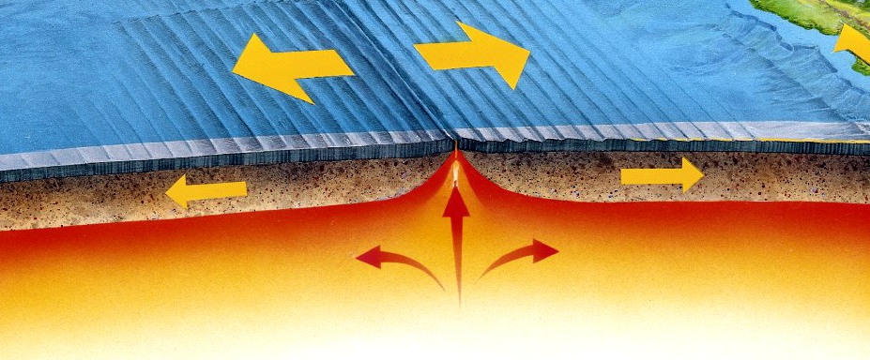
Divergent Boundaries
Sea-floor spreading causes plates to move apart.
Magma wells up to fill the gap.
Magma cools, adding material to each plate.

Slide 34
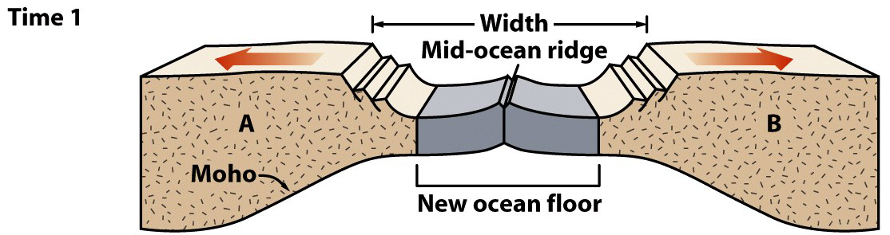
Divergent Boundaries
Sea-floor spreading progression.
  Early stage
    Rifting has progressed to mid-ocean ridge formation.
    Before substantial widening of the ocean.
    Forms a long, thin ocean basin with young oceanic crust.
  Example: The Red Sea
Note: This diagram only depicts the crust, not the entire lithosphere.

Slide 35
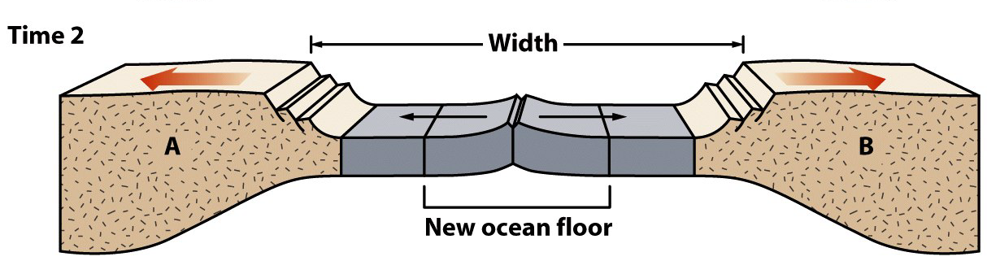
Divergent Boundaries
Sea-floor spreading progression.
  Mid-stage
    Ocean begins to widen.
    New seafloor is added at the mid-ocean ridge.
    Continents move farther apart.
  Example: Greenland and the North Atlantic
Note: This diagram only depicts the crust, not the entire lithosphere.

Slide 36
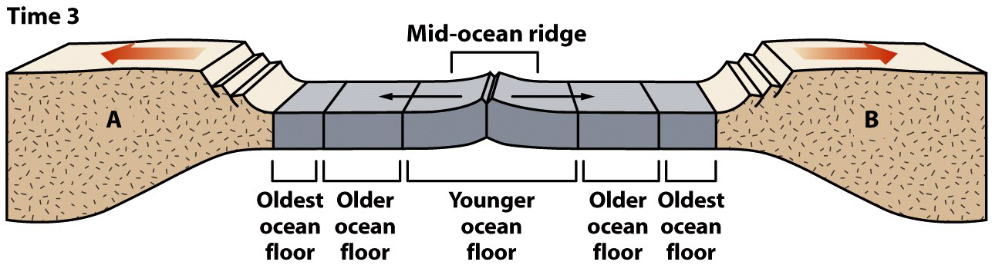
Divergent Boundaries
Sea-floor spreading progression.
  Late stage
    Mature, wide ocean basin.
    Linear increase in age with distance from central ridge.
    Edge of ocean basin - oldest; ridge proximal - youngest.
  Example: The Atlantic Ocean
Note: This diagram only depicts the crust, not the entire lithosphere.

Slide 37
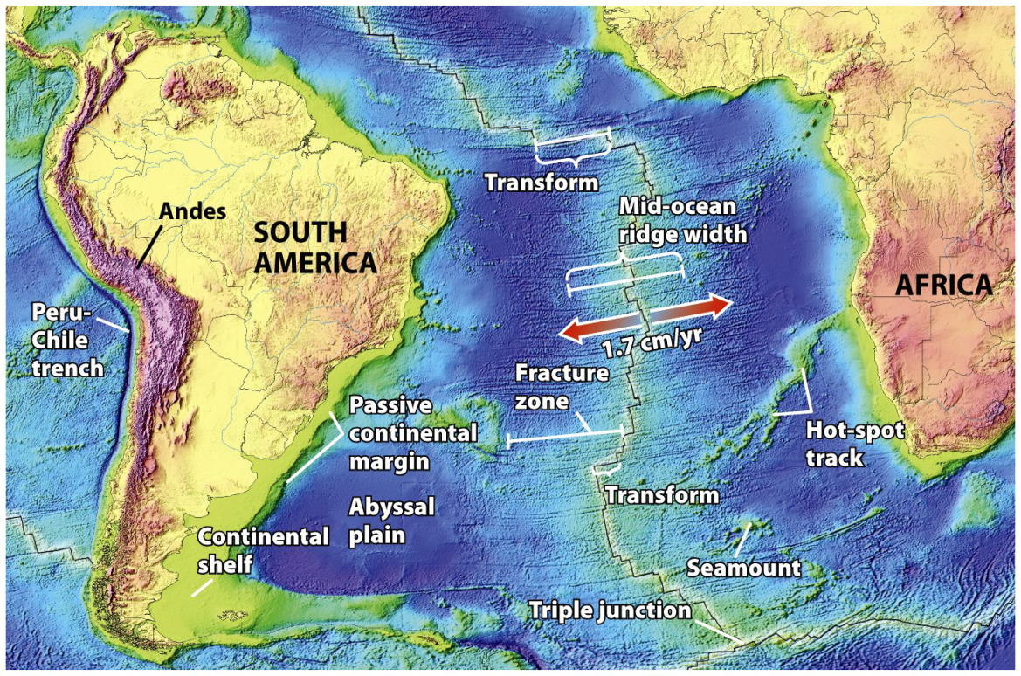
Mid-Ocean Ridges
Linear mountain ranges in Earth’s ocean basins.
Example: The Mid-Atlantic Ridge
  Snakes N-S through the entire Atlantic Ocean.
  Elevated ridge (1,500 km wide) 2 km above abyssal plains.
  Axial rift valley.
    500 m deep.
    10 km wide.
    Symmetric.
    Site of eruptions.

Slide 38
Mid-Ocean Ridges
Sea-floor spreading opens the axial rift valley.
Rising asthenosphere melts, forming mafic magma.
Pooled magma solidifies into oceanic crustal rock.
  Pillow basalt – Magma quenched at the sea floor.
  Dikes – Preserved magma conduits.
  Gabbro – Deeper magma.

Slide 39
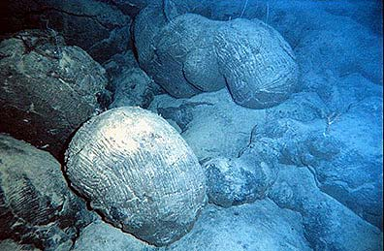
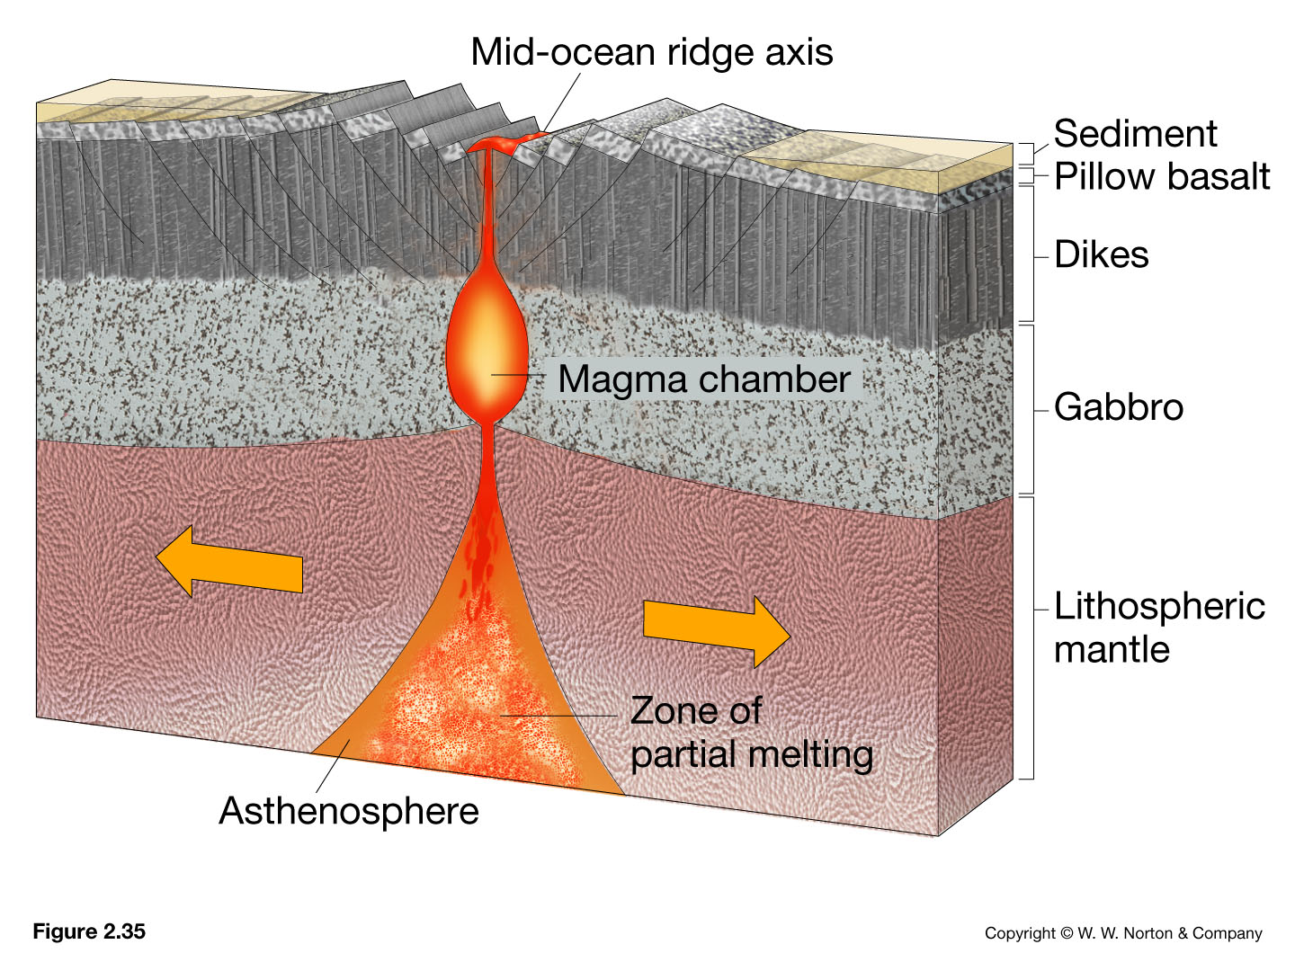
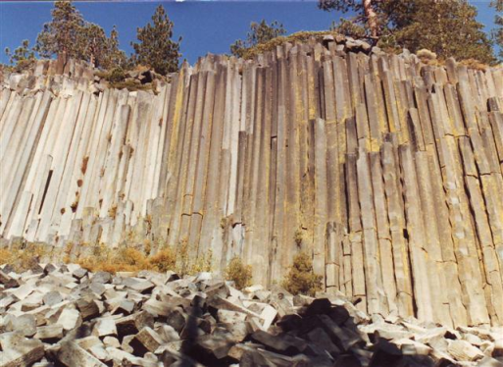
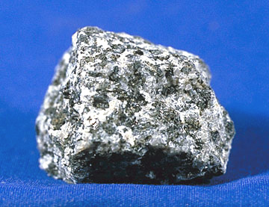
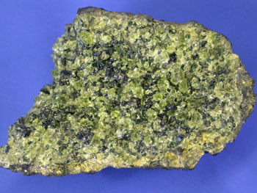
Extrusive igneous rocks
Intrusive igneous rocks
Notes:
Pillow basalts on the south Pacific seafloor -- Courtesy of NOAA. http://www.geology.sdsu.edu/how_volcanoes_work/
www.nationalparklover.com/devils_postpile.htm
www.mii.oeg
http://www.pitt.edu/~cejones/GeoImages/2IgneousRocks/IgneousTextures/1CoarseGrained.html

Slide 40
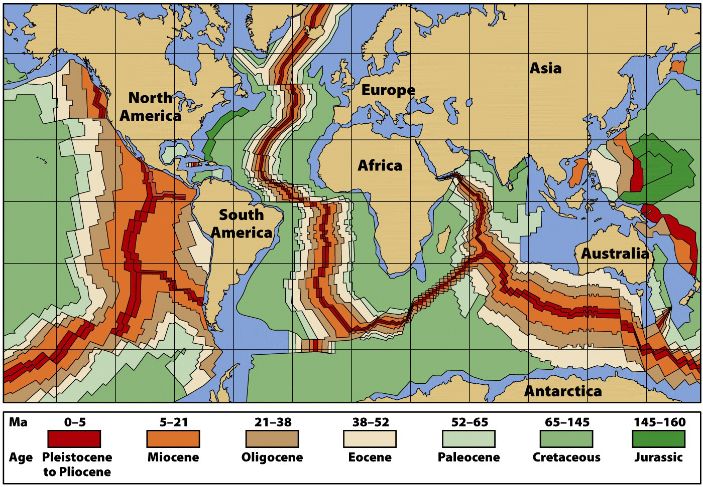
Ocean Crustal Age
Oceanic crust spreads away from the ridge axis.

Slide 41
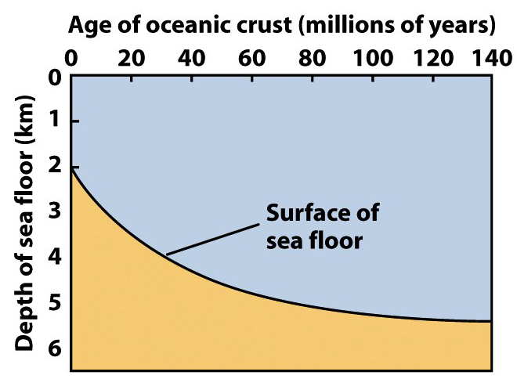
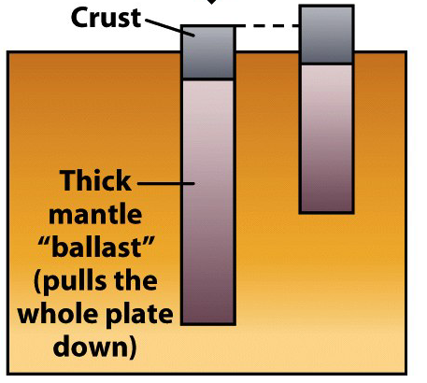
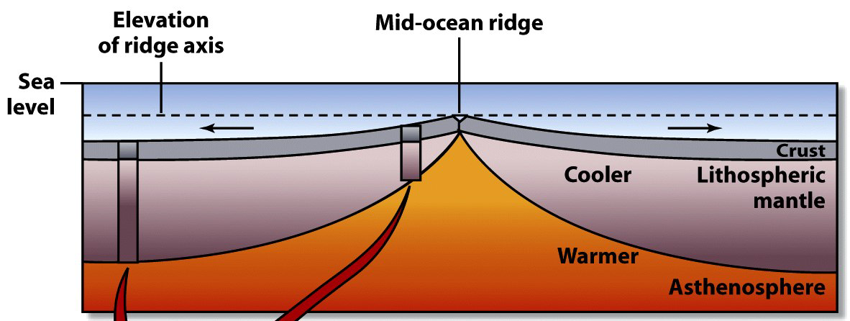
Oceanic Lithosphere
The hot asthenosphere is at the base of the MOR.
Aging ocean crust moves away from this heat…
  Cooling, increasing in density, and sinking.
  Accumulating increasing thicknesses of sediment.

Slide 42
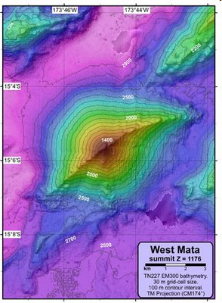
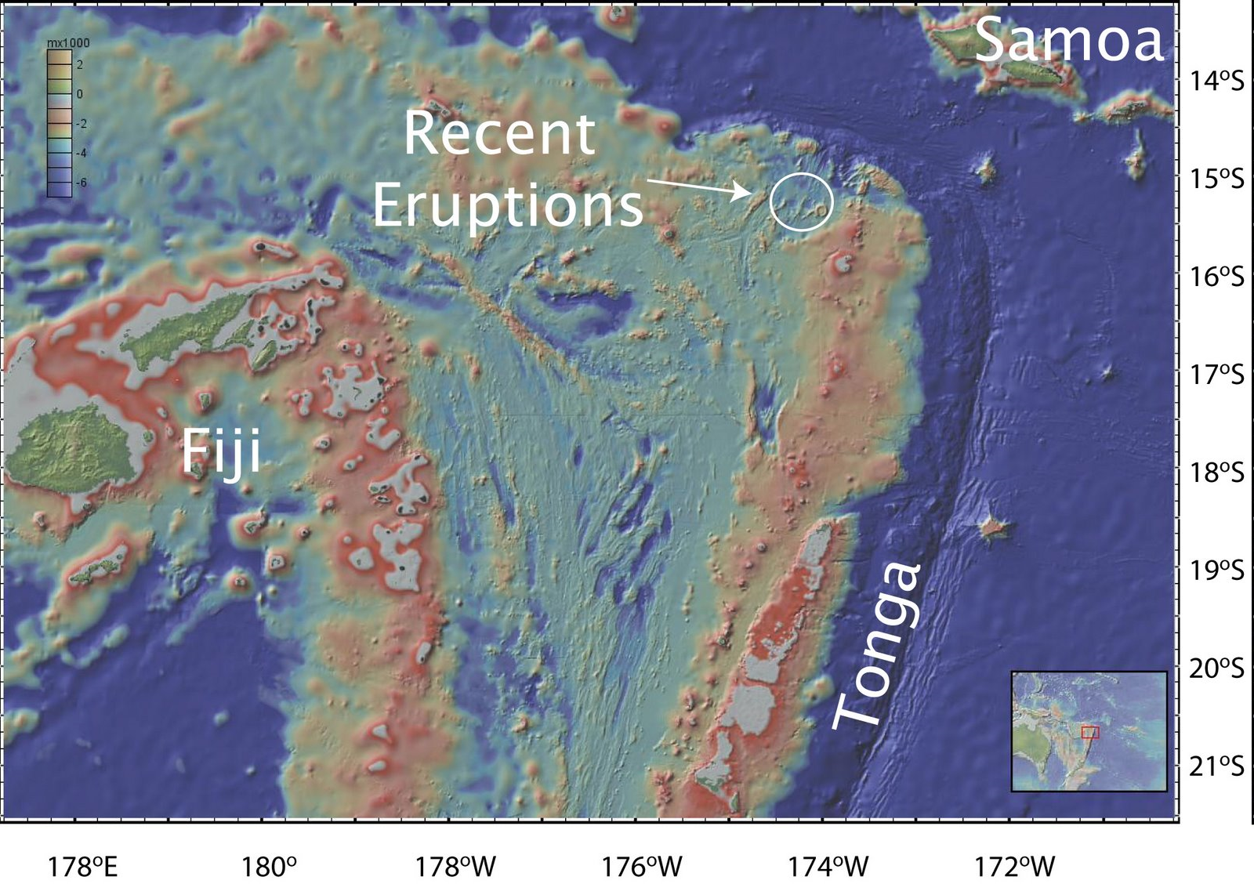
Neovolcanic activity in the NE Lau Basin
source

Slide 43
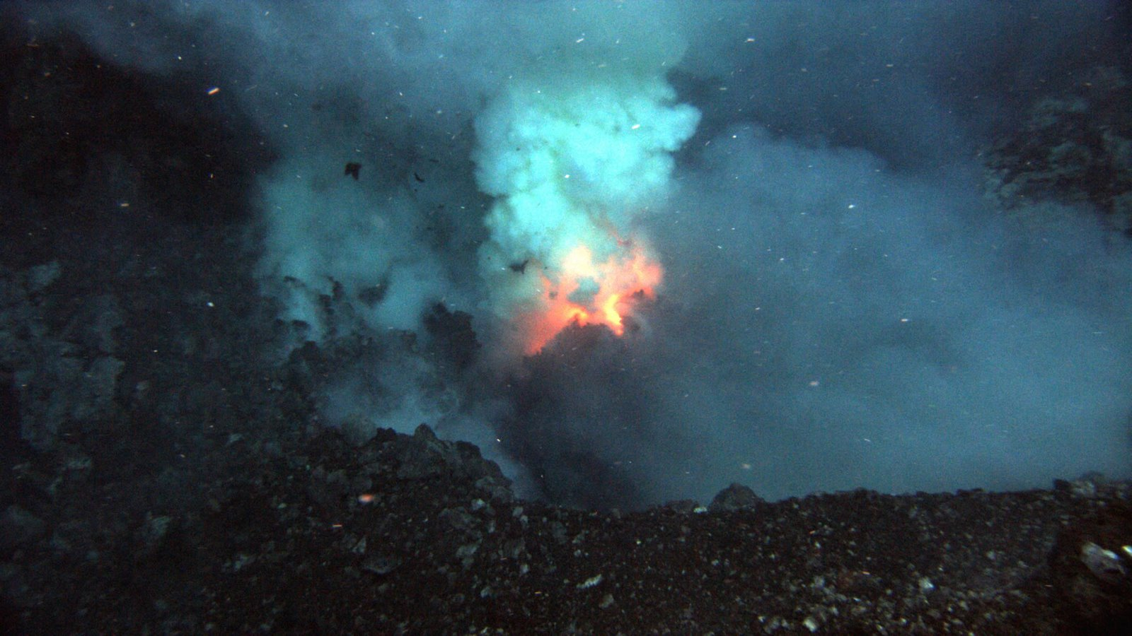
Neovolcanic activity in the NE Lau Basin
Prometheus eruptive vent at the summit of West Mata (1208 meters)
source

Slide 44
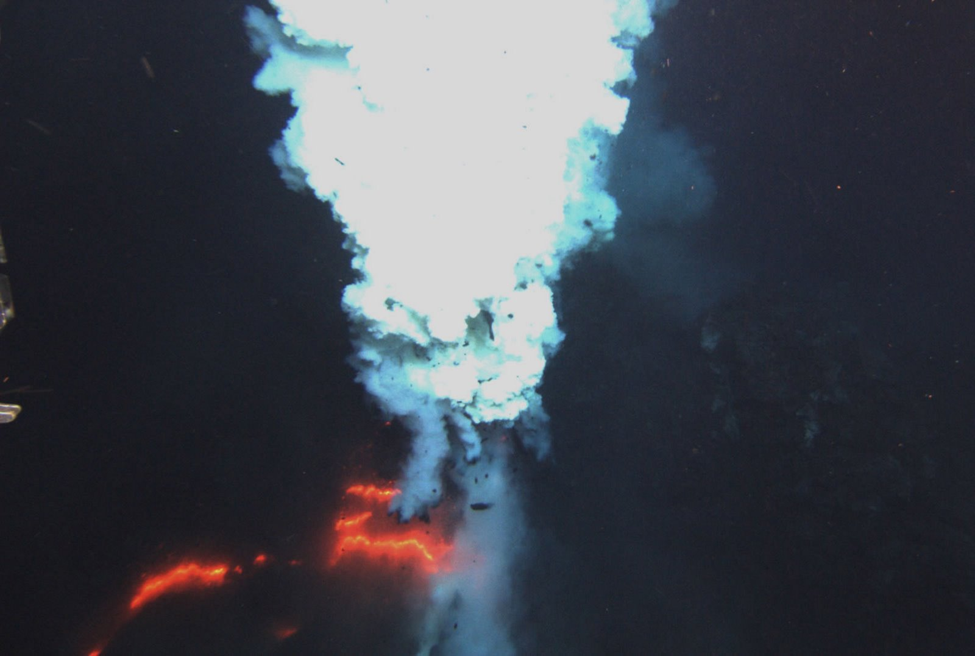
Neovolcanic activity in the NE Lau Basin
Hades eruptive vent at the summit of West Mata (1174 meters)
source

Slide 45
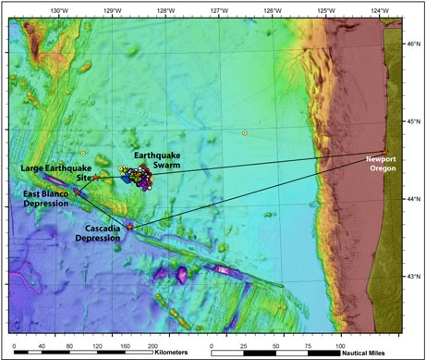
Mysterious "Swarm" of Quakes Strikes Oregon Waters
Colored dots show the earthquake "swarm" that struck waters off the shore of Oregon beginning in March 2008. Scientists are now planning a marine expedition (black line) to help unravel what is causing the mysterious temblors, which were detected by a Cold-War-era system of underwater microphones originally designed to track Russian submarines.
Image courtesy of NOAA Vents Program / Oregon State University CIMRS Program (source)
Notes:
museum

Slide 46
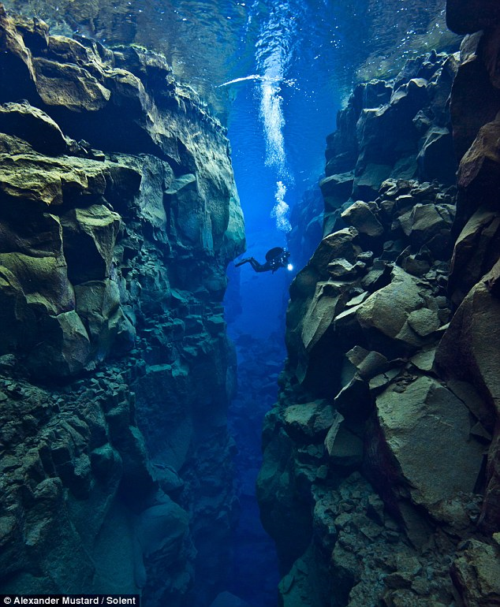
Spreading Apart:
Alex Mustard, dived 80ft into the crevice between the North American and Eurasian plates near Iceland to capture these spectacular photos
source

Slide 47
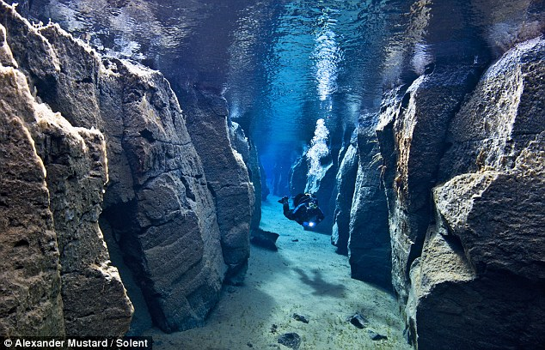
Spreading Apart:
source

Slide 48

Spreading Apart:
source

Slide 49

Tectonic Boundaries Evolve
Plate boundaries change over geologic time.
Oceanic plates.
  Created at MOR spreading centers.
  Destroyed at subduction zones.
Continental plates.
  Torn apart at rifts.
  Joined during collision.

Slide 50

Continental Rifting
Continental lithosphere can break apart.
  Lithosphere stretches and thins.
  Brittle upper crust faults.
  Ductile lower crust flows.
  Asthenosphere melts.
  Melts erupt, leading to…
  Sea-floor spreading.

Slide 51

Continental Rifting
Example: East Africa.
  The Arabian plate is rifting from
  the African plate.
  Rifting has progressed to
  sea-floor spreading in…
    The Red Sea
    The Gulf of Aden
  East African Rift – On-going rift.
    Thinned crust.
    Elongate trough.
    Volcanoes.

Slide 52

The East African rift
Spreading the continent apart 92 times as slow as a typical oceanic rift zone.
The rift forms one arm of a triple junction, from which the Red Sea and Gulf of Aden form somewhat more rapidly spreading rifts.

Slide 53


Slide 54

Continental Rifting
Basin and Range
  Region is slowly pulling apart
  No active spreading center

Slide 55

This Basin and Range terrain is found southwest of Salt Lake City, Utah.

Slide 56

Convergent plate boundaries
Where two plates collide
Types
  Oceanic-continental convergence
  Oceanic-oceanic convergence
  Continental-continental convergence

Slide 57


Subduction
Old oceanic lithosphere is more dense than mantle.
A flat-lying oceanic plate won’t subduct.
Bent down, the leading edge sinks like an anchor.

Slide 58

Subduction
The subducting plate descends at an average of 45°.
  Plate descent is revealed by Wadati-Benioff earthquakes.
    Mark frictional contact and mineral transformations.
    Earthquakes deepen away from trench.
Quakes cease below 660 km.

Slide 59

Fate of Subducted Plates?
Plate descent continues past the earthquake limit.
The lower mantle may be a “plate graveyard.”

Slide 60

Subduction Features
Subduction is associated with unique features.

Slide 61


Subduction
Accretionary prisms – Deformed sediment wedges.
  Sediments scraped off subducting plates are smeared and welded onto the overriding plates.
  These contorted sediments can be pushed above sea.
    Washington’s Olympic Peninsula & Taiwan.

Slide 62

Subduction
Volcanic arc – Volcanic belt on an overriding plate.
  The descending plate partially melts at ~ 150 km depth.
  Magmas burn upward, fueling volcanic eruptions.
  A curved Earth dictates that volcanic belts are curved.
Arc type depends on overriding plate.
  Continental crust – Continental arc.
  Oceanic – Island arc.

Slide 63

Ocean-Continent Convergence

Slide 64


Cascade Mountains, Pacific NW

Slide 65

Ocean-Ocean Convergence
Notes:
This figure shows oceanic-oceanic convergence. Reprinted by permission from Tarbuck, E. J., and Lutgens, F. K., Earth Science, 5th Ed. (Fig. 6.11), Merrill Publishing Company, 1992.

Slide 66

Subduction
Back arc basin – A marginal sea behind an arc.
  Forms between an island arc and a continent.
  Offshore subduction traps a piece of oceanic crust, or…
  Stretching creates a new spreading ridge.

Slide 67
Tectonic Settings and Volcanic Activity
Notes:
To view this animation, click “View” and then “Slide Show” on the top navigation bar.

Slide 68


Plate Collision
Subduction consumes ocean basins.
Ocean closure ends in continental collision.
  Buoyant continental crust will not subduct.
  Subduction ends; mountains are smashed upward.

Slide 69



Plate Collision
Plate tectonic collision may involve…
  Two continents.
  A continent and an island arc.
Collision “sutures” the convergent plate boundary.

Slide 70

Continent-Continent Convergence

Slide 71
Convergent Margins: India-Asia Collision
Notes:
To view this animation, click “View” and then “Slide Show” on the top navigation bar.

Slide 72

The collision of India and Asia produced the Himalayas (before)

Slide 73

The collision of India and Asia produced the Himalayas (after)

Slide 74

Transform fault boundaries
Plates slide past one another
No new lithosphere is created or destroyed
Most join two segments of a mid-ocean ridge as parts of prominent linear breaks in the oceanic crust known as fracture zones

Slide 75

Plate Tectonics
Types of transform faults
  Oceanic—wholly in ocean
  floor
  Continental—extends from
  mid-ocean ridge across the
  continent

Slide 76
Oceanic Transforms
The MOR axis is offset by transform faults.
  Offset of linear MOR is geometric necessity on a sphere.
  Transforms bear strong evidence of sea-floor spreading.
    Abundant earthquakes common between ridge segments.
    Earthquakes vanish past ridge segment overlaps.

Slide 77
Motion at Transform Boundaries
Notes:
To view this animation, click “View” and then “Slide Show” on the top navigation bar.

Slide 78

Transform Boundaries
Oceanic transforms – Offsets along the MOR.
  Older interpretation – Faulting occurs after MOR forms.
  Modern interpretation – Faulting occurs with the MOR.

Slide 79


Transform Boundaries
Continental transforms – Chop continental crust.
  Example: The San Andreas Fault.

Slide 80

Triple Junctions
Places where 3 plate boundaries coincide.
Multiple boundary combinations occur.
Triple junctions migrate and change across time.

Slide 81

This bathymetric map of the seafloor shows the Siqueiros transform fault in the eastern Pacific Ocean, illustrating the fragmented structure of the fault line. (Jian Lin, Jack Cook, and Patricia Gregg, Woods Hole Oceanographic Institution)
Source - Visualization of Siqueiros fault

Slide 82
Plate Tectonics
Hot spots
  Caused by rising plumes of mantle material
  Volcanoes can form over them (Hawaiian Island chain)
  Most mantle plumes are long-lived structures and at least some originate at great depth, perhaps at the mantle-core boundary

Slide 83
Hot Spot Volcano Tracks
Notes:
To view this animation, click “View” and then “Slide Show” on the top navigation bar.

Slide 84

Global Hot Spots

Slide 85

Volcanism on a tectonic plate moving over a hot spot

Slide 86

The Hawaiian Islands have formed over a stationary hot spot

Slide 87

Hawaiian Islands-Emperor Seamount Chain
Notes:
The chain of islands and seamounts that extends from Hawaii to the Aleutian Trench results from the movement of the Pacific Plate over the relatively stationary Hawaiian hotspot. Numbers indicate radiometric age dates in millions of years before present. After Tarbuck, E. J., and Lutgens, F. K., Earth Science, 8th Ed. (Fig. 7.24), Prentice-Hall, 1997

Slide 88
Applications of plate tectonics model to intraplate features
Seamounts and tablemounts
  Subsidence of flanks of mid-ocean ridge
  Wave erosion may flatten seamount

Slide 89


Slide 90
Motion at Plate Boundaries
Notes:
To view this animation, click “View” and then “Slide Show” on the top navigation bar.

Slide 91
Plate Motions Through Time
Notes:
To view this animation, click “View” and then “Slide Show” on the top navigation bar.

Slide 92
~ End ~

