Slide 1
Folds, Faults & Geologic Maps

Slide 2
Rock deformation
Deformation is a general term that refers to all changes in the original form and/or size of a rock body

Slide 3
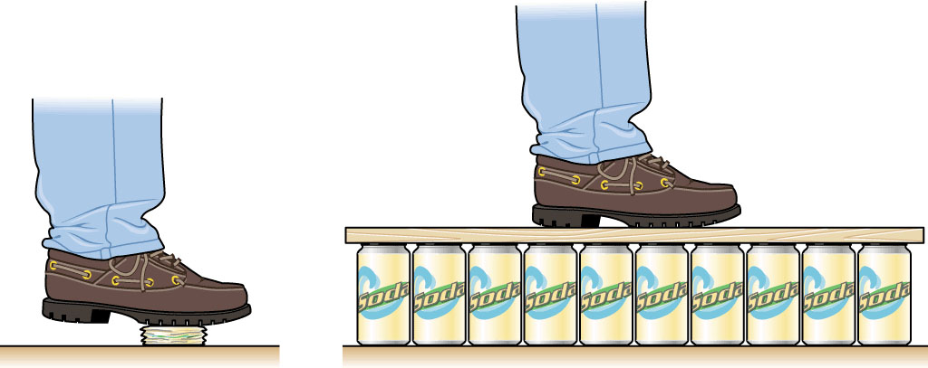
Rock deformation
Stress – The Cause of Deformation
  Geologic forces at work: Plate tectonics
  Stress = force/area

Slide 4
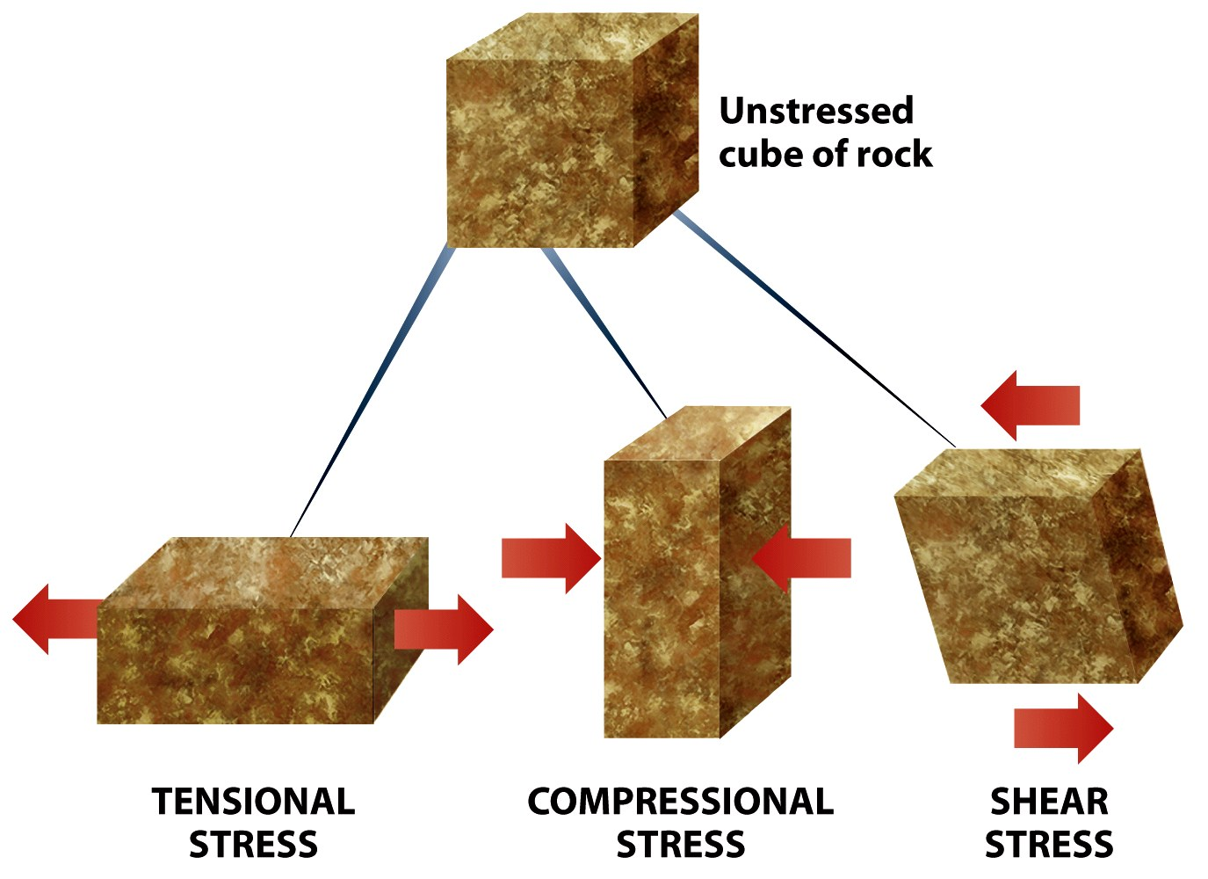
Rock deformation
Stress – The Cause of Deformation

Slide 5
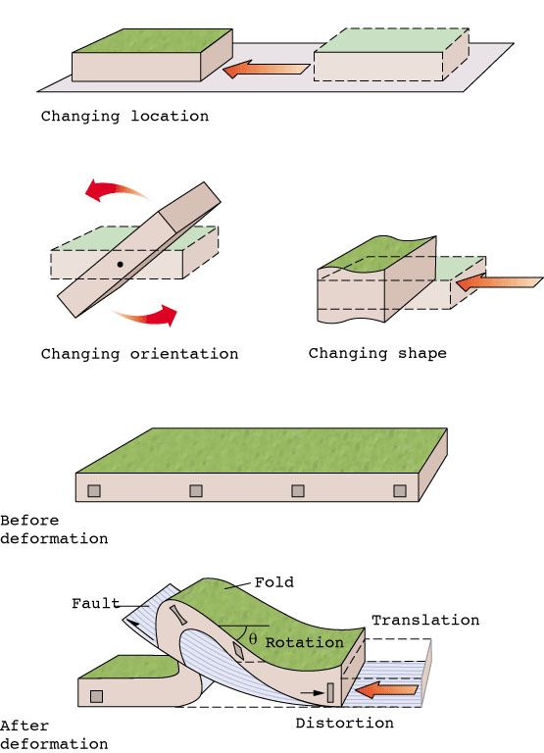
Components of Deformation
Relocation
Tilting
Changing shape
  Faulting
  Folding

Slide 6
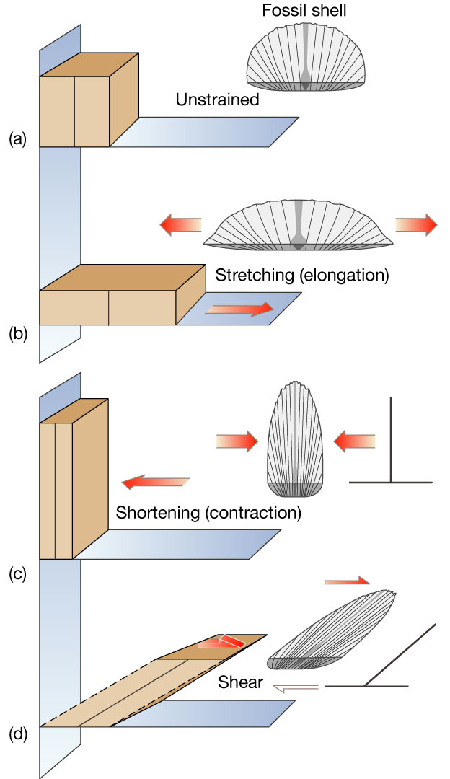
Rock deformation
Strain - change in shape due to deformation
  Types
    Stretching
    Shortening
    Shear

Slide 7
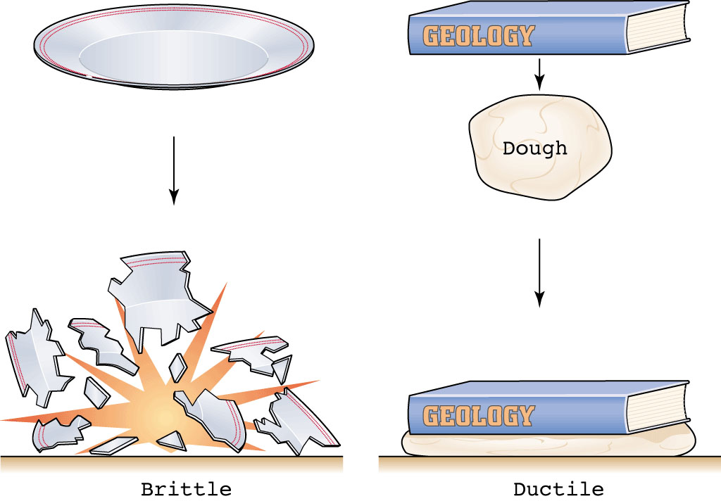
Rock deformation
Types of deformation
  Elastic
  Brittle
  Ductile

Slide 8


Rock deformation
Elastic deformation
  Temporary change in shape or volume from which a material rebounds after the stress is removed

Slide 9

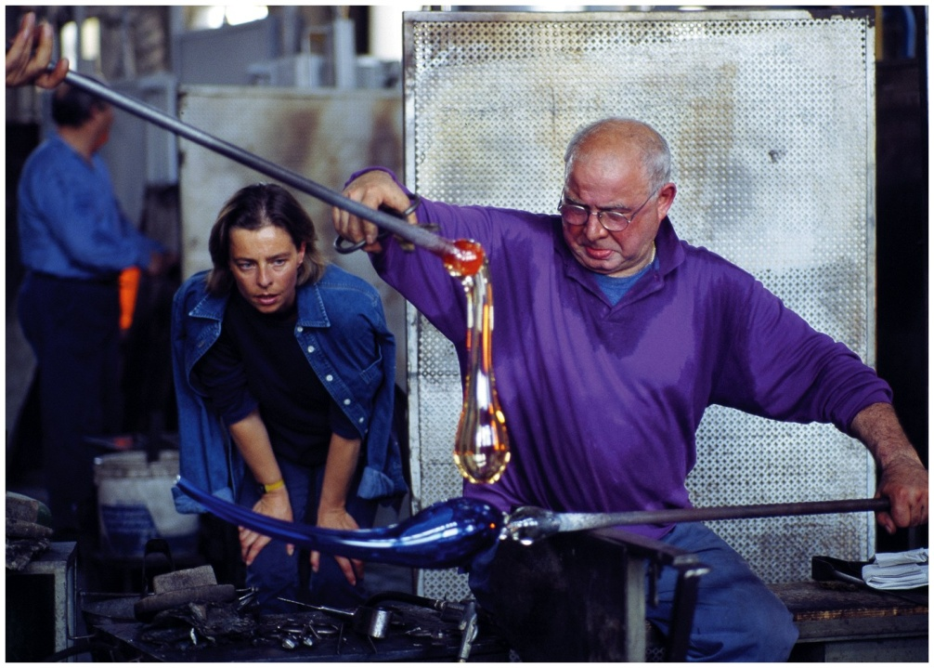
Rock deformation
Ductile deformation
  Permanent but gradual change in shape or volume of a material, caused by flowing or bending

Slide 10
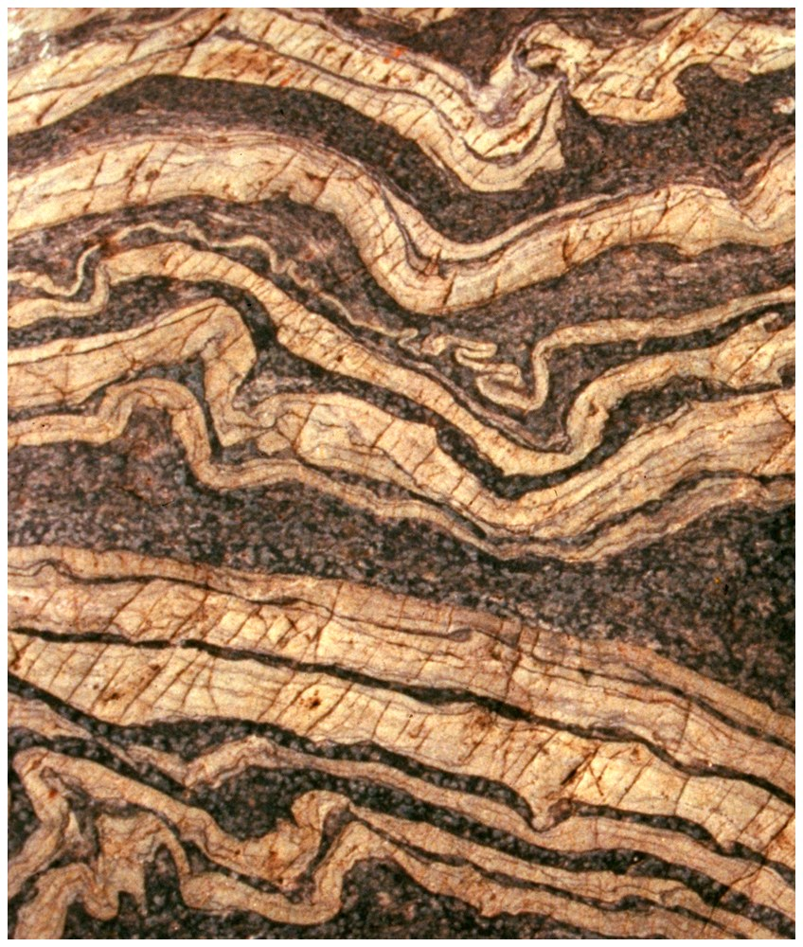
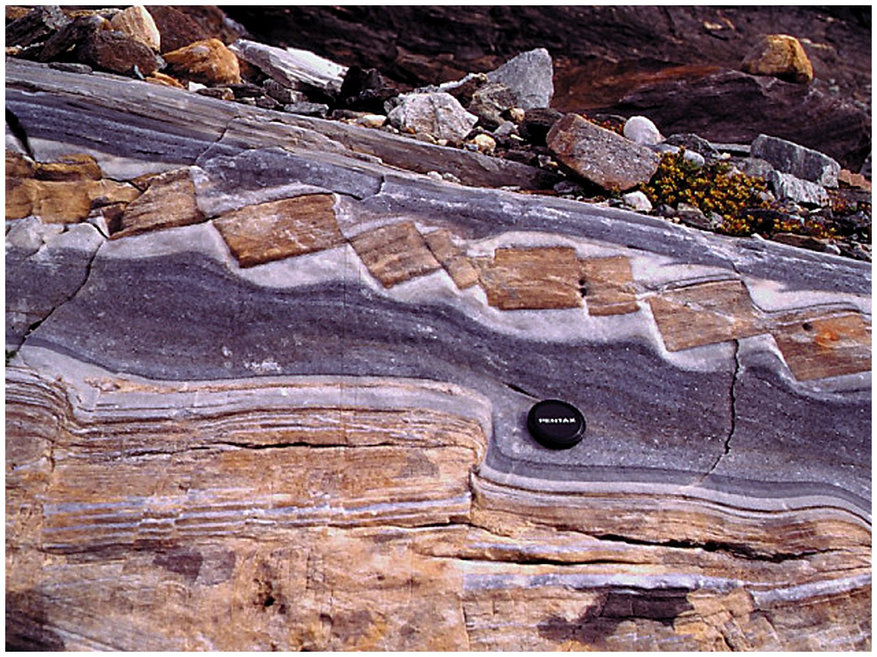
Rock deformation
Brittle deformation
  Permanent change in shape or volume, in which a material breaks or cracks

Slide 11
Deformation
Factors that influence the strength of a rock
  Temperature
  Pressure
  Rock type (composition)
  Rate of deformation
  Time

Slide 12
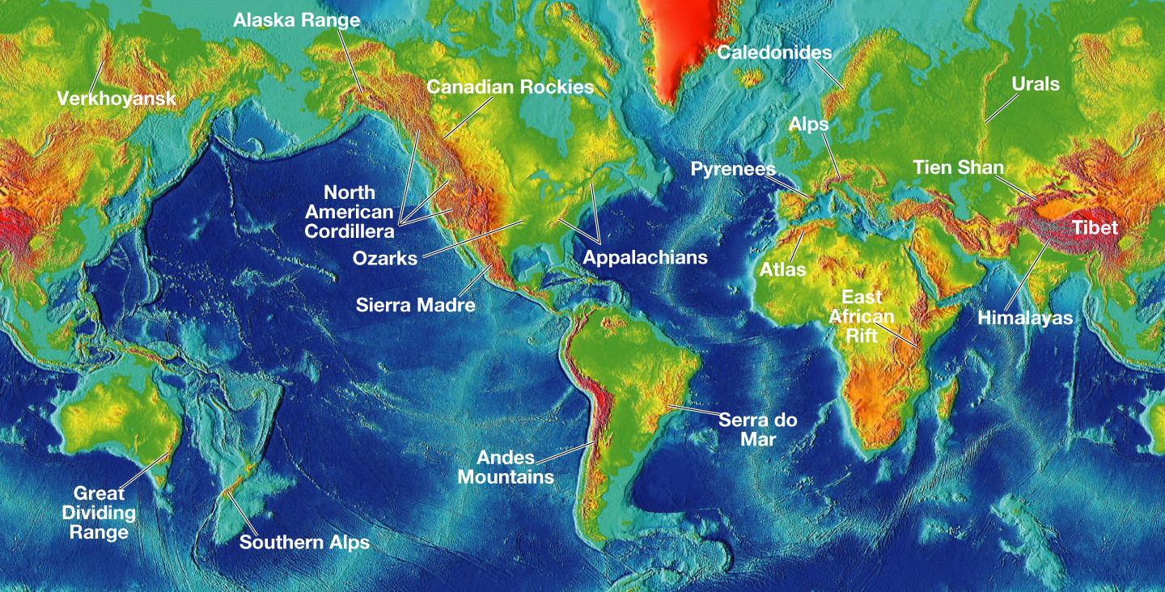
Most crustal deformation occurs along plate margins

Slide 13
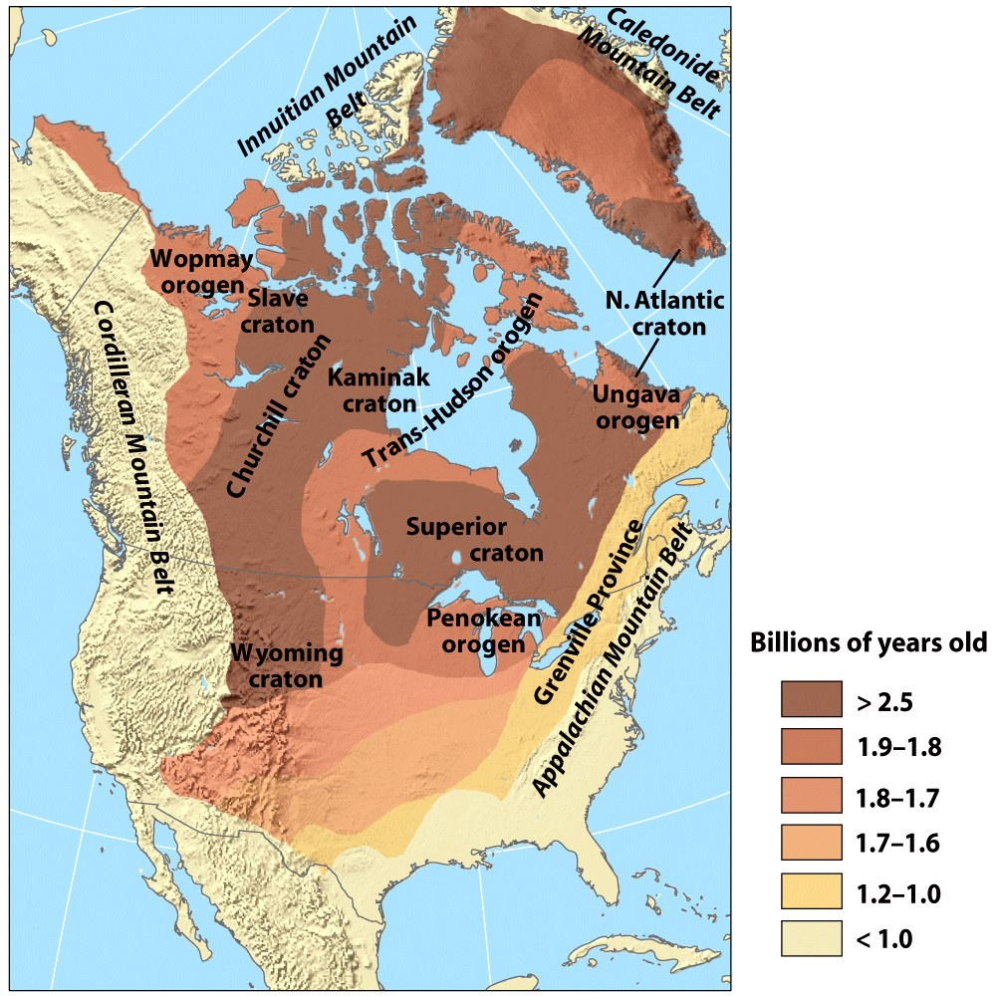
Rock Deformation
Craton: A region of continental crust that has remained tectonically stable for a very long time

Slide 14
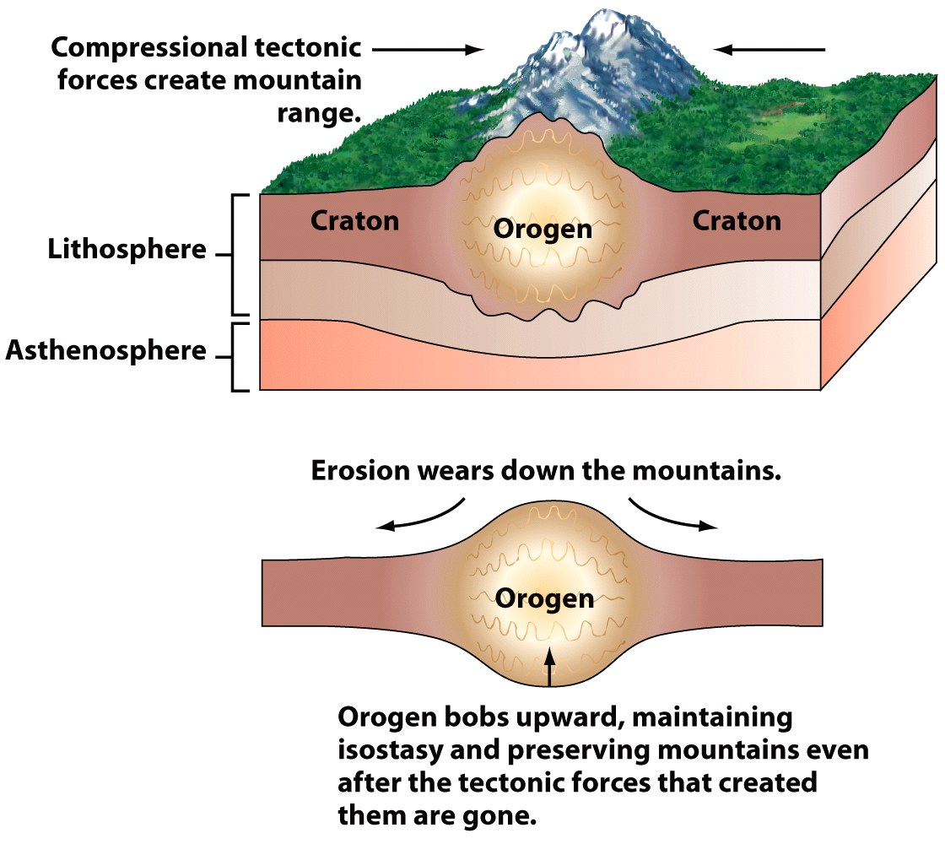
Rock Deformation
Orogen: An elongated region of crust that has been deformed and metamorphosed through a continental collision

Slide 15
Rock Deformation
Orogenesis refers to processes that collectively produce a mountain belt
Three mechanisms:
  Ocean-Ocean and Ocean-Continental Convergence
  Continental-Continental Convergence
  Continental Accretion

Slide 16
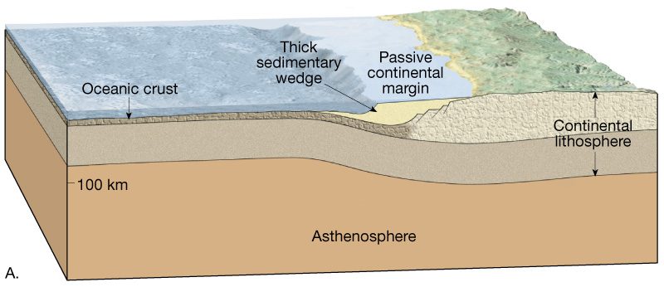
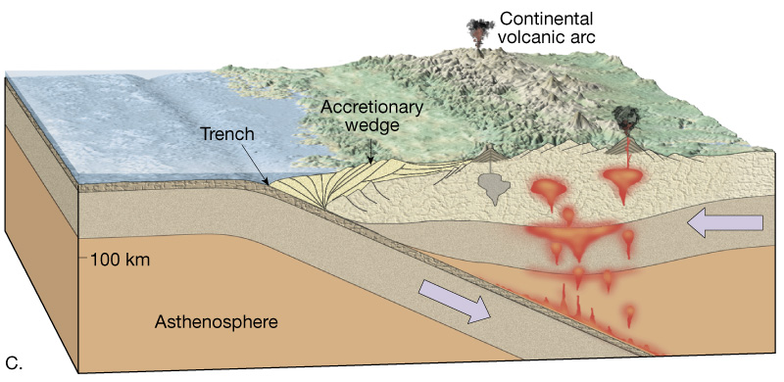
Orogenesis
Andean-type mountain building
Oceanic-Continental Subduction
Continental volcanic arcs forms

Slide 17
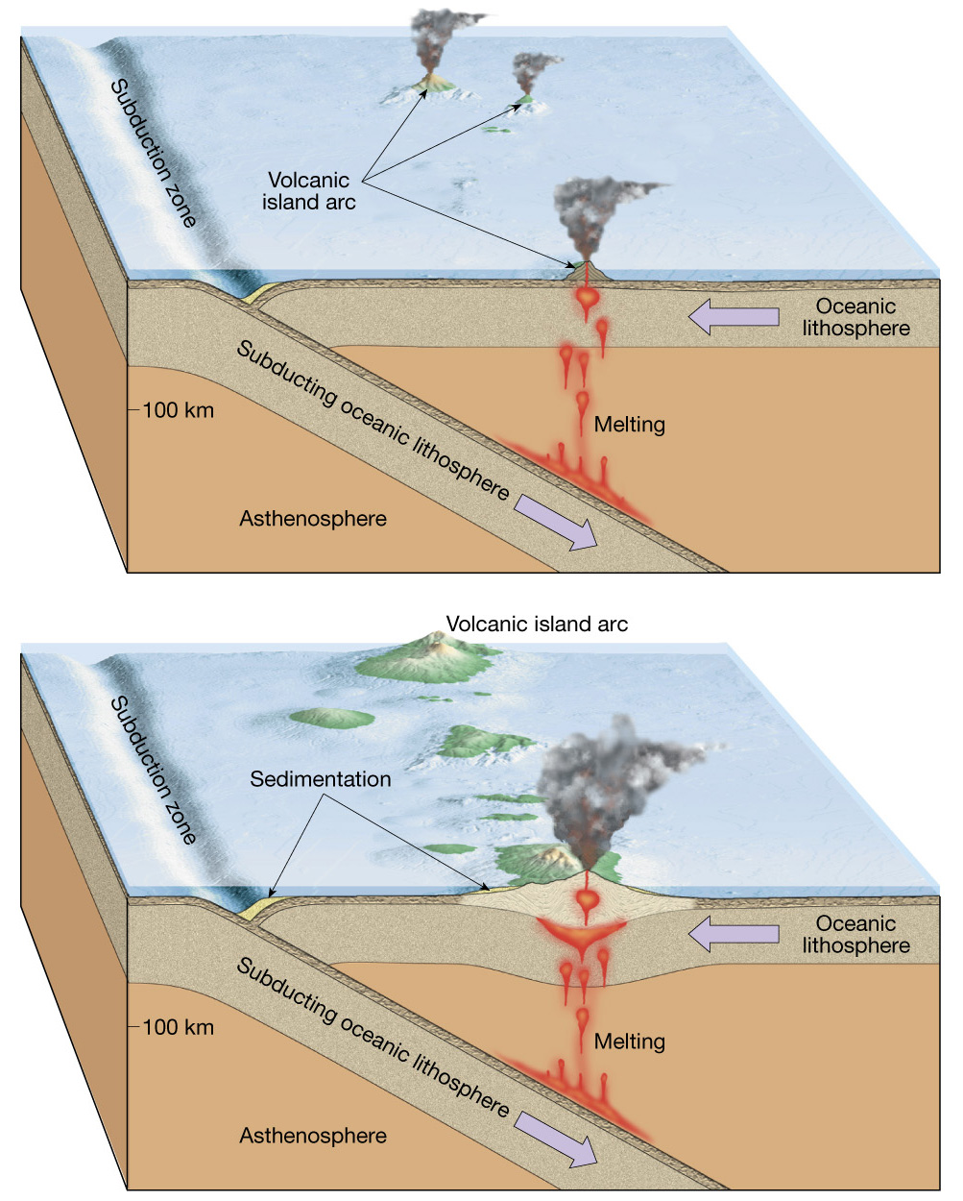
Orogenesis
Aleutian-type mountain building
Oceanic-Oceanic Subduction
Volcanic island arcs forms

Slide 18
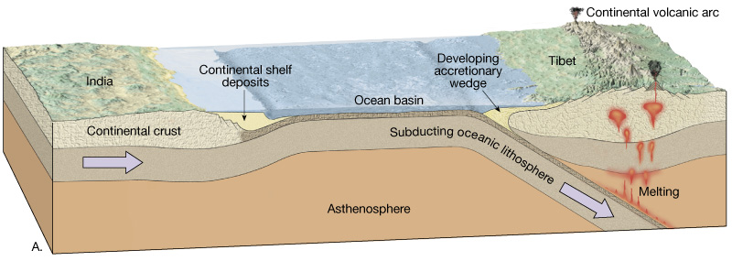
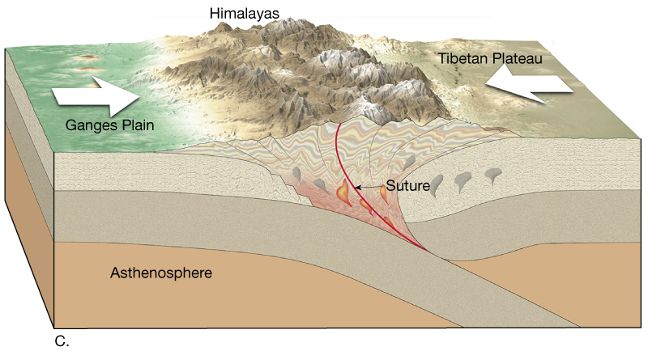
Orogenesis
Continental collisions
  Where two plates with continental crust converge
  Mountains form

Slide 19
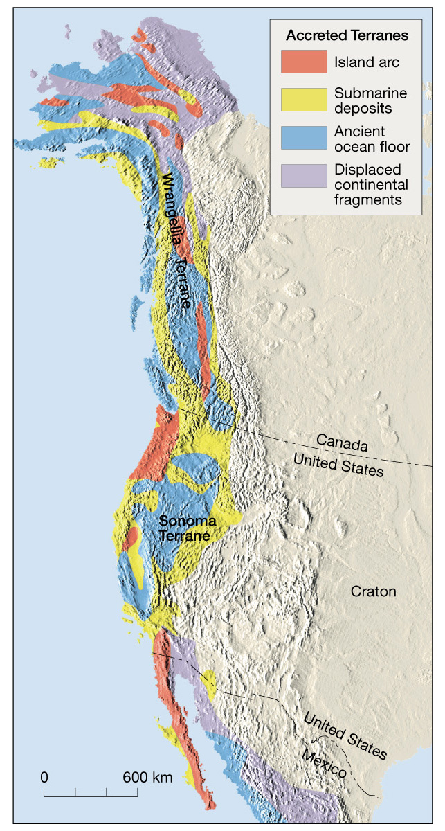
Orogenesis
Continental accretion
Small crustal fragments collide with and accrete to continental margins
Accreted crustal blocks are called terranes

Slide 20
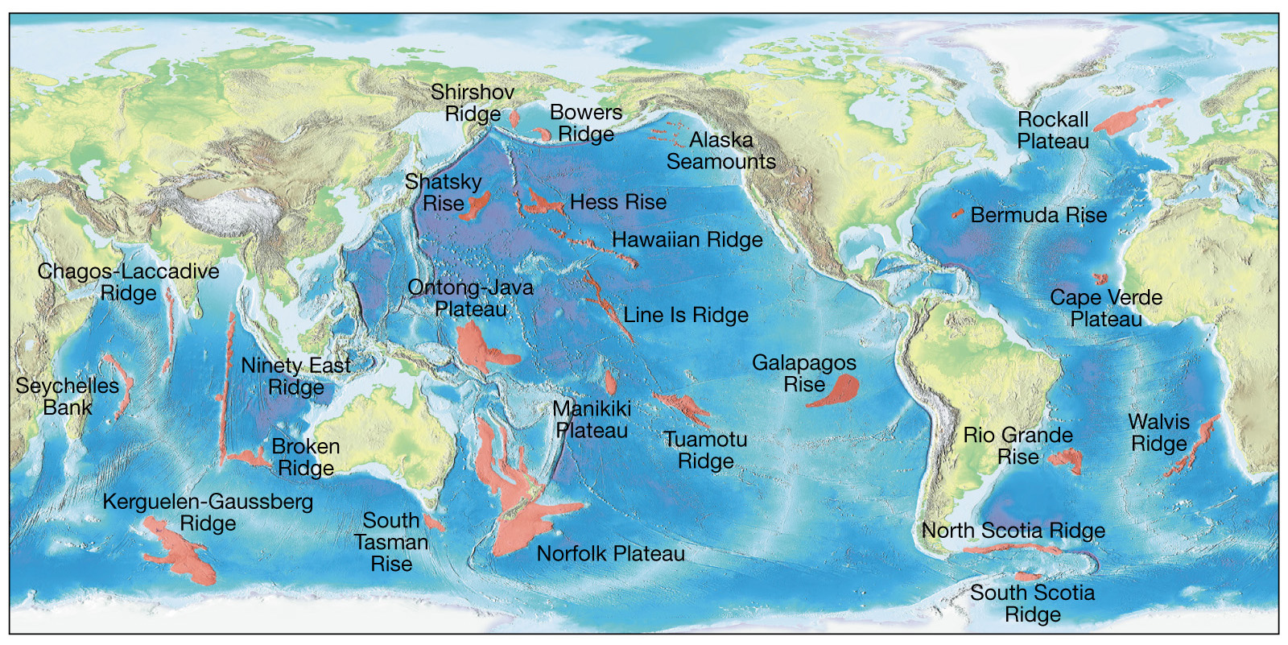
Distribution of modern day oceanic plateaus and other submerged crustal fragments

Slide 21
Folds
Rocks bent into a series of waves
Most folds result from compressional forces which shorten and thicken the crust
Types of folds
  Anticline – upfolded, or arched, rock layers
  Syncline – downfolded rock layers

Slide 22
Folds
Types of folds
  Anticlines and synclines can be
    Symmetrical - limbs are mirror images
    Asymmetrical - limbs are not mirror images
    Overturned - one limb is tilted beyond the vertical
  Where folds die out they are said to be plunging

Slide 23
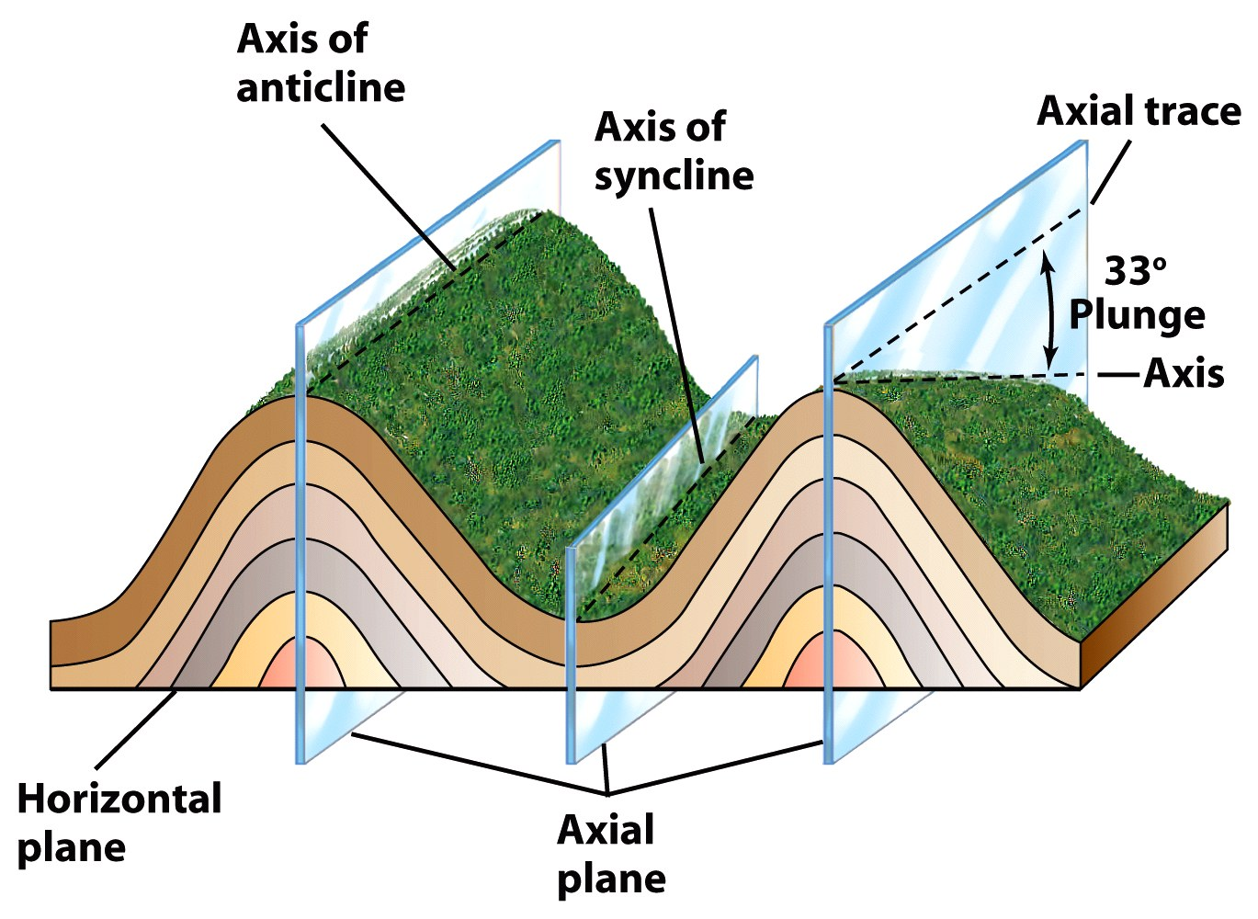

Slide 24
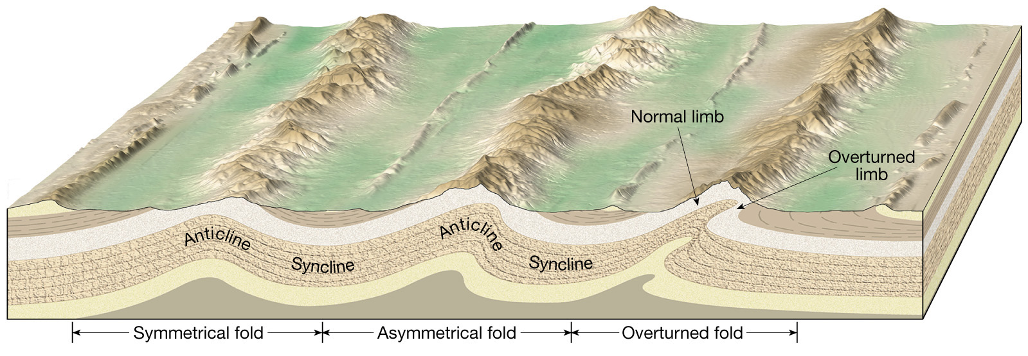
A series of anticlines and synclines

Slide 25
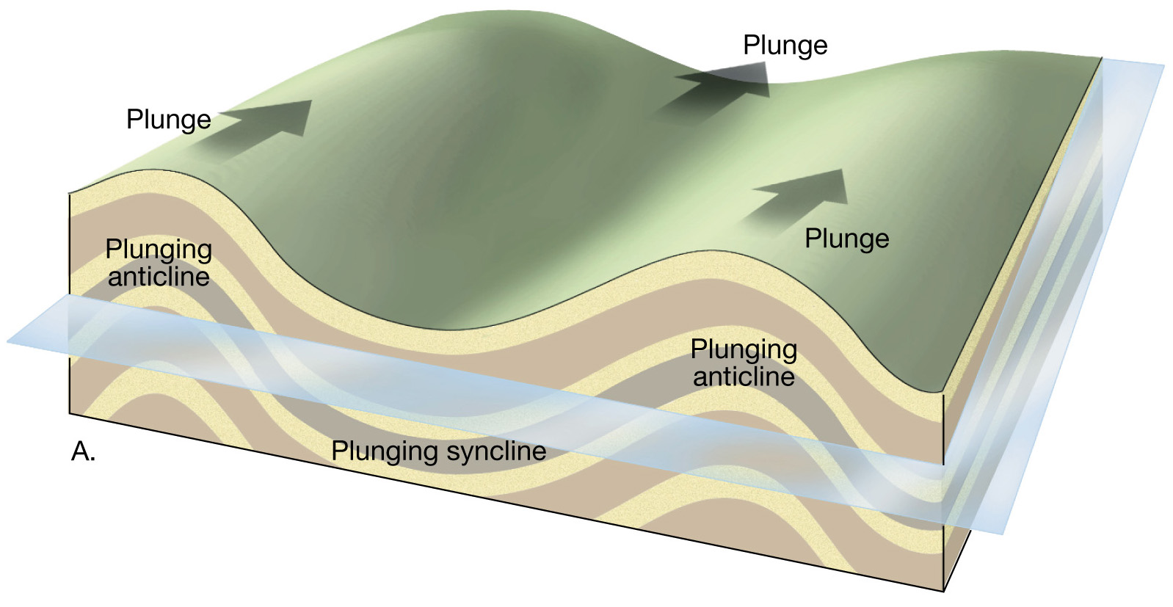
Plunging folds

Slide 26
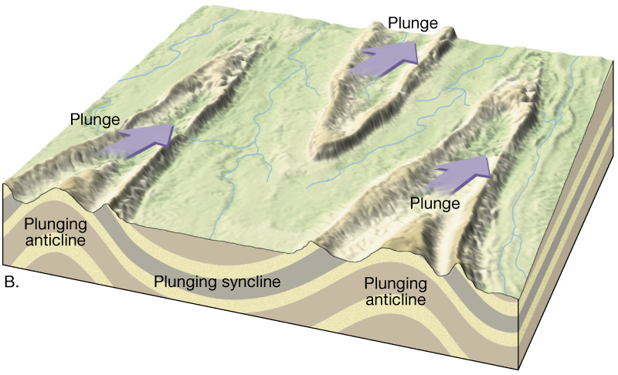
Outcrop patterns of plunging folds

Slide 27
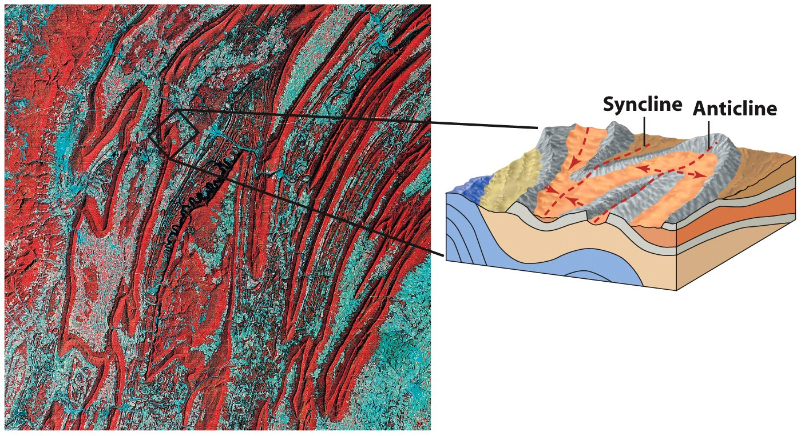
Folds in the Appalachian Mnts, Pennsylvania

Slide 28
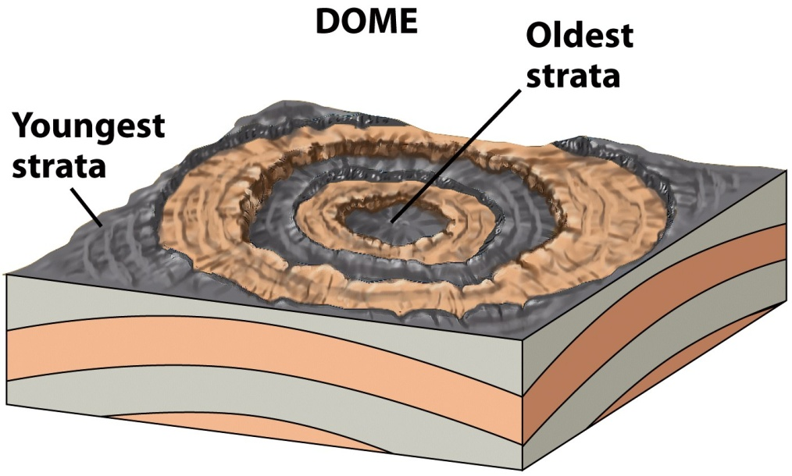
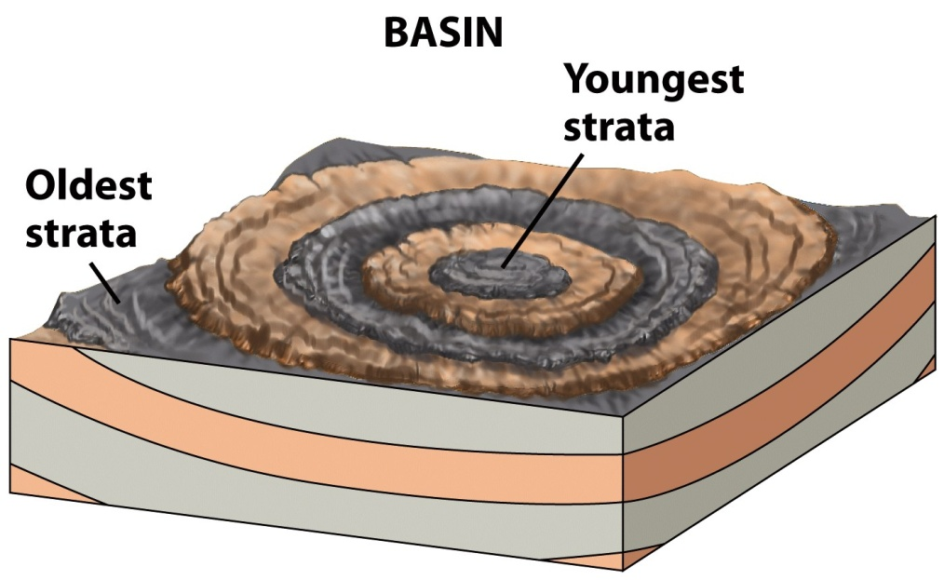
Folds
      Dome
Basin
Circular, or slightly elongated
Upwarped displacement of rocks
Oldest rocks in core
Circular, or slightly elongated
Downwarped displacement of rocks
Youngest rocks in core

Slide 29
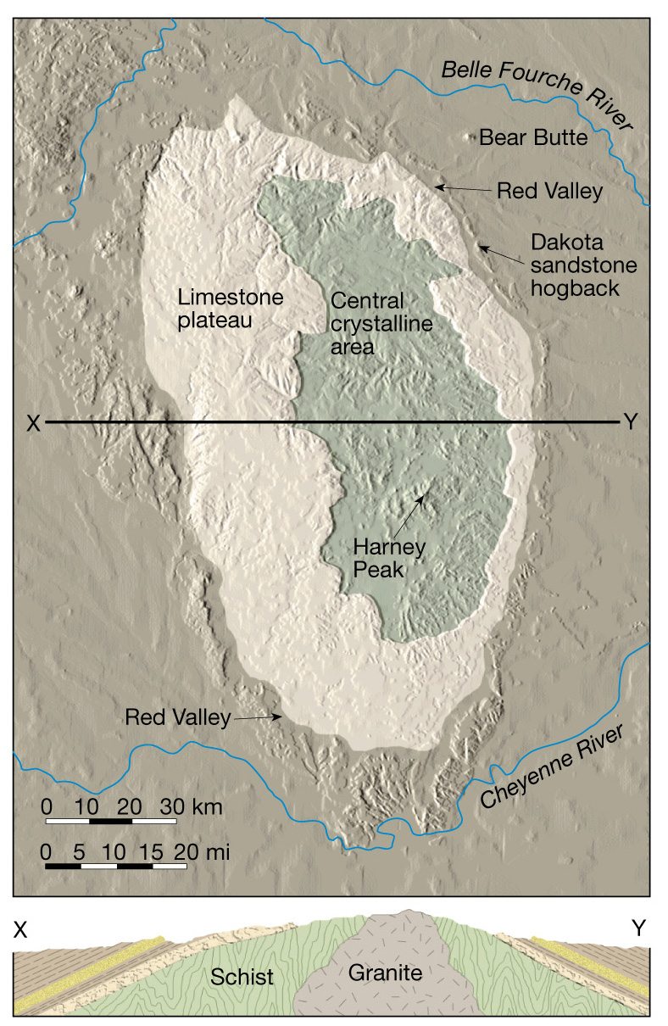
The Black Hills of South Dakota are a large dome

Slide 30
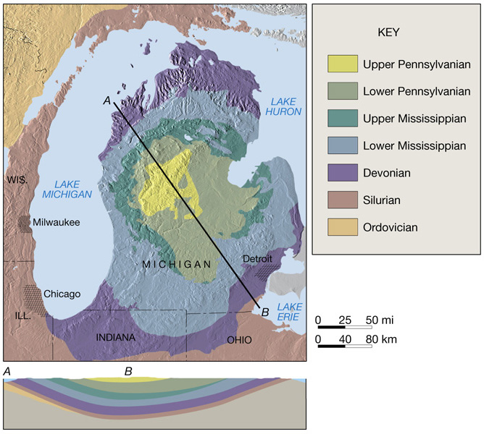
The bedrock geology of the Michigan Basin

Slide 31
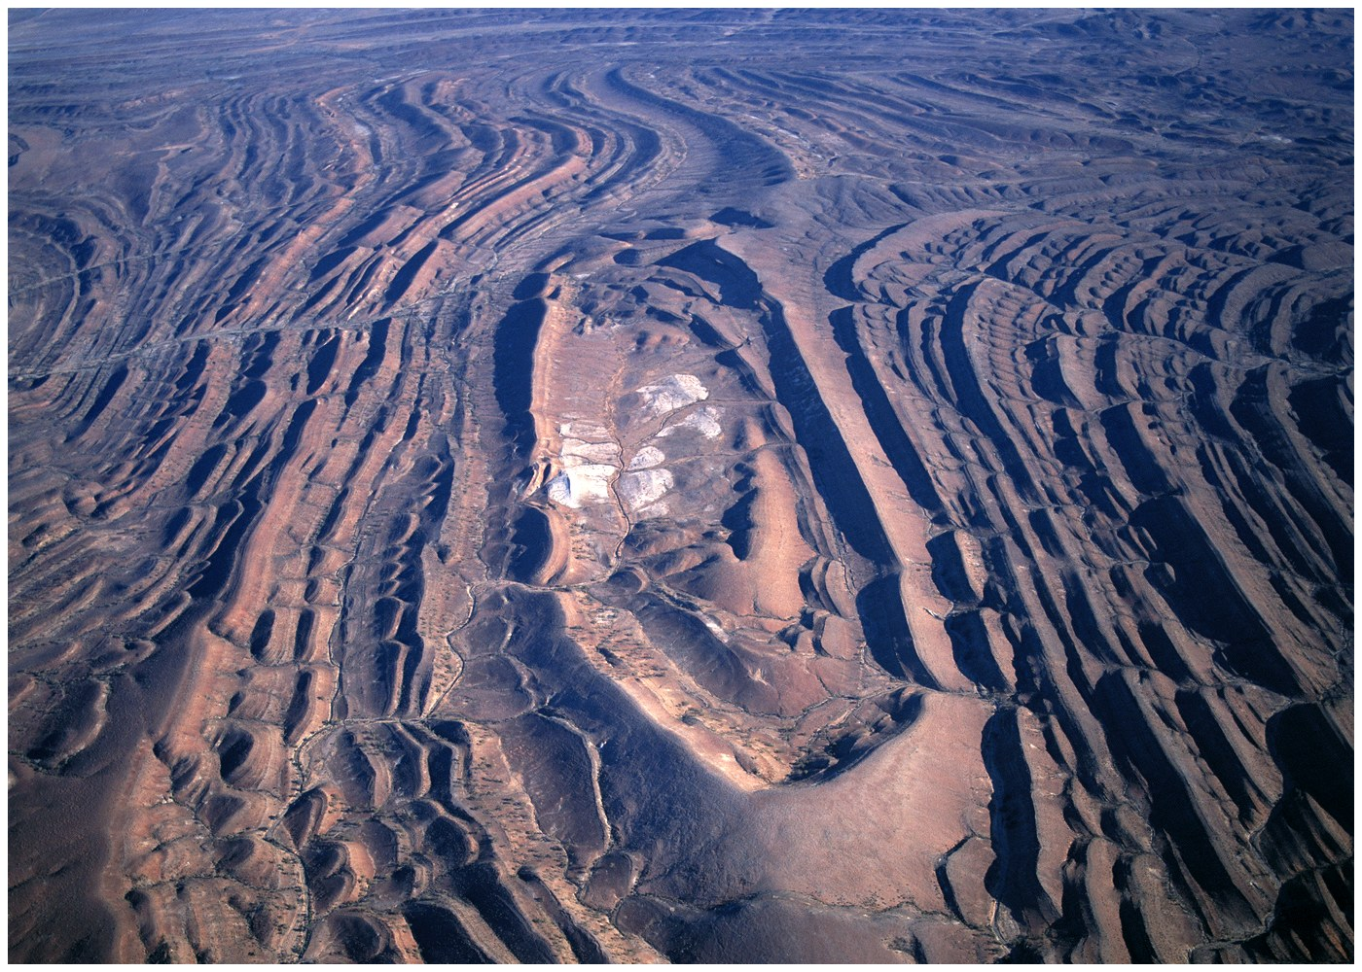
Dome in Flinders Range, South Australia

Slide 32
Faults
Faults are fractures (breaks) in rocks along which appreciable displacement has taken place

Slide 33
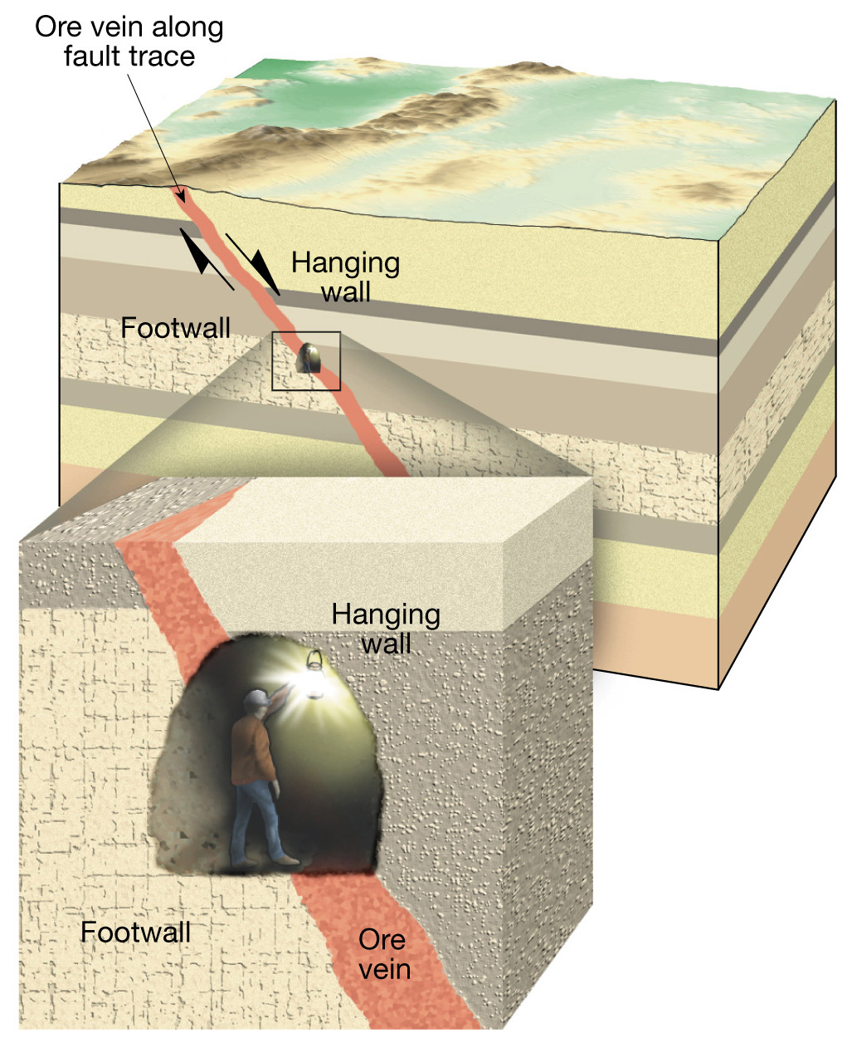
Concept of hanging wall and footwall along a fault

Slide 34
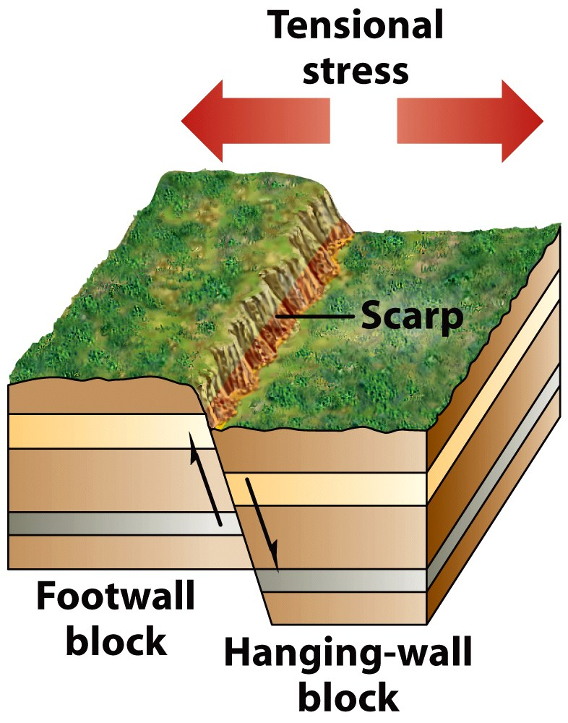
Types of Faults
Normal Faults

Slide 35
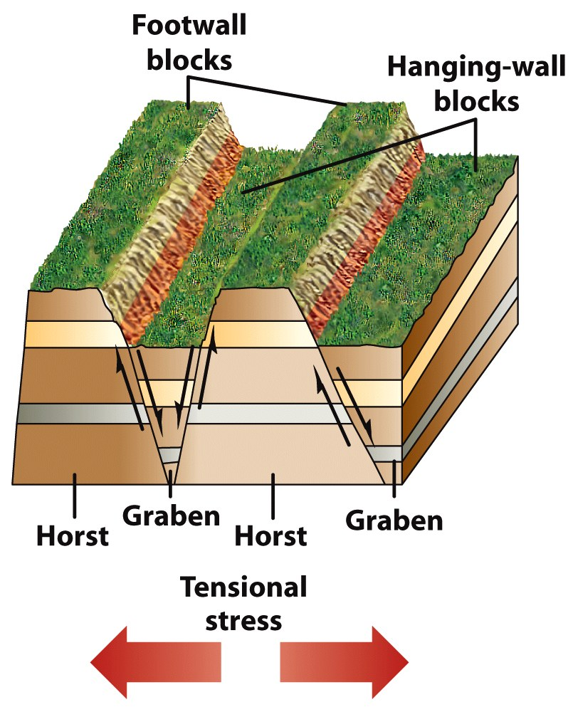
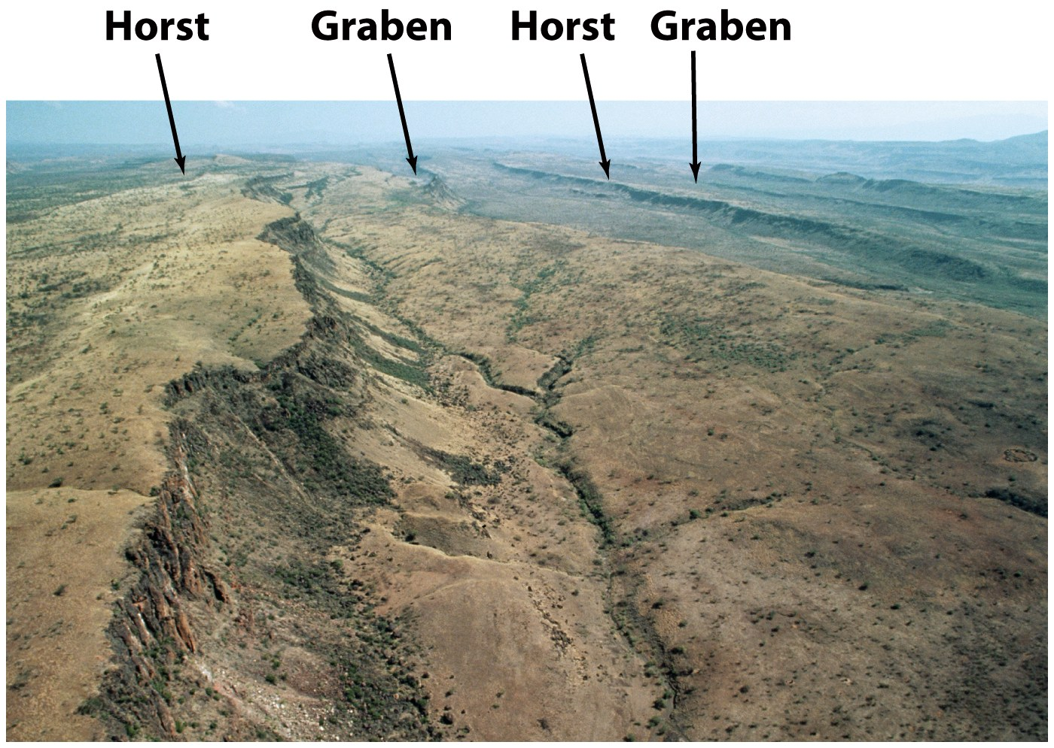
Normal Faults Extensional Tectonics

Slide 36
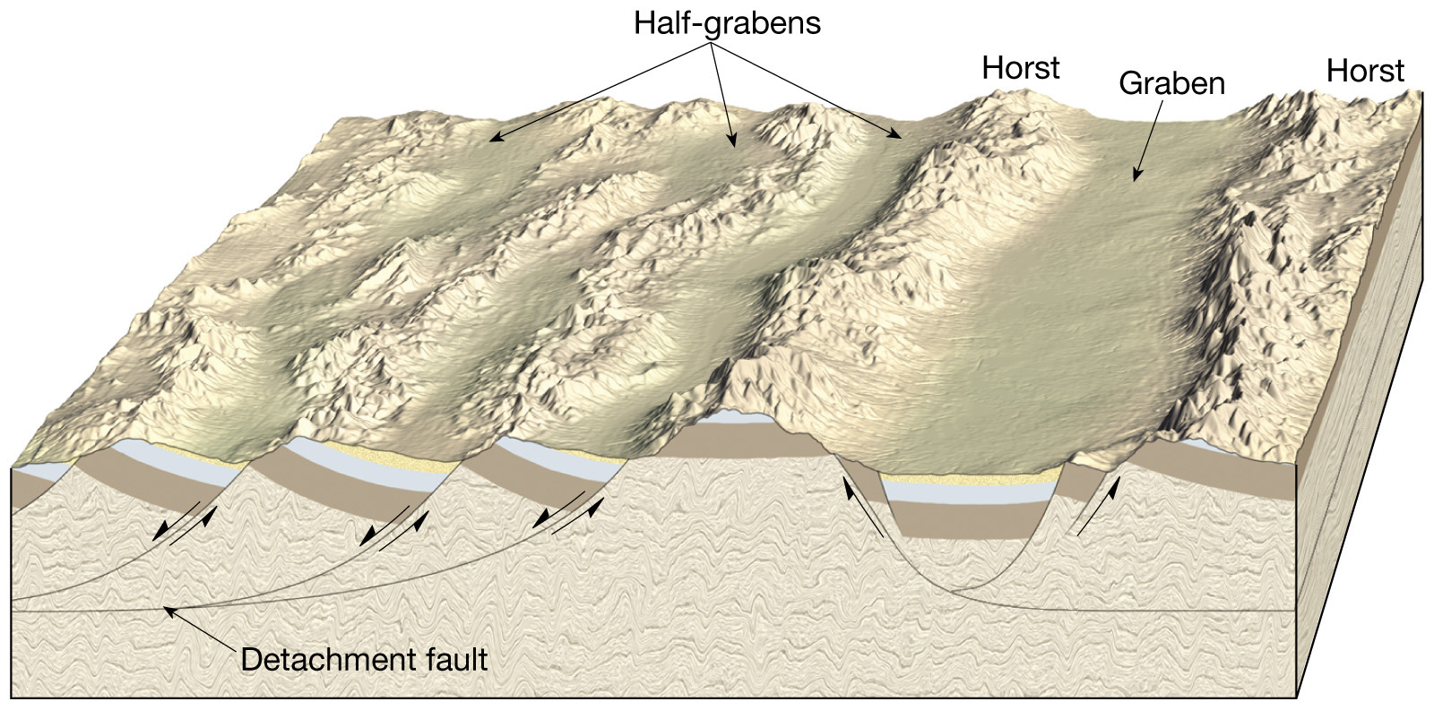
Fault block mountains produced by normal faulting

Slide 37
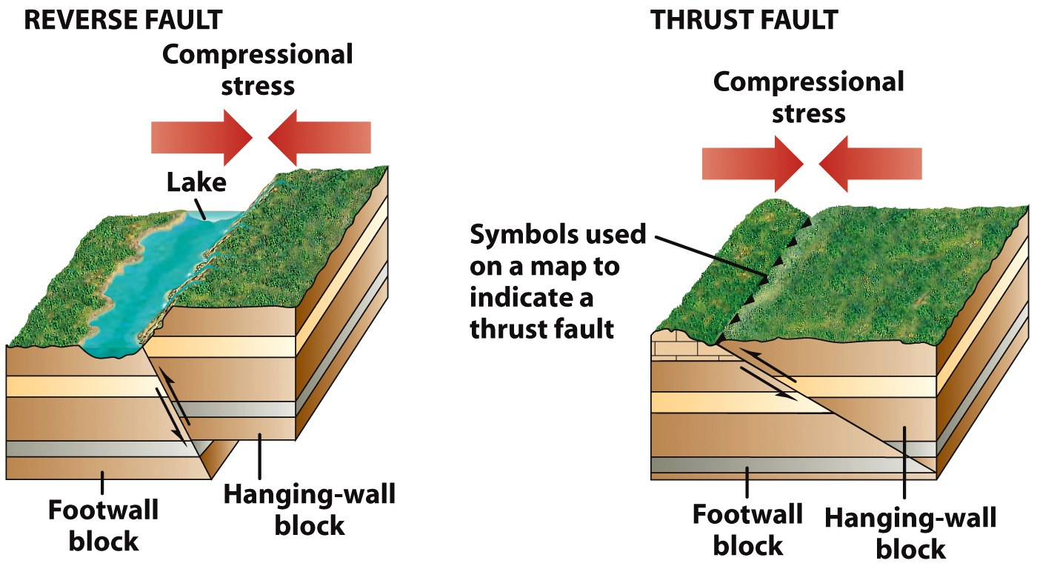
Types of Faults
Reverse
Thrust
    The block on top of the fault surface moves up and over the block on the bottom
    A reverse fault with a shallow angle of dip

Slide 38
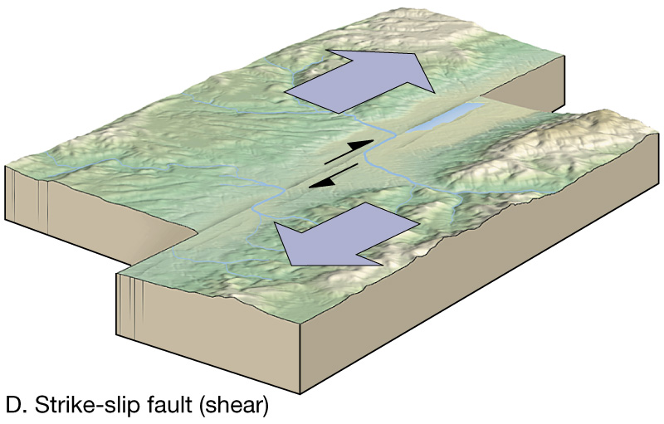
Types of Faults
Strike-slip faults
  Dominant displacement is horizontal and parallel to the trend, or strike
  Right, Left and Transform fault

Slide 39
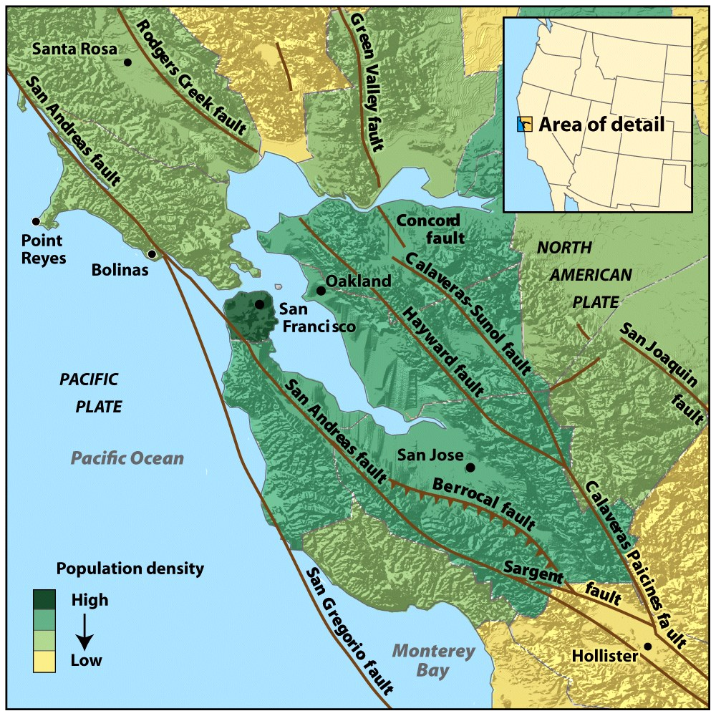

Slide 40
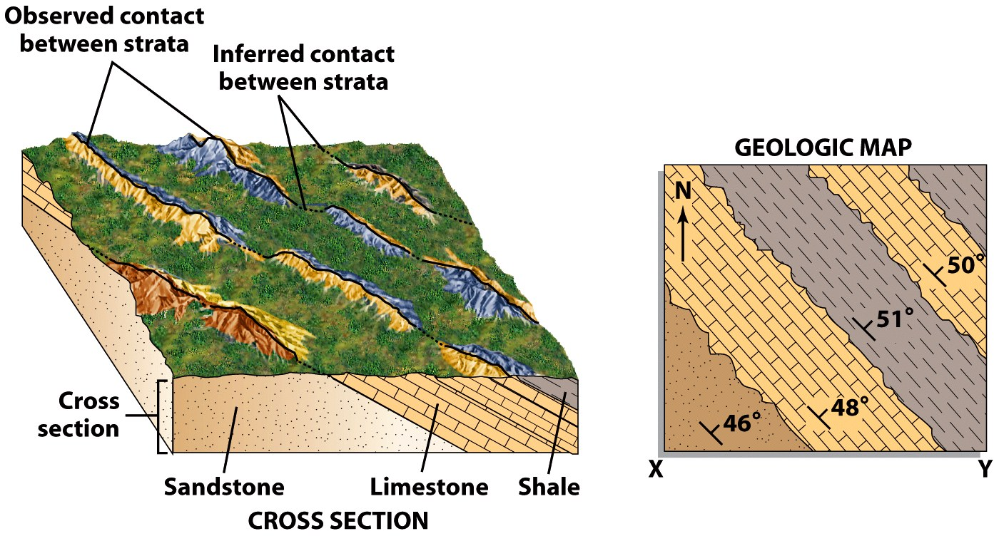
Geologic Maps
Shows the locations, kinds, & orientation of rock units & structural features (faults & folds)

Slide 41
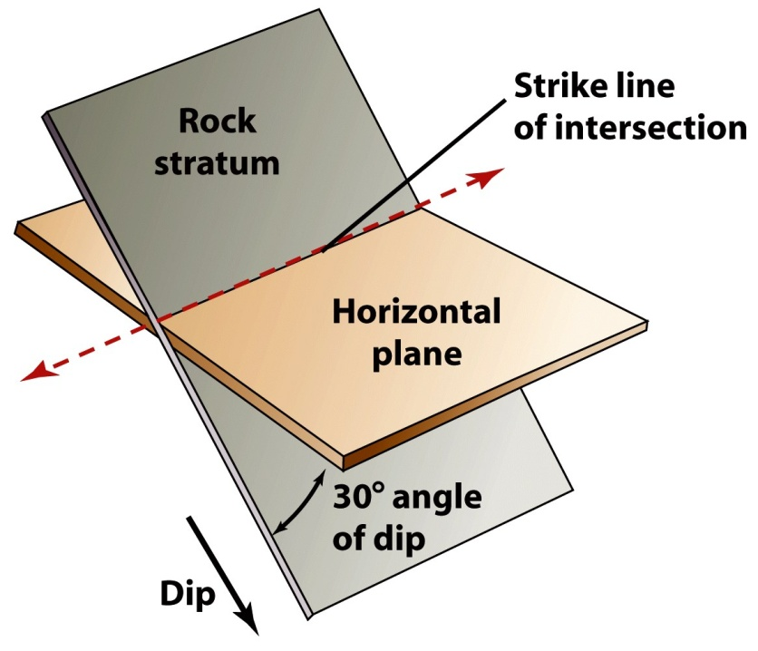
Geologic Mapping
Strike
  The compass orientation of the line of intersection between a horizontal plane and a planar feature (e.g. rock layer or fault)
Dip
  The angle between the tilted surface and a horizontal plane

Slide 42
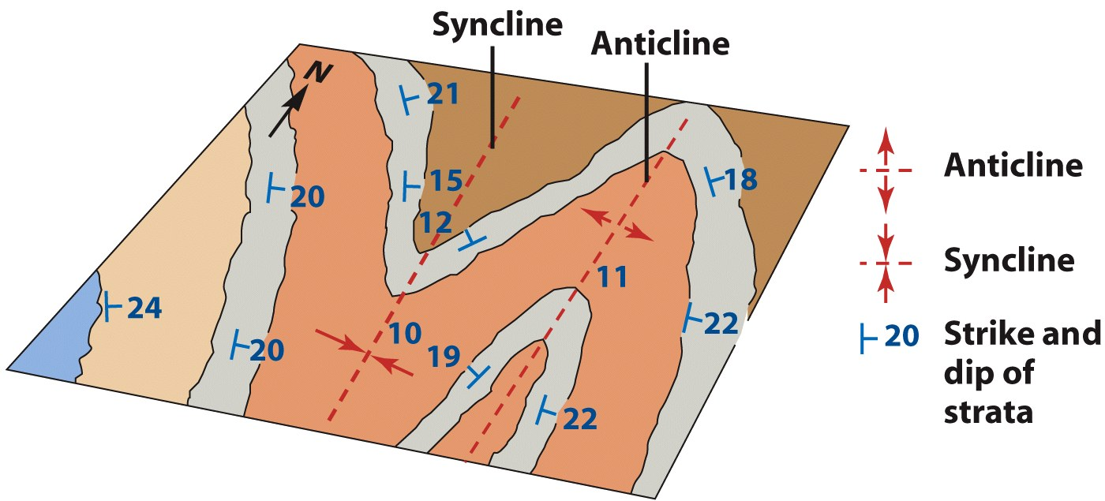
Geologic Mapping

Slide 43
Geologic Mapping
Making and interpreting geologic maps
  Topographic maps…
    Show the shape of a ground surface, as well as the location and elevation of surface features, usually by means of contour lines

Slide 44
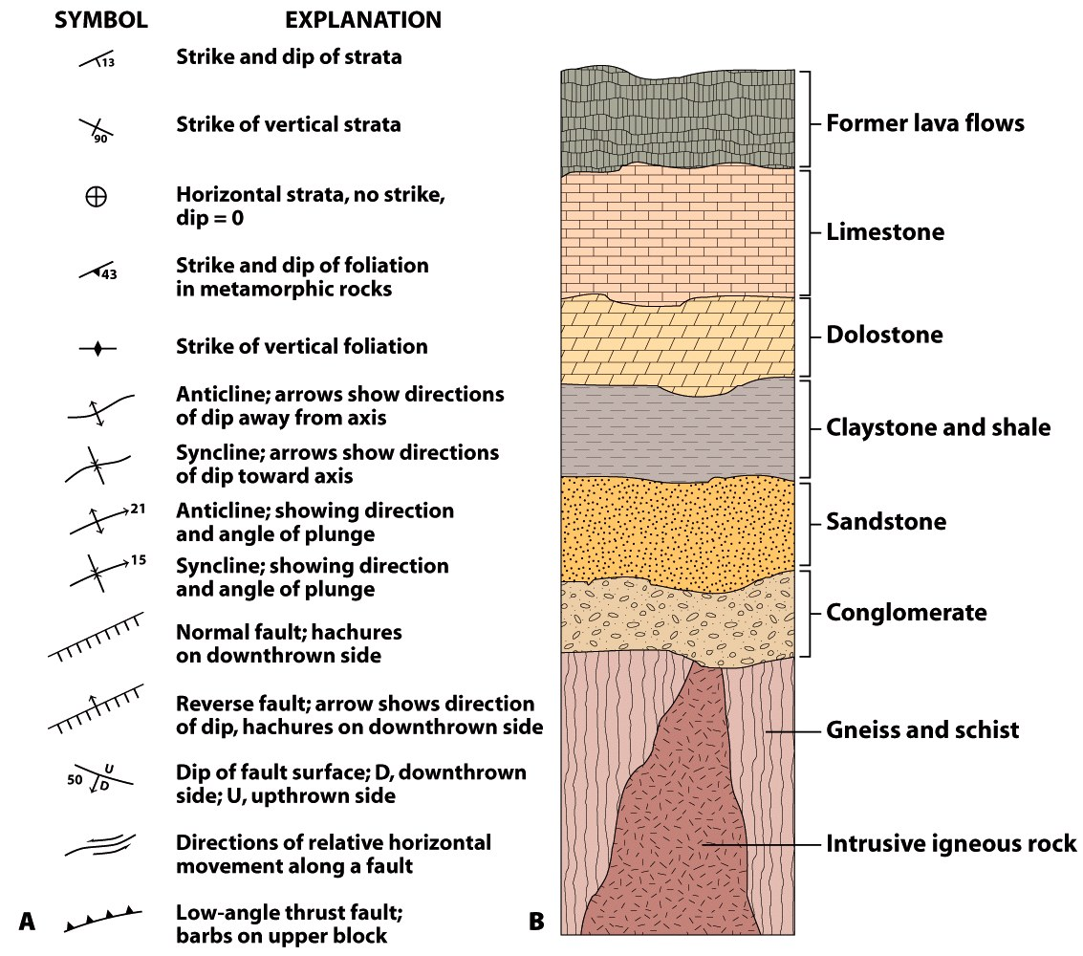
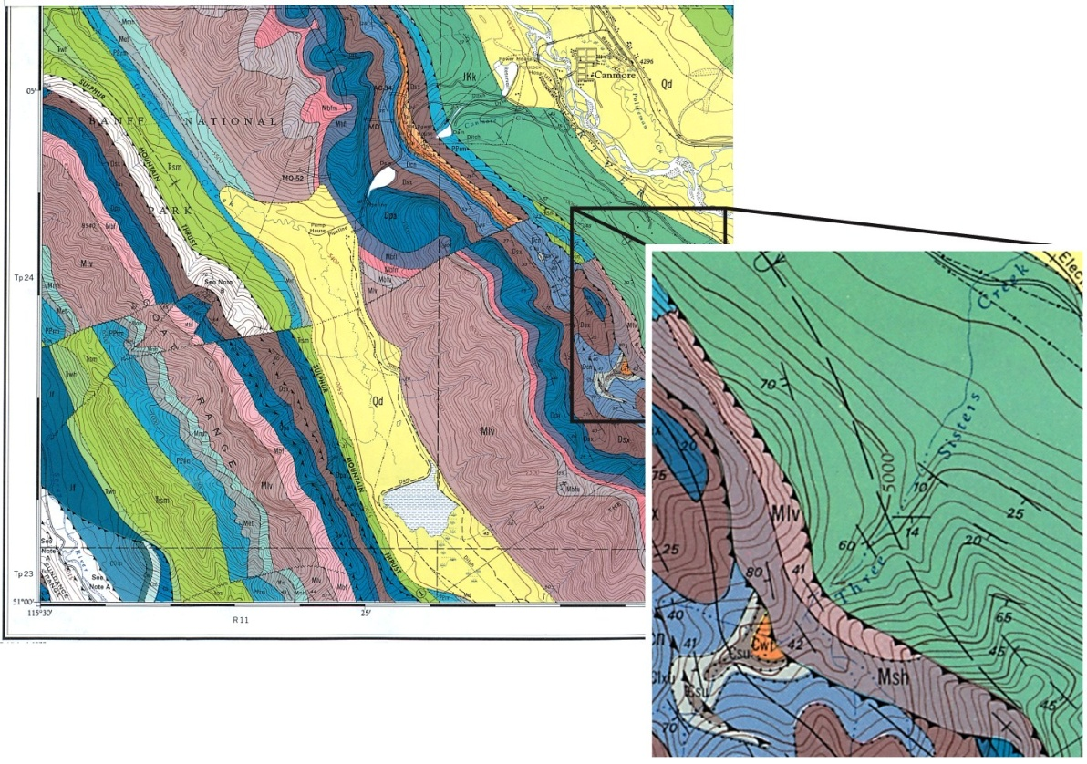
Geologic Maps

Slide 45
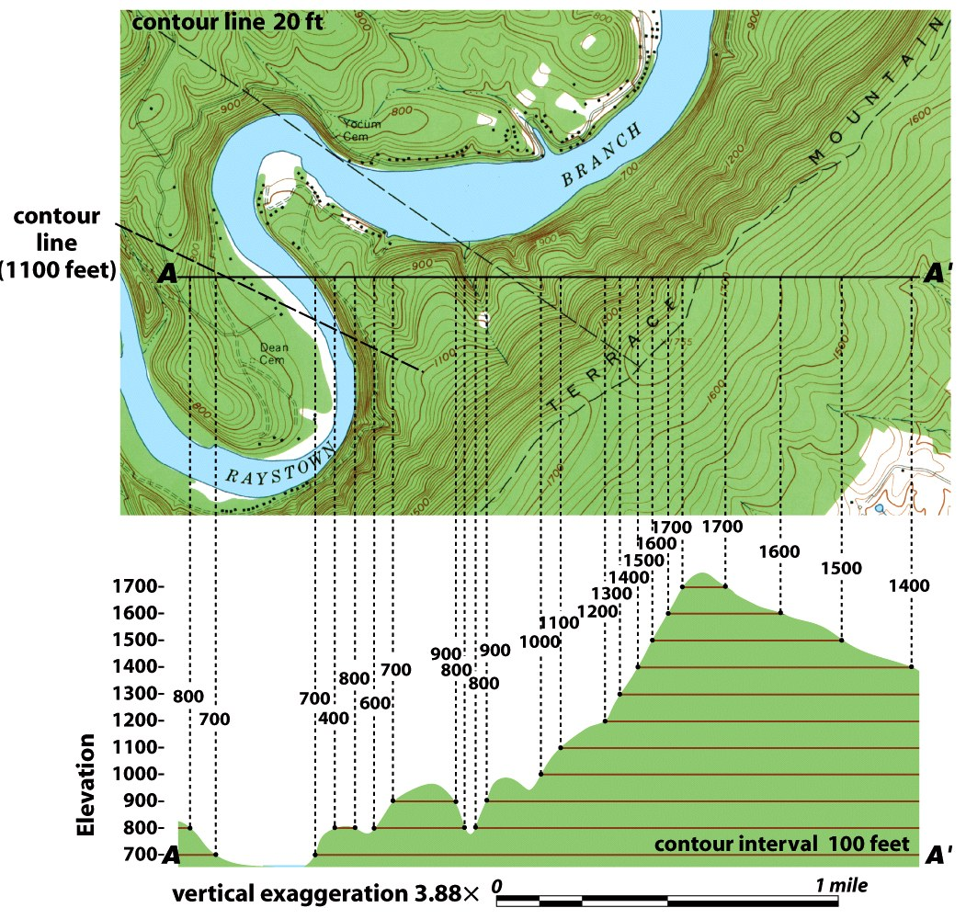

Slide 46
~ End ~

