Slide 1
Earthquakes
Whole lotta shakin’ goin’ on . . .

Slide 2
  Assessing the risk: How common is this disaster and where does this disaster normally occur?

Slide 3
Sources of Earthquakes
Convergent Plate Boundaries
  Subduction Zones
  Continental-Continental Collision Zones
Transform Plate Boundaries
Divergent Plate Boundaries
Intra-Plate Boundaries

Slide 4
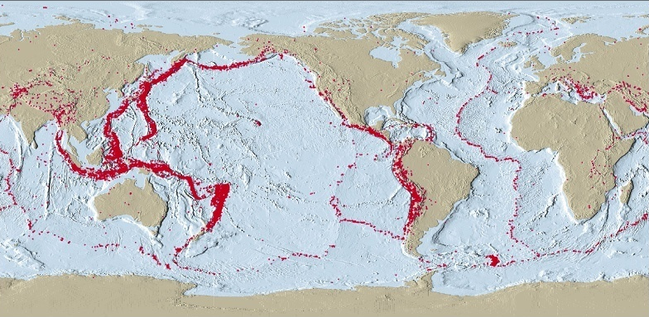
Distribution Of Magnitude 5 Or Greater Earthquakes, 1980 - 1990

Slide 5
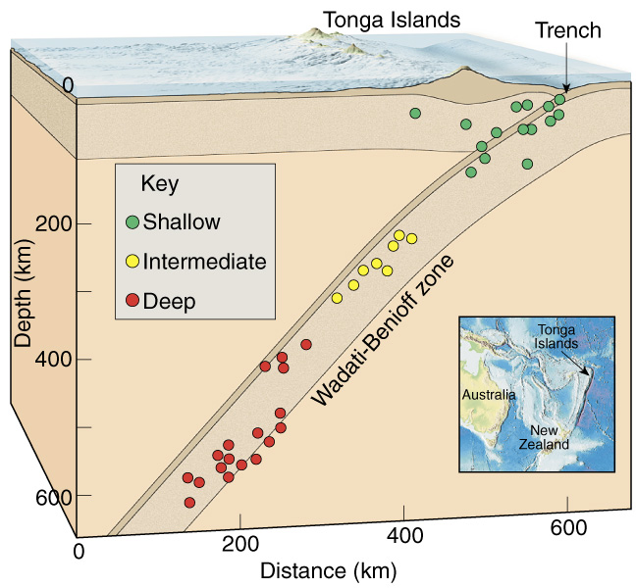
Earthquake Locations
Shallow
(up to 70 km below the surface)
Intermediate
(70 to 300 km)
Deep
(greater than 300 km)

Slide 6
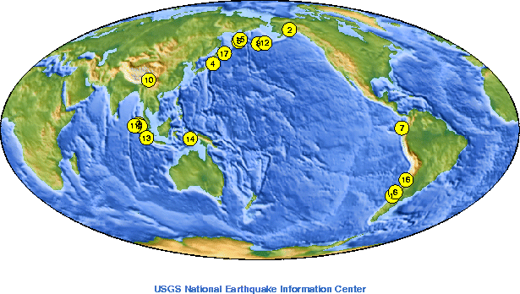
Largest Earthquakes Since 1900
 | Location | Date UTC | M
1. | Chile | 1960 05 22 | 9.5
2. | 1964 Great Alaska Earthquake | 1964 03 28 | 9.2
3. | Off the West Coast of Northern Sumatra | 2004 12 26 | 9.1
4. | Near the East Coast of Honshu, Japan | 2011 03 11 | 9.0
5. | Kamchatka | 1952 11 04 | 9.0
6. | Offshore Maule, Chile | 2010 02 27 | 8.8
7. | Off the Coast of Ecuador | 1906 01 31 | 8.8
8. | Rat Islands, Alaska | 1965 02 04 | 8.7
9. | Northern Sumatra, Indonesia | 2005 03 28 | 8.6
10. | Assam - Tibet | 1950 08 15 | 8.6
11. | Off the west coast of northern Sumatra | 2012 04 11 | 8.6
12. | Andreanof Islands, Alaska | 1957 03 09 | 8.6
13. | Southern Sumatra, Indonesia | 2007 09 12 | 8.5
14. | Banda Sea, Indonesia | 1938 02 01 | 8.5
15. | Kamchatka | 1923 02 03 | 8.5
16. | Chile-Argentina Border | 1922 11 11 | 8.5
17. | Kuril Islands | 1963 10 13 | 8.5
Source

Slide 7
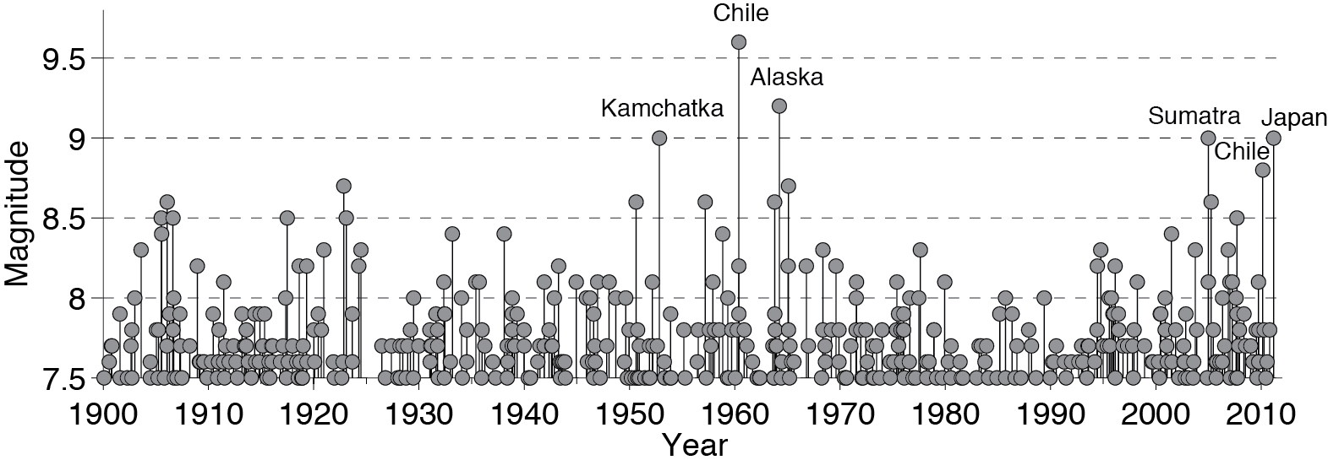
Largest Earthquakes Since 1900
Data: USGS PAGERCAT 1900-2008, USGS-NEIC & gCMT 2008-present
Figure courtesy of Charles Ammon, after Ammon et al., SRL, 2010

Slide 8
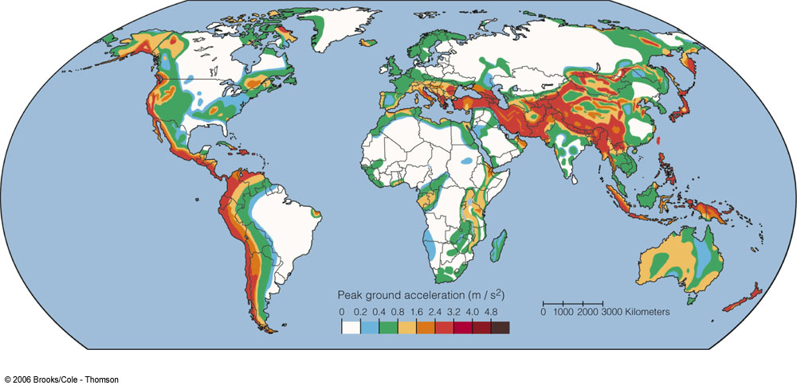
Global Earthquake Hazards
Image from Natural Hazards & Disasters 1/e, Hyndman & Hyndman

Slide 9
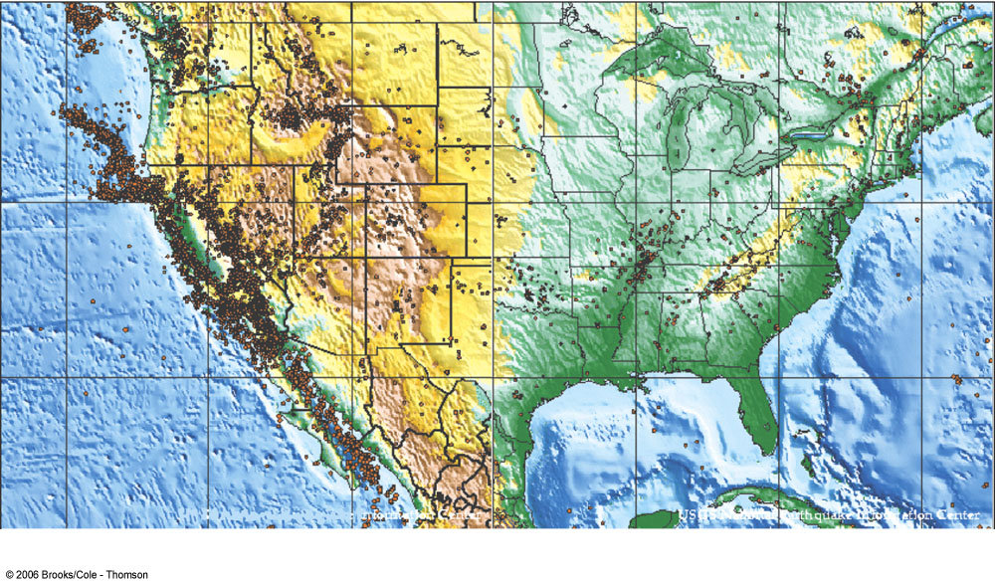
U.S. Earthquake Epicenters
Image from Natural Hazards & Disasters 1/e, Hyndman & Hyndman

Slide 10

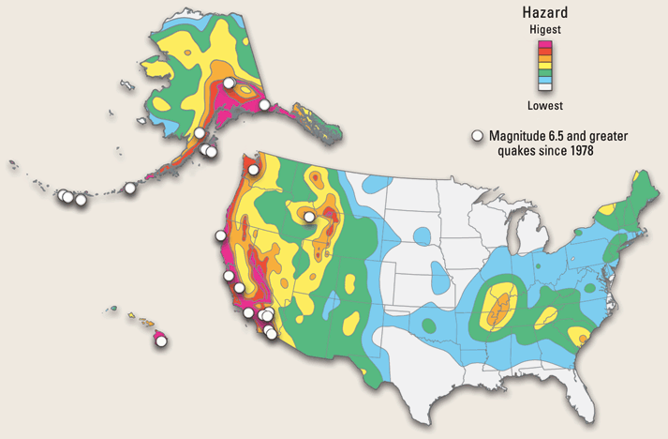


USGS National Seismic Hazard Map
2
4
1
5
3
6

Slide 11
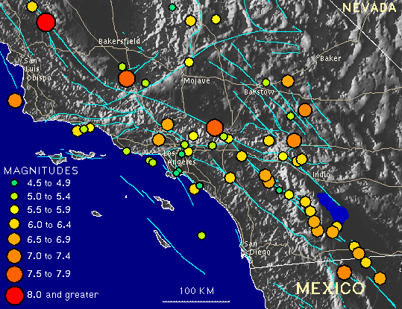
Historic California Earthquakes (+7 M)
1857 –Fort Tejon (8.25)
1972 – Owens Valley (7.2)
1906 – San Francisco (8.25)
1922 – W. of Eureka (7.3)
1923 – Cape Mendocino (7.2)
1927 – SW of Lompoc (7.3)
11150 – Imperial Valley (7.1)
1952 – Kern County (7.7)
1971 – San Fernando (6.5)
1980 – W. of Eureka (7.2)
1989 – Loma Prieta (7.1)
1991 – W. of Crescent City (7.1)
1992 – Cape Mendocino (7.2)
1992 – Landers (7.3)
1994 – Northridge (6.7)
1999 – Hector Mine (7.1)
(http://www.scecdc.scec.org/clickmap.html)

Slide 12
Map of southern California, with epicenters of historic earthquakes (as far back as 1812) of particular note plotted over the background topography. Shown, too, are major highways (in tan) and the surface traces of major faults (in greenish-blue). (http://www.scecdc.scec.org/clickmap.html)

Slide 13
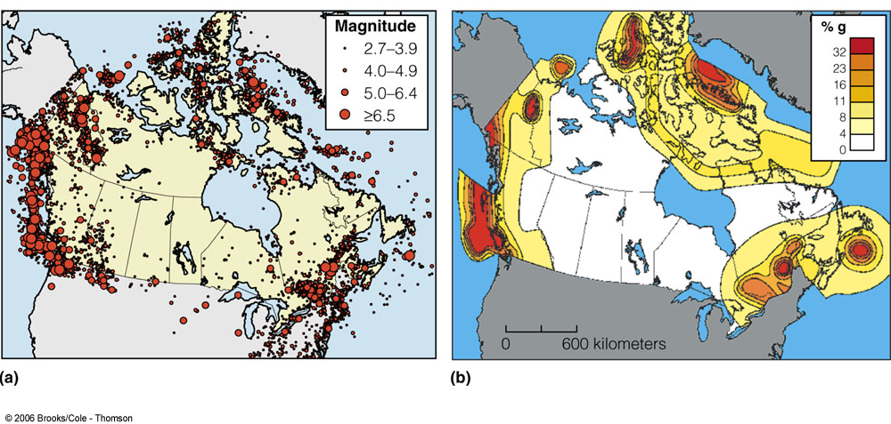
Canadian Earthquakes

Slide 14
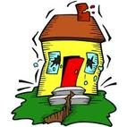
What are Earthquakes?
An earthquake is the vibration of Earth produced by the rapid release of energy

Slide 15
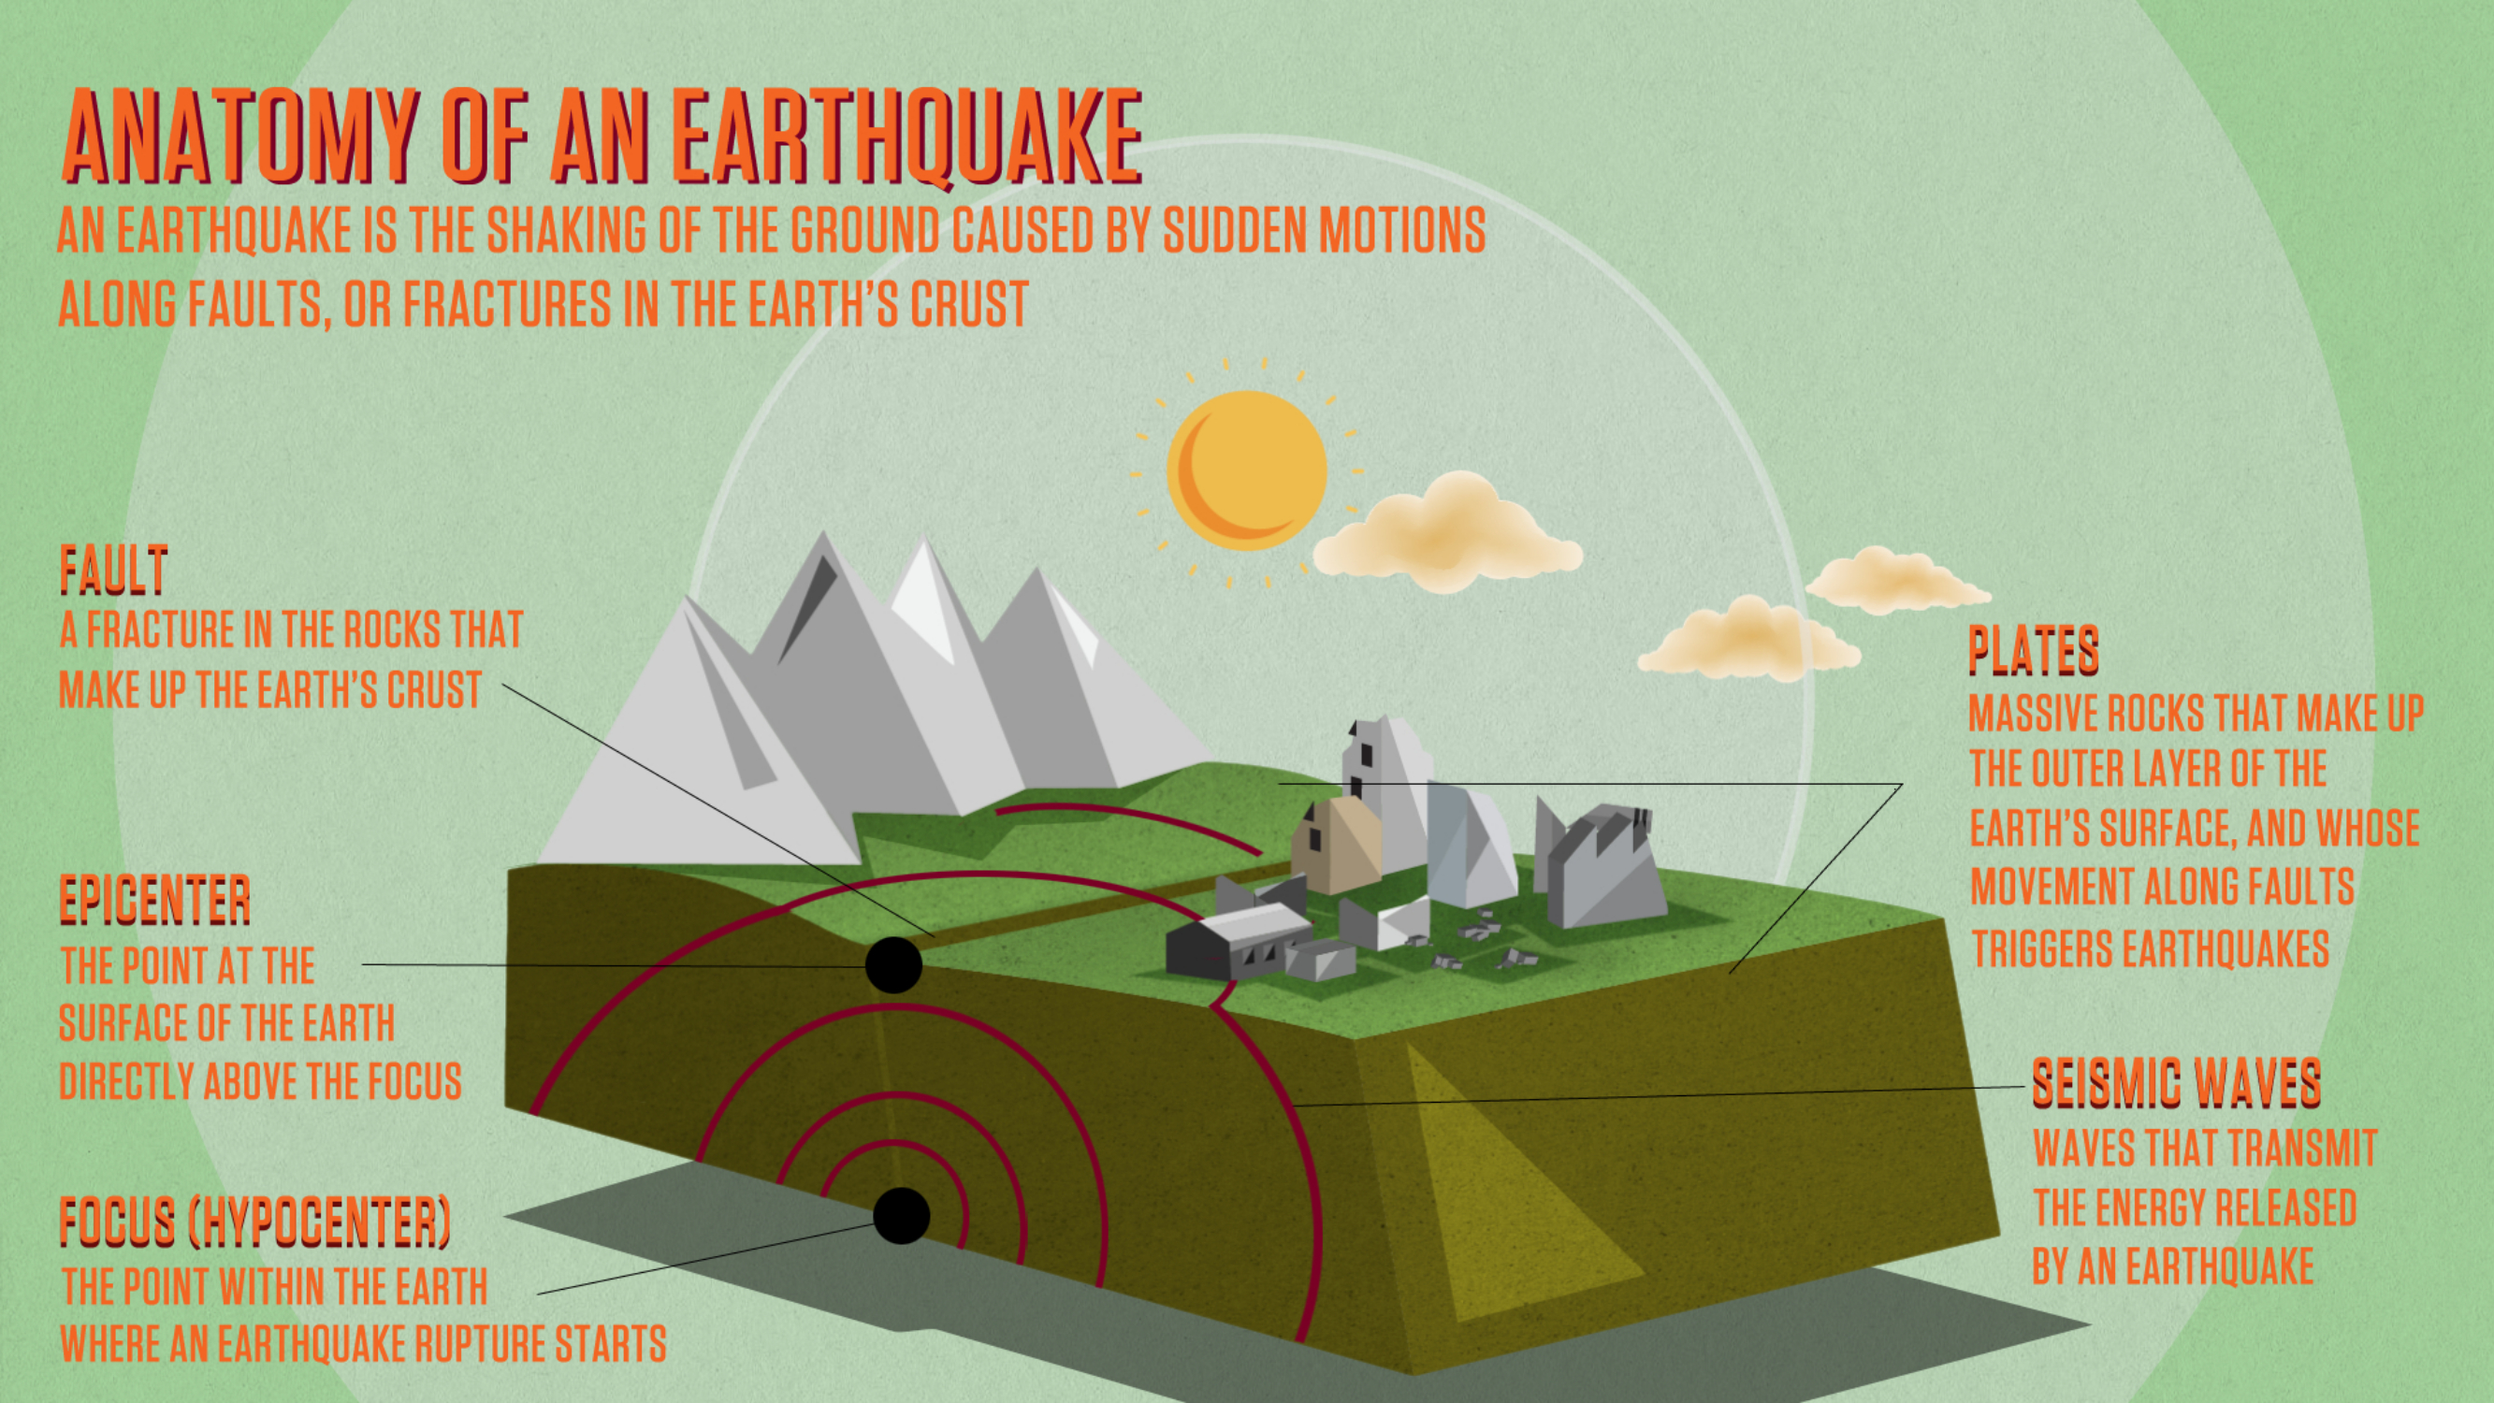
Notes:
http://science.kqed.org/quest/explainer/earthquakes/

Slide 16
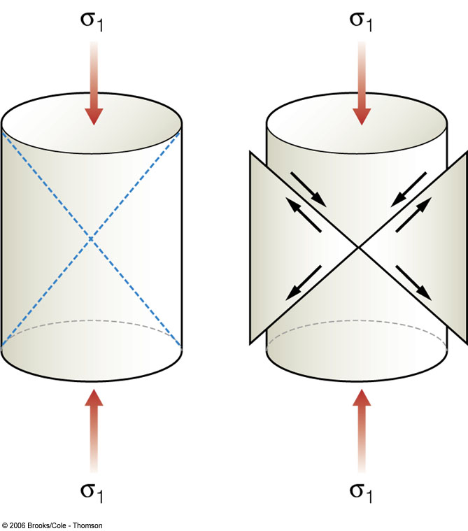
What Happens During an EQ?
Stress = forces acting upon the rock
Strain = the changes in the rock in response to stress
Image from Natural Hazards & Disasters 1/e, Hyndman & Hyndman

Slide 17
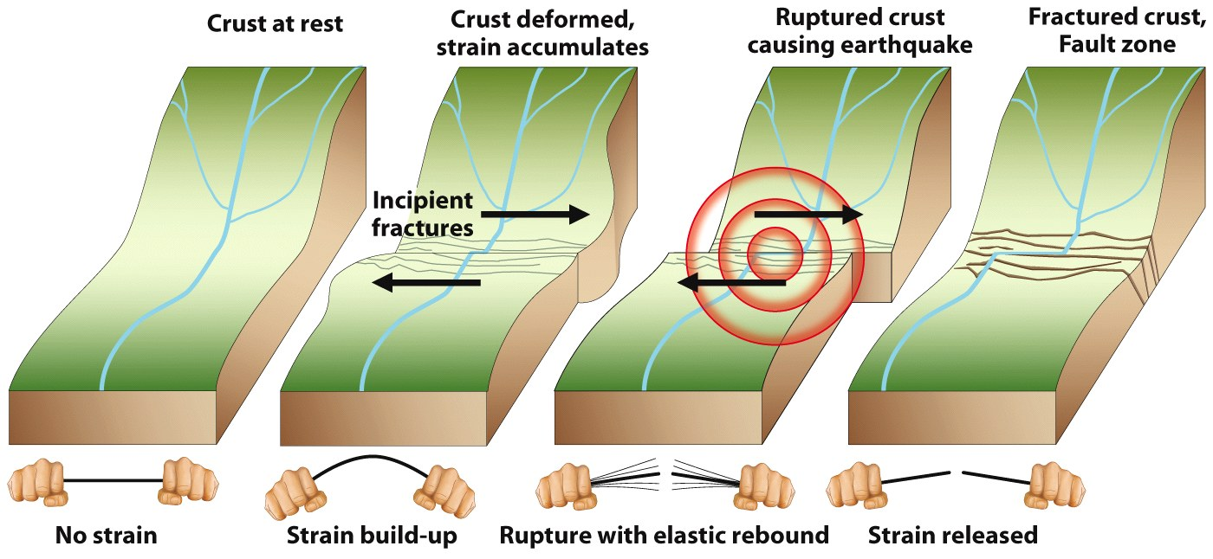
What Happens During an EQ?

Slide 18
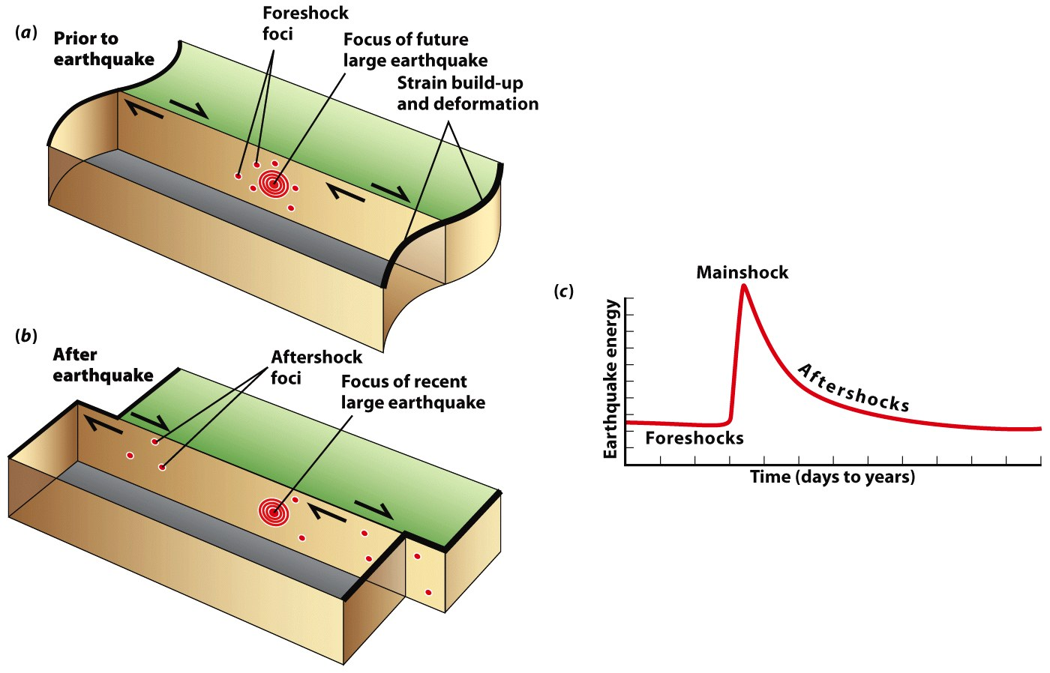
What Happens During an EQ?
Earthquakes tend to occur in Clusters!

Slide 19
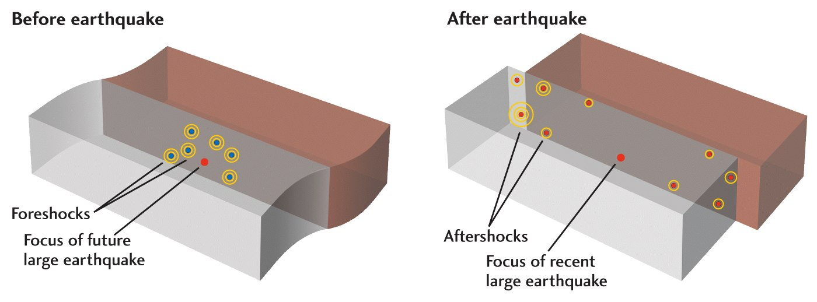
Foreshock, mainshock, aftershock
Foreshocks - small earthquakes that happen in the area where the mainshock will be.
Mainshock - the largest earthquake in a series of quakes; sometimes is preceded by a foreshock but is always followed by aftershocks.
Aftershock - earthquakes that occur after the mainshock as the ground is settling back down.

Slide 20
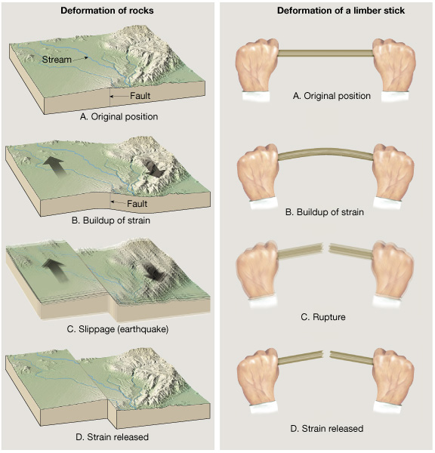
Elastic Rebound
The gradual accumulation and release of stress and strain is now referred to as the "elastic rebound theory" of earthquakes. Most earthquakes are the result of the sudden elastic rebound of previously stored energy. (source)

Slide 21
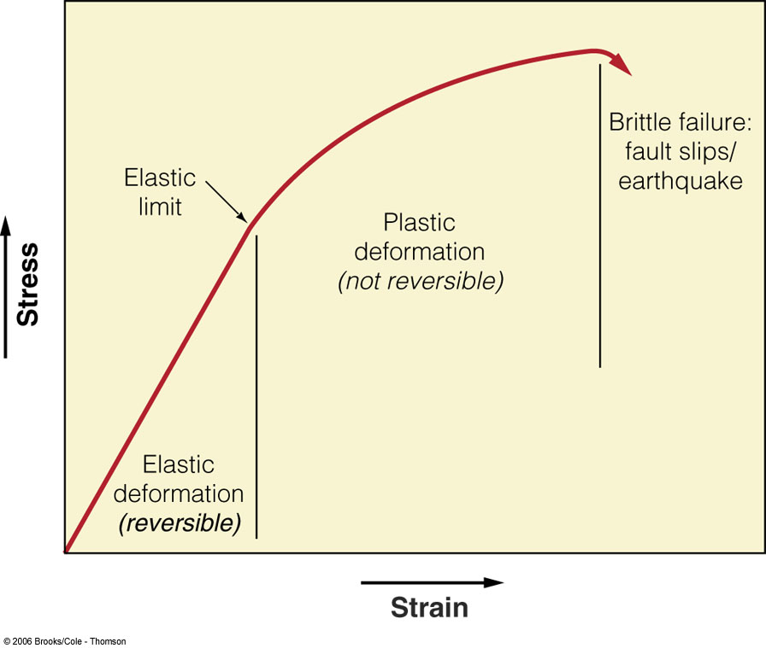

Slide 22
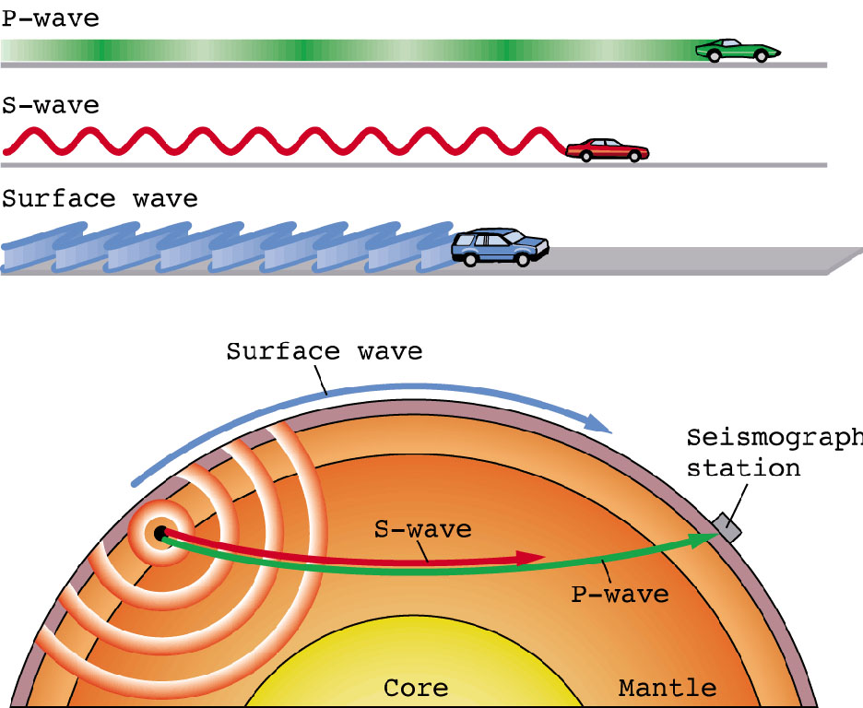
Seismic Waves
Two main types of
seismic waves
  Surface waves
    Rayleigh waves
    Love waves
  Body waves
    P waves
    S waves

Slide 23
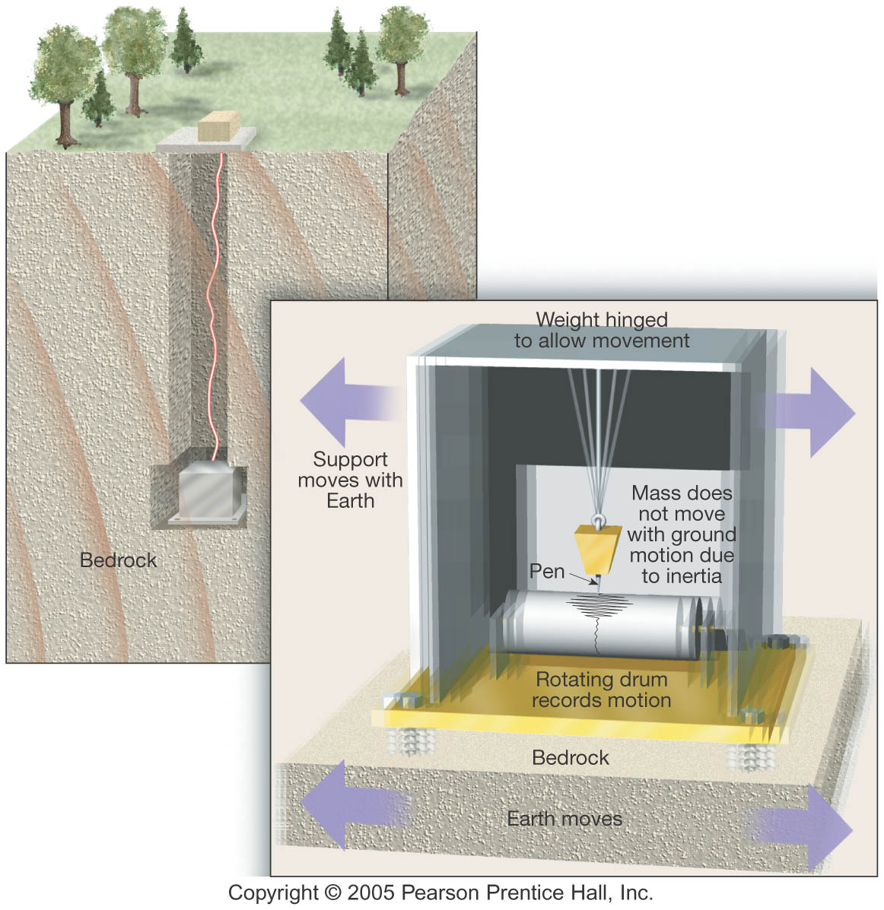
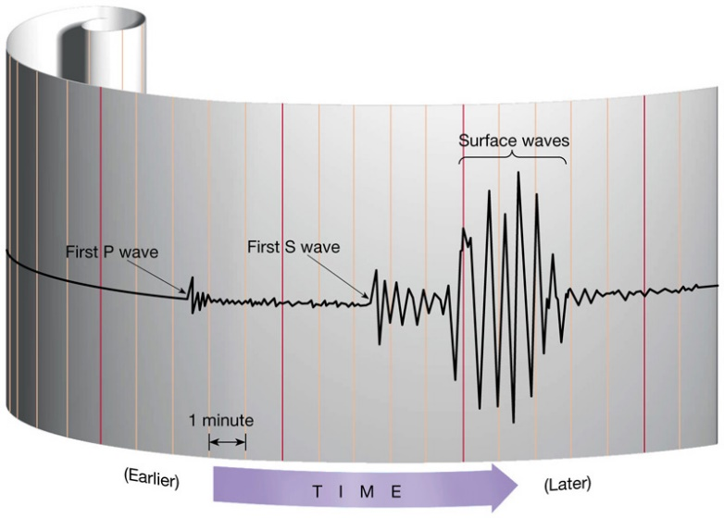
Seismic Waves
Seismograph
  Records movement
  of Earth
Seismogram
  Record produced by
  a seismograph

Slide 24
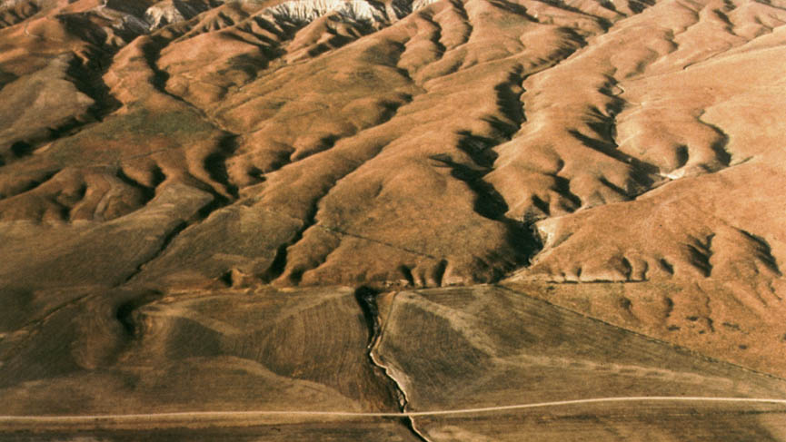
Faults are fractures in the crust along which appreciable displacement has occurred.
Stream displacement on the San Andreas Fault in the Carrizo Plain, CA Source

Slide 25
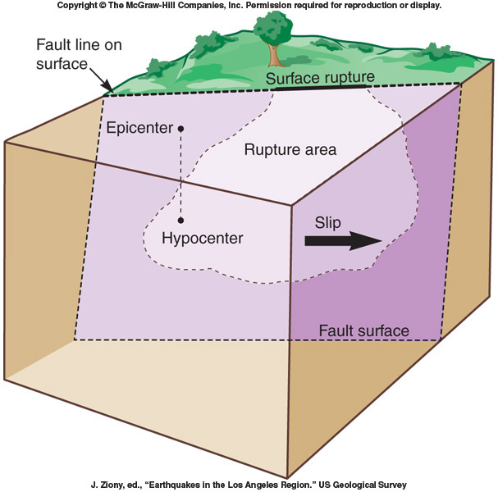
The displacement along a fault can occur at the surface (surface rupture) or at depth (rupture area) or both.
Movement can be horizontal and/or vertical.
The amount of displacement varies, but typically the larger the earthquake the more displacement there is.

Slide 26
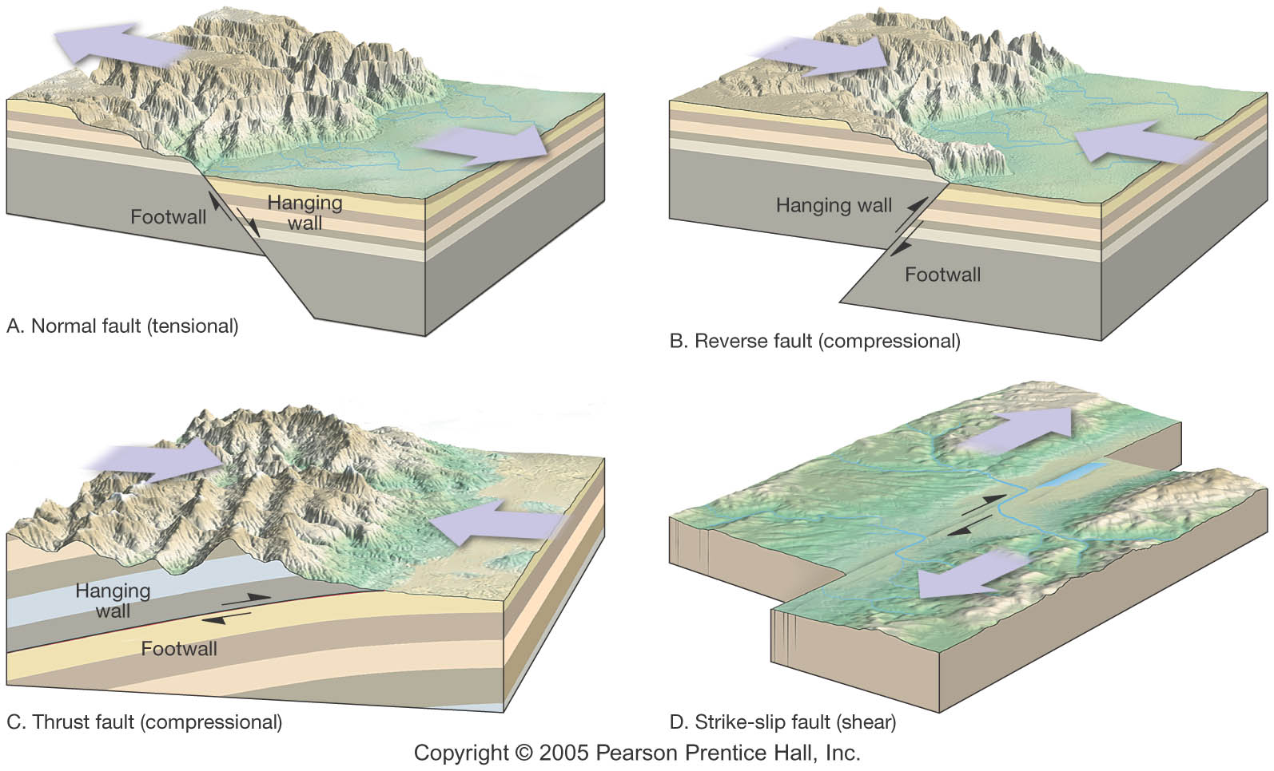
Types of Faults
Dip-Slip
  Normal
  Reverse
  Thrust
Strike-Slip
  Right lateral
  Left lateral
  Transform

Slide 27
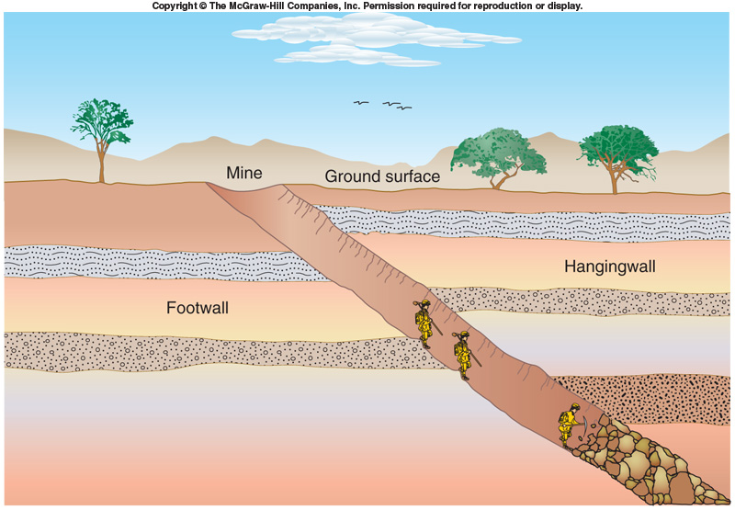
Dip Slip Faults
Hanging wall
Footwall
Movement is primarily vertical and parallel to the fault plane
May produce long, low cliffs called fault scarps

Slide 28
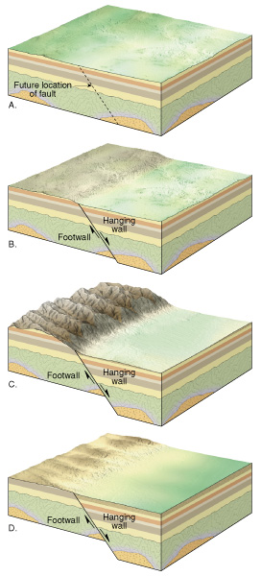
Dip Slip Faults
Normal Faults
  Hanging wall block moves down relative to the footwall block
  Accommodate lengthening or extension of the crust

Slide 29
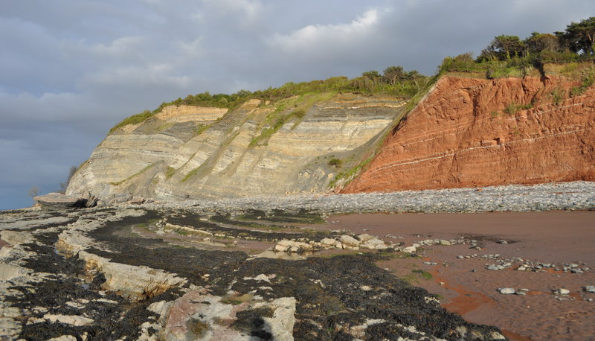
Normal Faults
Large normal fault in Triassic to Lower Jurassic Blue Anchor Formation sediments near Blue Anchor, Somerset, UK. Source

Slide 30
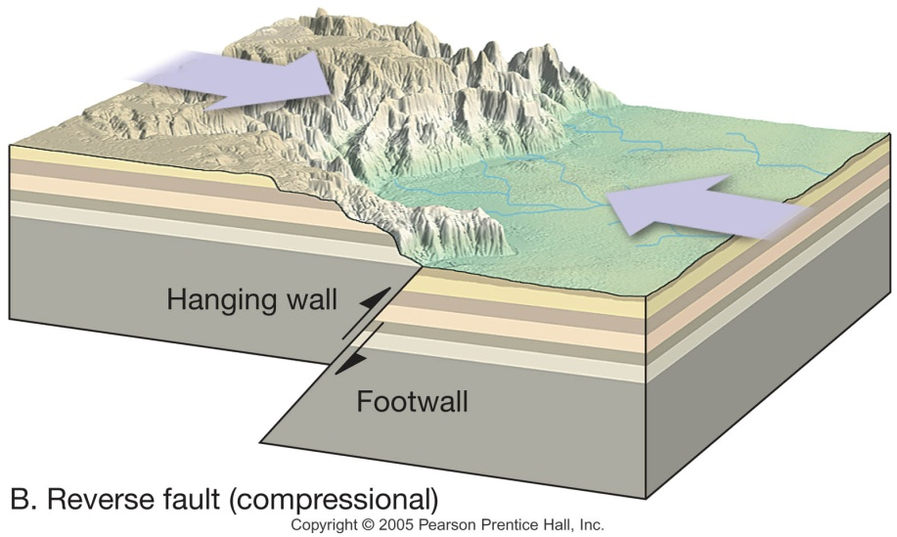
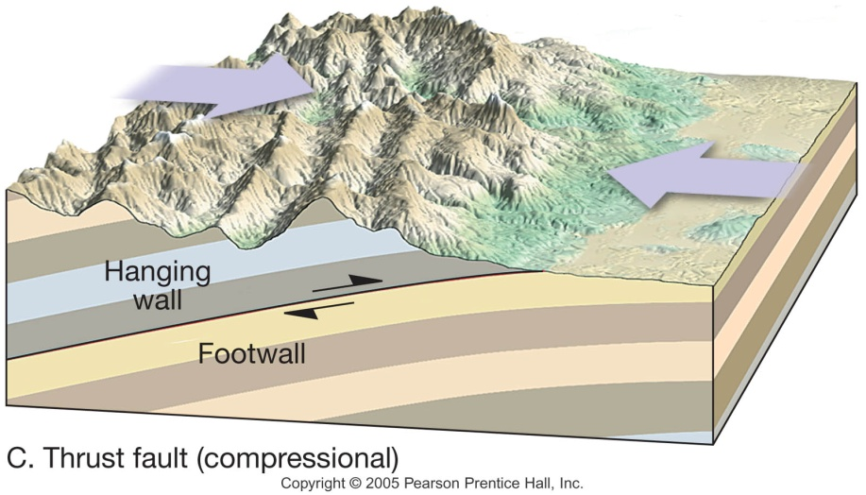
Dip Slip Faults
Reverse faults
  Hanging wall block moves up relative to the footwall block
  Reverse faults have dips greater than 45°
  Thrust faults have dips less then 45°
  Accommodate shortening of the crust (compression)

Slide 31
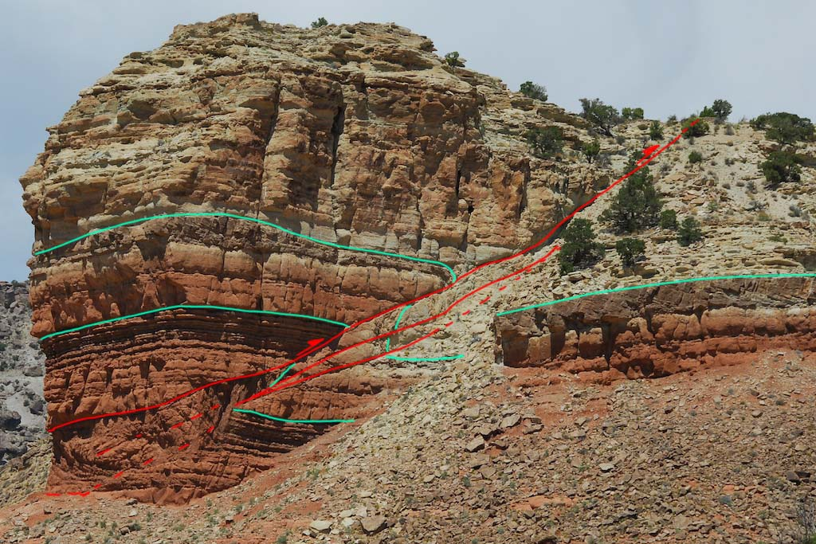
Reverse faults
Reverse fault zone, Ketobe Knob, Utah. Source

Slide 32
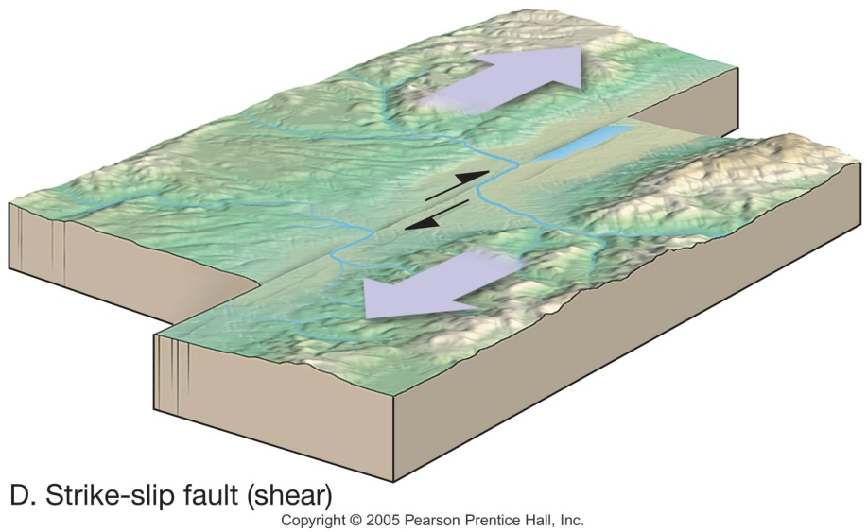
Strike-Slip Faults
Dominant displacement is horizontal and parallel to the strike of the fault
Right-lateral
Left-lateral
Transform fault

Slide 33
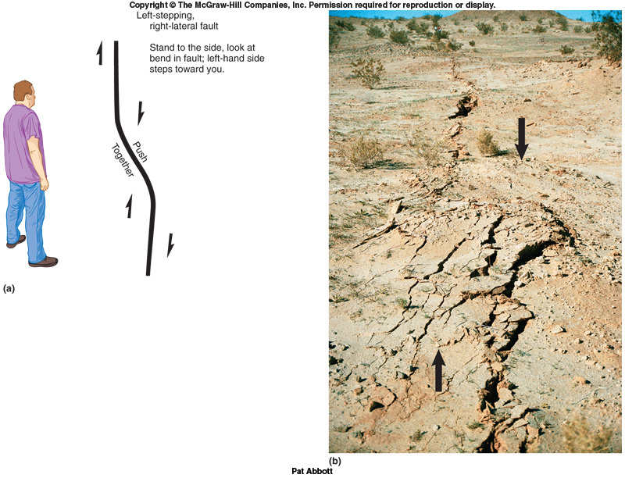

Slide 34
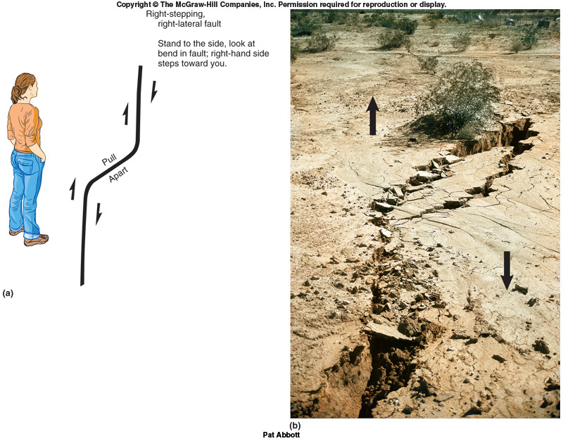

Slide 35
Measuring Earthquakes
Two measurements that describe the size of an earthquake:
  Intensity – a measure of the degree of earthquake shaking at a given locale based on the amount of damage
  Magnitude – estimates the amount of energy released at the source of the earthquake

Slide 36
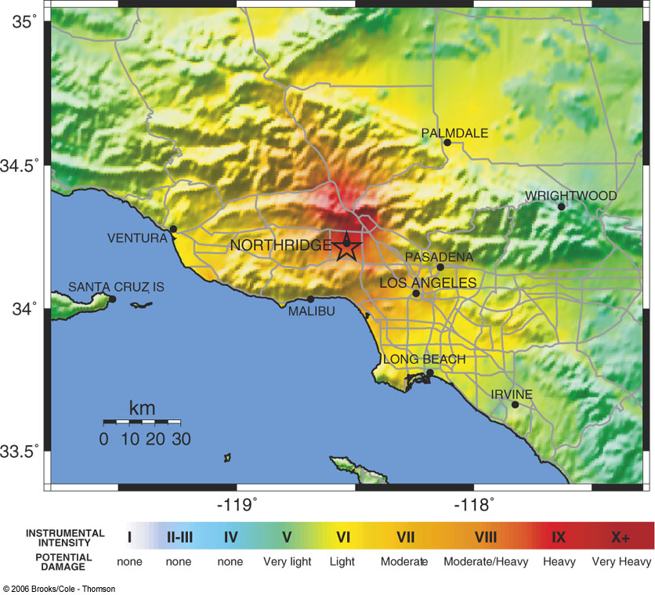
Measuring Earthquakes
Intensity Scales
  Modified Mercalli Intensity Scale
    Rates from I (not felt) to XII (total damage)
    The destruction caused may not be a true measure of the earthquakes actual severity
Image from Natural Hazards & Disasters 1/e, Hyndman & Hyndman

Slide 37
Measuring Earthquakes
Magnitude Scales
  Richter magnitude –
    Based on the amplitude of the largest seismic wave recorded
    Accounts for the decrease in wave amplitude with increased distance
    Used primarily for local/nearby earthquakes
    ML

Slide 38
Measuring Earthquakes
Magnitude Scales
  Moment magnitude
    Developed to more adequately estimate the size of very large earthquakes
    Derived from the amount of displacement that occurs along a fault
    Often used by seismologists
    MW

Slide 39
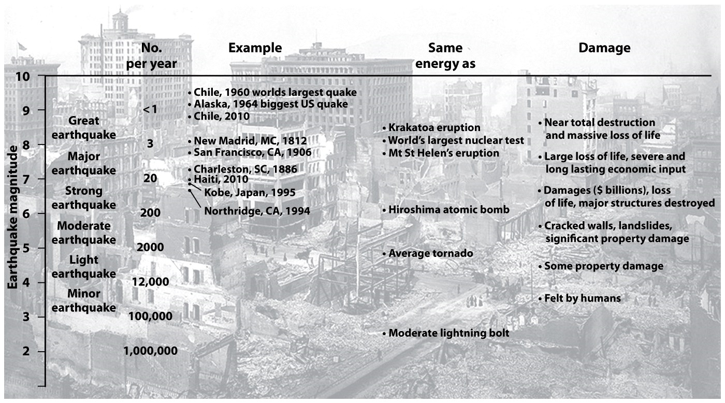

Slide 40
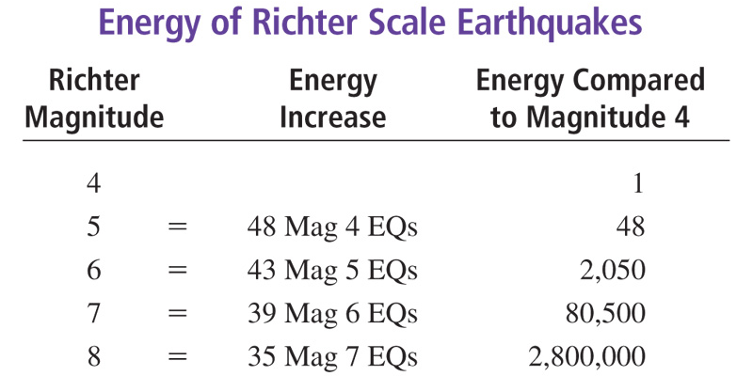
Image from Natural Hazards 6/e, Abbott

Slide 41
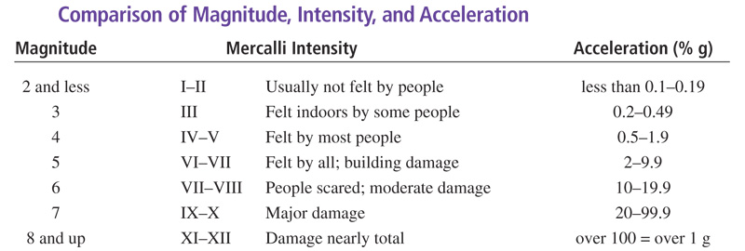
Image from Natural Hazards 6/e, Abbott

Slide 42
  Assessing the risk: What are the major causes of damage, destruction, death associated with this disaster?

Slide 43
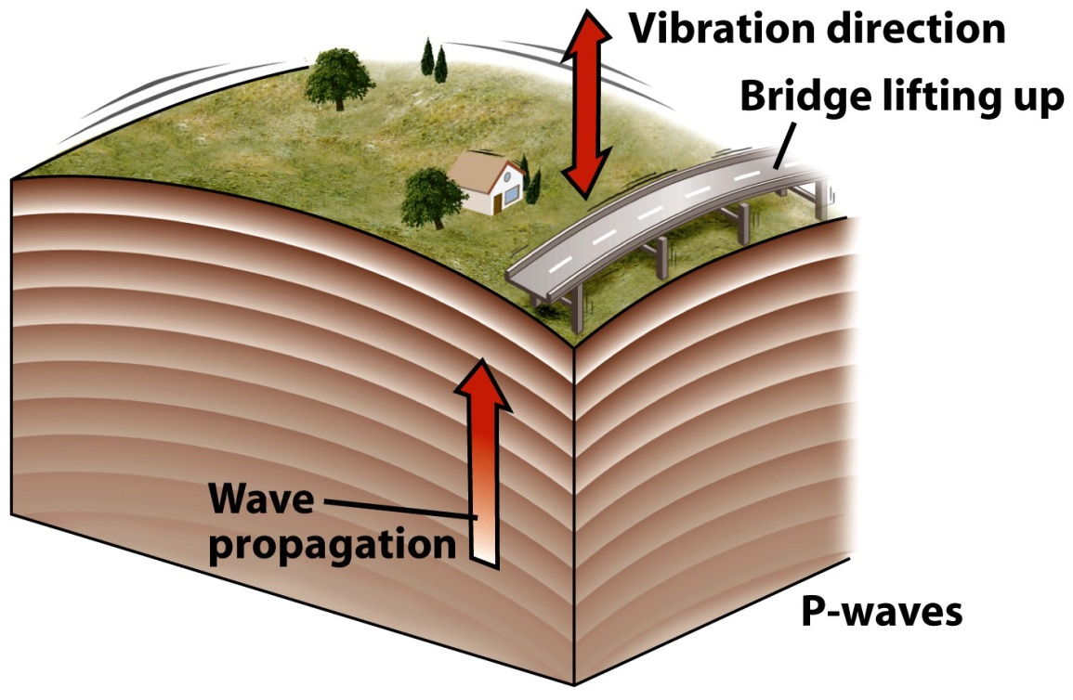
How Earthquakes cause Damage
P-waves are the 1st to arrive.
  They produce a rapid up-and-down
  motion.

Slide 44
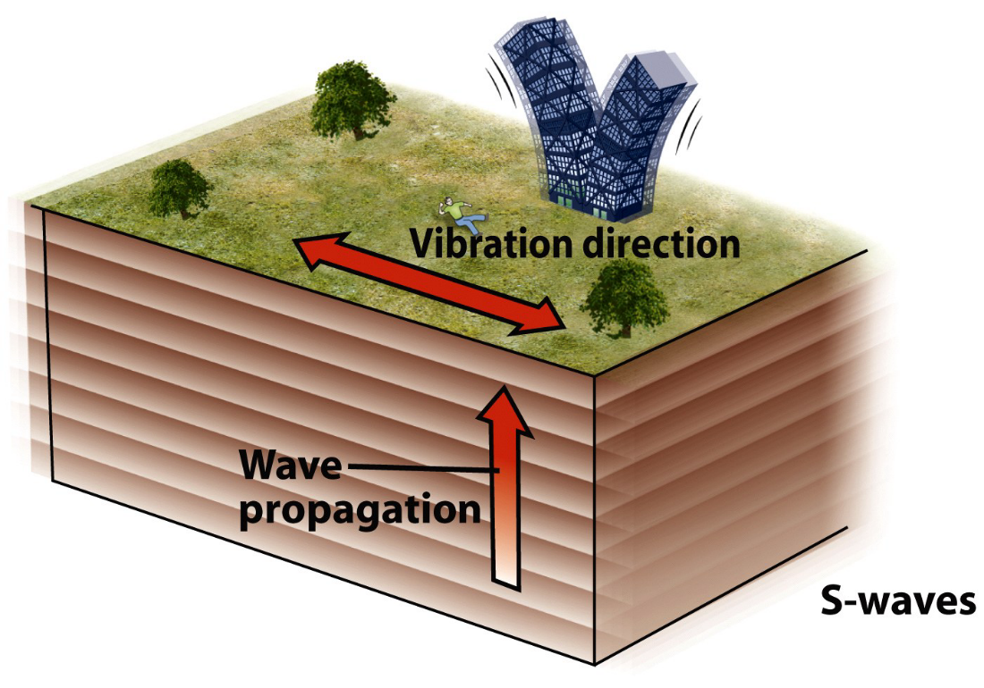
How Earthquakes cause Damage
S-waves arrive next.
  They produce a pronounced back-and-forth motion.
  This motion is usually
  much stronger than
  P-waves.
  S-waves cause
  extensive
  damage.

Slide 45
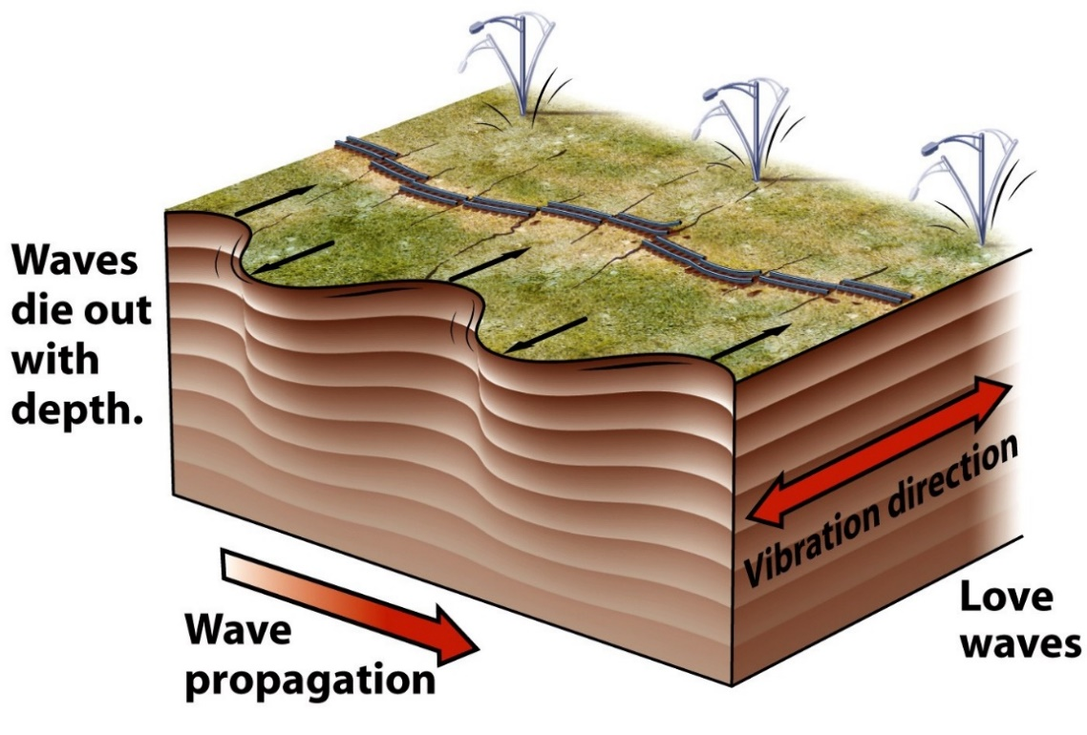
How Earthquakes cause Damage
Surface waves lag behind S-waves.
  Love waves are the first to follow.
  Ground writhes like a snake.

Slide 46
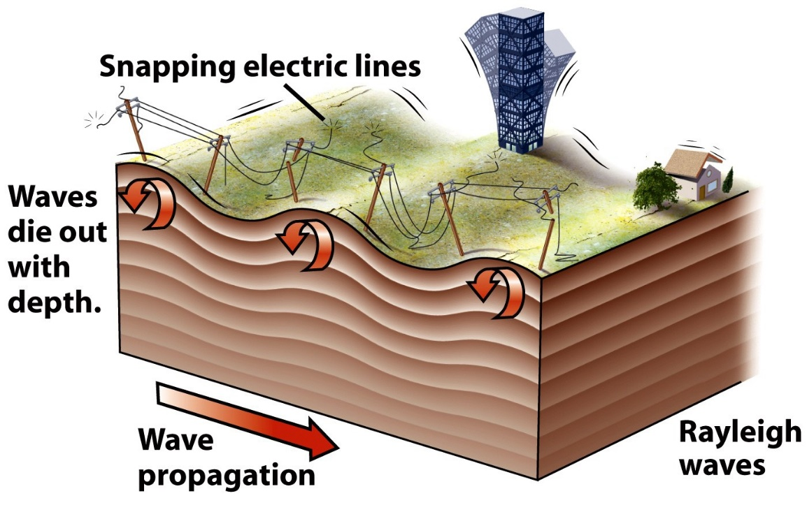
How Earthquakes cause Damage
R-waves (Raleigh) are the last to arrive.
  The land surface behaves like ripples in a pond.
  These waves may last longer than others.
  Causes extensive
  damage.

Slide 47
Earthquake Hazards
Ground Shaking
Surface Faulting
Fires
Tsunami

Slide 48
EQ Hazards – Ground Shaking
Severity of ground shaking depends on:
  Total energy released
  Distance from the source
  Acceleration
  Nature of the ground material
  Total time of shaking

Slide 49
EQ Hazards – Ground Shaking
Results:
  Liquefaction
  Landslides
  Ground Failure / Subsidence
  Building Collapse

Slide 50
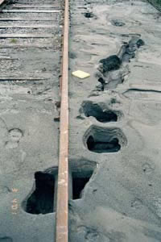
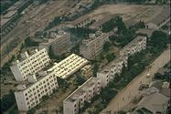
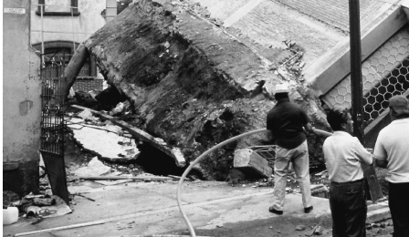
EQ Hazards – Ground Shaking
Liquefaction
The 1964 Niigata earthquake
The 1985 Mexican Earthquake
sand boils
Sand Volcano

Slide 51
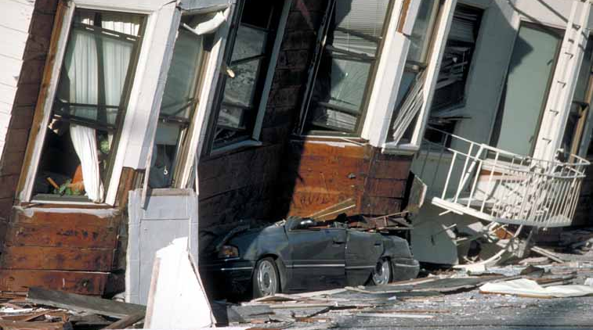
Liquefaction
An automobile lies crushed under the third story of this apartment building in the Marina District. The ground levels are no longer visible because of structural failure and sinking due to liquefaction. [J.K. Nakata, U.S. Geological Survey]

Slide 52
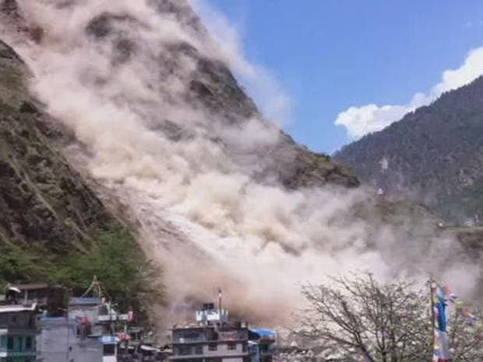
EQ Hazards – Ground Shaking
Landslides
“In the video released by the International Federation of Red Cross and Red Crescent Societies, large rocks and debris can be seen falling from a mountainside and onto the town near Dhunche on Nepal’s border with China.”
- http://www.independent.co.uk/
Notes:
http://www.independent.co.uk/news/world/asia/nepal-earthquake-video-massive-landslide-hits-dhunche-after-nepal-suffers-second-deadly-tremor-in-two-weeks-10244753.html

Slide 53
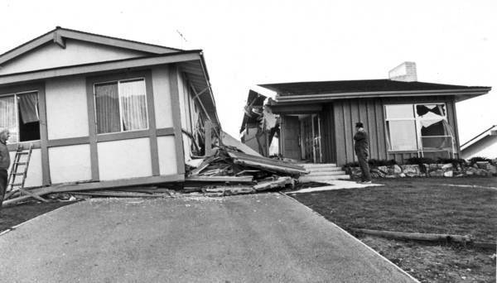
EQ Hazards – Ground Shaking
Ground Failure / Fissures
A home destroyed in the 1971 Sylmar earthquake, in which one side of the San Fernando fault moved as much as 8 feet from the other side. About 80% of the buildings along the fault suffered moderate to severe damage, illustrating the risks of building atop faults. (Los Angeles Times)
Notes:
http://articles.latimes.com/2013/oct/19/local/la-me-adv-earthquake-fault-law-20131020

Slide 54
EQ Hazards – Ground Shaking
Building Collapse
  Factors:
    Intensity of the earthquake
    Duration of the vibrations
    Nature of the material upon which the structure rests
    The design of the structure

Slide 55
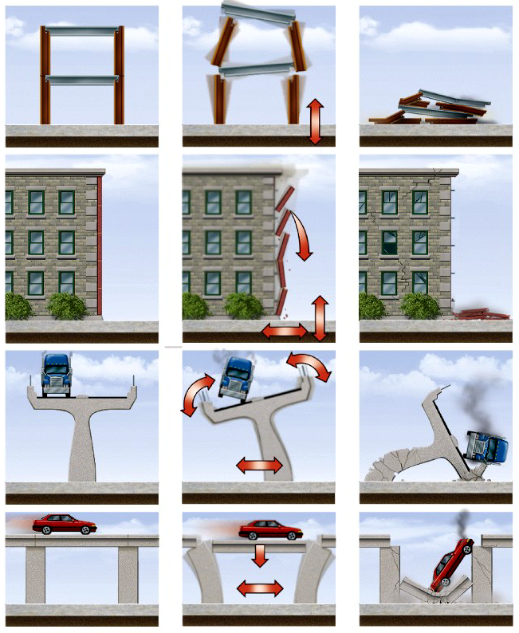
EQ Hazards – Ground Shaking
Building Collapse
  Slabs disconnect.
  Facades delaminate.
  Bridges topple.
  Bridges come apart.

Slide 56
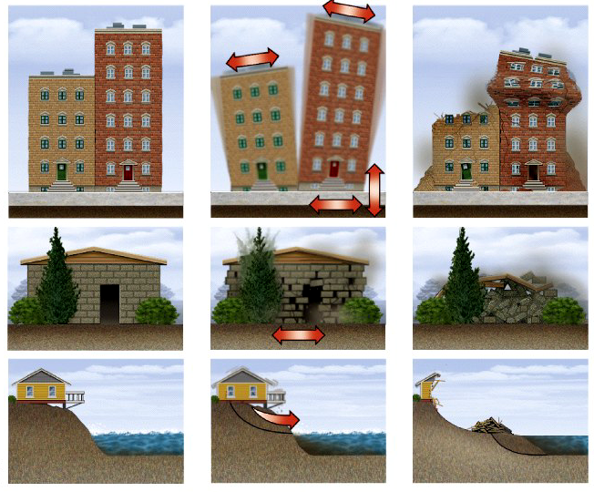
EQ Hazards – Ground Shaking
Building Collapse
  Buildings collide.
  Masonry
  disintegrates.
  Slopes collapse.

Slide 57
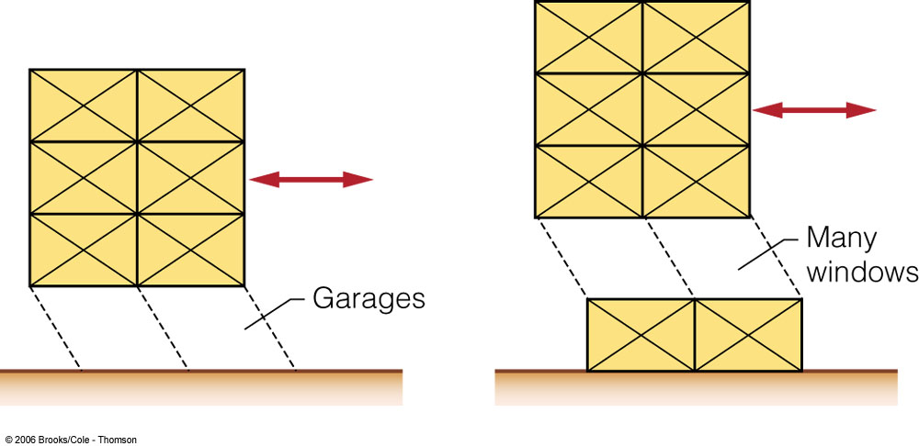
EQ Hazards – Ground Shaking
Building Collapse
Lateral failures
  Due to weak ground floors or lack of bracing
Image from Natural Hazards & Disasters 1/e, Hyndman & Hyndman

Slide 58
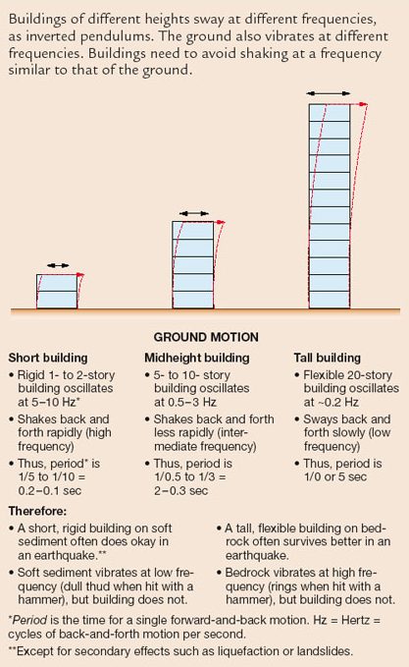
EQ Hazards – Ground Shaking
Building Collapse
Oscillations
  Ground shaking typically has frequencies of 0.1 to 30 oscillations / sec
Resonance
  Natural oscillation of a building is the same as that of the ground shaking
Image from Natural Hazards & Disasters 1/e, Hyndman & Hyndman

Slide 59



EQ Hazards – Ground Shaking
Building Collapse
U.S. Borax Bldg, Valencia, CA

Slide 60




EQ Hazards – Ground Shaking
Building Collapse

Slide 61



EQ Hazards – Ground Shaking
Building Collapse
U.S. Borax Bldg,
Valencia, CA

Slide 62


EQ Hazards – Ground Shaking
Building Collapse
Before EQ
After EQ
U.S. Borax Bldg, Valencia, CA

Slide 63

EQ Hazards – Surface Faulting
Urban area hazard
1971 Sylmar Earthquake & Alquist Priolo Fault Zones
http://www.quake.ca.gov/
gmaps/WH/regulatorymaps.htm
http://myhazards.calema.ca.gov/Default.aspx
February 9, 1971 Sylmar Earthquake
Notes:
http://gallery.usgs.gov/images/12_15_2008/h41Ogs6FEa/medium/kath1.jpg
http://gallery.usgs.gov/photos/h41Ogs6FEa_60
http://thesoutherncalifornian.blogspot.com/2015/02/six-interesting-facts-about-1971-sylmar.html

Slide 64
EQ Hazards – Surface Faulting
February 9, 1971 Sylmar Earthquake

Slide 65


EQ Hazards – Surface Faulting
Oct 1 1999 Hector Mine Earthquake
© Katherine Kendrick, USGS Pasadena
© Chris Walls, Earth Consultants International

Slide 66

EQ Hazards – Fires
Secondary hazard
Often caused by gas leaks
Notes:
http://pubs.usgs.gov/of/1996/ofr-96-0263/groundf2.htm

Slide 67

EQ Hazards – tsunami
Secondary hazard
Faulting on the seafloor
Aerial photo of March 11 tsunami hitting the Sendai Plain in northern Japan
(© 2013 State of California).
Notes:
http://www.conservation.ca.gov/cgs/geologic_hazards/Tsunami/Inundation_Maps/Pages/2011_tohoku.aspx

Slide 68

EQ Hazards – tsunami
Sources: 1

Slide 69

EQ Hazards – tsunami
Sources: 1

Slide 70

EQ Hazards – tsunami
Sources: 1

Slide 71

EQ Hazards – tsunami
Sources: 1

Slide 72
Prepare, Respond, & Recover

Slide 73
Earthquake Preparedness
Know your risk! Go to: http://myhazards.calema.ca.gov/Default.aspx
Sources of Earthquakes: Earthquakes commonly occur at plate boundaries

Slide 74

Before the Next Earthquake:
Prepare Your Home
Copyright 2015 Los Angeles Times
Notes:
http://articles.latimes.com/2014/mar/17/news/la-lh-earthquake-ready-home-20140317-dto

Slide 75
Prepare Your Home
Copyright 2015 Los Angeles Times

Slide 76

Prepare Yourself & Your Family
FEMA = http://www.ready.gov/earthquakes
American Red Cross = http://www.redcross.org/prepare/disaster/earthquake
LA County Emergency Survival Program (ESP) = http://www.espfocus.org/
Disaster Preparedness & Response - 211 LA County = https://www.211la.org/programs-services/disaster-preparedness-and-response-1/
Earthquake Country Alliance = http://www.earthquakecountry.org/
Notes:
http://www.malagaweather.com/earthquake.html

Slide 77

Respond: what to do during an earthquake
. . . And what not to do:
DO NOT run outside or to other rooms during shaking
DO NOT stand in a doorway
DO NOT get in the "triangle of life“ (always get next to a table rather than underneath it)
from: http://www.earthquakecountry.info/dropcoverholdon/
Notes:
http://www.malagaweather.com/earthquake.html

Slide 78

Drop, cover & hold on!
Why would the "triangle of life“ not work in this picture?

Slide 79

recover: what to do after an earthquake
  American Red Cross Safe and Well web site = http://www.redcross.org/find-help/contact-family/register-safe-listing
  Reconnect and Recover = http://earthquakecountry.org/step7/
Notes:
http://www.malagaweather.com/earthquake.html

Slide 80
Reducing the risk
  What, if anything, can be done to prevent this disaster from occurring?

Slide 81
Reducing the risk
  What can be done to reduce the damages caused by this disaster?

Slide 82

Deck of Cards Analogy
Individual cards loose, easy to fail
(unbraced)
Cards taped together are stronger
(braced)

Slide 83


Cross Bracing

Slide 84


EQ Hazards – Ground Shaking
Images from Natural Hazards & Disasters 1/e, Hyndman & Hyndman

Slide 85


Slide 86


Isolation pads

Slide 87
~ end! ~

