Slide 1

The 03/11/2011 Mw9.0 Tohoku, Japan Earthquake
Educational Slides
Created & Compiled by Gavin Hayes & David Wald
U.S. Geological Survey, National Earthquake Information Center
Contributions from:
Kuo-Wan Lin, USGS NEIC
Mike Hearne, USGS NEIC
Lisa Wald, USGS NEIC
Harley Benz, USGS NEIC
Erol Kalkan, USGS Menlo Park
Volkan Sevilgen, USGS Menlo Park
Jascha Polet, Cal Poly Pomona
Charles Ammon, Penn State University
Guangfu Shao, U. California, Santa Barbara
Gavin Hayes and Mike Hearne are contracted to work for the USGS NEIC by Synergetics Inc., Fort Collins, CO.

Slide 2
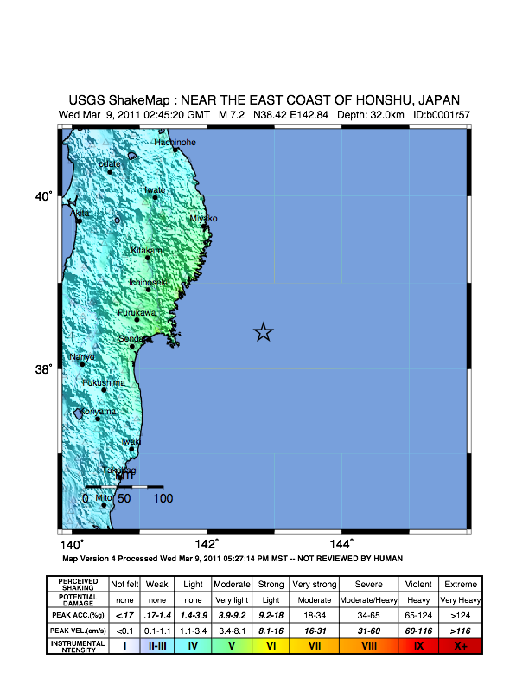
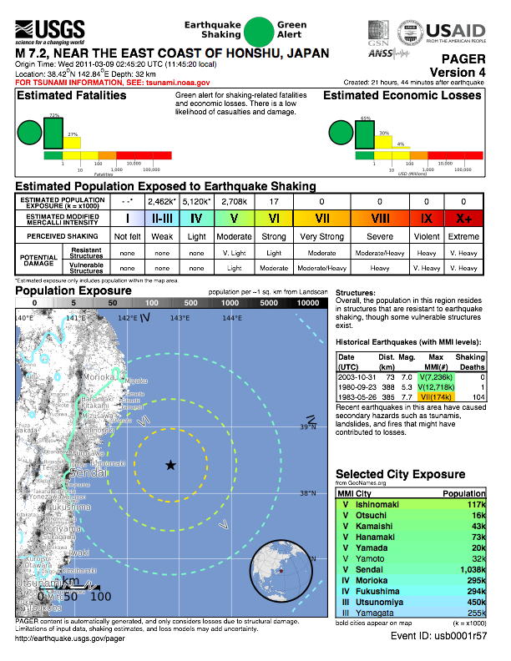
Offshore Honshu, Japan Earthquake, 03/09/2011, Mw 7.2

Slide 3
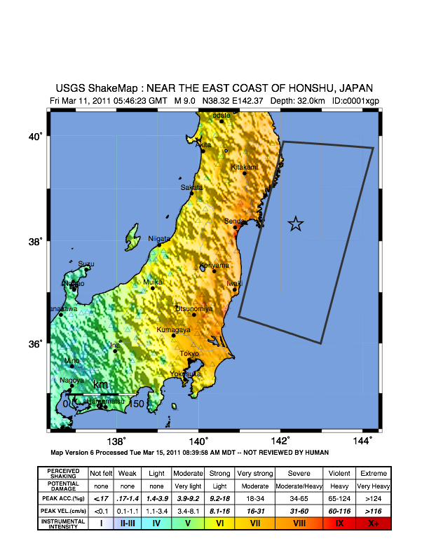
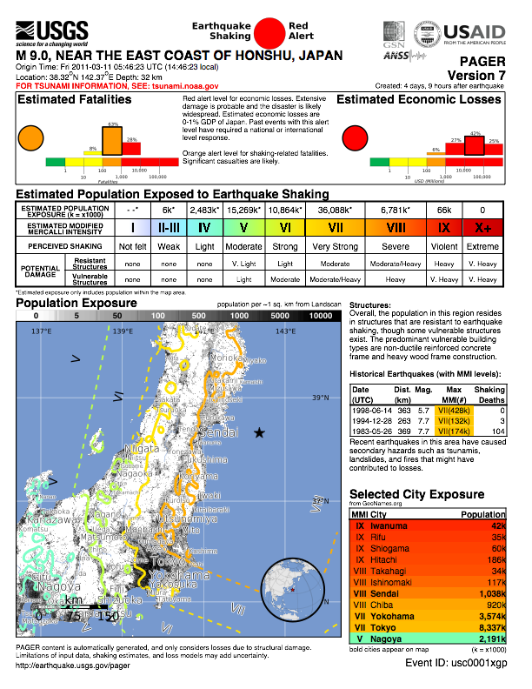
Tohoku, Japan Earthquake, 03/11/2011, Mw 9.0

Slide 4
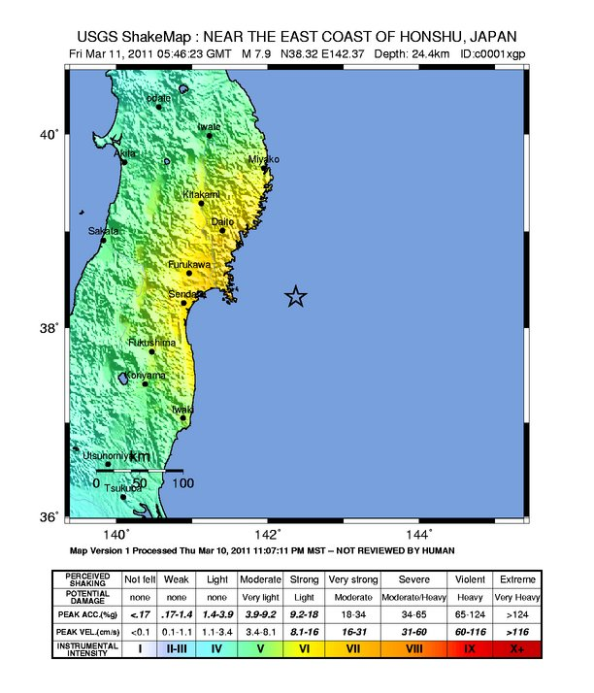
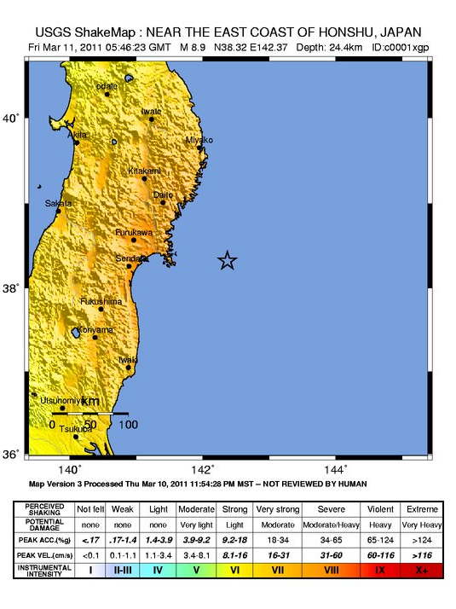
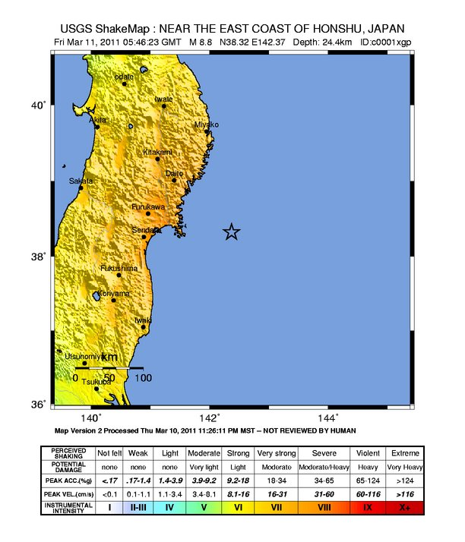
Tohoku, Japan Earthquake: ShakeMap Evolution
V1: O.T. +21 min M7.9
V2: O.T. +40 min M8.8
V3: O.T. +1 hr 9 min M8.9
(Led to PAGER RED Alert
42.9 minutes after origin)

Slide 5
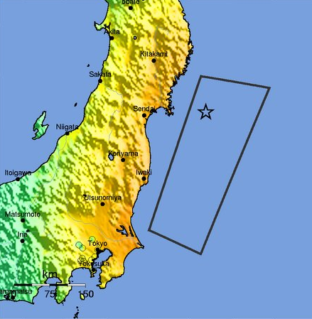
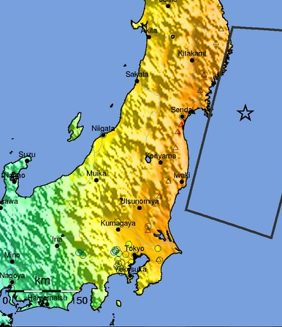
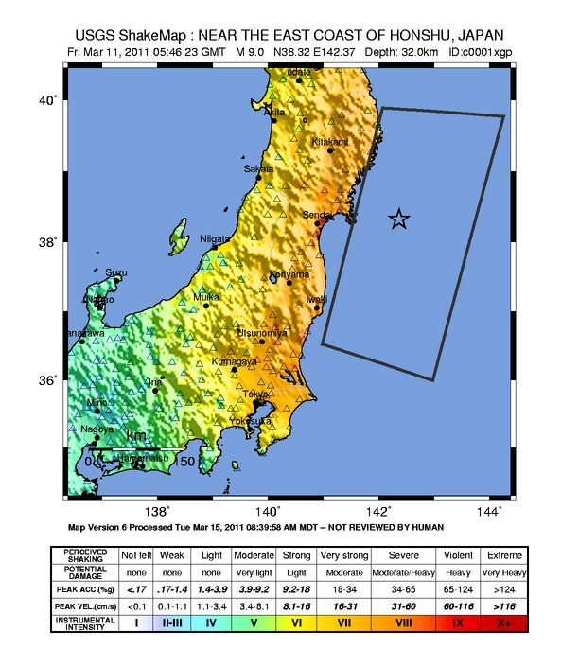
Tohoku, Japan Earthquake: ShakeMap Evolution
V6: OT +3 d 9 hr
M9.0
DYFI Data
273 K-NET stations
Finite fault from K-NET (NIED) inversion
V4: O.T. +2 h 22 min
M8.9
DYFI data
Finite fault inferred from aftershocks
V5: OT +2 d 11 hr
M9.0
DYFI Data
12 K-NET stations
Finite fault inferred from aftershocks

Slide 7
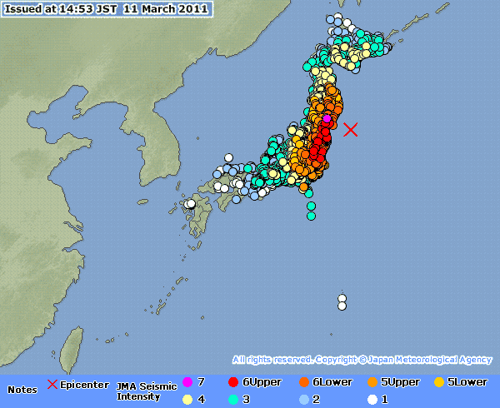
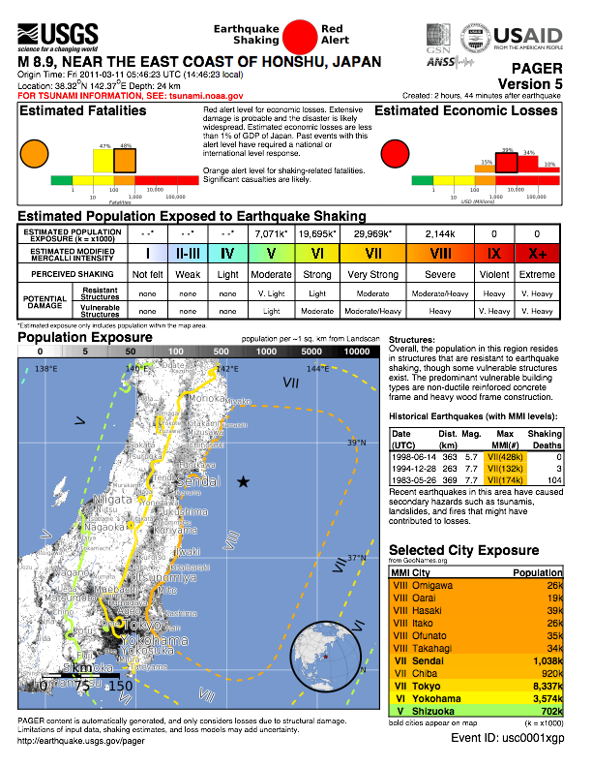

Slide 8
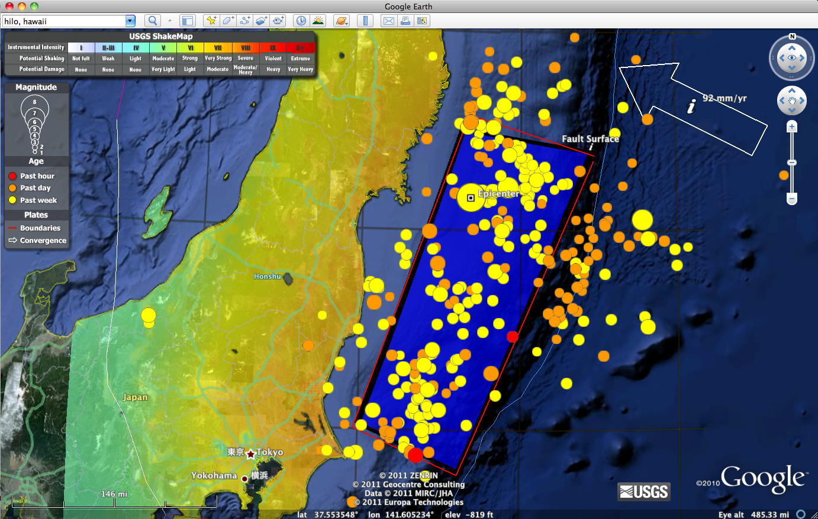
Shaking & Aftershocks (as of March 13th)

Slide 9
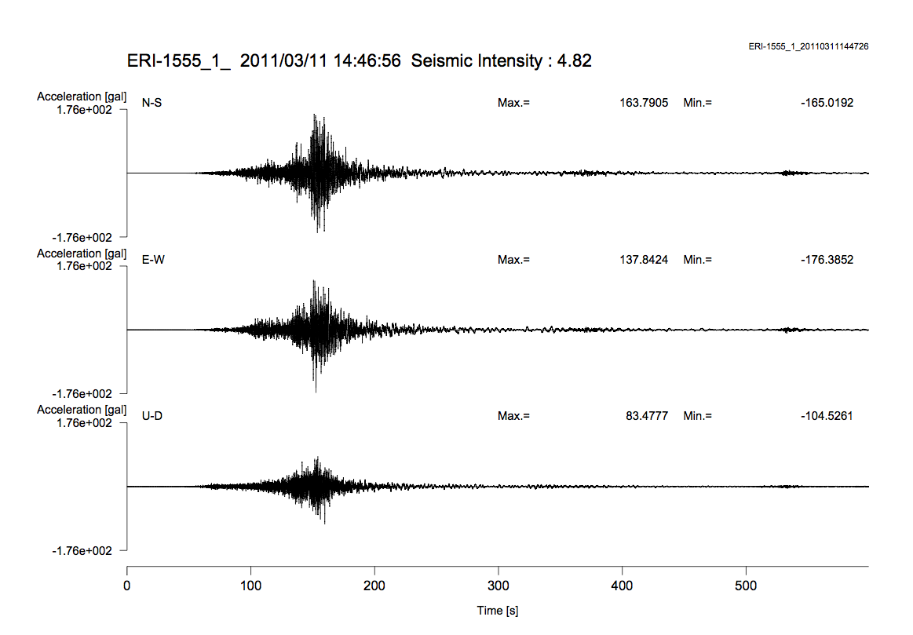
Tohoku, Japan Earthquake: Shaking Duration in Tokyo, Ground Acceleration

Slide 10
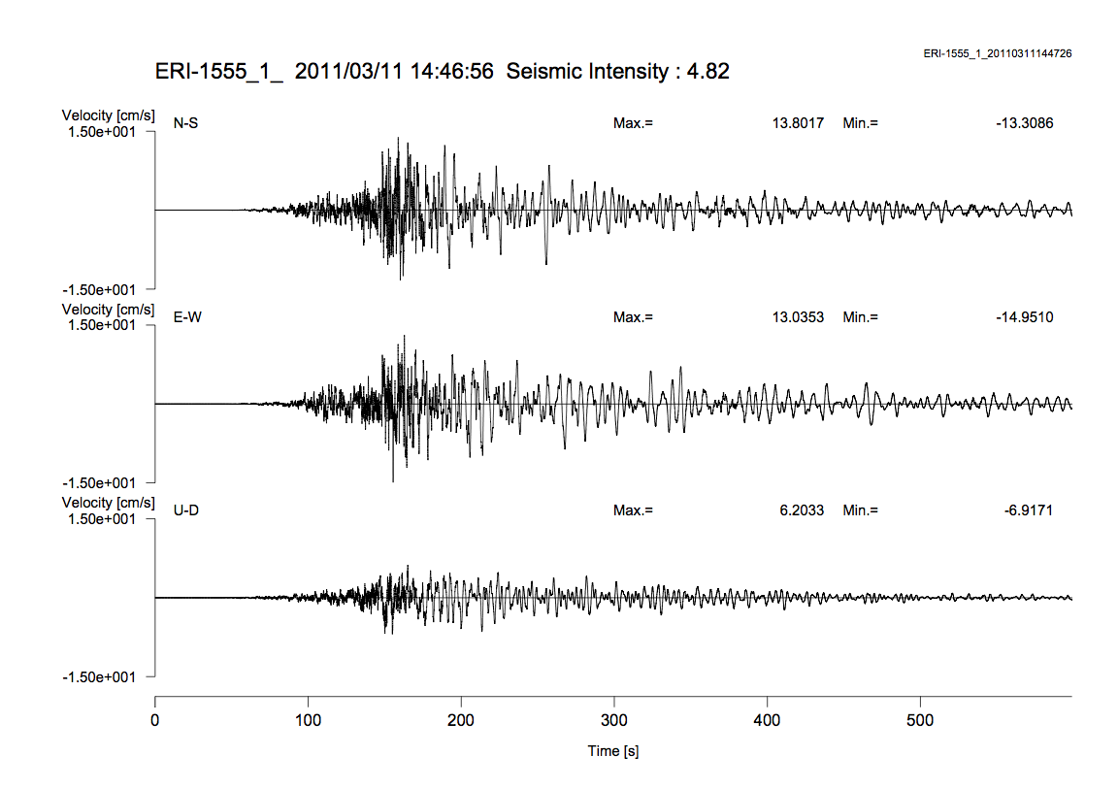
Tohoku, Japan Earthquake: Shaking Duration in Tokyo, Ground Velocity
6 minutes

Slide 11
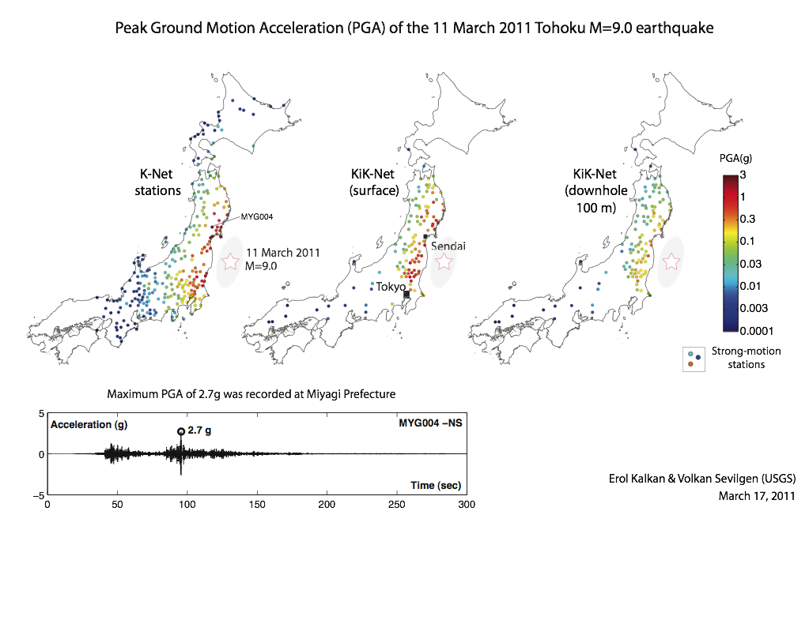

Slide 12
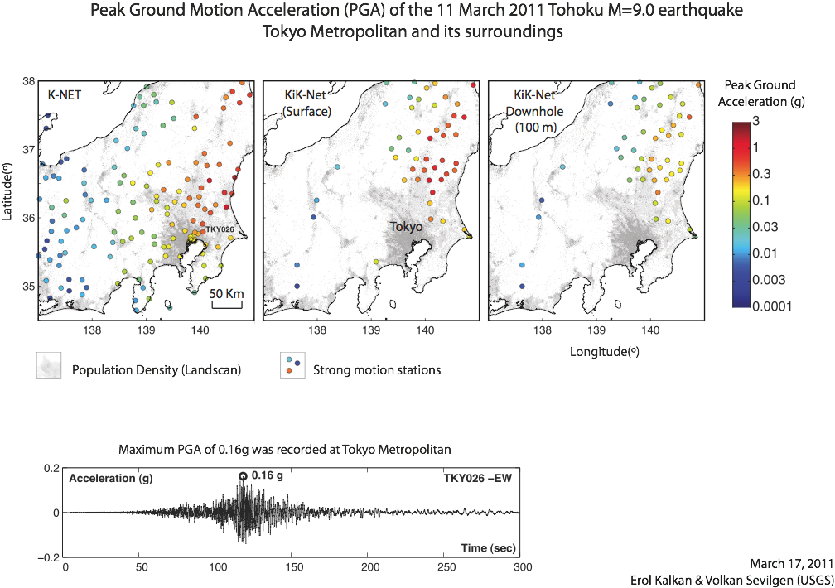

Slide 13
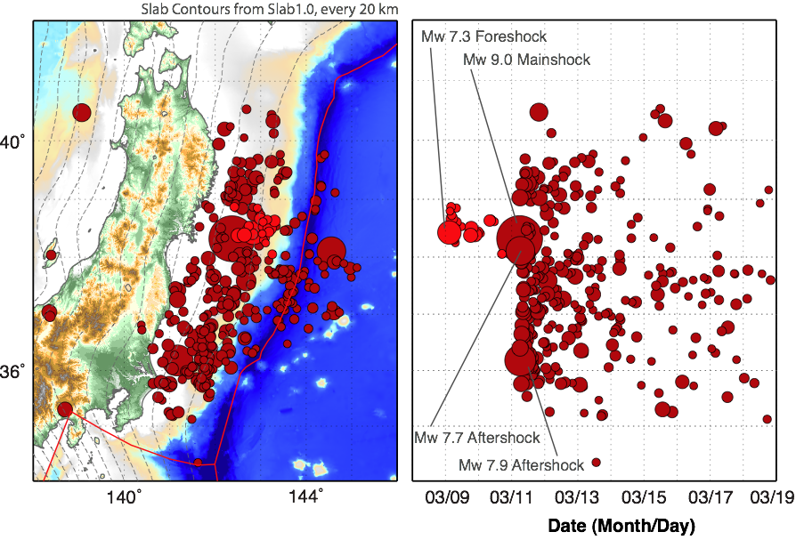
Tohoku, Japan Earthquake: Aftershock (and Foreshock) Sequence, 03/08/11 - 03/16/11
Note that the magnitudes of the 2011/03/11 06:15 (Mw 7.9) and 2011/03/11 06:25 (Mw 7.7) aftershocks were updated from earlier, lower estimates. Updates occurred on 03/16 and 03/18, respectively.

Slide 14
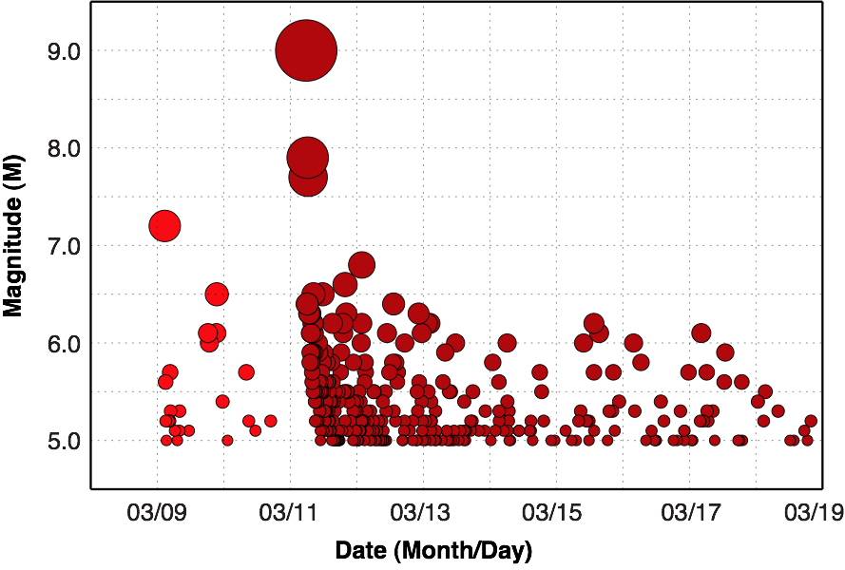
Tohoku, Japan Earthquake: Aftershock (and Foreshock) Sequence, M:Time History

Slide 15
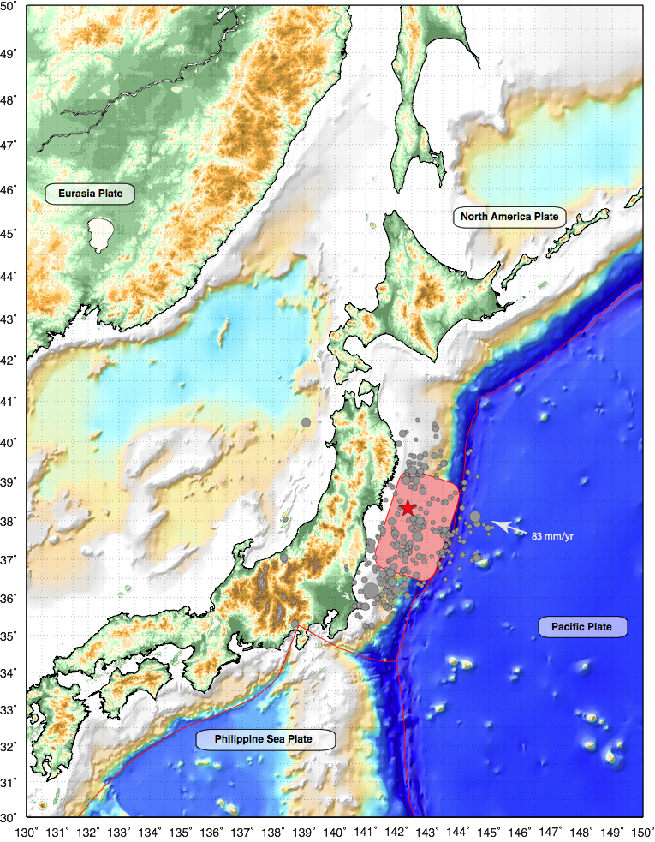
Tohoku, Japan Earthquake: Tectonic Summary
The magnitude 9.0 Tohoku earthquake on March 11, 2011, which occurred near the northeast coast of Honshu, Japan, resulted from thrust faulting on or near the subduction zone plate boundary between the Pacific and North America plates. At the latitude of this earthquake, the Pacific plate moves approximately westwards with respect to the North America plate at a rate of 83 mm/yr, and begins its westward descent beneath Japan at the Japan Trench.
The location, depth, and focal mechanism of the March 11 earthquake are consistent with the event having occurred on the subduction zone plate boundary.
Modeling of the rupture of this earthquake (red shading, approx.) indicate that the fault moved upwards of 30-40 m, and slipped over an area approximately 300 km long (along-strike) by 150 km wide (in the down-dip direction). The rupture zone is roughly centered on the earthquake epicenter along-strike, while peak slips were up-dip of the hypocenter, towards the Japan Trench axis. The March 11 earthquake was preceded by a series of large foreshocks over the previous two days, beginning on March 9th with a M 7.2 event approximately 40 km from the epicenter of the March 11 earthquake, and continuing with another three earthquakes greater than M 6 on the same day.

Slide 16
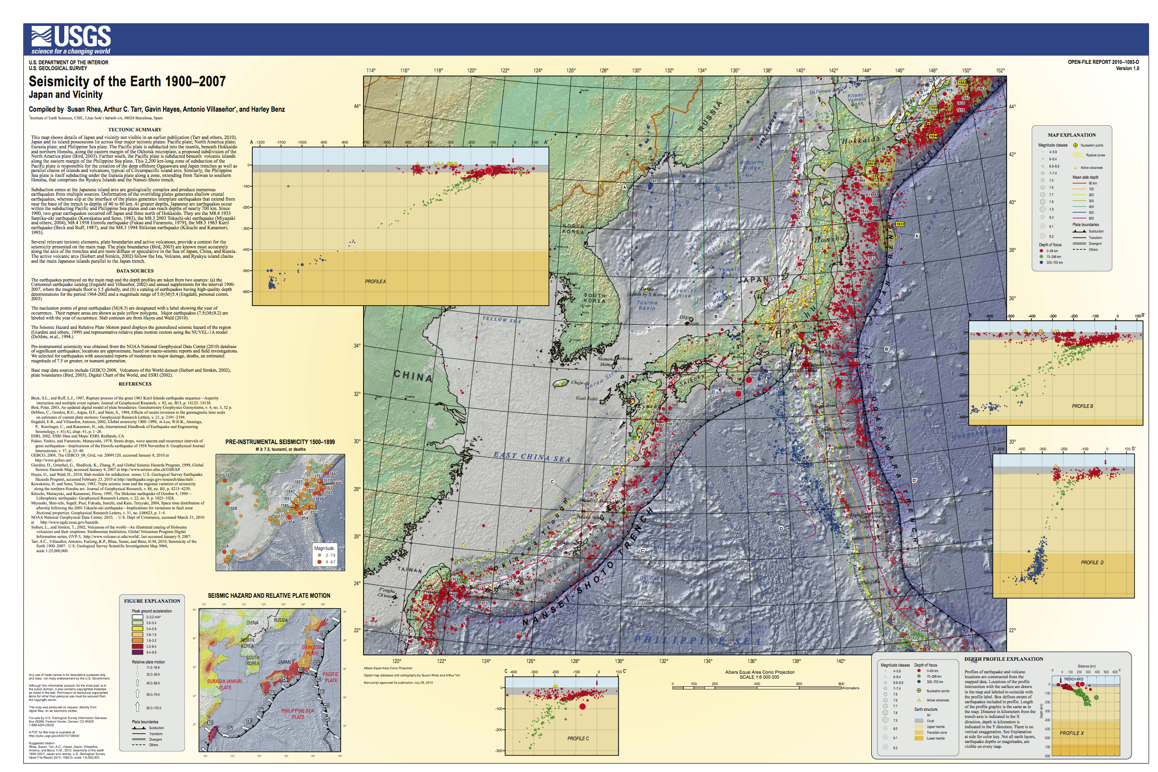
Japan Regional Seismicity, 1900-2007
USGS Poster/Open File Report 2010-1083-D

Slide 17
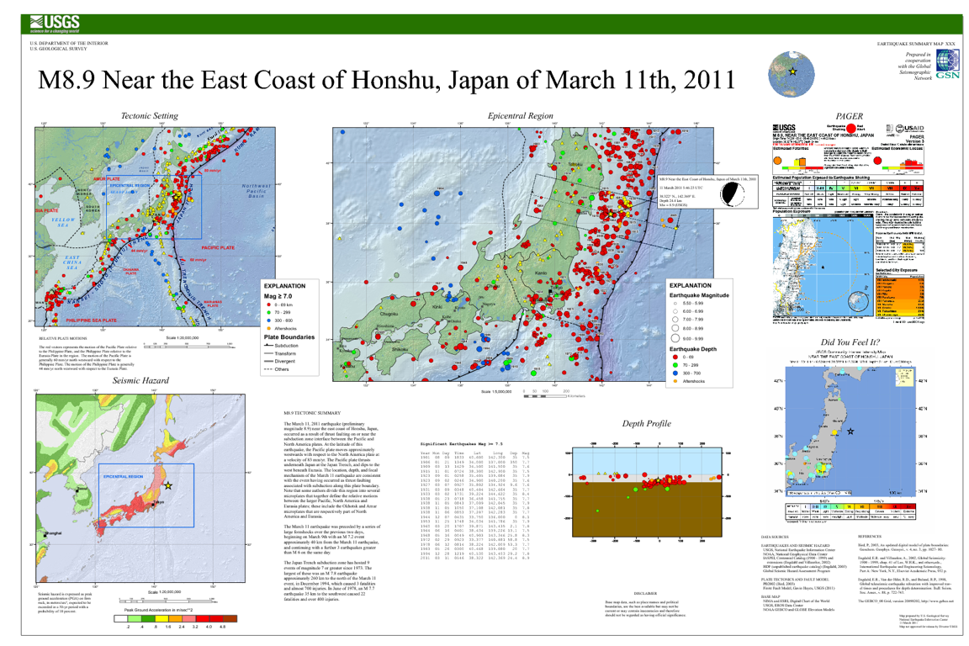
Tohoku, Japan Earthquake: Summary Poster
USGS V1 - 4.5 hrs after OT

Slide 18
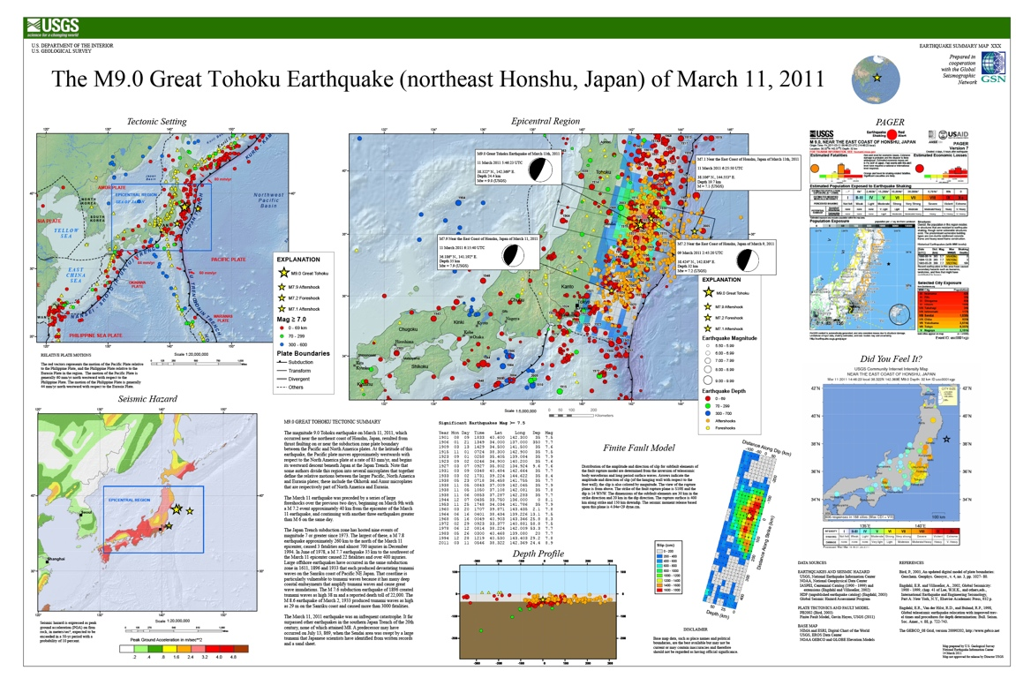
Tohoku, Japan Earthquake: Summary Poster
USGS Current Version

Slide 19


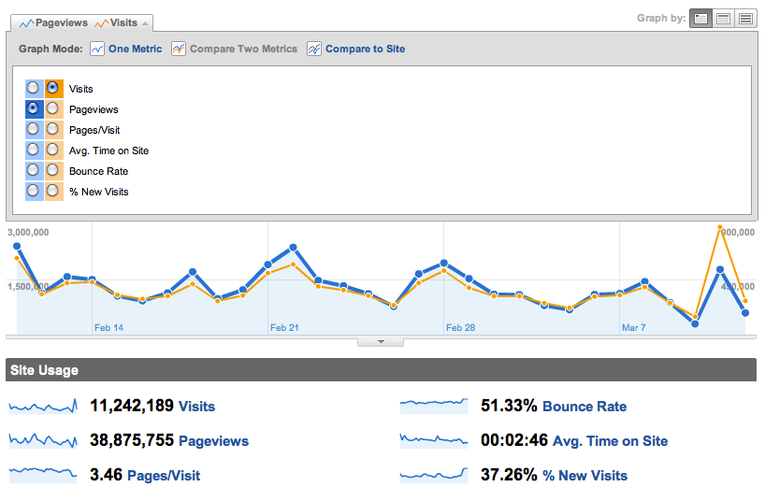
Web Traffic Statistics
Average – 400,000 visits/day & 1.5 million page views/day
Peak – 900,000 visits/day & 2.5 million page views/day
Tohoku
(M9.0) JP
Christchurch
(M6.1) NZ

Slide 20
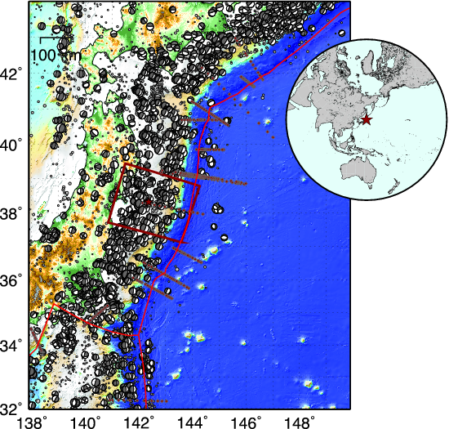
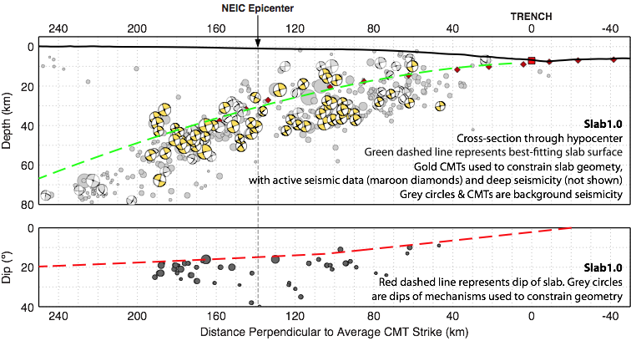
Tohoku, Japan Earthquake: Source Region Slab Geometry

Slide 21
Tohoku, Japan Earthquake: Source Region Slab Geometry

Slide 22
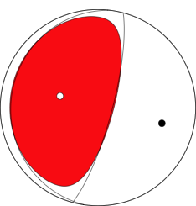





Tohoku, Japan Earthquake: Moment Tensor Solutions
(Faulting Mechanisms)
USGS Research Centroid Moment Tensor
Mw 8.9
Distributed ~34 minutes
after OT
global Centroid Moment Tensor V1
Mw 9.1
Released 7 hrs after OT
(Jascha Polet, Cal Poly Pomona)
USGS W-Phase V1
Mw 8.9
Released 1 hr after OT
global Centroid Moment Tensor V2
Mw 9.1
Released ~ 3 days after OT
USGS W-Phase V2
Mw 9.0
Released 6 hrs after OT
Earthquake Research Institute, Japan, CMT V1
Mw 9.0

Slide 23
Tohoku, Japan Earthquake: Source Region Slab Geometry

Slide 24
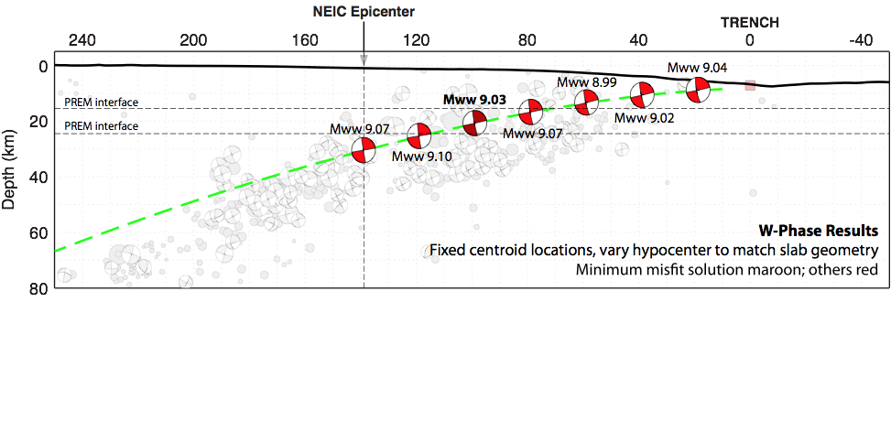
Tohoku, Japan Earthquake: Moment Tensor Analysis
Dip/Depth Sensitivity

Slide 25
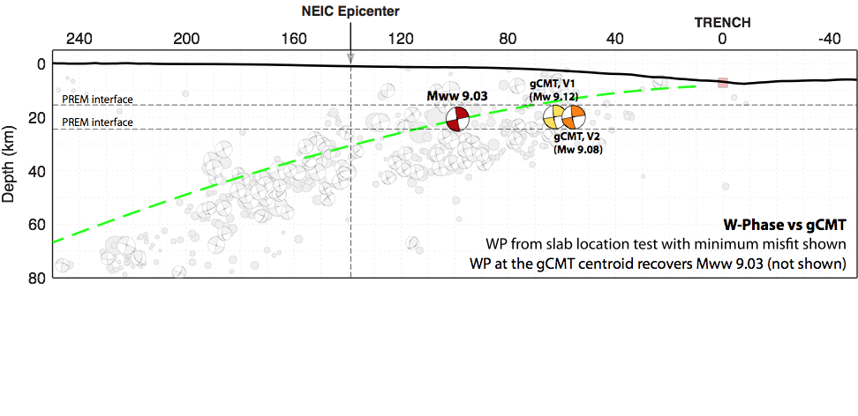
Tohoku, Japan Earthquake: Moment Tensor Analysis
Dip/Depth Sensitivity

Slide 26
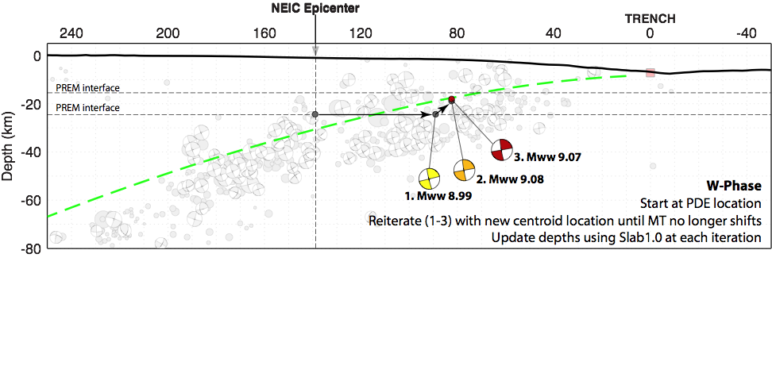
Tohoku, Japan Earthquake: Moment Tensor Analysis
Dip/Depth Sensitivity

Slide 27
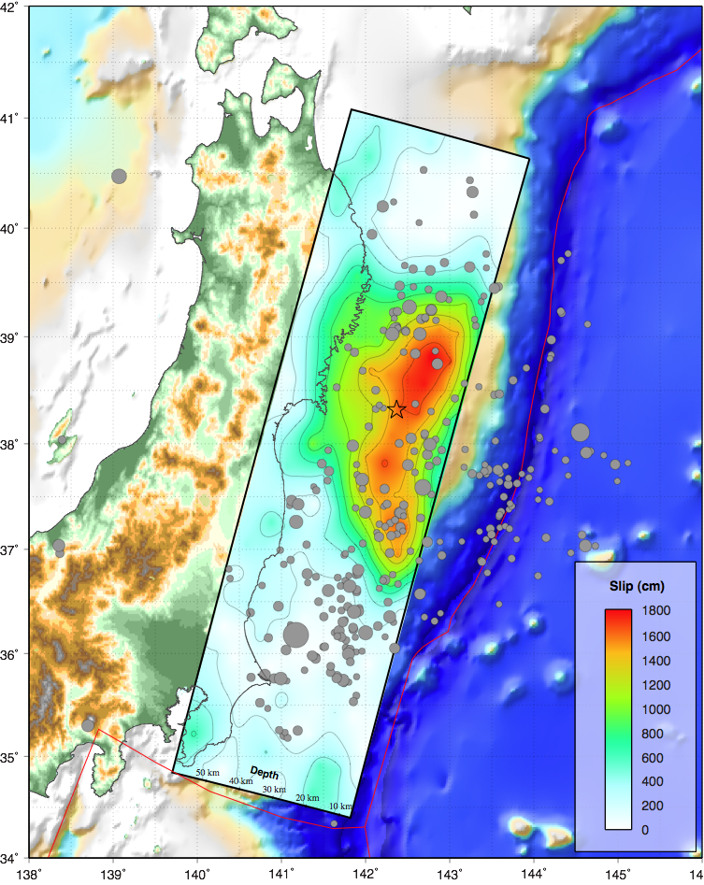
Tohoku, Japan Earthquake: Finite Fault Model
USGS V1 - 7 hrs after OT
Compact rupture, mostly bilateral about epicenter, peak slip up dip of hypocenter.
Rupture was likely restricted to the shallow trench, and GPS vectors suggest slip did not reach the plate boundary beneath the coastline.
Peak slips closer to 30+ m, inferred from updated modeling.
6

Slide 28
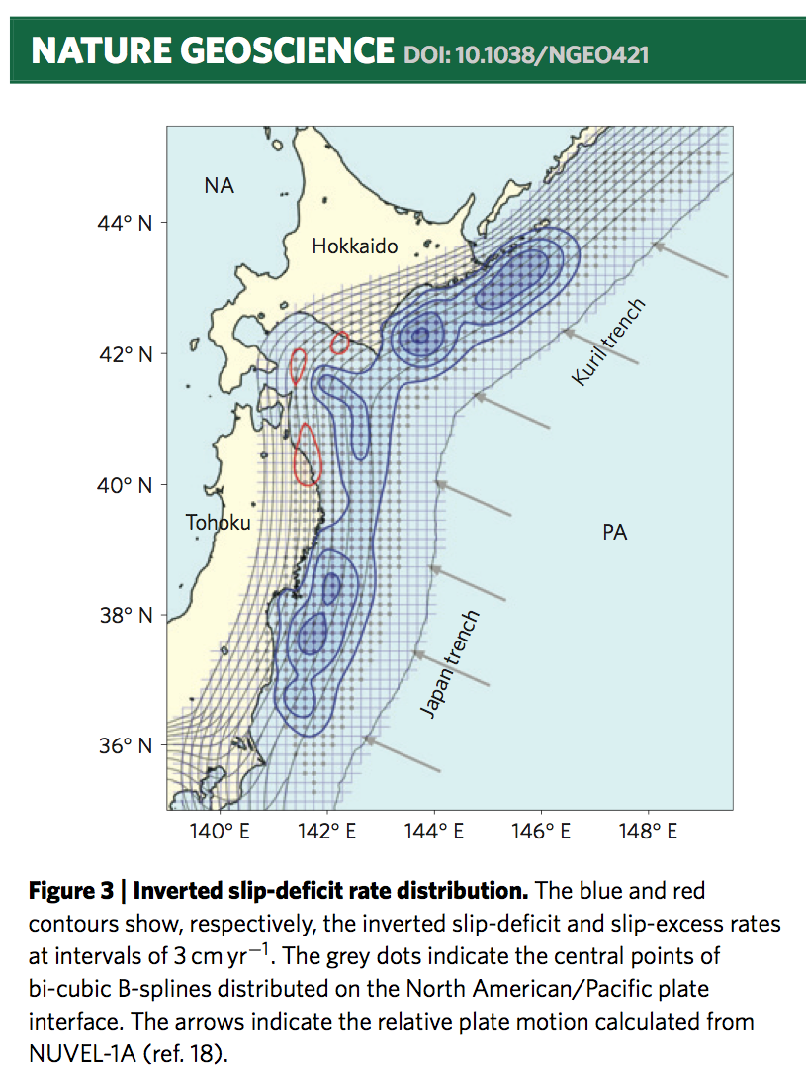
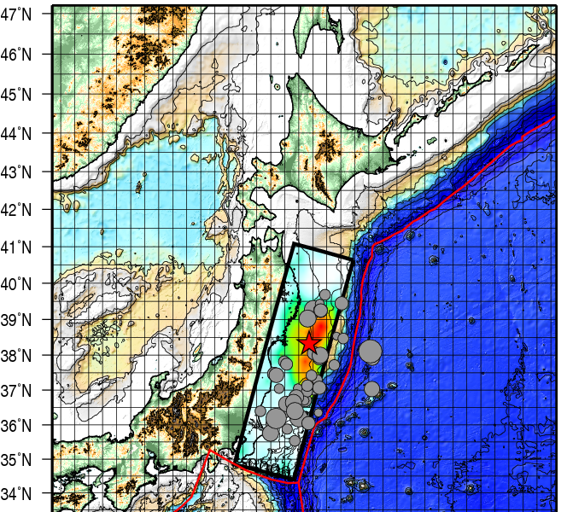
Finite Fault Model USGS V1 - Comparison with locking estimates (Hashimoto et al. ,2009, Nat. Geo.)

Slide 29
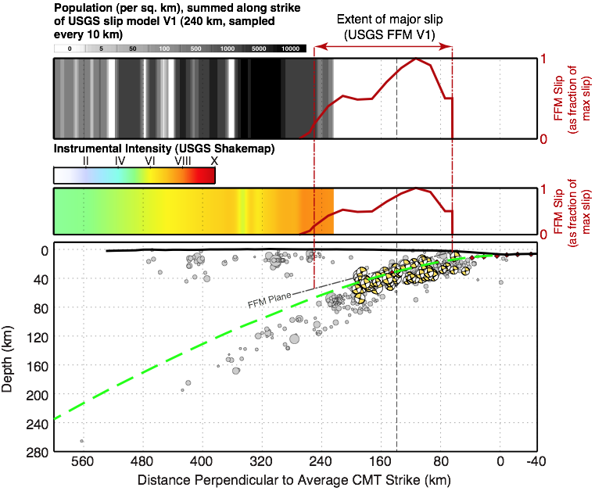
Tohoku, Japan Earthquake: Population Exposure & Shaking Intensities vs Slab Geometry & Slip Extent
Note that slip during the earthquake likely did not extend to the depths of the plate boundary directly under the Japan coastline as shown here, because GPS data indicate that the coastline moved down coseismically.

Slide 30
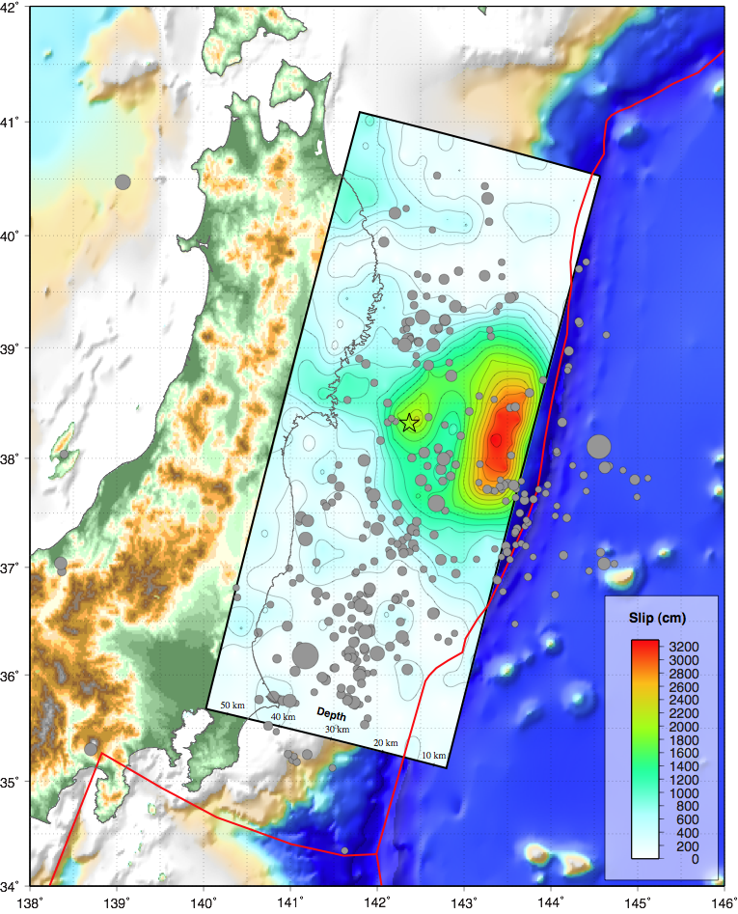
Tohoku, Japan Earthquake: Finite Fault Model
USGS V2 - 2011/03/18
Updated modeling shows peak slips of 30+ m, depending on the parameterization of rupture velocity. This updated model shows peak slip of ~32 m, using a range of rupture velocity from 1.25 - 3 km/s.
Models with constant rupture velocity show slips of 40-50 m, all at shallow depths. This may imply that the up-dip nature of rupture is well resolved, but peak slips are not.
‘Low’ slip regions near the fault edges, and fault base, are also poorly resolved.

Slide 31
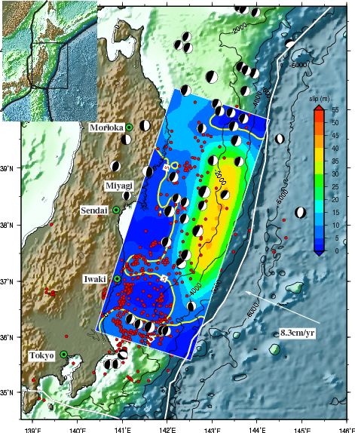
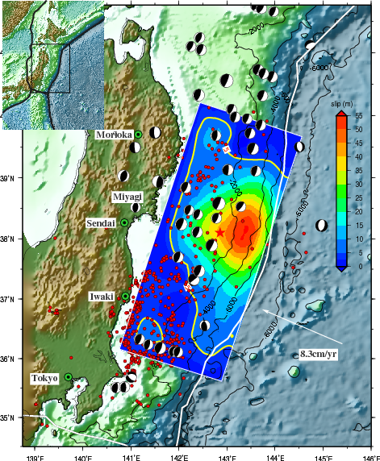
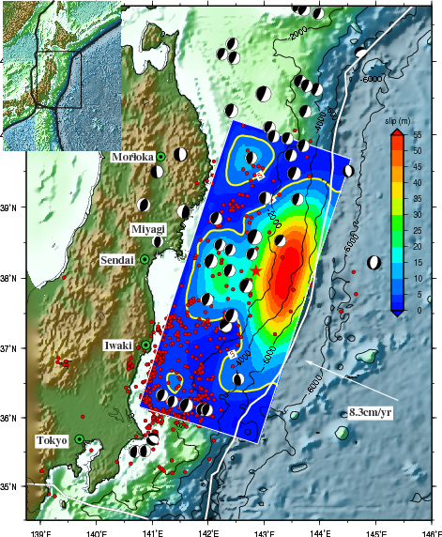
Tohoku, Japan Earthquake: Finite Fault Model
U. California, Santa Barbara
Version 1
NEIC Hypocenter
Version 2
JMA Hypocenter
(50 km ESE)
Version 3
Body & Surface Waves realigned using the 03/09/2011 Mw 7.3 foreshock.
Figures courtesy of Guangfu Shao, U. California, Santa Barbara

Slide 32
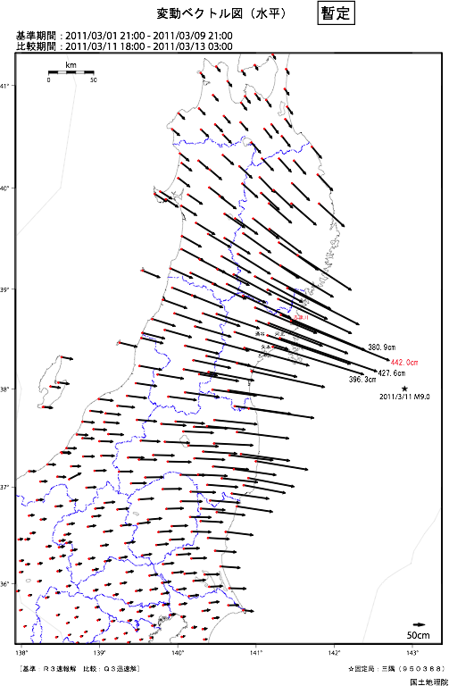
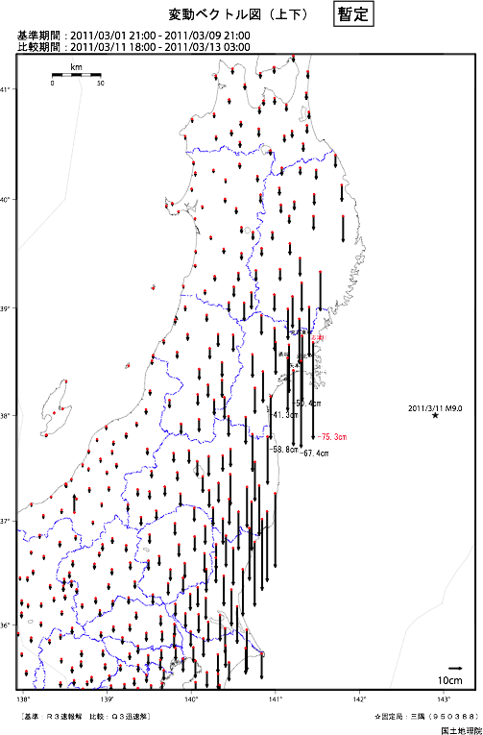
Tohoku, Japan Earthquake: GPS Displacements
Geospatial Information Authority of Japan

Slide 33
Tohoku, Japan Earthquake: Other Groups
Many groups have published (online) slip models for this earthquake; below is a list of some of these (note this is not complete):
Geospatial Information Authority, Japan (using regional GPS data):
http://www.gsi.go.jp/cais/topic110315-index-e.html
Charles Ammon, Penn State; Thorne Lay, UCSC; Hiroo Kanamori, Caltech:
http://eqseis.geosc.psu.edu/~cammon/Japan2011EQ/
Caltech Tectonics Observatory:
http://tectonics.caltech.edu/slip_history/
Yuji Yagi, Naoki Nishimura, University of Tsukuba:
http://www.geol.tsukuba.ac.jp/~yagi-y/EQ/Tohoku/
For a more comprehensive list of models, and results from other analyses, see the special IRIS website:
http://www.iris.edu/news/events/japan2011/

Slide 34
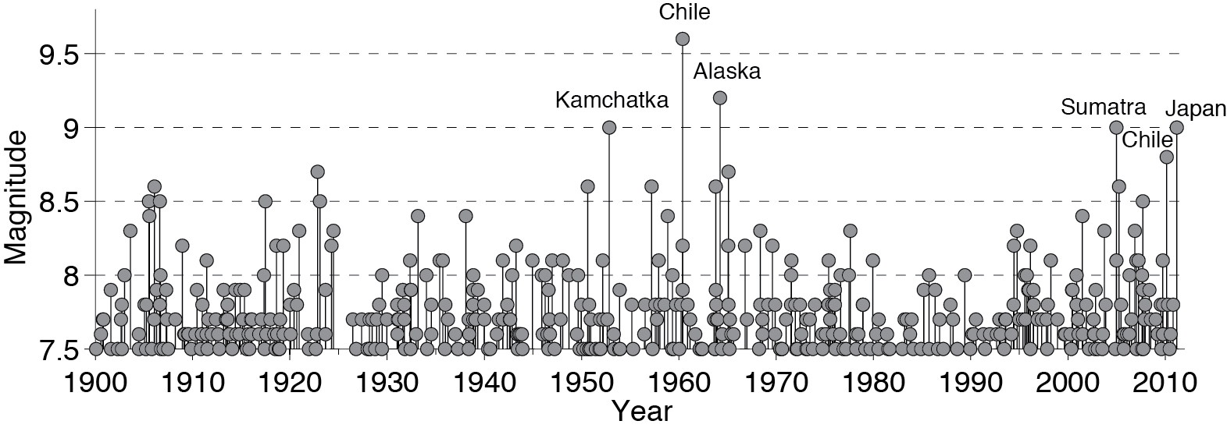
A History Of Large Earthquakes
Data: USGS PAGERCAT 1900-2008, USGS-NEIC & gCMT 2008-present
Figure courtesy of Charles Ammon, after Ammon et al., SRL, 2010

