Slide 1
Plate Tectonics, Part 1
Continental Drift & Seafloor Spreading

Slide 2
Plate Tectonics
A theory to explain:
  Global distribution of
    Volcanoes
    Earthquakes
    Faults
    Mountain belts
    Features of seafloor
  Evolution of continents and oceans
Synthesis of Continental Drift, Sea Floor Spreading & Paleomagnetism

Slide 3
Before Continental Drift
What were scientists thinking?
  The oceans and the continents were permanently fixed.
  There were no changes in continents back in time.
Evidence of drastic changes interpreted as…
  Shrinkage effects.
  Rebound from thick sediment loading.
  The result of “upheaval.”

Slide 4
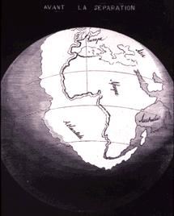
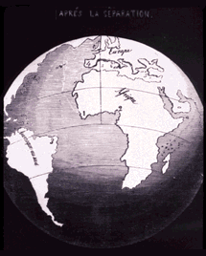
Continental Drift
1600 1625 1650 1675 1700 1725 1750 1775 1800 1825 1850 1875 1900 1925 1950 1975 2000
Geographic fit of continents
  first suggested as early as 1596 by the Dutch map maker Abraham Ortelius in Thesaurus Geographicus
  1858, geographer Antonio Snider-Pellegrini made a map showing how the continents fit together
Source: http://pubs.usgs.gov/gip/dynamic/historical.html

Slide 5
Eduard Seuss (1831 – 1914)
1600 1625 1650 1675 1700 1725 1750 1775 1800 1825 1850 1875 1900 1925 1950 1975 2000
Expert on the geography of the Alps
Research findings:
  The Alps to the north were once at the bottom of an ocean (Tethys ocean)
  glossopteris fern was found in fossils in South America, Africa, and India
proposed super continent “Gondwanaland”
  a land bridge connecting South America, Africa, India, Australia, and Antarctica
Source: http://en.wikipedia.org/wiki/Eduard_Suess

Slide 6
1855 - U.S. Navy Lt Matthew Maury
1600 1625 1650 1675 1700 1725 1750 1775 1800 1825 1850 1875 1900 1925 1950 1975 2000
creates a bathymetric map with a large, continuous mountain chain in the middle of the Atlantic Ocean
Confirmed by:
  trans-Atlantic telegraph cable
  WWI – echo soundings

Slide 7
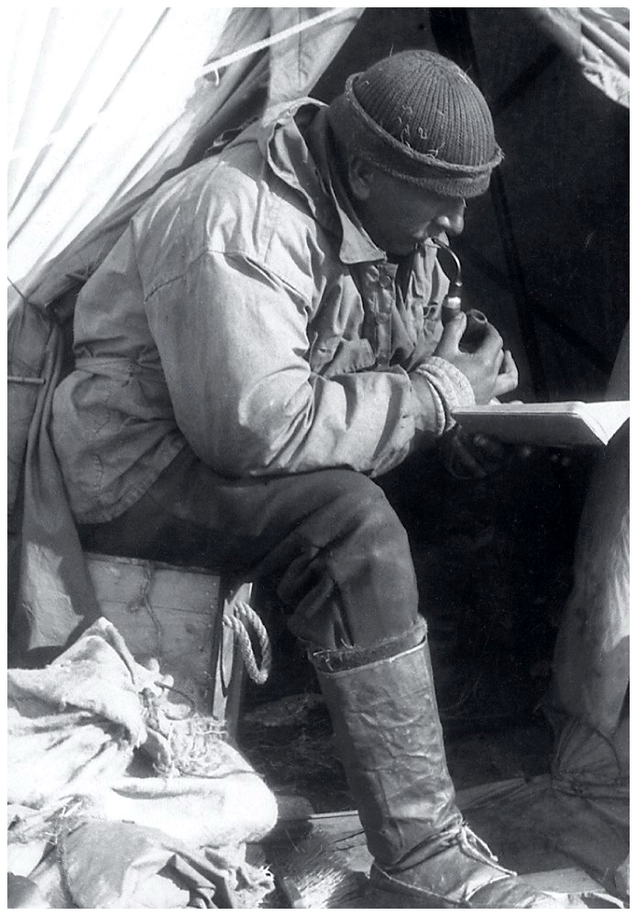
Alfred Wegener (1880-1930)
1600 1625 1650 1675 1700 1725 1750 1775 1800 1825 1850 1875 1900 1925 1950 1975 2000
Geologist & Meteorologist
  Greenland – arctic air circulation
  Cataloged fossils as a grad student
  Developed ideas while recovering from wounds received in WWI
Source: 1, 2

Slide 8
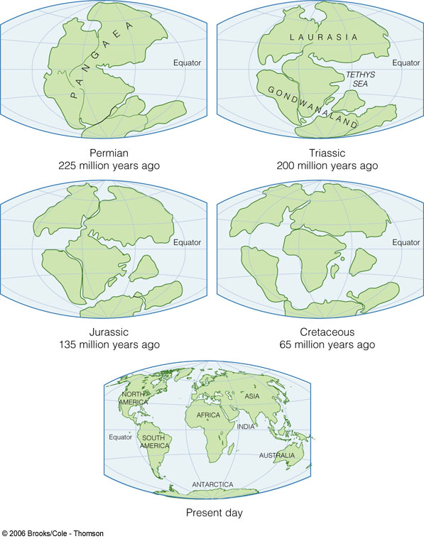
Alfred Wegener
1600 1625 1650 1675 1700 1725 1750 1775 1800 1825 1850 1875 1900 1925 1950 1975 2000
First proposed continental drift hypothesis in 1915
  Die Entstehung der Kontinente und Ozeane
  (The Origin of Continents and Oceans)
  Hypothesis: Supercontinent called “Pangaea” began breaking apart about 200 million years ago
Source: 1, 2

Slide 9
Breakup of Pangaea
Notes:
To view this animation, click “View” and then “Slide Show” on the top navigation bar.

Slide 10
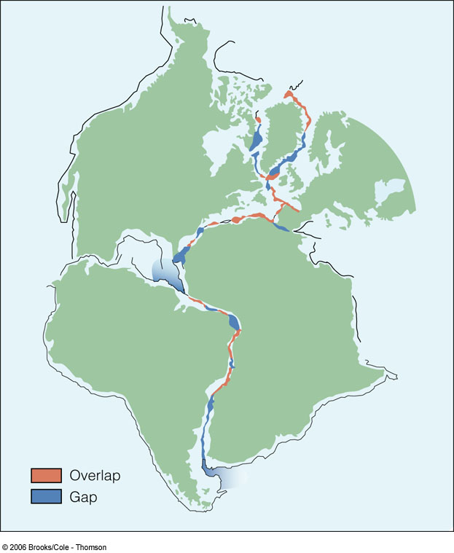
Wegener’s Evidence
1600 1625 1650 1675 1700 1725 1750 1775 1800 1825 1850 1875 1900 1925 1950 1975 2000
Fit of the continents

Slide 11
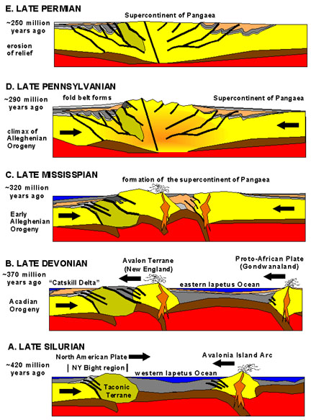
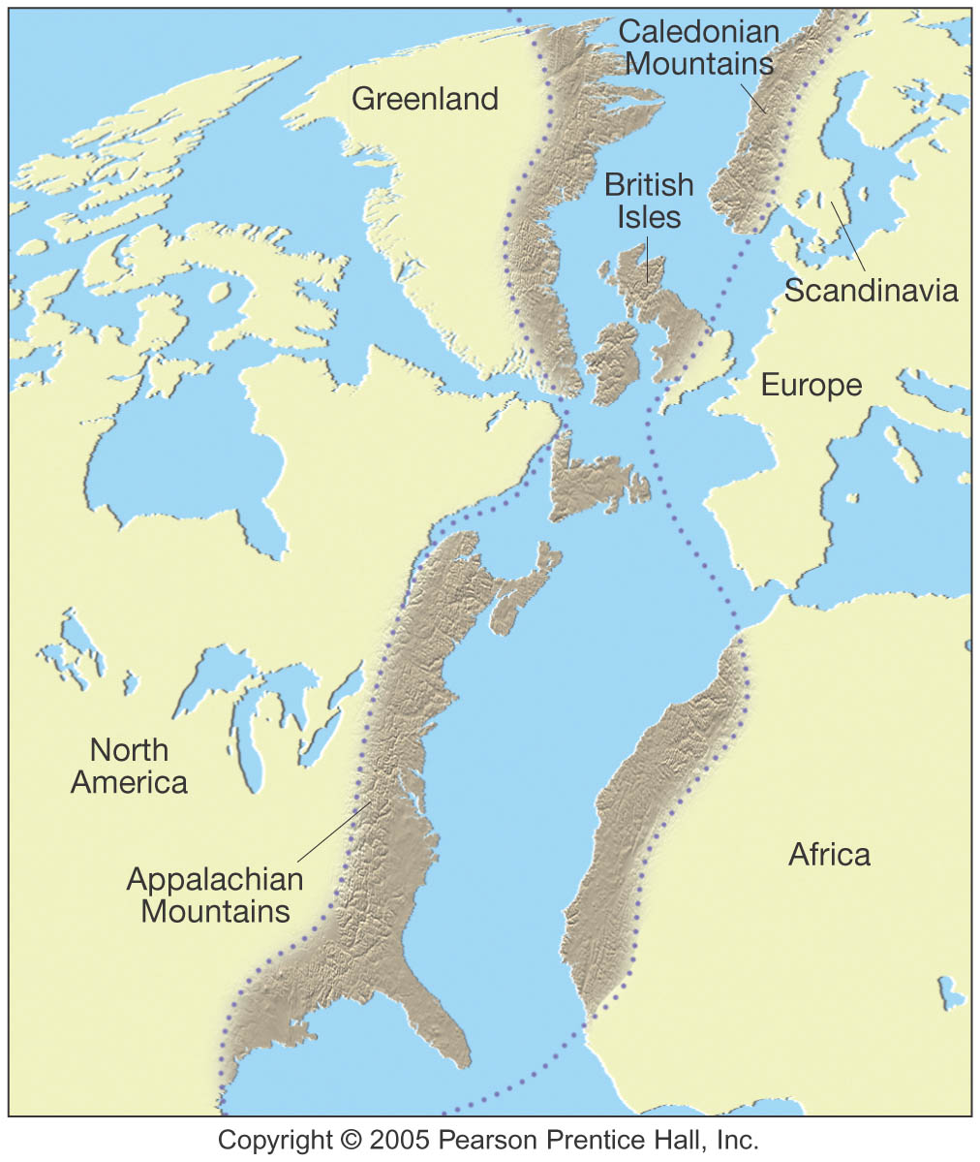
Wegener’s Evidence
1600 1625 1650 1675 1700 1725 1750 1775 1800 1825 1850 1875 1900 1925 1950 1975 2000
Fit of the continents
Rock type & structural similarities
Low metamorphism
High metamorphism
Low metamorphism
Source: 1, 2

Slide 12
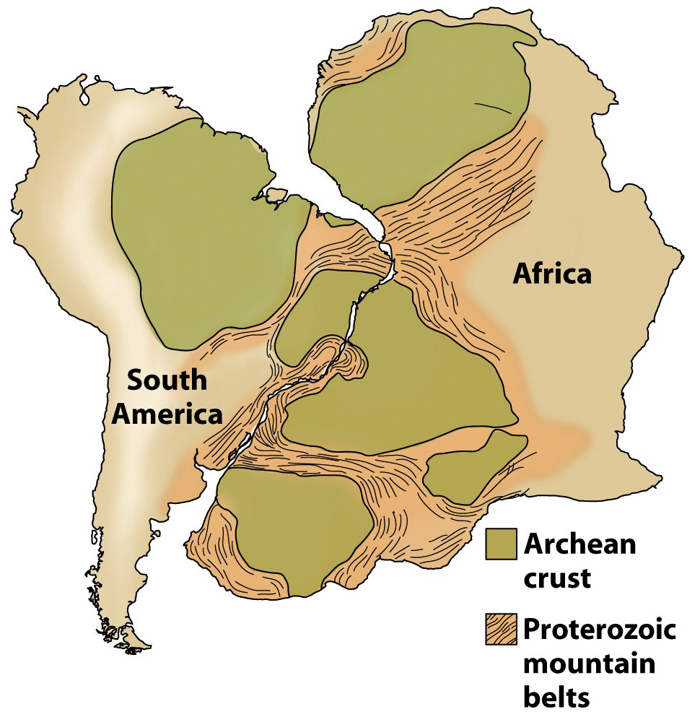
Rock type & structural similarities
1600 1625 1650 1675 1700 1725 1750 1775 1800 1825 1850 1875 1900 1925 1950 1975 2000
Geologic phenomena match across the Atlantic.
  Geologic structures.
  Rock types.
  Rock ages.

Slide 13
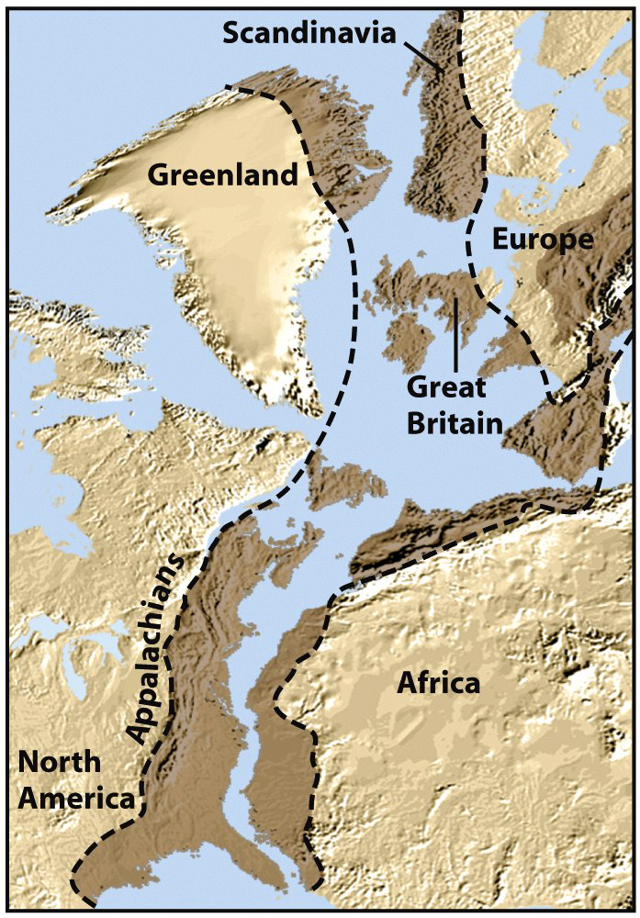
Rock type & structural similarities
1600 1625 1650 1675 1700 1725 1750 1775 1800 1825 1850 1875 1900 1925 1950 1975 2000
Geologic phenomenon match across the Atlantic.
  Mountain belts.
    Appalachians.
    Caledonides.

Slide 14
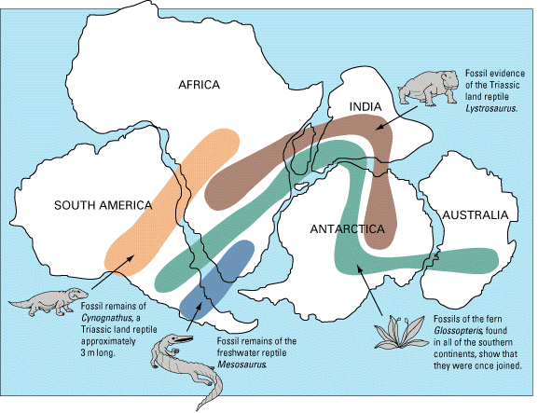
Wegener’s Evidence
1600 1625 1650 1675 1700 1725 1750 1775 1800 1825 1850 1875 1900 1925 1950 1975 2000
Fit of the continents
Rock type & structural similarities
Fossil evidence
Continental drift fossil evidence. As noted by Snider-Pellegrini and Alfred Wegener, the locations of certain fossil plants and animals on present-day, widely separated continents would form definite patterns (shown by the bands of colors), if the continents are rejoined.
Source: 1, 2

Slide 15
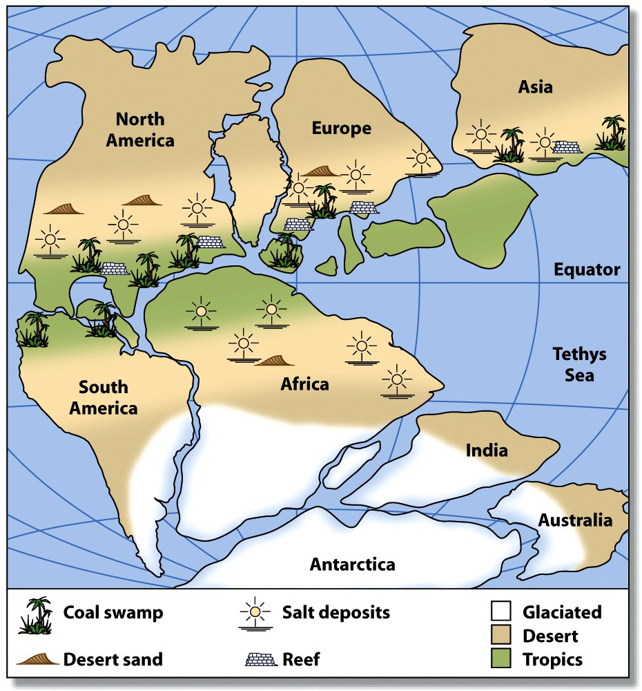
Wegener’s Evidence
1600 1625 1650 1675 1700 1725 1750 1775 1800 1825 1850 1875 1900 1925 1950 1975 2000
Fit of the continents
Rock type & structural similarities
Fossil evidence
Paleoclimatic evidence

Slide 16
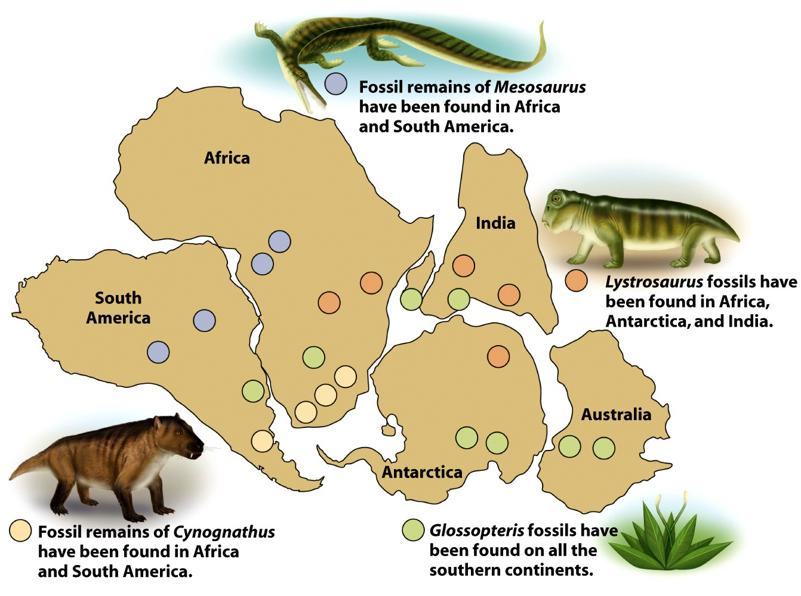
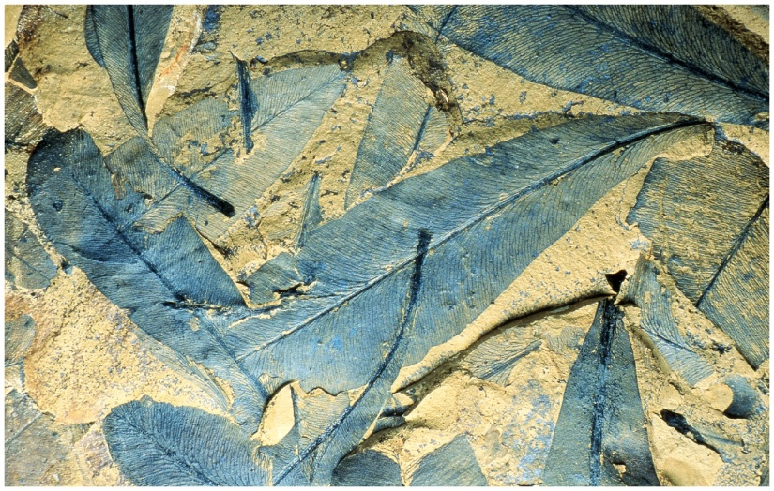
Wegener’s Fossil Evidence
1600 1625 1650 1675 1700 1725 1750 1775 1800 1825 1850 1875 1900 1925 1950 1975 2000
Identical fossils found on widely separated land.
  Mesosaurus – A freshwater reptile.
  Glossopteris – Subpolar plant
  with heavy seeds.

Slide 17
Wegener’s Fossil Evidence
1600 1625 1650 1675 1700 1725 1750 1775 1800 1825 1850 1875 1900 1925 1950 1975 2000
Identical fossils found on widely separated land.
  Lystrosaurus – A non-swimming, land-dwelling reptile.
  Cynognathus – A non-swimming, land-dwelling reptile.
These organisms could not
have crossed an ocean.

Slide 18
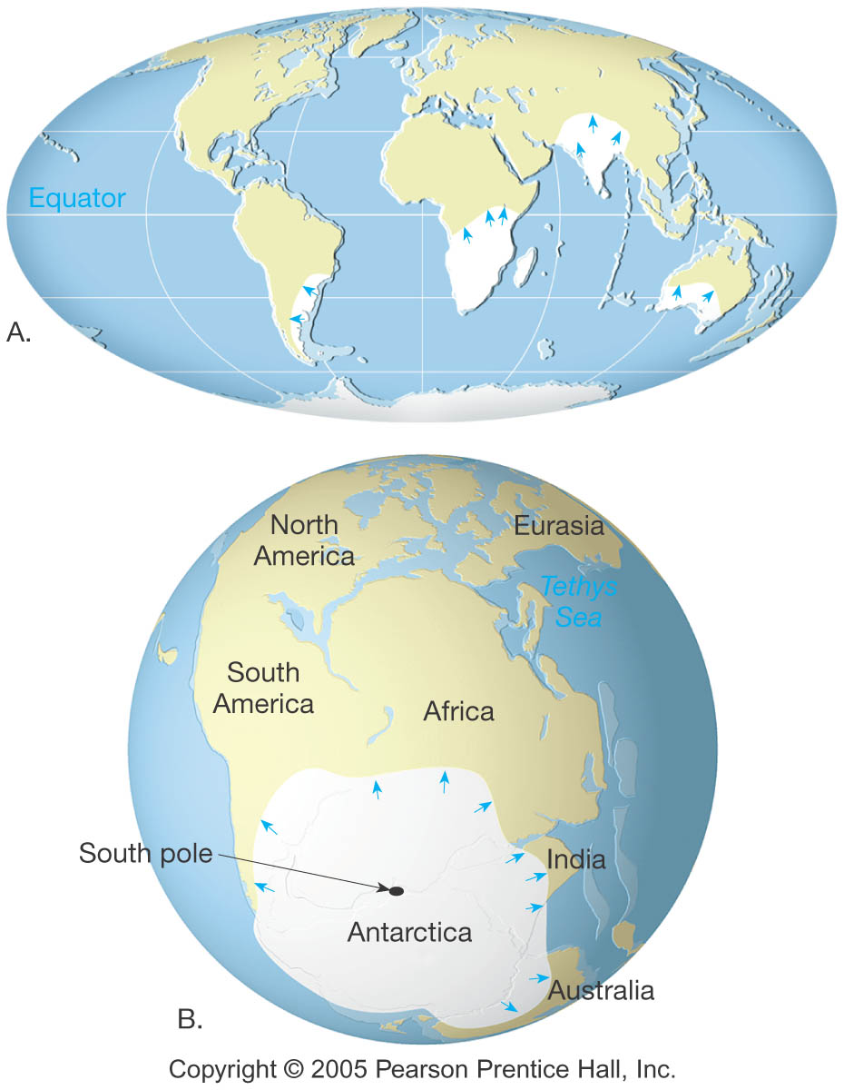
Wegener’s Evidence
1600 1625 1650 1675 1700 1725 1750 1775 1800 1825 1850 1875 1900 1925 1950 1975 2000
Fit of the continents
Rock type & structural similarities
Fossil evidence
Paleoclimatic evidence
Glacial evidence

Slide 19
Alfred Wegener
1600 1625 1650 1675 1700 1725 1750 1775 1800 1825 1850 1875 1900 1925 1950 1975 2000
Wegener had some ideas as to how the continents moved, but could not prove his theory
Hypothesis largely ignored
Died in Greenland researching arctic weather

Slide 20
WWII & the 1950s
1600 1625 1650 1675 1700 1725 1750 1775 1800 1825 1850 1875 1900 1925 1950 1975 2000
1947 – U.S.S. Atlantis discovers that sediments in the Atlantic Ocean are much thinner than originally thought
1950s – use of magnetometers revealed odd magnetic variations on the ocean floor

Slide 21
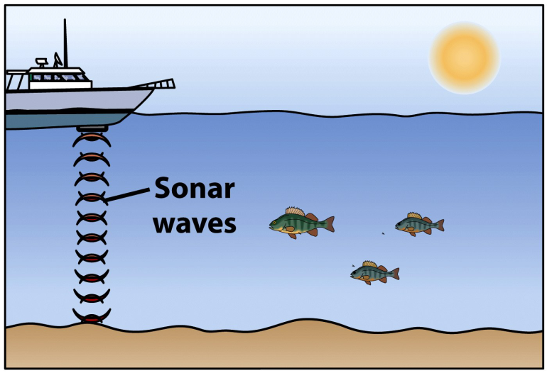
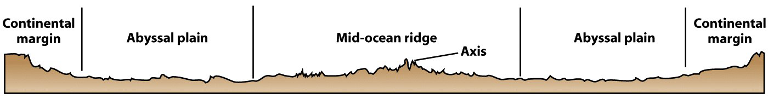
WWII & the 1950s
1600 1625 1650 1675 1700 1725 1750 1775 1800 1825 1850 1875 1900 1925 1950 1975 2000
In the 1950s, ocean bathymetry was mapped by sonar.
  The deepest parts of the ocean occur near land.
  A mountain range runs through every ocean basin.
  Submarine volcanoes form
  lines across ocean floors.

Slide 22
WWII & the 1950s
1600 1625 1650 1675 1700 1725 1750 1775 1800 1825 1850 1875 1900 1925 1950 1975 2000
By 1950, we had learned much about oceanic crust.
Oceanic crust is covered by sediment.
  Thickest near the continents.
  Thinnest (or absent) at the mid-ocean ridge.
Oceanic crust is mafic (basalt and gabbro).
  No granitic rocks.
  No metamorphic rocks.
High heat flow characterizes the mid-ocean ridge.

Slide 23
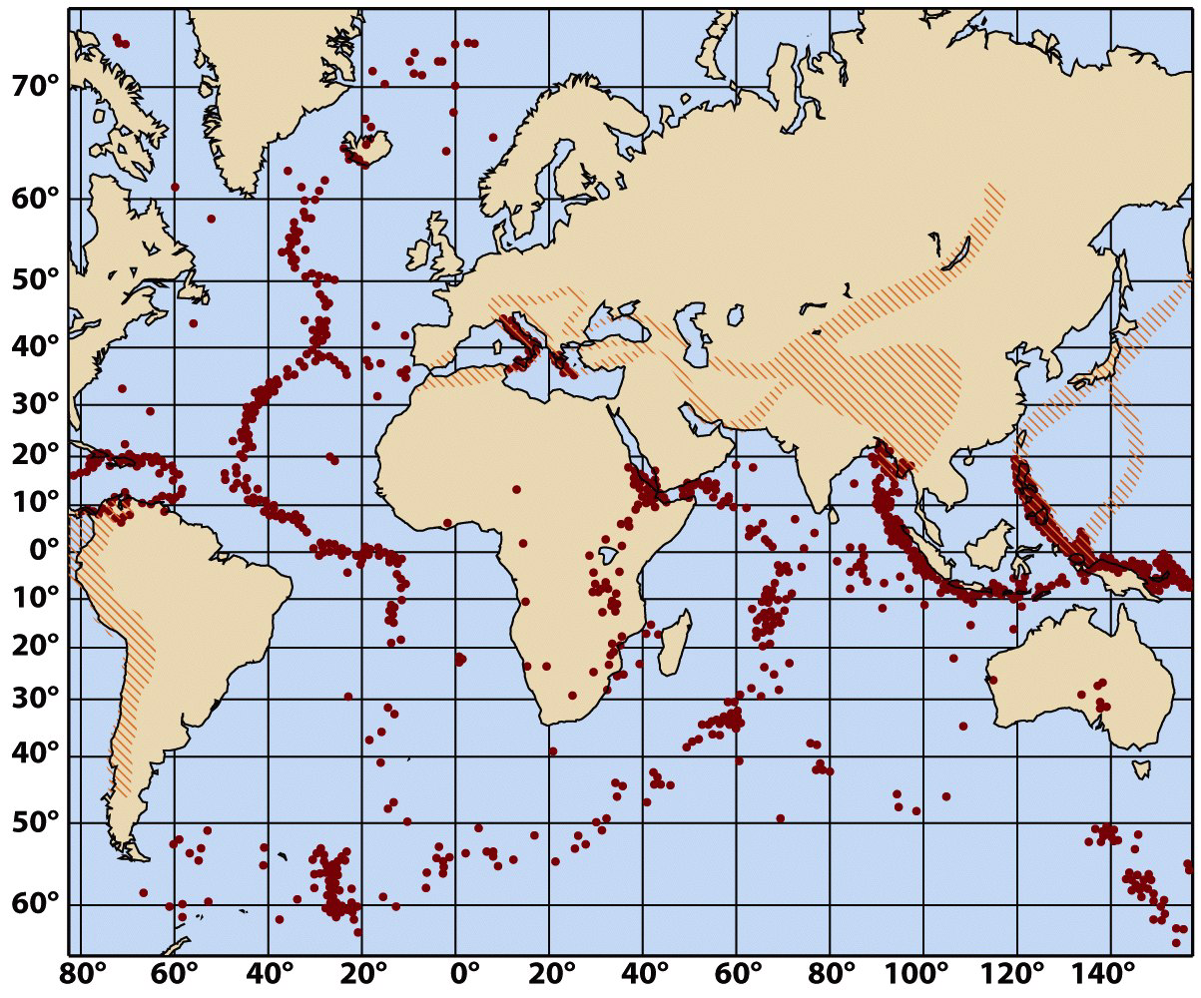
WWII & the 1950s
1600 1625 1650 1675 1700 1725 1750 1775 1800 1825 1850 1875 1900 1925 1950 1975 2000
Belts of concentrated subsea earthquakes were found.
They were limited
to…
  Parts of oceanic
  fracture zones.
  Mid-ocean ridge axes.
  Deep ocean trenches.

Slide 24
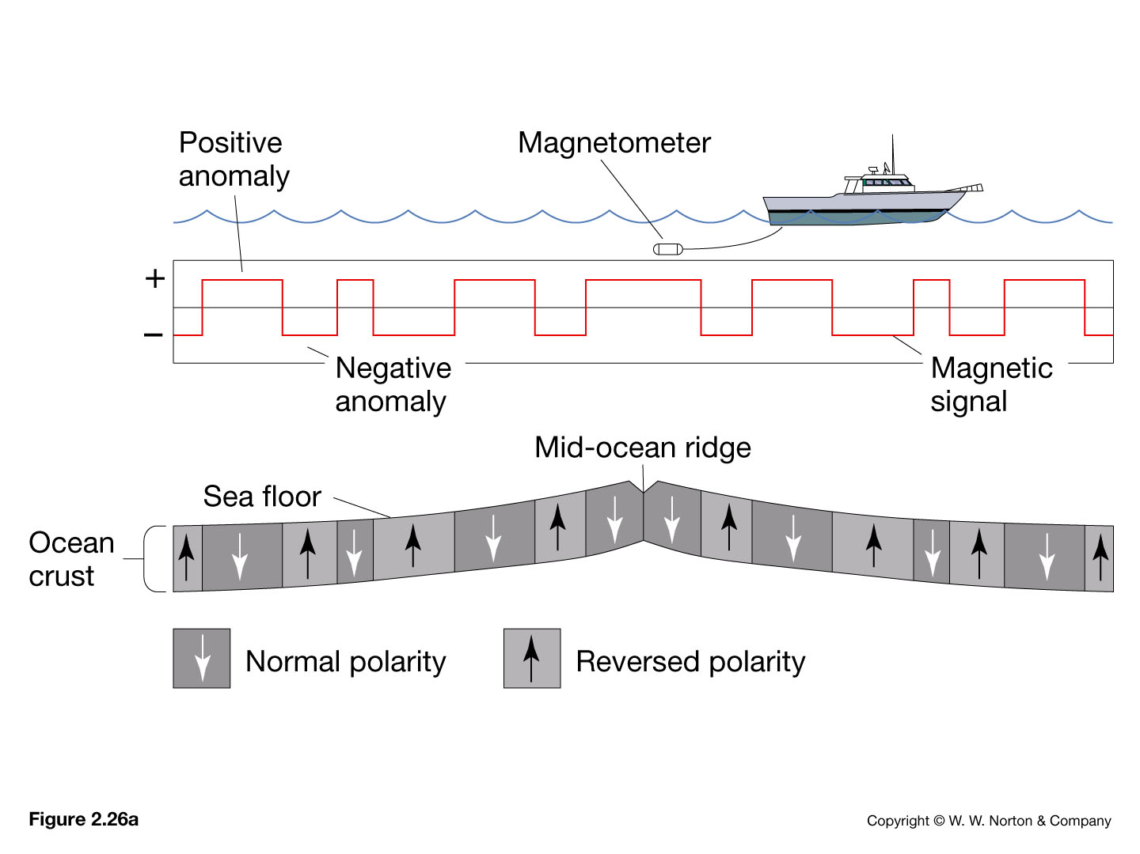
WWII & the 1950s
1600 1625 1650 1675 1700 1725 1750 1775 1800 1825 1850 1875 1900 1925 1950 1975 2000
So, what’s a magnetometer?
  Detects iron-bearing or magnetic objects
  Allows ships to find submarines before the submarine found them
  Strange readings reported

Slide 25
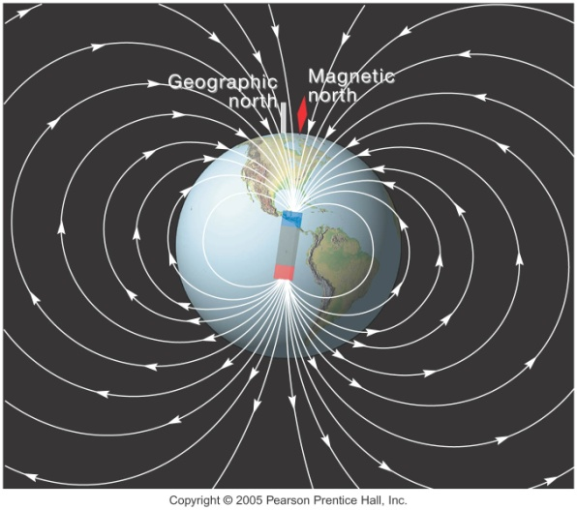
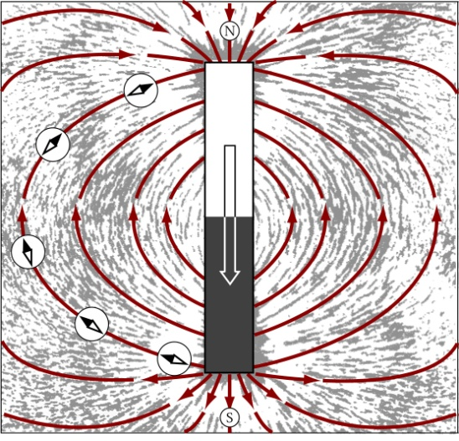
WWII & the 1950s
1600 1625 1650 1675 1700 1725 1750 1775 1800 1825 1850 1875 1900 1925 1950 1975 2000
So, what is the “Earth’s Magnetic Field”?
  Earth's magnetic field resembles that produced by a large bar magnet.
  Magnetic field lines “wrap” around Earth
  Magnetic north ≠ true north

Slide 26
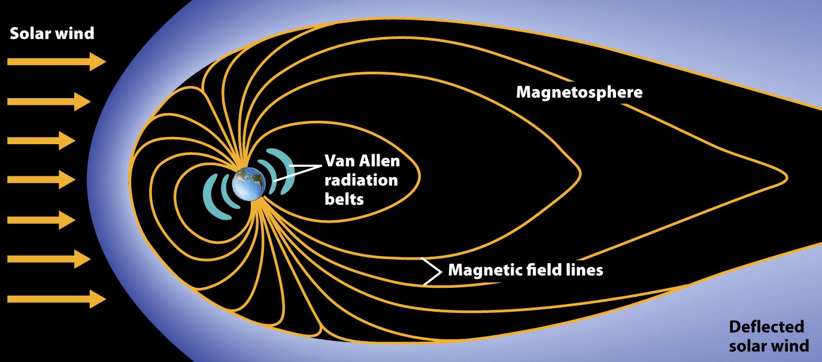
The Van Allen Belts
The solar wind is deflected by the magnetosphere.
Near the Earth, the stronger magnetic field forms the Van Allen belts, which arrest deadly cosmic radiation.

Slide 27
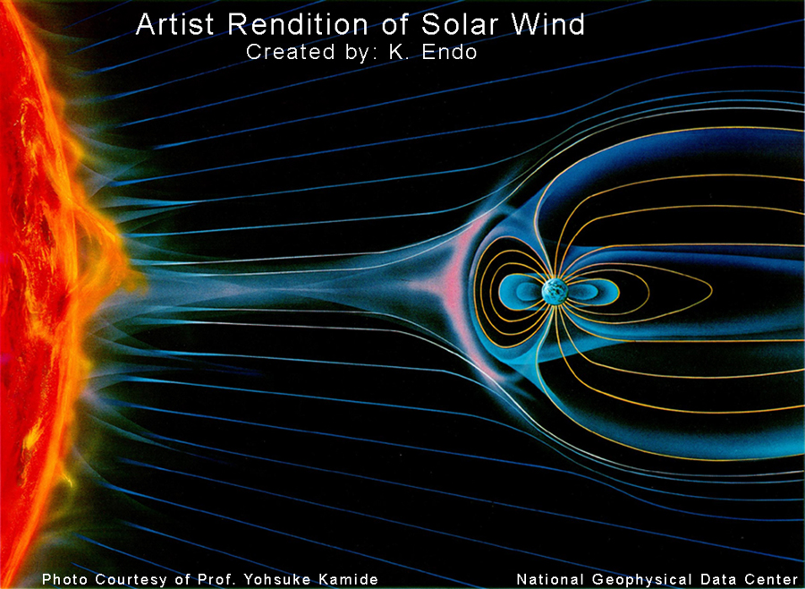
The magnetosphere shields the surface of the Earth from the charged particles of the solar wind. It is compressed on the day (Sun) side due to the force of the arriving particles, and extended on the night side. (Image not to scale.) Source
http://www.ngdc.noaa.gov/seg/geomag/icons/solarexp.jpg

Slide 28
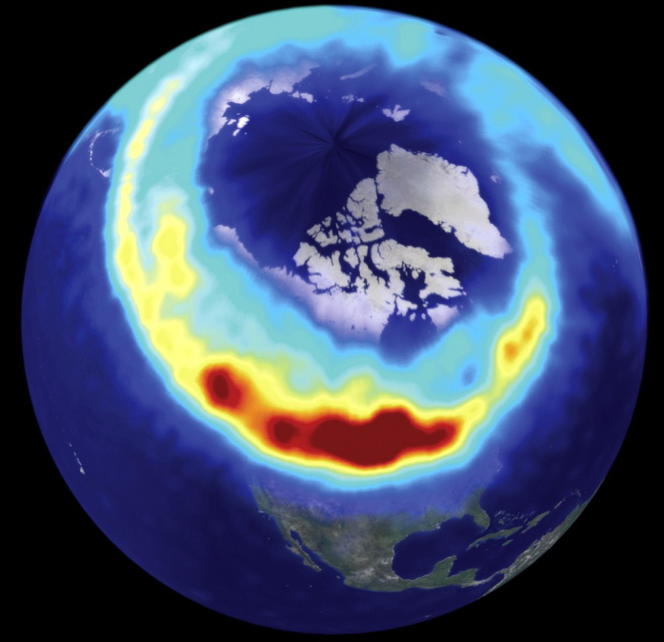
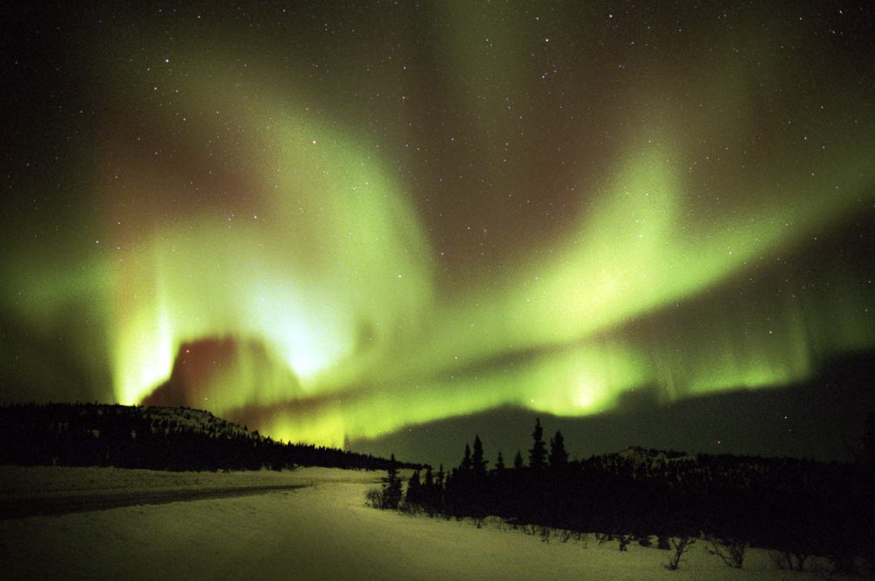
Aurorae
Some ions escape Van Allen belts.
  These ions are pulled to the magnetic poles and create light in the upper atmosphere.
  Aurora borealis & Aurora australis

Slide 29
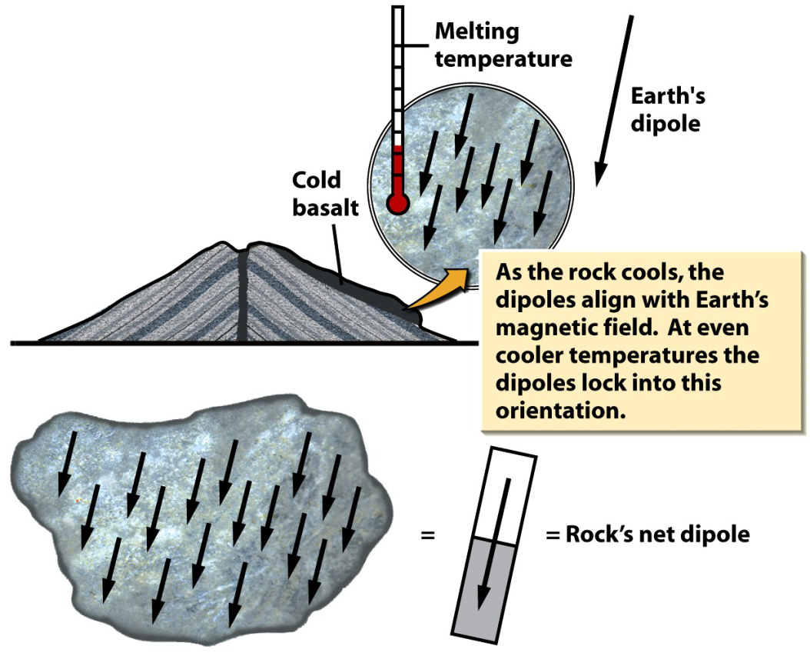
Paleomagnetism
1600 1625 1650 1675 1700 1725 1750 1775 1800 1825 1850 1875 1900 1925 1950 1975 2000
Magnetic field of the
Earth is imprinted
upon iron-bearing
rocks when they form
Provides a record of:
  magnetic reversals
  original latitude
Supports Continental Drift Hypothesis

Slide 30
Understanding Inclination and Declination
Notes:
To view this animation, click “View” and then “Slide Show” on the top navigation bar.

Slide 31
Seafloor Spreading and Seafloor Magnetization
Notes:
To view this animation, click “View” and then “Slide Show” on the top navigation bar.

Slide 32
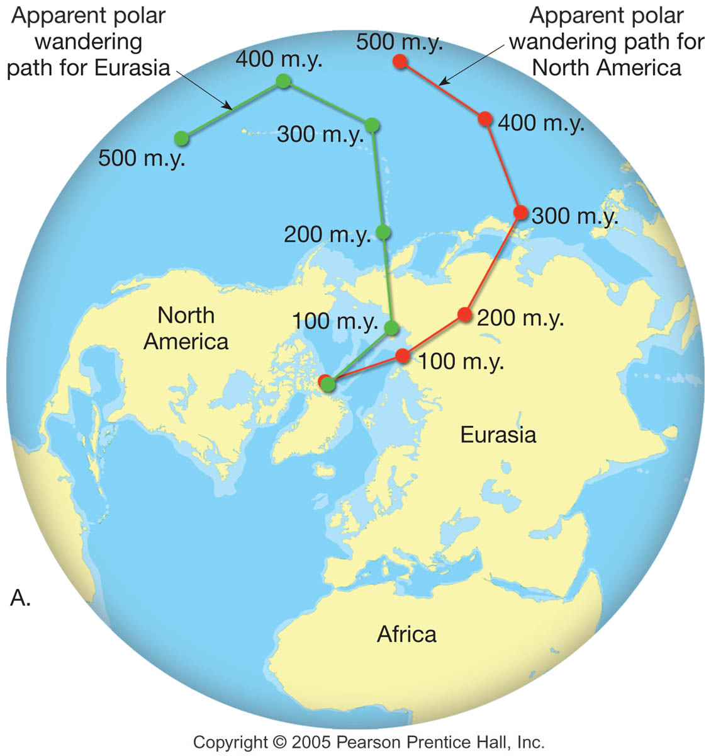
Polar
Wander
A. The more westerly path determined from North American data is thought to have been caused by the westward drift of North America by about 24 degrees from Eurasia.

Slide 33
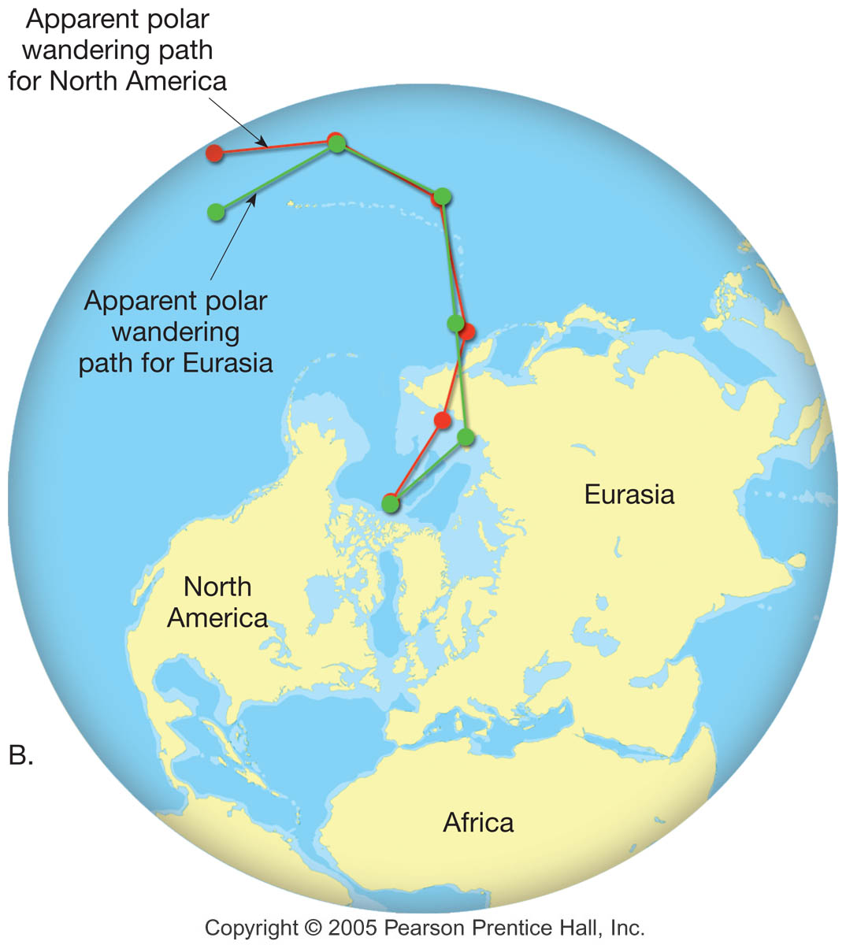
Polar
Wander
B. The positions of the wandering paths when the landmasses are reassembled in their predrift locations.

Slide 34
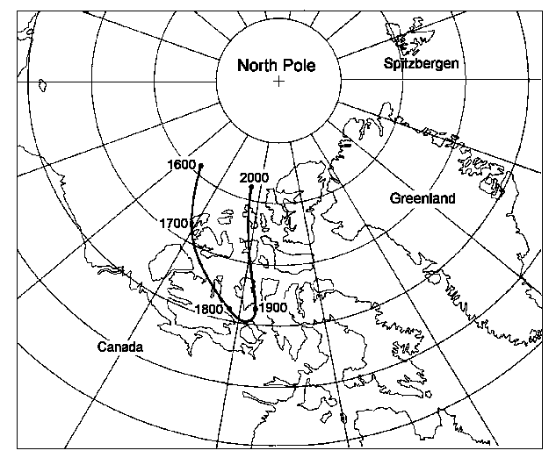
Movement of the magnetic north pole from 1600 to 2000
Source: http://www.tgo.uit.no/articl/roadto.html

Slide 35
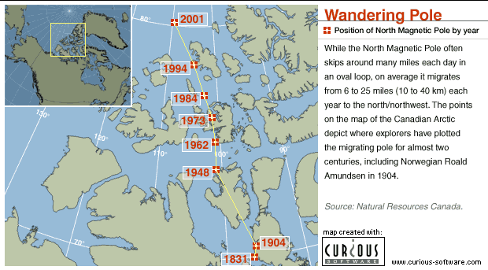

Slide 36
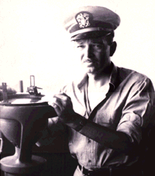
Harry Hess & Sea Floor Spreading
1600 1625 1650 1675 1700 1725 1750 1775 1800 1825 1850 1875 1900 1925 1950 1975 2000
Harry Hess
  Princeton Professor and Navy Reservist
  Called on to serve in WWII
    Got command of his own ship!
    Got cool new toys to play with!
      Echo sounder
      Magnetometer
    Kept instruments running 24/7
http://pubs.usgs.gov/gip/dynamic/HHH.html

Slide 37
Harry Hess & Sea Floor Spreading
1600 1625 1650 1675 1700 1725 1750 1775 1800 1825 1850 1875 1900 1925 1950 1975 2000
What Harry – and his crew – did:
  conducted echo-sounding surveys in the Pacific while cruising from one battle to the next
  measured the oceans to the deepest points to date (7 miles)
  discovered hundreds of flat-topped mountains on the Pacific floor (guyots, after Princeton’s first geology professor)
Sources: http://pubs.usgs.gov/gip/dynamic/HHH.html; http://www.pbs.org/wgbh/aso/databank/entries/bohess.html

Slide 38
Harry Hess & Sea Floor Spreading
1600 1625 1650 1675 1700 1725 1750 1775 1800 1825 1850 1875 1900 1925 1950 1975 2000
WWII ends, Harry head back to Princeton
  Starts to study data & continued researching guyots and midocean ridges
  1953 Great Global Rift discovered (not by Hess)
  Begins to put the pieces of the puzzle together
Sources: http://pubs.usgs.gov/gip/dynamic/HHH.html; http://www.pbs.org/wgbh/aso/databank/entries/bohess.html

Slide 39
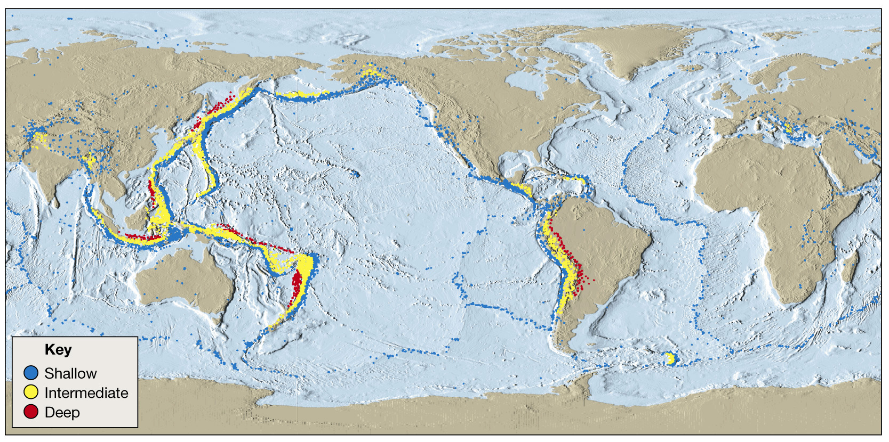
1600 1625 1650 1675 1700 1725 1750 1775 1800 1825 1850 1875 1900 1925 1950 1975 2000
1. Earthquakes at ridges and subduction zones
Distribution of magnitude 5 or greater earthquakes, 1980 - 1990

Slide 40
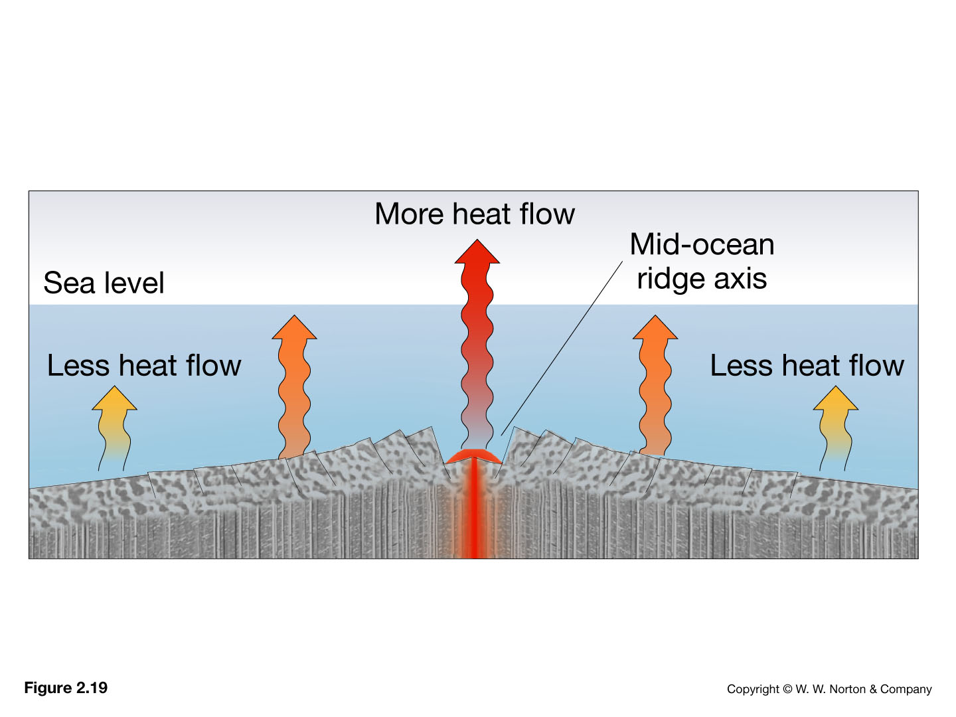
1600 1625 1650 1675 1700 1725 1750 1775 1800 1825 1850 1875 1900 1925 1950 1975 2000
2. Heat flow highest at ridges, decreases away from ridges

Slide 41
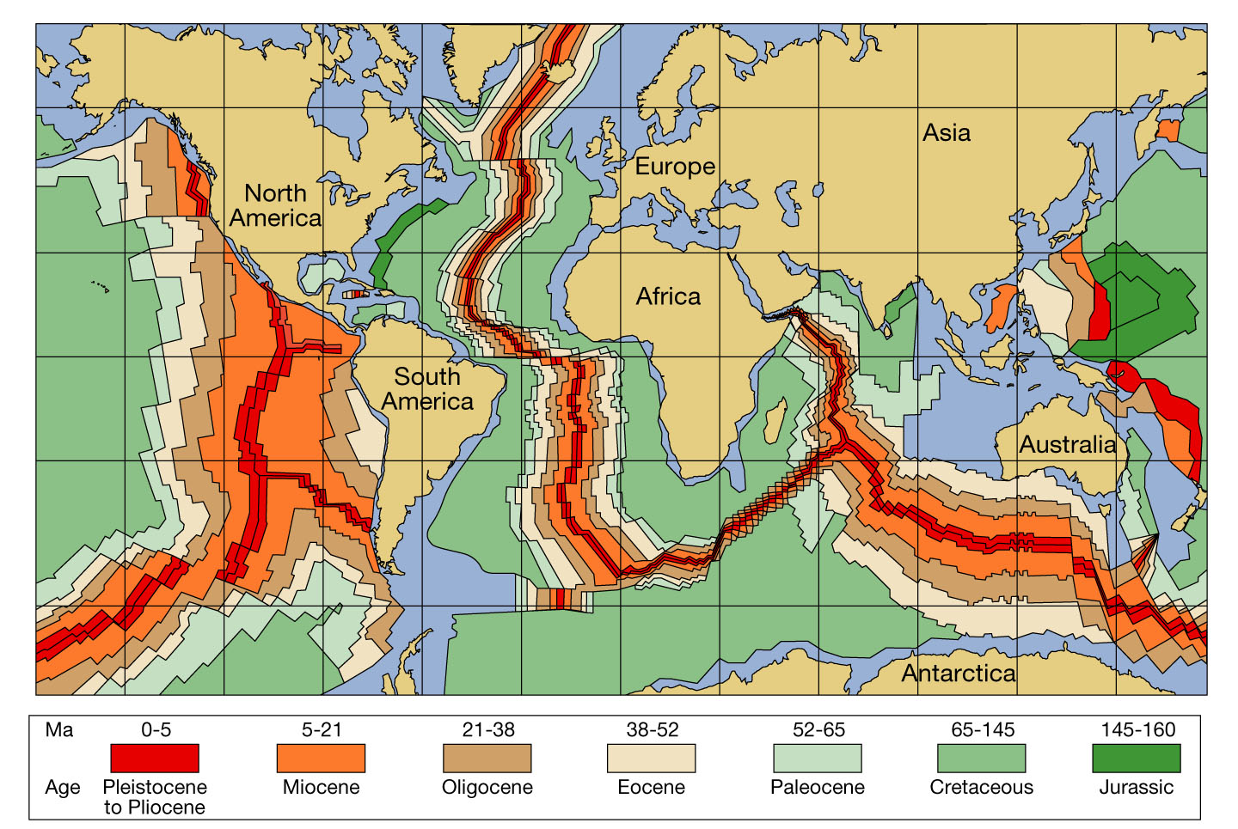
1600 1625 1650 1675 1700 1725 1750 1775 1800 1825 1850 1875 1900 1925 1950 1975 2000
3. Radiometric dating shows oldest crustal rocks on sea floor of 200 m.y.
4. Sediments older away from ridges

Slide 42
1600 1625 1650 1675 1700 1725 1750 1775 1800 1825 1850 1875 1900 1925 1950 1975 2000
5. Earth’s magnetic field reverses, this change recorded by iron minerals in rocks
Notes:
Schematic representation of magnetic intensities recorded as a magnetometer is towed across a segment of the oceanic ridge.
Notice the symmetrical stripes of low- and high-intensity magnetism that parallel the ridge crest.

Slide 43
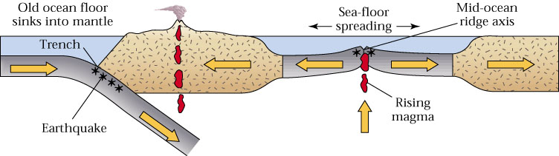
Harry Hess & Sea Floor Spreading
1600 1625 1650 1675 1700 1725 1750 1775 1800 1825 1850 1875 1900 1925 1950 1975 2000
Proposed Sea Floor Spreading Hypothesis in 1960 (“Essay in Geopoetry”)
  New crust forms at ocean ridges
  Old crust consumed at trenches
  Developed theory of sea floor spreading driven by convection cells
Sources: http://pubs.usgs.gov/gip/dynamic/HHH.html; http://www.pbs.org/wgbh/aso/databank/entries/bohess.html

Slide 44
Seafloor Spreading and Plate Boundaries
Notes:
To view this animation, click “View” and then “Slide Show” on the top navigation bar.

Slide 45
Putting it all together: The Theory of Plate Tectonics
        Continental Drift
        + Sea-Floor Spreading
        + Paleomagnetism
        = Plate Tectonics

Slide 46
~ End ~

