Slide 1
Plate Tectonics, Part 2
Layers of the Earth

Slide 2
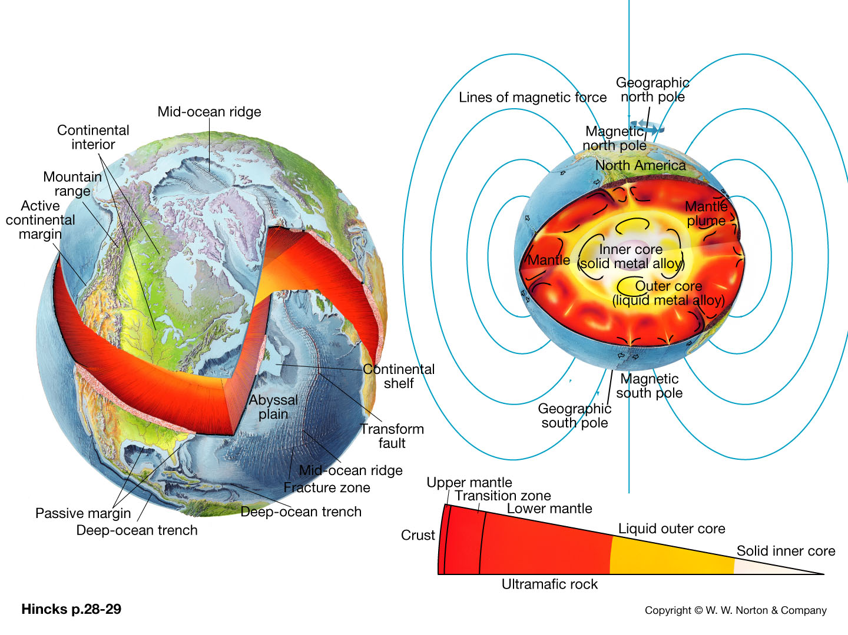

Slide 3
Plate Tectonics
Earth’s lithosphere is broken up into plates
Hot, weak asthenosphere allows for plates to move
Plates are in motion and continually changing in shape and size
  Move very slowly – 5 cm/yr

Slide 4
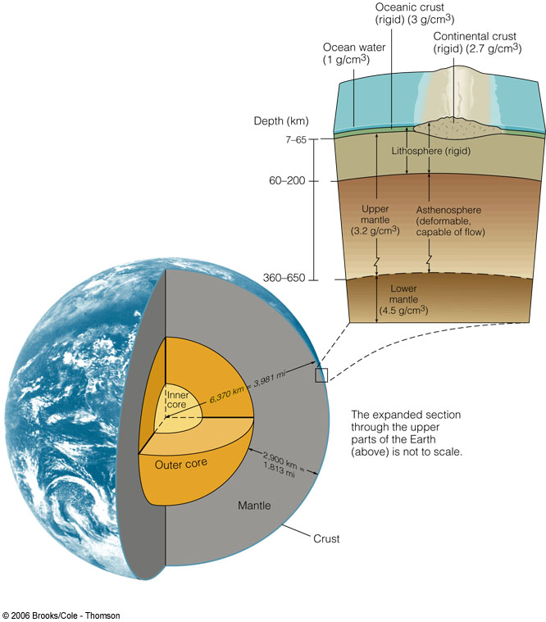
Structure of the Earth
Layers – by composition
  Crust
  Mantle
  Core

Slide 5
Structure of the Earth
Layers – by physical properties
  Lithosphere
  Asthenosphere
  Mesosphere
  Outer Core
  Inner Core

Slide 6
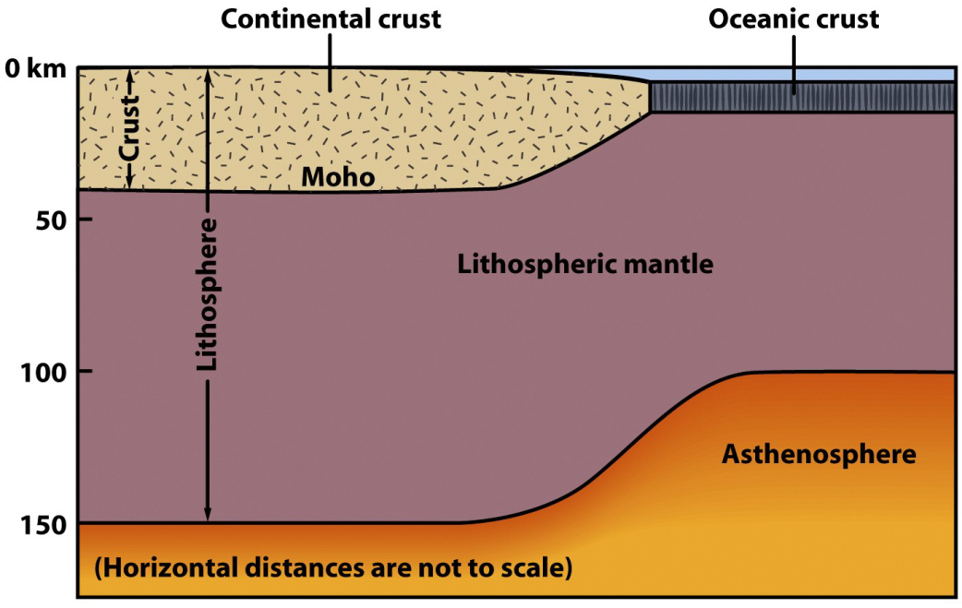
The Lithosphere
The outermost 24-150 km of Earth.
Behaves as a non-flowing, rigid material.
The material that moves as tectonic plates.
Made of 2
components:
crust and
upper mantle
(asthenosphere)

Slide 7
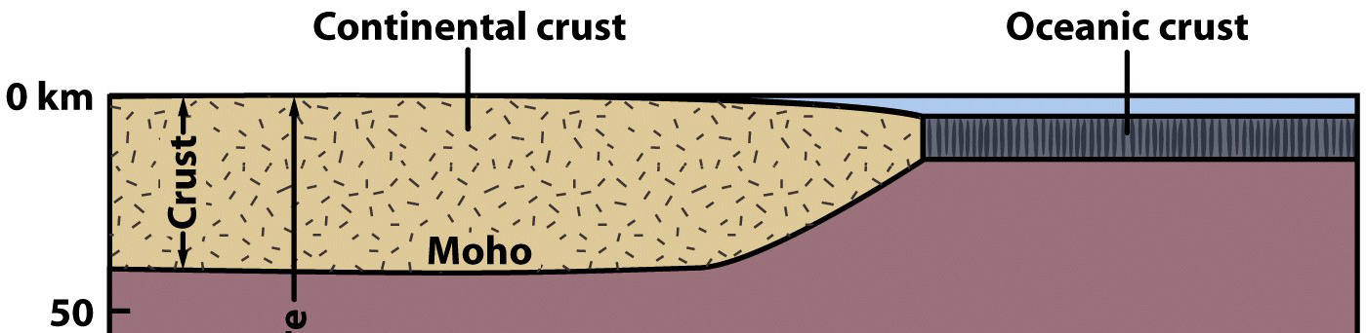
The Crust
The outermost “skin” of Earth with variable thickness.
  Thickest under mountain ranges (70 km – 40 miles).
  Thinnest under mid-ocean ridges (3 km – 2 miles).

Slide 8
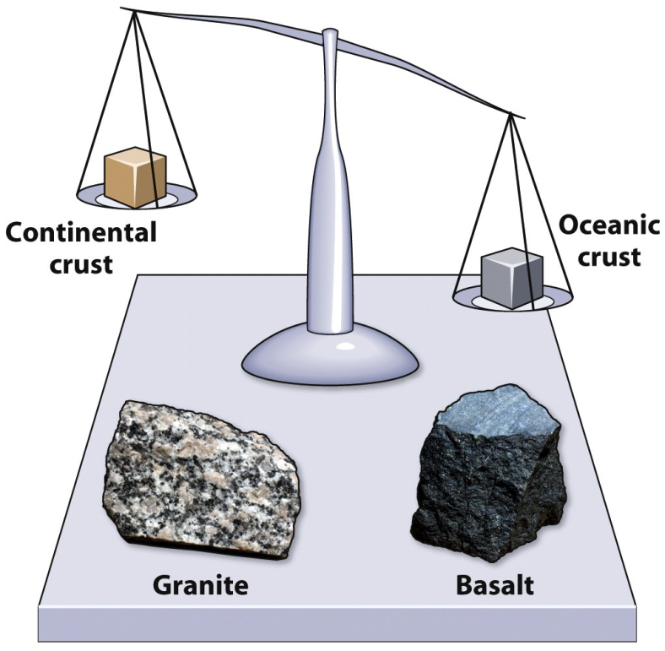

The Crust
Crustal density controls surface position.
  Continental crust: Less dense; “floats higher.”
  Oceanic crust: More dense: “floats lower.”

Slide 9
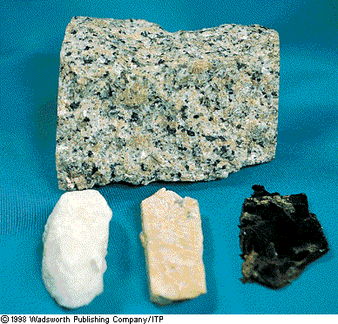
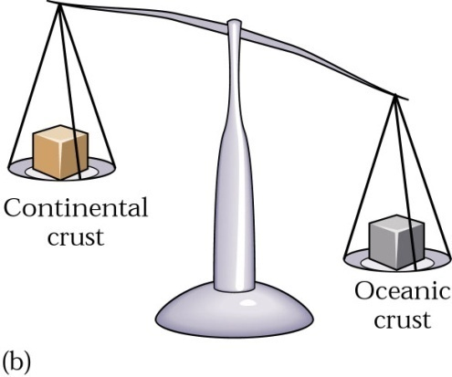
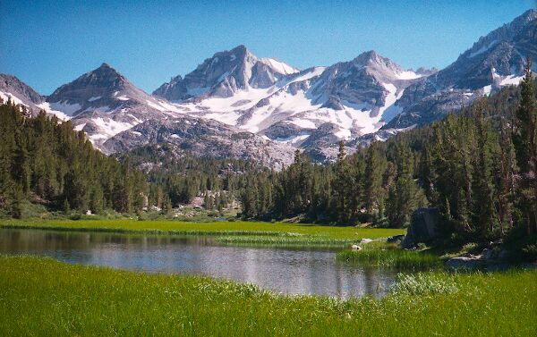
The Crust
Continental crust
  Average rock density about 2.7 g/cm³
  Composition = the felsic igneous rock granodiorite

Slide 10
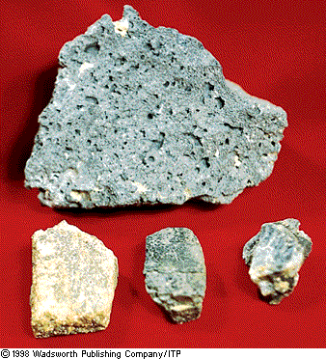
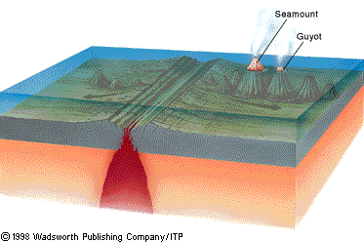
The Crust
Oceanic crust
  Density about 3.0 g/cm³
  Composed mainly of the igneous rock basalt

Slide 11
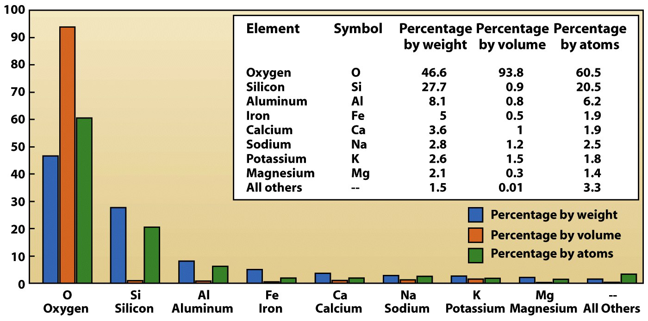
The Crust
98.5% of the crust is comprised of just 8 elements.

Slide 12
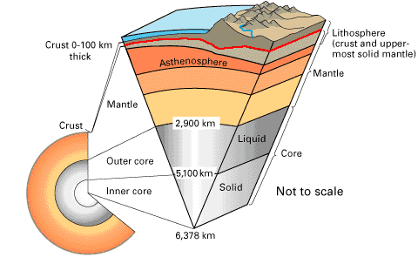
The Crust
The Mohorovicic discontinuity
  Separates the crust from the upper mantle.
  Discovered in 1909 by
  Andrija Mohorovicic.
  Marked by a change
  in the velocity of
  P waves.
source

Slide 13
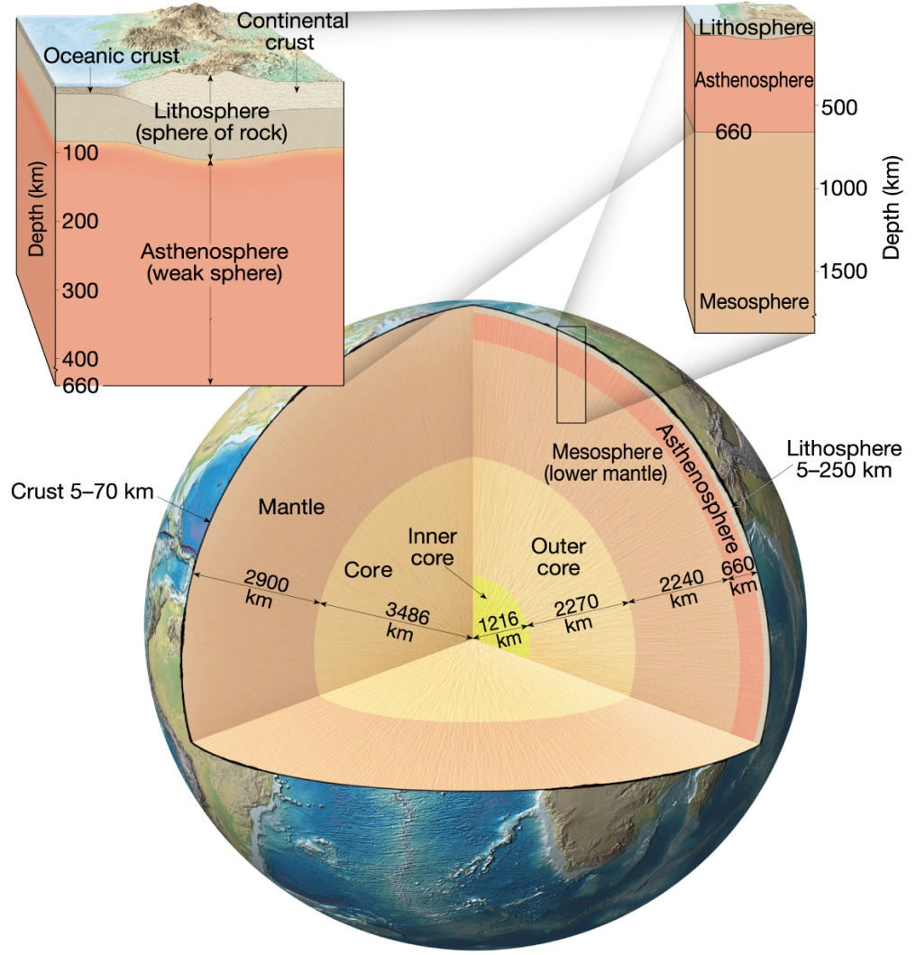
The Mantle
Contains 82% of Earth’s
volume
2,885 km thick.
Composition is the
ultramafic rock peridotite.
Solid, rocky layer, below
~24 -150 km, the rock is hot
enough to flow.
It convects: hot mantle rises, cold mantle sinks.

Slide 14
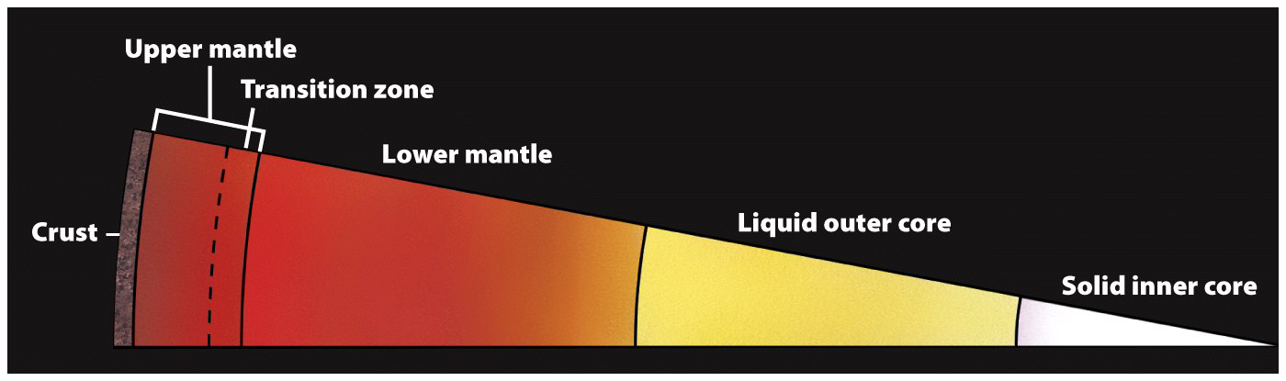
The Mantle
Three subdivisions:
  Upper = Asthenosphere
  Transitional
  and lower = Mesosphere.

Slide 15
The Core
Outer core
  Liquid iron-nickel-sulfur
  2,255 km thick
  Density – 10-12 g/cm³
Inner core
  Solid iron-nickel alloy
  Radius of 1,220 km.
  Density – 13 g/cm³

Slide 16
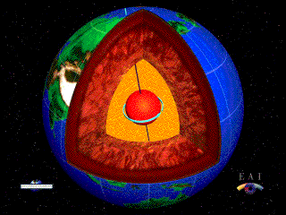
The Core
Responsible for Earth’s magnetic field
  Made of material that conducts electricity
  Core is mobile
Very hot
  3,950 Kelvin
  6,650º F / 3,677º C
Source

Slide 17
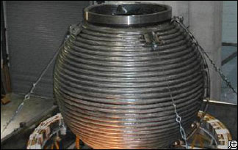
Magnetic Reversals
Computer models:
  The Earth’s magnetic field is sustained by a geodynamo (generates new magnetic fields)
  Usually the fields line up; when they don’t, an unstable area forms.
  If the area grows large enough a flip will occur
  One such are is forming in the east-central Atlantic Ocean source & Image source

Slide 18
Magnetic Reversals
Mathematical models:
  the more tidily the undulations in Earth's magnetic field align with the equator, the more prone the field is to reversing its polarity. source
Other factors:
  Rapid changes in the churning of the liquid of the outer core can weaken the Earth’s magnetic field. source

Slide 19
Magnetic Reversals
Reversal rate varies wildly
  Last 10 – 20 million years = average rate of
  5 times/million years
  Cretaceous Normal Synchron (84 – 125 million years ago) = only flipped once or twice
Flips take thousands of years to complete
Last flip? 780,000 years ago
source

Slide 20
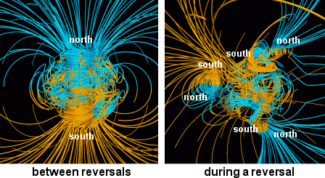
Credit & Copyright: Gary A. Glatzmaier (UCSC)

Slide 21
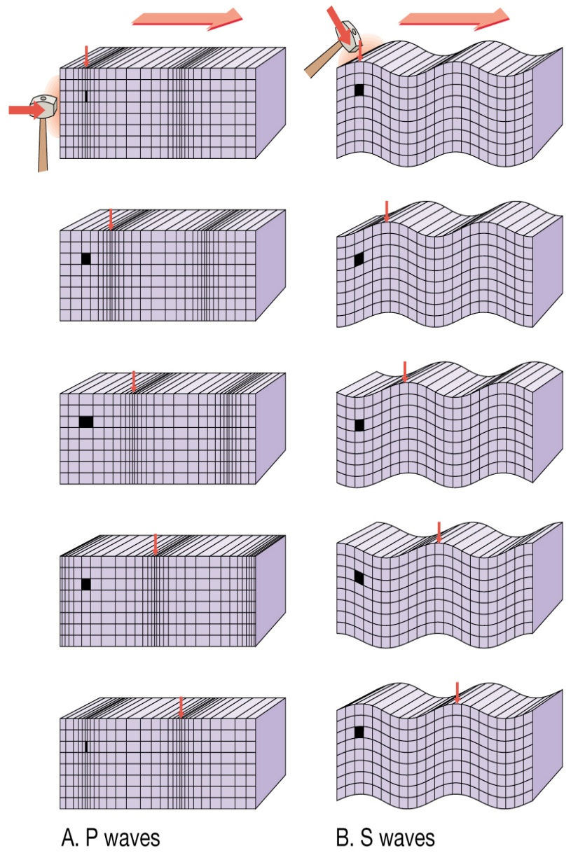
Structure of the Earth
Seismic waves
  P waves
    Travels through liquids as well as solids
    In all materials, P waves travel faster than do S waves
  S waves
    Cannot travel through liquids

Slide 22
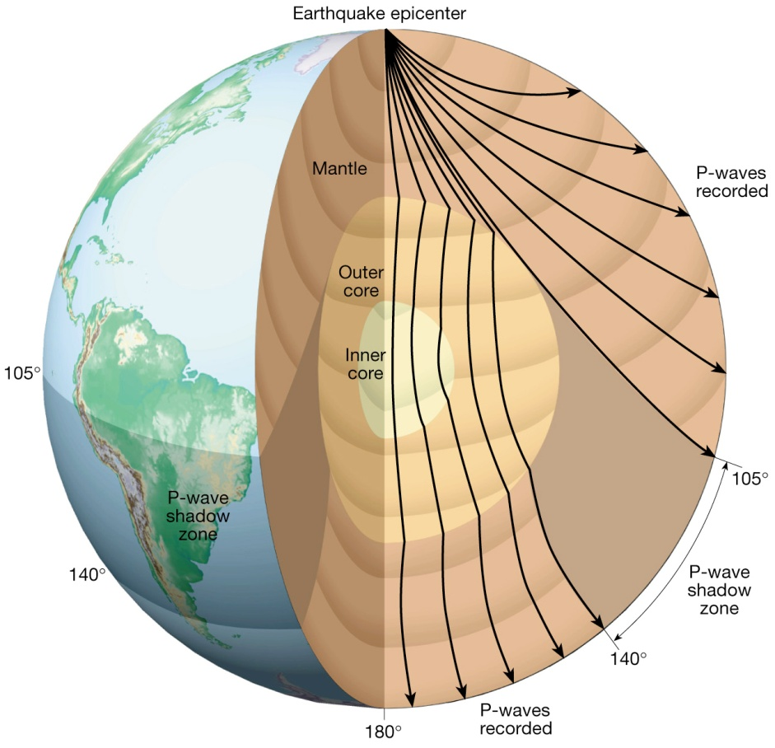
Structure of the Earth
Seismic waves
  Seismic waves refract as they pass from one material to another
  P & S wave shadow zones
P-Wave Shadow Zone

Slide 23
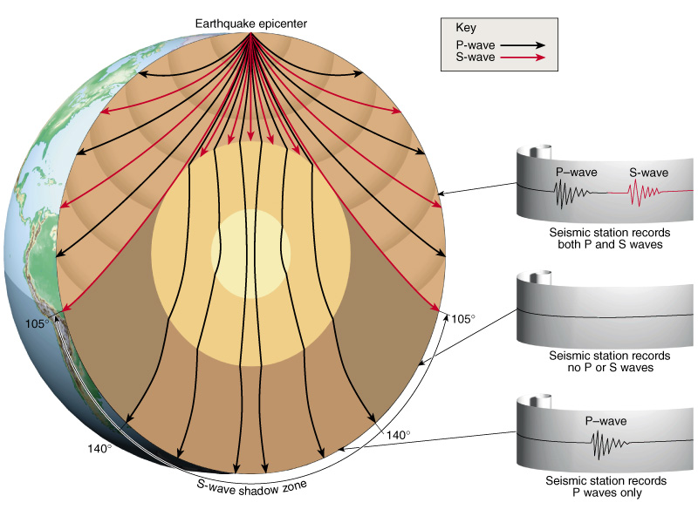
Structure of the Earth
Seismic waves
  Seismic waves refract as they pass from one material to another
  P & S wave shadow zones
S-Wave Shadow Zone

Slide 24
~ End ~

