Slide 1
Plate Tectonics, Part 3
Plate Tectonics

Slide 2
Plate Tectonics
A theory to explain:
  Global distribution of
    Volcanoes
    Earthquakes
    Faults
    Mountain belts
    Features of seafloor
  Evolution of continents and oceans
Synthesis of Continental Drift, Sea Floor Spreading & Paleomagnetism

Slide 3
Plate Boundary Features
Notes:
To view this animation, click “View” and then “Slide Show” on the top navigation bar.

Slide 4
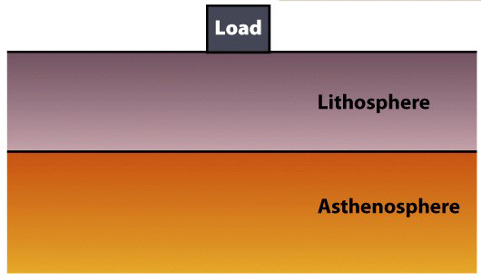
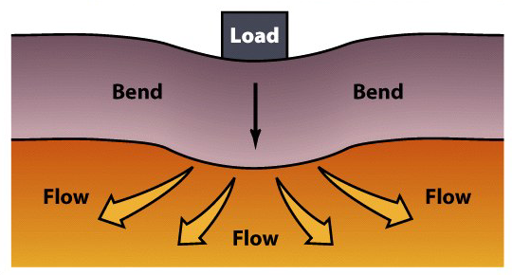
Lithosphere
Tectonic plates are fragments of lithosphere.
  Lithosphere is made of both crust and the upper mantle.
  The lithosphere is in motion over the asthenosphere.
  Lithosphere bends elastically when loaded.
  Asthenosphere flows plastically when loaded.

Slide 5
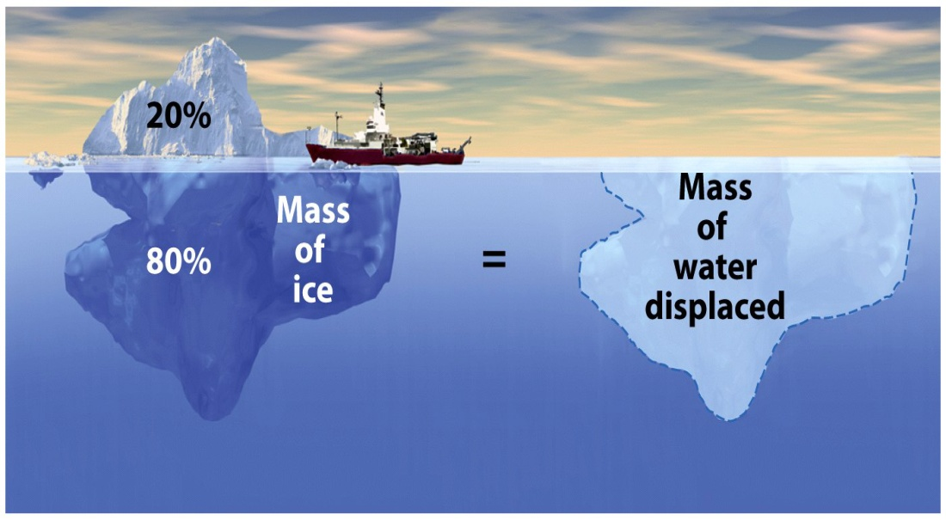
Buoyancy
Floating solids displace water equal to their mass.
This concept applies to lithospheric plates.
  Continental – Floats higher.
  Oceanic – Sinks lower.

Slide 6
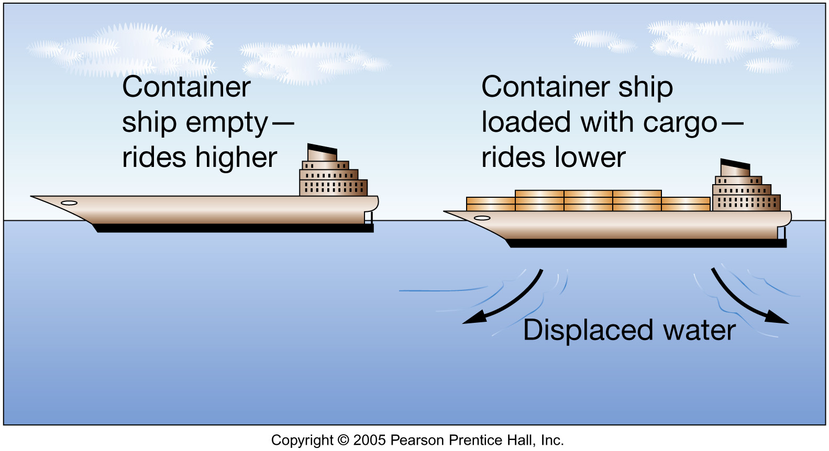
Fig. 1.14

Slide 7
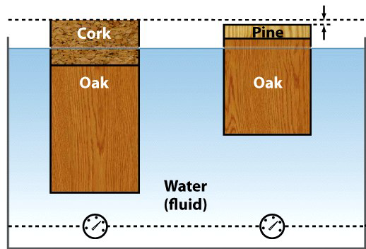
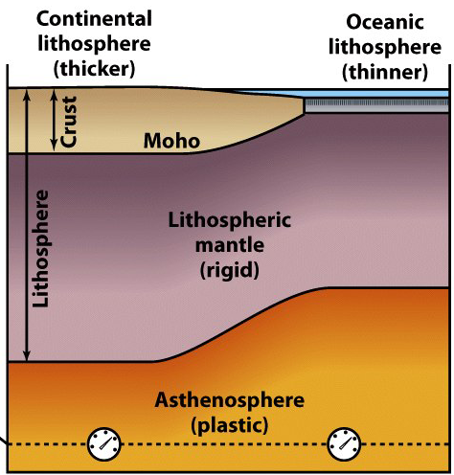
2 Types of Lithosphere
Continental ~ 150 km thick.
  Granitic crust.
    35-40 km thick.
    Lighter (less dense) .
    More buoyant – Floats higher.
Oceanic ~ 7 to 88 km thick.
  Basaltic crust.
    7-10 km thick.
    Heavier (more dense).
    Less buoyant – Sinks lower.

Slide 8
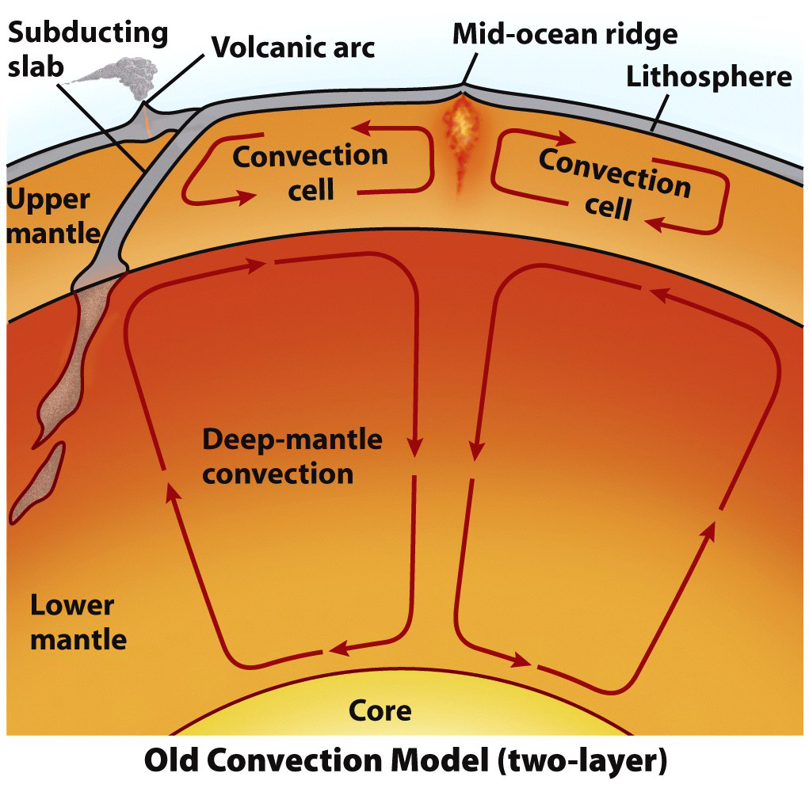
Driving Mechanisms
Old: Plates are dragged atop a convecting mantle.
  Plate motions are much
  too complex.
  Convection does occur.
    It is not the prime
    driving mechanism.

Slide 9
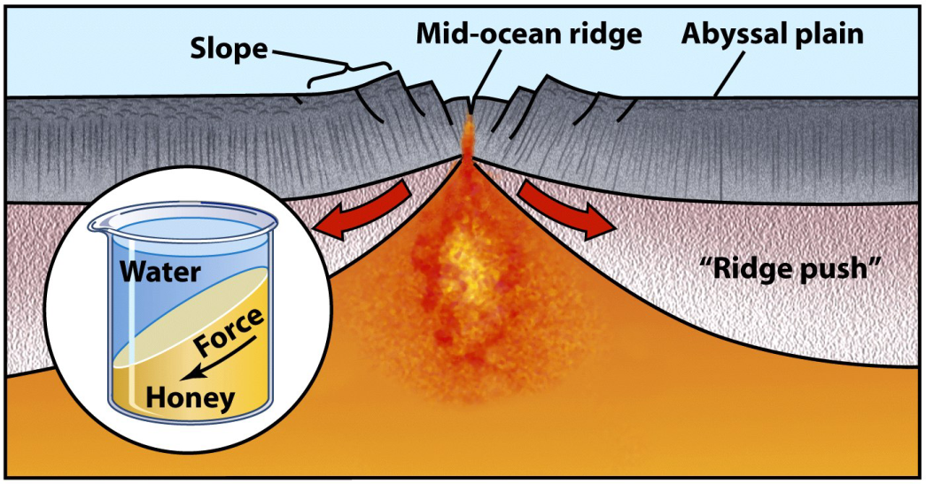
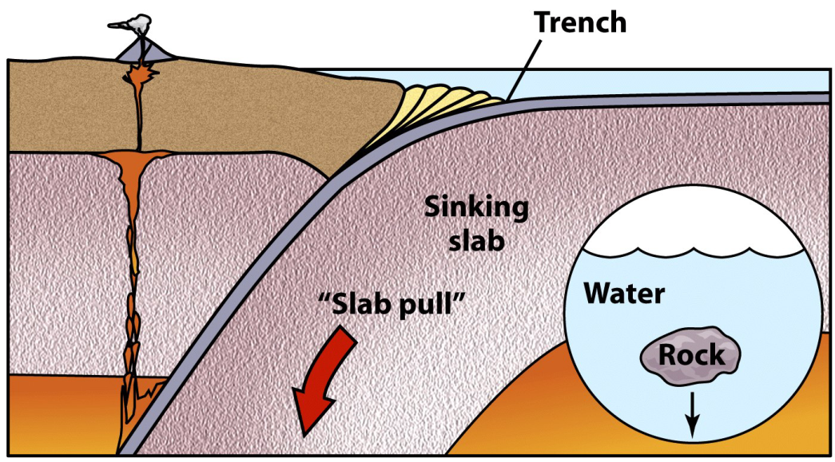
Driving Mechanisms
Modern: 2 other forces drive plate motions.
  Ridge-push – Elevated MOR pushes adjacent lithosphere.
  Slab-pull – Gravity pulls a subducting plate downward.
  Convection in the asthenosphere adds or subtracts.

Slide 10
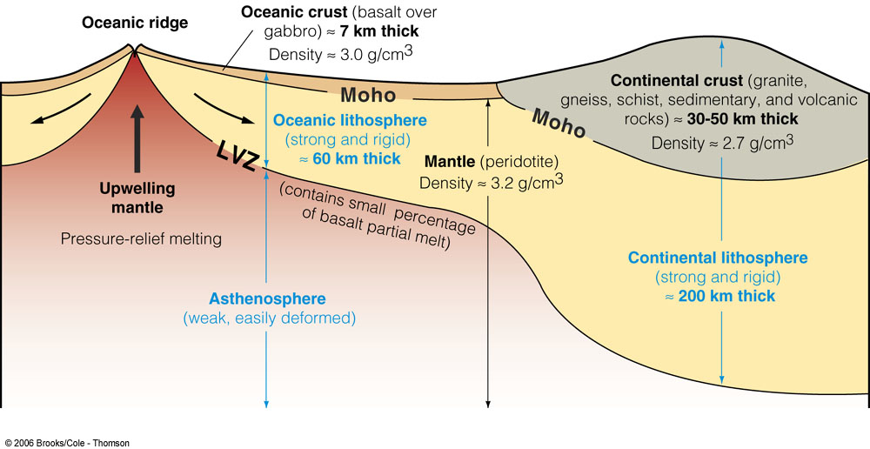
Asthenosphere & mantel rises up at weak spots
Heavy areas push down on asthenosphere & mantel

Slide 11
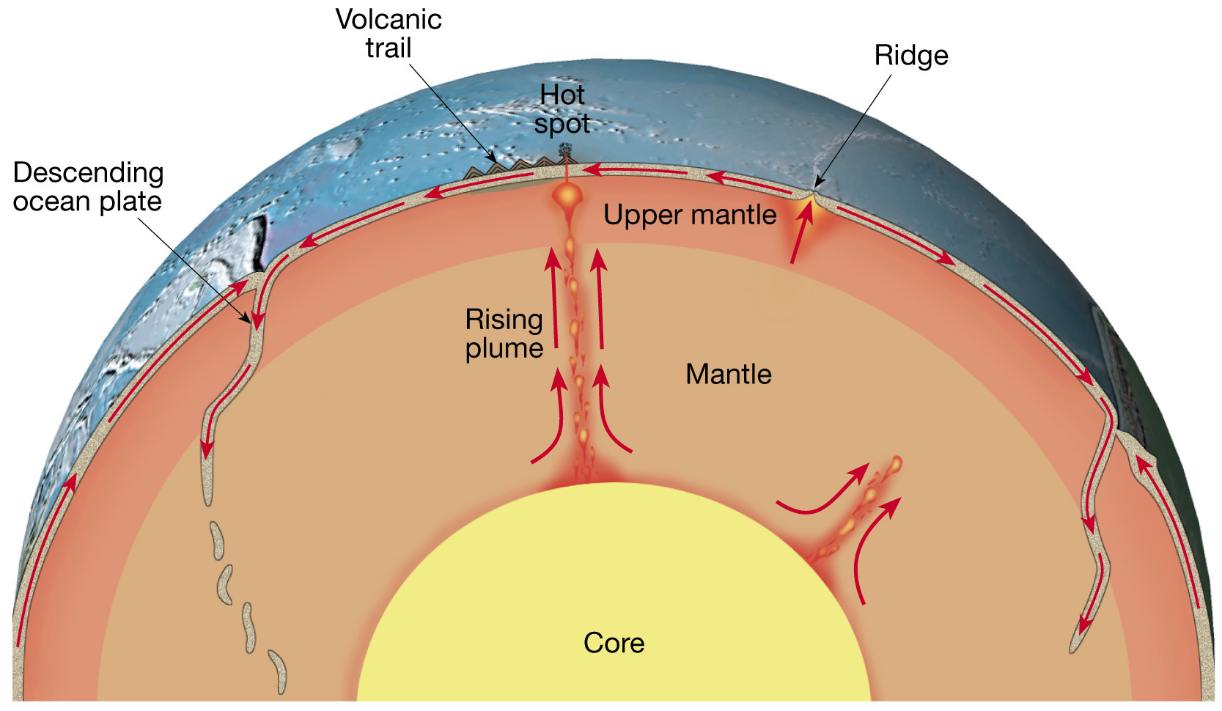
Push – Pull Theory
Asthenosphere & mantel rises up at weak spots
push
Descending plate pushes down into asthenosphere & mantel
pull

Slide 12
Push – Pull Theory
push
pull

Slide 13
Convection and Tectonics
Notes:
To view this animation, click “View” and then “Slide Show” on the top navigation bar.

Slide 14
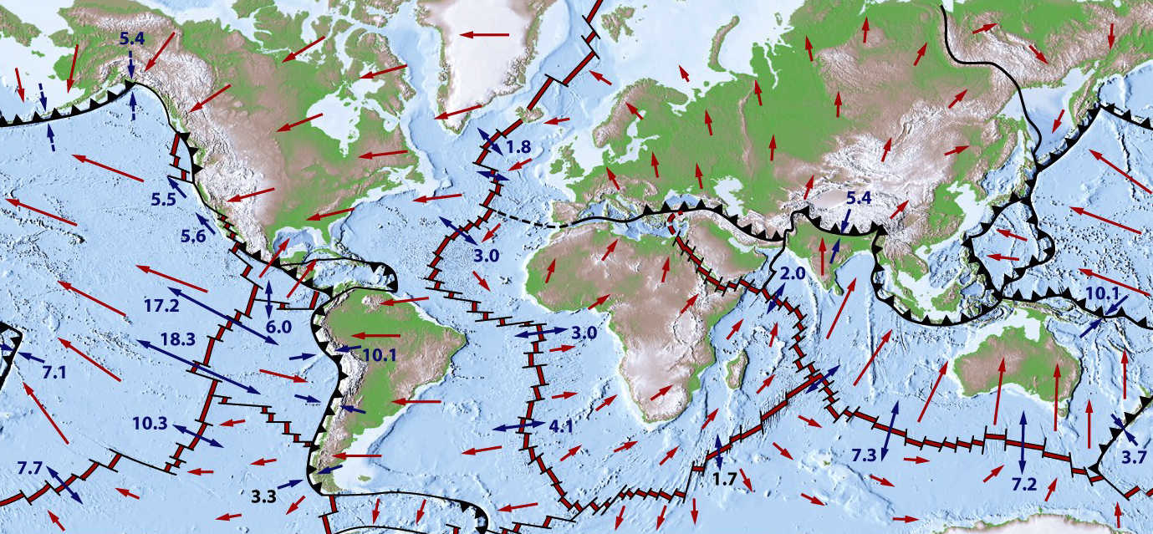
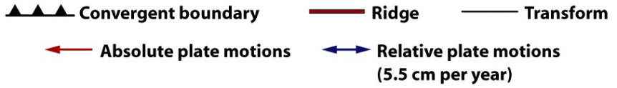
Plate Velocities
Absolute plate velocities may be mapped by…
  Plotting plate motion relative to a fixed spot in the mantle.
  Measuring volcano ages / distance along a hot spot track.

Slide 15
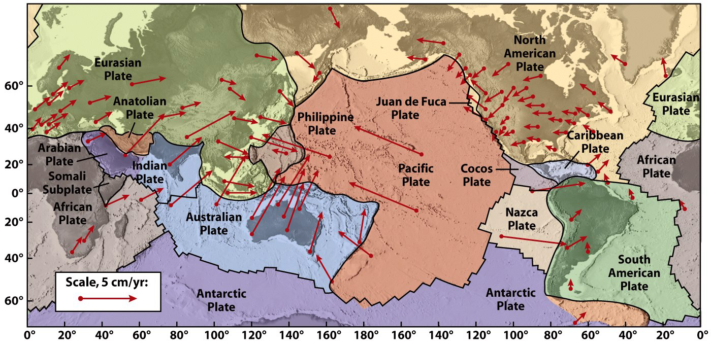
Plate Velocities
Plate vectors are determined GPS measurements.
  Global Positioning System (GPS) uses satellites.
  Knowledge of plate motion is now accurate and precise.

Slide 16
Plate Tectonics
Plate boundaries
  All major interactions among individual plates occur along their boundaries

Slide 17
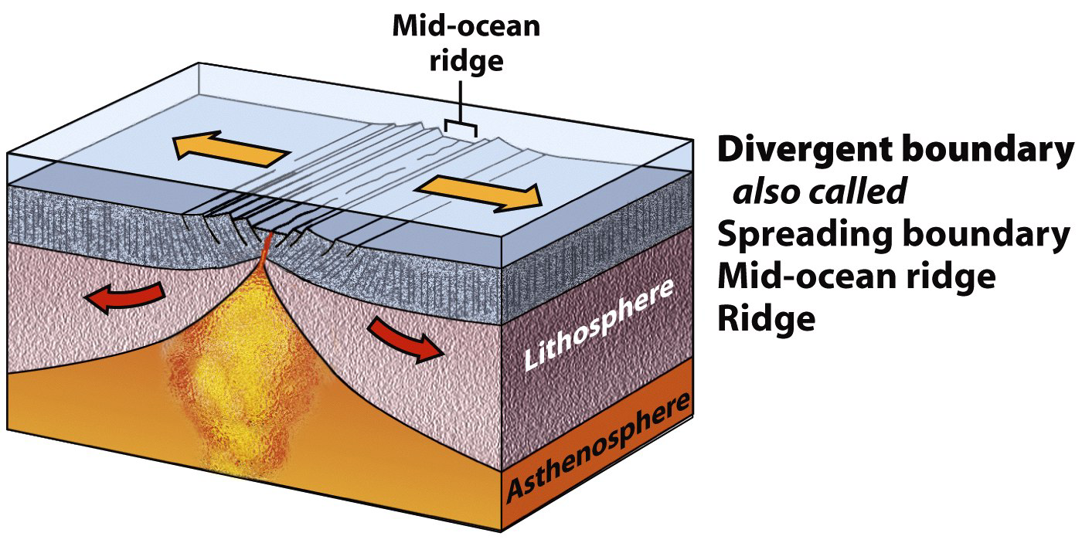
Plate Boundaries: 3 Types
Divergent – Tectonic plates move apart.

Slide 18
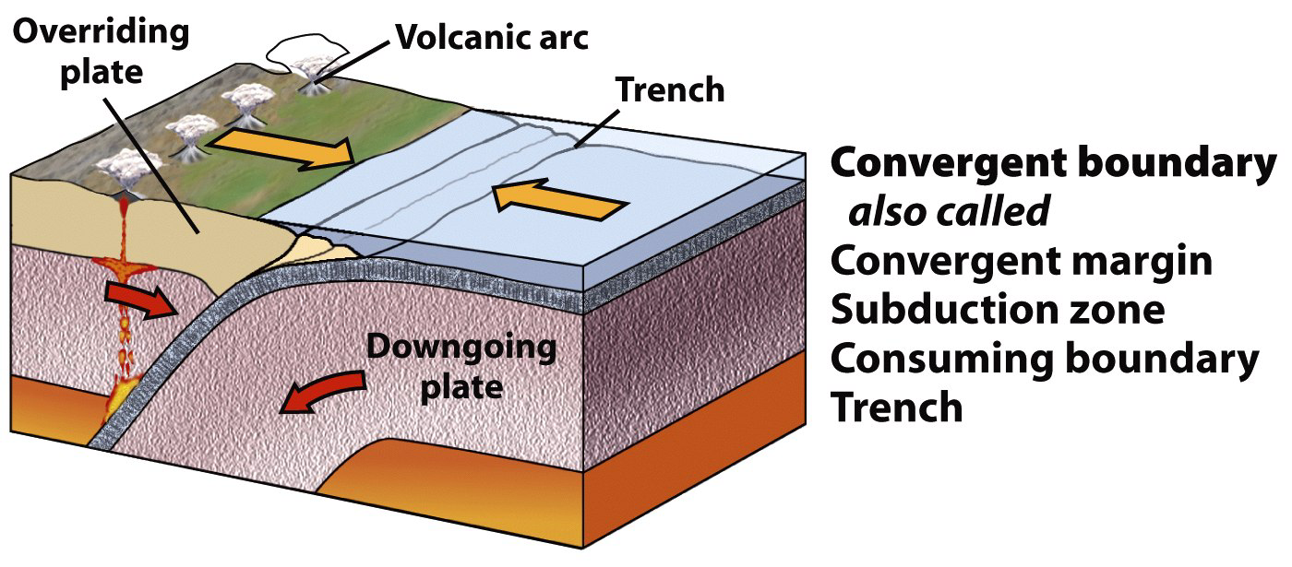
Plate Boundaries: 3 Types
Convergent – Tectonic plates move together.

Slide 19
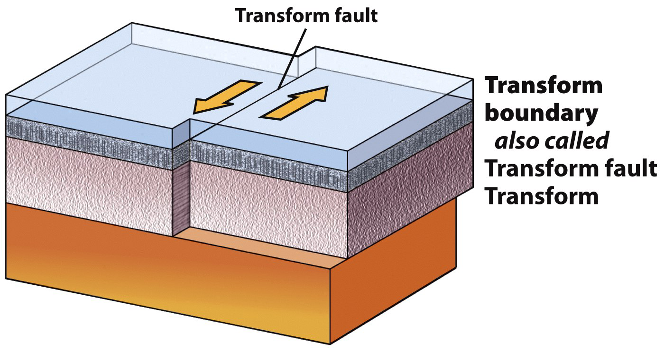
Plate Boundaries: 3 Types
Transform – Tectonic plates slide sideways.

Slide 20
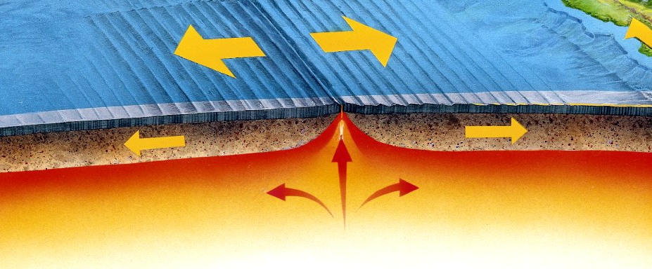
Divergent Boundaries
Sea-floor spreading causes plates to move apart.
Magma wells up to fill the gap.
Magma cools, adding material to each plate.

Slide 21
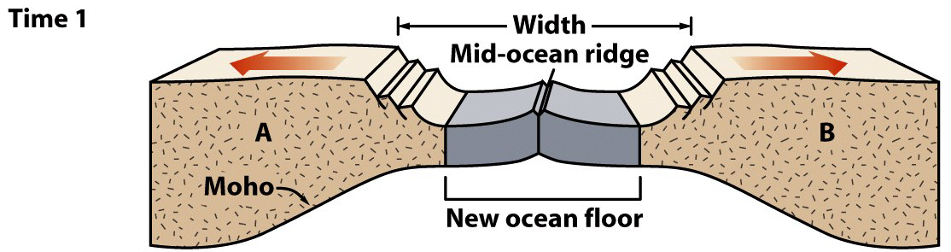
Divergent Boundaries
Sea-floor spreading progression.
  Early stage
    Rifting has progressed to mid-ocean ridge formation.
    Before substantial widening of the ocean.
    Forms a long, thin ocean basin with young oceanic crust.
  Example: The Red Sea
Note: This diagram only depicts the crust, not the entire lithosphere.

Slide 22
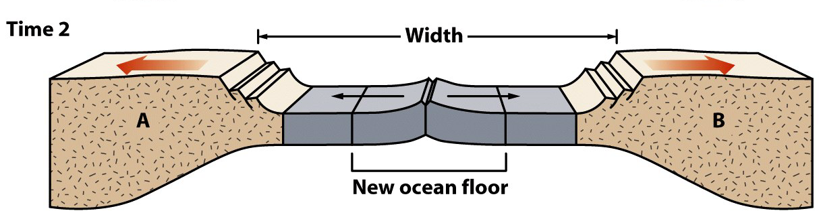
Divergent Boundaries
Sea-floor spreading progression.
  Mid-stage
    Ocean begins to widen.
    New seafloor is added at the mid-ocean ridge.
    Continents move farther apart.
  Example: Greenland and the North Atlantic
Note: This diagram only depicts the crust, not the entire lithosphere.

Slide 23
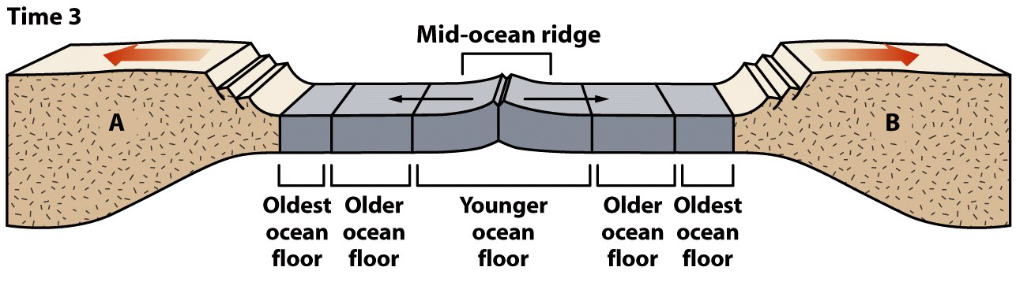
Divergent Boundaries
Sea-floor spreading progression.
  Late stage
    Mature, wide ocean basin.
    Linear increase in age with distance from central ridge.
    Edge of ocean basin - oldest; ridge proximal - youngest.
  Example: The Atlantic Ocean
Note: This diagram only depicts the crust, not the entire lithosphere.

Slide 24
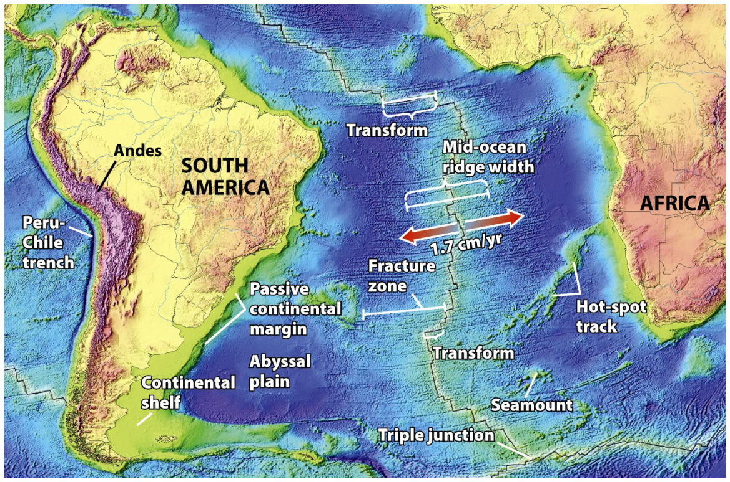
Mid-Ocean Ridges
Linear mountain ranges in Earth’s ocean basins.
Example: The Mid-Atlantic Ridge
  Snakes N-S through the entire Atlantic Ocean.
  Elevated ridge (1,500 km wide) 2 km above abyssal plains.
  Axial rift valley.
    500 m deep.
    10 km wide.
    Symmetric.
    Site of eruptions.

Slide 25
Mid-Ocean Ridges
Sea-floor spreading opens the axial rift valley.
Rising asthenosphere melts, forming mafic magma.
Pooled magma solidifies into oceanic crustal rock.
  Pillow basalt – Magma quenched at the sea floor.
  Dikes – Preserved magma conduits.
  Gabbro – Deeper magma.

Slide 26
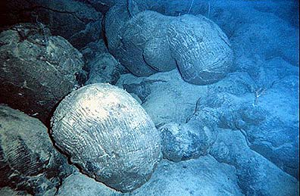
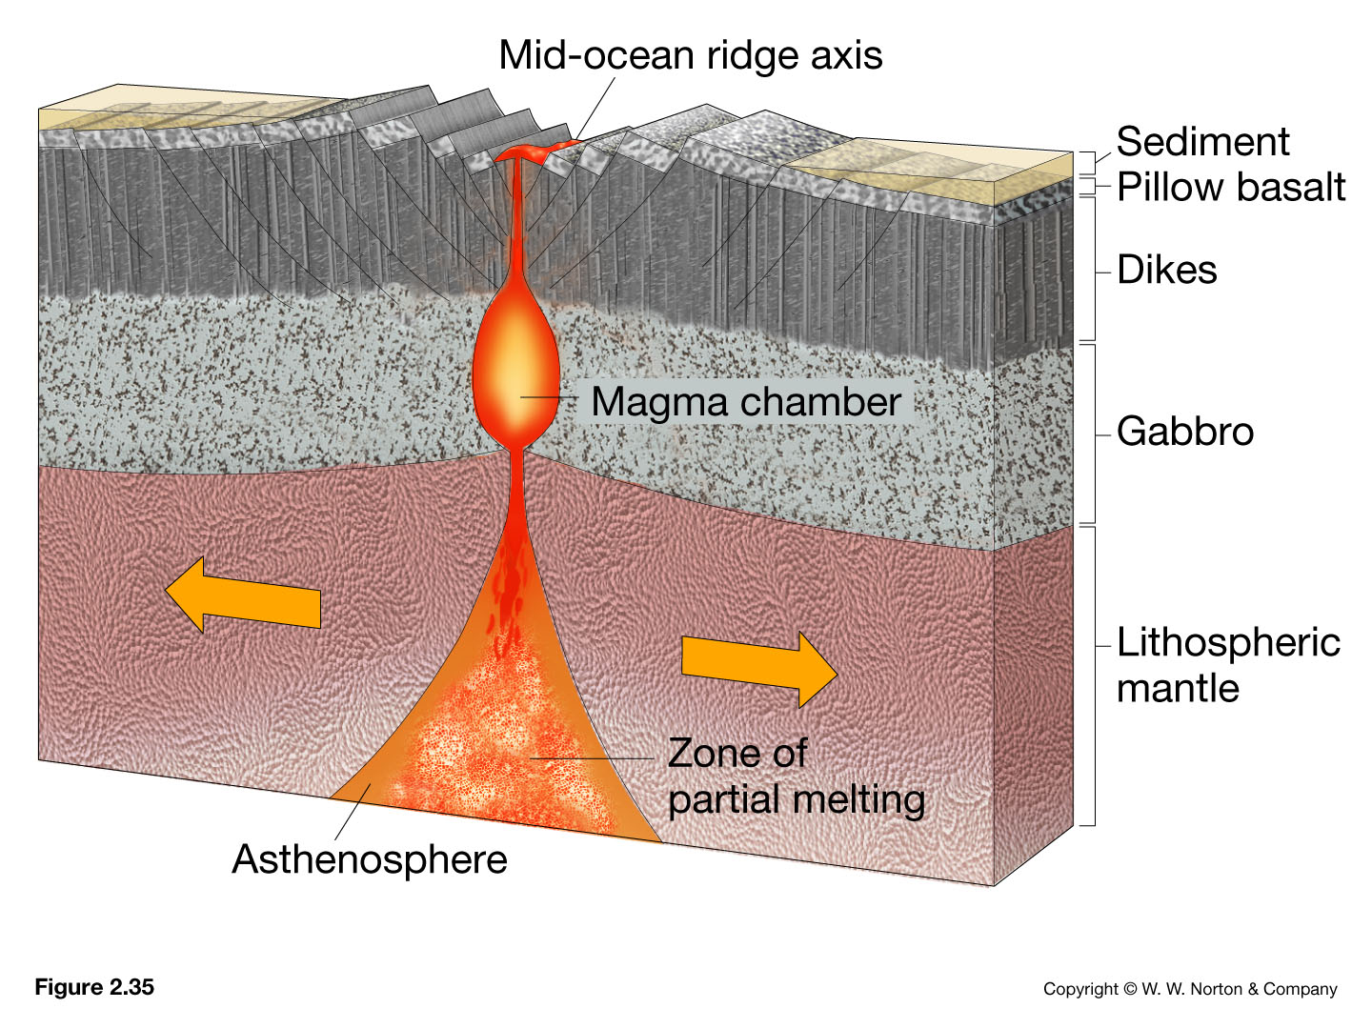
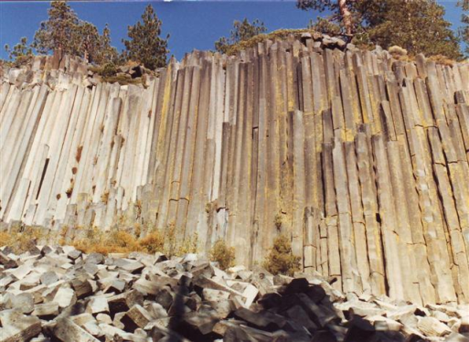
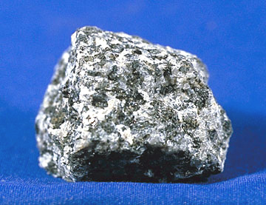
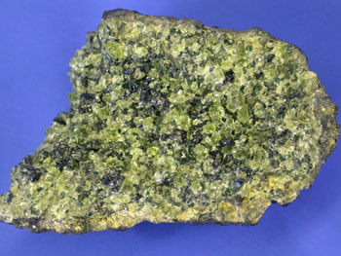
Extrusive igneous rocks
Intrusive igneous rocks
Notes:
Pillow basalts on the south Pacific seafloor -- Courtesy of NOAA. http://www.geology.sdsu.edu/how_volcanoes_work/
www.nationalparklover.com/devils_postpile.htm
www.mii.oeg
http://www.pitt.edu/~cejones/GeoImages/2IgneousRocks/IgneousTextures/1CoarseGrained.html

Slide 27
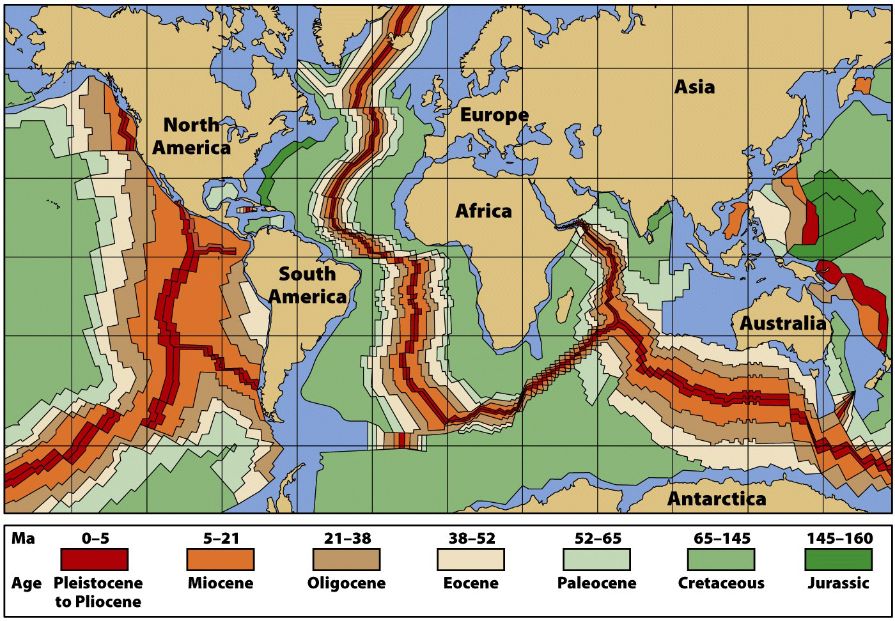
Ocean Crustal Age
Oceanic crust spreads away from the ridge axis.

Slide 28
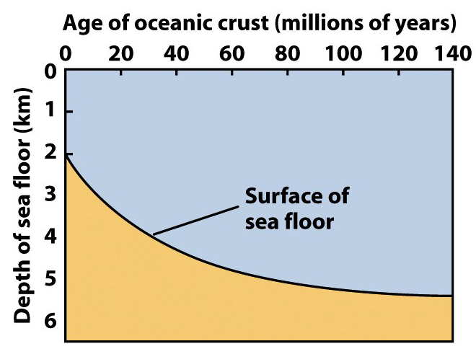
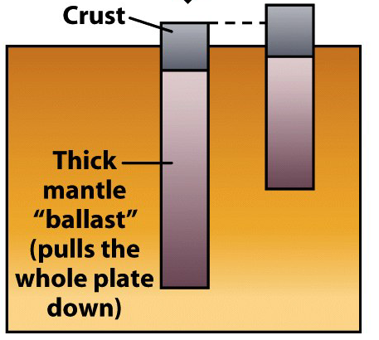
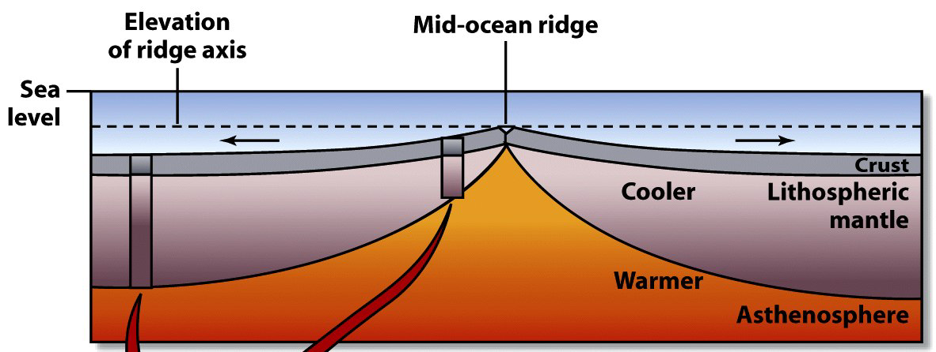
Oceanic Lithosphere
The hot asthenosphere is at the base of the MOR.
Aging ocean crust moves away from this heat…
  Cooling, increasing in density, and sinking.
  Accumulating increasing thicknesses of sediment.

Slide 29
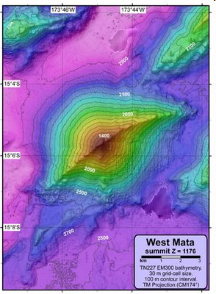
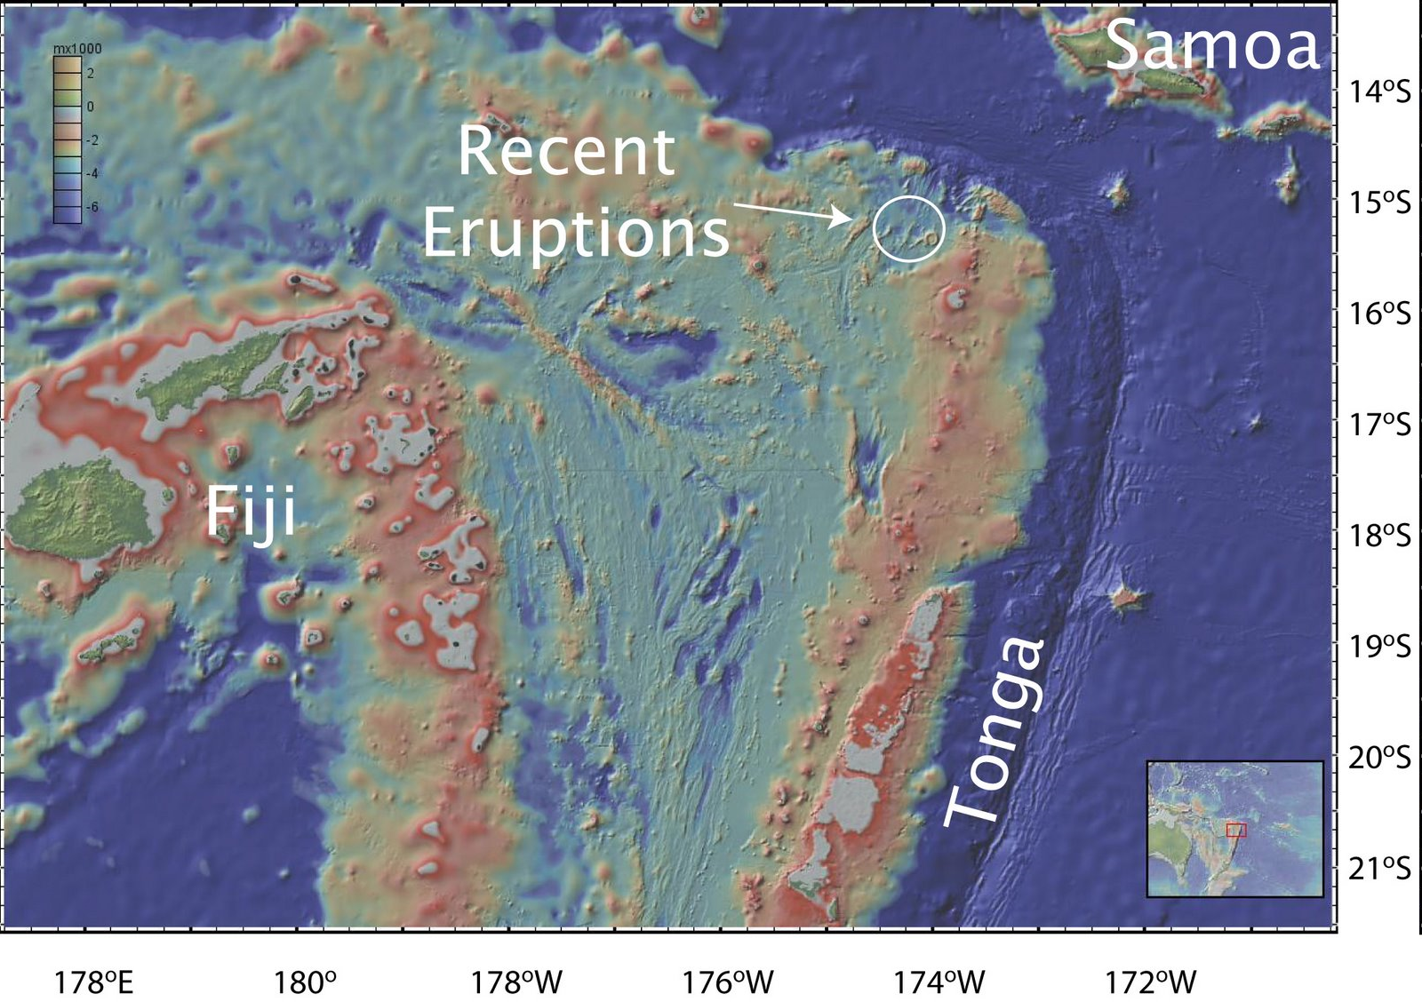
Neovolcanic activity in the NE Lau Basin, Tonga Ridge
source

Slide 30
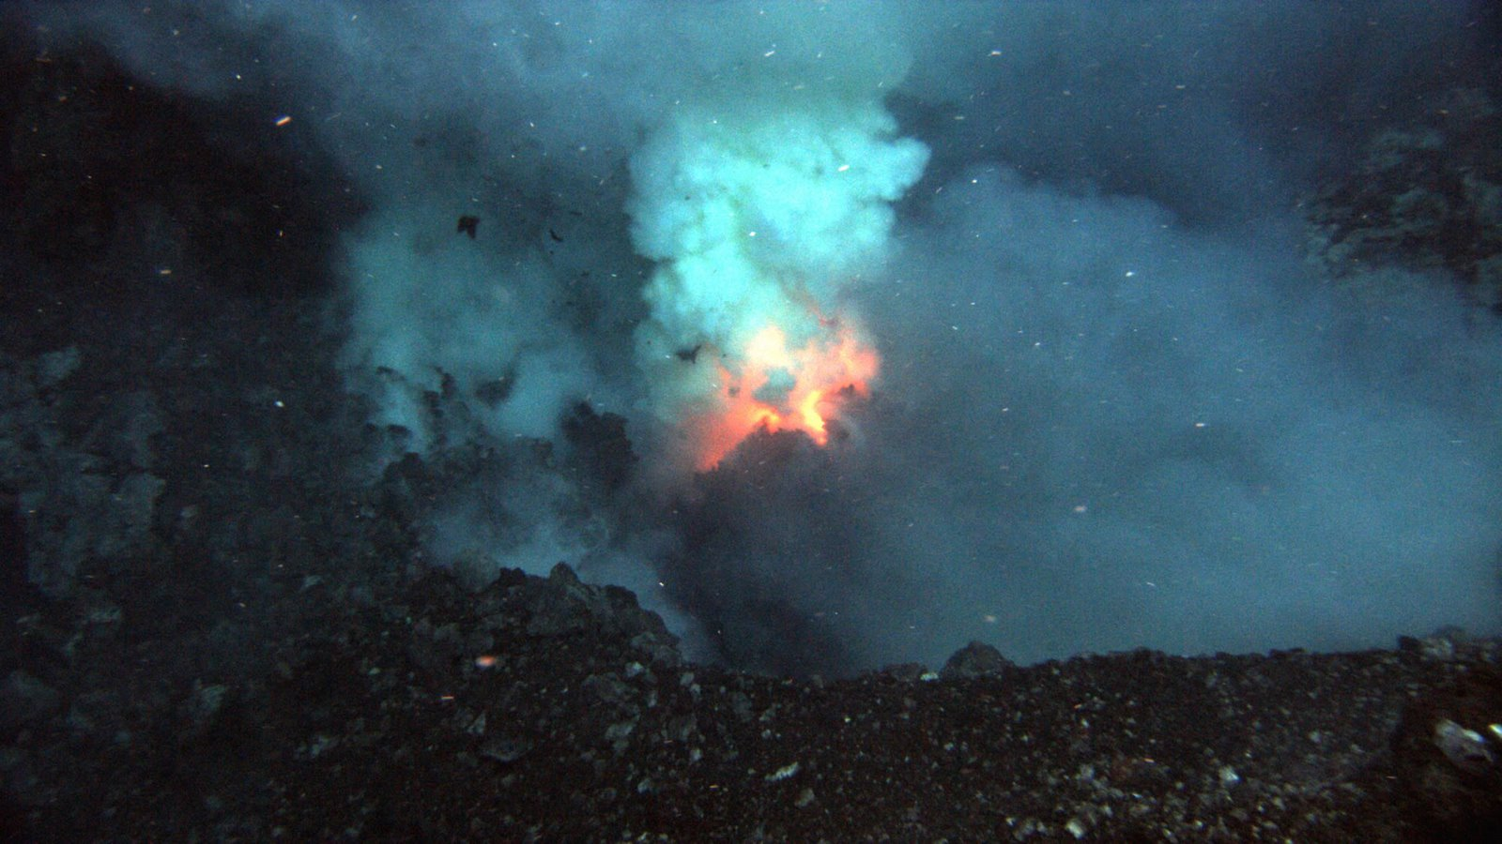
Neovolcanic activity in the NE Lau Basin
Prometheus eruptive vent at the summit of West Mata (1208 meters)
source

Slide 31
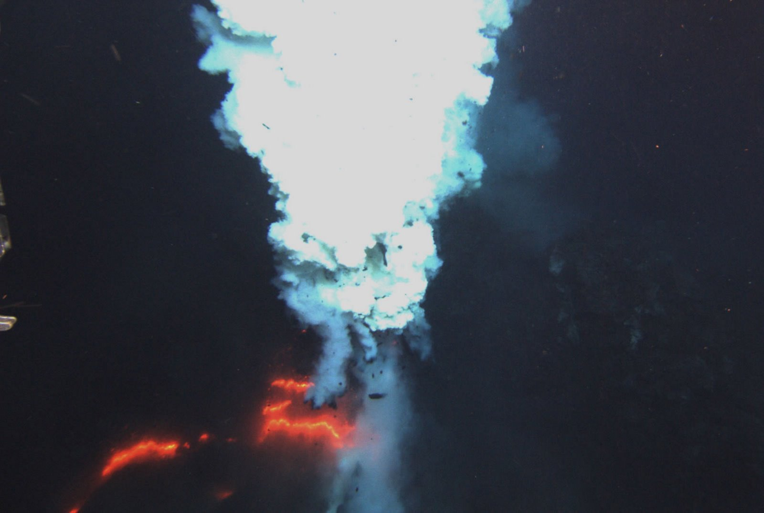
Neovolcanic activity in the NE Lau Basin
Hades eruptive vent at the summit of West Mata (1174 meters)
source

Slide 32
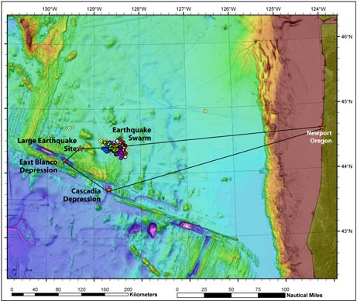
Mysterious "Swarm" of Quakes Strikes Oregon Waters
Colored dots show the earthquake "swarm" that struck waters off the shore of Oregon beginning in March 2008. Scientists are now planning a marine expedition (black line) to help unravel what is causing the mysterious temblors, which were detected by a Cold-War-era system of underwater microphones originally designed to track Russian submarines.
Image courtesy of NOAA Vents Program / Oregon State University CIMRS Program (source)
Notes:
museum

Slide 33
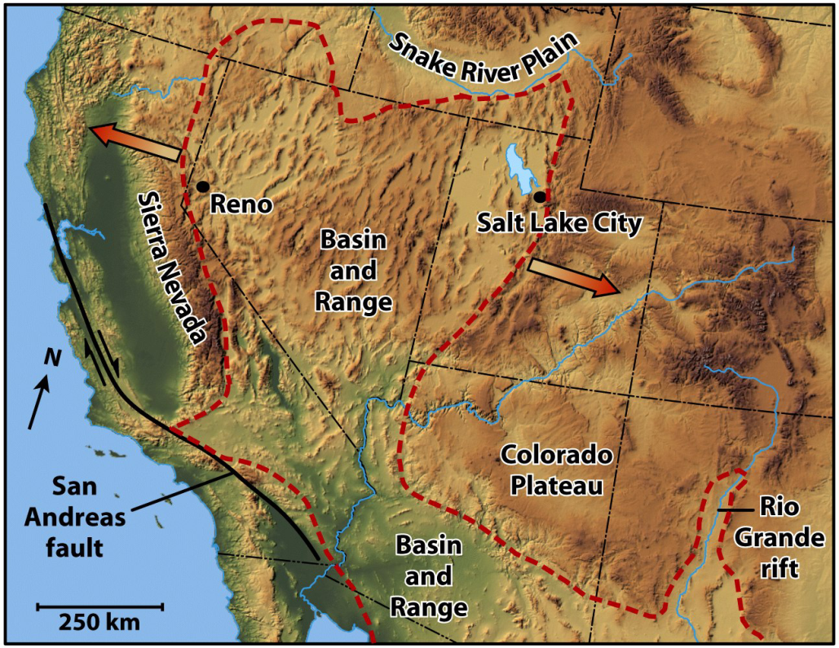
Tectonic Boundaries Evolve
Plate boundaries change over geologic time.
Oceanic plates.
  Created at MOR spreading centers.
  Destroyed at subduction zones.
Continental plates.
  Torn apart at rifts.
  Joined during collision.

Slide 34
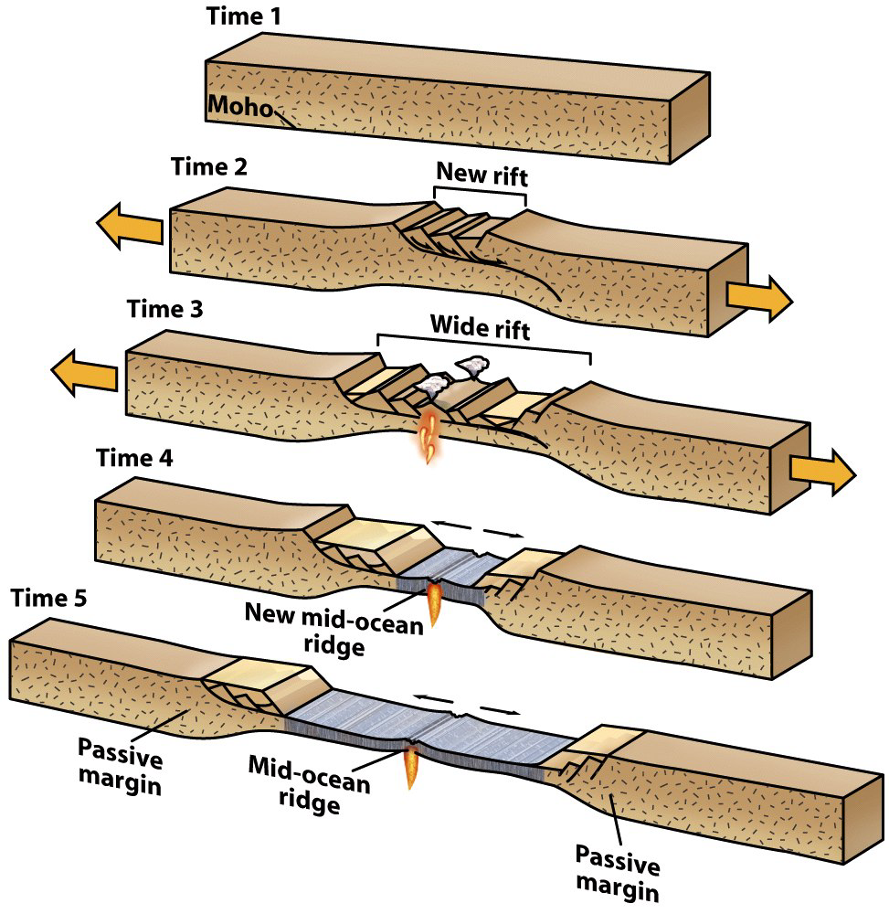
Continental Rifting
Continental lithosphere can break apart.
  Lithosphere stretches and thins.
  Brittle upper crust faults.
  Ductile lower crust flows.
  Asthenosphere melts.
  Melts erupt, leading to…
  Sea-floor spreading.

Slide 35
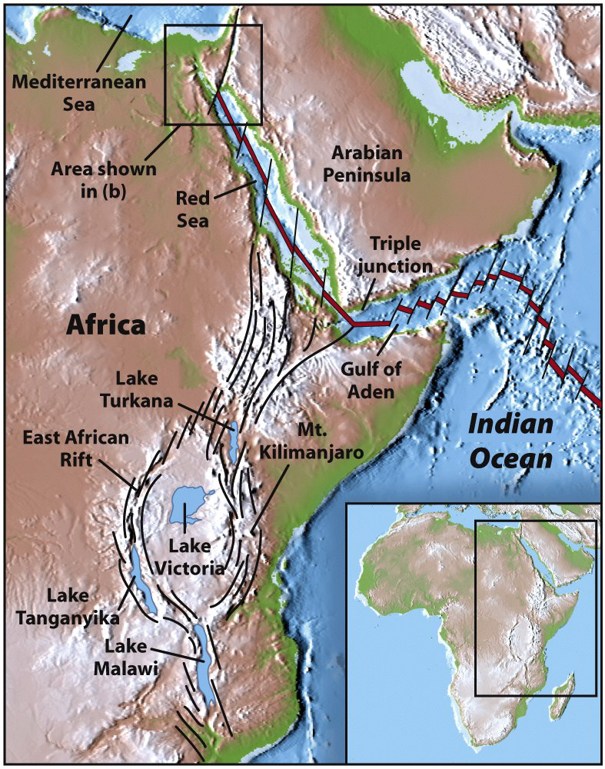
Continental Rifting
Example: East Africa.
  The Arabian plate is rifting from
  the African plate.
  Rifting has progressed to
  sea-floor spreading in…
    The Red Sea
    The Gulf of Aden
  East African Rift – On-going rift.
    Thinned crust.
    Elongate trough.
    Volcanoes.

Slide 36
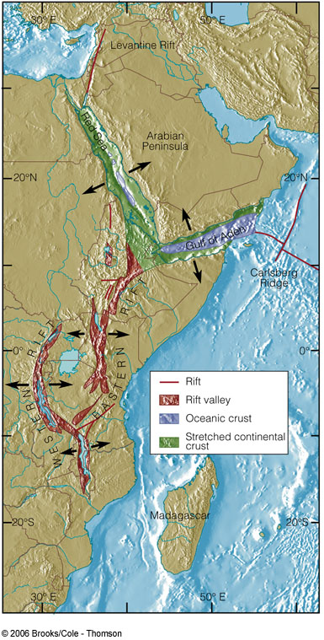
The East African rift
Spreading the continent apart 88 times as slow as a typical oceanic rift zone.
The rift forms one arm of a triple junction, from which the Red Sea and Gulf of Aden form somewhat more rapidly spreading rifts.

Slide 37
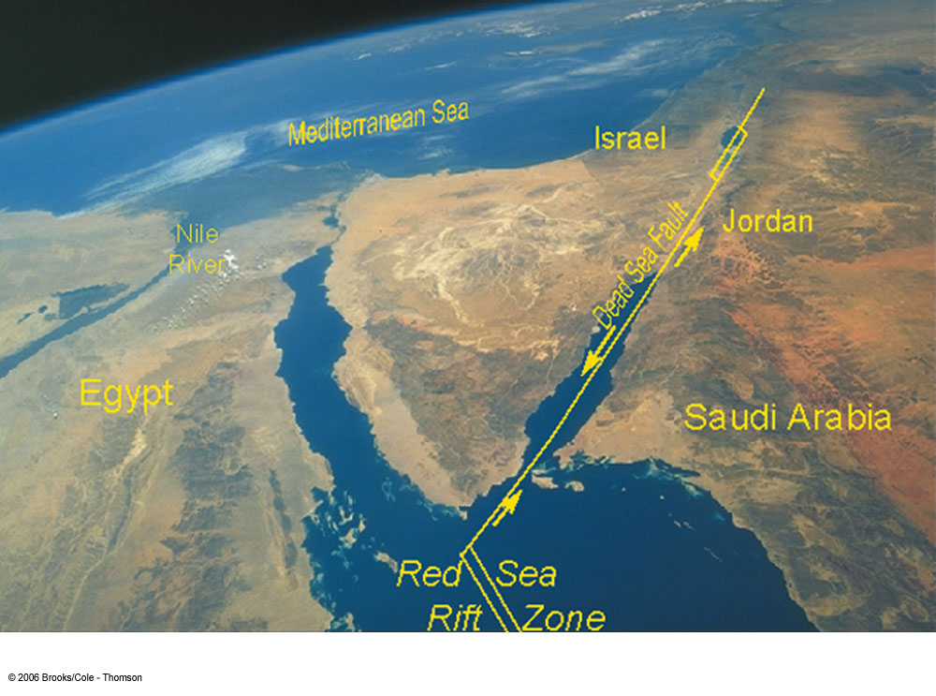

Slide 38
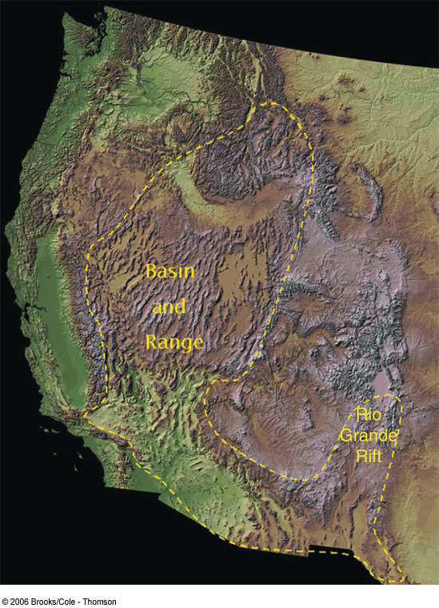
Continental Rifting
Basin and Range
  Region is slowly pulling apart
  No active spreading center

Slide 39
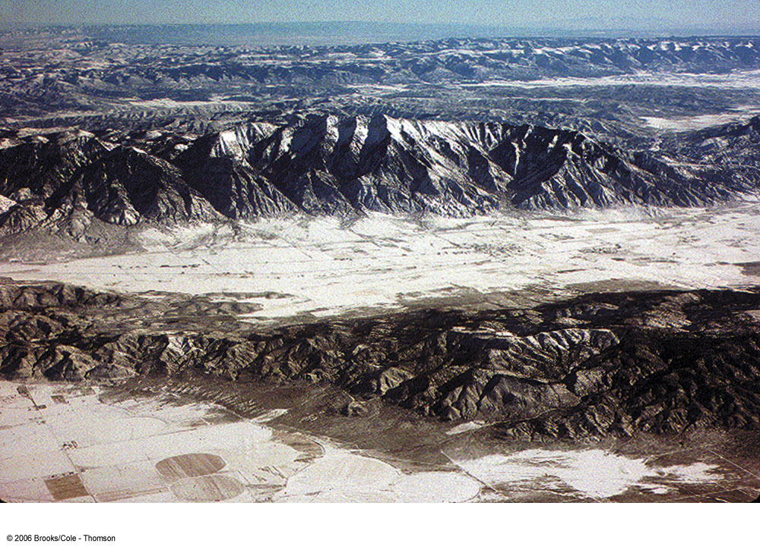
This Basin and Range terrain is found southwest of Salt Lake City, Utah.

Slide 40
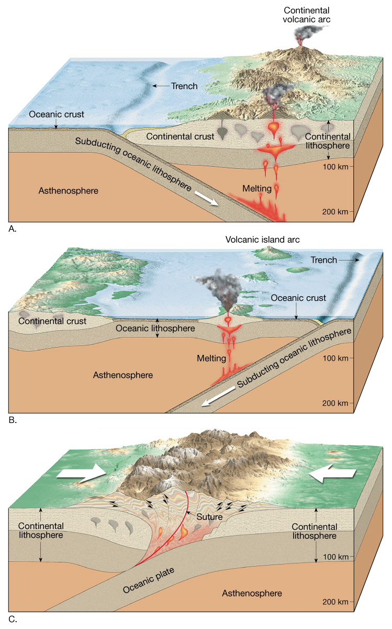
Convergent plate boundaries
Where two plates collide
Types
  Oceanic-continental convergence
  Oceanic-oceanic convergence
  Continental-continental convergence

Slide 41
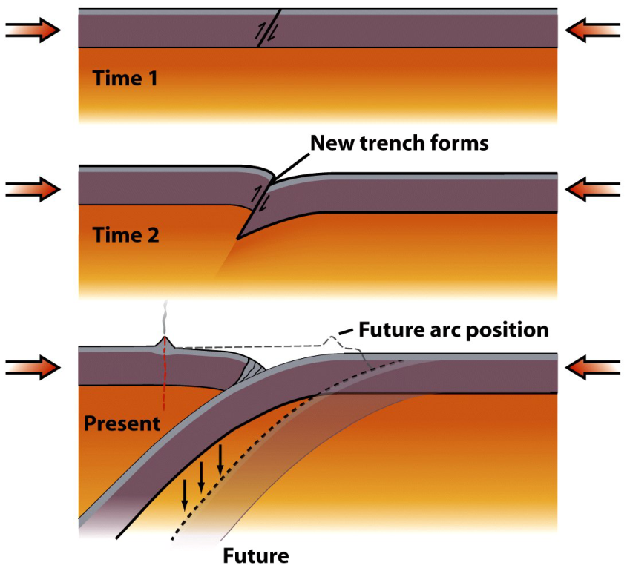
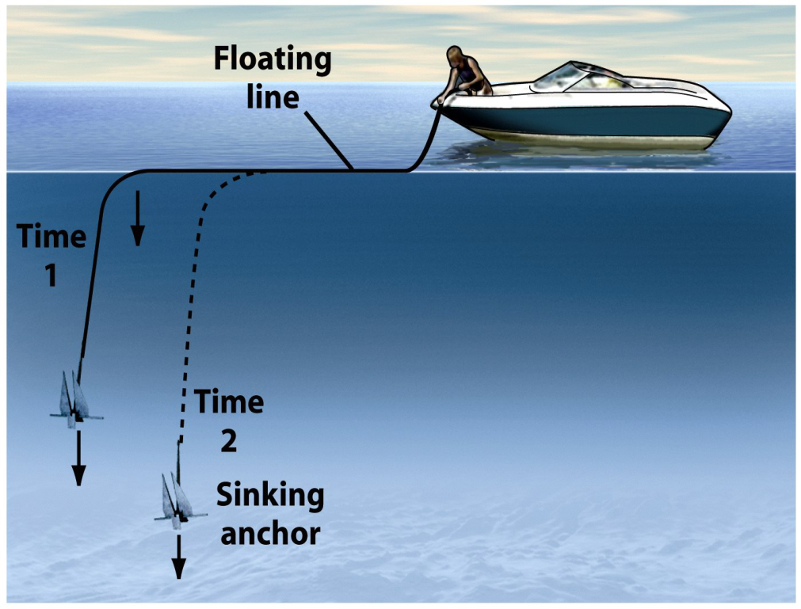
Subduction
Old oceanic lithosphere is more dense than mantle.
A flat-lying oceanic plate won’t subduct.
Bent down, the leading edge sinks like an anchor.

Slide 42
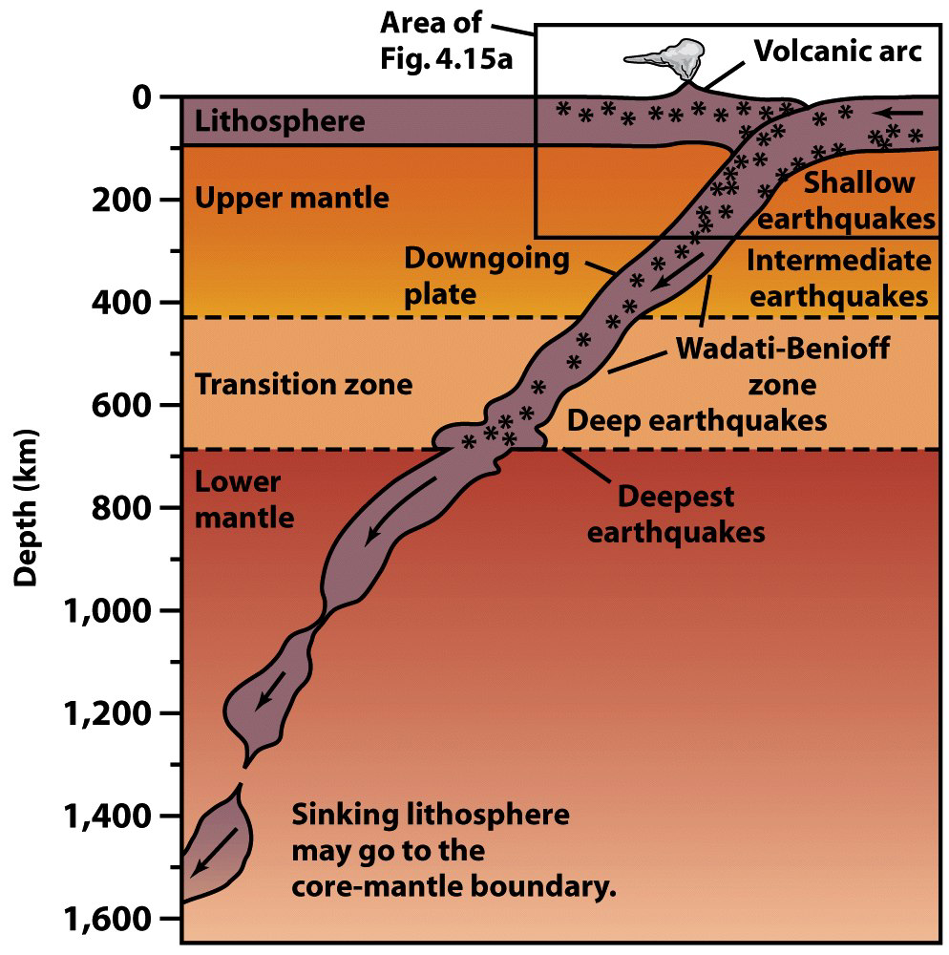
Subduction
The subducting plate descends at an average of 45°.
  Plate descent is revealed by Wadati-Benioff earthquakes.
    Mark frictional contact and mineral transformations.
    Earthquakes deepen away from trench.
Quakes cease below 660 km.

Slide 43
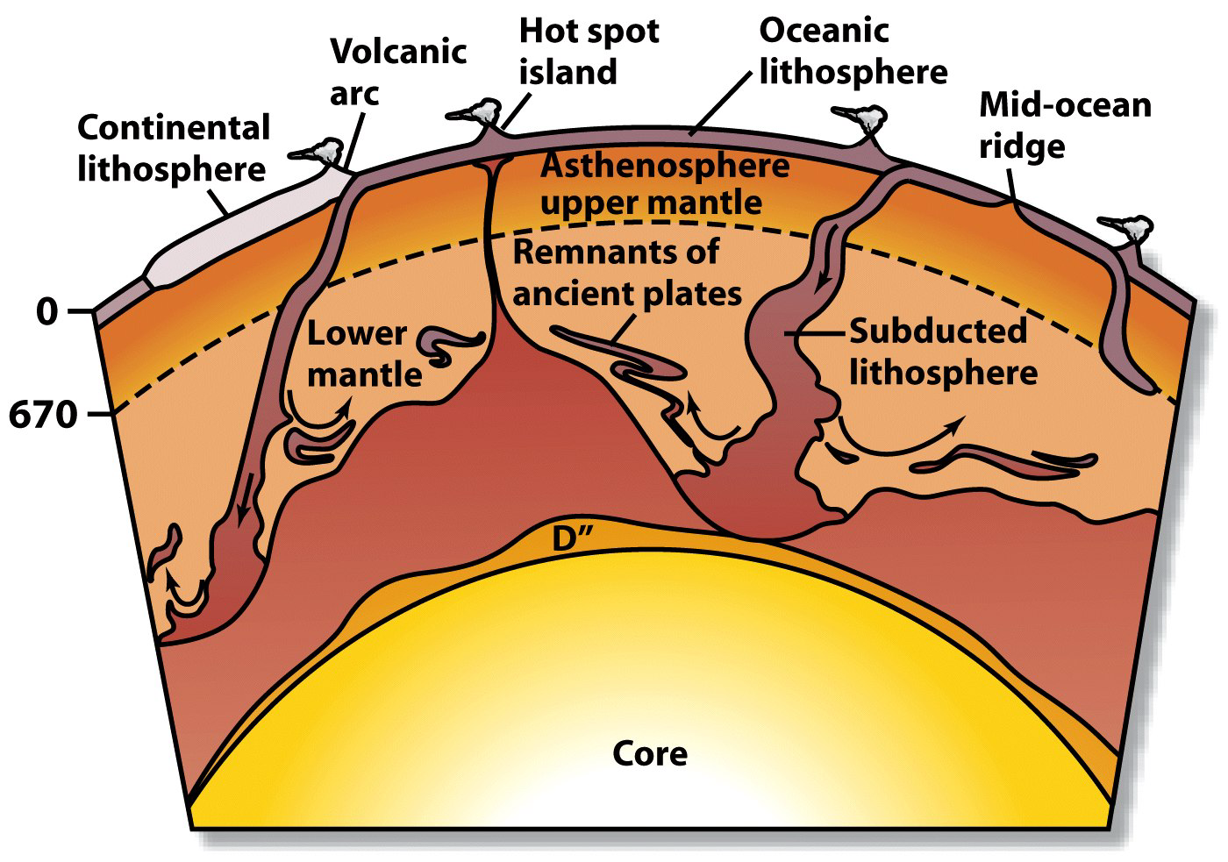
Fate of Subducted Plates?
Plate descent continues past the earthquake limit.
The lower mantle may be a “plate graveyard.”

Slide 44
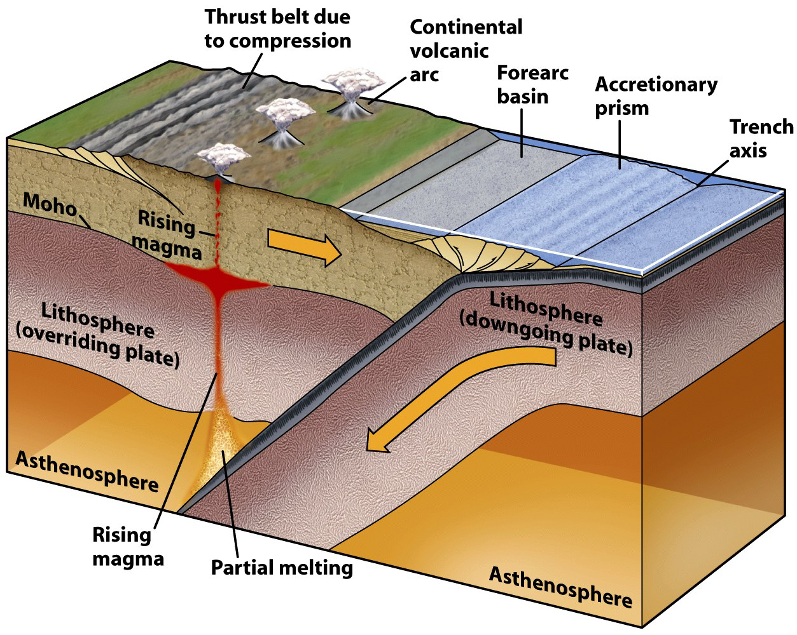
Subduction Features
Subduction is associated with unique features.

Slide 45
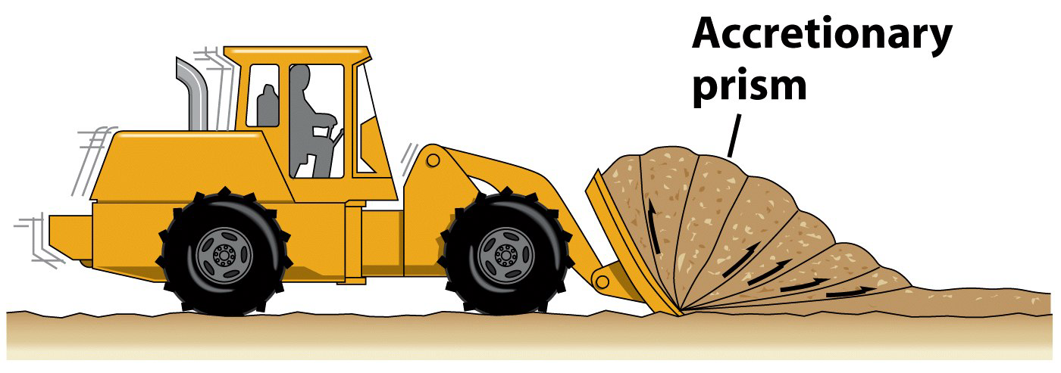

Subduction
Accretionary prisms – Deformed sediment wedges.
  Sediments scraped off subducting plates are smeared and welded onto the overriding plates.
  These contorted sediments can be pushed above sea.
    Washington’s Olympic Peninsula & Taiwan.

Slide 46

Subduction
Volcanic arc – Volcanic belt on an overriding plate.
  The descending plate partially melts at ~ 150 km depth.
  Magmas burn upward, fueling volcanic eruptions.
  A curved Earth dictates that volcanic belts are curved.
Arc type depends on overriding plate.
  Continental crust – Continental arc.
  Oceanic – Island arc.

Slide 47

Ocean-Continent Convergence

Slide 48


Cascade Mountains, Pacific NW

Slide 49

Ocean-Ocean Convergence
Notes:
This figure shows oceanic-oceanic convergence. Reprinted by permission from Tarbuck, E. J., and Lutgens, F. K., Earth Science, 5th Ed. (Fig. 6.11), Merrill Publishing Company, 1988.

Slide 50

Subduction
Back arc basin – A marginal sea behind an arc.
  Forms between an island arc and a continent.
  Offshore subduction traps a piece of oceanic crust, or…
  Stretching creates a new spreading ridge.

Slide 51
Tectonic Settings and Volcanic Activity
Notes:
To view this animation, click “View” and then “Slide Show” on the top navigation bar.

Slide 52


Plate Collision
Subduction consumes ocean basins.
Ocean closure ends in continental collision.
  Buoyant continental crust will not subduct.
  Subduction ends; mountains are smashed upward.

Slide 53



Plate Collision
Plate tectonic collision may involve…
  Two continents.
  A continent and an island arc.
Collision “sutures” the convergent plate boundary.

Slide 54

Continent-Continent Convergence

Slide 55
Convergent Margins: India-Asia Collision
Notes:
To view this animation, click “View” and then “Slide Show” on the top navigation bar.

Slide 56

The collision of India and Asia produced the Himalayas (before)

Slide 57

The collision of India and Asia produced the Himalayas (after)

Slide 58

Transform fault boundaries
Plates slide past one another
No new lithosphere is created or destroyed
Most join two segments of a mid-ocean ridge as parts of prominent linear breaks in the oceanic crust known as fracture zones

Slide 59

Plate Tectonics
Types of transform faults
  Oceanic—wholly in ocean
  floor
  Continental—extends from
  mid-ocean ridge across the
  continent

Slide 60
Oceanic Transforms
The MOR axis is offset by transform faults.
  Offset of linear MOR is geometric necessity on a sphere.
  Transforms bear strong evidence of sea-floor spreading.
    Abundant earthquakes common between ridge segments.
    Earthquakes vanish past ridge segment overlaps.

Slide 61
Motion at Transform Boundaries
Notes:
To view this animation, click “View” and then “Slide Show” on the top navigation bar.

Slide 62

Transform Boundaries
Oceanic transforms – Offsets along the MOR.
  Older interpretation – Faulting occurs after MOR forms.
  Modern interpretation – Faulting occurs with the MOR.

Slide 63


Transform Boundaries
Continental transforms – Chop continental crust.
  Example: The San Andreas Fault.

Slide 64

Triple Junctions
Places where 3 plate boundaries coincide.
Multiple boundary combinations occur.
Triple junctions migrate and change across time.

Slide 65

This bathymetric map of the seafloor shows the Siqueiros transform fault in the eastern Pacific Ocean, illustrating the fragmented structure of the fault line. (Jian Lin, Jack Cook, and Patricia Gregg, Woods Hole Oceanographic Institution)
Source - Visualization of Siqueiros fault

Slide 66
Hot Spots
Caused by rising plumes of mantle material
Volcanoes can form over them (Hawaiian Island chain)
Most mantle plumes are long-lived structures and at least some originate at great depth, perhaps at the mantle-core boundary

Slide 67

Volcanism on a tectonic plate moving over a hot spot

Slide 68


Hot Spots
Volcanic plumes independent of tectonic plates.
  Mafic magmas derived from the lower mantle.
  Tattoo overriding plates with volcanoes.

Slide 69


Hot Spots
Volcanoes perforate overriding plates.
Make volcanoes that drift off-plume.
  Volcano goes extinct and erodes.
  Subsidence creates a guyot.
  Supports sea-floor spreading.

Slide 70


Hot Spots
Hot spot volcanoes create seamounts.
  Seamounts age away from originating hot spot.
  Age change marks direction of overriding plate motion.

Slide 71
Hot Spot Volcano Tracks
Notes:
To view this animation, click “View” and then “Slide Show” on the top navigation bar.

Slide 72

The Hawaiian Islands have formed over a stationary hot spot

Slide 73

Hawaiian Islands-Emperor Seamount Chain
Notes:
The chain of islands and seamounts that extends from Hawaii to the Aleutian Trench results from the movement of the Pacific Plate over the relatively stationary Hawaiian hotspot. Numbers indicate radiometric age dates in millions of years before present. After Tarbuck, E. J., and Lutgens, F. K., Earth Science, 8th Ed. (Fig. 7.24), Prentice-Hall, 1887

Slide 74
Applications of plate tectonics model to intraplate features
Seamounts and tablemounts
  Subsidence of flanks of mid-ocean ridge
  Wave erosion may flatten seamount

Slide 75

Fig. 2.26

Slide 76
Applications of plate tectonics model to intraplate features
Coral reefs associated with subsiding seafloor
Fringing
Barrier
Atoll

Slide 77

Coral reef development
Fig. 2.27

Slide 78
Motion at Plate Boundaries
Notes:
To view this animation, click “View” and then “Slide Show” on the top navigation bar.

Slide 79
Plate Motions Through Time
Notes:
To view this animation, click “View” and then “Slide Show” on the top navigation bar.

Slide 80

Basic Plate Boundaries
Basic Plate Boundaries
Geologists define three types of plate boundary, based simply on the relative motions of the plates on either side of the boundary. These basic types-divergent, convergent, and transform plate boundaries–are shown in the following three-part animation.

Slide 81

Formation of Ocean Crust
Formation of Ocean Crust
Oceanic crust forms around and above a steady-state magma chamber. As the animation progresses, gabbro forms on the sides, dikes form above, and pillows form at the Earth's surface. Note that although the ridge maintains a consistent size and shape, the sea-floor grows wider.

Slide 82

The Process of Subduction
The Process of Subduction
At convergent plate boundaries or convergent margins, two plates, at least one of which is oceanic, move toward each other. But rather than butting each other like angry rams, one oceanic plate bends and begins to sink down into the asthenosphere beneath the other plate. This sinking process, termed subduction, is shown in the following animation.

Slide 83

Transform Faulting
Transform Faulting
This animation shows the development of a transform fault along a divergent plate boundary. Plates slide past one another along a transform fault without the formation of new plate or the consumption of old plate. As this process occurs, new sea floor forms along the mid ocean ridge.

Slide 84

Hot Spot Volcanoes
Hot Spot Volcanoes
This animation shows how hot spot volcanoes arise. A mantle plume beneath an oceanic plate creates a hot spot at the base of the lithosphere, and a volcano forms. Because the hot spot remains fixed as the plate moves over it, this volcano eventually becomes extinct and a new one forms. In time, a chain of extinct volcanoes develops, with a live volcano over the hot spot as the last link in the chain.

Slide 85

The Process of Rifting
The Process of Rifting
Rifting is the process by which a continent splits and separates to form a new divergent boundary. This animation shows the progressive formation and evolution of a continental rift, and the formation of a mid-ocean ridge.

Slide 86

Zoomable Art: The Theory of Plate Tectonics
Zoomable Art:
The Theory of Plate Tectonics
The outer portion of the Earth is a relatively rigid layer called the lithosphere. The mantle below the lithosphere is relatively plastic (it can flow) and is called the asthenosphere. According to the theory of plate tectonics, the lithosphere is broken into about twenty plates that move relative to each other. For more information, see Section 4.8 What Drives Plate Motion? starting on p. 107 and the Featured Painting on pp. 108-109 in your textbook.

Slide 87
What a Geologist Sees: Plate Boundaries
What a Geologist Sees:
Plate Boundaries
A photo from space shows the Sinai Peninsula, separated from Egypt to the west and the Arabian Peninsula to the east by rifts, narrow belts where the crust has stretched and broken apart. A geologist’s sketch highlights the plate boundaries.

Slide 88
~ End ~

