Slide 1
Geol 150 Lab
Field Trip to The Palos Verdes Peninsula

Slide 2
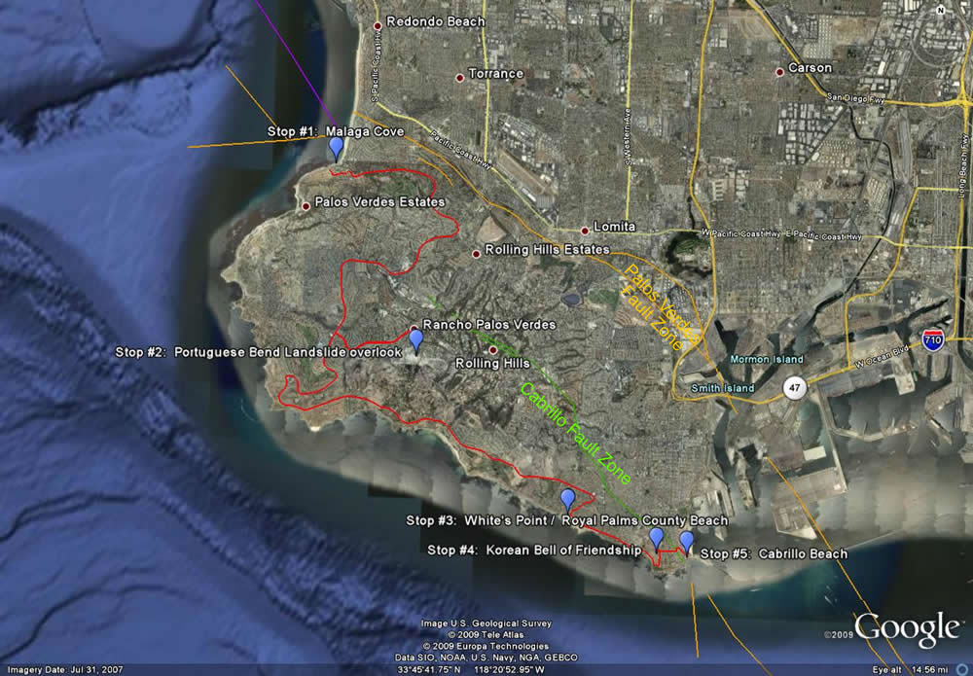

Slide 3
Stop 1. Malaga Cove
Peninsula uplifted by the Palos Verdes Fault
Miocene aged sediments
  Diatomite
  Chert
  Siltstone
  Conglomerate

Slide 4
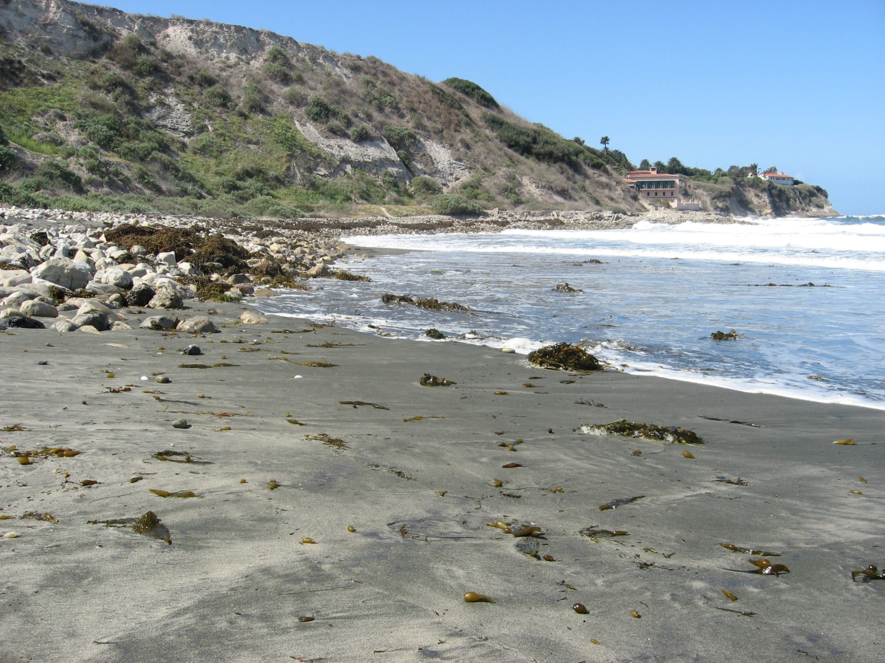
Malaga Cove, CA
coarser sediment = steeper beach
Finer sediment = flatter beach
© 2009 Sonjia Leyva

Slide 5
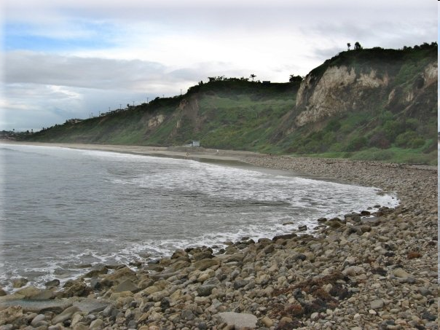
Malaga Cove, CA
Finer sediment = flatter beach
coarser sediment = steeper beach
© 2009 Sonjia Leyva

Slide 6
Stop 2. Portuguese Bend Landslide
Ancient Landslide
Sliding on a layer of bentonite
Reactivated in 1956
Still moving today

Slide 8
Stop 3. Whites Point (Royal Palms State Beach)
Altamira Shale exposed here
Compression or recumbent fold
Petroleum seeps

Slide 9
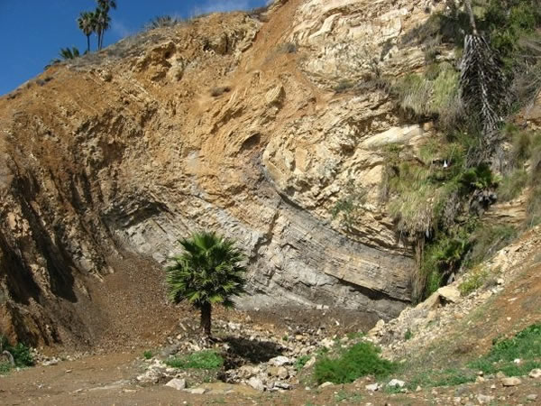

Slide 10
Stop 4. The Korean Friendship Bell
Located on a marine terrace
270° views of coastline in this area
  Strategic location during WWII

Slide 11
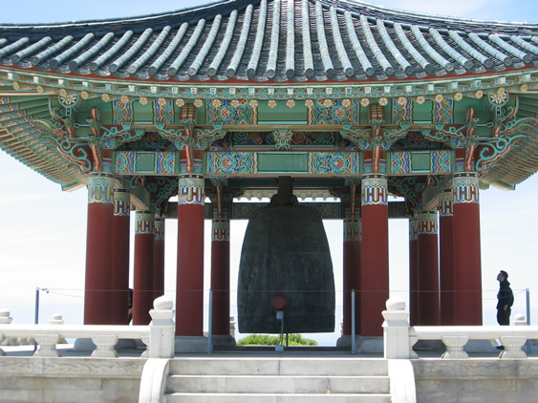

Slide 12
Stop 5. Wilmington Oil Field and Terminal Island
Originally a wetland/marsh area
Discovered in early 1900s
90% of oil recovered
Subsidence of Long Beach area
1933 Long Beach EQ

