Slide 1
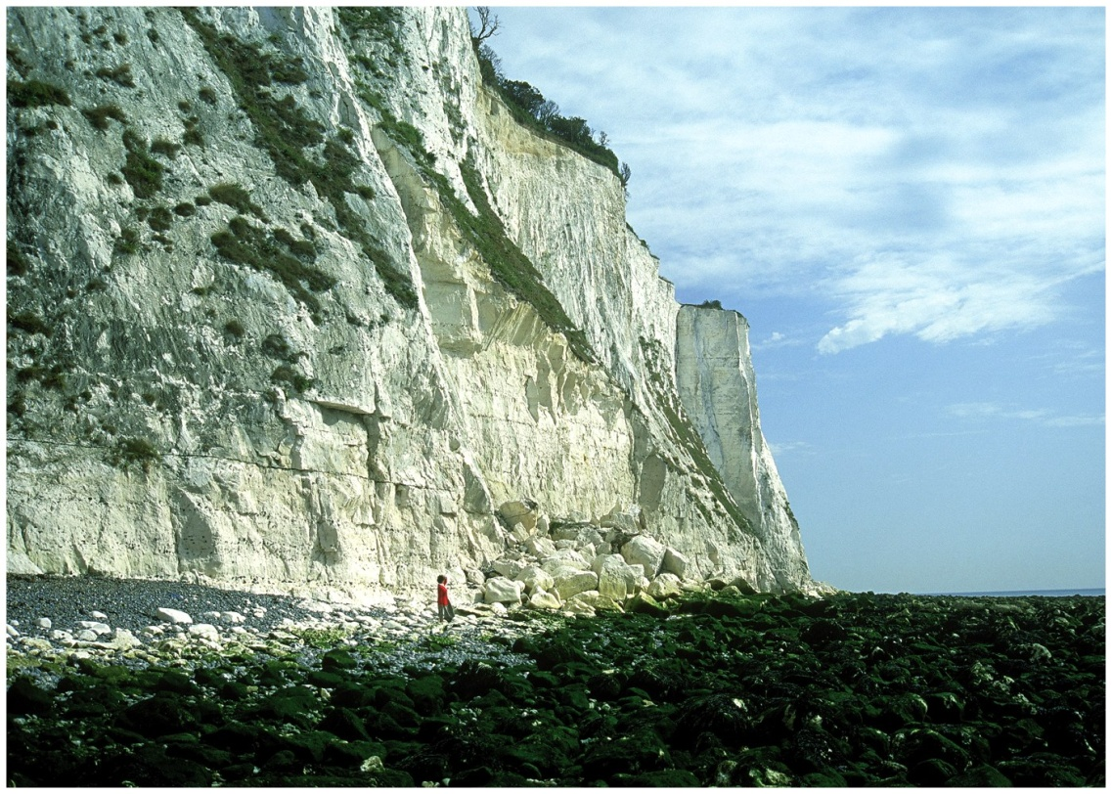
HOW OLD IS OLD? The Rock Record and Deep Geologic Times

Slide 2
Objectives
Distinguish between relative and numerical age
Define stratigraphy and the four main principles
Explain why gaps are common in rock record
Distinguish four units of geologic time
Describe the process of radioactive decay
Explain why the oldest rocks are not necessarily the same age as the planet

Slide 3
Relative Age
Sequence of past geologic events
The age of rock, fossils, or other geologic feature relative to another feature
Derived from three basic principles of stratigraphy

Slide 4
Relative Age
Stratigraphy
The science of rock layers and the processes by which they are formed
Principal of original horizontality: water laid sediments are deposited in horizontal strata
Principle of stratigraphic superposition: each stratum is younger than the stratum below it
Principle of lateral continuity: sediments deposited in continuous layers
Principle of cross-cutting relationship: stratum must be older than any feature that cuts or disrupts it

Slide 5
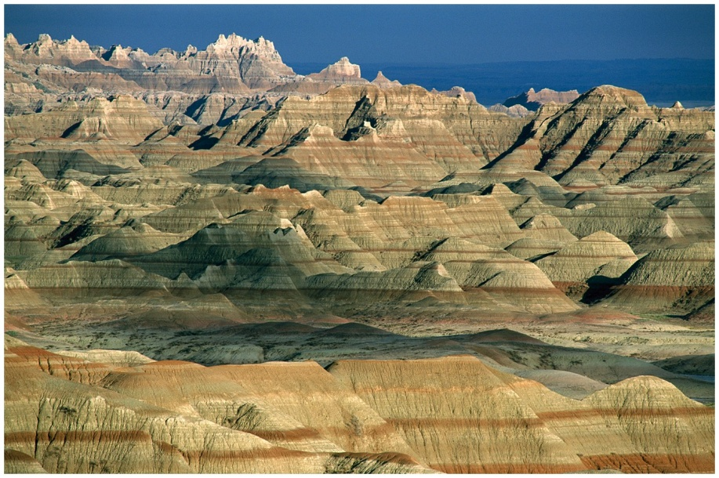
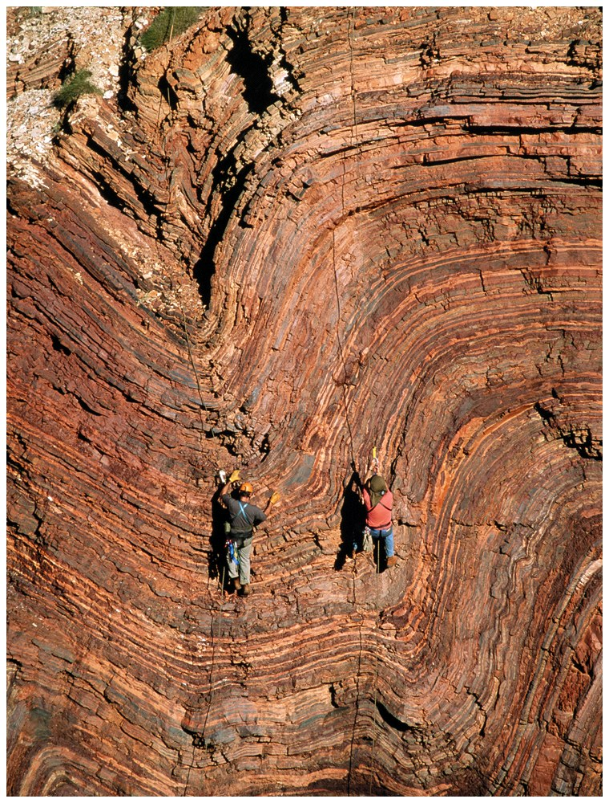
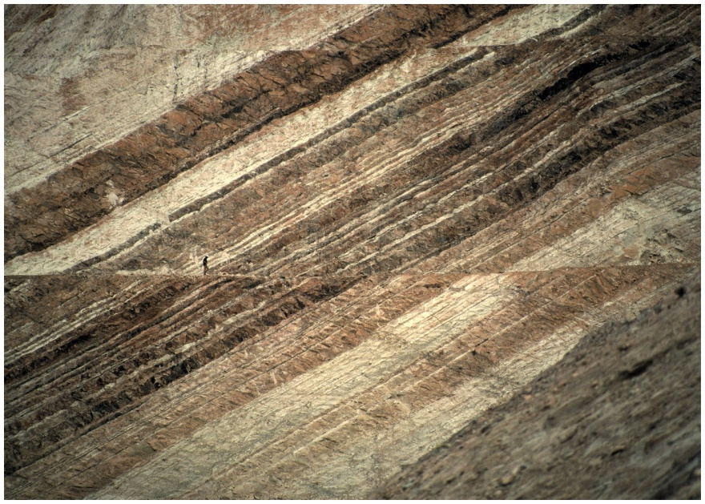
Stratigraphy

Slide 6
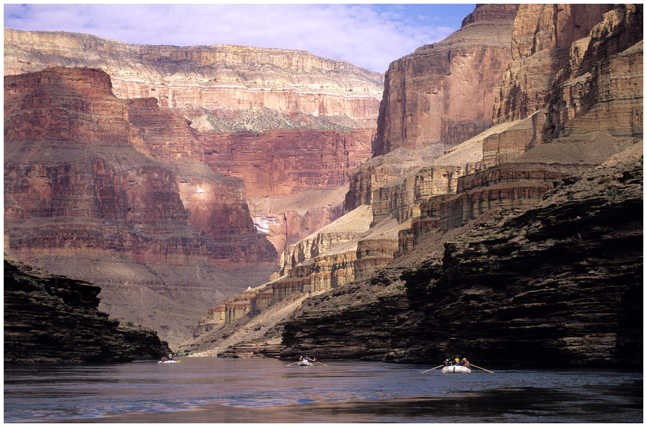
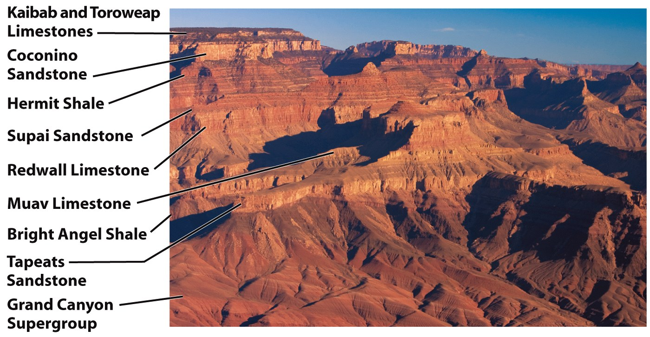
Stratigraphy

Slide 7
Gaps in the record
Numerical ages
The age of a rock or geological feature in years before the present
Unconformity
A substantial gap in a stratigraphic sequence that marks the absence of a part of the rock record

Slide 8
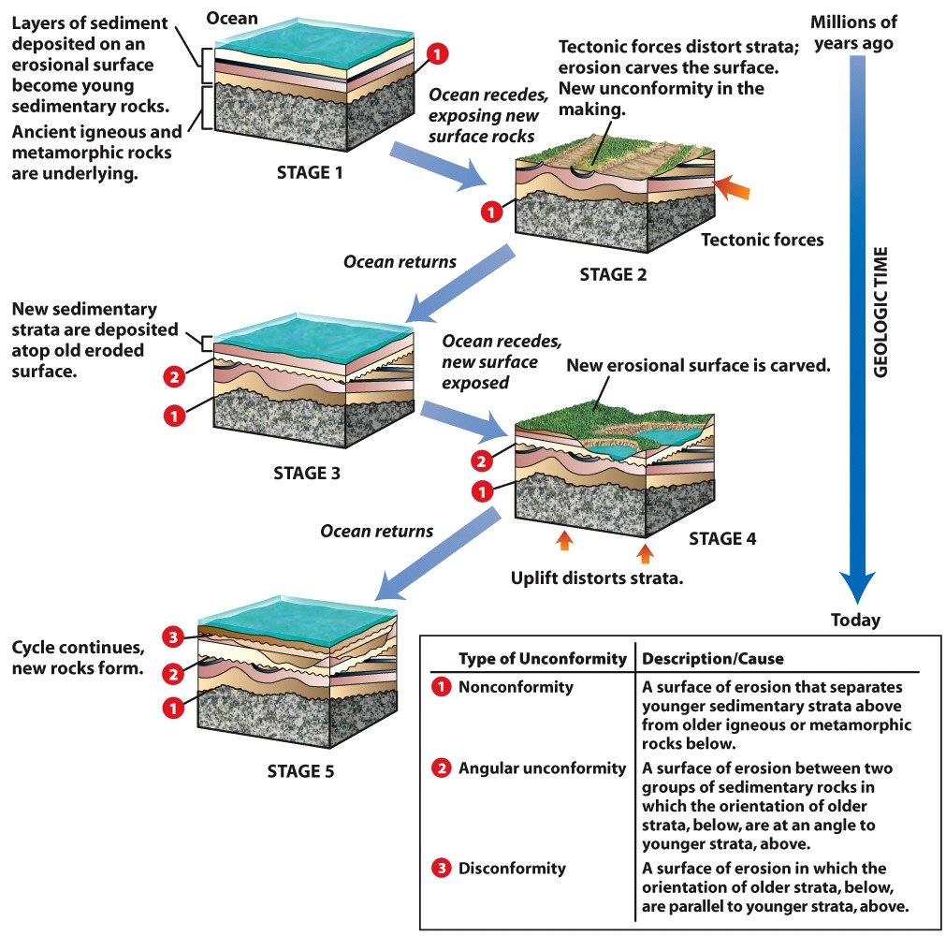
Gaps in the record

Slide 9
Fossils and Correlation
Paleontology
The study of fossils and the record of ancient life on Earth
The use of fossils for the determination of relative ages
Fossils
Shells, bones or wood whose form has been preserved in sedimentary rocks
Imprints of soft animal tissue
Preserved tracks or footprints

Slide 10
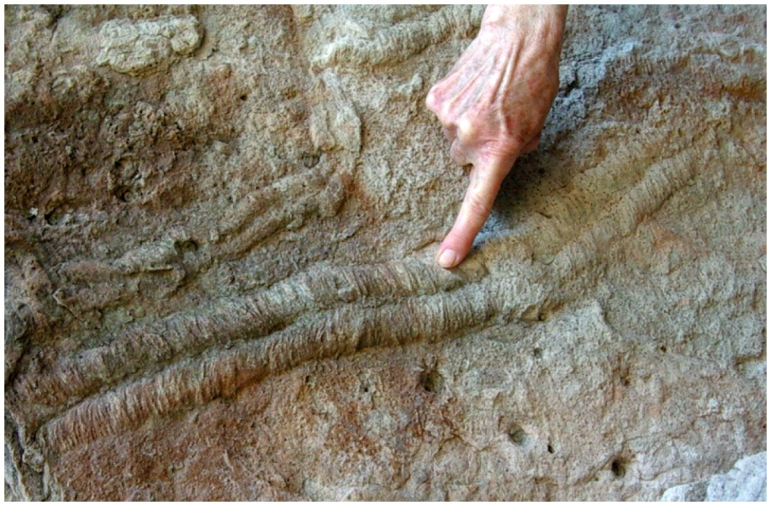
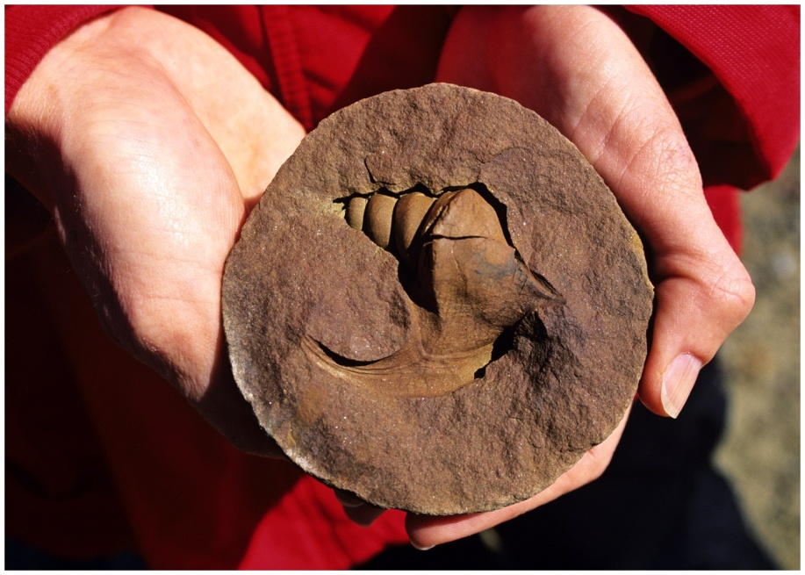
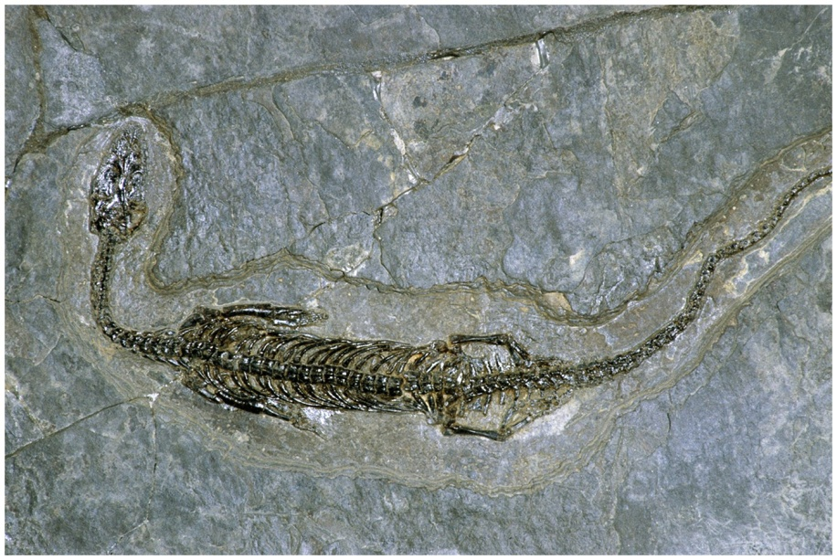
Fossils and Correlation

Slide 11
Fossils and Correlation
Principle of faunal and floral succession: stratigraphic ordering of fossil assemblages
Fauna: animals
Flora: plants
Succession: new species succeed earlier ones over time
Correlation
A method of equating the ages of strata that come from two or more different places

Slide 12
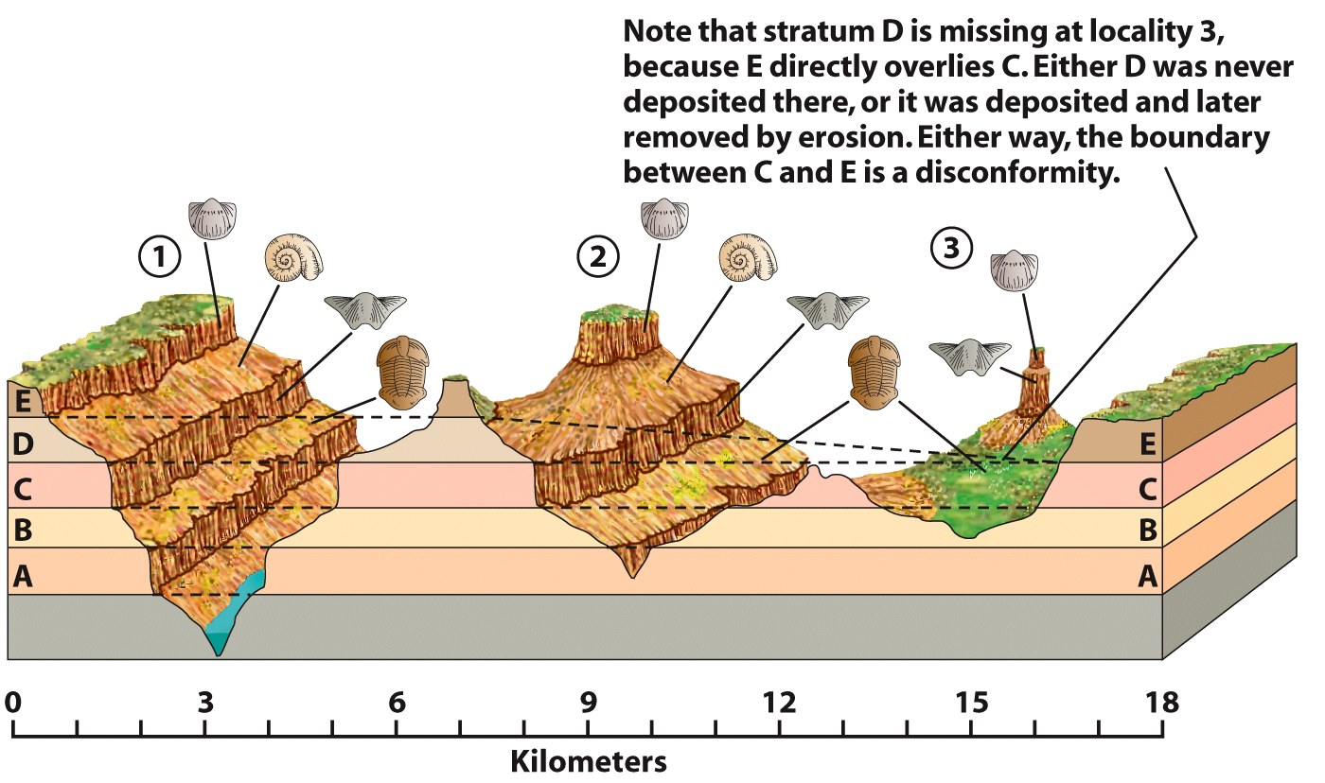
Fossils and Correlation

Slide 13
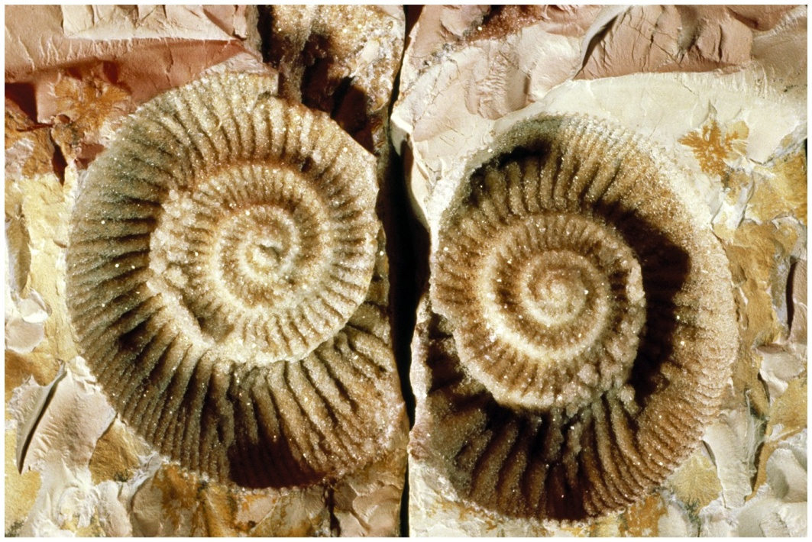
The Geologic Column
The succession of all known strata, fitted together in relative chronological order
Gaps in record could be filled with evidence from around the world
Stratigraphic time scale

Slide 14
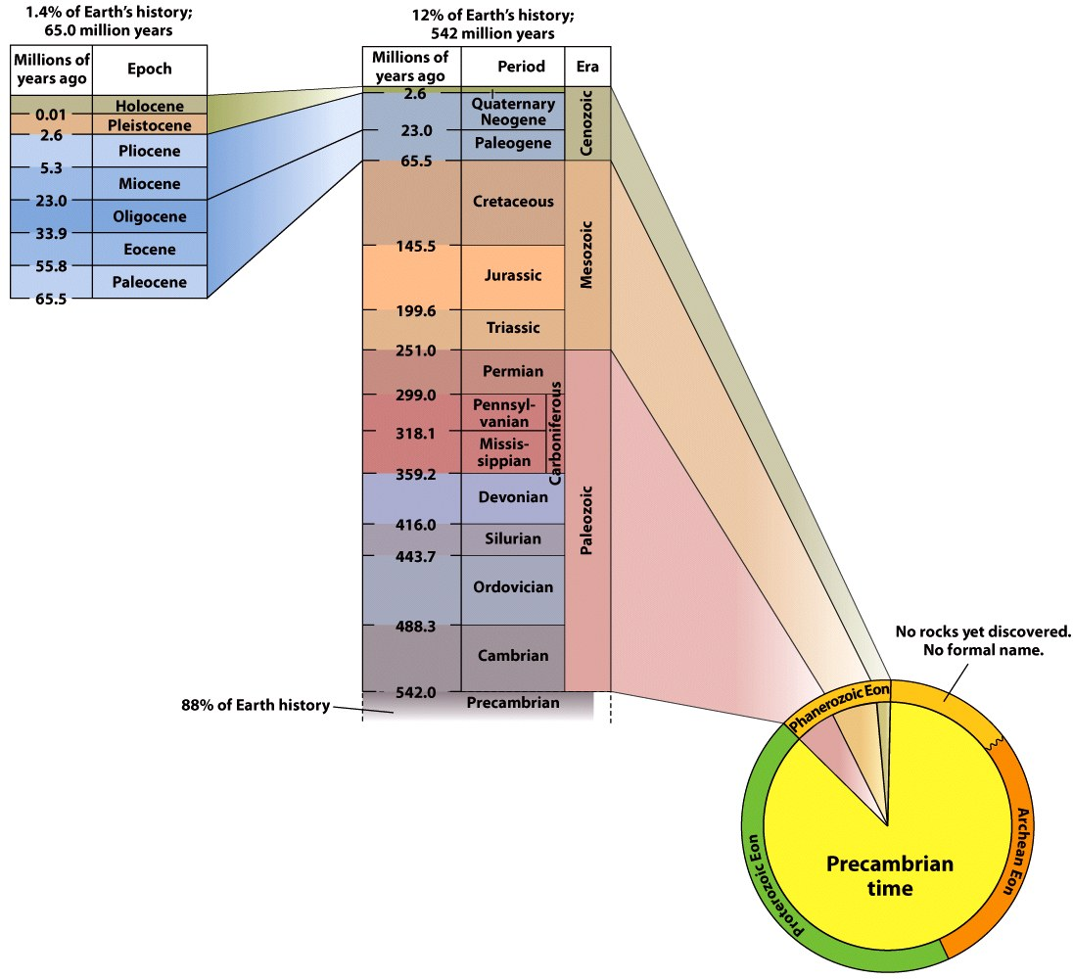
The Geologic Column

Slide 15
Eons and Eras
Earth’s history divided into three eons
Hadean
Time between Earth’s creation and age of the oldest rocks discovered
Archean
Roughly when single cell life developed
Proterozoic
Multi-celled, soft bodied organisms emerged

Slide 16
Eons and Eras
Phanerozoic: Current eon, means “visible life”
Divided into three eras
Paleozoic (“ancient life”)
Mesozoic (“middle life”)
Cenozoic (“recent life”)

Slide 17
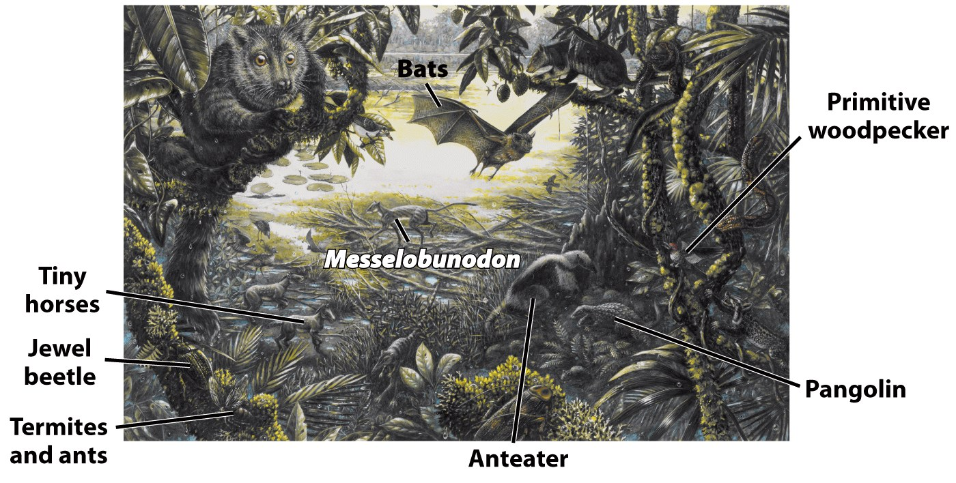
Eons and Eras

Slide 18
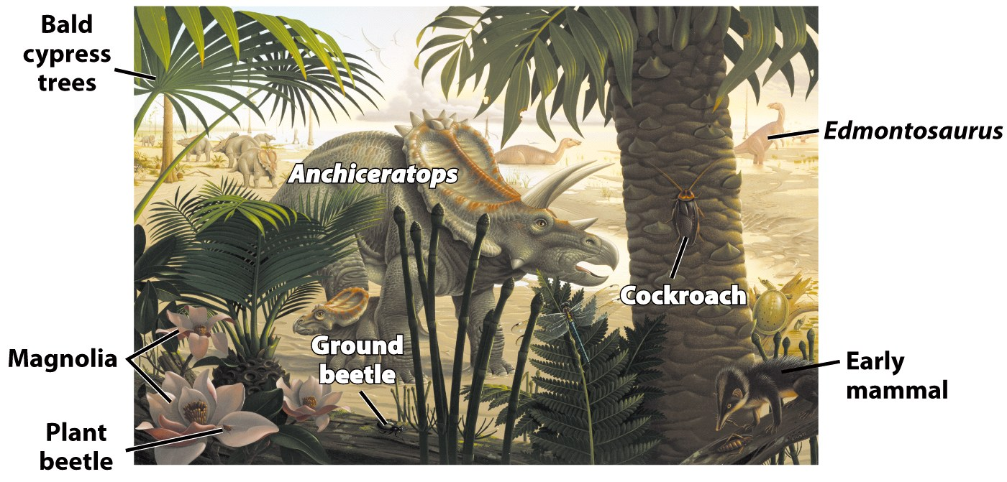
Eons and Eras

Slide 19
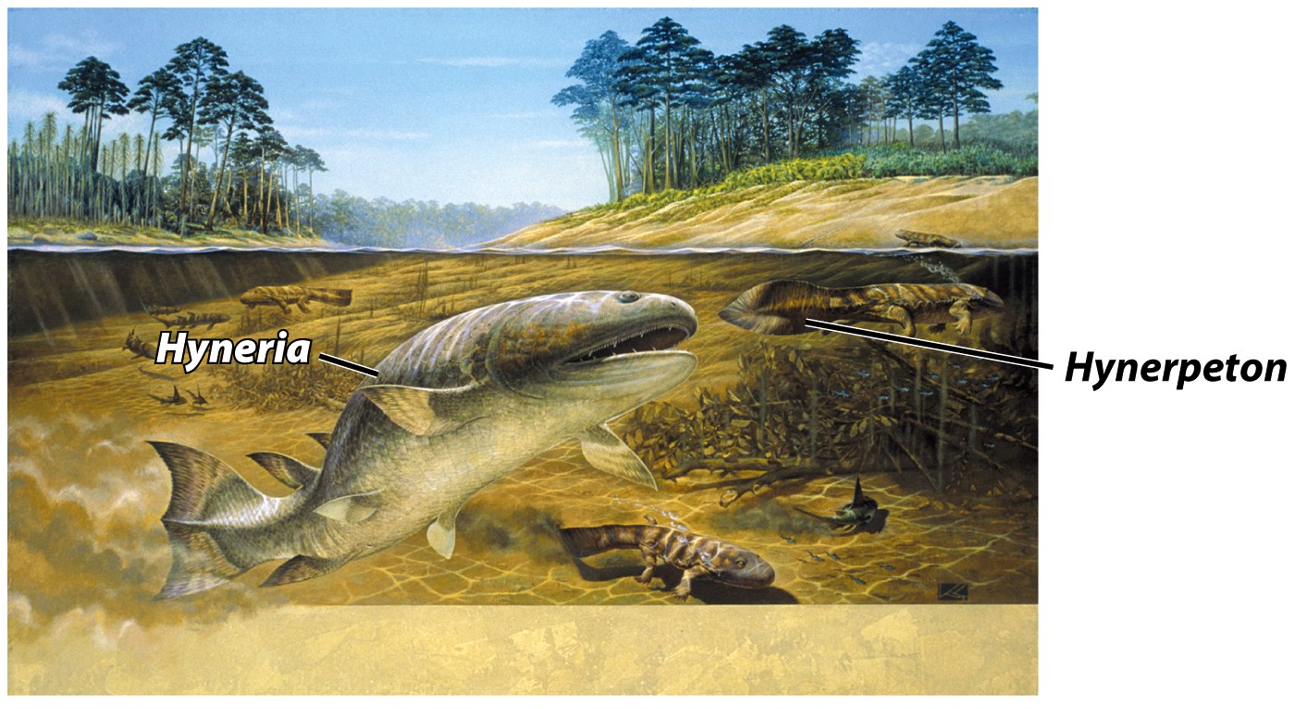
Eons and Eras

Slide 20
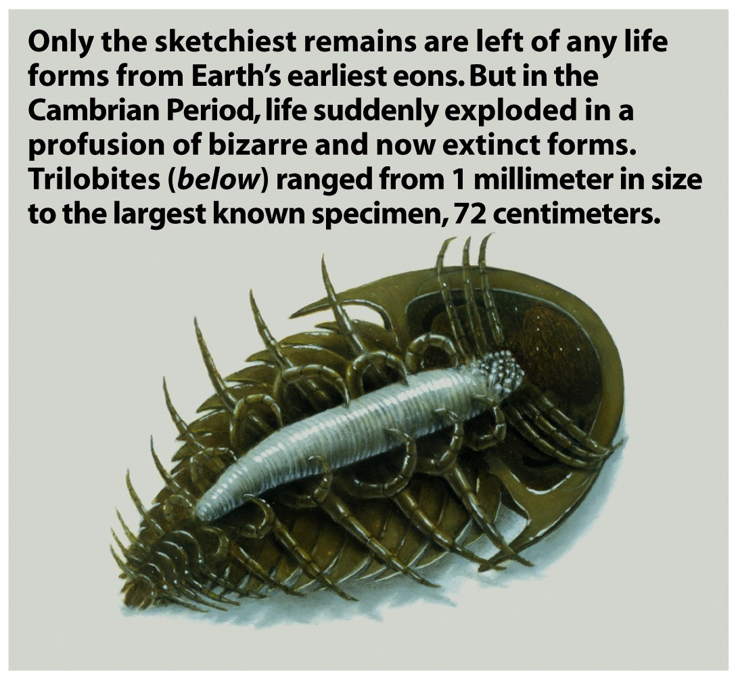
Eons and Eras
Eras are divided into shorter units called periods.
Cambrian explosion
Time of unprecedented diversification of life
Time preceding Cambrian Period and rocks that formed then is called Precambrian
Periods are divided into epochs

Slide 21
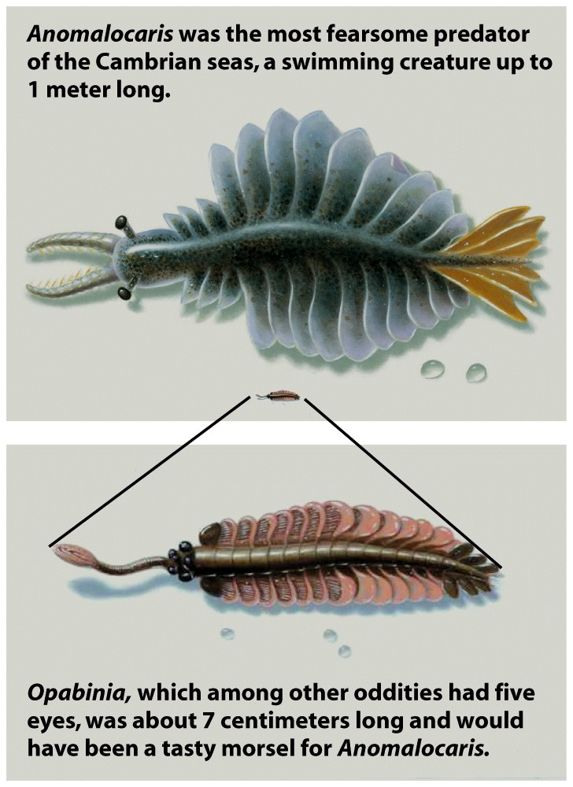
Eons and Eras

Slide 22
Numerical Age
Early attempts during 19th century
Edmund Halley: suggested age based on rate of salt accumulation
John Joly: calculated Halley’s suggested approach- derived age of Earth as 90 million years old
Charles Darwin: believed evolution a slow process; therefore Earth had to be > 300 million years old
Lord Kelvin: used law of thermodynamics to calculate length of time Earth was a solid body- derived an age of 20 million years

Slide 23
Numerical Age

Slide 24
Numerical Age
Radioactivity
A process in which an element spontaneously transforms
End product is either another isotope of the same element or into a different element

Slide 25
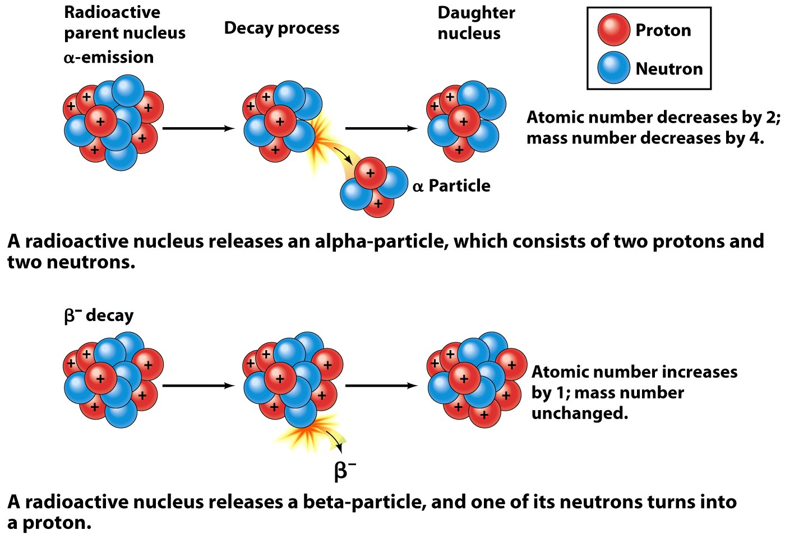
Numerical Age

Slide 26
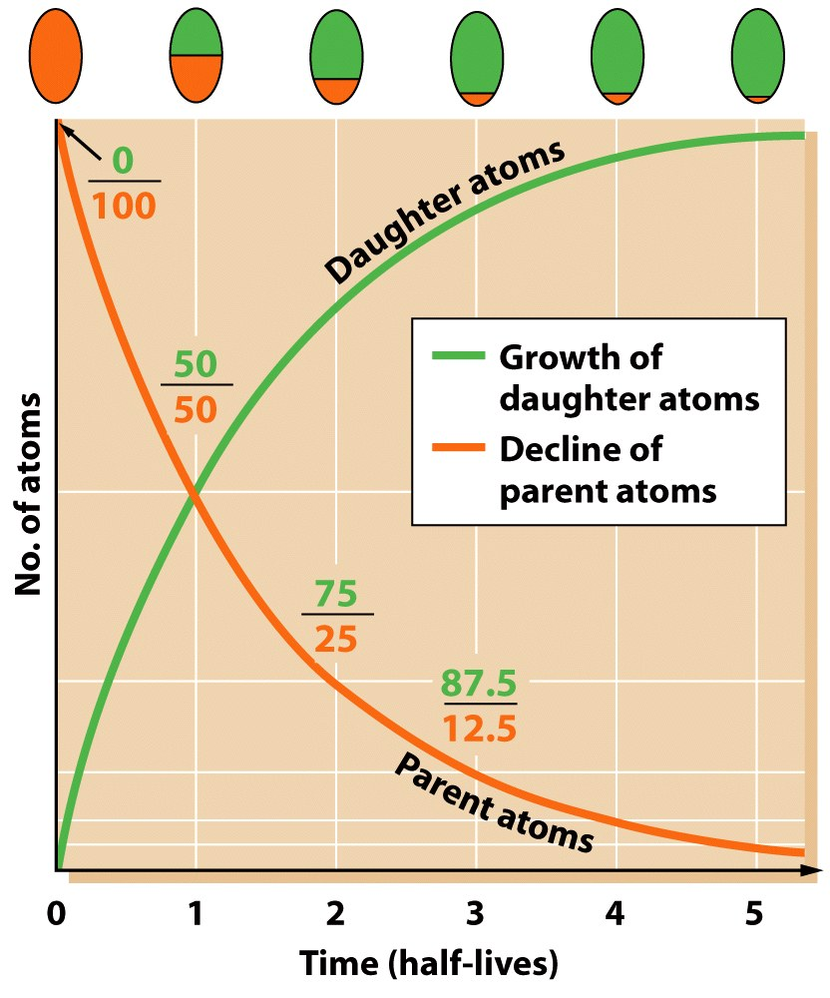
Rates of decay
Half life
Time needed for half of the parent atom of a radioactive substance to decay into daughter atoms
Radiometric dating
The use of naturally occurring radioactive isotopes to determine the numerical age of minerals, rocks and fossils

Slide 27
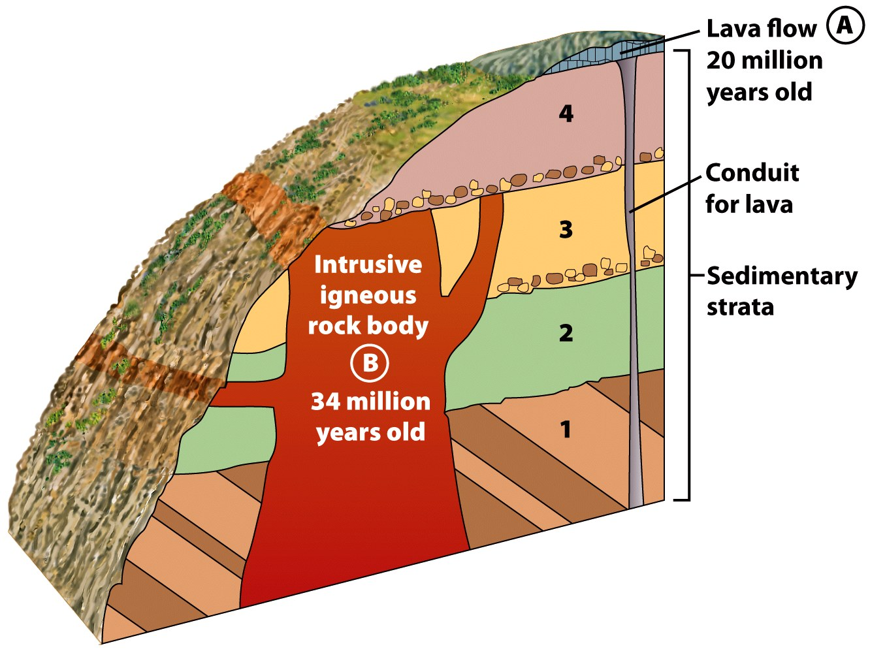
Rates of decay
Examine Figure 3.15 and determine the age of rock layer 4

Slide 28
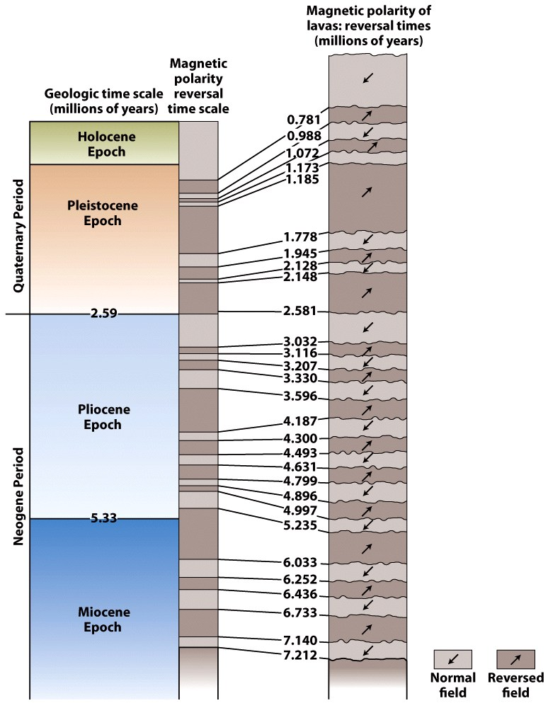
Magnetic Polarity Dating
Paleomagnetism
The study of rock magnetism to determine the intensity and direction of Earth’s magnetic field in the geologic past
Magnetic reversal
A period of time in which Earth’s magnetic polarity reverses itself

Slide 29
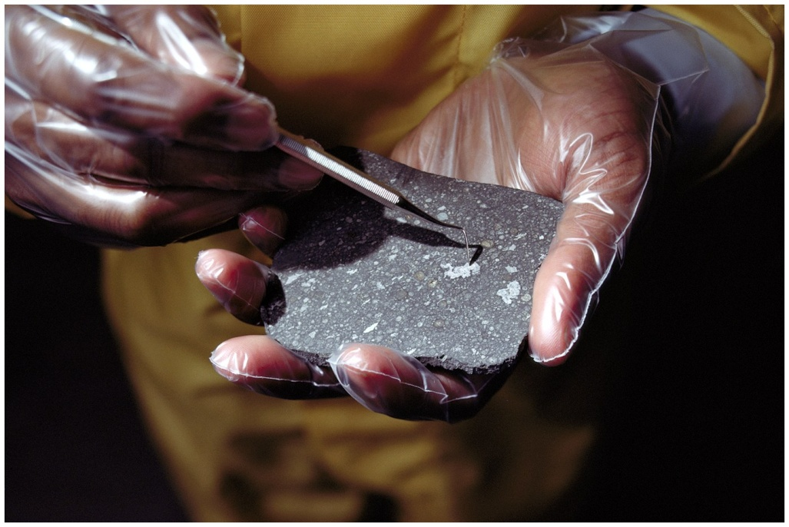
The Age of Earth
Oldest rock dated to about 4 billion years
Geologic alteration and recycling of materials
Carbonaceous chondrites
Meteorites believed to contain unaltered material from the formation of the solar system.
Around 4.56 billion years old

Slide 30
Critical Thinking
If the half life of Carbon-14 is 5730 years, then 11,460 years, how much Carbon-14 remains?
Would a surface between adjacent parallel layers of sediment be a disconformity if erosion had not occurred? Explain.
Use an average rate of deposition of sediment of 1 cm a year to estimate the time needed for 2 km of sediment to deposit. Where might errors come from in your estimate?

