Slide 1
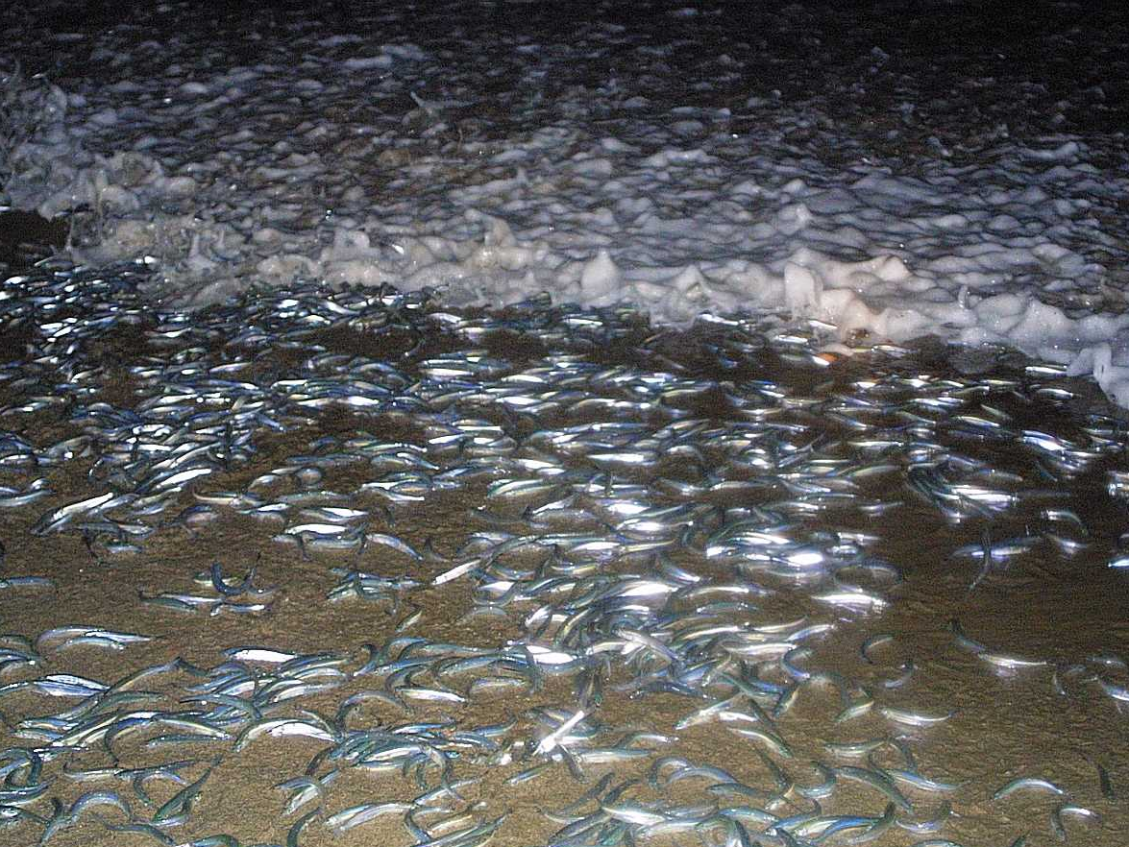
Physical Oceanography
Tides

Slide 2
Tides
Tides are caused by the gravitational force of the moon and sun and the motion of earth.
The wavelength of tides can be half the circumference of earth.
Tides are forced waves because they are never free of the forces that cause them.

Slide 3
Moon Tide
Produced by the moon’s gravitation force on water
A bulge of water is created by the moon’s gravitational force
Centrifugal forces produces a bulge on the opposite side of the Earth & an area of low water between the tidal bulges

Slide 4
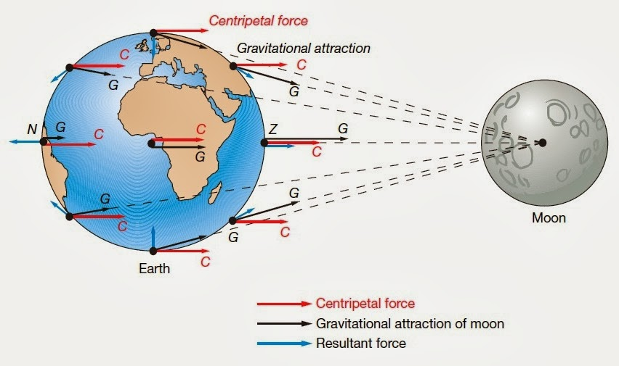
Source : Trujillo,Alan P., Essentials of oceanography / Al Trujillo, Harold Thurman. 10th ed
Notes:
The action of gravity and inertia on particles at five different locations on Earth. Forces are balanced only at point CE, the center of Earth. Note the bulges that are aligned with the moon as Earth spins on its axis. The key to understanding the equilibrium theory of tides is to see Earth turning beneath these bulges.

Slide 5
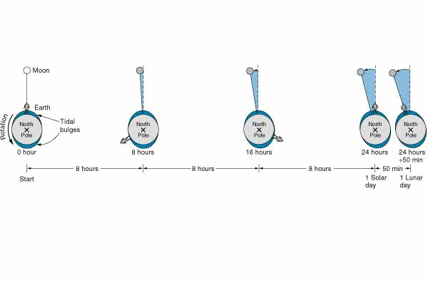
Lunar Day
A lunar day is the time that elapses between when the moon is directly overhead and the next time the moon is directly overhead.

Slide 6
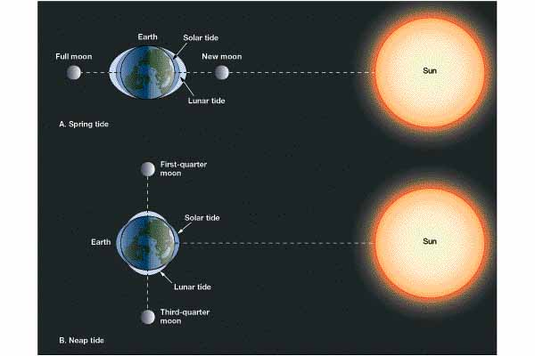
Spring Tides
During the period of a new moon, the moon and sun are lined up on the same side of the Earth
Produces the greatest range between high water and low water

Slide 7
Neap Tides
Produced when the moon is at a right angle to the line of centers of the Earth and the sun
The range between high and low water is small

Slide 8
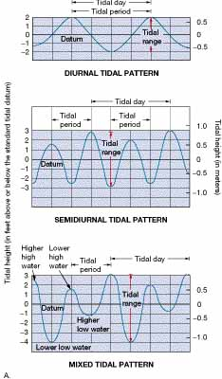
Tide Patterns
Diurnal tide
One high and one low tide per day
Semidiurnal
Twice occurring high and low tide sequences
High and low tides are both at the same level
Semidiurnal mixed tide
Each high tide reaches different heights
Each low tide falls to different levels

Slide 9
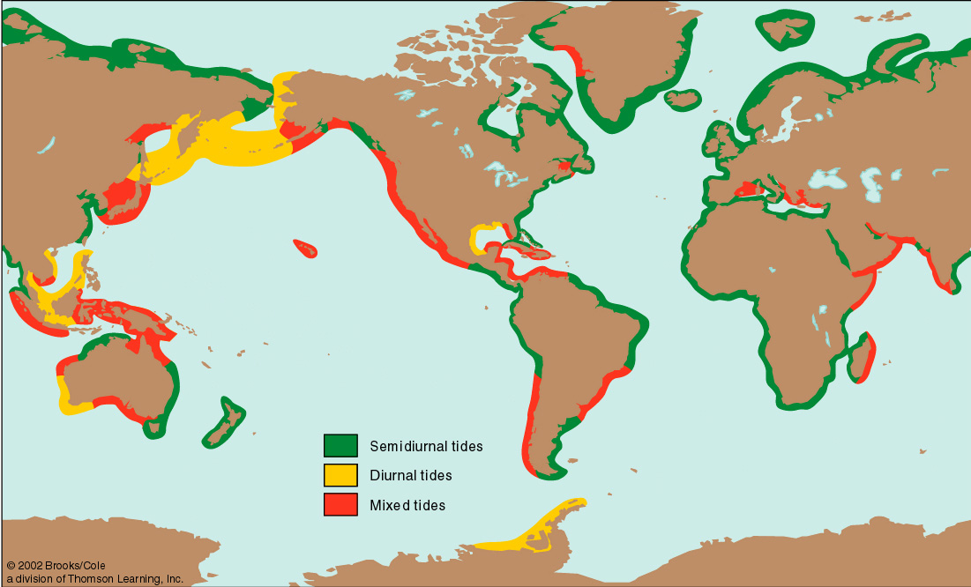
Tide Patterns
The worldwide distribution of the three tidal patterns.

Slide 10
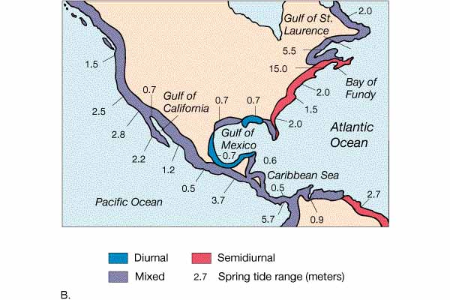
Tide Patterns

Slide 11
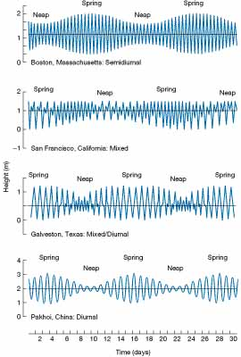
Tide Patterns
Examples of monthly tidal curves
Top: Boston, Massachusetts, showing semidiurnal tidal pattern.
Upper middle: San Francisco, California, showing mixed tidal pattern with strong diurnal tendencies.
Bottom: Pakhoi, China, showing diurnal tidal pattern.

Slide 12
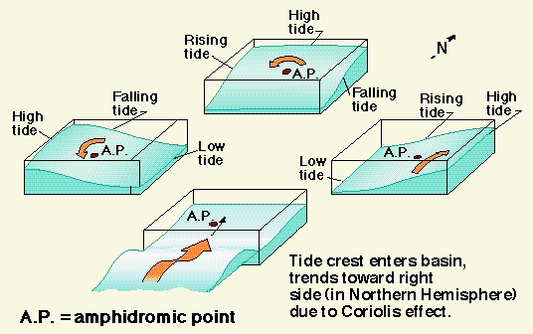
Tide Patterns
Amphidromic Points
A "no-tide" point in an ocean
About a dozen amphidromic points exist in the world ocean.
Sometimes called
a node.

Slide 13
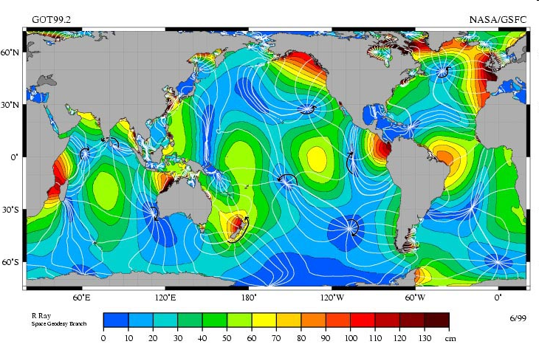
Amplitude is indicated by color, and the white lines are cotidal differing by 1 hr. The curved arcs around the amphidromic points show the direction of the tides, each indicating a synchronized 6 hour period.
R. Ray, TOPEX/Poseidon: Revealing Hidden Tidal Energy en:GSFC,en:NASA

Slide 14
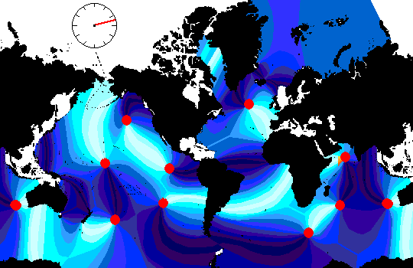
Animated map of the tidal nodes of the Earth
Notes:
http://www.reddit.com/r/Damnthatsinteresting/comments/1yoys0/animated_map_of_the_tidal_nodes_of_the_earth/

Slide 15
Tides in a Confined Basin
Tidal ranges vary across the ocean basin
Largest variations occur at the edges
Especially in bays and inlets
Energy is concentrated in a small area
A mini amphidromic system develops
Extreme tides in areas where there are natural oscillation periods of 12 or 24 hours

Slide 16
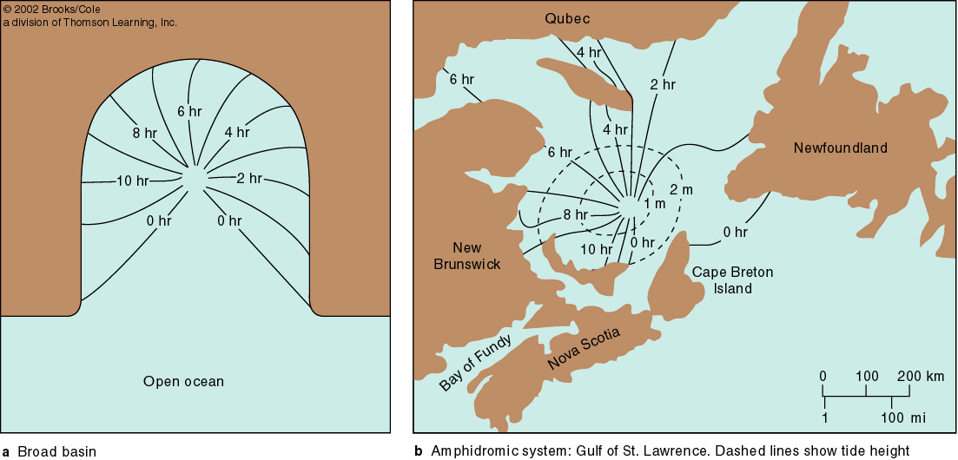
Tides in Confined Basins
.
The tidal range is determined by basin configuration

Slide 17
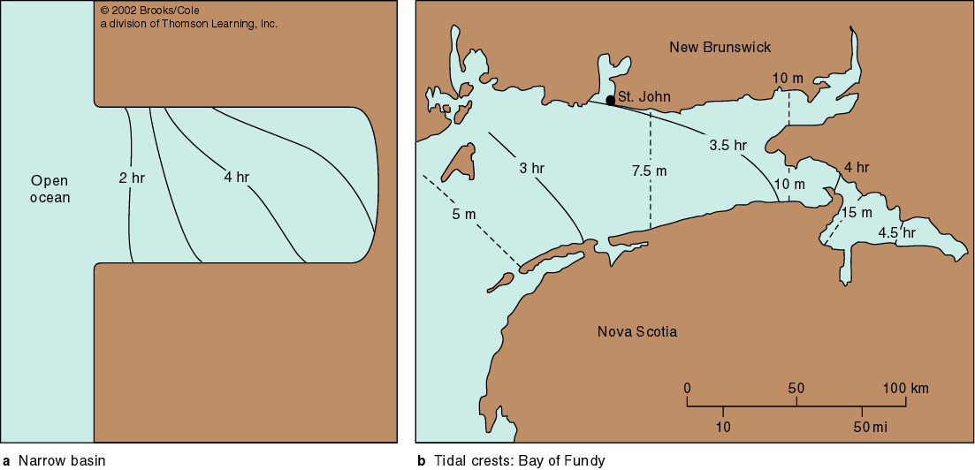
Tides in Confined Basins
Tides in a narrow basin. Note that a true amphidromic system does not develop because space for rotation is not available.

Slide 18
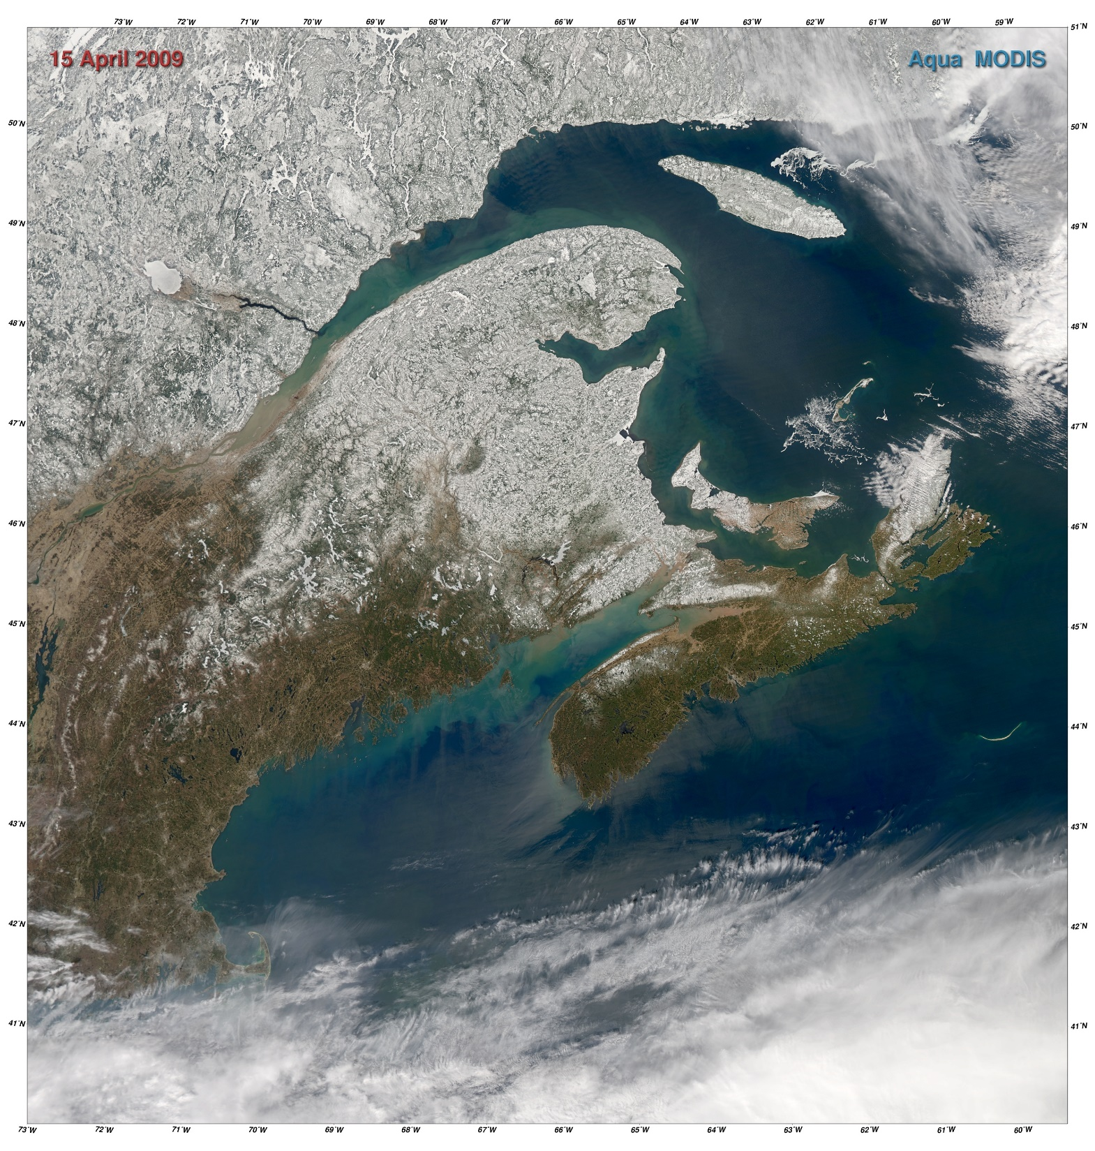
Bay of Fundy, Nova Scotia World’s Largest Tidal Range
Spring Tide Timelapse, Halls Harbour Video: https://youtu.be/hbzwzrZXUKA

Slide 19
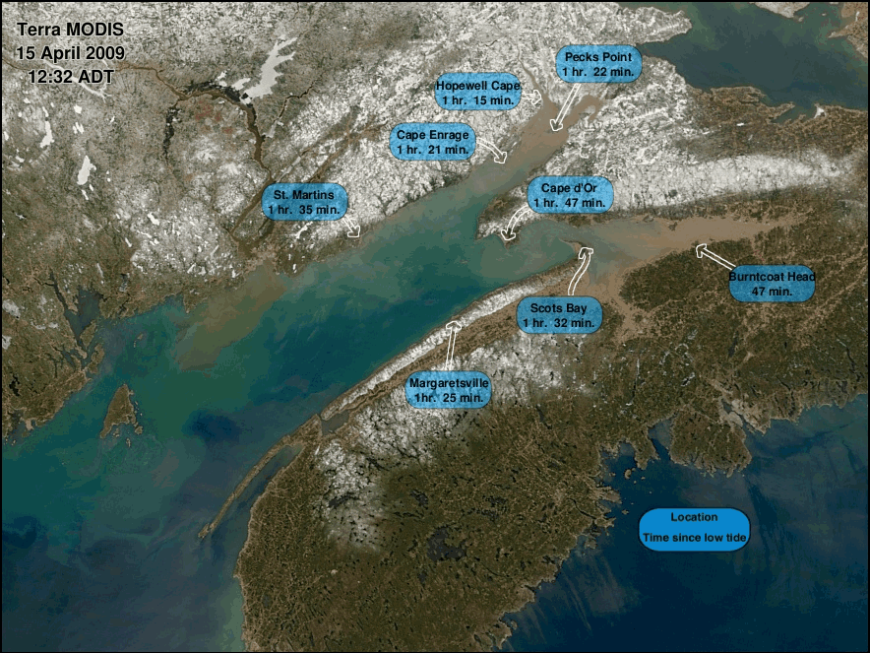
The tide was rising in the Bay of Fundy when the two MODIS sensors (on the Terra and Aqua spacecraft) flew overhead on April 15, 2009. Terra flew by a little over an hour after low tide, and Aqua flew past an hour and 47 minutes later.
Notes:
http://oceancolor.gsfc.nasa.gov/MODIS/HTML/BayOfFundy.html

Slide 20
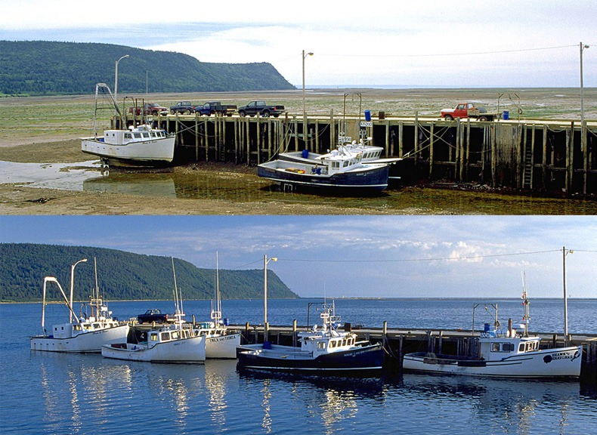
Source: 1

Slide 21
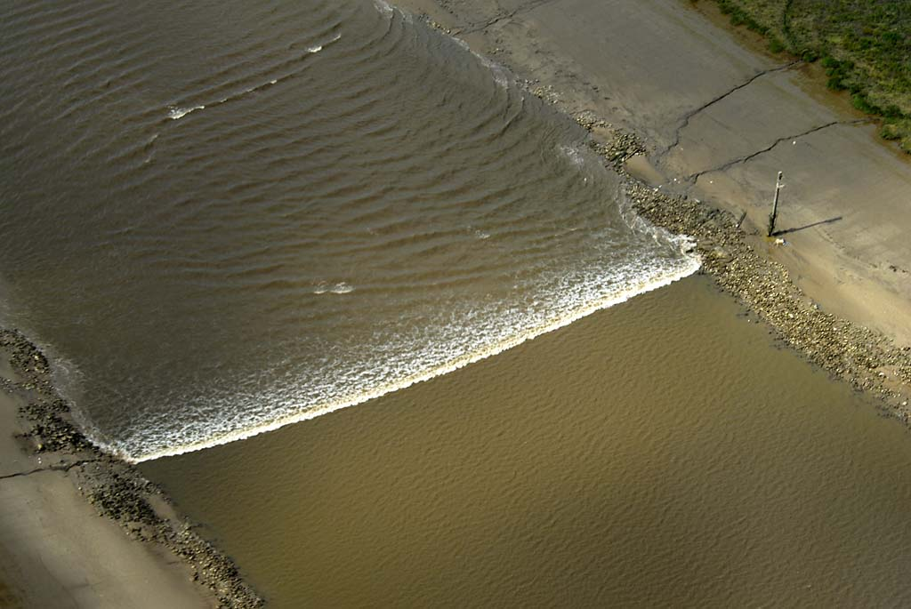
Tidal Bore - A true tidal wave
"River Ribble bore" by Frangle Plazma Goat - Own work. Licensed under CC BY-SA 3.0 via Wikimedia Commons
Notes:
A high, often breaking wave generated by a tide crest that advances rapidly up an estuary or river
Occurs in inlets and some rivers exposed to great tidal fluctuations
"River Ribble bore" by Frangle Plazma Goat - Own work. Licensed under CC BY-SA 3.0 via Wikimedia Commons - http://commons.wikimedia.org/wiki/File:River_Ribble_bore.jpg#/media/File:River_Ribble_bore.jpg

Slide 22
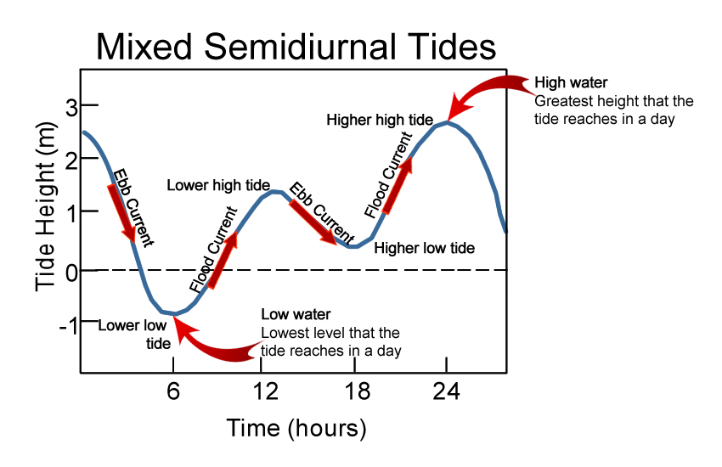
Tidal terms & currents

Slide 23
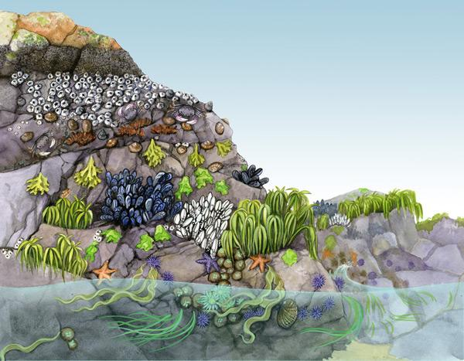
Tides and Marine Organisms
Notes:
http://www.comminternet.com/websites/harmonartillustrations.com/store/murals.php

Slide 24
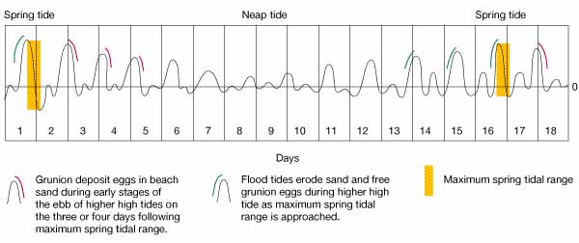
Tides and Marine Organisms
Grunions! (Leuresthes tenuis)
Spawn from late February to early September

Slide 25
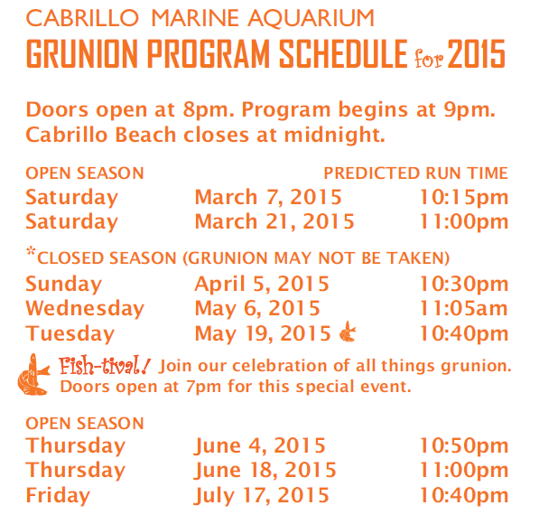
Notes:
http://www.cabrillomarineaquarium.org/events-news/events-details.asp?id=1364

Slide 26
Tidal Power
Tidal energy can be exploited in two ways:
By building semi-permeable undersea tidal turbines across estuaries with a high tidal range.
By harnessing offshore tidal streams

Slide 27
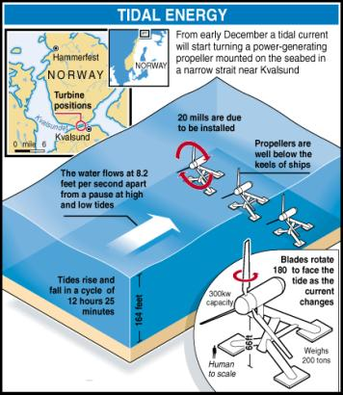
Tidal Power
Notes:
http://www.poemsinc.org/FAQtidal.html

Slide 28
List of World Main Tidal Power Stations
Country
Power Station
Tidal Loss (m)
Capacity (MW)
Operated Since
France
Langce
8.5
240
1966
Canada
Andeboriece
7.1
19.1
1984
Former Soviet Union
Gicelaya
3.9
0.4
1968
China
Jiangxia
5.1
3.2
1980
China
Baishakou
2.4
0.64
1978
China
Xingfuyang
4.5
1.28
1989
China
Yuepu
3.6
0.15
1971
China
Haishan
4.9
0.15
1975
China
Shashan
5.1
0.04
1961
China
Liuhe
2.1
0.15
1976
China
Guozishan
2.5
0.04
1977
Notes:
http://www.newenergy.org.cn/english/ocean/casestudy/tide/

Slide 29
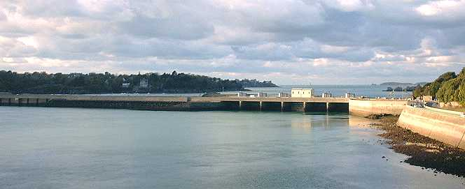
Tidal Power
La Rance, France - world's first tidal power plant
Average tidal range 27 feet
Dam encloses 8.5 sq. miles
Capacity is 320,000 KW
Notes:
http://armorance.free.fr/barrage.htm

Slide 30
Tidal Power
Low Production but also Low Environmental Impact
No noxious waste
No consumption of resources
Minimum disturbance to scenery

Slide 31
~ End ~

