Slide 1
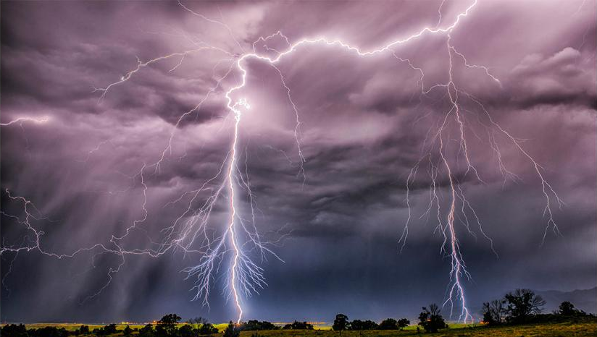
Storms

Slide 2
Assessing the risk
How common is this disaster and where does this disaster normally occur?

Slide 3
Weather and climate
Weather
Weather is over a short period of time
Constantly changing
Climate
Climate is over a long period of time
Generalized composite of weather

Slide 4
Weather and climate
Elements of weather and climate
Temperature
Humidity
Cloudiness
Precipitation
Air Pressure
Winds speed and direction
Latitude and altitude can change these items
Together they all create various types of storms

Slide 5
Changes of State
Water uniquely occurs naturally as solid, liquid and gas in the atmosphere
Energy is absorbed or liberated as water changes state
The amount of heat per gram absorbed or liberated is known as latent heat

Slide 6
In the upper atmosphere, air is:
Cooler
Expands
Water vapor tends to condense
Water vapor will condense & form clouds
Air is now more dense and cool
The air cools as the molecules get further apart
Air is cool and dense
Air begins to sink
The air molecules will expand
The air compresses
As it rises, it is under less pressure
The air molecules are closer together
Warm air will rise up
The air heats up and dries out
At sea level, air is:
Warmer
More compressed
Can hold more water vapor

Slide 7
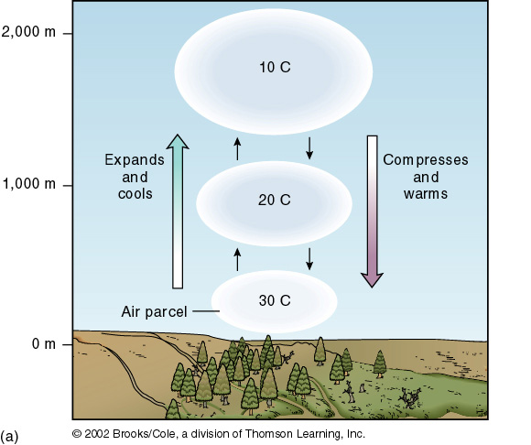
Adiabatic heating / cooling

Slide 8
Solar Heating & Latitude
Indirect – less sun, less heat, spread over wide area,
most energy is reflected, amount varies with season
Direct – more sun, more heat, concentrated in small area;
most energy absorbed; constant year-round

Slide 9
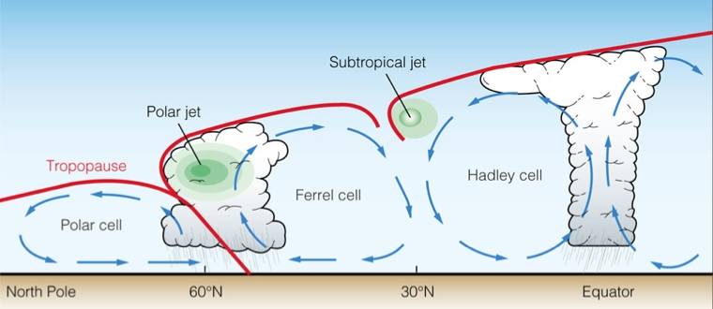
Atmospheric circulation cells in the northern hemisphere
Warm air rises up,
Cools, condenses,
Water vapor → clouds
Cold air sinks,
Compresses, heats up & dries out
Source: 1

Slide 10
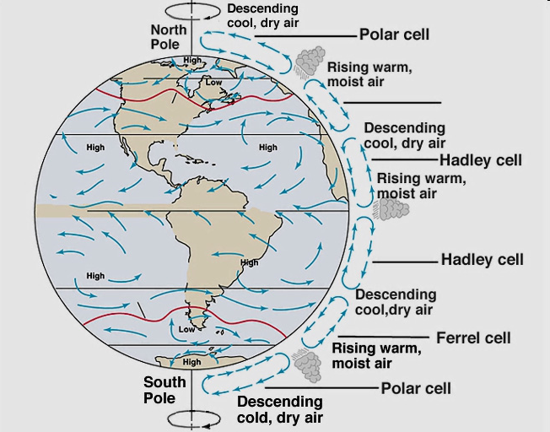
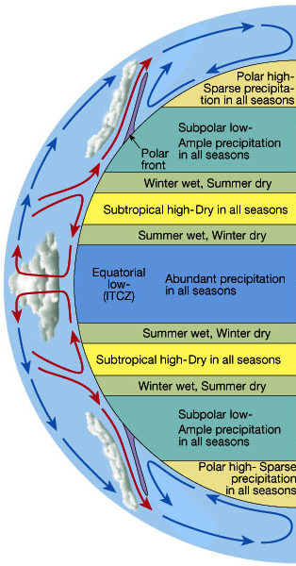
Six Cell Circulation Model and Idealized zonal precipitation patterns owing to atmospheric circulation.
adapted from:
The Atmosphere, 8th edition, Lutgens and Tarbuck, 8th edition, 2001.
low
source

Slide 11
Air Masses
Are large bodies of air with nearly uniform temperature, humidity and density throughout
Air passing over land or water will take on the characteristics of the surface below
Can move within or between circulation cells

Slide 12
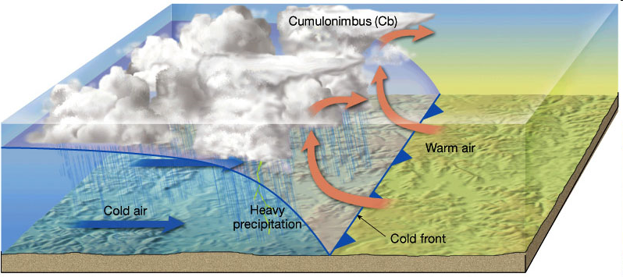
Schematic cross-section of a cold front.
Figure 9.6 in The Atmosphere, 8th edition, Lutgens and Tarbuck, 8th edition, 2001.
Notes:
Schematic cross-section of a warm front. Figure 9.6 in The Atmosphere, 8th edition, Lutgens and Tarbuck, 8th edition, 2001.

Slide 13
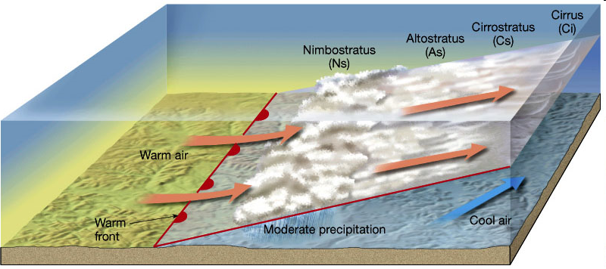
Schematic cross-section of a warm front.
Figure 9.6 in The Atmosphere, 8th edition, Lutgens and Tarbuck, 8th edition, 2001.

Slide 14
Atmospheric Rossby waves

Slide 15
Meanders in the polar jet create troughs and ridges
Forms cyclones and anticyclones

Slide 16
Cyclones
Low pressure zone in polar jet trough
Winds at surface flow counterclockwise towards the core
Air is updrafted and cooled
Forms clouds, rain and upper level outflow of air

Slide 17
Anticyclones
High pressure zone at ridge of polar jet
Air converges in upper atmosphere
Descends towards the ground
Flows outward at surface
Dry, windy conditions

Slide 18
So, how common are storms, and where does they normally occur?
Storms are regional atmospheric disturbances; they typically have high winds and most have precipitation.
Storms occur all over the world.
The type and frequency of the storm varies depending on where you are.

Slide 19
Assessing the risk
What are the major causes of damage, destruction, death associated with this disaster?

Slide 20
What are the major causes of damage, destruction, death associated with this disaster?
That depends on the disaster . . .

Slide 21
Types of Storms
Thunderstorms
Wind
Extratropical cyclones
Tropical cyclones

Slide 22
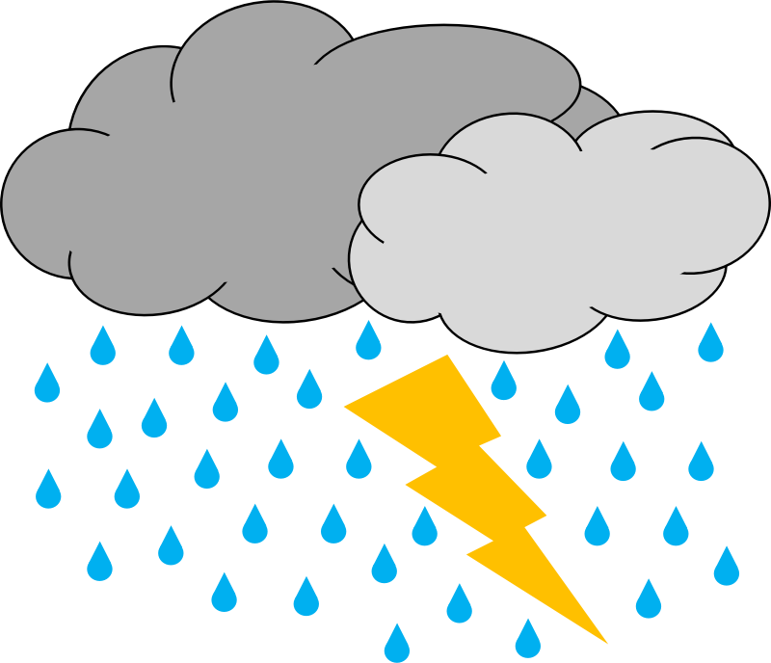
Thunderstorms

Slide 23
Thunderstorm Formation
Lift
Instability
Adequate Moisture
Forms when warm air rises up into the cooler air above. The greater the temperature difference, the greater the instability will be.
As air rises, water vapor cools and condenses to form clouds.
Phase change releases energy, which allows for more air to be updrafted.
Altitude | Surrounding Air Temp. | Rising Air Temp.
0 feet | 70 °F | 70 °F
1,000 feet | 63 °F | 64.6 °F
2,000 feet | 57 °F | 59.2 °F
Source: The USA TODAY Weather Book
Notes:
http://kids.britannica.com/comptons/art-53902/In-orographic-lift-moist-air-moves-up-the-windward-side
http://usatoday30.usatoday.com/weather/wstabil.htm

Slide 24
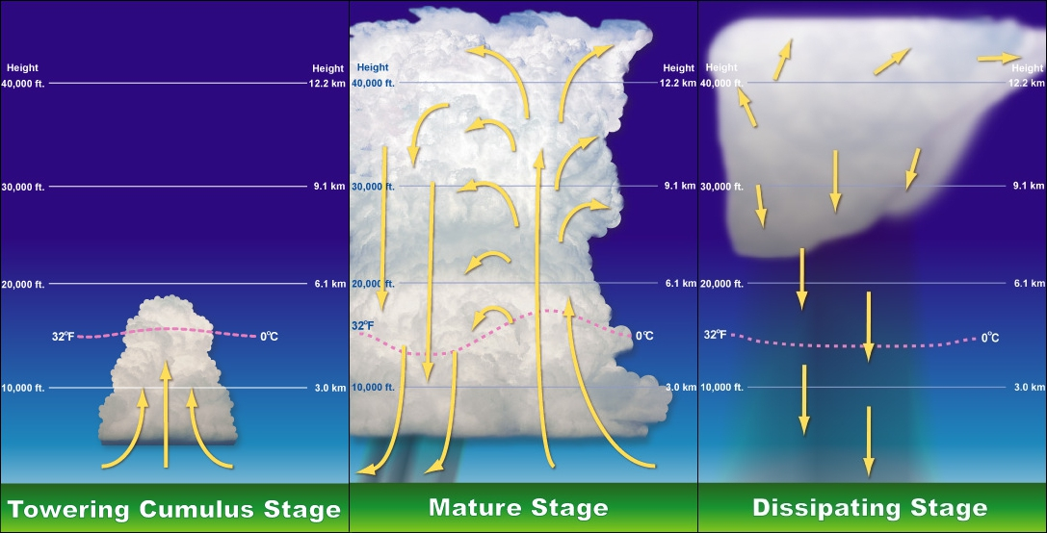
Stages of a thunderstorm's life
Rising air creates towering cumulus clouds
Little to no rain
Some lightning!
Hail, heavy rain, lightning, strong winds & tornadoes
Storm is black or dark green
Rainfall decreases
Occasional strong wind bursts
Lightning still a danger.
Notes:
"Thunderstorm formation" by Tstorm-tcu-stage.jpg: NOAATstorm-mature-stage.jpg: NOAATstorm-dissipating-stage.jpg: NOAAderivative work: The High Fin Sperm Whale - Tstorm-tcu-stage.jpgTstorm-mature-stage.jpgTstorm-dissipating-stage.jpg. Licensed under Public Domain via Wikimedia Commons - https://commons.wikimedia.org/wiki/File:Thunderstorm_formation.jpg#/media/File:Thunderstorm_formation.jpg

Slide 25
Thunderstorm classification
Single Cell
a single thunderstorm with one main updraft
20 – 30 minutes
Usually not strong enough to produce severe weather
Image source: http://fox41blogs.typepad.com/wdrb_weather/science/page/35/
Notes:
http://www.erh.noaa.gov/rnk/SKYWARNonline_files/800x600/slide19.html

Slide 26
Thunderstorm classification
Multicell cluster
Contain several single cell storms
Most common
Individual cells: 20 – 30 minutes
Entire storm: hours
Heavy rain common; winds, hail & weak tornados possible
Notes:
http://www.erh.noaa.gov/rnk/SKYWARNonline_files/800x600/slide21.html

Slide 27
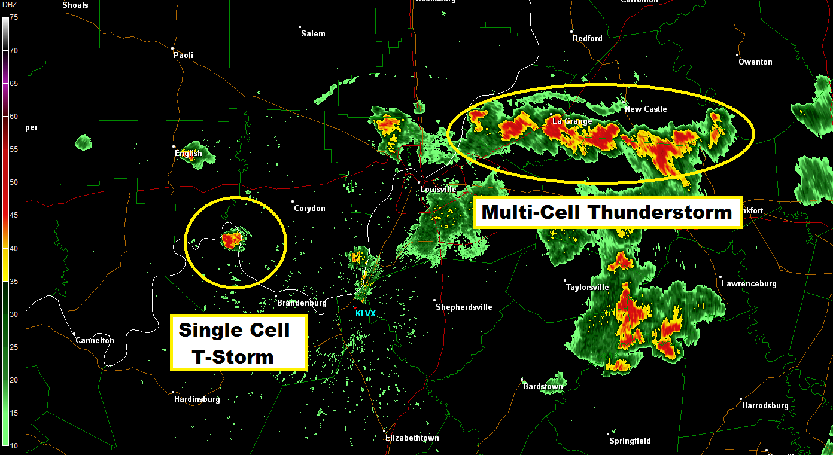
Notes:
http://fox41blogs.typepad.com/wdrb_weather/science/page/35/

Slide 28
Thunderstorm classification
Multicell line
When multicell clusters form a line
Image source: http://www.srh.noaa.gov/jetstream/tstorms/tstrmtypes.htm
Notes:
http://www.erh.noaa.gov/rnk/SKYWARNonline_files/800x600/slide21.html

Slide 29
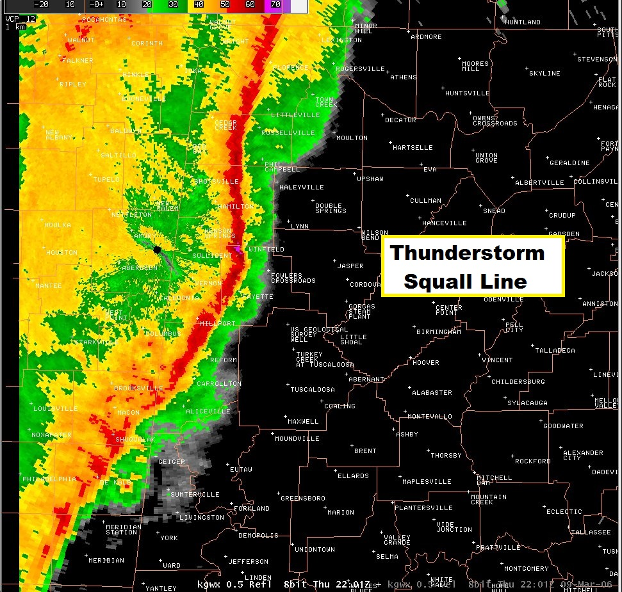
Notes:
http://fox41blogs.typepad.com/wdrb_weather/science/page/35/

Slide 30
Thunderstorm classification
Supercells
Large, quasi-steady storms
Wind speed & direction vary with height
Separate updrafts & downdrafts
Can produce tornadoes
Image source: http://travel.nationalgeographic.com/travel/traveler-magazine/photo-contest/2012/entries/142847/view/ Supercell Thunderstorm over Nebraska
Notes:
http://www.erh.noaa.gov/rnk/SKYWARNonline_files/800x600/slide21.html

Slide 31
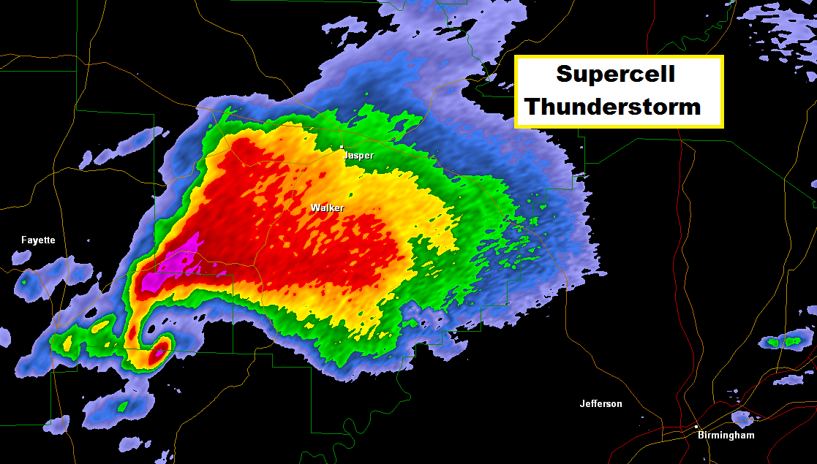
Notes:
http://fox41blogs.typepad.com/wdrb_weather/science/page/35/

Slide 32
Thunderstorm Related Hazards
Lightning
Damaging winds
Tornadoes
Floods *
Source: 1

Slide 33
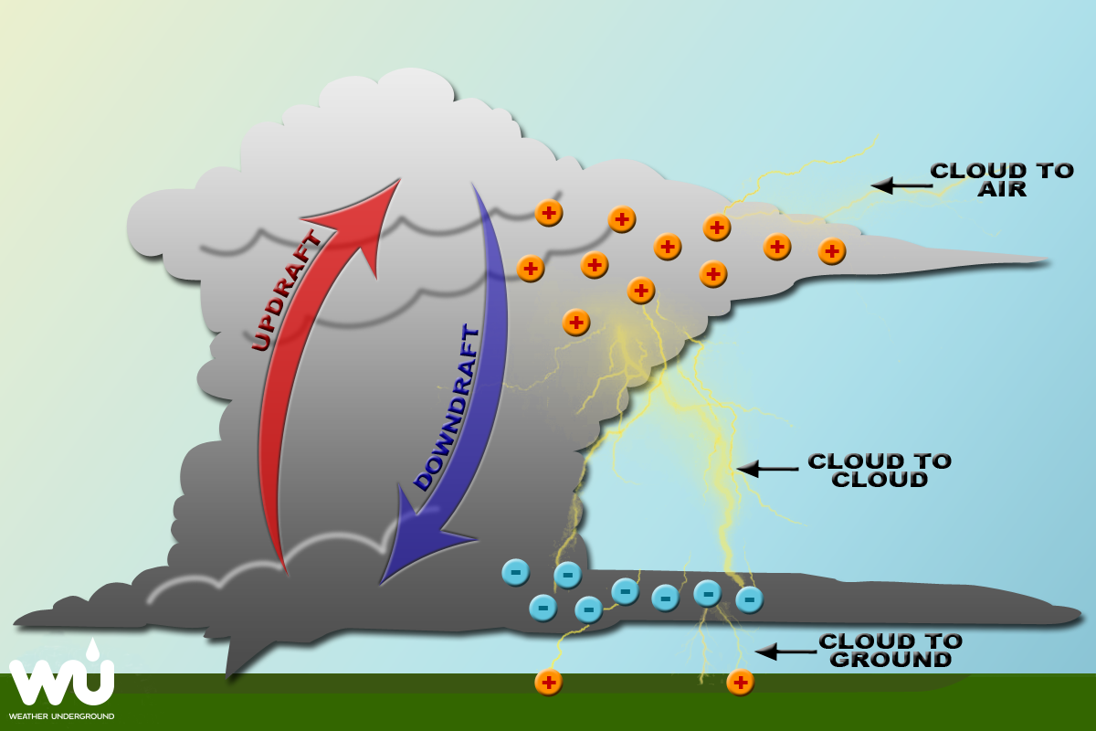
Thunderstorm Hazards: Lightning
Creation:
Tiny water droplets are updrafted to the top of the cloud
Hail and ice are downdrafted to the bottom of the cloud
They collide, the water droplets freeze, release latent heat (& energy) which warms the hail & ice
Forms graupel
Notes:
http://www.wunderground.com/resources/education/lightning.asp?MR=1

Slide 34
Thunderstorm Hazards: Lightning
Creation:
The graupel then collides with more water droplets.
Electrons are sheared off the ascending particles and attach to the descending particles.
The storm now has positively charged particles at the top and negatively charged particles at the bottom.
Notes:
http://www.wunderground.com/resources/education/lightning.asp?MR=1

Slide 35
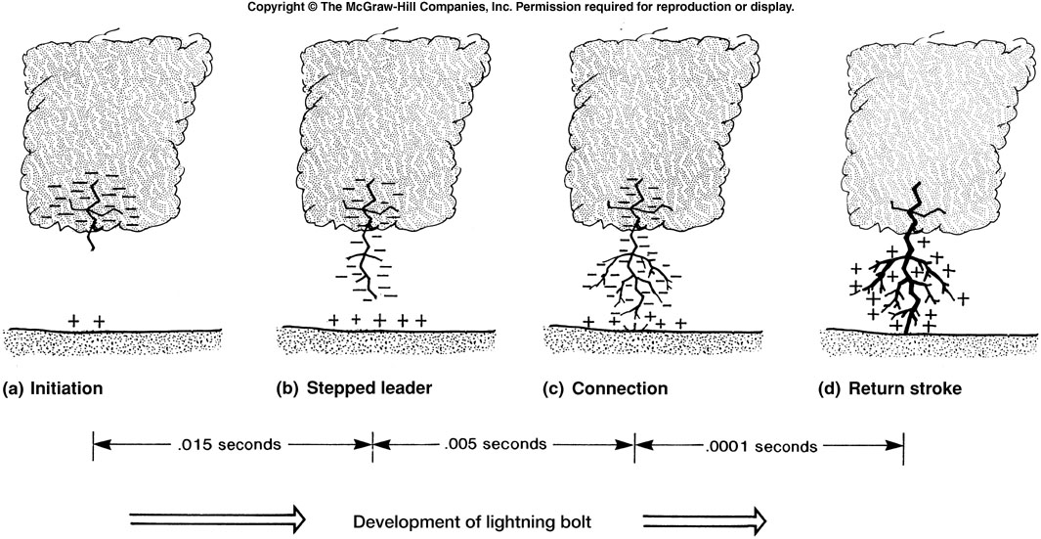

Slide 36
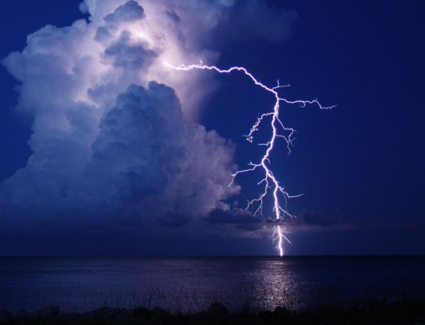
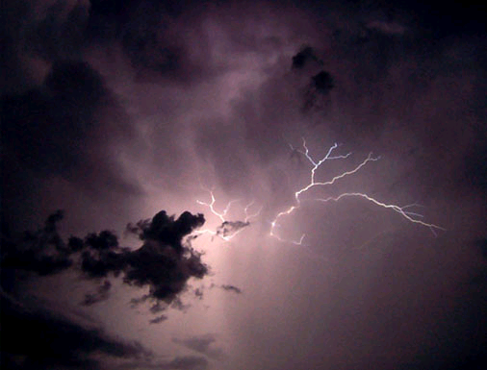
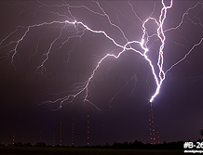
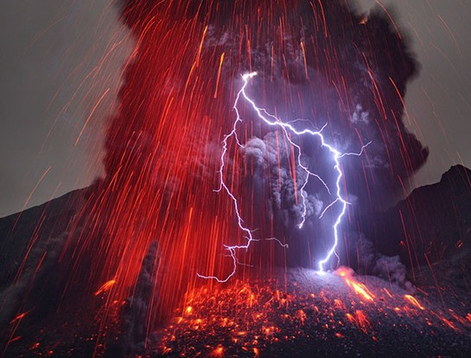
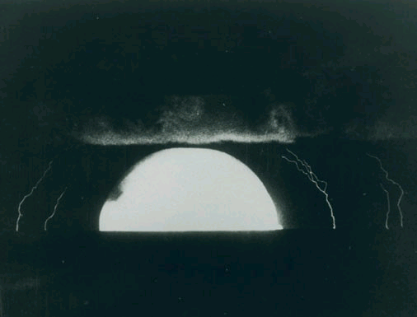
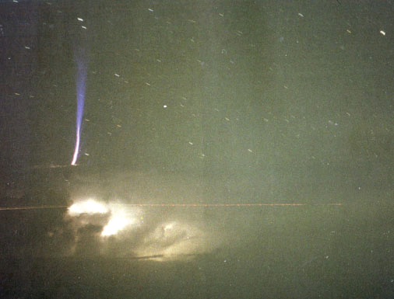
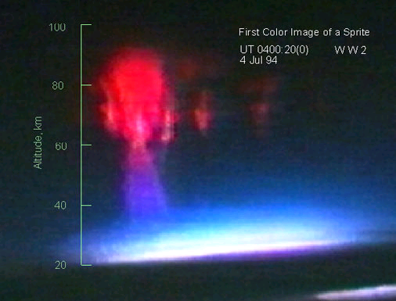
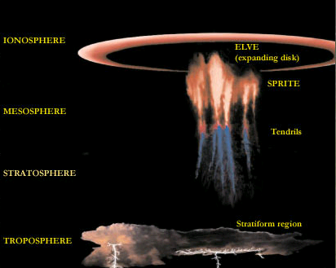
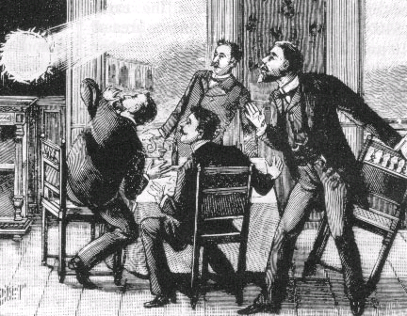
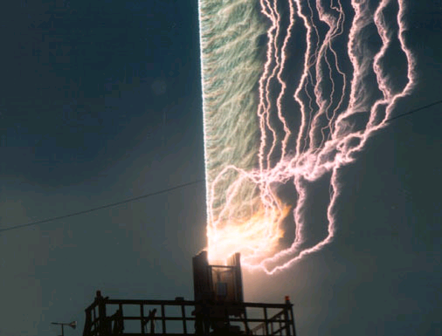
Thunderstorm Hazards: Lightning
cloud-to-ground | Cloud discharge | Earth-to-cloud | Volcanic Lightning | Nuclear Lightning
Blue Jets | Red Sprites | Elves | Ball lightning | Triggered Lightning
Notes:
http://environment.nationalgeographic.com/wallpaper/environment/photos/lightning-cloud-ground/cloud-ground-lightning13/
http://www.pbs.org/wgbh/nova/earth/lightning-types.html
http://stormhighway.com/storms/lightning/upward_tower/
http://www.wired.co.uk/news/archive/2013-03/13/volcano-lightning

Slide 37
Thunderstorm Hazards: Winds
Includes:
wind shear turbulence
straight-line winds
wind shears
gust fronts
and downbursts
Source: 1

Slide 38
Thunderstorm Hazards: Winds
Wind Shear
Change in the speed of wind at various altitudes
Change in the direction of wind at various altitudes
Source: 1

Slide 39
Thunderstorm Hazards: Winds
Microbursts
Small in size (outflow less than 2½ miles)
Winds +168 mph
Macrobursts
Larger (outflow greater than 2½ miles)
Winds 130 mph
Tucson Wet Microburst: https://vimeo.com/135811823
Source: 1

Slide 40
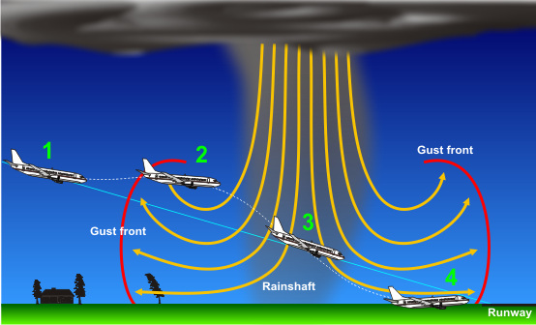
Microbursts and aircraft
Source: 1

Slide 41
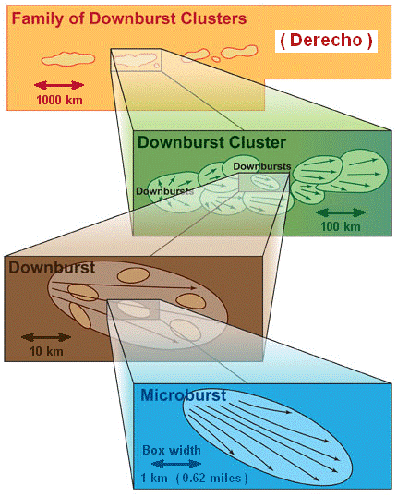
Thunderstorm Hazards: Winds
Derechos
a widespread, long-lived wind storm
associated with bands of rapidly moving thunderstorms (bow echoes, squall lines, or quasi-linear convective systems)
A typical derecho consists of numerous downburst clusters
Notes:
http://www.spc.noaa.gov/misc/AbtDerechos/derechofacts.htm
"Derecho development" by Dennis Cain and Stephen Corfidi at the U.S. National Weather Service - http://www.spc.noaa.gov/misc/AbtDerechos/derechofacts.htm#development. Licensed under Public Domain via Wikimedia Commons - https://commons.wikimedia.org/wiki/File:Derecho_development.png#/media/File:Derecho_development.png

Slide 42
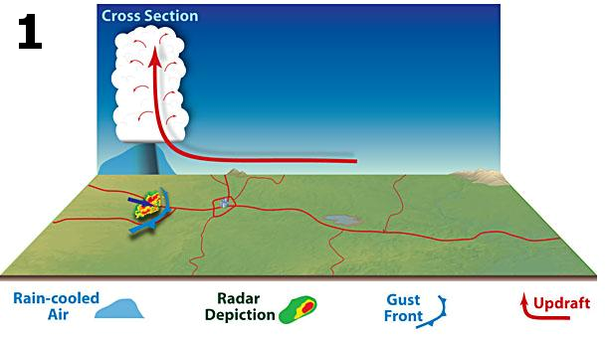
"Derecho development" by Dennis Cain and Stephen Corfidi at the U.S. National Weather Service
Notes:
http://www.spc.noaa.gov/misc/AbtDerechos/derechofacts.htm#development.

Slide 43
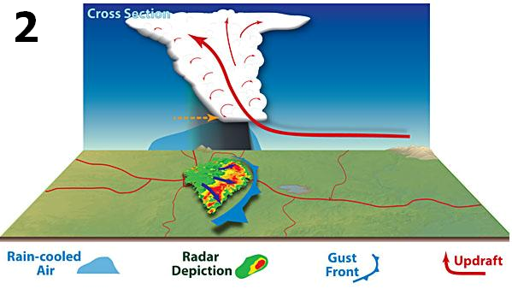
"Derecho development" by Dennis Cain and Stephen Corfidi at the U.S. National Weather Service
Notes:
http://www.spc.noaa.gov/misc/AbtDerechos/derechofacts.htm#development.

Slide 44
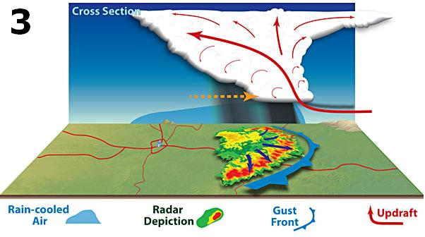
"Derecho development" by Dennis Cain and Stephen Corfidi at the U.S. National Weather Service
Notes:
http://www.spc.noaa.gov/misc/AbtDerechos/derechofacts.htm#development.

Slide 45
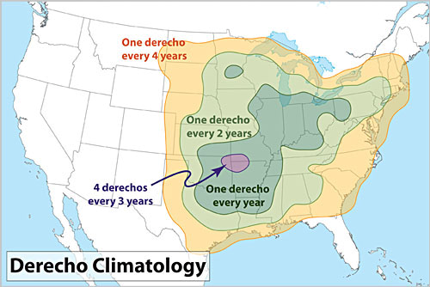
Notes:
"Derechoclimo" by National Weather Service Forecast Office, Cleveland, OH - National Weather Service Forecast Office, Cleveland, OH. url:http://www.erh.noaa.gov/er/cle/wx_events/2012/June/29/derechoclimo.png. Licensed under Public Domain via Wikimedia Commons - https://commons.wikimedia.org/wiki/File:Derechoclimo.png#/media/File:Derechoclimo.png

Slide 46
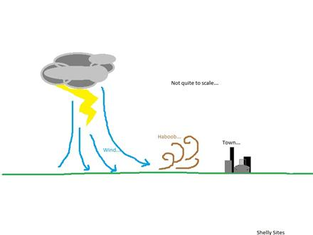
Thunderstorm Hazards: Winds
Haboobs are dust storms that form from the downdrafts from thunderstorms.
The leading edge is called a gust front.
Source: 1, 2

Slide 47
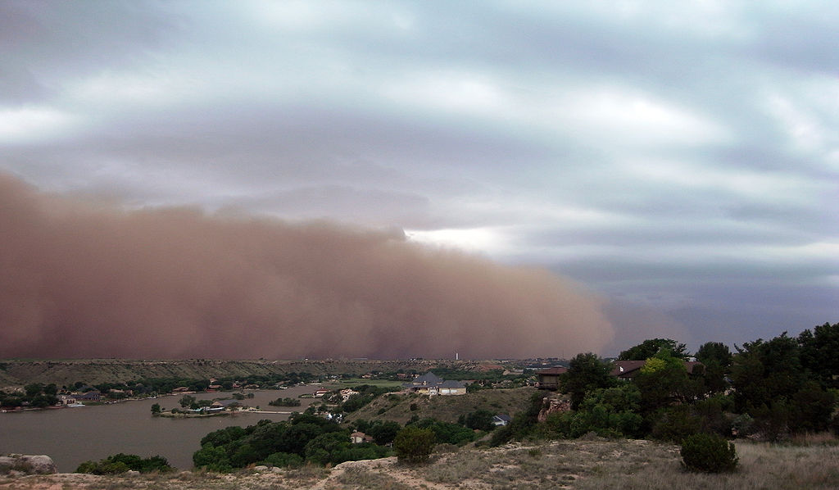
Haboob, Ransom Canyon, Texas - 2009
Notes:
"Haboob Ransom Canyon Texas 2009" by Leaflet - Own work. Licensed under CC BY-SA 3.0 via Wikimedia Commons - https://commons.wikimedia.org/wiki/File:Haboob_Ransom_Canyon_Texas_2009.jpg#/media/File:Haboob_Ransom_Canyon_Texas_2009.jpg

Slide 48
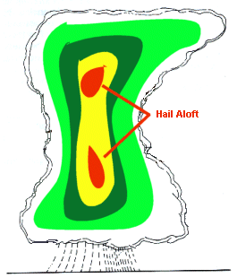
Thunderstorm Hazards: Hail
Forms when updrafts in a thunderstorm carry raindrops upward into the freezing levels of the atmosphere
Grows by collision with supercooled water drops
Source: 1, 2

Slide 49
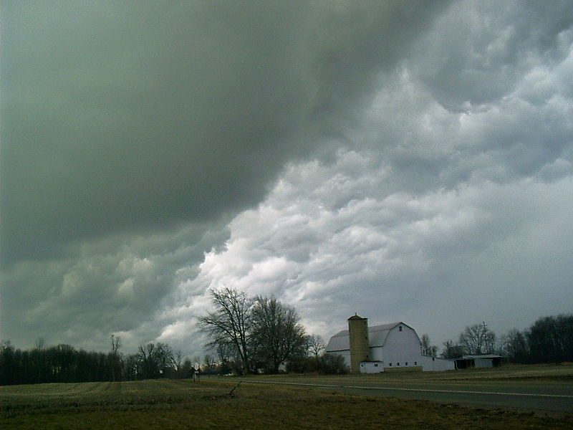
Hail clouds often exhibit a characteristic green coloration
Pea sized hail producing clouds near Kinderhook, Michigan March 20, 2003
Photo Credit: National Oceanic and Atmospheric Administration/Department of Commerce

Slide 50
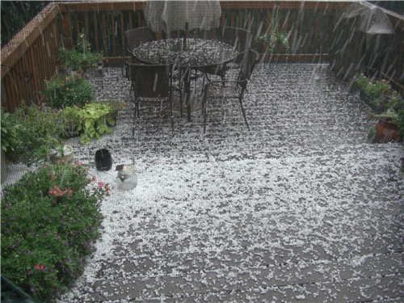
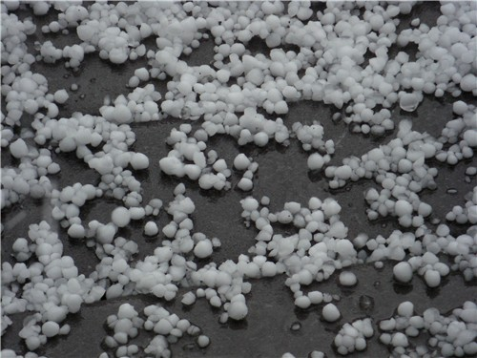
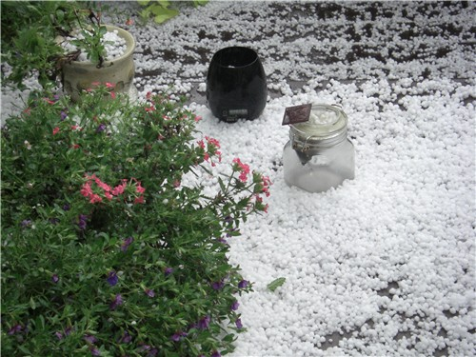
State College, PA Hailstorm
Source: 1

Slide 51
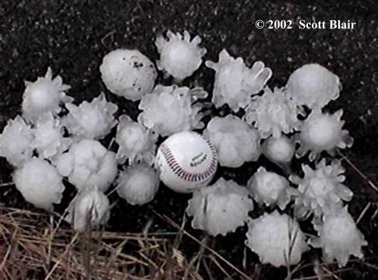
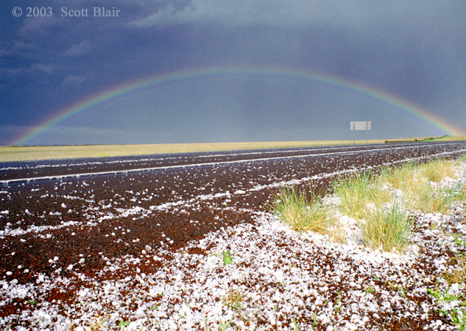
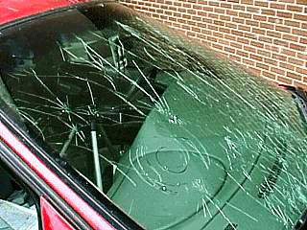
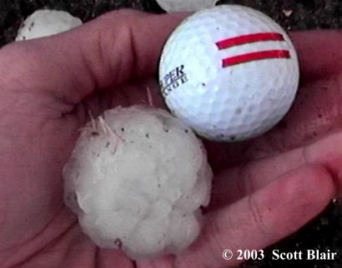
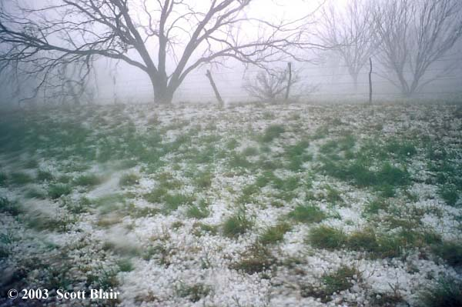
Notes:
http://www.targetarea.net/photohai.html

Slide 52
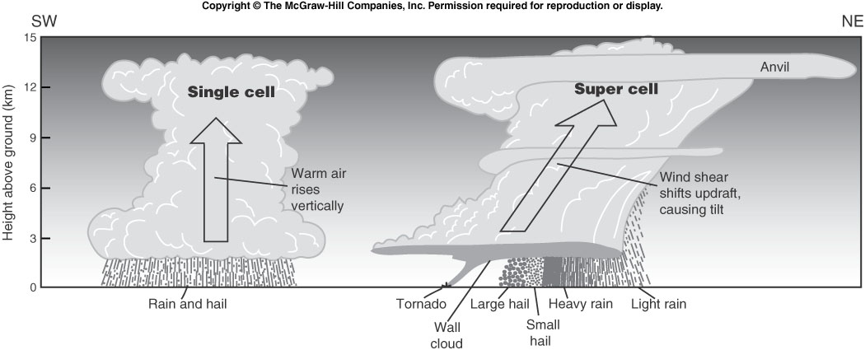
Thunderstorm Hazards: Tornadoes
Why do some thunderstorms spawn tornadoes while others do not?
Notes:
Image/chart: Natural Disasters, 4/e by Patrick L. Abbott

Slide 53
Thunderstorm Hazards: Tornadoes
How a Tornado Forms
Moist air from Gulf of Mexico
Fast moving cold, dry air mass from Canada
Jet stream moving east at 150 mph
Warm moist Gulf air releases latent heat, creates strong updraft
Updraft sheared by polar air, then twisted in a different direction by jet stream
Notes:
Image/chart: Natural Disasters, 4/e by Patrick L. Abbott

Slide 54
Thunderstorm Hazards: Tornadoes
The Fujita-Pearson Scale
Dr. T. Theodore Fujita in 1971
Goals:
categorize each tornado by its intensity and its area
estimate a wind speed associated with the damage caused by the tornado
The F Scale is a set of wind estimates (not measurements) based on damage!
Notes:
http://www.spc.noaa.gov/efscale/

Slide 55
Thunderstorm Hazards: Tornadoes
Problems with the F Scale:
It is subjective based solely on the damage caused by a tornado
No recognition in difference in construction
Difficult to apply with no damage indicators
Based on the worst damage (even if it is one building or house)
Overestimates wind speeds greater than F3
The "Modified" Fujita Scale, Created in 1992
Notes:
http://www.spc.noaa.gov/efscale/

Slide 56
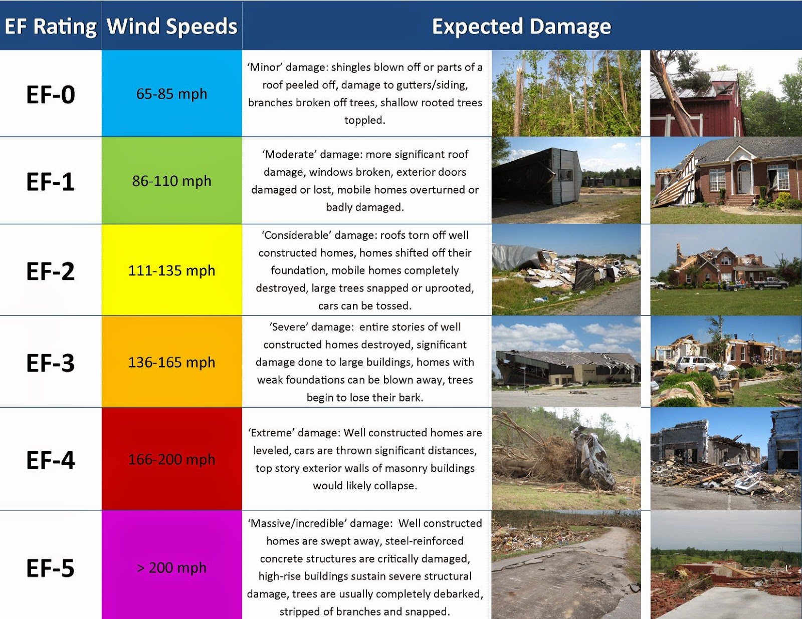
Notes:
http://wx4cast.blogspot.com/2014/05/the-ef-scale.html

Slide 57
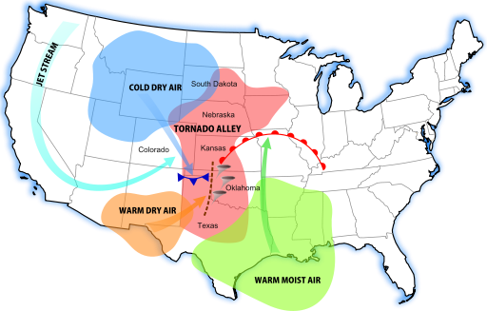
A diagram of tornado alley based on 1 tornado or more per decade. Rough location (pink), and its contributing weather systems
Notes:
"Tornado Alley Diagram" by Dan Craggs - Own work. Licensed under CC BY-SA 3.0 via Commons - https://commons.wikimedia.org/wiki/File:Tornado_Alley_Diagram.svg#/media/File:Tornado_Alley_Diagram.svg

Slide 58
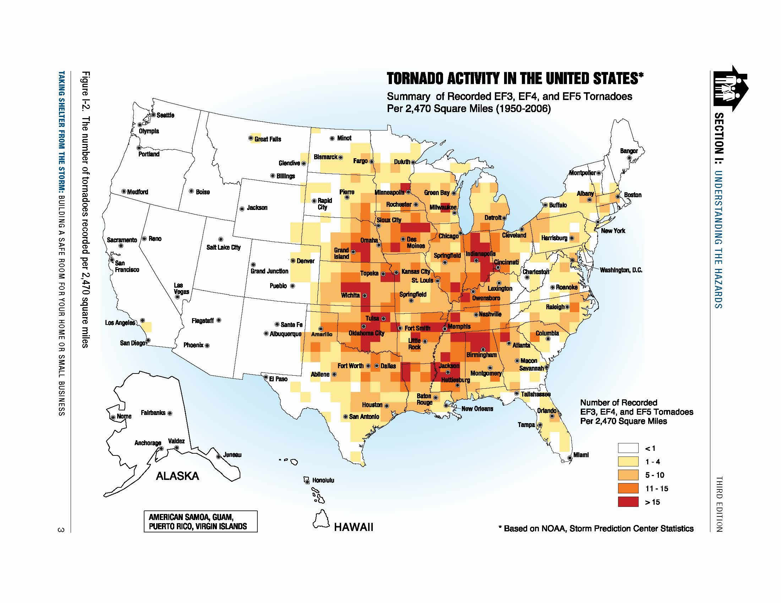
Notes:
http://www.weather.gov/media/bis/FEMA_SafeRoom.pdf

Slide 59
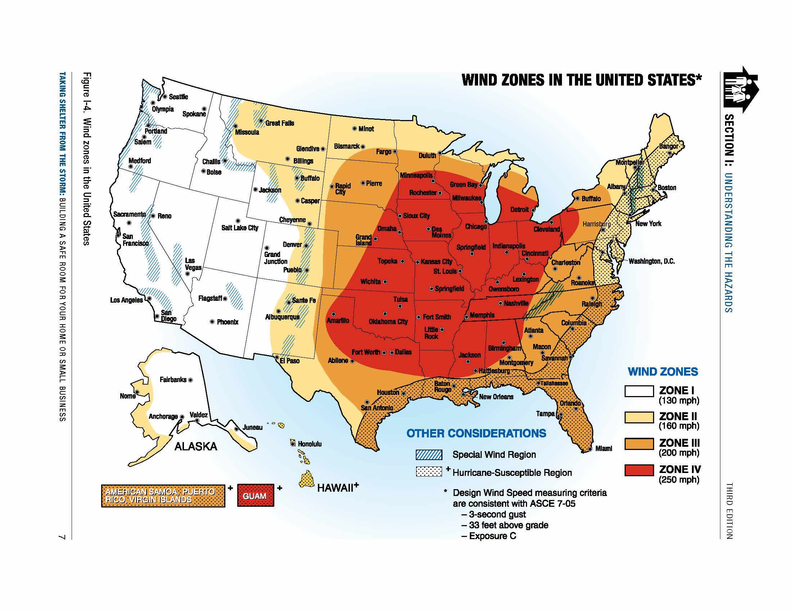
Notes:
http://www.weather.gov/media/bis/FEMA_SafeRoom.pdf

Slide 60
Thunderstorm Hazards: Tornadoes
Why don’t tornadoes strike large cities?
Occur over large regions
Cities are relatively small targets
Oklahoma City Tornado (1999)
Time’s “10 Deadliest Tornadoes in U.S. History”

Slide 61
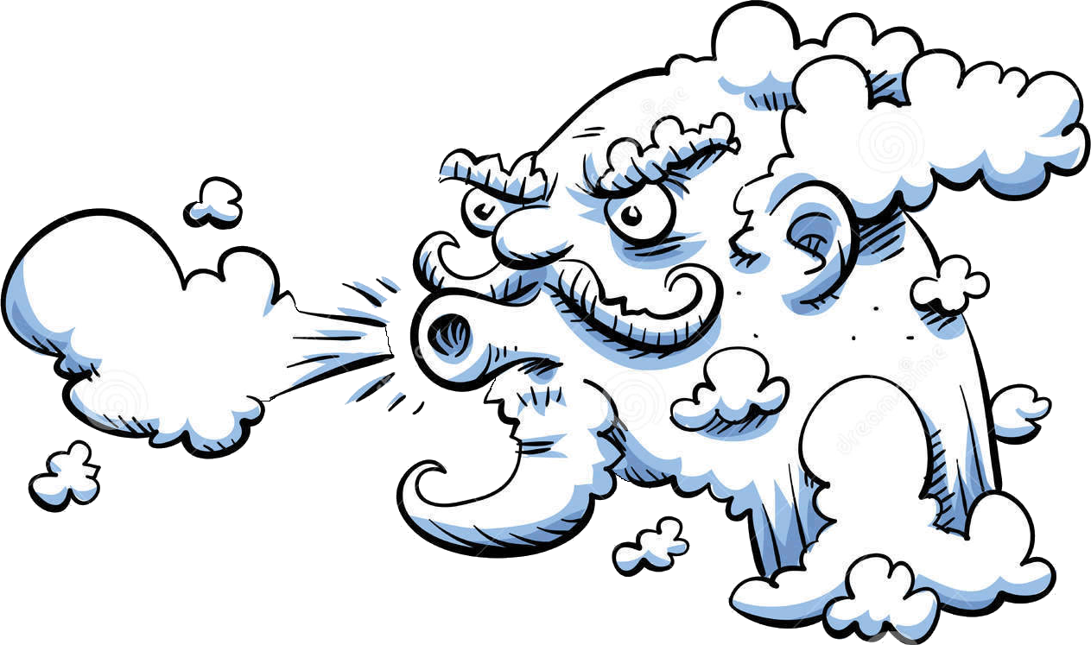
Windstorms

Slide 62
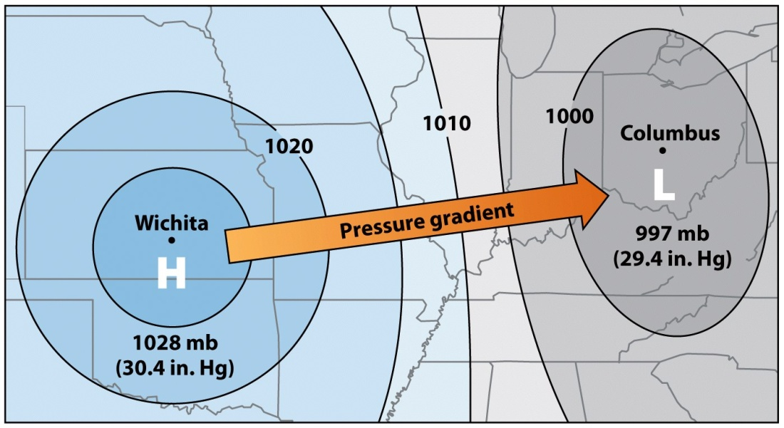
Wind
Definition: a horizontal motion of air
Caused by differences in atmospheric pressure
Maximum pressure change is perpendicular to these lines (pressure gradient)

Slide 63
Local / Regional Winds
Sea & Land Breezes
Valley & Mountain Breezes
Foehn winds
Katabatic winds
Monsoons

Slide 64
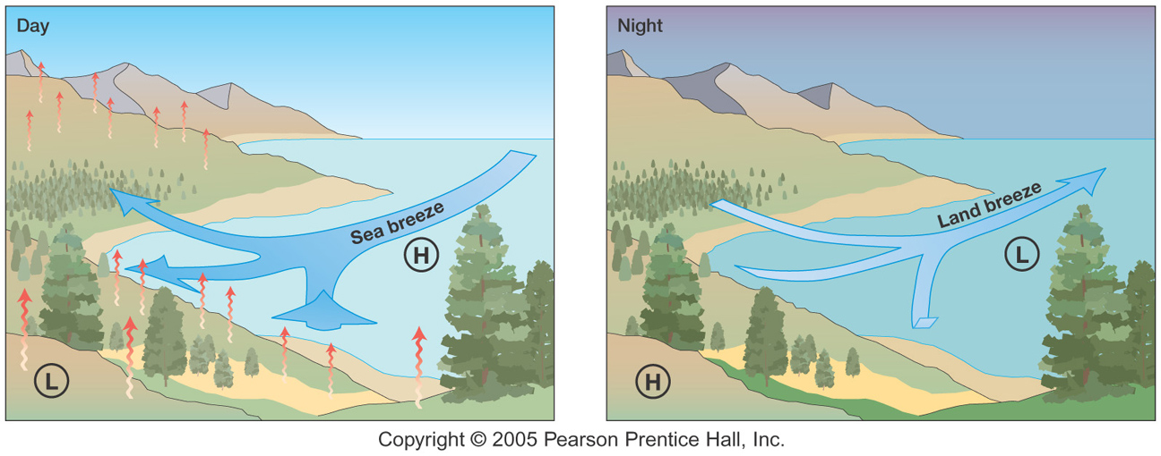
Sea and Land Breezes

Slide 65
Mountain and Valley Breezes

Slide 66
Foehn winds
A type of dry down-slope wind which occurs in the lee (downwind side) of a mountain range. AKA “Rain-shadow” wind
Source: 1, 2,

Slide 67
Katabatic winds
A wind that carries high density air from a higher elevation down a slope under the force of gravity
Santa Ana winds
Source: 1, 2

Slide 68
Santa Ana Wind Flow
Santa Ana wind flow through the typical canyons/passes/river valleys where strongest winds will be found include the Santa Clara River Valley, the Cajon Pass and the Banning Pass. Highest wind speeds are located within the canyons and passes themselves, as air funnels through (example of Bernoulli’s Principle).
Source: 1

Slide 69
Extratropical Storms

Slide 70
Extratropical Cyclones
Forms outside the tropics
Center of storm is colder than the surrounding air.
Has fronts.
Strongest winds in the upper atmosphere.
Occurs mainly in the winter when temperature and density differences are the most pronounced.

Slide 71
Extratropical Cyclones
Blizzards
Form when a cyclone brings:
Cold 60 km/hr winds
Freezing temperatures
Lots of snow
Can travel very slowly
Storm itself usually doesn’t kill

Slide 72
Extratropical Cyclones
Ice Storms
Formation:
Falling snow and ice melt, change to rain, then freeze again as they reach the ground
Sleet & Freezing rain

Slide 73
Tropical Storms

Slide 74
Tropical Cyclones
Forms over a tropical ocean.
Center of storm is warmer than the surrounding air.
Has no fronts.
Strongest winds are near the Earth's surface.

Slide 75
Tropical Cyclones
Great masses of warm, moist air
Only natural disaster with a human name*
Occur in all tropical oceans except for the South Atlantic**
North Atlantic and eastern Pacific = hurricanes
Western Pacific = typhoons
Indian ocean = tropical cyclones
Australia = willi-willi (aboriginal name) or typhoons
* Current list of names: http://www.srh.weather.gov/jetstream/tropics/tc_names.htm
** Or so we thought until 2006!

Slide 76
Tropical Cyclone Origins
Cannot form at the equator (Coriolis effect = 0)
Notes:
Image/chart: Natural Hazards and Disasters, 1/e by Hyndman & Hyndman

Slide 77
Points of Origin by 10-Day Period
The figures above show the points of tropical cyclone genesis by 10-day periods during the hurricane season. These figures depict named storms only; no subtropical storms or unnamed storms. The source years include 1851-2009 for the Atlantic and 1949-2009 for the Eastern Pacific from the HURDAT database.
Notes:
http://www.nhc.noaa.gov/climo/

Slide 78
Climatological Areas of Origin and Typical Hurricane Tracks by Month
The figures above show the zones of origin and tracks for different months during the hurricane season. These figures only depict average conditions. Hurricanes can originate in different locations and travel much different paths from the average. Nonetheless, having a sense of the general pattern can give you a better picture of the average hurricane season for your area.

Slide 79
Notes:
http://www.weatherwizkids.com/weather-hurricane.htm

Slide 80
Tropical Cyclone Formation
Tropical Wave | These are the most common of tropical disturbances with about 100 forming each season. They lack a closed circulation, which is when there are winds in every direction. Wind speeds are less than 20 knots, or 25 mph.
Tropical Disturbance | An area of thunderstorms that lasts for at least 24 hours and has heavy rains and high winds.
Tropical Depression | A wave becomes a depression when there is a presence of a closed circulation, and sustained winds are 20 knots, or 25 mph. At this point, the system is still quite disorganized.
Tropical Storm | A depression becomes a tropical storm when shower and thunderstorm activity moves over the closed circulation, and sustained winds reach at least 35 knots, or 39 mph. At this point, the system is capable of causing minimal damage.
Tropical Cyclone (Hurricane) | Storm has sustained surface wind speeds consistently over 74 mph
Notes:
http://www.ncpiedmontweather.com/2014/06/hurricane-formation-weather-101/

Slide 81
Notes:
https://www.meted.ucar.edu/bom/tropical_intensity/media/graphics//dvorak_scale.jpg

Slide 82
The Eye
Central portion of the storm
As wind speed increases, winds are spiraled upwards prior to reaching the center
A distinctive clear “eye” is formed
Used as the threshold of hurricane status
Strongest winds are located on the walls of the eye

Slide 83
Notes:
"Hurricane-en" by Kelvinsong - Own work. Licensed under CC BY 3.0 via Commons - https://commons.wikimedia.org/wiki/File:Hurricane-en.svg#/media/File:Hurricane-en.svg

Slide 85
Notes:
https://www.meted.ucar.edu/tropical/textbook_2nd_edition/navmenu.php?tab=9&page=1.0.0

Slide 86
Northern Australia was battered by two potent tropical cyclones within six hours on the same day in February 2015.
Notes:
http://earthobservatory.nasa.gov/NaturalHazards/view.php?id=85335&src=nha

Slide 87
Three simultaneously active typhoons on July 9: (from left to right) Linfa, Chan-hom and Nangka - Jul 9 2015
Notes:
"Linfa, Chan-hom, and Nangka in the West Pacific - Jul 9 2015 0230z" by SSEC/CIMSS, University of Wisconsin–Madison. Licensed under Attribution via Commons - https://commons.wikimedia.org/wiki/File:Linfa,_Chan-hom,_and_Nangka_in_the_West_Pacific_-_Jul_9_2015_0230z.png#/media/File:Linfa,_Chan-hom,_and_Nangka_in_the_West_Pacific_-_Jul_9_2015_0230z.png

Slide 88
Infrared satellite image of 08/23/2015 showing three tropical cyclones active in the North Pacific
Notes:
http://mitigat.com/2015/08/23/18/52/32/it-is-a-trio-in-the-pacific/

Slide 89
Color-enhanced infrared satellite image of 08/23/2015 showing several tropical waves & disturbed weather cells
Notes:
http://mitigat.com/2015/08/23/18/52/32/it-is-a-trio-in-the-pacific/

Slide 90
The Bermuda High pressure system sits over the Atlantic during summer. Acting as a block that hurricanes cannot penetrate, the size and location of this system can determine where hurricanes go. A normal Bermuda High often leads to hurricanes moving up the east coast and out to sea. During summer 2004 and 2005, the Bermuda High expanded to the south and west, which steered hurricanes into the Gulf of Mexico rather than up the east coast or curving out to sea. Once in the Gulf, most hurricane paths will involve landfall at some location.
Notes:
http://svs.gsfc.nasa.gov/cgi-bin/details.cgi?aid=10069

Slide 91
Hurricane Paths

Slide 93
Hurricane Damages
Heavy Surf
Heavy Rains
Storm Surge
Flooding
High Winds
Coastal Erosion

Slide 94
Hurricane Damages – Heavy Surf
2005 – Hurricane Katrina in Florida
Russell Crossey and his dog get a serious soaking Thursday on the north jetty of the Boynton Inlet in Manalapan, Florida, as huge waves, whipped up by Katrina, break against the wall. (cnn.com)
Keena Baker took this photo of waves hitting the Dan Russell Municipal Pier in Panama City Beach. The pier is still damaged from Hurricane Dennis that hit Florida in July. (cnn.com)

Slide 95
Hurricane Damages – Heavy Rains

Slide 96
Hurricane Damages – Storm Surge
Notes:
Image/chart: Natural Disasters, 4/e by Patrick L. Abbott

Slide 97
Hurricane Damages – Storm Surge
A casino barge sits among homes in Biloxi (Photo: AP) (cbsnews.com)
2005 – Hurricane Katrina
20+ feet (6 m) at Louisiana / Mississippi border
10 feet (3 m) at Mobile Bay, Alabama
The storm surge from Hurricane Katrina floods a parking lot in downtown Mobile, Ala. (AP Photo/Michelle Rolls, Mobile Register)

Slide 98
Hurricane Damages – Urban Floods
2005 – Hurricane Katrina in the Gulf States
Oil slick in water surrounding a house in New Orleans (AFP/Pool/Vincent Laforet)
The Mound Underpass on Interstate 10 is flooded near downtown New Orleans on Monday. (cnn.com)
Floodwaters from Hurricane Katrina fill the streets near downtown New Orleans Tuesday, Aug. 30, 2005 in New Orleans. (AP Photo/David J. Phillip)

Slide 99
Hurricane Damages – Urban Floods
Rising water caused by Superstorm Sandy rushes into the The Hugh L. Carey (Brooklyn-Battery) Tunnel in New York City on October 29, 2012.

Slide 100
Hurricane Damages – Urban Floods
New York Fire Department rescue boats, along 14th St, heading toward the East River on a rescue mission in the wake of Hurricane Sandy, on October 29, 2012, in New York

Slide 101
Hurricane Damages – Wind
Wind speed varies depending upon which side of the hurricane you’re on.
Amount of damage on the coastline will vary accordingly
Notes:
Image/chart: Natural Disasters, 4/e by Patrick L. Abbott

Slide 102
Hurricane Damages – Wind
2015 – Hurricane Katrina in the Gulf States
Trees litter New Orleans streets after Hurricane Katrina pounded the city on Aug. 29, 2005. (Dave Martin/AP Photo) (abcnews.com)
Debris from the storm in Mississippi. (Mississippi Press-Register, William Colgin/AP Photo) (abcnews.com)

Slide 103
Hurricane Damages – Erosion
2012 – Hurricane Sandy

Slide 104
Prepare, Respond, & Recover

Slide 105
PREPARE: Storms
Have an emergency kit and family communications plan.
Watch the weather
Postpone outdoor activities
Secure outdoor objects that could blow away or cause damage
Minimize travel. If travel is necessary, keep a disaster supplies kit in your vehicle.
Bring pets/companion animals inside
Notes:
http://www.redcross.org/prepare/disaster/thunderstorm
http://www.wikihow.com/Prepare-for-a-Thunderstorm
http://m.fema.gov/before-thunderstorms-lightning

Slide 106
PREPARE: Storms
Have an emergency kit and family communications plan.
Watch the weather
Postpone outdoor activities
Secure outdoor objects that could blow away or cause damage
Minimize travel. If travel is necessary, keep a disaster supplies kit in your vehicle.
Bring pets/companion animals inside
Notes:
http://www.redcross.org/prepare/disaster/thunderstorm
http://www.wikihow.com/Prepare-for-a-Thunderstorm
http://m.fema.gov/before-thunderstorms-lightning

Slide 107
PREPARE: Storms
Expect to be without power
Pack your freezer with bags of water. That will keep your food colder, longer.
Make sure you have flashlights and plenty of batteries.
Stock up on plenty of water and non-perishable food items.
Charge your cellphones.
Fuel up your car.
Visit an ATM in case they close down in a power outage.
Notes:
http://usatoday30.usatoday.com/weather/resources/safety/wtstorm.htm

Slide 108
PREPARE: Storms
Thunderstorms
A THUNDERSTORM WATCH means a thunderstorm is possible for your area.
A THUNDERSTORM WARNING means a thunderstorm is taking place in your area.

Slide 109
PREPARE: Storms
Tornadoes
Safe Rooms
Best ones are underground
Some are above ground

Slide 110
PREPARE: Storms
Snow/Ice storms & Blizzards
Winter Storm Outlook - Winter storm conditions are possible in the next 2 to 5 days.
Winter Weather Advisory - Winter weather conditions are expected to cause significant inconveniences and may be hazardous. When caution is used, these situations should not be life threatening.
Winter Storm Watch - Winter storm conditions are possible within the next 36 to 48 hours. People in a watch area should review their winter storm plans and stay informed about weather conditions.
Winter Storm Warning - Life-threatening, severe winter conditions have begun or will begin within 24 hours. People in a warning area should take precautions immediately.
Notes:
http://www.redcross.org/prepare/disaster/winter-storm

Slide 111
PREPARE: Storms
Winter Storms: Special supplies
Rock salt
Sand to improve traction.
Snow shovels and other snow removal equipment.
Sufficient heating fuel. You may become isolated in your home and regular fuel sources may be cut off. Store a good supply of dry, seasoned wood for your fireplace or wood-burning stove.
Adequate clothing and blankets to keep you warm.
Notes:
http://www.ready.gov/winter-weather

Slide 112
PREPARE: Storms
Winter Storms: Preventing Freezing Pipes
Drain water from swimming pool and water sprinkler supply lines following manufacturer's or installer's directions.
Remove, drain, and store hoses used outdoors.
Insulate pipes not in heated areas of the home
Open kitchen and bathroom cabinet doors to allow warmer air to circulate around the plumbing
Let the cold water drip from the faucet served by exposed pipes during extreme cold weather
Keep the thermostat set to the same temperature both during the day and at night.
Notes:
http://www.ready.gov/winter-weather

Slide 113
RESPOND: Storms
If outside, seek shelter
Postpone outdoor activities
If you can hear thunder, you are close enough to be in danger from lightning.
Secure shutters, windows and doors
Avoid using electrical equipment
Notes:
http://www.redcross.org/prepare/disaster/thunderstorm
http://www.wikihow.com/Prepare-for-a-Thunderstorm
http://m.fema.gov/before-thunderstorms-lightning

Slide 114
RECOVER: Storms
Stay away from storm-damaged areas
Do not drive or walk through flooded areas
Stay away from downed power lines and report them immediately.
Help people who may require special assistance, such as infants, children and the elderly or disabled.
Notes:
http://www.redcross.org/prepare/disaster/thunderstorm
http://www.wikihow.com/Prepare-for-a-Thunderstorm
http://m.fema.gov/before-thunderstorms-lightning

Slide 115
RECOVER: Storms
STAY SAFE!
Go to a designated public shelter if you have been told to evacuate or you feel it is unsafe to remain in your home. Text SHELTER + your ZIP code to 43362 (4FEMA)
Register on the American Red Cross Safe and Well web site to let your family and friends know you are safe. (https://safeandwell.communityos.org/cms/index.php)

Slide 116
Reducing the risk
What, if anything, can be done to prevent this disaster from occurring?

Slide 117
Reducing the risk
What can be done to reduce the damages caused by this disaster?

Slide 118
Notes:
http://www.nola.com/homegarden/index.ssf/2014/06/is_your_house_hurricane-season.html

Slide 119
Reducing the risk: Thunderstorms
Stay out of water. It’s a great conductor of electricity
If you can hear thunder, lightning is a risk
If you are: | Then:
In a forest | Seek shelter in a low area under a thick growth of small trees.
In an open area | Go to a low place such as a ravine or valley. Be alert for flash floods.
On open water | Get to land and find shelter immediately.
Notes:
http://usatoday30.usatoday.com/weather/resources/safety/wtstorm.htm

Slide 120
Reducing the risk: Winter Storms
Prepare your home as needed
Stay indoors
Do not try to remove all of the snow on your walkway/driveway at once!
Beware of ice and slippery surfaces
Notes:
http://usatoday30.usatoday.com/weather/resources/safety/wtstorm.htm

Slide 121
Reducing the risk: Hurricanes
Prepare your home as needed
Stay indoors
Evacuate if told to do so
Stay out of water. It’s a great conductor of electricity
If you can hear thunder, lightning is a risk
Notes:
http://usatoday30.usatoday.com/weather/resources/safety/wtstorm.htm

Slide 122
Reducing the risk: Windstorms
Let me tell you a little story . . .
Notes:
http://usatoday30.usatoday.com/weather/resources/safety/wtstorm.htm

Slide 123
November 30th, 2011 Windstorm
Recorded wind speeds:
Henninger Flats, Calif. (2,800 ft., near Pasadena): 167 mph (unofficial)
Los Angeles (LAX Airport), Calif.: 47 mph
Hardest hit areas were:
Altadena, Arcadia, Covina, Duarte, El Monte, La Crescenta, Monrovia, Montebello, Rosemead, San Gabriel, and Temple City
Source: 1

Slide 124
Portland And Seattle Weather Linked To What Caused The Southern California “Santa Ana’ Wind Storm
Source: 1

Slide 126
LADWP Storm Outage Map as of 6 pm December 1, 2011

Slide 131
What My Family Learned:
Power outage
Without power for 10 days
Why??
Riser to connect power to house needed to be fixed first.
Need an electrician to do so
Problems:
Food spoiled, lack of heat*, lack of entertainment for kids . . .

Slide 132
What My Family Learned:
Tree removal
Insurance deemed storm “an act of God”
THEREFORE, limited liability
THEREFORE, neighbor not liable (despite the fact that the tree hadn’t been cared for properly)
Cost to remove tree? $1,000*

Slide 133
What My Family Learned:
Things done right?
Called insurance right away
Took LOTS of pictures
Neighbor to south let us run an extension cord from his house so we’d have power
Old house = no Central Air/Heating = floor furnaces = still have heat!
EMERGENCY SUPPLIES

Slide 134
~ end! ~

